Slide 1
532: Dungeon Master
★★★☆☆
題組：Problem Set Archive with Online Judge
題號：532: Dungeon Master
解題者：張宥君
解題日期：2022年4月28日
題意：給無數組L=level,R=row,C=col表地牢的尺寸，接著給地牢的cells，A cell full of rock is indicated by a ‘#’ and empty cells are represented by a ‘.’
Starting position: ‘S’
Exit: ’E’
It takes one minute to move one unit north, south, east, west, up or down. 求逃出時間

Slide 2
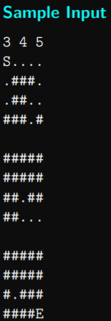

題意範例：
input:
1 3 3
S##
#E#
###
0 0 0
Output:
Trapped!

Slide 3
解法：
1. BFS
Breadth: 6 directions
queue storing {x,y,z,t}
2. mark visited points
3. when queue is empty and still no point match E, print
Trapped!
解法範例：無
討論：無

