Slide 1
Order-Preserving Matching
Jinil Kim, Peter Eades, Rudolf Fleischer, Seok-Hee Hong,
Costas S. Iliopoulos, Kunsoo Park, Simon J. Puglisi, Takeshi Tok
Theoretical Computer Science 525 (2014) pp.68–79
Presenter: Guan-Ting Chen
Date: Feb. 16, 2022

Slide 2
Abstract
We introduce a new string matching problem called order-preserving matching on numeric strings, where a pattern matches a text if the text contains a substring of values whose relative orders coincide with those of the pattern. Order-preserving matching is applicable to many scenarios such as stock price analysis and musical melody matching in which the order relations should be matched instead of the strings themselves. Solving order-preserving matching is closely related to the representation of order relations of a numeric string. We deﬁne the preﬁx representation and the nearest neighbor representation of the pattern, both of which lead to eﬃcient algorithms for order-preserving matching. We present eﬃcient algorithms for single and multiple pattern cases. For the single pattern case, we give an O(nlogm) time algorithm and optimize it further to obtain O(n + mlogm) time. For the multiple pattern case, we give an O(nlogm) time algorithm.

Slide 3

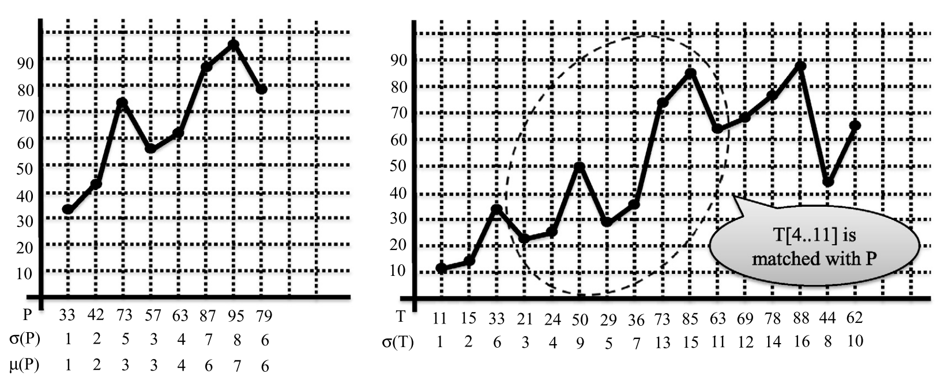
Order-Preserving Matching

Slide 4
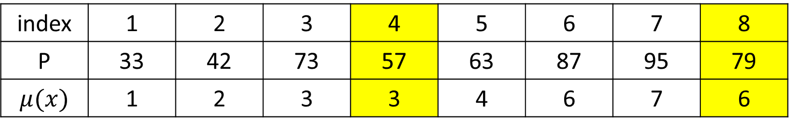
Preﬁx representation
Order-statistic tree
index | 1 | 2 | 3 | 4 | 5 | 6 | 7 | 8
P | 33 | 42 | 73 | 57 | 63 | 87 | 95 | 79
$$μ(x)$$ | 1 | 2 | 3 | 3 | 4 | 6 | 7 | 6
P[1…4]
P[1…8]

Slide 5
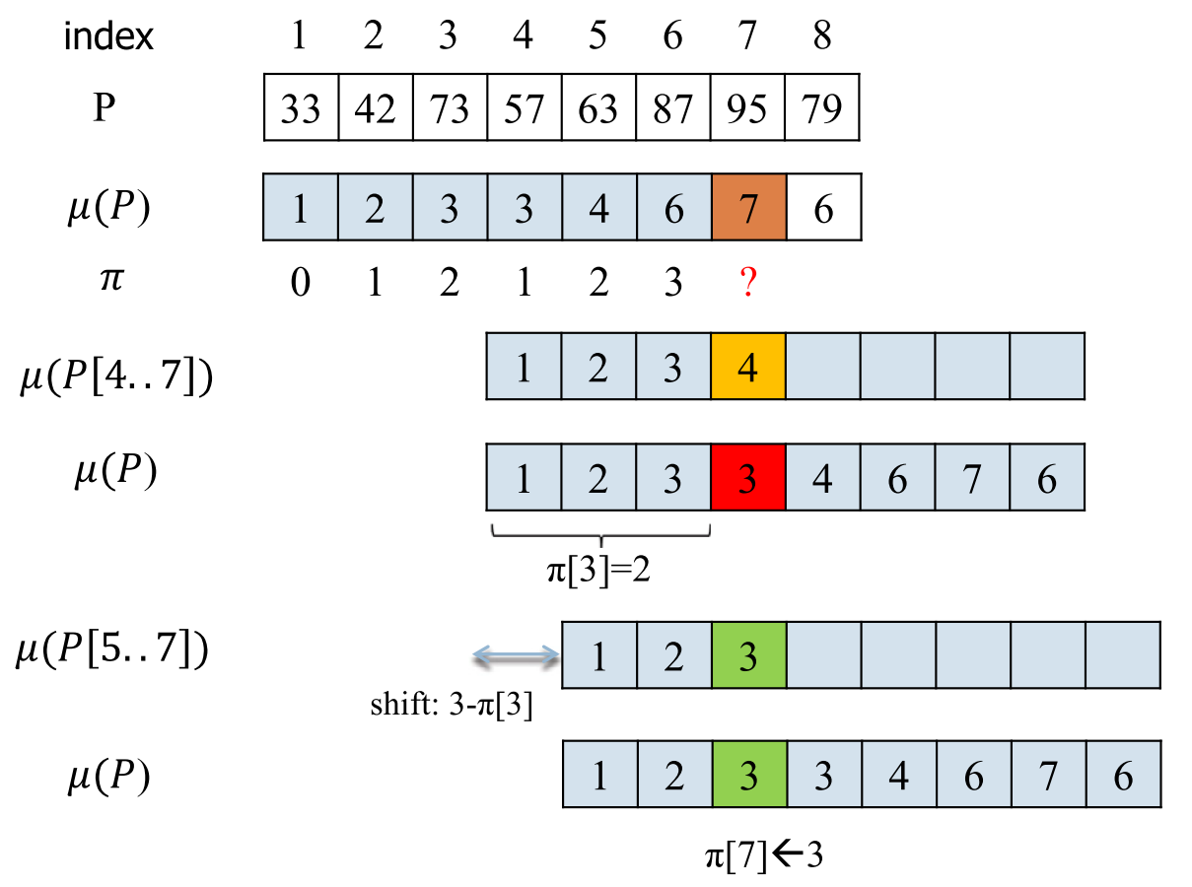
Failure Function
參考KMP Algorithm
Proper prefix and proper suffix

Slide 6
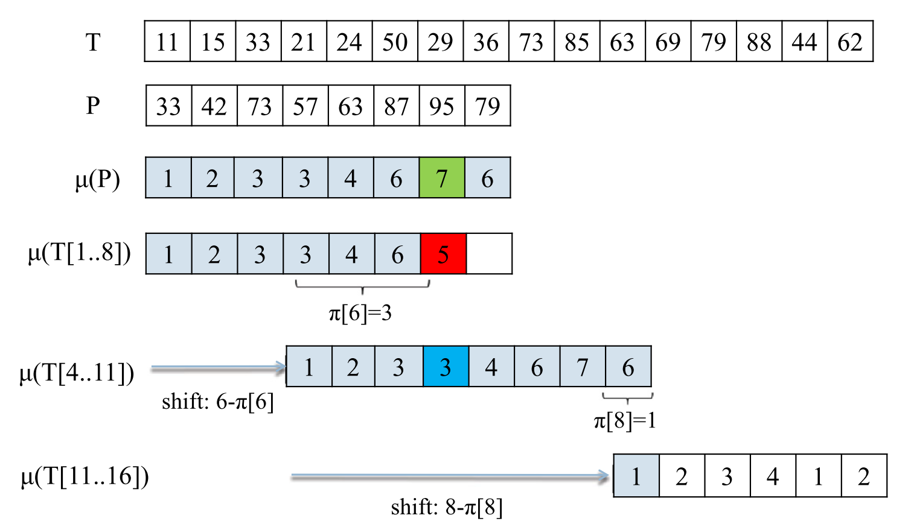
O(nlogm) algorithm

Slide 7
Time Complexity
O(nlogm)
Preﬁx representation
O(mlogm)
Failure function
O(mlogm)
Text Search
O(nlogm)

Slide 8
Nearest Neighbor Representation
i | 1 | 2 | 3 | 4 | 5 | 6 | 7 | 8
P | 33 | 42 | 73 | 57 | 63 | 87 | 95 | 79
μ(P) | 1 | 2 | 3 | 3 | 4 | 6 | 7 | 6
π(P) | 0 | 1 | 2 | 1 | 2 | 3 | 3 | 1
V_{p}(P)[i] | -∞ | 1 | 2 | 2 | 4 | 3 | 6 | 3
V_{n}(P)[i] | ∞ | ∞ | ∞ | 3 | 3 | ∞ | ∞ | 6
V_{p}(P)
在 index i 之前，小於 x[i] 的元素中最大元素的 index
V_{n}(P)
在 index i 之後，大於 x[i] 的元素中最小元素的 index

Slide 9
Failure Function
87 < 95 < ∞
Index: 3
P
73 < 57 < ∞
Index: 3

Slide 10
O(n + mlogm) algorithm
29 < 36 < 50
Index: 7 6
95 < 79 < 87
Index: 7 6

Slide 11
Time Complexity
O(n + mlogm)
Nearest Neighbor Representation
O(mlogm)
Failure function
O(m)
Text Search
O(n)

Slide 12
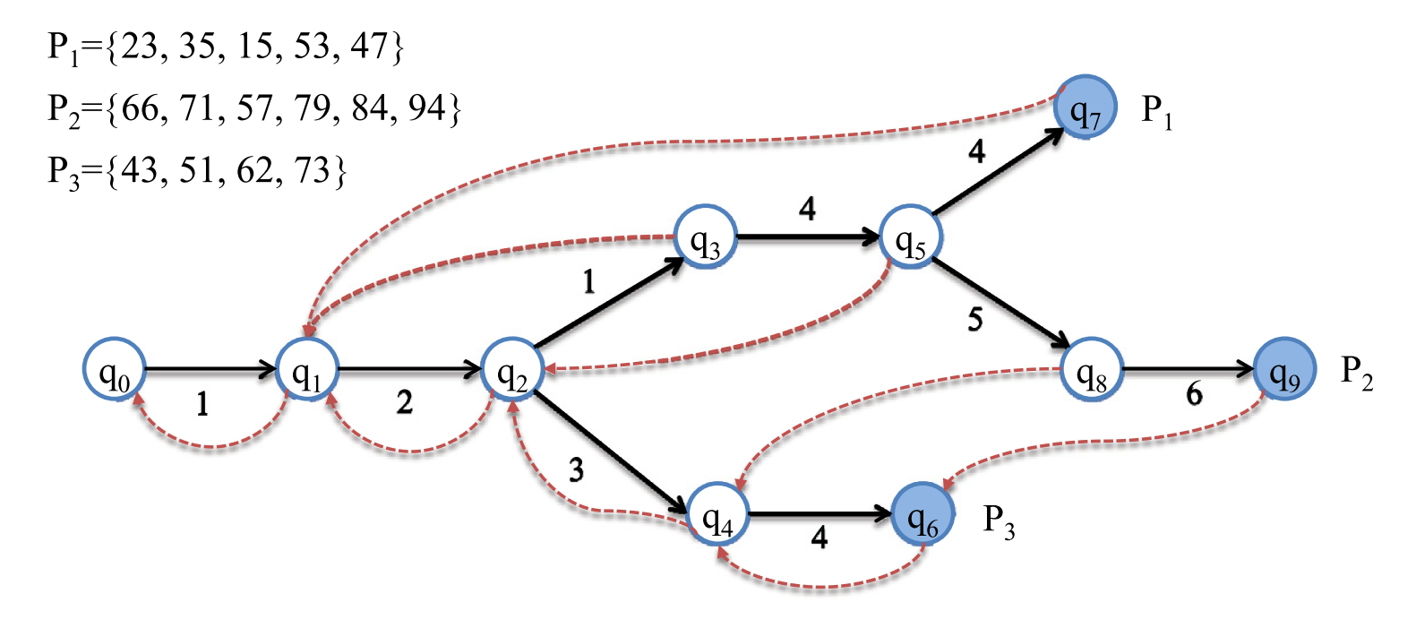
Multiple Patterns
參考 Aho–Corasick automaton
μ(P₁) = [1, 2, 1, 4, 4]
μ(P₂) = [1, 2, 1, 4, 5, 6]
μ(P₃) = [1, 2, 3, 4]

Slide 13
Failure Function
μ(P₁) = [1, 2, 1, 4, 4]
μ(P₂) = [1, 2, 1, 4, 5, 6]
μ(P₃) = [1, 2, 3, 4]
Proper Suffix
P₂[3…5] = {57, 79, 84}
μ(P₂[3…5]) = {1, 2, 3}

Slide 14
Time Complexity
O(nlogm)
Preﬁx Representation
O(mlogm)
Failure function
O(mlogm)
Text Search
O(nlogm)

