Slide 1
Algorithms for computing variants of the longest common subsequence problem
Costas S. Iliopoulos, M. Sohel Rahman
Theoretical Computer Science 395 (2008) 255–267
Presenter: Cheng-Han Ho
Date: Feb. 16, 2022

Slide 2
Abstract (1/2)
The longest common subsequence (LCS) problem is one of the classical and well-studied problems in computer science. The computation of the LCS is a frequent task in DNA sequence analysis, and has applications to genetics and molecular biology. In this paper we introduce new variants of LCS problem and present efficient algorithms to solve them. In particular we introduce the notion of gap constraints in the LCS problems. For the LCS problem with fixed gap, we first present a naive algorithm runs in O(n² + R(K + 1) ² ) time, where R is the total number of ordered pairs of positions at which the two strings match and K is the fixed gap constraint. We then improve the running time to O(n² + RK + R log log n) using some novel techniques.

Slide 3
Abstract (2/2)
Furthermore, we present an algorithm that is independent of K and runs in O(n² + R log log n) time. Using these techniques, we also present a new O(n²) algorithm to solve the original LCS problem. Additionally, we modify our algorithms to handle elastic and rigid gaps. We also apply the notion of rigidness to the original LCS problem and modify the traditional dynamic programming solution to handle the rigidness presenting a O(n²) algorithm to solve the problem. Finally, we also improve the solution to Rigid Fixed Gap LCS to O(n² ). Notably, in all of the above cases, we assume that the two given strings are of equal length i.e. n. But our results can be easily extended to handle two strings of different length.

Slide 4
FIG (LCS Problem with Fixed Gap)
X = ABCCDEFGACD
Y = AFCGFCABD
Let S = LCS(X, Y) = ACFAD
when K = 1, S is not FIG
when K = 2, S is FIG

Slide 5
FIG
K+1
 |  | Y₁ | Y₂ | ... | Y_{j-1-K} | … | Y_{j-1} | Y_{j} | … | Y_{n}
X₁
X₂
⋮
X_{i-1-K}
⋮
X_{i-1}
X_{i} |  |  |  |  |  |  |  | ●
⋮
X_{n}
每個 match 需檢查 (K + 1)²
共 R 個 matches
O(n² + R(K + 1) ² )
K+1

Slide 6
An improved algorithm for FIG
reduce (K + 1)² to (K + 1)
使用 n 條 vEB 記錄每一行中(K+1)個值
當 X_{i} = Y_{j}，只需檢查 (K+1)條 vEB 中的最大值
 |  | Y₁ | Y₂ | ... | Y_{j-1-K} | … | Y_{j-1} | Y_{j} | … | Y_{n}
X₁
X₂
⋮
X_{i-1-K}
⋮
X_{i-1}
X_{i} |  |  |  |  |  |  |  | ●
⋮
X_{n}

Slide 7
vEB (Van Emde Boas tree)
maintain a sorted list of integers in the range [1..n]
insert & delete: O(log log n)
find_next & find_previous : O(1)
find_maximum : O(1)

Slide 8
An improved algorithm for FIG
Step.1: 找出所有 match pairs
Step.2: 處理每一列的 match
Step.3: 走到新的一列時，需更新 n 條 vEB

Slide 9
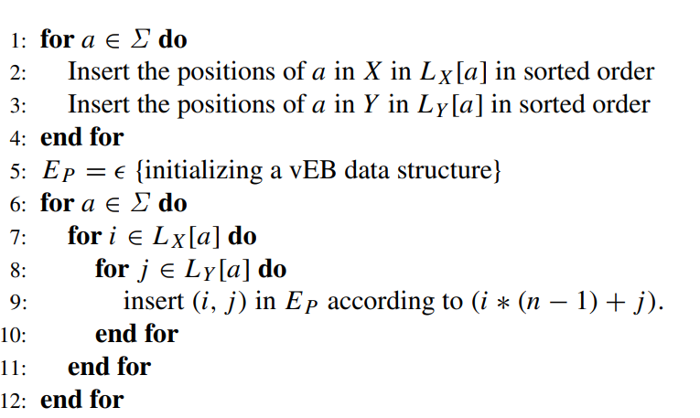
An improved algorithm for FIG
Step.1: 找出所有 match pairs
O(R log log n²) = O(R log log n)

Slide 10
An improved algorithm for FIG
 |  | Y₁ | Y₂ | ... | Y_{j-1-K} | … | Y_{j-1} | Y_{j} | … | Y_{n}
X₁
X₂
⋮ |  |  |  |  | ●
X_{i-1-K}
⋮
X_{i-1}
X_{i} |  |  |  |  |  | ●
⋮ |  |  |  | ●
X_{n}
Step.2: 處理每一列的 match

Slide 11
An improved algorithm for FIG
 |  | Y₁ | Y₂ | ... | Y_{j-1-K} | … | Y_{j-1} | Y_{j} | … | Y_{n}
X₁
X₂
⋮ |  |  |  |  | ●
X_{i-1-K}
⋮
X_{i-1}
X_{i} |  |  |  |  |  | ●
⋮ |  |  |  | ●
X_{n}
Step.3: 走到新的一列時，
需更新 n 條 vEB

Slide 12
An improved algorithm for FIG
O(n² + R(K + 1) ² ) => O(n² + RK)
maintaining vEB: O(R log log n)
FIG can be solved in O(n² + RK + R log log n)

Slide 13
A K-independent algorithm for FIG
RMAX (Range Maxima Query Problem)
Suppose that we are given a sequence A = a₁a₂…a_{n}
A Range Maxima (minima) Query specifies an interval I = (i_{s}, i_{e}), 1 ≤ i_{s} ≤ i_{e} ≤ n and the goal is to find the index with maximum (minimum) value a_{m} for a_{m} ∈ I.
solved in O(n) pre-processing time and O(1) time per query
O(n² + RK + R log log n) => O(n² + R log log n)

Slide 14
RLCS (Rigid LCS Problem)
1 2 3 4 5 6 7 8
X = FCGFCABD
Y = FGACD
RLCS = FAD
FA: 6-4 = 3 – 1
AD: 8-6 = 5 - 3

Slide 15
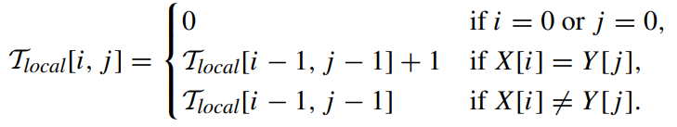
RLCS (Rigid LCS Problem)
 |  | Y₁ | Y₂ | ... | Y_{j-1-K} | … | Y_{j-1} | Y_{j} | … | Y_{n}
X₁
X₂
⋮
X_{i-1-K}
⋮
X_{i-1}
X_{i} |  |  |  |  |  |  |  | ●
⋮
X_{n}
1 2 3 4 5 6 7 8
X = FCGFCABD
Y = FGACD
RLCS = FAD
FA: 6 - 4 = 3 – 1
AD: 8 - 6 = 5 - 3

Slide 16
RIFIG (LCS Problem with Rigid Fixed Gap)
X = FCGFCABD
Y = FGACD
FGC is not RIFIG
X = FCGFCABD
Y = FGACD
FAD is RIFIG
 |  | Y₁ | Y₂ | ... | Y_{j-1-K} | … | Y_{j-1} | Y_{j} | … | Y_{n}
X₁
X₂
⋮
X_{i-1-K}
⋮
X_{i-1}
X_{i} |  |  |  |  |  |  |  | ●
⋮
X_{n}

Slide 17
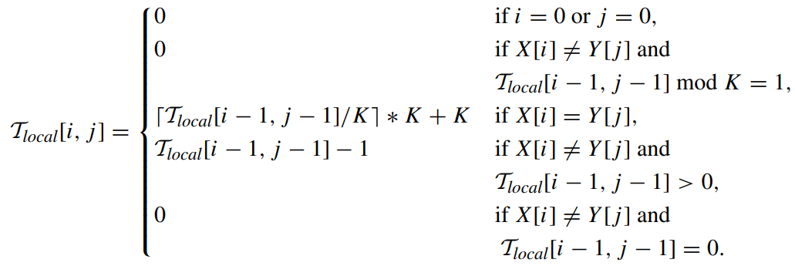
RIFIG (LCS Problem with Rigid Fixed Gap)
 |  | Y₁ | Y₂ | Y₃ | Y₄ | Y₅ | Y₆
X₁ |  | ●
X₂
X₃ |  |  |  | ●
X₄
X₅
X₆ |  |  |  |  |  |  | ●
K-modulo arithmetic
solved in O(n²)
2
1
4
3
0
2
K = 2

