Slide 1
On Almost Monge All Scores Matrices
Amir Carmel, Dekel Tsur, Michal Ziv-Ukelson
Algorithmica, 2019
Volume 81, pp. 47-68
Presenter: Tsung-Lin Lu
Date: Feb. 16, 2022

Slide 2
Abstract
The all scores matrix of a grid graph is a matrix containing the optimal scores of paths from every vertex on the first row of the graph to every vertex on the last row. This matrix is commonly used to solve diverse string comparison problems. All scores matrices have the Monge property, and this was exploited by previous works that used all scores matrices for solving various problems. In this paper, we study an extension of grid graphs that contain an additional set of edges, called bridges. Our main result is to show several properties of the all scores matrices of such graphs. We also give an O(r(nm + n²)) time algorithm for constructing the all scores matrix of an m × n grid graph with r bridges.

Slide 3
Outlines
All scores matrices
Definitions
Property
Lemma : Basic properties
Lemma : Algorithm DIFF
Lemma : Algorithm D_{first}

Slide 4
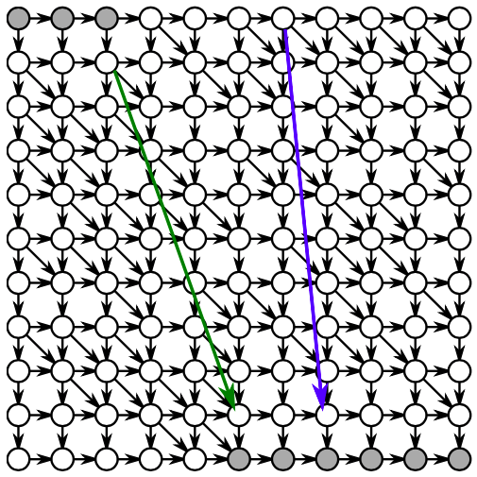
All scores matrices
The all scores matrix of two strings A and B is a (|B| + 1) × (|B| + 1) matrix that stores the optimal alignment scores between A and every substring of B.
All scores matrices with r bridges :
B
Authors | Year | Time complexity
Cabello et al. | 2013 | O(rmnlog²(nm) + n²)
Carmel et al. | 2019 | O(r(nm + n²))
A

Slide 5
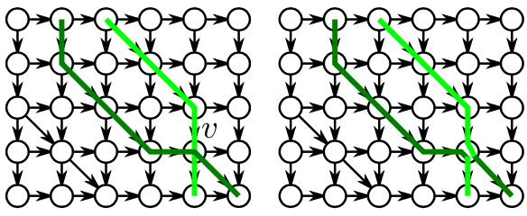
Definitions
All scores matrix D[i, j] : LCS(A[0...m], B[i...j])
Density matrix D􏰂[i, j] = (D[i, j] + D[i − 1, j − 1]) − (D[i − 1, j] + D[i, j − 1]). (對角-反對角)
D_{first}[i,j] is a subset of S that there is an s-path from (0, i) to (m, j) with score D[i, j].
(a) The crossing paths property yielding the Monge property in grid graphs.
(b) The crossing paths property no longer holds

Slide 6
start(f₁)
 | 0 | 1 | 2 | 3 | 4 | 5 | 6 | 7 | 8 | 9 | 10
0 | 0 | 1 | 2 | 3 | 4 | 7 | 7 | 7 | 7 | 7 | 8
1 | -1 | 0 | 1 | 2 | 3 | 7 | 7 | 7 | 7 | 7 | 7
2 | -2 | -1 | 0 | 1 | 2 | 7 | 7 | 7 | 7 | 7 | 7
3 | -3 | -2 | -1 | 0 | 1 | 2 | 3 | 4 | 5 | 6 | 7
4 | -4 | -3 | -2 | -1 | 0 | 1 | 2 | 4 | 4 | 5 | 6
5 | -5 | -4 | -3 | -2 | -1 | 0 | 1 | 4 | 4 | 4 | 5
6 | -6 | -5 | -4 | -3 | -2 | -1 | 0 | 4 | 4 | 4 | 4
7 | -7 | -6 | -5 | -4 | -3 | -2 | -1 | 0 | 1 | 2 | 3
8 | -8 | -7 | -6 | -5 | -4 | -3 | -2 | -1 | 0 | 1 | 2
9 | -9 | -8 | -7 | -6 | -5 | -4 | -3 | -2 | -1 | 0 | 1
10 | -10 | -9 | -8 | -7 | -6 | -5 | -4 | -3 | -2 | -1 | 0
0 1 2 3 4 5 6 7 8 9 10
0
1
2
3
4
5
6
7
8
9
10
(a) A grid graph with two bridges.
f₁ = 7
f₂ = 4
(b) D
end(f₁)
 | 0 | 1 | 2 | 3 | 4 | 5 | 6 | 7 | 8 | 9 | 10
0 | 0 | 0 | 0 | 0 | 0 | 1 | 1 | 1 | 1 | 01 | 0
1 |  | 0 | 0 | 0 | 0 | 1 | 1 | 1 | 1 | 1 | 01
2 |  |  | 0 | 0 | 0 | 1 | 1 | 1 | 1 | 1 | 01
3 |  |  |  | 0 |  | 0 | 0 | 02 | 0 | 0 | 0
4 |  |  |  |  | 0 | 0 | 0 | 2 | 02 | 0 | 0
5 |  |  |  |  |  | 0 | 0 | 2 | 2 | 02 | 0
6 |  |  |  |  |  |  | 0 | 2 | 2 | 2 | 02
7 |  |  |  |  |  |  |  | 0 | 0 | 0 | 0
8 |  |  |  |  |  |  |  |  | 0 | 0 | 0
9 |  |  |  |  |  |  |  |  |  | 0 | 0
10 |  |  |  |  |  |  |  |  |  |  | 0
(c) D􏰂 : Only the non-zero values
 | 1 | 2 | 3 | 4 | 5 | 6 | 7 | 8 | 9 | 10
1 |  |  |  |  | 1 |  |  |  |  | -1
2 |  |  |  |  | 1
3 |  |  |  |  | -4 | 1 | 1 | 1 | 1 | 1
4 |  |  |  |  |  |  | 1 | -1
5 |  |  |  |  |  |  | 1 |  | -1
6 |  |  |  |  |  |  | 1 |  |  | -1
7 |  |  |  |  |  |  | -3 | 1 | 1 | 1
8
9
10
(d) D_{first}

Slide 7
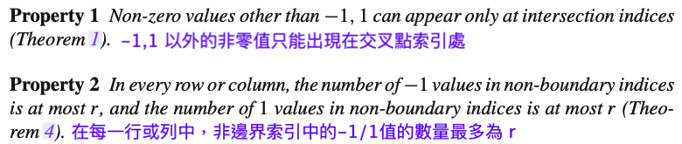
Property
 | 0 | 1 | 2 | 3 | 4 | 5 | 6 | 7 | 8 | 9 | 10
0 | 0 | 1 | 2 | 3 | 4 | 7 | 7 | 7 | 7 | 7 | 8
1 | -1 | 0 | 1 | 2 | 3 | 7 | 7 | 7 | 7 | 7 | 7
2 | -2 | -1 | 0 | 1 | 2 | 7 | 7 | 7 | 7 | 7 | 7
3 | -3 | -2 | -1 | 0 | 1 | 2 | 3 | 4 | 5 | 6 | 7
4 | -4 | -3 | -2 | -1 | 0 | 1 | 2 | 4 | 4 | 5 | 6
5 | -5 | -4 | -3 | -2 | -1 | 0 | 1 | 4 | 4 | 4 | 5
6 | -6 | -5 | -4 | -3 | -2 | -1 | 0 | 4 | 4 | 4 | 4
7 | -7 | -6 | -5 | -4 | -3 | -2 | -1 | 0 | 1 | 2 | 3
8 | -8 | -7 | -6 | -5 | -4 | -3 | -2 | -1 | 0 | 1 | 2
9 | -9 | -8 | -7 | -6 | -5 | -4 | -3 | -2 | -1 | 0 | 1
10 | -10 | -9 | -8 | -7 | -6 | -5 | -4 | -3 | -2 | -1 | 0
0 1 2 3 4 5 6 7 8 9 10
 | 1 | 2 | 3 | 4 | 5 | 6 | 7 | 8 | 9 | 10
1 |  |  |  |  | 1 |  |  |  |  | -1
2 |  |  |  |  | 1
3 |  |  |  |  | -4 | 1 | 1 | 1 | 1 | 1
4 |  |  |  |  |  |  | 1 | -1
5 |  |  |  |  |  |  | 1 |  | -1
6 |  |  |  |  |  |  | 1 |  |  | -1
7 |  |  |  |  |  |  | -3 | 1 | 1 | 1
8
9
10
0
1
2
3
4
5
6
7
8
9
10

Slide 8

Lemma : Basic properties
 | 0 | 1 | 2 | 3 | 4 | 5 | 6 | 7 | 8 | 9 | 10
0 | 0 | 1 | 2 | 3 | 4 | 7 | 7 | 7 | 7 | 7 | 8
1 | -1 | 0 | 1 | 2 | 3 | 7 | 7 | 7 | 7 | 7 | 7
2 | -2 | -1 | 0 | 1 | 2 | 7 | 7 | 7 | 7 | 7 | 7
3 | -3 | -2 | -1 | 0 | 1 | 2 | 3 | 4 | 5 | 6 | 7
4 | -4 | -3 | -2 | -1 | 0 | 1 | 2 | 4 | 4 | 5 | 6
5 | -5 | -4 | -3 | -2 | -1 | 0 | 1 | 4 | 4 | 4 | 5
6 | -6 | -5 | -4 | -3 | -2 | -1 | 0 | 4 | 4 | 4 | 4
7 | -7 | -6 | -5 | -4 | -3 | -2 | -1 | 0 | 1 | 2 | 3
8 | -8 | -7 | -6 | -5 | -4 | -3 | -2 | -1 | 0 | 1 | 2
9 | -9 | -8 | -7 | -6 | -5 | -4 | -3 | -2 | -1 | 0 | 1
10 | -10 | -9 | -8 | -7 | -6 | -5 | -4 | -3 | -2 | -1 | 0
 | 1 | 2 | 3 | 4 | 5 | 6 | 7 | 8 | 9 | 10
1 |  |  |  |  | 1 |  |  |  |  | -1
2 |  |  |  |  | 1
3 |  |  |  |  | -4 | 1 | 1 | 1 | 1 | 1
4 |  |  |  |  |  |  | 1 | -1
5 |  |  |  |  |  |  | 1 |  | -1
6 |  |  |  |  |  |  | 1 |  |  | -1
7 |  |  |  |  |  |  | -3 | 1 | 1 | 1
8
9
10

Slide 9
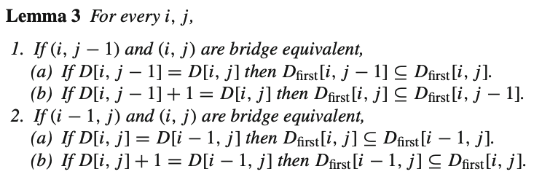
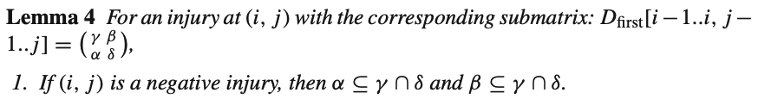
Lemma : Basic properties
 | 0 | 1 | 2 | 3 | 4 | 5 | 6 | 7 | 8 | 9 | 10
0 | 0 | 0 | 0 | 0 | 0 | 1 | 1 | 1 | 1 | 01 | 0
1 |  | 0 | 0 | 0 | 0 | 1 | 1 | 1 | 1 | 1 | 01
2 |  |  | 0 | 0 | 0 | 1 | 1 | 1 | 1 | 1 | 01
3 |  |  |  | 0 |  | 0 | 0 | 02 | 0 | 0 | 0
4 |  |  |  |  | 0 | 0 | 0 | 2 | 02 | 0 | 0
5 |  |  |  |  |  | 0 | 0 | 2 | 2 | 02 | 0
6 |  |  |  |  |  |  | 0 | 2 | 2 | 2 | 02
7 |  |  |  |  |  |  |  | 0 | 0 | 0 | 0
8 |  |  |  |  |  |  |  |  | 0 | 0 | 0
9 |  |  |  |  |  |  |  |  |  | 0 | 0
10 |  |  |  |  |  |  |  |  |  |  | 0

Slide 10

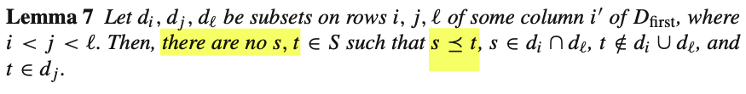
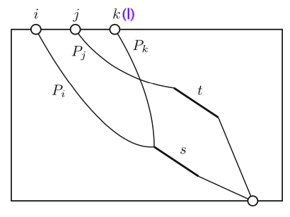
Lemma : Basic properties
D_{s}[i,j] is the maximum score of an s-path from (0,i) to (m, j).

Slide 11
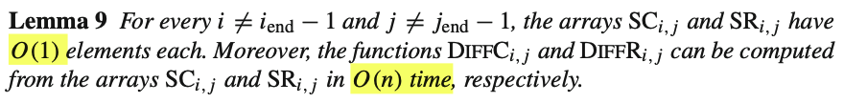
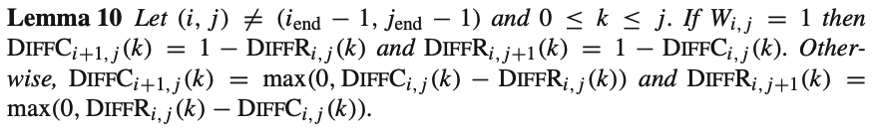
Lemma : Algorithm DIFF
An index k for which DiffC_{i, j}(k − 1) ≠ DiffC_{i, j}(k) will be called a step index of DiffC_{i, j}.
Compute SCi+1, j and SRi, j+1 by O(n). There are O(n + m) pairs i, j.
Time complexity of the algorithm is O(n2 + nm).

Slide 12
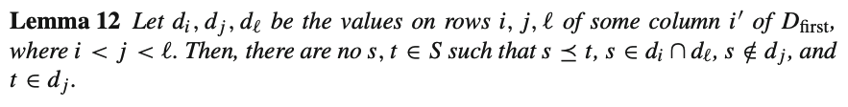
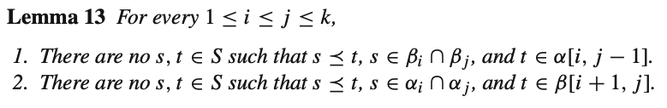

Lemma : Algorithm D_{first}

Slide 13
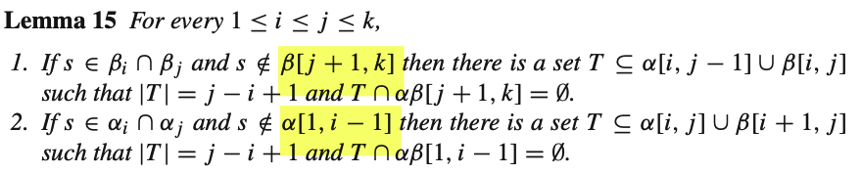

Lemma : Algorithm D_{first}

Slide 14
Thank you for listening

Slide 15
Abstract
s

