Slide 1
Efficient Merged Longest Common Subsequence Algorithms for Similar Sequences ​
Kuo-Tsung Tseng, De-Sheng Chan, Chang-Biau Yang and Shou-Fu Lo
Theoretical Computer Science
Volume 708, 17 January 2018, Pages 75-90
Presenter: Chien-Ting Lee
Date: Mar. 23, 2022

Slide 2
Abstract(1/2)
Given a pair of merging sequences A, B and a target sequence T , the
merged longest common subsequence (MLCS) problem is to find out
the longest common subsequence (LCS) between sequences E(A, B)
and T , where E(A, B) is obtained from merging two subsequences of
A and B. In this paper, we first propose an algorithm for solving the
MLCS problem in O(n|∑| + (r − L + 1)Lm) time and O(n|∑| + Lm)
space, where r and L denote the lengths of T and MLCS, respectively,
and m and n denote the shorter and longer lengths of A and B,
respectively. From the time complexity, it is clear that our algorithm is
very efficient when T and E(A, B) are very similar.

Slide 3
Abstract(2/2)
With slight modification, our algorithm can also solve another merged
LCS problem variant, the block-merged LCS (BMLCS) problem, in
O(n|∑|+(r − L +1)Lδ) time and O(n|∑|+ Lδ) space, where δ denotes the
larger number of blocks of A and B. Experimental results show that
our algorithms are faster than other previously published MLCS and
BMLCS algorithms for sequences with high similarities.

Slide 4
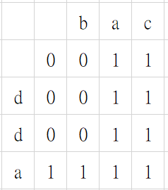
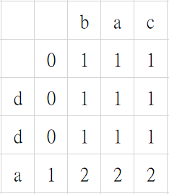
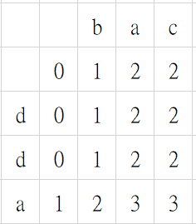
MLCS (merged LCS)
Target:aba A:dda B:bac
a ab aba
O(rnm) |T | = r |A| = m |B| = n

Slide 5
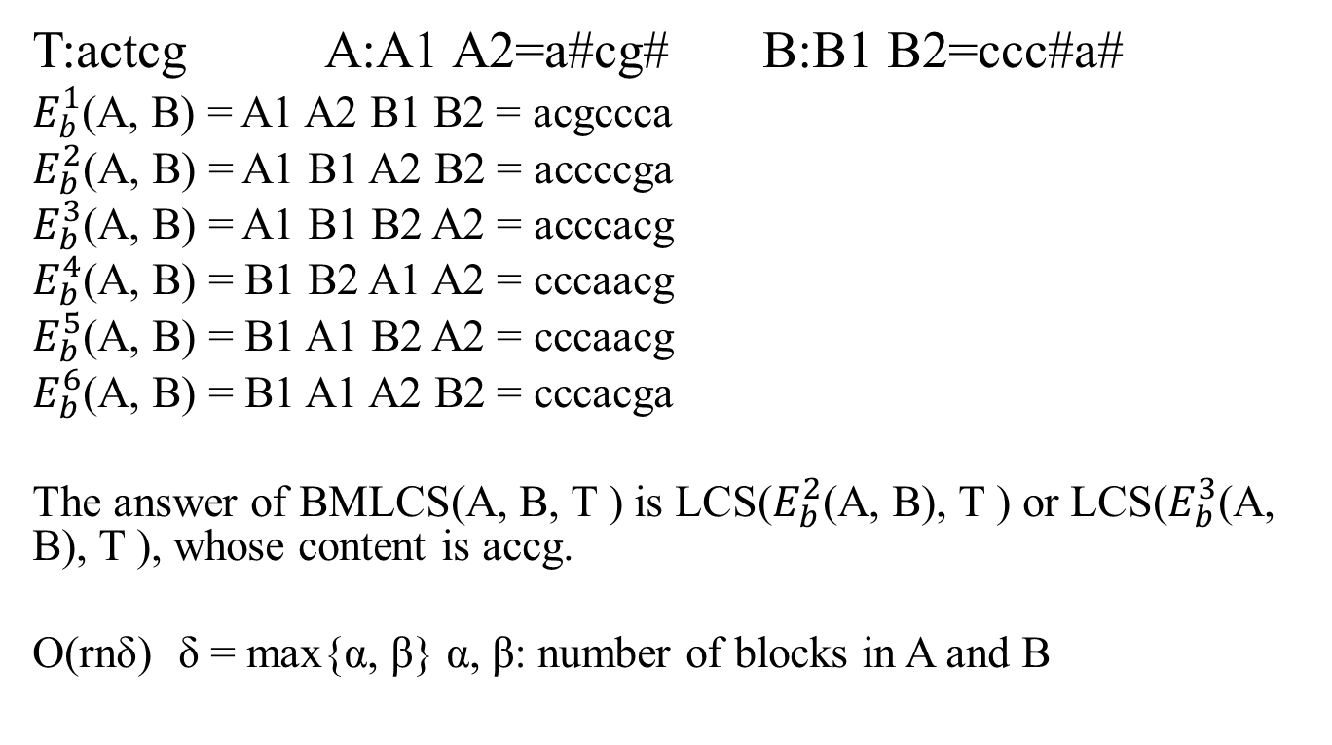
BMLCS (block-merged LCS)
T:actcg A:A1 A2=a#cg# B:B1 B2=ccc#a#
$E_{b}^{1}$(A, B) = A1 A2 B1 B2 = acgccca
$E_{b}^{2}$(A, B) = A1 B1 A2 B2 = accccga
$E_{b}^{3}$(A, B) = A1 B1 B2 A2 = acccacg
$E_{b}^{4}$(A, B) = B1 B2 A1 A2 = cccaacg
$E_{b}^{5}$(A, B) = B1 A1 B2 A2 = cccaacg
$E_{b}^{6}$(A, B) = B1 A1 A2 B2 = cccacga
The answer of BMLCS(A, B, T ) is LCS($E_{b}^{2}$(A, B), T ) or LCS($E_{b}^{3}$(A, B), T ), whose content is accg.
O(rnδ)δ = max{α, β} α, β: number of blocks in A and B
Notes:
O(|T|(|A|+|B|)(α+β))

Slide 6
MLCS in this paper
D_{k,s} , where k, s ≥ 0, denote the dominating set {i2, j2 | MLCS(A1..i2 , B1.. j2 , T1..k) = s, and for any <i1, j1> that dominates <i2, j2> , MLCS(A1..i1 , B1.. j1 , T1..k) ≤ s − 1}.
Ex:
A = acg B = ccca T = actcgc. D_{1,1} = {<1, 0>,<0, 4>}
<2,0> dominate <2,4>
Dominate:Merge two sets of 2-tuples and to remove all 2-tuples that are dominated by others.
EX:
W = {<1,1> ,<2,0> ,<2,4>}. We get Dominate(W) = {<1,1> ,<2,0>}, since <2,4> is dominated by <2,0> .
Notes:
Dk,s是一個集合 裡面的放置的元素為 可以使得目標字船長度為K的情況下，最後MLCS的長度為S時，被Merge的兩個字串的index
_{因為我們要找最長的，}D_{1,1集合處理完之後，下一個就是找}D_{2,2，所以當然是多看一個目標字元，看能否使長度多1}

Slide 7

MLCS in this paper
ExtA(D_{X,Y}), ExtB(D_{X,Y})
D_{X,Y}$→$ D_{X+1,Y+1} 's elements
ExtA(D_{1,1}) = {<2, 0>,<2, 4> }
ExtB(D_{1,1}) = {<1, 1>}
Notes:
Dk,s是一個集合 裡面的放置的元素為 可以使得目標字船長度為K的情況下，最後MLCS的長度為S時，被Merge的兩個字串的index
_{因為我們要找最長的，}D_{1,1集合處理完之後，下一個就是找}D_{2,2，所以當然是多看一個目標字元，看能否使長度多1}

Slide 8
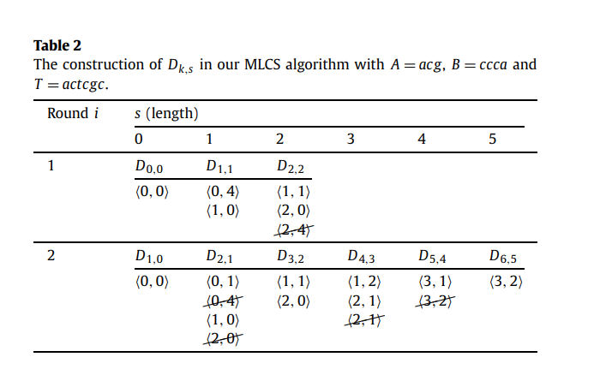
MLCS in this paper
.
O(n|∑| + (r − L + 1)Lm)
Notes:
n|∑| 為Successor table
迴圈最多(r − L +1) times 6-5+1=2
L為MLCS長度
m為Dominate 時間

Slide 9
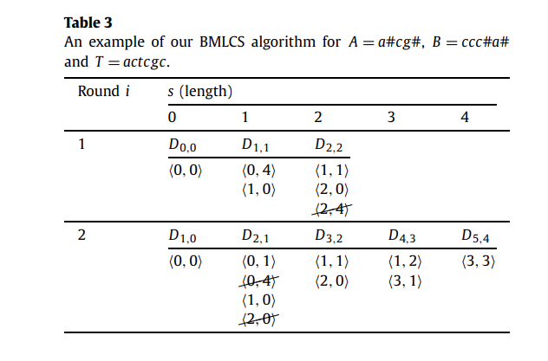
BMLCS in this paper
.
BExtA(1,1)=∅ BExtA(2,0)=∅
BExtB(1,1)=<1,2> BExtB(2,0)=<3,1>
O(n|∑| + (r − L + 1) Lδ)
Notes:
n|∑| 為Successor table
迴圈最多(r − L +1) times
L為MLCS長度
δ為larger number of blocks of A and B

Slide 10
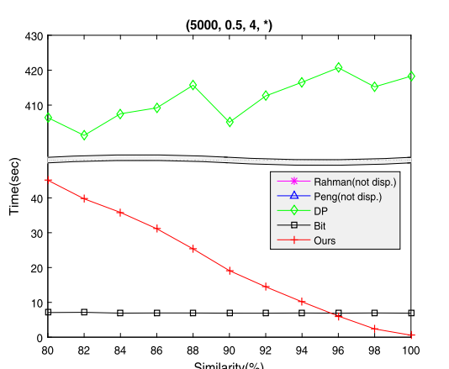
Experimental results
Notes:
(T長度,相似度字串A與目標字串T數量比例,字母種類,algorithm名稱)
similarity解與原字串相似度

Slide 11
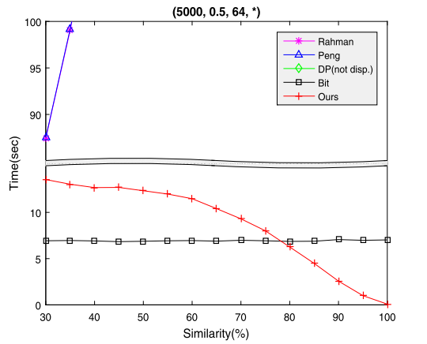
Experimental results
Notes:
(T長度,相似度字串A與目標字串T數量比例,字母種類,algorithm名稱)
similarity解與原字串相似度

Slide 12
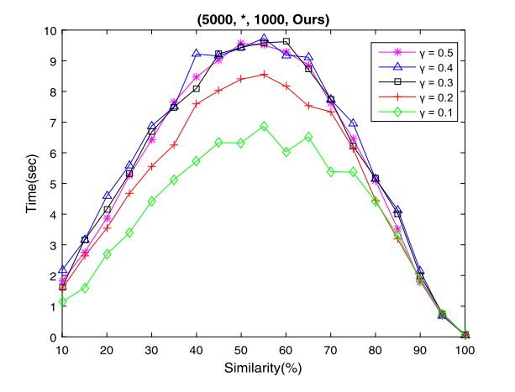
Experimental results
Notes:
O(n|∑|+(r − L +1)Lm)
L = r/2 , whose similarity is 50%
https://www.geogebra.org/graphing?lang=zh-TW
f(x)=x (1-x)
解釋為何會凸起

