Slide 1
A Diagonal-Based Algorithm for the Longest Common Increasing Subsequence Problem ​
Shou-Fu Lo, Kuo-Tsung Tseng, Chang-Biau Yang and Kuo-Si Huang
Theoretical Computer Science
Volume 815, 2 May 2020, Pages 69-78
Presenter: Chien-Ting Lee
Date: Apr. 26, 2022

Slide 2
Abstract(1/2)
The longest common increasing subsequences (LCIS) problem is to
find out a common increasing subsequence with the maximal length of
two given sequences A and B. In this paper, we propose an algorithm
for solving the LCIS problem with O((n + L(m − L))loglog|∑|) time
and O(n) space, where m and n denote the lengths of A and B,
respectively, m ≤ n, L denotes the LCIS length, and ∑ denotes the
alphabet set. The main idea of our algorithm is to extend the answer
from some previously feasible solutions, in which the domination
function is invoked. To accomplish the extension and domination
functions, the data structure of the van Emde Boas tree is utilized.
Notes:
parentheses

Slide 3
Abstract(2/2)
From the time complexity, it is obvious that our algorithm is extremely
efficient when L is very small or L is close to m. Some experiments are
performed to demonstrate the efficiency of our algorithm.

Slide 4
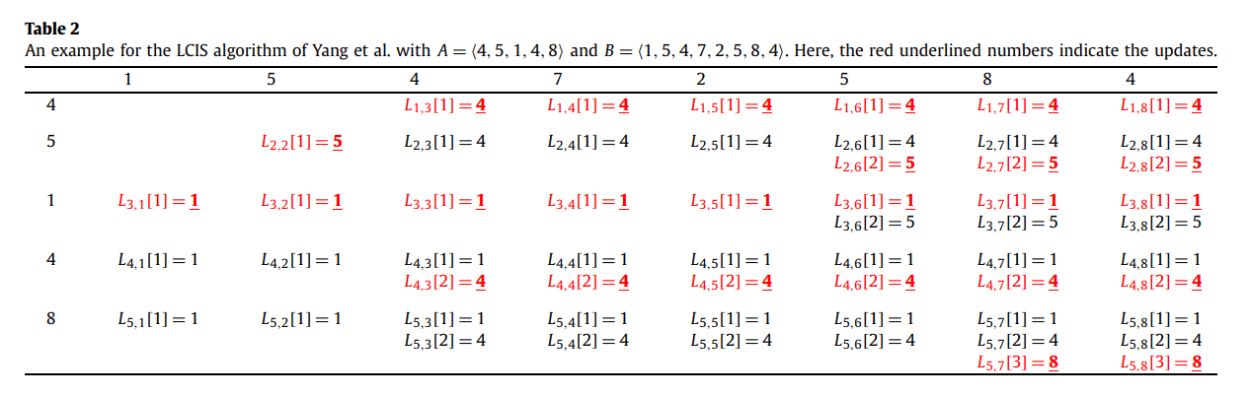
LCIS(DP)
A=<4,5,1,4,8> B=<1,5,4,7,2,5,8,4>
O(mn)
Notes:
O((n + L(m − L))loglog|∑|)

Slide 5
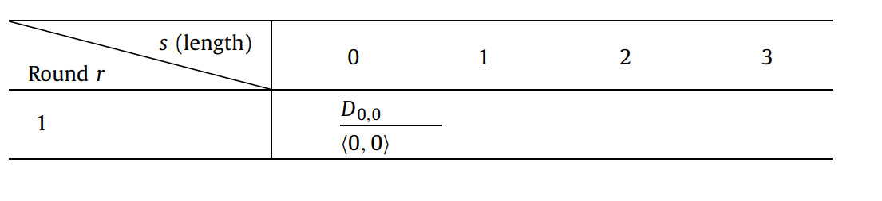
LCIS(diagonal-based)
A=<4,5,1,4,8> B=<1,5,4,7,2,5,8,4>
Notes:
只先看A的第一個字母去找出在B字串的哪邊然後紀錄此數字的值與位置
A看0個數字然後長度為0時共同最大數字，與此數字在B的哪邊

Slide 6
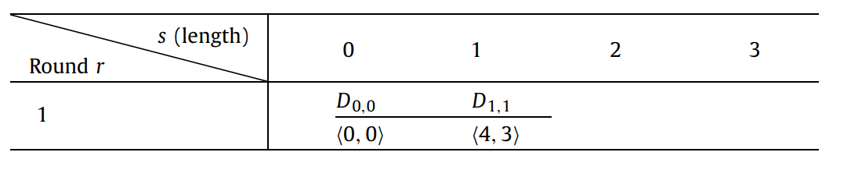
LCIS(diagonal-based)
A=<4,5,1,4,8> B=<1,5,4,7,2,5,8,4>
Notes:
A看1個數字然後長度為1時的狀況
那我們應該由前面所記錄的INDEX在往後延伸，也就是位置0再繼續往後找
我們可以在B的第三個位置找到

Slide 7
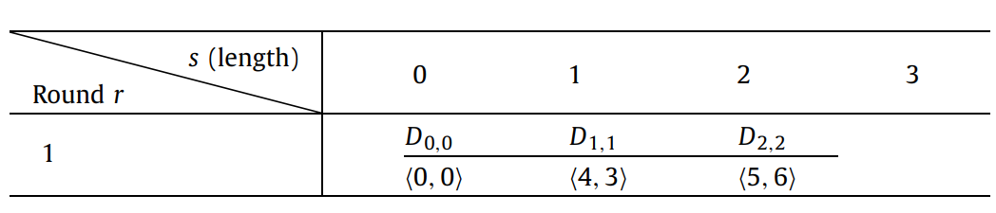
LCIS(diagonal-based)
A=<4,5,1,4,8> B=<1,5,4,7,2,5,8,4>

Slide 8
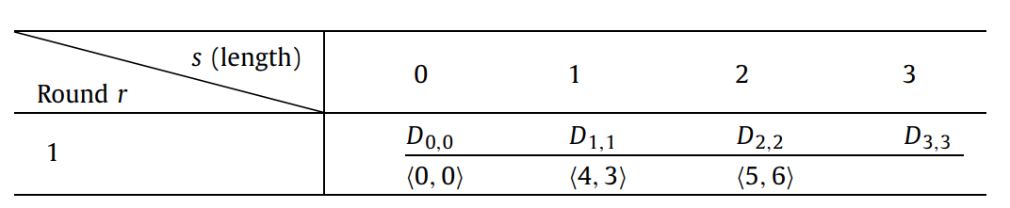
LCIS(diagonal-based)
A=<4,5,1,4,8> B=<1,5,4,7,2,5,8,4>

Slide 9
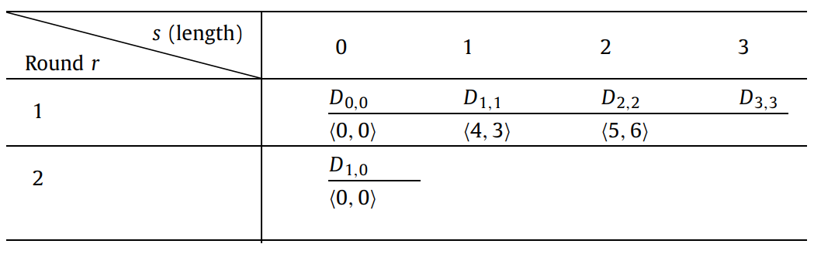
LCIS(diagonal-based)
A=<4,5,1,4,8> B=<1,5,4,7,2,5,8,4>
Notes:
第二ROUND時我們就會多看一個字母，也就是一開始A字串就看到第一個字母

Slide 10
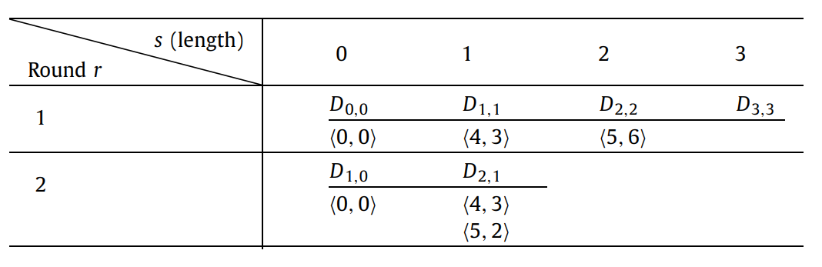
LCIS(diagonal-based)
A=<4,5,1,4,8> B=<1,5,4,7,2,5,8,4>
Notes:
<0,0>產生<5,2>
D1,1的4,3
那這時候會比較是否有DOMINATE的狀況發生
這兩個數字的含意為目前LCIS最大的數字與此數字所在的位置故當然在長度一樣的情況下這兩個數值是越小越好，這樣才能使長度盡可能地變大，所以就繼續不需要做刪除的動作

Slide 11
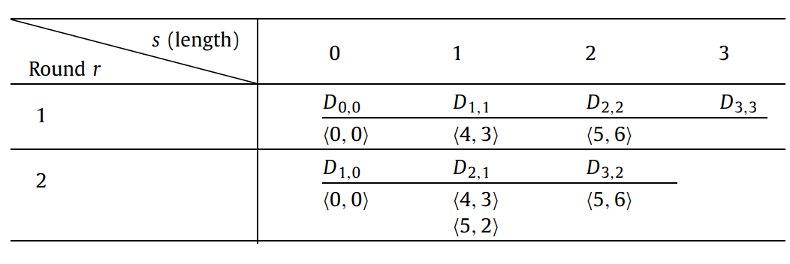
LCIS(diagonal-based)
A=<4,5,1,4,8> B=<1,5,4,7,2,5,8,4>

Slide 12
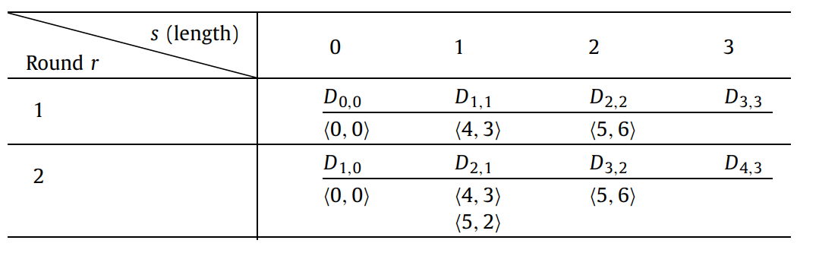
LCIS(diagonal-based)
A=<4,5,1,4,8> B=<1,5,4,7,2,5,8,4>

Slide 13
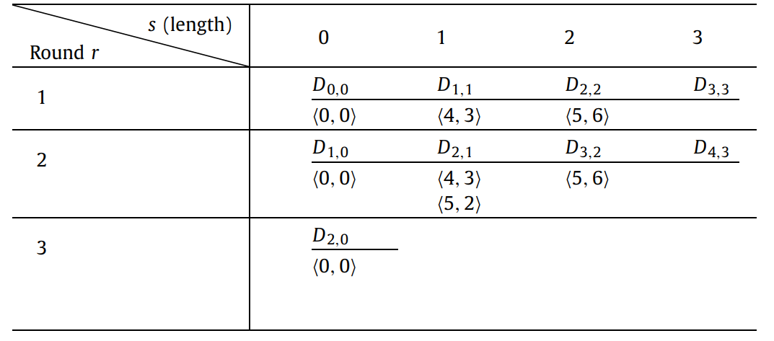
LCIS(diagonal-based)
A=<4,5,1,4,8> B=<1,5,4,7,2,5,8,4>

Slide 14
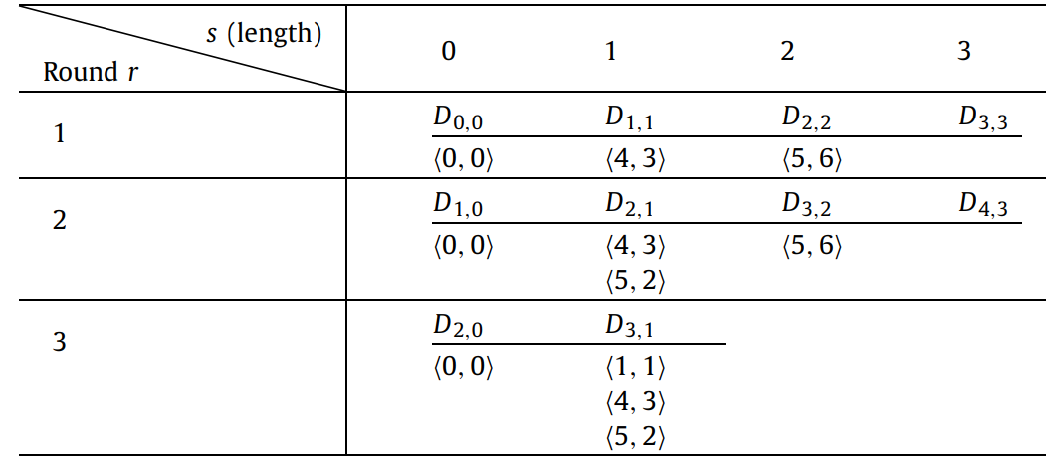
LCIS(diagonal-based)
A=<4,5,1,4,8> B=<1,5,4,7,2,5,8,4>

Slide 15
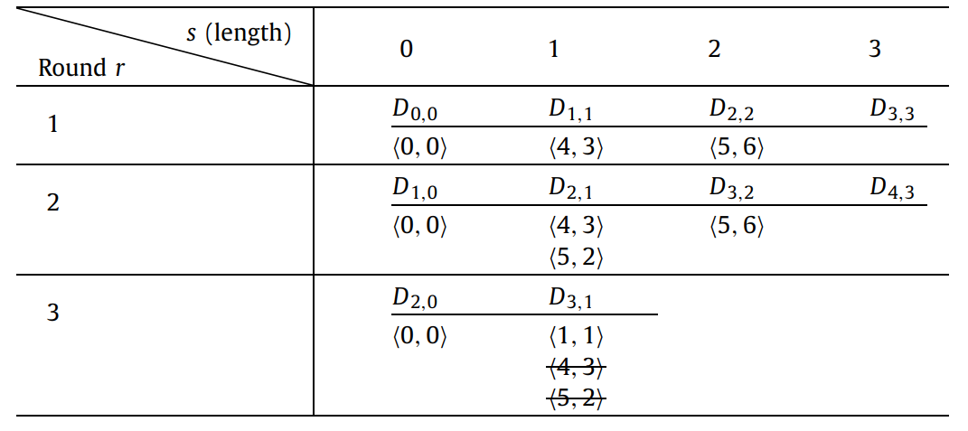
LCIS(diagonal-based)
A=<4,5,1,4,8> B=<1,5,4,7,2,5,8,4>
Notes:
這兩個數字的含意為LCIS最大的值與他所在的位置故當然在長度一樣的情況下這兩個數值是越小越好，這樣才能使長度盡可能地變大，所以<4,3> <5,2>這兩個元素都被<1,1>dominate所以這兩個元素皆可被刪除

Slide 16
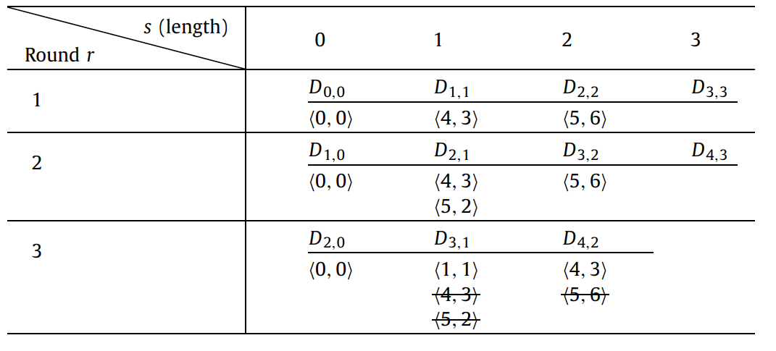
LCIS(diagonal-based)
A=<4,5,1,4,8> B=<1,5,4,7,2,5,8,4>

Slide 17
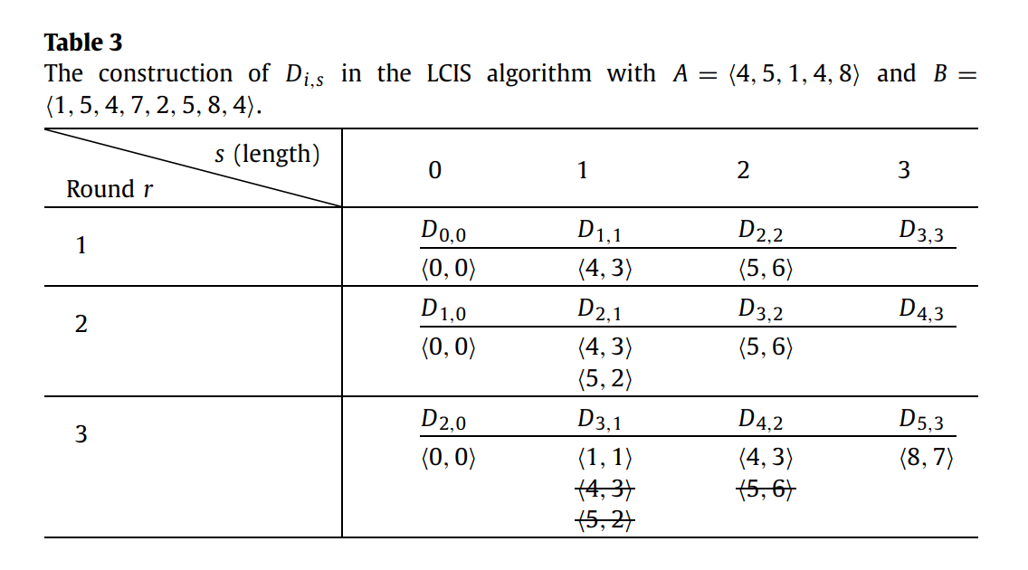
LCIS(diagonal-based)
A=<4,5,1,4,8> B=<1,5,4,7,2,5,8,4>
O((n + L(m − L))loglog|∑|)
Notes:
Di,j
(m-L)=共需幾round
L為LCIS的長度
n*loglog|∑| 為前處理
loglog|∑| 為所使用的資料結構操作所花時間

Slide 18
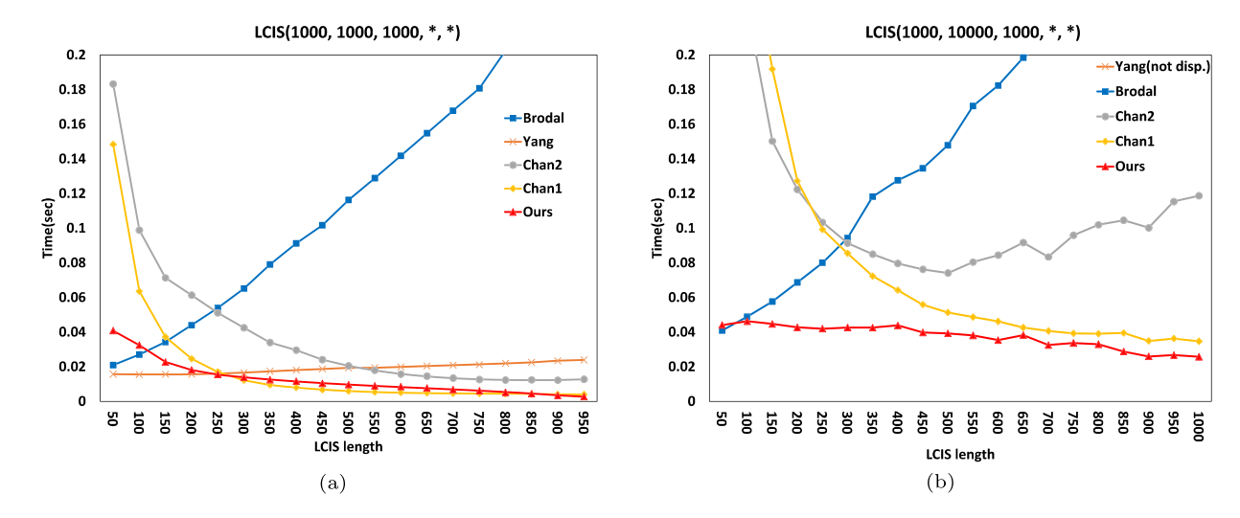
Experimental results
O((n + L(m − L))loglog|∑|)
Notes:
(a長度,b長度,字母種類,lcis長度,algorithm名稱)

