Slide 1
Noisy Sorting Capacity
Ziao Wang, Nadim Ghaddar, Lele Wang
arXiv:2202.01446v1, Information Theory,
Feb. 3, 2022
Presenter: Shin-Cheng Lin
Date: May 3, 2022

Slide 2
Abstract
Sorting is the task of ordering n elements using pairwise comparisons. It is well known that m = (nlogn) comparisons are both necessary and sufficient when the outcomes of the comparisons are observed with no noise. In this paper, we study the sorting problem in the presence of noise. Unlike the common approach in the literature which aims to minimize the number of pairwise comparisons m to achieve a given desired error probability, our goal is to characterize the maximal ratio nlogn/m such that the ordering of the elements can be estimated with a vanishing error probability asymptotically.

Slide 3
Abstract
The maximal ratio is referred to as the noisy sorting capacity. In this work, we derive upper and lower bounds on the noisy sorting capacity. The algorithm that attains the lower bound is based on the well known Burnashev–Zigangirov algorithm for coding over channels with feedback. By comparing with existing algorithms in the literature under the proposed framework, we show that our algorithm can achieve a strictly larger ratio asymptotically.

Slide 4
Noisy Searching Problem
Find the index i* such that θ_{i*} ＜ θ ＜ θ_{i*+1}
p = 1 → nlogn / n = logn
p = (1/2, 1] → mn / n = m
Achievable rate R = (logn)/m

Slide 5
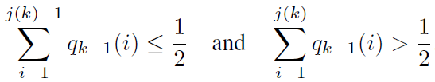
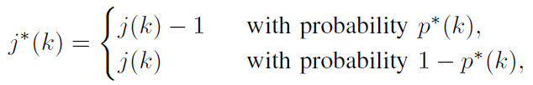

Burnashev–Zigangirov Algorithm
1. find the most likely position of θ.
Where

Slide 6
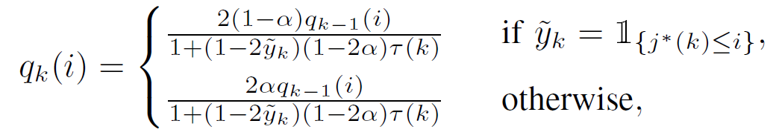
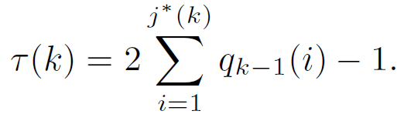


Burnashev–Zigangirov Algorithm
2. submmit query θ_{j*(k)} and receive noisy response Y_{k}.
3.update q_{k}(i)
Where
and

Slide 7
Burnashev–Zigangirov Algorithm
4. return the most likely position of θ.
arg max_{i} q_{m}(i)

Slide 8
Noisy Sorting Algorithm
Get the most correct position of each element by Burnashev–Zigangirov Algorithm.
Implement insertion sorting.

Slide 9
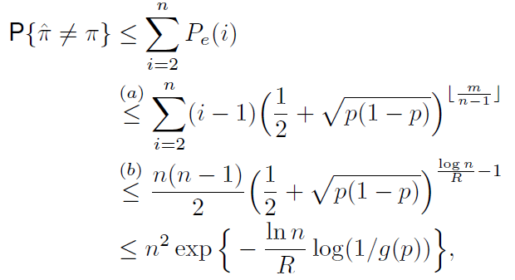


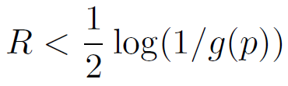
The error probability
gose to zero as n → ∞ if

Slide 10
