Slide 1
The Game of Bridge:
A Challenge for ILP
Swann Legras, C’eline Rouveirol, and V’eronique Ventos
28th International Conference, ILP 2018, Ferrara, Italy, September 2–4, 2018, Proceedings
Presenter: Ying-Yu Lin
Date: May.3, 2022

Slide 2
Abstract
Designs of champion-level systems dedicated to a game have been considered as milestones for Artificial Intelligence. Such a success has not yet happened for the game of Bridge because (i) Bridge is a partially observable game (ii) a Bridge player must be able to explain at some point the meaning of his actions to his opponents. This paper presents a simple supervised learning problem in Bridge: given a ‘limit hand’, should a player bid or not, only considering his hand and the context of his decision. We describe this problem and some of its candidate modelisations. We then experiment state of the art propositional machine learning and ILP systems on this problem. Results of these preliminary experiments show that ILP systems are competitive or even outperform propositional Machine Learning systems. ILP systems are moreover able to build explicit models that have been validated by expert Bridge players.

Slide 3

Opening Bid problem
$cn with n∈$ {1..52}
$position∈\{1..4\}$
$vulnerability∈\left\{1..4\right\}$
$class∈$ {0,1} , class = 1 if the expert opens and 0 if he passes

Slide 4
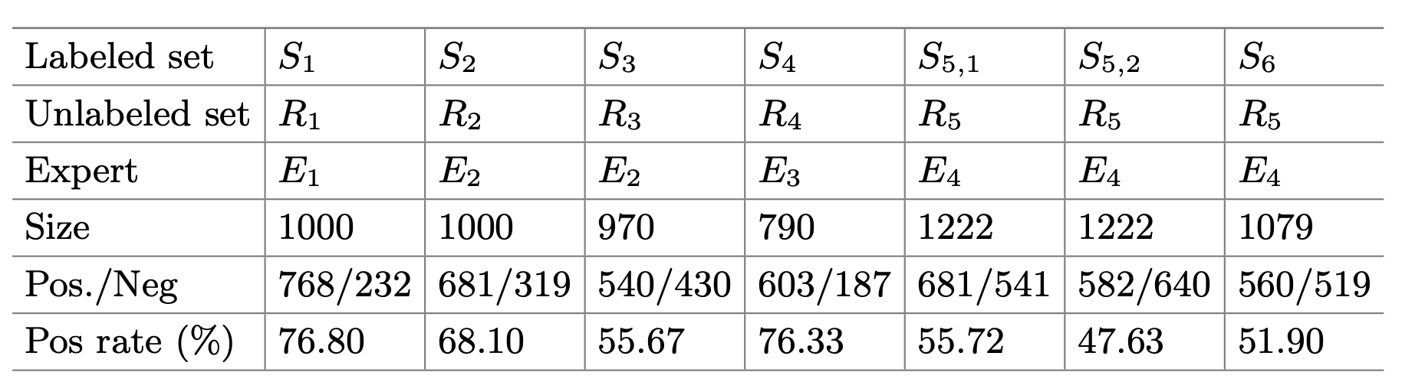
DataSets

Slide 5
Build Rule Sets with ILP System
Tilde: first order logical decision tree
Aleph : top-down
Select example
Build most-specific-clause
Search
Remove redundant

Slide 6
Relation Representation
BK₀:
- open(E , Class)
has_hand(E , H)
has_card(E , C)
position(E , P)
vuln(E , V₁ , V₂)
- open(e₁ , pos)
has_hand(e₁,[c6,c9,d2,d10,dq,dk,h2,h3,hq,s4,s6,s10,sa])
has_card(e₁ , c9)
position(e₁, 4)
vuln(e₁ , g , r) g : not vulnerable , r : vulnerable

Slide 7
Relation Representation
BK₁:
- has_suit(Card , Suit)
has_rank(Card , Rank)
minor(Card)
honor(Card)
small_card(Card)
- nb(E , Suit , Number)
plusvalue(E)
lteq(Number , Number)
gteq(Number , Number)
BK₂:
List_honor(E , Suit , ListH)

Slide 8
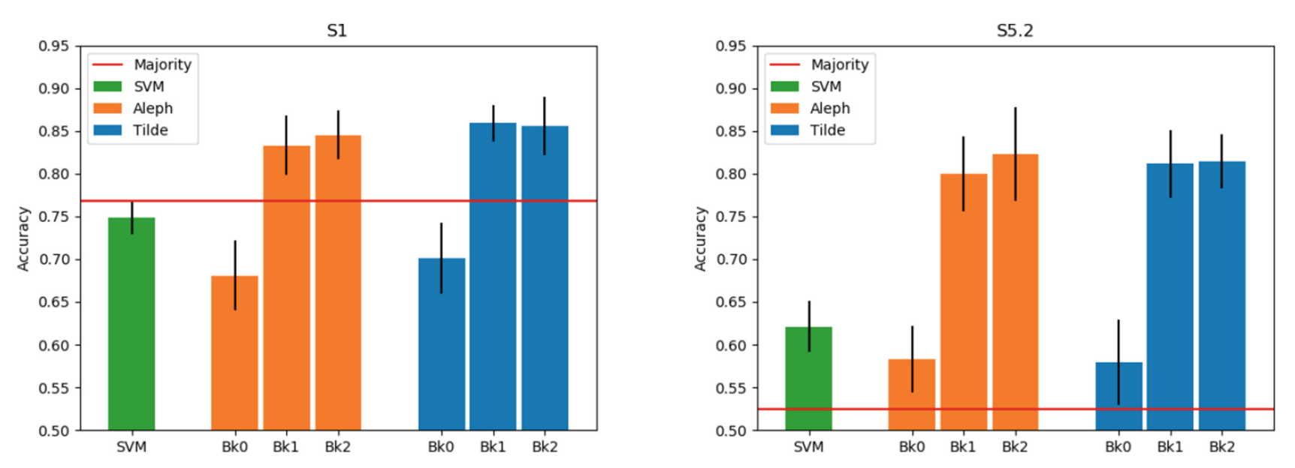
Experiment

Slide 9
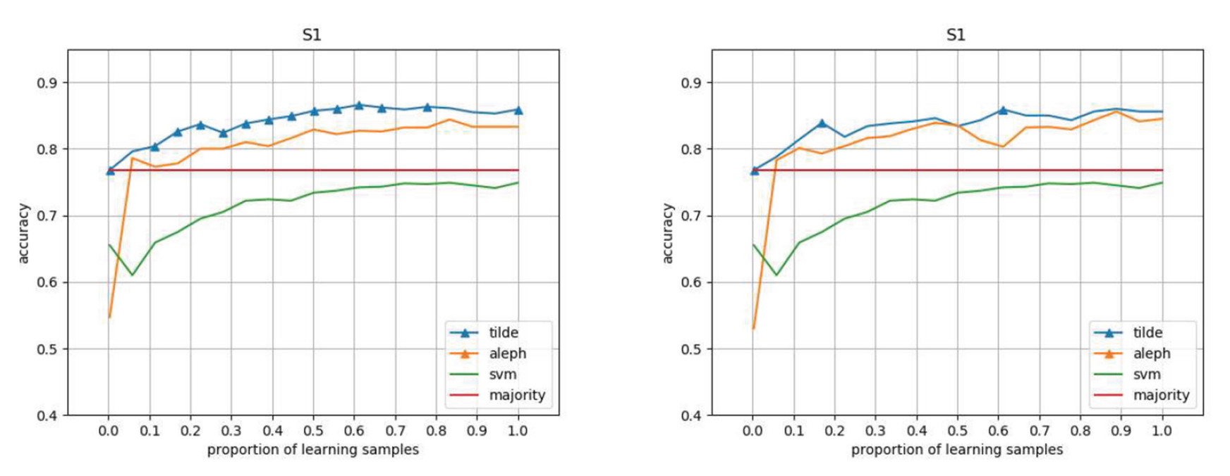
Experiment
BK₁
BK₂

Slide 10
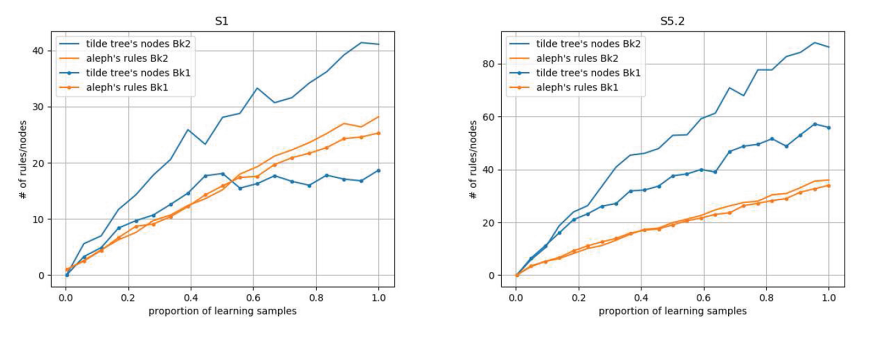
Experiment

Slide 11
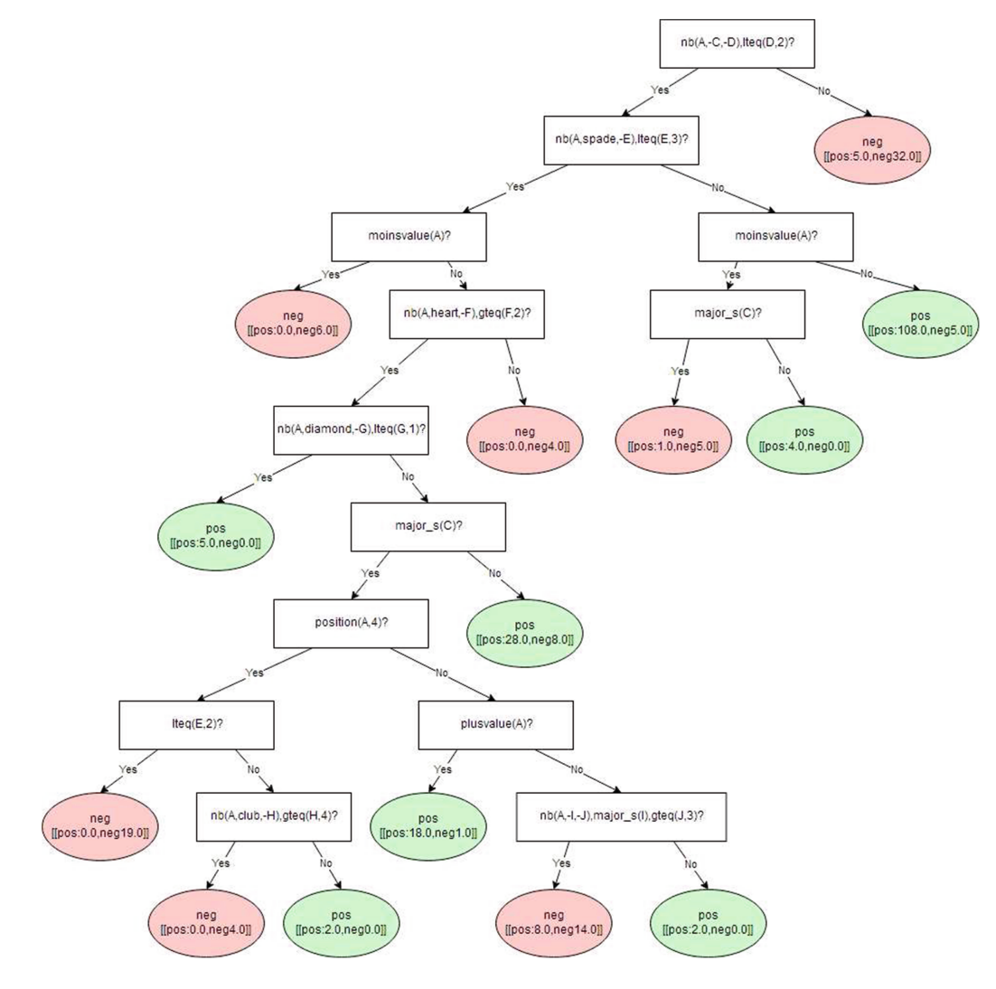
Expert Validation
279 examples:
No hand with more than 5 cards in a suit
Position cannot be 3

