Slide 1
Longest increasing subsequences in sliding windows
Michael H. Albert , Alexander Golynski , Angele M. Hamel, Alejandro Lopez-Ortiz , S. Srinivasa Rao , Mohammad Ali Safari
Theoretical Computer Science 321 (2004) 405–414
Presenter: Cheng-Han Ho
Date: May 9, 2022

Slide 2
Abstract
We consider the problem of finding the longest increasing subsequence in a sliding window over a given sequence (LISW). We propose an output-sensitive data structure that solves this problem in time O(n log log n +OUTPUT) for a sequence of n elements. This data structure substantially improves over the naive generalization of the longest increasing subsequence algorithm and in fact produces an output-sensitive optimal solution.

Slide 3
LIS (Longest Increasing Subsequence)
3
35
25
257
247
2478
1478
1468
A = 35274816
O(n log log n)

Slide 4
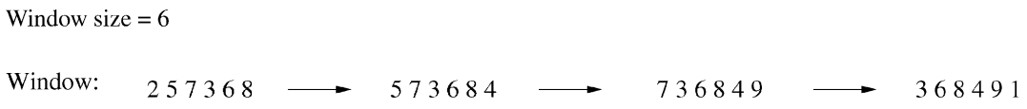
LISW (Longest increasing subsequences in sliding windows)
A = 257368491
each window: O(w log log w)
naive LISW: O(nw log log w)

Slide 5
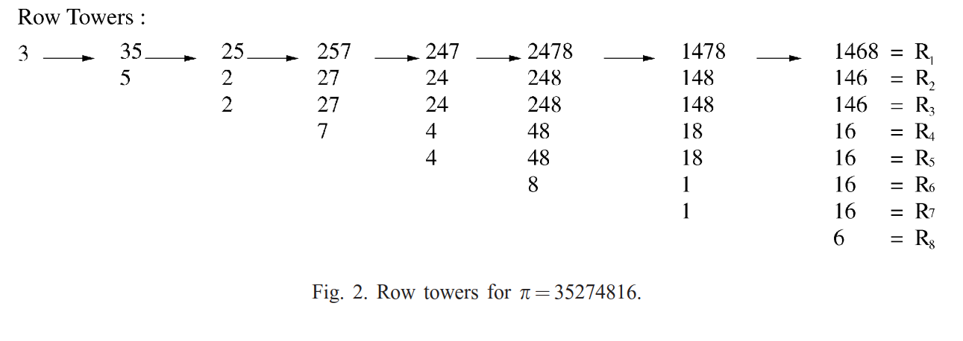
row tower

Slide 6
drop out times
drop out times = (7, 3, 8, 1)

Slide 7
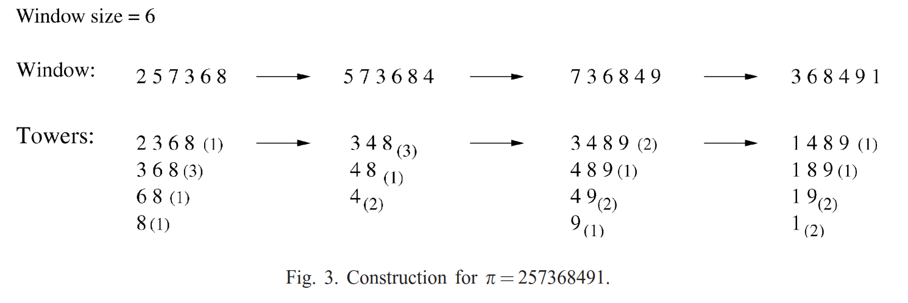
sliding window (1/3)
drop out times = (1, 4, 5, 6)
remove 2: (3, 4, 5)
add 4: (3, 6, 4)

Slide 8
sliding window (2/3)
drop out times = (3, 6, 4)
remove 5: (2, 5, 3)
add 9: (2, 5, 3, 6)

Slide 9
sliding window (3/3)
drop out times = (2, 5, 3, 6)
remove 7: (1, 4, 2, 5)
add 1: (6, 1, 4, 2) (6, 1, 2, 4)

Slide 10



complexity
remove / add : O(𝓁)
initialization:
output:
total:

