Slide 1
A bit-pattern-based matrix strategy for efficient iconic indexing of symbolic pictures
Ye-In Chang, Bi-Yen Yang, Wei-Horng Yeh
Pattern Recognition Letters 24 (2003) 537–545
Presenter : Yu-Ju Liao
Date :May 10, 2022

Slide 2
Abstract
In this paper, we propose an efficient iconic indexing strategy called bit-pattern-based matrix (BP matrix) for symbolic pictures, in which each spatial relationship between any two objects along the x-axis (or y-axis) is represented as a binary-bit pattern and is recorded in a matrix. There are 12 bits in each bit pattern. When the bits in a certain subset of those 12 bits are set to 1, they denote a certain spatial relationship. Bit-wise-and/bit-wise-or operations are used for query processing; therefore, they are efficient enough as compared to the previous approaches. From our simulation, we show that the proposed BP matrix strategy requires shorter time for query processing than the generalized prime-number-based matrix strategy.

Slide 3
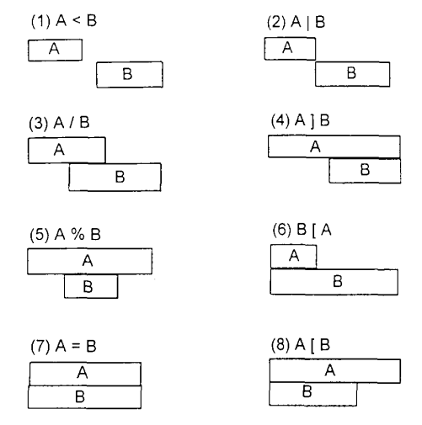
Spatial operators

Slide 4
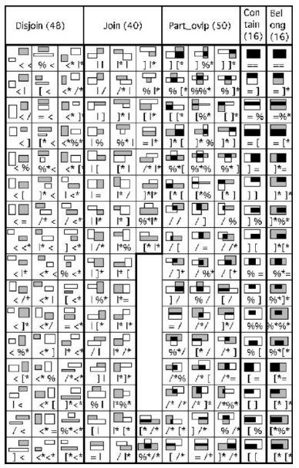
Spatial categories
Disjoin
Join
Contain
Belong
Part_overlap

Slide 5
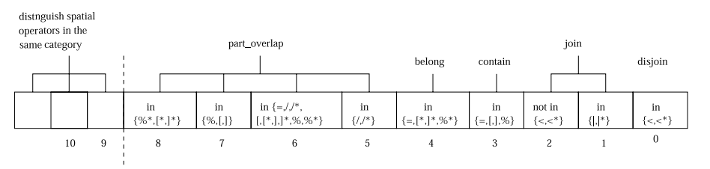
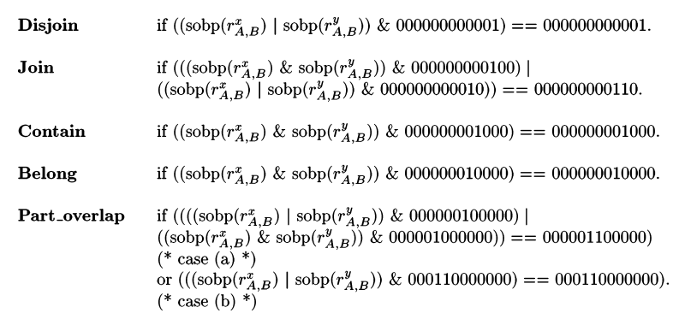
Bit string

Slide 6
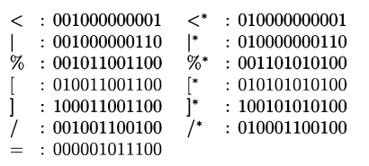
bit string

Slide 7
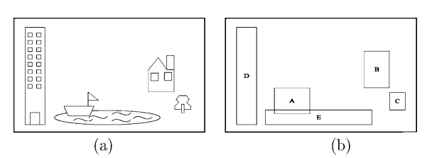
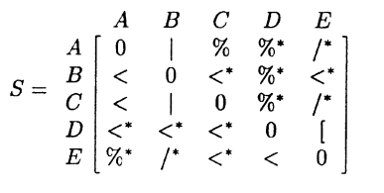
Spatial matrix

Slide 8
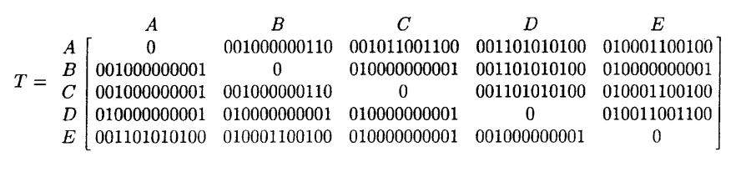
BP matrix

Slide 9
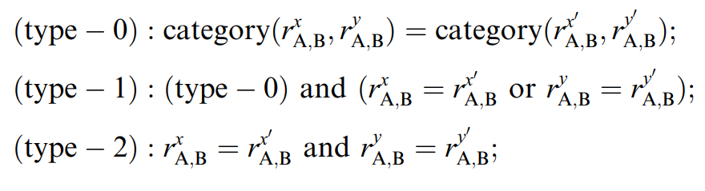
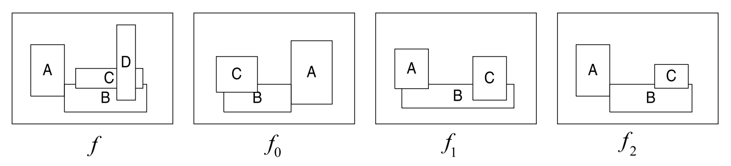
Similarity retrieval

Slide 10
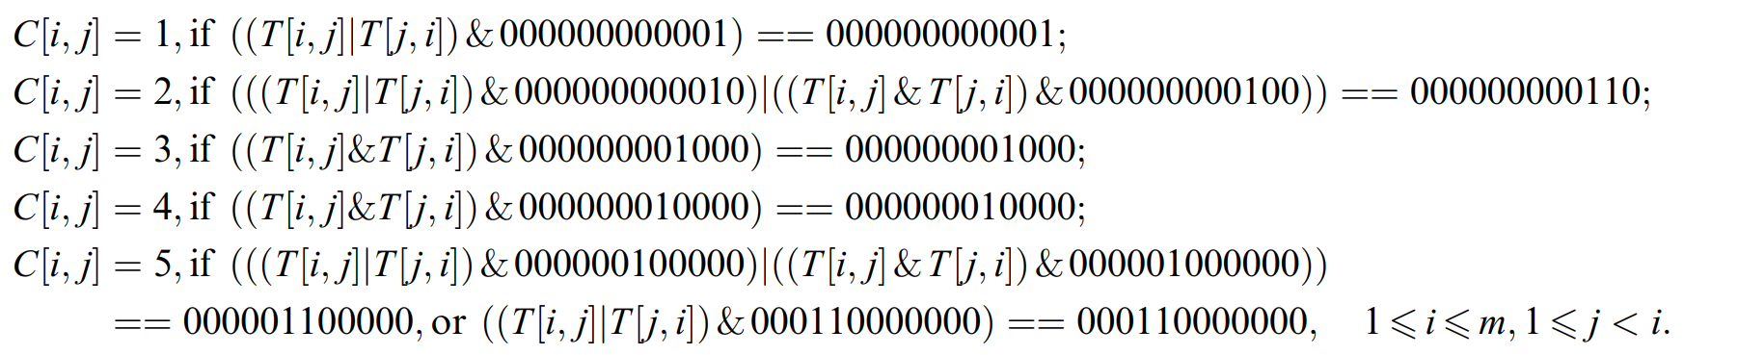
Matrix C

Slide 11
Algorithm
(type-0)
C = C1 - C2. If C is zero in the lower triangular matrix, these two pictures are of type-0 similarity.
(type-1)
(1) Algorithm (type-0) passed
(2) T = T1 - T2
(3) T* = T(i,j) * T(j,i), if T* is zero in the lower triangular matrix
(type-2)
T = T1 - T2. If T is zero, these two pictures are of type-2 similarity

