Slide 1
Scaled and Permuted String Matching
Information Processing Letters 92 (2004) 293-297
Ayelet Butman, Revital Eres, Gad M.Landau
Presenter: Jen-Hui Wang
Date:2006.1.5

Slide 2
Abstract
The goal of scaled permuted string matching is to find all occurrences of a pattern in a text, in all possible scales and permutations. Given a text of length n and a pattern of length m we present an O(n) algorithm.

Slide 3
Introduction
Many types of differences between the patterns were defined, for example, errors (Hamming distance, LCS, Edit distance), rotations, scaling, or permutation. Most of the theoretical work has dealt with one type of difference at a time. This paper is one of the first attempts to deal with two types of differences together – scaling and permutation.

Slide 4
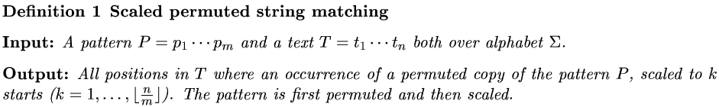
Scaled permuted string matching

Slide 5
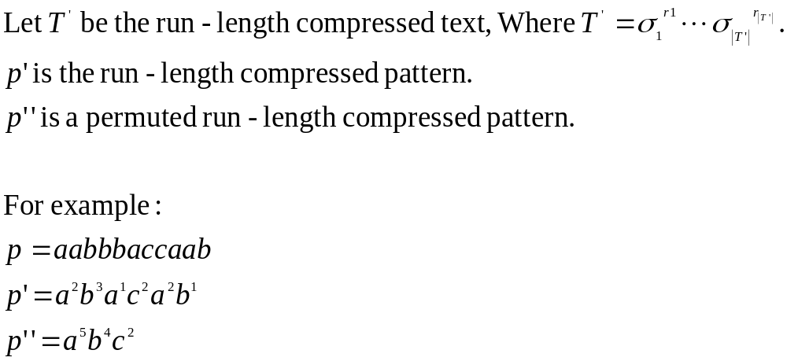
Permuted string matching over run-length encoded text
Define:

Slide 6
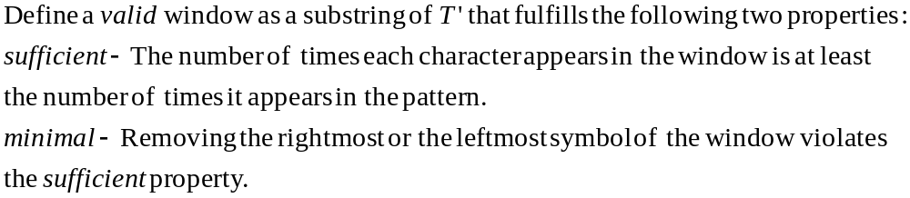
Permuted string matching over run-length encoded text
The technique we use is similar to the sliding window technique:
A window is shifted on T’ from left to right in order to locate all the matches.
The window is a substring of T’ that represents a candidate for a match.
(The window size is not fixed)

Slide 7





Permuted string matching over run-length encoded text
Note that:
The valid window property does not ensure a match.
If a permutation of the pattern occurs in a valid window of T’, ,
then only the characters can appear more times in this window
than they appear in P’’.
If then the pattern may occur more than once in the valid window. Also, if the pattern may occur more than once in .
A permuted pattern occurs in the text only in a valid window (including the symbols on the left and right of the window).

Slide 8


Permuted string matching over run-length encoded text
The valid windows are found by scanning the text from left to right, using two point, left and right. To discover each valid window, the right pointer moves first to find a sufficient window and then the left pointer moves to find valid window within the sufficient window. Each move of the right pointer increases the size of the window. The right pointer moves as long as deleting the leftmost symbol of the window violates the sufficient property of the window.
When this symbol can finally be removed, the right pointer stops and the left pointer starts moving. Each move of the left pointer decreases the size of the window. The pointer moves as long as deleting the left leftmost symbol of the window does not violate the sufficient property of the window. At this point, a new valid window has been found.

Slide 9




Example

Slide 10





A linear time algorithm for the scaled permuted string matching problem

Slide 11
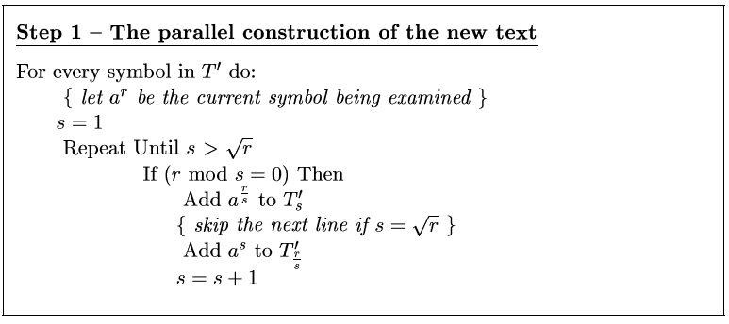
A linear time algorithm for the scaled permuted string matching problem

Slide 12
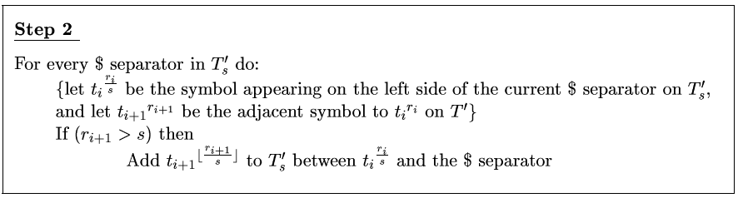
A linear time algorithm for the scaled permuted string matching problem

Slide 13

A linear time algorithm for the scaled permuted string matching problem

Slide 14
Time complexity
The running time of both Stage 1 and Stage 2 is bounded by the length of the new texts, hence the total time complexity is O(n).

