Slide 1
Fragment assembly with double-barreled data
Pavel A. Pevzner, Haixu Tang,
BIOINFORMATICS, Vol. 17, Suppl.1, Pages S225–S233, 2001
Date: Jan. 13, 2006

Slide 2
ABSTRACT
For the last twenty years fragment assembly was dominated by the “overlap - layout - consensus” algorithms that are used in all currently available assembly tools. However, the limits of these algorithms are being tested in the era of genomic sequencing and it is not clear whether they are the best choice for large-scale assemblies. Although the “overlap - layout - consensus” approach proved to be useful in assembling clones, it faces difficulties in genomic assemblies: the existing algorithms make assembly errors even in bacterial genomes. We abandoned the “overlap - layout - consensus” approach in favour of a new Eulerian Superpath approach that outperforms the existing algorithms for genomic fragment assembly.

Slide 3
In this paper we describe our new EULER-DB algorithm that, similarly to the Celera assembler takes advantage of clone-end sequencing by using the double-barreled data. However, in contrast to the Celera assembler, EULER-DB does not mask repeats but uses them instead as a powerful tool for contig ordering. We also describe a new approach for the Copy Number Problem: “How many times a given repeat is present in the genome?”. For long nearly-perfect repeats this question is notoriously difficult and some copies of such repeats may be “lost” in genomic assemblies. We describe our EULER-CN algorithm for the Copy Number Problem that proved to be successful in difficult sequencing projects.

Slide 4
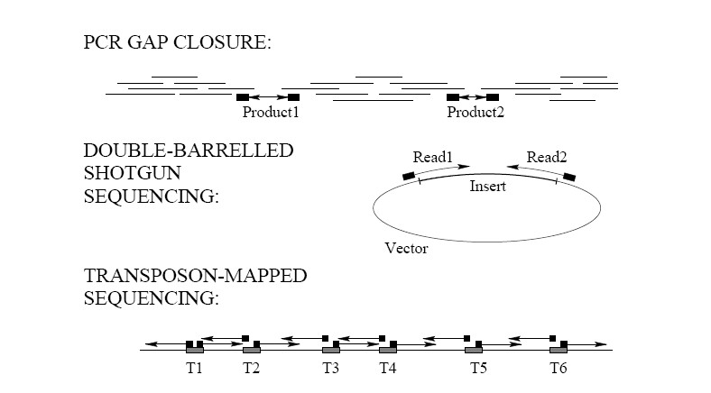

Slide 5
EULERIAN SUPERPATH APPROACH
Construct a graph whose edges correspond to l -tuples and to find a
path visiting every edge of this graph exactly once.
For a set of reads S = {s1, . . . , sn}
define Sl as the collection of all l-tuples from strings from S.
Given a set of reads S = {s1, . . . , sn}, define the de Bruijn graph G(Sl)
with vertex set Sl−1 (the set of all (l−1)-tuples from S) as follows.
An (l − 1)-tuple v ∈ Sl−1 is joined by a directed edge with
an (l − 1)-tuple w ∈ Sl−1, if Sl contains an l-tuple
for which the first l − 1 nucleotides coincide with v and the last l−1
nucleotides coincide with w.
Each l-tuple from Sl corresponds to an edge in G.

Slide 6
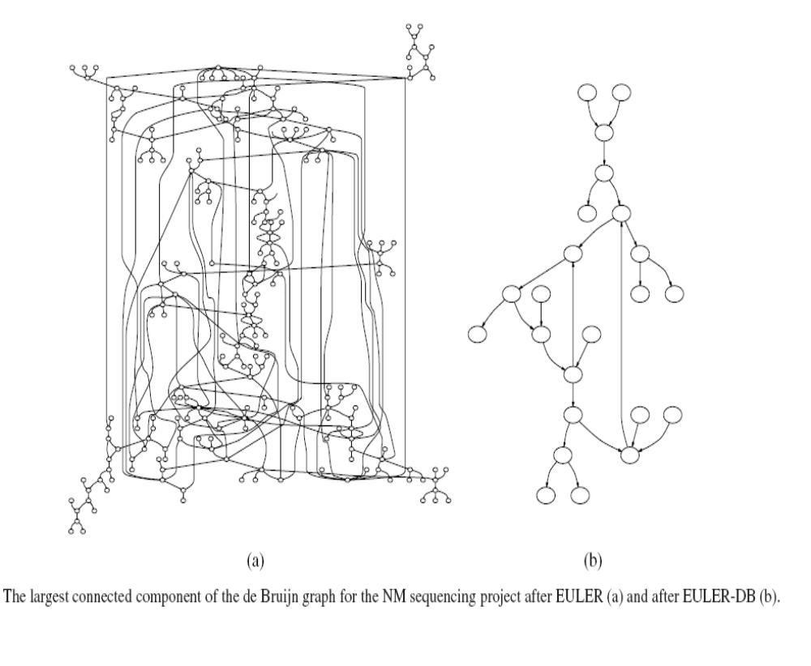
EULERIAN SUPERPATH APPROACH
If S contains the only sequence s1, then this sequence corresponds to
a path visiting each edge of G exactly once, an Eulerian path .

Slide 7
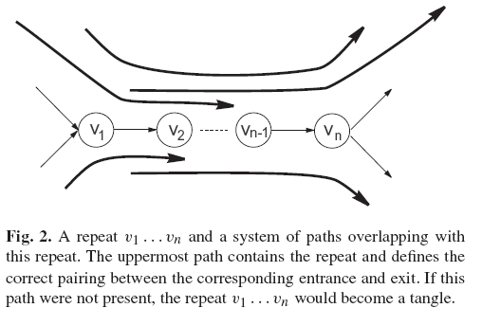
Every sequencing read corresponds to a path in the de Bruijn graph
called a read-path.
A path v1 . . .vn in the de Bruijn graph is called a repeat if indegree(v1)
> 1, outdegree(vn) > 1, and outdegree(vi) = 1 for 1 ≤ i ≤ n − 1 (Figure 2).
Edges entering the vertex v1 are called entrances into a repeat
while edges leaving the vertex vn are called exits from a repeat.

Slide 8
Most repeats can be resolved by read-paths (i.e., paths in the de Bruijn
graph that correspond to sequencing reads) covering these repeats.
A repeat is called a tangle if there is no read-path containing this repeat
some parts of the de Bruijn graph are impossible to untangle due to
long perfect repeats that are not covered by any read-paths.

Slide 9
EULER-DB ALGORITHM
EULER-DB provides the possibility to analyze DB data in a new way
That allows one to transform mate-pair “read1 - GAP of length
d - read2” into mate-read “read1 - DNA SEQUENCE of length d –
read2” in most cases.
EULER-DB maps every read into some edge(s) of the de Bruijn graph.
EULER-DB views such paths as long artificial mate-reads and analyzes
them with the same Eulerian Superpath algorithm that is used for the
analysis of standard reads.

Slide 10
In most cases both reads r 1 and r 2 from the mate-pair (r 1, r 2) are
mapped to the same graph component. In this case one can find a path
between these reads and compare the length d(r 1, r 2)of this path with
an estimated distance l(r 1, r 2) between clone ends
(we assume that d(r 1, r 2) = ∞ if such path does not exist).
In most cases such path is unique and its length approximately
matches the clone length (d(r1, r2) ≈ l(r1, r2)).

Slide 11
In the case of multiple paths between r 1 and r 2 in the de Bruijn graph,
there are three possibilities:
The clone length l(r 1, r 2) does not match the length of any path
between r1 and r2. Such situations often correspond to errors in the DB
data (see below for the case d(r1, r2)=∞).
The clone length l(r1, r2) matches the length of exactly one path
between r1 and r2. In this case we transform the mate-pair into the
corresponding mate-read.

Slide 12
The clone length l(r1, r2) matches the length of more than one path
between r1 and r2. In this case there is no sufficient information (yet) to
transform the mate-pair into the mate-read.
The mate-pair is kept in the DB data in a hope that it will be resolved at
the following iterations：

Slide 13
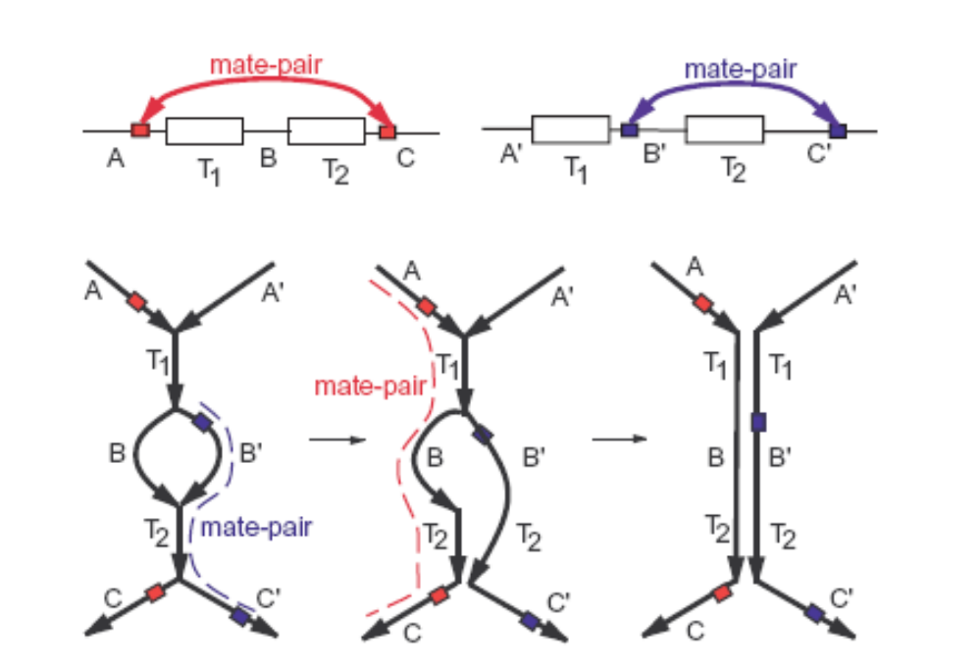
Figure 4(a) presents an example of two tangles T1 and T2 separated by non-repeated regions B and B’ (red and blue boxes on the edges of the de Bruijn Graph show two mate-pairs).
Fig. 4. (a)
Tangle resolution in the case when the clone length matches the length of more than one path between reads from the mate-pair.

Slide 14
The red mate-pair corresponds to multiple paths (A T1 B T2 C and A T1 B’ T2 C) and cannot be
transformed into a mate-read while the blue mate-pair corresponds to an unique path. A transformation of
the blue mate-pair into a mate-path and the subsequent equivalent transformation lead to a modification of the de Bruijn graph (Figure 4(a)) with the red mate-pair now corresponding to the unique path. This path generates a mate-read that leads to resolution of both tangles.
Fig. 4. (a)
Tangle resolution in the case when the clone length matches the length of more than one path between reads from the mate-pair.

Slide 15
EULER-DB reduces the number of contigs from 149 to 117 if only
mate-pairs from non-repeated regions are used.
Use of mate-pairs that partially overlap the repeats further reduces the
number of contigs to 91.
EULER-DB typically resolves all tangles except tangles that are longer
than the length of the insert. In the NM project (with insert length up to
1800) EULER left only 5 unresolved tangles of length 3610, 3215, 2741,
2503,and 1831.

Slide 16
After completing EULER-DB, we build scaffolds using DB data as
“bridges’ between different contigs (EULER-SF).
We first describe EULER-SF for a simple case of error-free DB data.
A vertex v is called a source if indegree(v) = 0, and a sink if
outdegree(v) = 0.
An edge (v,w) in a graph G is called an initial (terminal) edge if it is the
only edge incident to a source (sink) in the graph.
Source
Sink

Slide 17
A vertex v in a graph is called balanced if indegree(v) = outdegree(v).
A graph is semi-balanced if
(i) all its vertices except sources and sinks are balanced, and
(ii) all its connected component contain some sources and sinks.
A semi-balanced graph can be transformed into an Eulerian graph
(Figure 4(c)) by adding a number of edges connecting some sinks with
some sources.

Slide 18
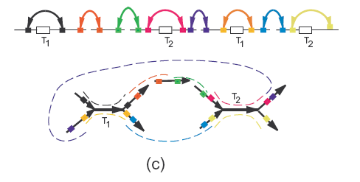
Figure 4(c) illustrates a small sequencing project resulted in 5 islands
with 2 tangles of multiplicity 2.
The de Bruijn graph for this project consists of 3 connected
components with 11 edges.
Every mate-pair with d(r1, r2) = ∞“suggests” an edge connecting a sink with a source in the de Bruijn graph.
An Eulerian path in the resulting graph defines the correct scaffold (Figure 4(c)).

Slide 19

Scaffolding Problem
Scaffolding Problem.Given a semi-balanced graph G with a set of
mate-pairs, transform it into an Eulerian graph with maximum number
of feasible mate-pairs.
Let (r1, r2) be a mate-pair with read r1 mapped to a terminal edge and
read r2 mapped to an initial edge in the de Bruijn graph.
Denote as an extension of read r1 till the end of the terminal edge
it belongs to.
define as an extension of r2 from the beginning of the initial edge till
the end of r2.

Slide 20

EULER-SF substitutes the mate-pair (r1, r2) by a new extended mate-
pair if some distance constrains are satisfied.
Define b(r1, r2) = as a lower bound for the distance between
reads r1 and r2 in the final sequence.
If b(r1, r2) ≤ l(r1, r2) then the mate-pair (r1, r2) supports the gap edge e
with the length equal to the estimated gap length l(r1, r2) − b(r1, r2).
EULER-SF transforms mate-pairs into extended mate-pairs and adds
gap edges into the de Bruijn graph to form scaffolds.

Slide 21
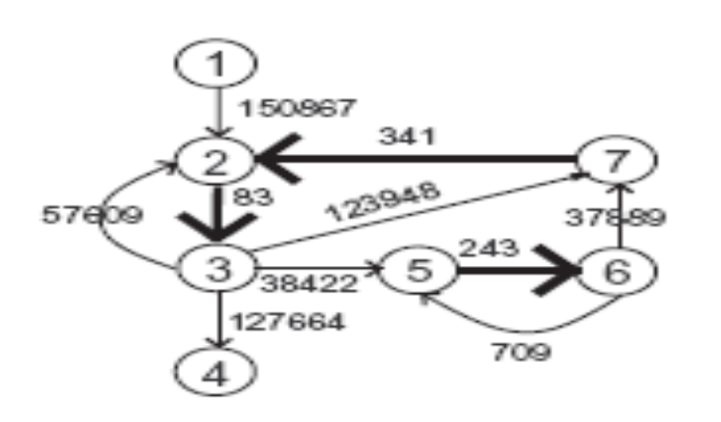
COMPUTING REPEAT COPY NUMBERS
The existing implementation of EULER-CN uses a simple labeling
procedure that assigns the copy numbers in a greedy fashion by
iteratively checking the flow balance condition (the Kirkhoff low) in
every vertex and modifying multiplicities of some edges.
For example, since there are 4 edges leaving vertex 3 and only one
edge (2,3) entering vertex 3, the edge (2,3) is a tangle with multiplicity
at least 4.

Slide 22
Let’s assume for simplicity that G(V, E,w) is a graph with a single
source s and sink t and unit edge multiplicities (w(e) = 1 for all e ∈ E).
For a vertex v ∈ V define div(v) as the sum of multiplicities of edges
entering v minus the sum of multiplicities of edges leaving v.
A graph is called balanced if div(v) = 0 for every vertex v ∈ V , except
for the source and the sink.
The graph in Figure 5 is not balanced and we are interested in a way to
increase the multiplicities of its edges to make a balanced graph
G(V, E, f ) with the same edge set and w(e) ≤ f (e) for all e ∈ E.
The balanced graph G(V, E, f ) is called a flow from s to t and div(t)
is called the value of flow f .

Slide 23
Copy Number Problem
For an edge e in a graph G(V, E, w), find a flow G(V, E, f ) minimizing
the multiplicity f (e) of the edge e.
The Copy Number Problem can be solved by finding a minimal flow in a
network with lower capacity bounds.
To make this reduction, we add an artificial edge from the sink to the
source in G and assume the unit lower capacities on all edges in G.
A flow with the minimum multiplicity of the edge e = (v,w) in this graph
corresponds to a solution of the Minimum Flow Problem from w to v
satisfying the lower capacity constraints.
The minimum flows can be found by an application of the Min-Flow
Max-Cut theorem

Slide 24
CONCLUSIONS
All “overlap-layout-consensus” algorithms are “afraid” of repeats and
the Celera assembler has no choice but to mask the repeats.
EULER does not require masking the repeats but instead provides a
clear view of repeats (tangles) in the genome.
These tangles may be resolved either by double-barreled Information
(EULER-DB) or by additional PCR experiments (EULER-PCR, work in
progress).

