Slide 1
The LCA Problem Revisited
Michael A. Bender and Martin Farach-Colton
In Proceeding of Latin American Theoretical Informatics (LATIN), Vol. 1776 of LNCS, SpringerVerlag (2000) pp. 88-94
Presenter: Yung-Hsing Peng
Date: Oct. 05, 2006

Slide 2
Abstract
We present a very simple algorithm for the Least Common Ancestor problem. We thus dispel the frequently held notion that an optimal LCA computation is unwieldy and unimplementable. Interestingly, this algorithm is a sequentialization of a previously known PRAM algorithm of Berkman, Breslauer, Galil, Schieber, and Vishkin [1].

Slide 3
Least Common Ancestor (LCA)
a
b
c
d
e
f
g
h
i
j
k
l
m
Ex: b is the LCA of e and l, a is the LCA of f and h
→ How fast can you determine the LCA of given two nodes?

Slide 4
Main Idea
The authors reduce LCA to ± 1 RMQ (range minimum query)
± 1 RMQ can be optimized in both preprocessing and querying time.
With O(n) time preprocessing, any LCA query can be answered in constant time.
n: number of nodes

Slide 5
Reducing LCA to ± 1 RMQ
Label each node with its depth
0
a
1
1
1
b
c
d
2
2
2
2
2
2
e
f
g
h
i
j
3
3
3
k
l
m
Euler tour produces the sequence 0121232321012101212321210
0 | 1 | 2 | 1 | 2 | 3 | 2 | 3 | 2 | 1 | 0 | 1 | 2 | 1 | 0 | 1 | 2 | 1 | 2 | 3 | 2 | 1 | 2 | 1 | 0
a | b | e | b | f | k | f | l | f | b | a | c | g | c | a | d | h | d | i | m | i | d | j | d | a
The LCA of f and h → The min element in range (f, h) = min(210121012) = 0 = a

Slide 6
Answering ± 1 RMQ in Constant Time
Naïve preprocessing: O(n²) time and space for storing RMQ of all intervals.
Better solution: O(nlogn) time and space for storing RMQ of intervals of length l , where l = 2^{c} and 1≤ c ≤ logn.
This paper: O(n) time and space preprocessing, which is optimal.

Slide 7
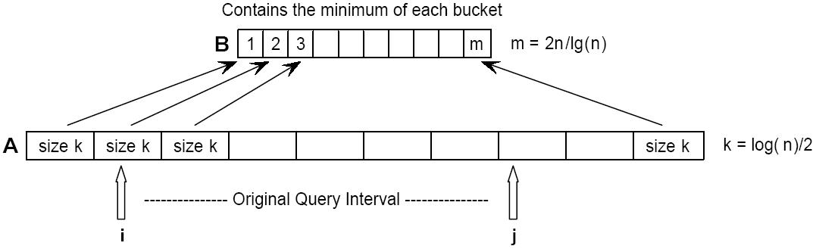
Optimal Preprocessing for ± 1 RMQ (1/2)
For each bucket in A, we have 2^{k} possible instantiations, each of which has k² possible queries. Also, for each possible query we need lgk bits to locate the index of its RMQ.
Total O(2^{k}·k²·lgk) = O(n^{0.5}·lg²n·lglgn) = o(n) bits
Note that o(n) bits is enough for all buckets because they are identical.
B requires O(mlgm) = O((n/lgn) · (lgn-lglgn)) = O(n) time and space preprocessing.
→ O(n) + o(n) = O(n) time and space preprocessing for both A and B.

Slide 8
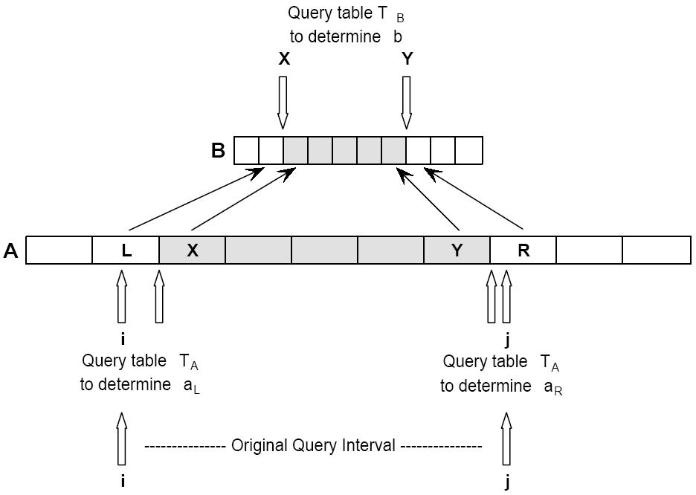
Optimal Preprocessing for ± 1 RMQ (2/2)
(1) Queries in one bucket: constant time
(2) Queries over several buckets: min(a_{L}, b, a_{R}) → constant time
→ With O(n) time preprocessing, ± 1 RMQ can be answered in O(1) time.

Slide 9
About LCA
The LCA problem can be answered in O(1) time with O(n) time and space preprocessing. (± 1 RMQ)
In a suffix tree, the LCA can be used to determine the longest common prefix (lcp) of two given suffixes.
The authors show that general RMQ can also be solved by finding the LCA on a cartesian tree.

Slide 10
General RMQ and Cartesian Tree
A: Array of number
9 | 2 | 8 | 6 | 1 | 10 | 4 | 5 | 7 | 3
Cartesian tree of A
1
2
3
9
6
4
8
10
5
7
Ex: RMQ(10 → 7) = RMQ(10, 4, 5, 7) = 4 = LCA(10, 7)
General RMQ on A can be reduced to LCA on the cartesian tree of A.
How fast can you construct a cartesian tree?

Slide 11
Constructing a Cartesian Tree in Linear Time
A: Array of number
A[i]: new element
A[j]: RMQ(A[1, i-1])
C_{x,y}: Cartesian tree of A[x, y]
j
i
Constructing C_{1,i} with C_{1,i-1}:
Case1: A[i] ≤ A[j]
→ A[i] becomes the root of C_{1,i}, and C_{1,i-1} is the left subtree of A[i]
Case2: A[i] > A[j]
A[j] remains the root of C_{1,i}, and the cartesian tree C_{j+1},i is the right subtree of A[j]
From case 1&2, one can construct C_{1,i} by comparing A[i] with nodes on the rightmost path of C_{1,i-1}. If the comparing order is from leaf to root, it’s the same as stack push-pop.
→ C_{1,n} can be constructed in O(n) time.

Slide 12
Conclusion of This Paper
The authors proposed a much simpler way to implement optimal preprocessing for LCA. (± 1 RMQ)
The general RMQ problem can also be answered in O(1) time with O(n) time and space preprocessing. (RMQ → LCA → ± 1 RMQ)
Next, we give some examples for the usage of RMQ.

Slide 13
Usages of RMQ
With the aid of RMQ, the following problems can be answered in optimal querying time with O(n) time and space preprocessing.
(1)The FIND_LESS_THAN problem that asks for all elements s < c in a given subarray A[x,y].
(2)The document retrieval problem.
(3)1D discretely scaled string matching. (detail omitted)
The FIND_LESS_THAN problem can be recursively solved.
The document retrieval problem can be reduced to the FIND_LESS_THAN problem.

Slide 14
The Document Retrieval Problem (1/3)
We have m documents T₁, T₂,…T_{m}, where |T₁|+|T₂|+…+|T_{m}| = n.
Assume you can only preprocess these documents in O(n) time.
Given a pattern P, can you report all documents which contain P in optimal O(|P|+U) time? (U: number of documents that contain P)
Let D = T₁$T₂$...$T_{m}, a naïve search by using the suffix tree of D will take O(|P|+n) time in worst case.

Slide 15
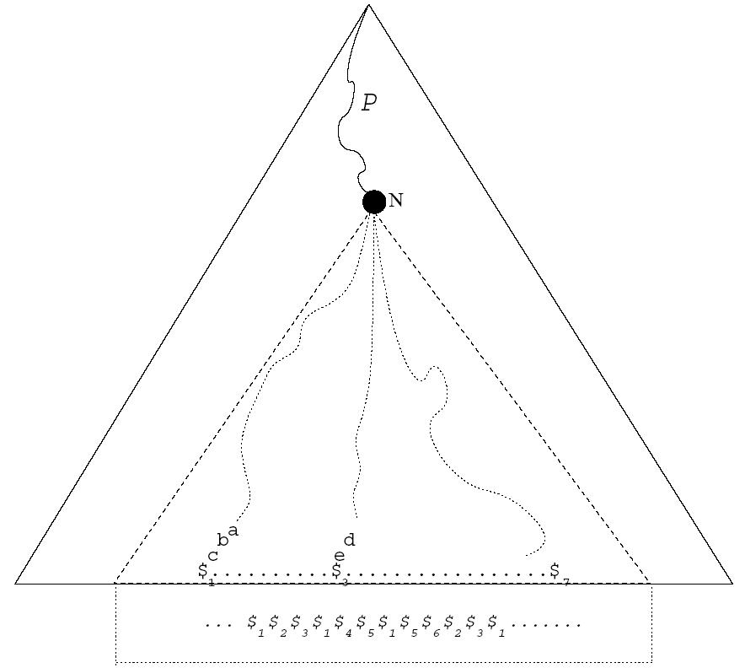
The Document Retrieval Problem (2/3)
Suffix tree of D
A document may contain more than one P.
This problem can be reduced to reporting all distinct integers in an given interval.

Slide 16
The Document Retrieval Problem (3/3)
index
1 | 2 | 3 | 4 | 5 | 6 | 7 | 8 | 9 | 10 | 11 | 12
1 | 2 | 3 | 1 | 4 | 5 | 1 | 5 | 6 | 2 | 3 | 1
-1 | -1 | -1 | 1 | -1 | -1 | 4 | 6 | -1 | 2 | 3 | 7
integers
last position
To obtain the indices of all distinct integers in a given interval [i, j], one can simply find the indices of all elements less than i in the interval [i, j] of the array last position. (Why?)
It takes O(U) time to report all distinct integers. (FIND_LESS_THAN)
Searching P in D takes O(|P|) time
→ The document retrieval problem can be answered in optimal O(|P|+U) time.

Slide 17
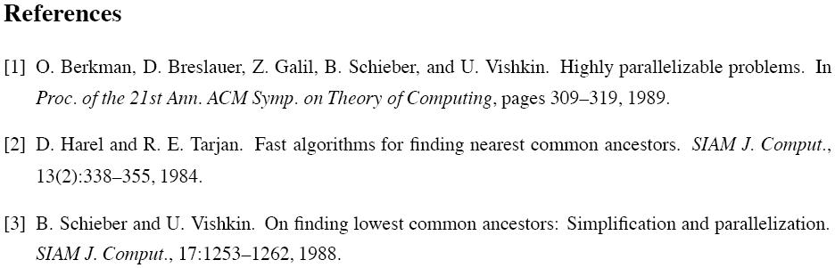
http://theory.lcs.mit.edu/classes/6.897/spring03/

