Slide 1
An Improved Algorithm for Computing the Edit Distance of Run-Length Coded Strings
H. Bunke and J. Csirik
Information Processing Letters, Vol. 54, 1995, pp. 93–96
Date: Dec. 21, 2006
Introducer: Hsing-Yen Ann

Slide 2
Problem Definition
Run-length coding compression
aaaaabbbccccdd ➔ a⁵b³c⁴d²
Given two compressed strings A and B, to find the edit distance without uncompressing A and B.
A: length n, compressed length k
B: length m, compressed length l
Edit cost: M=0, I=1, D=1, R=I+D=2

Slide 3
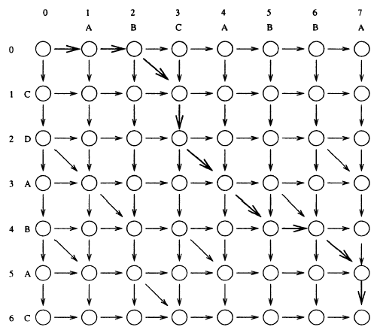
Some Properties on Edit Distance (1/3)
Edit distance: minimal-cost path in edit graph

Slide 4
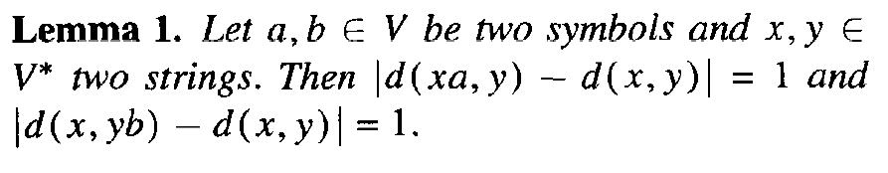
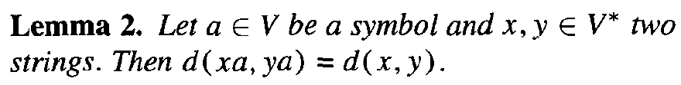
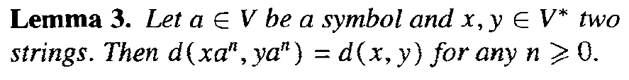
Some Properties on Edit Distance (2/3)

Slide 5
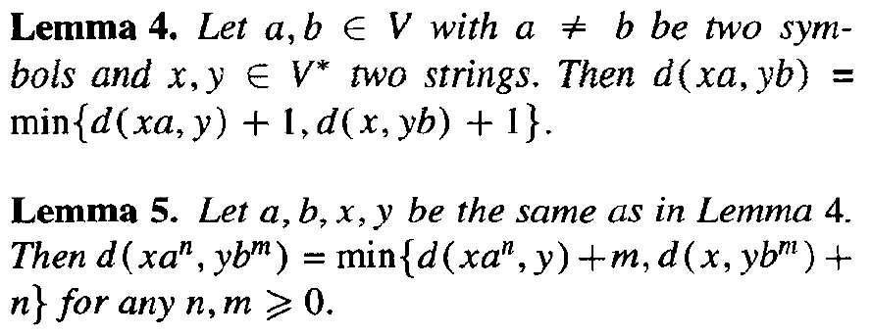
Some Properties on Edit Distance (3/3)

Slide 6
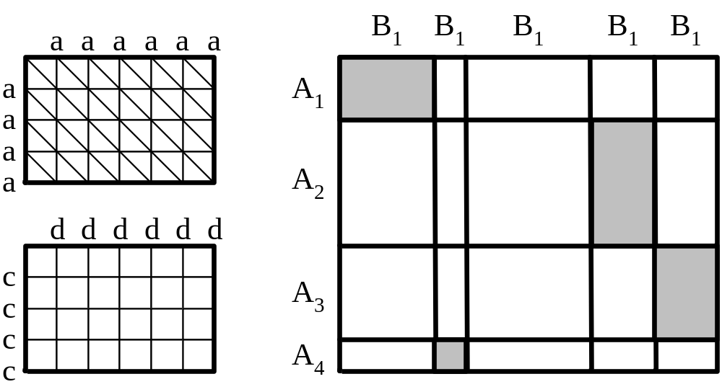
Subdivision of the Edit Matrix

Slide 7
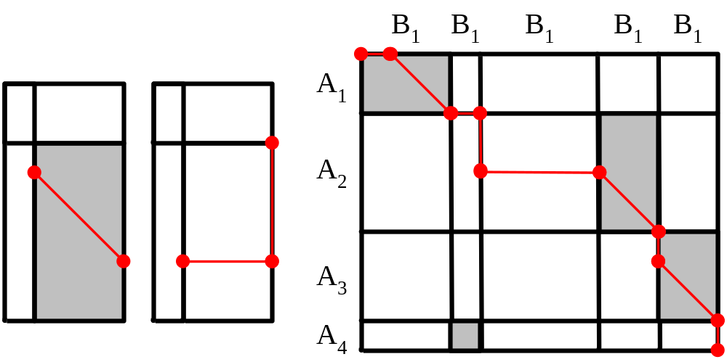
The Algorithm

Slide 8
Conclusion
Only the nodes on block boundaries needs to be calculated.
The algorithm has a time and space complexity of O(ln + km) .

