Slide 1
MULTIPROSPECTOR:
An Algorithm for the Prediction of
Protein-protein Interactions by Multimeric Threading
Long Lu, Hui Lu, and Jeffrey Skolnick
PROTEINS: Structure, Function, and Genetics 49:350–364 (2002)
Presenter: Chiao-Wei Chiu (邱喬偉)
Date: Dec. 21, 2006

Slide 2
Abstract
In this postgenomic era, the ability to identify protein-protein
interactions on a genomic scale is very important to assist
in the assignment of physiological function.
Because of the increasing number of solved structures involving
protein complexes, the time is ripe to extend threading to
the prediction of quaternary structure.
In this spirit, a multimeric threading approach has been developed.
The approach is comprised of two phases.
In the first phase, traditional threading on a single chain is applied to
generate a set of potential structures for the query sequences.
In particular, we use our recently developed threading algorithm,
PROSPECTOR.

Slide 3
Abstract (cont.)
Then, for those proteins whose template structures are part of a known
complex, we rethread on both partners in the complex and now include
a protein-protein interfacial energy. To perform this analysis,
a database of multimeric protein structures has been constructed,
the necessary interfacial pairwise potentials have been derived,
and a set of empirical indicators to identify true multimers based
on the threading Z-score and the magnitude of the interfacial energy
have been established.
Thus, a promising approach to help assist in the assignment of
protein-protein interactions on a genomic scale has been developed.

Slide 4
Introduction
Input:
protein sequence X, Y
Output:
total energy, interfacial energy, Z-scores

Slide 5
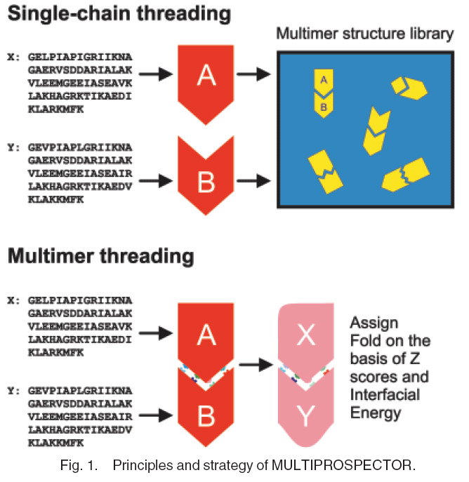

Slide 6
DIMER: A Database of
Dimer(二聚物) Template Structures
The Protein Data Bank (PDB) stores three-dimensional structures of macromolecules, some of which are co-crystallized proteins.
Our dimer database, DIMER, is constructed by selecting the co-crystallized records from the PDB with use of the criteria listed below:
The resolution of the two-chain PDB records should be 2.5 Å.
The threshold for the number of interacting residues is set to be 30 to avoid crystallizing artifacts. Interacting residues are defined as a pair of residues from different chains that have at least one pair of heavy atoms within 4.5 Å of each other.
Each chain in the dimer database should have 30 amino acids to be considered as a domain.
Dimers in the database should not have 35% identity with each other (i.e., at most, one chain in a complex can have 35% identity to any of the chains in another complex.
The dimers should be confirmed in the literature as genuine dimers instead of crystallization artifacts.

Slide 7
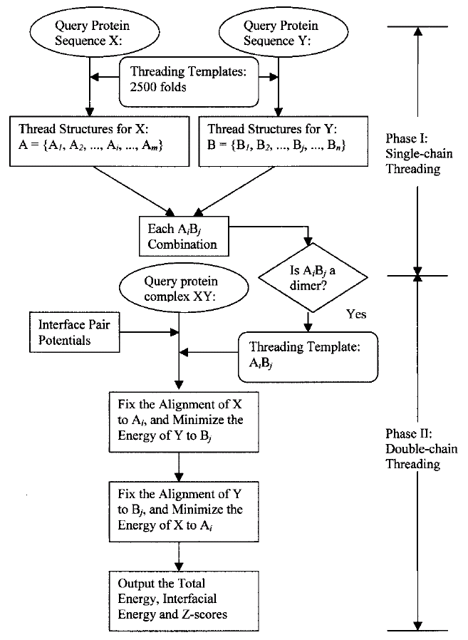
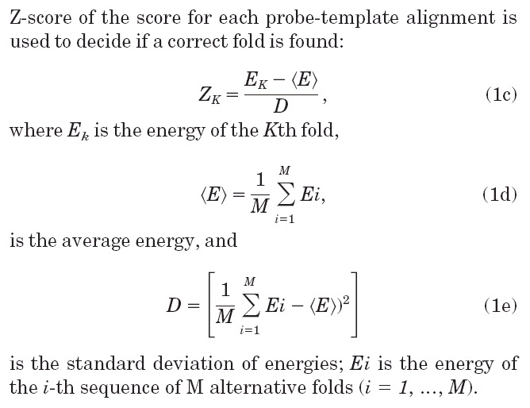
Multimeric
Threading
Protocol

Slide 8
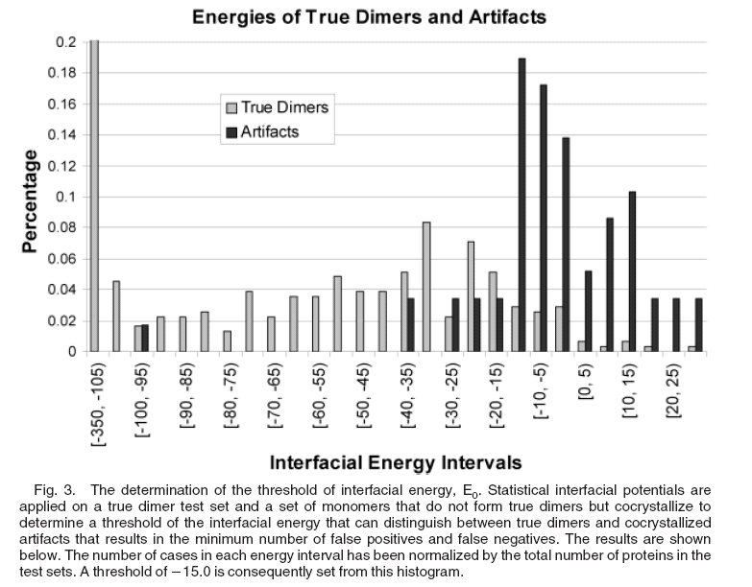

Slide 9
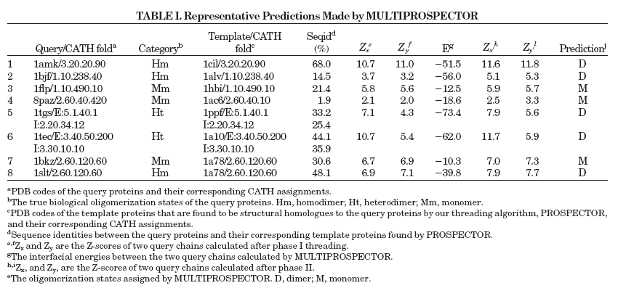
Test Cases

Slide 10
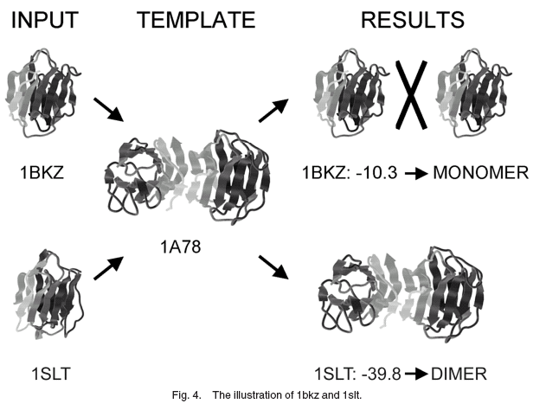
Results

Slide 11
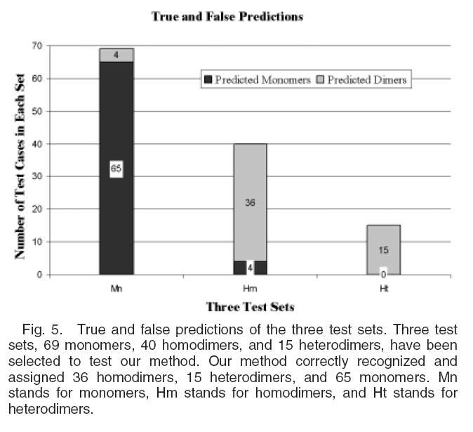

Slide 12
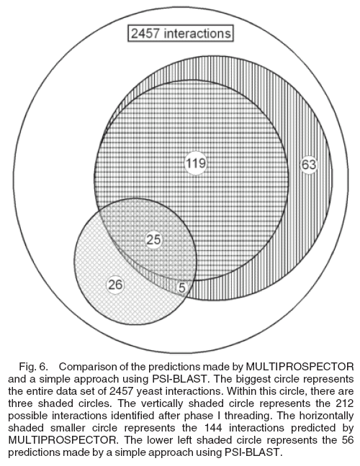

Slide 13
Discussion
Improvement:
by incorporating the multi-chain PDB records, the interface database can and will be expanded.
by using the new version of threading algorithm
by including distance-dependent terms or detailed atomic interactions
Comparing with PSI-BLAST, because the prediction results of these two methods are not completely overlapped, it is possible for us to use PSI-BLAST to improve our method.

Slide 14
Web Site Access
http://bioinformatics.danforthcenter.org/services/proint/
The resulting predictions will be e-mailed to the user, typically within 24 hr. Included in these predictions are the predicted association state and the monomer structure, and when appropriate, the pair of proteins predicted to interact and a model of the predicted quaternary dimeric structure.

