Slide 1
常用資料分析方法
July 6, 2011
Hung-Hsin Chen( 陳紘昕)

Slide 2
Outline
Python language introduction
Classification and regression problem
Principal component analysis (PCA)
Linear discriminant analysis (LDA)
Quadratic discriminant analysis (QDA)
Python packages
Quiz

Slide 3

Python language
Official site: http://www.python.org
Who is using Python?
Google, Yahoo, Nokia, IBM, NASA…
Script program language
Object-oriented program language
General-purpose program language
Supporting many operation systems
Easy to learn!!

Slide 4
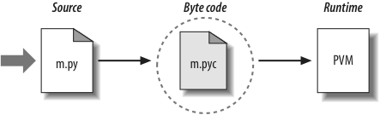
Python implementations
Common implementations (virtual machine):
CPython (C)
JPython (Java)
IronPython (.Net)
PyPy (Python)
Version 2.x (recommendation)
Version 3.x (many packages don’t support it)

Slide 5
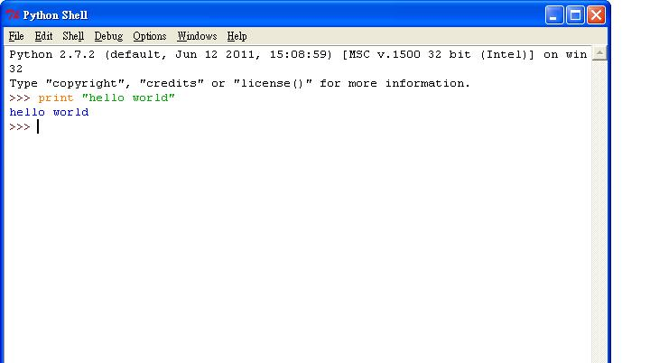
Python development environment
IDLE (built-in)

Slide 6
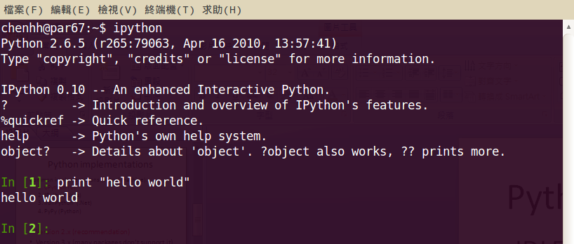
Python development environment
iPython (interactive command line)

Slide 7
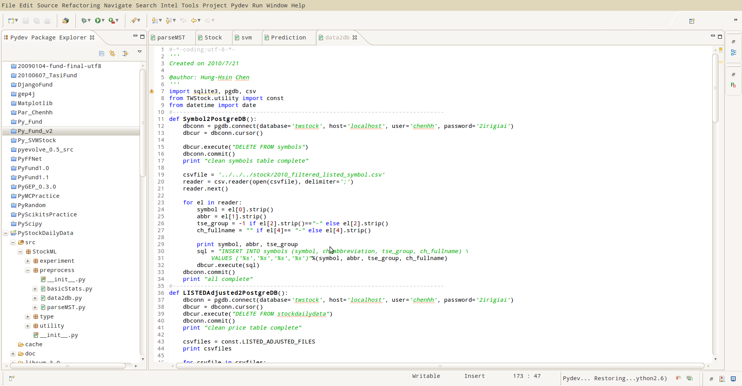
Python development environment
Eclipse + pydev (middle or large scale project)

Slide 8
Properties
以冒號(:)做為敘述的開始
不必使用分號(;)做為結尾
井字號(#)做為單行註解符號
使用tab鍵做為縮排區塊的依據(所以不使用括號)
不必指定變數型態 (runtime時才會進行binding)

Slide 9
Basic operation
expression
3 + 5
3 + (5 * 4)
3 ** 2
‘Hello’ + ‘World’
variable
a = 4 << 3
b = a * 4.5
c = (a+b)/2.5
a = “Hello World”
型別是動態的，會根據指定時的物件來決定型別

Slide 10
Conditional statements
if-else
if a < b:
z = b
else:
z = a
pass – do nothing
if a < b:
pass
else:
z = a
也可以這樣寫:
z = b if a < b else a
因為Python以縮排為區塊判斷，因此不做任何事情時必須使用pass

Slide 11
Conditional statements
Elif:
if a == ‘+’:
op = PLUS
elif a == ‘-’:
op = MINUS
else:
op = UNKNOWN
沒有switch的語法
boolean– and, or, not
if b >= a and b <= c:
print ‘b is between a and c’
if not (b < a or c > c):
print ‘b is still between a and c’
if 1<a<15: print “a in 1 and 15”

Slide 12
Number and string
Numbers
a = 3 # Integer
b = 4.5 # Float point
c = 51728888333L # Long Integer
d = 4 + 3j # Complex number
Strings
a = ‘Hello’ # Single quotes
b = “World” # Double quotes
c = “Bob said ‘hey there.’”
d = ‘’’A triple qouted string
can span multiple lines
like this’’’
e = “””Also works for double quotes”””
f = “hello %s, today is %s”%(var1, var2)

Slide 13
List
任意物件的串列
a = [2, 3, 4] # A list of integer
b = [2, 7, 3.5, “Hello”] # A mixed list
c = [] # An empty list
d = [2, [a, b]] # A list containing a list
e = a + b # Join two lists
串列的操作
w = a[1] # Get 2nd element (0 is first)
x = b[1:3] # Return a sub-list
y = a[-1] # get last element
z = d[1][0][2] # Nested lists
b[0] = 42 # Change an element
cpy = a[:] # copy of list a
a.append(3) #append number 3 to list a
a.pop() #return last element of a, and delete it

Slide 14
Tuples (read only list)
Tuples
f = (2,3,4,5) # A tuple of integers
g = (,) # An empty tuple
h = (2, [3,4], (10,11,12))
Tuples的操作
x = f[1] # Element access. x = 3
y = f[1:3] # Slices. y = (3,4)
z = h[1][1] # Nesting. z = 4
與list類似，最大的不同tuple是一種唯讀且不可變更的資料結構

Slide 15
Dictionaries
Dictionaries (關聯陣列)
a = { } # An empty dictionary
b = { ’x’: 3, ’y’: 4 }
c = { ’uid’: 105,
’login’: ’beazley’,
’name’ : ’David Beazley’
}
Dictionaries的存取
u = c[’uid’] # Get an element
c[’shell’] = "/bin/sh“ # Set an element
if c.has_key("directory"): #check element
d = c[’directory’]
else:
d = None
d = c.get("directory",None)

Slide 16
Loops
while
while a < b:
# Do something
a = a + 1
for
for i in [3, 4, 10, 25]:
print i
for c in "Hello World":
print c
for i in range(0,100):
print i

Slide 17
Function
def
# Return the remainder of a/b
def remainder(a, b):
q = a/b
r = a - q*b
return r
a = remainder(42,5) # a = 2
回傳一個以上的值
def divide(a,b):
q = a/b
r = a - q*b
return q,r
x,y = divide(42,5) # x = 8, y = 2

Slide 18
Class
class
class Account:
def __init__(self, initial): #constructor
self.balance = initial
def deposit(self, amt):
self.balance = self.balance + amt
def withdraw(self,amt):
self.balance = self.balance - amt
def getbalance(self):
return self.balance
使用定義好的class
a = Account(1000.00)
a.deposit(550.23)
a.deposit(100)
a.withdraw(50)
print a.getbalance()

Slide 19
Exceptions
try
try:
f = open("foo")
except IOError:
print "Couldn’t open ’foo’. Sorry."
raise
def factorial(n):
if n < 0:
raise ValueError,"Expected non-negative number"
if (n <= 1): return 1
else: return n*factorial(n-1)
沒有處理的例外(程式會直接停止)
>>> factorial(-1)
Traceback (innermost last):
File "<stdin>", line 1, in ?
File "<stdin>", line 3, in factorial
ValueError: Expected non-negative number

Slide 20
I/O
open()
f = open("foo","w") # Open a file for writing
g = open("bar","r") # Open a file for reading
檔案的讀取/寫入
f.write("Hello World")
data = g.read() # Read all data
line = g.readline() # Read a single line
lines = g.readlines() # Read data as a list of lines
格式化的輸入輸出
使用%來格式化字串
for i in range(0,10):
f.write("2 times %d = %d\n" % (i, 2*i))

Slide 21
Module
一個檔案即為一個模組
# numbers.py
def divide(a,b):
q = a/b
r = a - q*b
return q,r
def gcd(x,y):
g = y
while x > 0:
g = x
x = y % x
y = g
return g
import敘述
import numbers
x,y = numbers.divide(42,5)
n = numbers.gcd(7291823, 5683)

Slide 22
Built-in modules
String processing
Operating system interfaces
Networking
Threads
GUI
Database
Language services
Securitysss
…
Using module
import string
...
a = string.split(x)

Slide 23


Matrix addition & subtraction

Slide 24
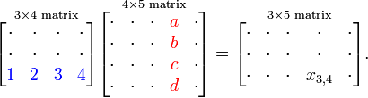
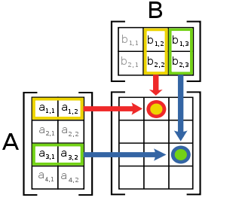
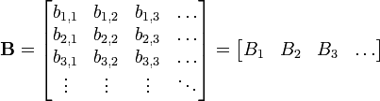
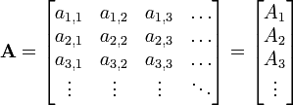
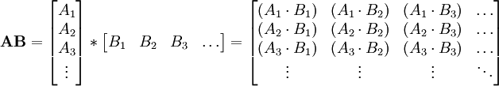
Matrix multiplication
Vector form:
Note: A*B ≠ B*A (矩陣乘法不具交換性)

Slide 25



Matrix scalar multiplication & transpose
Transpose:
Transpose property:
(A^{T})^{T}=A
(A+B)^{T} = A^{T} + B^{T}
(AB)^{T} = B^{T}A^{T}
det(A^{T})= det(A)
c is real number, c^{T}= c
Inner product : A ．B=AB^{T} (or A^{T}B)

Slide 26



Diagonal matrix and trace
Diagonal matrix:
Trace:
Trace = (-2) + 1 + (-1) = -2

Slide 27
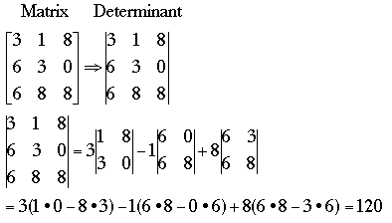
Determinant
Property (all matrices are sqaure):
det(AB)= det(A) det(B)
If A⁻¹ exist, det(A⁻¹) = 1/det(A)

Slide 28
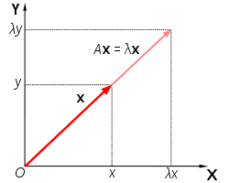


Eigenvector and eigenvalue
Vector X is eigenvector of matrix A if:
AX = λX
λ is eigenvalue of matrix A
λ=3 or 1, 可再求出對應的eigenvector各為[1, 1]與[-1, 1]

Slide 29
Covariance matrix Σ
Covariance of data X, Y:
X=[1, 2 ,3], Y=[4,5,6]
E(x) = 2, E(y)=5, E(xy) = (4+10+18)/3 = 32/3
σ_{xy} = 32/3 – 10 = 2/3

Slide 30
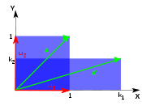

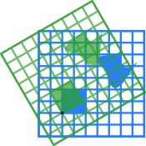

Linear transform
X, Y: vector, c: real number, A: matrix
T(cX+Y) = cT(X) + T(Y), T(X) = AX
Scaling:
Rotation:
Counter clockwise

Slide 31
Data representation
Partial iris flower data set:
Attributes (features) |  |  |  | Class
Sepal Length | Sepal Width | Petal Length | Petal Width | Species
5.1 | 3.5 | 1.4 | 0.2 | setosa
4.9 | 3 | 1.4 | 0.2 | setosa
4.7 | 3.2 | 1.3 | 0.2 | setosa
4.6 | 3.1 | 1.5 | 0.2 | setosa
5 | 3.6 | 1.4 | 0.2 | setosa
0 | 3.2 | 4.7 | 1.4 | versicolor
6.4 | 3.2 | 4.5 | 1.5 | versicolor
6.9 | 3.1 | 4.9 | 1.5 | versicolor
5.5 | 2.3 | 4 | 1.3 | versicolor
6.5 | 2.8 | 4.6 | 1.5 | versicolor
6.3 | 3.3 | 6 | 2.5 | virginica
5.8 | 2.7 | 5.1 | 1.9 | virginica
7.1 | 3 | 5.9 | 2.1 | virginica
6.3 | 2.9 | 5.6 | 1.8 | virginica
6.5 | 3 | 5.8 | 2.2 | virginica
One data is usually called a point or an instance
We can treat the attributes as a matrix.

Slide 32
Normalization
Attributes (features)
Sepal Length | Sepal Width | Petal Length | Petal Width
-0.20 | 1.38 | -1.31 | -1.26
-0.32 | -0.19 | -1.31 | -1.26
-0.43 | 0.44 | -1.36 | -1.26
-0.49 | 0.13 | -1.25 | -1.26
-0.26 | 1.70 | -1.31 | -1.26
-3.17 | 0.44 | 0.44 | 0.18
0.56 | 0.44 | 0.33 | 0.31
0.85 | 0.13 | 0.54 | 0.31
0.04 | -2.39 | 0.07 | 0.06
0.62 | -0.82 | 0.38 | 0.31
0.50 | 0.75 | 1.12 | 1.51
0.21 | -1.13 | 0.65 | 0.79
0.97 | -0.19 | 1.07 | 1.03
0.50 | -0.50 | 0.91 | 0.67
0.62 | -0.19 | 1.02 | 1.15
Avg μ: 0.0 | 0.0 | 0.0 | 0.0
Stdev σ: 1.0 | 1.0 | 1.0 | 1.0
Attributes (features)
Sepal Length | Sepal Width | Petal Length | Petal Width
5.1 | 3.5 | 1.4 | 0.2
4.9 | 3 | 1.4 | 0.2
4.7 | 3.2 | 1.3 | 0.2
4.6 | 3.1 | 1.5 | 0.2
5 | 3.6 | 1.4 | 0.2
0 | 3.2 | 4.7 | 1.4
6.4 | 3.2 | 4.5 | 1.5
6.9 | 3.1 | 4.9 | 1.5
5.5 | 2.3 | 4 | 1.3
6.5 | 2.8 | 4.6 | 1.5
6.3 | 3.3 | 6 | 2.5
5.8 | 2.7 | 5.1 | 1.9
7.1 | 3 | 5.9 | 2.1
6.3 | 2.9 | 5.6 | 1.8
6.5 | 3 | 5.8 | 2.2
Avg μ: 5.44 | 3.06 | 3.87 | 1.25
Stdev σ: 1.71 | 0.32 | 1.89 | 0.83
(X- μ )/ σ

Slide 33
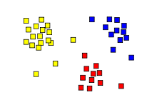
Classification problem
The values of the class are discrete
class ={Setosa, Versicolor, Virginica}
Attributes (features) |  |  |  | Class
Sepal Length | Sepal Width | Petal Length | Petal Width | Species
5.1 | 3.5 | 1.4 | 0.2 | setosa
4.9 | 3 | 1.4 | 0.2 | setosa
4.7 | 3.2 | 1.3 | 0.2 | setosa
4.6 | 3.1 | 1.5 | 0.2 | setosa
5 | 3.6 | 1.4 | 0.2 | setosa
0 | 3.2 | 4.7 | 1.4 | versicolor
6.4 | 3.2 | 4.5 | 1.5 | versicolor
6.9 | 3.1 | 4.9 | 1.5 | versicolor
5.5 | 2.3 | 4 | 1.3 | versicolor
6.5 | 2.8 | 4.6 | 1.5 | versicolor
6.3 | 3.3 | 6 | 2.5 | virginica
5.8 | 2.7 | 5.1 | 1.9 | virginica
7.1 | 3 | 5.9 | 2.1 | virginica
6.3 | 2.9 | 5.6 | 1.8 | virginica
6.5 | 3 | 5.8 | 2.2 | virginica

Slide 34
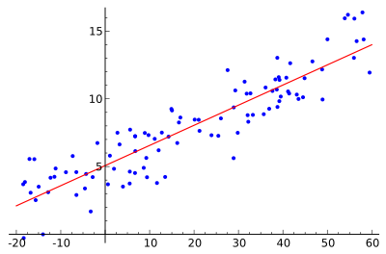
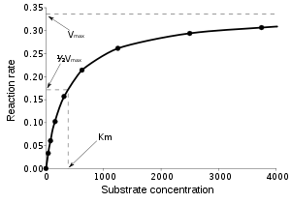
Regression problem
The values of the class are continuous (real number)
Linear regression:
Attribute | Class
X₁ | Y₁
X₂ | Y₂
X₃ | Y₃
… | …
X_{n} | Y_{n}
Nonlinear regression:

Slide 35
Principle component analysis (PCA)
X_{i}=(x_{i1}, x_{i2},…,x_{id}), i=1,2,…,m (m筆資料，d個特徵)
Goal: find p≦d attributes which containing the maximum amount variance in the data
Car | Design+ Performance | Design- Performance
V | 130 | -50
T | 130 | 50
F | 140 | 0
Stdev | 5.78 | 50
Car | Design | Performance
V | 40 | 90
T | 90 | 40
F | 70 | 70
Stdev | 25.16 | 25.16

Slide 36
Standard inner product
X
θ
v
X=(2,2), ||X|| = 2
V=(3,4), ||V|| = 5
<X,V> = 6 + 8 = 14 = 2*5 *cos θ
cos θ = 1.4, θ =cos⁻¹(1.4)

Slide 37
Vector projection
X
θ
投影長度
單位
v
假設V的長度為1 (i.e. ||V||=1)
即X投影到V的係數為<X, V>=X^{T}V=V^{T}X
X=(2,2), ||X|| = 2
V=(3,4), ||V|| = 5
=>V* = (3/5, 4/5)
<X, V*> = 14/5
X project to V: 14/5*(3/5, 4/5)

Slide 38
Variance
We projected all normalized points X₁, X₂,…,X_{m} to normalized vector V
Coefficient: V^{T}X₁, V^{T}X₂,…, V^{T}X_{m}
_{投影後資料的變異數:}
Σ: covariance matrix of all points

Slide 39
Original data:
Normalized data:
Car | Design | Performance | Space
A | 25 | 60 | 58
B | 75 | 35 | 40
C | 50 | 74 | 68
D | 60 | 30 | 40
E | 50 | 80 | 70
F | 80 | 90 | 95
G | 45 | 50 | 50
Avg | 55.00 | 59.86 | 60.14
Stdev | 18.71 | 22.81 | 19.55
Car | Design | Performance | Space
A | -1.60 | 0.01 | -0.11
B | 1.07 | -1.09 | -1.03
C | -0.27 | 0.62 | 0.40
D | 0.27 | -1.31 | -1.03
E | -0.27 | 0.88 | 0.50
F | 1.34 | 1.32 | 1.78
G | -0.53 | -0.43 | -0.52
Avg | 0.00 | 0.00 | 0.00
Stdev | 1.00 | 1.00 | 1.00
Covariance matrix:
Covariance matrix:
350.00 | 5.00 | 74.17
5.00 | 520.14 | 427.02
74.17 | 427.02 | 382.14
1.00 | 0.01 | 0.20
0.01 | 1.00 | 0.96
0.20 | 0.96 | 1.00

Slide 40
資料投影至normalized vector V: (1/3, 2/3, 2/3 )^{T}
投影(旋轉)前:
投影(旋轉)後:
Car | Design | Performance | Space
A | -1.60 | 0.01 | -0.11
B | 1.07 | -1.09 | -1.03
C | -0.27 | 0.62 | 0.40
D | 0.27 | -1.31 | -1.03
E | -0.27 | 0.88 | 0.50
F | 1.34 | 1.32 | 1.78
G | -0.53 | -0.43 | -0.52
Avg | 0.00 | 0.00 | 0.00
Stdev | 1.00 | 1.00 | 1.00
Car | 1/3*Design+ 2/3*Performance+ 2/3*Space
A | -0.6034
B | -1.0572
C | 0.5923
D | -1.4706
E | 0.8359
F | 2.5153
G | -0.8122
Avg | 0.00
Stdev | 1.3953
1.00 | 0.01 | 0.20
0.01 | 1.00 | 0.96
0.20 | 0.96 | 1.00
(1/3)
(2/3)
(2/3)
1.9467 = (1/3, 2/3, 2/3)

Slide 41
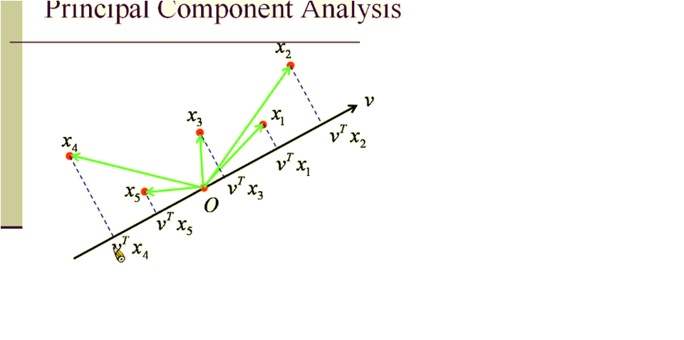
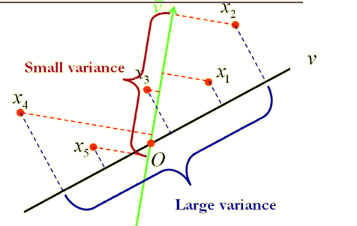
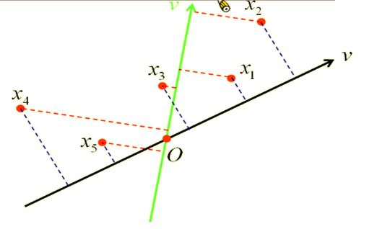
如何找出投影(旋轉)後，具有最大變異數的方向?

Slide 42
Principal component analysis (PCA)
投影後，變異數為最大值的投影(旋轉)方向:
||V|| = 1 => V^{T}V-1=0
Lagrange multiplier:
Lagrange multiplier介紹
最佳旋轉方向為共變異數矩陣的eigenvector且為unit vector
此eigenvector的λ值(eigenvalue)為所求出λ的最大值

Slide 43
Eigenvalues: 0.023272
Eigenvectors: (0.13868, 0.69254, -0.70792)^{T}
Eigenvalues: 0.995251
Eigenvectors: (0.978264,, -0.010942)^{T}
Eigenvalues: 1.981477
Eigenvectors: (0.15417, 0.69102, 0.70621)^{T}
Covariance matrix:
1.00 | 0.01 | 0.20
0.01 | 1.00 | 0.96
0.20 | 0.96 | 1.00
Normalized data:
Car | 0.15417*Design+ 0.69102*Performance+ 0.70621*Space
A | -0.3203
B | -1.3160
C | 0.6711
D | -1.5911
E | 0.9252
F | 2.3785
G | -0.7474
Avg | 0
Stdev | 1.4076
Car | Design | Performance | Space
A | -1.60 | 0.01 | -0.11
B | 1.07 | -1.09 | -1.03
C | -0.27 | 0.62 | 0.40
D | 0.27 | -1.31 | -1.03
E | -0.27 | 0.88 | 0.50
F | 1.34 | 1.32 | 1.78
G | -0.53 | -0.43 | -0.52
Avg | 0.00 | 0.00 | 0.00
Stdev | 1.00 | 1.00 | 1.00

Slide 44
任意兩個eigenvectors均為正交(orthogonal) (i.e. <v_{i}, v_{j}>=0 if i is not equal to j)
所以與最大投影方向正交，且變異數為第二大投影方向，即為covariace matrix中第二大eigenvalue所對應的eigenvector。
以此類推
Eigenvalues: 0.995251
Eigenvectors: (0.978264, -0.207074, -0.010942)^{T}
Eigenvalues: 0.023272
Eigenvectors: (0.13868, 0.69254, -0.70792)^{T}
Car | 0.978264*Design+ (-0.207074)*Performance+ (-0.010942)*Space
A | -1.56881
B | 1.28278
C | -0.39426
D | 0.54382
E | -0.44986
F | 1.01407
G | -0.42773
Avg | 0
Stdev | 0.99762
Car | 0.13868*Design+ 0.69254*Performance+ (-0.70792)*Space
A | -0.1404378
B | 0.1228879
C | 0.1078619
D | -0.1401297
E | 0.2176299
F | -0.1616754
G | -0.0061367
Avg | 0
Stdev | 0.15255

Slide 45
Contribution of the components
資料分散程度 = 不同主成份變異數之和
主成份對資料的貢獻程度 = 主成份的變異數/資料分散程度
Eigen- value | Eigenvector |  |  | stdev | variance | contrib. | cumulative contrib.
1.981477 | 0.15417 | 0.69102 | 0.70621 | 1.408 | 1.98133 | 66.05% | 66.05%
0.995251 | 0.97826 | -0.20707 | -0.01094 | 0.998 | 0.99524 | 33.18% | 99.22%
0.023272 | 0.13868 | 0.69254 | -0.70792 | 0.153 | 0.023271 | 0.78% | 100.00%

Slide 46
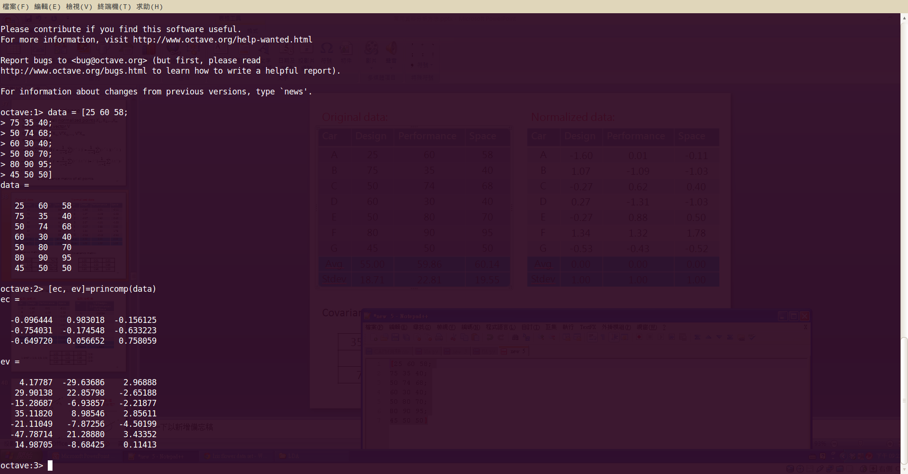
Implementation
Octave(Matlab)

Slide 47
MDP package PCA example:
import mdp
import numpy as np
#simple method
x = np.array([[25, 60, 58],[75, 35, 40], [50, 74, 68],
[60, 30, 40],[50, 80, 70],[80, 90, 95],
[45, 50, 50]], dtype=np.float64)
y = mdp.pca(x)
print y
'''
[[ 4.17786865 -29.63685872 -2.96888257]
[ 29.90138121 22.85797839 2.65188058]
[-15.28686955 -6.93857189 2.21877026]
[ 35.11819855 8.98545695 -2.8561105 ]
[-21.11049327 -7.87255639 4.50198724]
[-47.7871355 21.28879749 -3.43351521]
[ 14.98704991 -8.68424583 -0.1141298 ]]
'''
#detail
pcan = mdp.nodes.PCANode(output_dim=3)
pcar = pcan.execute(x) #投影後的全部結果
print pcan.get_explained_variance() #變量的累積貢獻度
print pcan.get_projmatrix() #projection mtx(eigen mtx)

Slide 48
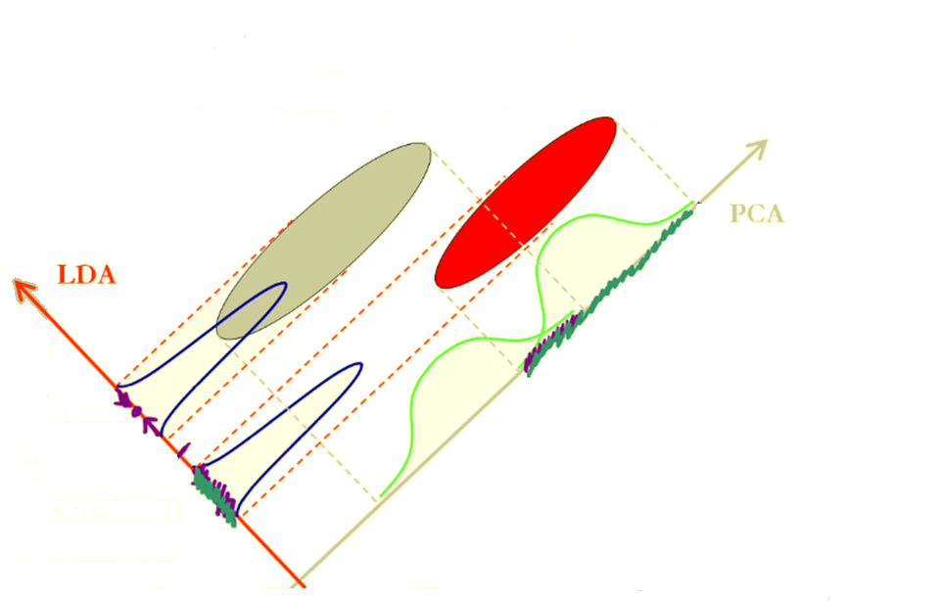
Linear discriminant analysis (LDA)
也稱Fisher linear discriminant (FLD)
PCA是將資料投影(旋轉)至variance最大的方向，但不一定是分類效果最佳的方向。
LDA是將資料投影（旋轉）至分類效果最佳的方向

Slide 49
Notations
L : number of classes
N_{i}: number of samples in class i
N : number of all samples
X^{(i)}_{j}: the j-th sample in class I
所以第i類有X^{(i)}₁,X^{(i)}₂,…,X^{(i)}_{Ni}個points

Slide 50
Projection
We projected all points to vector V
Coefficient: V^{T}X⁽¹⁾₁,V^{T}X⁽¹⁾₂,…,V^{T}X⁽¹⁾_{N1}, V^{T}X⁽²⁾₁,V^{T}X⁽²⁾₂,…,V^{T}X⁽²⁾_{N2},…, V^{T}X^{(L)}₁,V^{T}X^{(L)}₂,…,V^{T}X^{(L)}_{NL}
投影（旋轉）後，第i類的中心點之係數：
scalar
col. vector

Slide 51
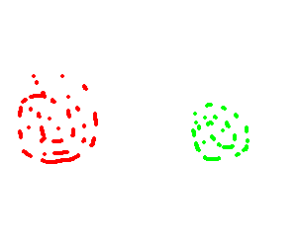
Within & between class scatter
Within-class
Within-class
Class 1
Class 2
Between-class
V
Within-class scatter指的是同一類別內資料的分散程度
Between-class scatter指的是不同類別間資料的分散程度

Slide 52
Between class scatter matrix
The sum of square –distance between class means
matrix

Slide 53
Between class scatter matrix
matrix
m_{x}: 每個類別的中心點加權之後的中心點

Slide 54
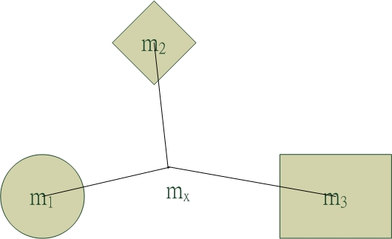
Car | Design | Performance | Space | Sell
A | 25 | 60 | 58 | Bad
B | 75 | 35 | 40 | Middle
C | 50 | 74 | 68 | Middle
D | 60 | 30 | 40 | Bad
E | 50 | 80 | 70 | Good
F | 80 | 90 | 95 | Good
G | 45 | 50 | 50 | Middle
 | Percentage | Middle point
Good | 28.57% | 65.00 | 85.00 | 82.50
Middle | 42.86% | 56.67 | 53.00 | 52.67
Bad | 28.57% | 42.50 | 45.00 | 49.00
Weight middle point (m_{x}) |  | 55.00 | 59.86 | 60.14

Slide 55
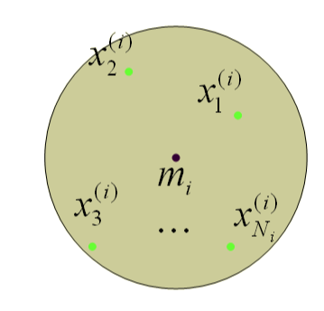
Within class scatter matrix
The sum of all class-variances is:

Slide 56
Car | Design | Performance | Space | Sell
E | 50 | 80 | 70 | Good
F | 80 | 90 | 95 | Good
middle point | 65 | 85 | 82.5
B | 75 | 35 | 40 | Middle
C | 50 | 74 | 68 | Middle
G | 45 | 50 | 50 | Middle
middle point | 56.67 | 53 | 52.67
A | 25 | 60 | 58 | Bad
D | 60 | 30 | 40 | Bad
middle point | 42.5 | 45 | 49

Slide 57
Multiclass linear discriminant analysis
投影(旋轉)後，能夠將類別分的最開的向量V如下:
(組間差距/組內差距)的最大化
Lagrange multiplier:
最佳旋轉方向V為最大eigenvalue所對應之eigenvector

Slide 58
Eigenvalue: 7.414
Eigenvector( -0.301, -0.720, 0.624)
Eigenvalue: 0.483
Eigenvector: (-0.187, -0.563, 0.804)
Eigenvalue: 0
Eigenvector: (-0.215, 0.695, -0.685)
因此將三維資料投影到由
( -0.301, -0.720, 0.624)與
(-0.187, -0.563, 0.804)兩向量所形成的平面時，分散效果最佳

Slide 59
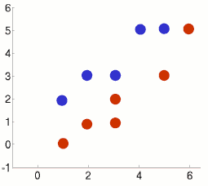
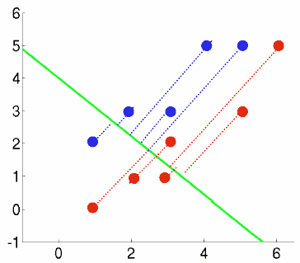
LDA 2-class classifier
Point | Class
(1,2) | 1
(2,3) | 1
(3,3) | 1
(4,5) | 1
(5,5) | 1
(1,0) | -1
(2,1) | -1
(3,1) | -1
(3,2) | -1
(5,3) | -1
(6,5) | -1
M₁ | (3, 3.6)
M₋₁ | (3.3, 2)
M_{x} | (3.18, 2.72)
Σ_{w}=[27.3, 24;
24, 23.2],
Σ_{b}=[0.3, -1.5;
-1.5, 7]
V
V=(-0.67,0.75), λ₁=4.6
λ₂=0,
這表示二維資料最多取得一個最佳旋轉方向
Notes:
c1=[1 2;2 3;3 3;4 5;5 5]’
c2=[1 0;2 1;3 1;3 2;5 3;6 5]‘
m1=mean(c1,'c')
m2=mean(c2,'c')
m=(m1*5+m2*6)/11
c1_m1=c1-mtlb_repmat(m1,1,5)
S1=c1_m1*c1_m1’
c2_m2=c2-mtlb_repmat(m2,1,6)
S2=c2_m2*c2_m2’
Sw=S1+S2
Sb=5*(m1-m)*(m1-m)'+6*(m2-m)*(m2-m)‘
[V,D] = mtlb_eig(inv(Sw)*Sb)

Slide 60
import numpy as np
import numpy.linalg as la
x1 = np.matrix('1.0, 2.0; 2.0, 3.0; 3.0, 3.0; 4.0, 5.0; 5.0, 5.0')
x2 = np.matrix('1.0, 0.0; 2.0, 1.0; 3.0, 1.0; 3.0, 2.0; 5.0, 3.0;6.0, 5.0')
totalnum = float(len(x1)+len(x2))
m1= x1.mean(axis=0)
m2 =x2.mean(axis=0)
mx = len(x1)/totalnum*m1 + len(x2)/totalnum*m2
print "m1:", m1, "m2:", m2, "mx:", mx
#between class
sigma_b1 = (m1-mx).T*(m1-mx)
sigma_b2 = (m2-mx).T*(m2-mx)
sigma_b = len(x1)/totalnum*sigma_b1 + len(x2)/totalnum*sigma_b2
print "between mtx:\n",sigma_b
#within class
sigma_w1 = sum( [(pt-m1).T*(pt-m1) for pt in x1])
sigma_w2 = sum( [(pt-m2).T*(pt-m2) for pt in x2])
sigma_w = 1.0/totalnum * (sigma_w1+sigma_w2)
print "within mtx:\n", sigma_w
#solve eigenvalue for np.inv(sigma_w)*sigma_b
print "eigens:\n",la.eig(la.inv(sigma_w)*sigma_b)

Slide 61
W
V
LDA分析後，兩類別分得更開，但各自類別卻縮的較近
可利用與V正交的向量W為分類函數(linear discriminant function, f(x) = <W, x>+c)
未知類別的點x代入W計算，計算值>0為藍色類別, 計算值<0為紅色類別)
Notes:
c1=[1 2;2 3;3 3;4 5;5 5]’
c2=[1 0;2 1;3 1;3 2;5 3;6 5]‘
m1=mean(c1,'c')
m2=mean(c2,'c')
m=(m1*5+m2*6)/11
c1_m1=c1-mtlb_repmat(m1,1,5)
S1=c1_m1*c1_m1’
c2_m2=c2-mtlb_repmat(m2,1,6)
S2=c2_m2*c2_m2’
Sw=S1+S2
Sb=5*(m1-m)*(m1-m)'+6*(m2-m)*(m2-m)‘
[V,D] = mtlb_eig(inv(Sw)*Sb)

Slide 62
Linear discriminant function
surface: w₁x₁+w₂x₂+…+w_{n}x_{n}+c = 0
=> W^{T}X+c=0 (vector form)
向量V為(-0.67,0.75), 因為W與V正交，所以向量W為(0.75, 0.67)
假設W通過兩類中心點 (3, 3.6), (3.3, 2)的中點 (3.15, 2.8)
可算出常數c=-(0.75*3.15+0.67*2.8) = 4.2385
Surface: 0.75x₁+0.67x₂-4.2385=0

Slide 63
LDA – Mahalanobis distance
一維資料: 工廠中，產品被分為良品與不良品的分數如下
假設良品與不良品均為常態分佈
1-D Mahalanobis distance:
 | 良品 | 不良品
 | 69 | 33
 | 72 | 30
 | 57 | 60
 | 69 | 18
 | 51 | 27
 | 66 | 72
 | 60 | 57
 | 69 | 9
 | 54 | 45
 | 66 | 42
avg μ | 63.30 | 39.30
Std σ | 7.27 | 19.72
若一未知類別產品分數為54分
因為距離不良品中心d₂較近， 所以判斷為不良品

Slide 64
Multivarite Mahalanobis distance:
student | score1 | score2 | class | student | score1 | score2 | class
1 | 50 | 70 | good | 3 | 50 | 50 | bad
2 | 20 | 80 | good | 7 | 80 | 60 | bad
4 | 70 | 60 | good | 8 | 70 | 70 | bad
5 | 90 | 90 | good | 9 | 30 | 50 | bad
6 | 50 | 90 | good
10 | 60 | 80 | good
avg | 56.67 | 78.33 |  | avg | 57.50 | 57.50
var | 546.67 | 136.67 |  | var | 491.67 | 91.67
covar | 11.11 |  |  | covar | 118.75
若有未知類別的學生成績為(30, 40):
d₁²=11.766, d₂²= 3.4099
可知離bad class距離較近，所以分類為bad

Slide 65
mlpy package LDA example:
import numpy as np
import mlpy
xtr = np.array([[1.0, 2.0, 3.1, 1.0], # first sample
... [1.0, 2.0, 3.0, 2.0], # second sample
... [1.0, 2.0, 3.1, 1.0]]) # third sample
ytr = np.array([1, -1, 1]) # classes
fda = mlpy.Fda() # initialize fda class
fda.compute(xtr, ytr) # compute fda
fda.predict(xtr) # predict fda model on training data
#array([ 1, -1, 1])
xts = np.array([4.0, 5.0, 6.0, 7.0]) # test point
fda.predict(xts) # predict fda model on test point
#-1
fda.weights(xtr, ytr) # compute weights on training data
#array([ 9.60629896, 9.77148463, 9.82027615, 11.58765243])
scikits.learn package LDA example:
import numpy as np
from scikits.learn.lda import LDA
X = np.array([[-1, -1], [-2, -1], [-3, -2], [1, 1], [2, 1], [3, 2]])
y = np.array([1, 1, 1, 2, 2, 2])
clf = LDA()
clf.fit(X, y)
#LDA(priors=None, n_components=None)
print clf.predict([[-0.8, -1]])
#[1]

Slide 66
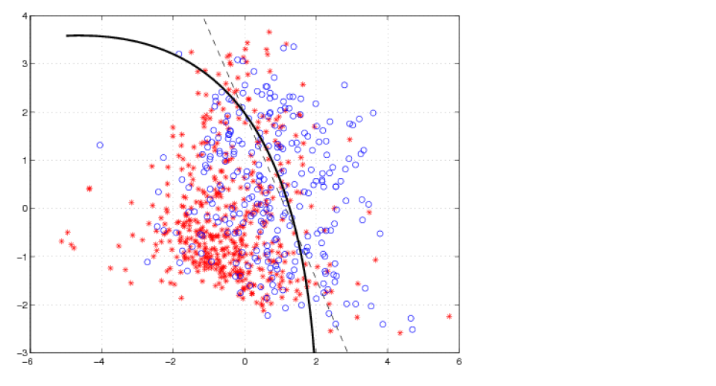
Quadratic discriminant analysis (QDA)
LDA
QDA

Slide 67
scikits.learn package QDA example:
import numpy as np
from scikits.learn.qda import QDA
xtr = np.array([[50.0, 70.0],
[20.0, 80.0],
[50.0, 50.0],
[70.0, 60.0],
[90.0, 90.0],
[50.0, 90.0],
[80.0, 60.0],
[70.0, 70.0],
[30.0, 50.0],
[60.0, 80.0]])
ytr = np.array([1,1,2,1,1,1,2,2,2,1])
clf=QDA()
clf.fit(xtr, ytr)
print clf.predict([[-0.8, -1]])

Slide 68
Python packages
Mathematics
NumPy: fundamental package for scientific computing
SciPy: extension of NumPy with many mathematics packages
cvxopt: convex optimization
PyMC: Bayesian estimation, Markov chain Monte Carlo (MCMC)

Slide 69
Machine learning:
Scikits.learn: classic machine learning algorithms
Scikits.ann: wrapper for the Approximate Nearest Neighbor (ANN) Library
Scikits.datasmooth: numerical methods for smoothing data
Scikits.statmodel: complement to scipy for statistical computations
Scikits.timeseries: for processing time series data
MDP: collection of supervised and unsupervised learning algorithm
PyML: focuses on SVMs and other kernel methods
Pyevolve: genetic algorithm and genetic programming
Shogun (Python interface): A large scale machine learning toolbox

Slide 70
Plot & Image
Matplotlib: 2D plotting library
OpenCV (Python interface): real time computer vision
PIL: image processing for many image file formats
Web:
lxml: for processing XML and HTML file
Django: Python web framework
More information (scipy topical software)

Slide 71
常用dataset來源
Weka software collection: http://www.cs.waikato.ac.nz/ml/weka/index_datasets.html
UCI machine learning repository:
http://www.ics.uci.edu/~mlearn/

Slide 72
Quiz
使用PCA找出iris dataset中，最大的二個主成份的貢獻度以及主成份之值
使用LDA建立iris dataset的預測模型，並做self test(即把training data做為testing data)求模型的預測正確率
Iris data set(wiki)

Slide 73

Thank you!!

