Slide 1
Support Vector Machine and PDBSelect
Presenter: Dong-Jian Lin
Date: July 21, 2011
Email: lindj@par.cse.nsysu.edu.tw

Slide 2
Outline
Support Vector Machine (SVM)
LIBSVM
PDBSelect
Homework

Slide 3
Support Vector Machine
由Vapnik根據統計學理論提出的machine learning
支持向量機
是一種用來做分類(classification)與迴歸(regression)的工具
給予一群已分類好的資料，SVM可以經由訓練(training)獲得一組模型(model)；之後利用此模組去對未分類的資料進行預測

Slide 4
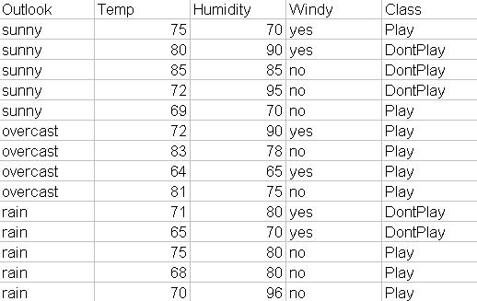
Support Vector Machine
Example: Play golf?
Training data
Model

Slide 5
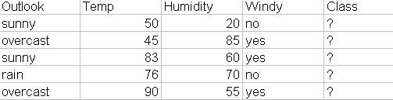
Support Vector Machine
Model
Testing data
Predicted
Class

Slide 6
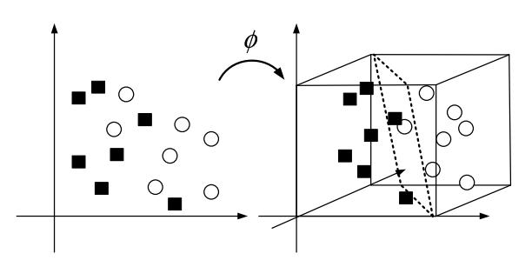
Support Vector Machine
原理
Hyperplan

Slide 7
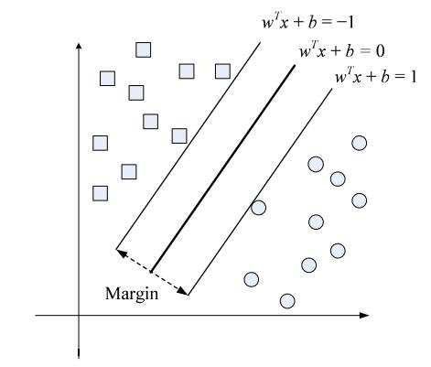
Support Vector Machine
Hyperplan
maximizing

Slide 8
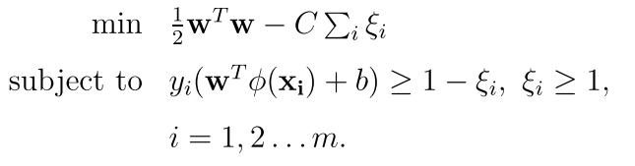
Support Vector Machine
目的: 在高維度空間找到一超平面可以分離不同資料群，並使不同資料群之間的間距是最大的。
上述動作等於解下列方程式:
Cost

Slide 9




Support Vector Machine
Kernel function:
  Linear:
  Polynomial:
  Radial basis function (RBF):
  Sigmoid:
Gamma

Slide 10
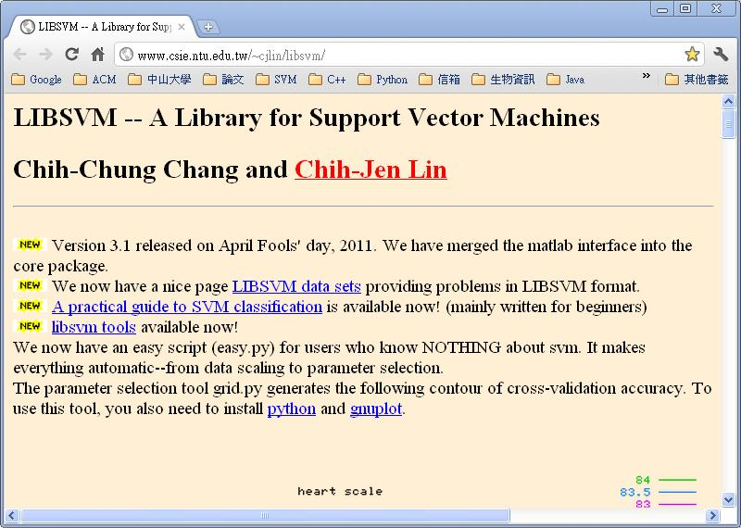
LIBSVM
台灣大學林智仁老師
http://www.csie.ntu.edu.tw/~cjlin/libsvm/

Slide 11
LIBSVM
軟體安裝:
  LIBSVM (Version 3.1) http://www.csie.ntu.edu.tw/~cjlin/libsvm/ 下載並解壓縮至C槽
  gnuplot (Version 4.4.3) http://sourceforge.net/projects/gnuplot/files/gnuplot/4.4.3/ 選取gp443win32.zip下載並解壓縮至C槽
  Python

Slide 12
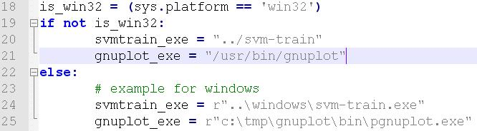
LIBSVM
修改 C:\libsvm-3.1\tools\grid.py

Slide 13
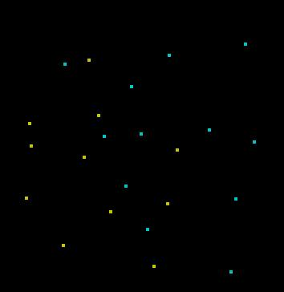

LIBSVM
資料格式:
  [label] [index1]:[value1] [index2]:[value2] ...
  [label] [index1]:[value1] [index2]:[value2] ...
Examples:
  1 1:0.386000 2:0.902000
  1 1:0.310000 2:0.792000
  …
  2 1:0.568000 2:0.668000
  2 1:0.650000 2:0.908000
  …

Slide 14
LIBSVM
LIBSVM執行流程:
  特徵正規化 (Normalization)
  資料切割 (Folding) → 訓練資料 與 測試資料
  訓練資料: 調整 cost 與 gamma 參數
  訓練資料: 產生預測模組
  訓練資料: 自我測試 (Self test)
  利用預測模組去預測測試資料

Slide 15
LIBSVM
特徵正規化 (Normalization)
  import os,sys,shutil
  svm_scale_exe = "C:\\libsvm-3.1\\windows\\svm-scale.exe"
  file = point.data
  file_scaled = point.scaled
  cmdline = "%s -l -1 -u 1 %s > %s" %(svm_scale_exe, file, file_scaled)
  os.system(cmdline)

Slide 16
LIBSVM
資料切割 (Folding) → 訓練資料 與 測試資料
  1 1:0.386000 2:0.902000
  1 1:0.602000 2:0.862000
  1 1:0.310000 2:0.792000
  1 1:0.302000 2:0.672000
  2 1:0.568000 2:0.668000
  2 1:0.764000 2:0.524000
  2 1:0.514000 2:0.658000
  ……
  2 1:0.890000 2:0.846000
  2 1:0.928000 2:0.684000
  2 1:0.650000 2:0.908000
  2 1:0.540000 2:0.956000
point.scaled
point.train
point.test

Slide 17
LIBSVM
訓練資料: 調整 cost 與 gamma 參數
  import os,sys,shutil
  python_exe = "C:\\Python26\\python "
  svm_grid_exe = "C:\\libsvm-3.1\\tools\\grid.py"
  file_train = point.train #訓練資料
  cmdline = "%s %s %s" %(python_exe, svm_grid_exe, file_train)
  os.system(cmdline)

Slide 18
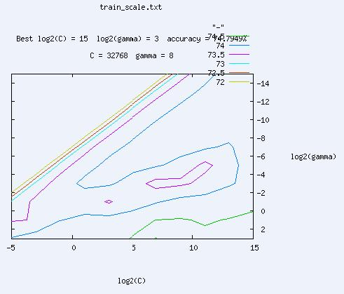
LIBSVM

Slide 19
LIBSVM
訓練資料: 產生預測模組
  import os,sys,shutil
  svm_train_exe = "C:\\libsvm-3.1\\windows\\svm-train.exe"
  cost = 32768
  gamma = 8
  file_train = point.train #訓練資料
  model = point.mode
  cmdline = "%s -c %f -g %f -q %s %s" %(svm_train_exe, cost, gamma, file_train, model)
  os.system(cmdline)

Slide 20
LIBSVM
訓練資料: 自我測試 (Self test)
  import os,sys,shutil
  svm_predict_exe = "C:\\libsvm-3.1\\windows\\svm-predict.exe "
  file_train = point.train #訓練資料
  model = point.mode
  result = point.train.result
  cmdline ='%s %s %s %s'%(svm_predict_exe, file_train, model, result)
  os.system(cmdline)

Slide 21
LIBSVM
利用預測模組去預測測試資料
  import os,sys,shutil
  svm_predict_exe = "C:\\libsvm-3.1\\windows\\svm-predict.exe "
  file_test = point.test #訓練資料
  model = point.mode
  result = point.test.result
  cmdline ='%s %s %s %s'%(svm_predict_exe, file_test, model, result)
  os.system(cmdline)

Slide 22
LIBSVM
point.test point.test.result
  1 1:0.310000 2:0.792000 2
  1 1:0.302000 2:0.672000 1
  2 1:0.568000 2:0.668000 1
  2 1:0.764000 2:0.524000 2
  2 1:0.514000 2:0.658000 1
  2 1:0.650000 2:0.908000 2
  2 1:0.540000 2:0.956000 2

Slide 23
PDBSelect
PDB 資料龐大，如何取得研究目標蛋白質?
  從相關的蛋白質資料庫取得 (eg. CASP7)
  經過篩選取得蛋白質
PDB-REPRDB (Representative protein chains from PDB)

Slide 24
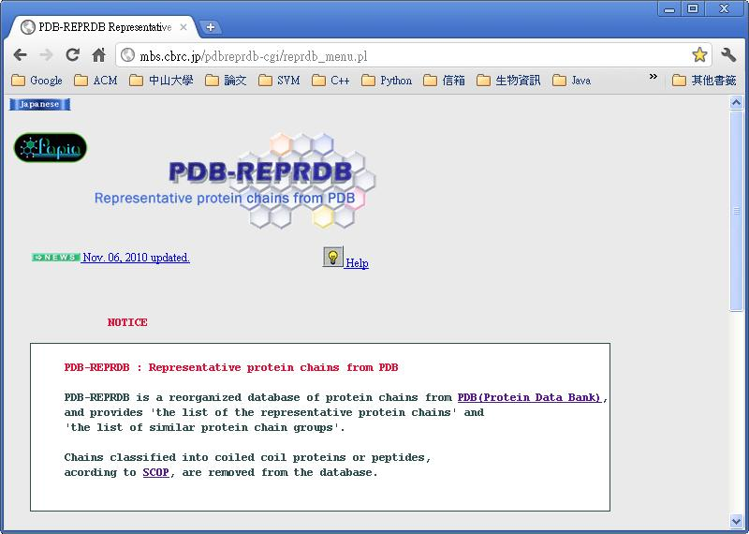
PDBSelect
http://mbs.cbrc.jp/pdbreprdb-cgi/reprdb_menu.pl

Slide 25
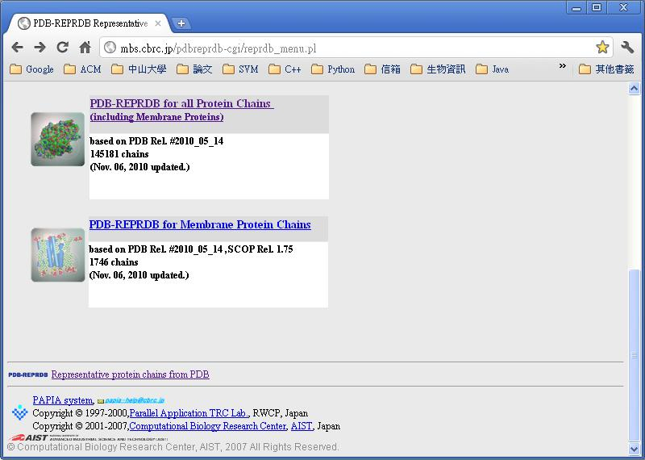
PDBSelect

Slide 26
PDBSelect
Two-phase selector:
  Phase 1 : Eliminate and sort chains
  Phase 2 : Select representative chains

Slide 27
PDBSelect
Factor of phase 1:
  Resolution
  R-factor
  Number of chain break
  Rate of non-standard amino acid residues
  Rate of residues with only CA coordinates
  Rate of residues with only backbone coordinates
  Number of residues
  MUTANT
  COMPLEX
  FRAGMENT
  NMR (核磁共振)
  Membrane Proteins (膜蛋白)

Slide 28
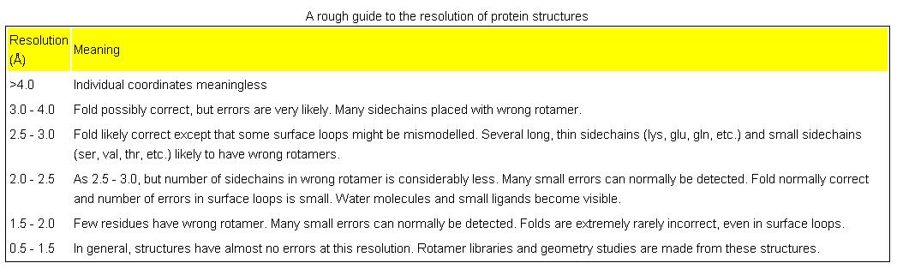
PDBSelect
Resolution
R-factor: no greater than (resolution in Å) / 10

Slide 29
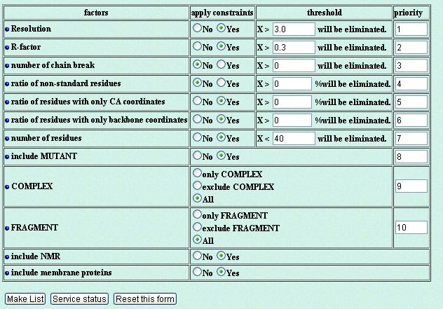
PDBSelect
Phase 1

Slide 30
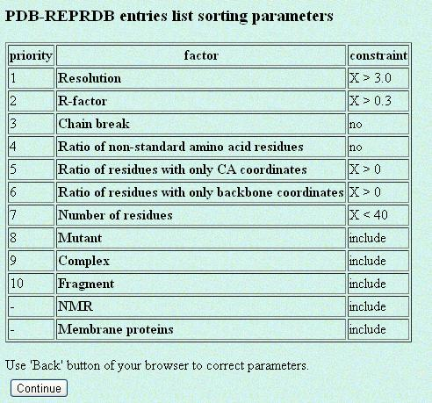
PDBSelect

Slide 31
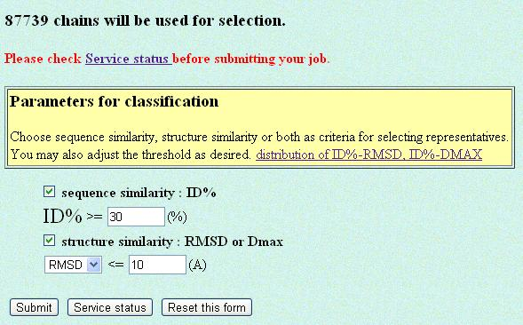
PDBSelect
Phase 2 : Select representative chains

Slide 32

PDBSelect
Factor of phase 2:
  Sequence similarity : ID% (Identity), chains whose ID% are over the threshold will be classified into the same group.
  Structure similarity : RMSD (Root mean square deviation) or Dmax, chains whose RMSD or Dmax are under the threshold will be classified into the same group.

Slide 33
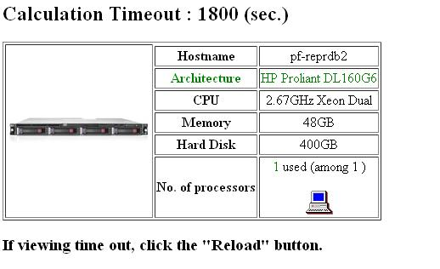
PDBSelect

Slide 34
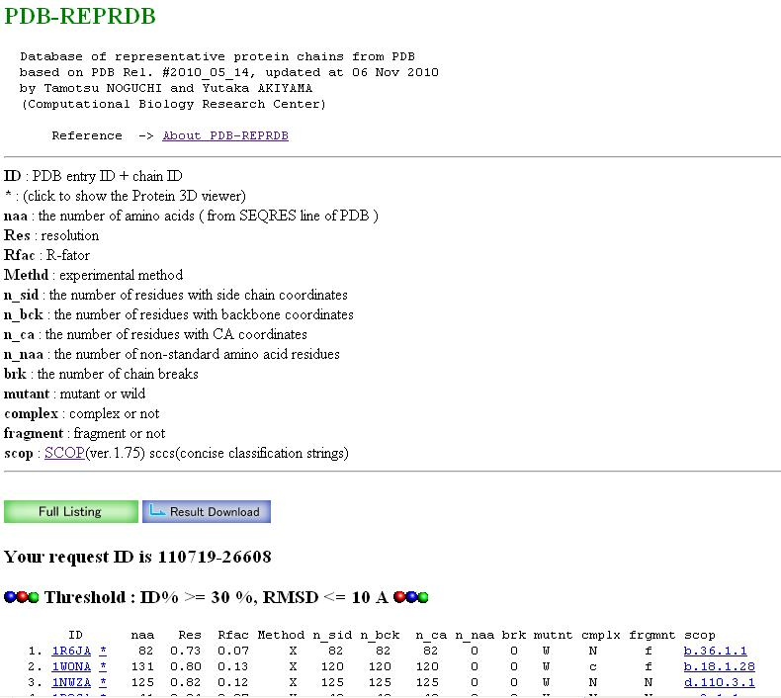

Slide 35
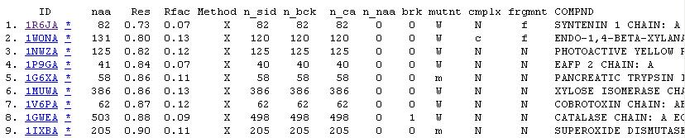
PDBSelect
Full listing

Slide 36
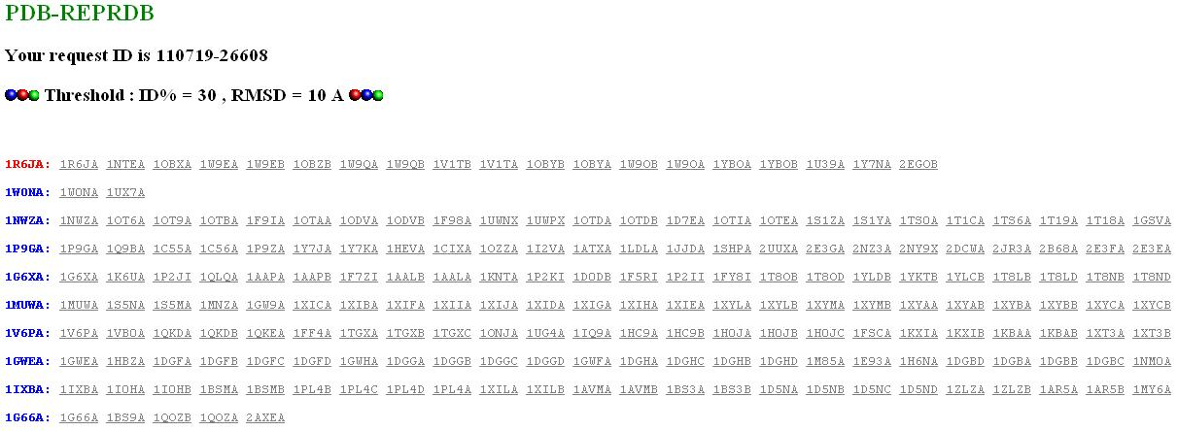
PDBSelect
1R6JA

Slide 37
PDBSelect
Step 1
Step 2
Step 3
Step 4
Step 5
Step 6

Slide 38
Homework
Hw1: example.train與example.test分別是訓練資料範例檔案與測試資料範例檔案，請參考example.train或example.test，把creals檔案改成LIBSVM的檔案格式，對creals執行投影片#14步驟，最後繳交測試資料檔案、預測結果檔案、預測準確率。 註:將Class欄位的A改成數字0，B改成數字1；奇數項資料為訓練資料，偶數項資料為測試資料 。
Hw2: 根據下表的設定條件執行PDB-REPRDB，將產生的PDB entry ID取出寫入pdbid.txt，最後繳交 pdbid.txt

Slide 39
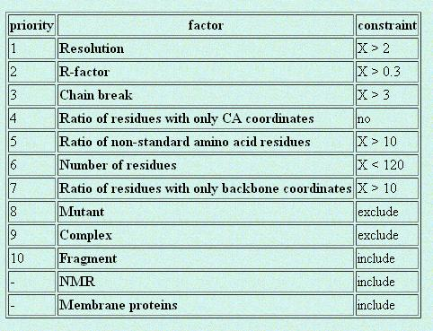
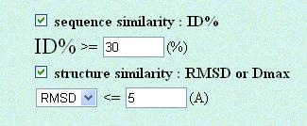
Homework

