Slide 1
基本特徵選擇方法

Slide 2
大綱
問題定義
迴歸問題與相關係數
分類問題與Fisher score
Mutual information
註：相關更詳細方法，請參閱python之numpy套件與IPython之pylab說明文件

Slide 3
問題定義
迴歸問題是用來找"連續"目標(應)變數y和自變數x關係
  股票價格預測、藥物活性預測等
分類問題是用來找"離散"目標(應)變數y和自變數x關係
  股票漲/跌預測、蛋白質種類預測、字元辨識等

Slide 4
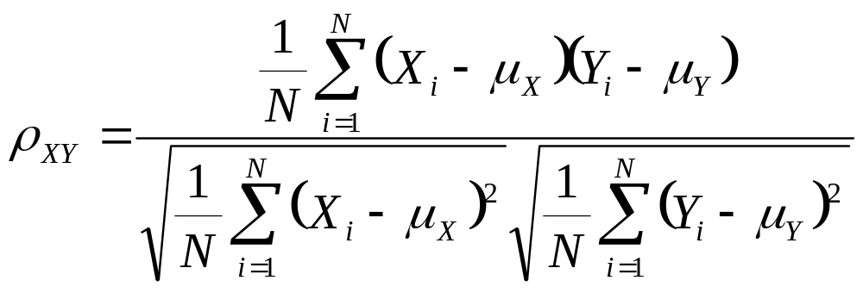
相關係數
衡量數值變數間線性關係的程度

Slide 5
相關係數
計算y, x1,x2之相關係數
y=[0, 1, 2, 3, 4, 5, 6, 7, 8, 9]
x1=[0.0, 1.5, 3.0, 4.5, 6.0, 7.5, 9.0, 10.5, 12.0, 13.5]
x2=[1, 0, 0, 0, 0, 1, 1, 1, 1, 0]
#算y,x1,x2平均與標準差
y_bar,x1_bar,x2_bar=4.5, 6.75, 0.5
std_y,std_x1,std_x2 = 2.87, 4.31, 0.5
#算共變異數(公式中分子)
cov_y_x1 = sum([(y[i]-y_bar)*(x1[i]-x1_bar) for i in range(len(y))])/len(y) = 12.38
cov_y_x2 = sum([(y[i]-y_bar)*(x2[i]-x1_bar) for i in range(len(y))])/len(y) = 0.35
#算相關數
cor_y_x1 = cov_y_x1 / std_y / std_x1 = 1
cor_y_x2 = cov_y_x2 / std_y / std_x2 = 0.24
Notes:
import numpy
y=[0, 1, 2, 3, 4, 5, 6, 7, 8, 9]
x1=[0.0, 1.5, 3.0, 4.5, 6.0, 7.5, 9.0, 10.5, 12.0, 13.5]
x2=[1, 0, 0, 0, 0, 1, 1, 1, 1, 0]
#算平均與標準差
y_bar=mean(y); x1_bar=mean(x1); x2_bar=mean(x2)
std_y = std(y); std_x1 = std(x1); std_x2 = std(x2);
#算共變異數(公式中分子)
cov_y_x1 = sum([(y[i]-y_bar)*(x1[i]-x1_bar) for i in range(len(y))])/len(y)
cov_y_x2 = sum([(y[i]-y_bar)*(x2[i]-x1_bar) for i in range(len(y))])/len(y)
#算相關數
cor_y_x1 = cov_y_x1 / std_y / std_x1; print(cor_y_x1)
cor_y_x2 = cov_y_x2 / std_y / std_x2; print(cor_y_x2)
print(('Correlation for dim1 & dim2: %02f, %02f') % (cor_y_x1, cor_y_x2))
#繪圖
import matplotlib.pyplot as plt
fig = plt.figure()
ax = fig.add_subplot(111)
ax.plot(x2,y,'x-',x1,y,'o--')
leg = ax.legend(('y vs.x2, cor = ' + str(cor_y_x2), 'y vs. x1, cor = ' + str(cor_y_x1)), 'upper center', shadow=True)
ax.set_ylim([-1,max(y)+1]); ax.set_xlim([-1,max(x1)+1]);
ax.grid(False)
ax.set_xlabel('x1 or x2')
ax.set_ylabel('y')
ax.set_title('Correlation between x1 or x2 and y')

Slide 6
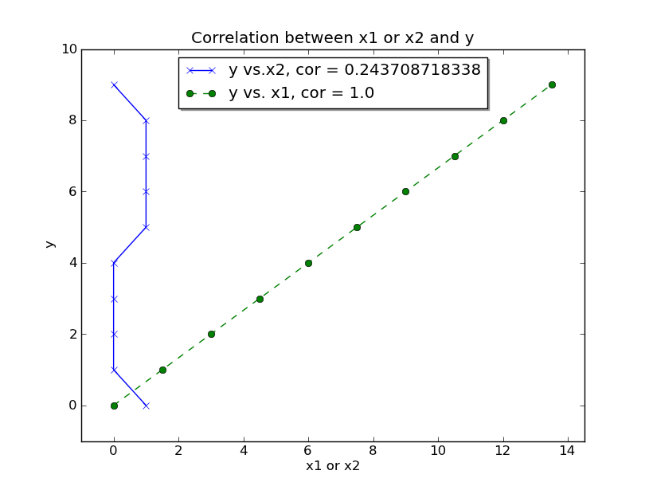
相關係數

Slide 7


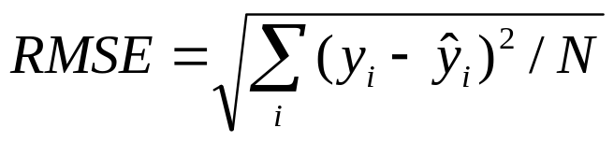
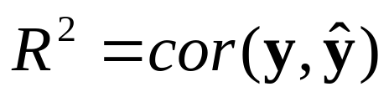
簡單線性迴歸
希望用x預測y
衡量迴歸好壞的方法
  RMSE (Root mean square of error)
  R-square (目標y值和預測ŷ值相關係數)

Slide 8
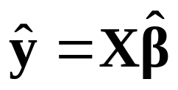
簡單線性迴歸
希望用x預測y
訓練
y=[0, 1, 2, 3, 4, 5, 6, 7, 8, 9]
x1=[0.0, 1.5, 3.0, 4.5, 6.0, 7.5, 9.0, 10.5, 12.0, 13.5]
x2=[1, 0, 0, 0, 0, 1, 1, 1, 1, 0]
預測

Slide 9
簡單線性迴歸
import numpy
import numpy.linalg
def get_beta(x,y):
X = column_stack((x,[1]*len(x)));
#return(dot(dot(inv(dot(X.T,X)),X.T),y))
return(lstsq(X,y))
y=[0, 1, 2, 3, 4, 5, 6, 7, 8, 9]
x1=[0.0, 1.5, 3.0, 4.5, 6.0, 7.5, 9.0, 10.5, 12.0, 13.5]
x2=[1, 0, 0, 0, 0, 1, 1, 1, 1, 0]
beta1 = get_beta(x1,y); beta2 = get_beta(x2,y);
y_pred1 = dot(column_stack((x1,[1]*len(x1))),beta1[0])
y_pred2 = dot(column_stack((x2,[1]*len(x2))),beta2[0])
RMSE1 = sqrt(sum([(y[i]-y_pred1[i])**2 for i in range(len(y))])/len(y))
RMSE2 = sqrt(sum([(y[i]-y_pred2[i])**2 for i in range(len(y))])/len(y))
numpy的lstsq為現成可用函式
Notes:
import numpy
import numpy.linalg
def get_beta(x,y):
X = column_stack((x,[1]*len(x)));
return(lstsq(X,y))
y=[0, 1, 2, 3, 4, 5, 6, 7, 8, 9]
x1=[0.0, 1.5, 3.0, 4.5, 6.0, 7.5, 9.0, 10.5, 12.0, 13.5]
x2=[1, 0, 0, 0, 0, 1, 1, 1, 1, 0]
beta1 = get_beta(x1,y); beta2 = get_beta(x2,y);
y_pred1 = dot(column_stack((x1,[1]*len(x1))),beta1[0])
y_pred2 = dot(column_stack((x2,[1]*len(x2))),beta2[0])
#繪圖
RMSE1 = sqrt(sum([(y[i]-y_pred1[i])**2 for i in range(len(y))])/len(y))
RMSE2 = sqrt(sum([(y[i]-y_pred2[i])**2 for i in range(len(y))])/len(y))
print('RMSE1: %f, RMSE2: %f' % (RMSE1,RMSE2))
import matplotlib.pyplot as plt
fig = plt.figure()
ax = fig.add_subplot(111)
ax.plot(x2,y,'x',x1,y,'o',x2,y_pred2,'rx:', x1,y_pred1,'r*-')
leg = ax.legend(('y vs.x2', 'y vs. x1', 'pred_y vs. x2, RMSE='+format(RMSE2,'0.00'), 'pred_y vs. x1, RMSE='+format(RMSE1,'0.00')), 'upper center', shadow=True)
ax.set_ylim([-1,max(y)+1]); ax.set_xlim([-1,max(x1)+1]);
ax.grid(False)
ax.set_xlabel('x1 or x2')
ax.set_ylabel('y')
ax.set_title('Correlation between x1 or x2 and y')

Slide 10
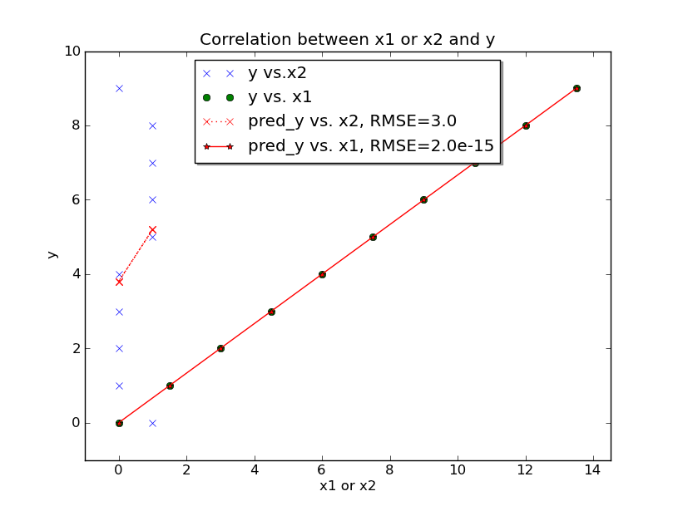
簡單線性迴歸(繪圖)

Slide 11
簡單線性迴歸
小結
  在一般情況下，若自變數(須連續性資料)和應變數相關係數越高，則迴歸效果會較佳
  若自變數本身相異值不多，其和應變數相關係數一般不高

Slide 12
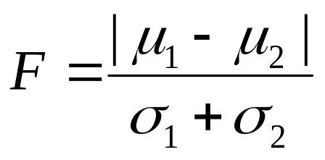
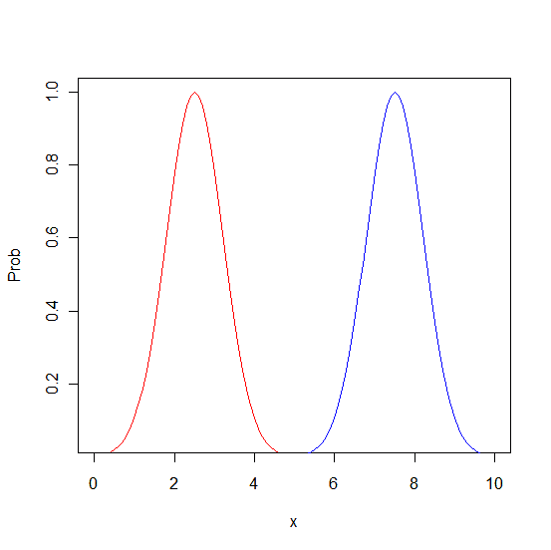
Fisher score
衡量變數可分離目標(類別)變數的程度
μ1
μ2
σ1
σ2

Slide 13
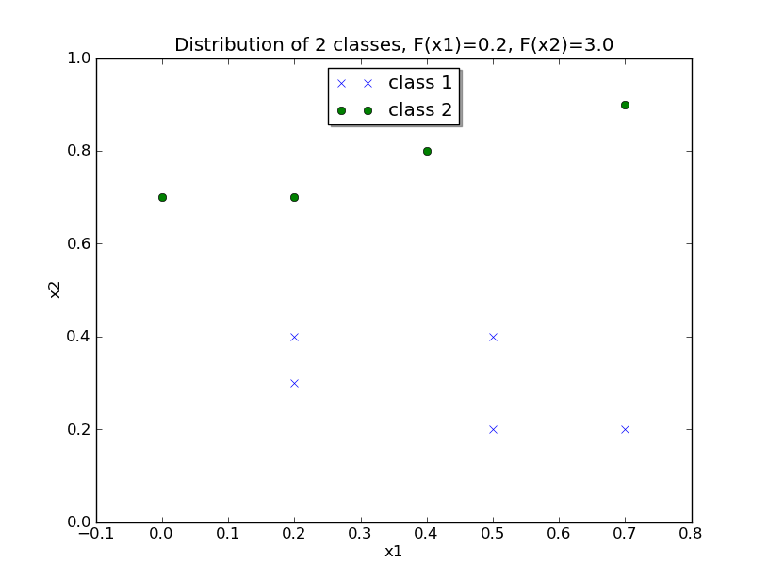
Fisher score
Class x1 x2
[-1. , 0.5, 0.4]
[-1. , 0.5, 0.2]
[-1. , 0.2, 0.3]
[-1. , 0.7, 0.2]
[-1. , 0.2, 0.4]
[ 1. , 0.7, 0.8]
[ 1. , 0.7, 0.9]
[ 1. , 0.0, 0.7]
[ 1. , 0.4, 0.8]
[ 1. , 0.2, 0.7]
Notes:
import matplotlib.pyplot as plt
import numpy
data = [-1. , 0.5, 0.4, -1. , 0.5, 0.2, -1. , 0.2, 0.3, -1. , 0.7, 0.2, -1. , 0.2, 0.4, 1. , 0.7, 0.8, 1. , 0.7, 0.9, 1. , 0. , 0.7, 1. , 0.4, 0.8, 1. , 0.2, 0.7]
data = asarray(data).reshape((10,3))
fig = plt.figure()
ax = fig.add_subplot(111)
ax.plot(data[0:5,1], data[0:5,2],'x', data[6:10,1], data[6:10,2],'o')
leg = ax.legend(('class 1', 'class 2'), 'upper center', shadow=True)
ax.set_ylim([0,1]); ax.set_xlim([-0.1,0.8]);
ax.grid(False)
ax.set_xlabel('x1'); ax.set_ylabel('x2')
#F-score
def F_score(x1_,x2_):
mean1 = mean(x1_); mean2 = mean(x2_);
std1 = std(x1_); std2 = std(x2_)
return(abs(mean1-mean2)/(std1+std2))
F1 = F_score(data[0:5,1], data[6:10,1])
F2= F_score(data[0:5,2], data[6:10,2])
ax.set_title('Distribution of 2 classes, F(x1)='+format(F1,'0.00')+', F(x2)='+format(F2,'0.00'))

Slide 14
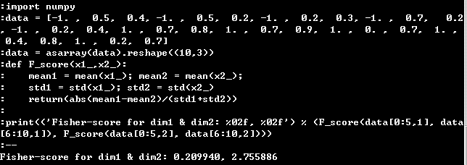
Notes:
import numpy
data = [-1. , 0.5, 0.4, -1. , 0.5, 0.2, -1. , 0.2, 0.3, -1. , 0.7, 0.2, -1. , 0.2, 0.4, 1. , 0.7, 0.8, 1. , 0.7, 0.9, 1. , 0. , 0.7, 1. , 0.4, 0.8, 1. , 0.2, 0.7]
data = asarray(data).reshape((10,3))
def F_score(x1_,x2_):
mean1 = mean(x1_); mean2 = mean(x2_);
std1 = std(x1_); std2 = std(x2_)
return(abs(mean1-mean2)/(std1+std2))
print(('Fisher-score for dim1 & dim2: %02f, %02f') % (F_score(data[0:5,1], data[6:10,1]), F_score(data[0:5,2], data[6:10,2])))

Slide 15
簡單線性分類器
利用y=Xβ來進行分類，其中y={+1,-1}
預測時，y=sign(Xβ)
Class x1 x2
[-1. , 0.5, 0.4]
[-1. , 0.5, 0.2]
[-1. , 0.2, 0.3]
[-1. , 0.7, 0.2]
[-1. , 0.2, 0.4]
[ 1. , 0.7, 0.8]
[ 1. , 0.7, 0.9]
[ 1. , 0.0, 0.7]
[ 1. , 0.4, 0.8]
[ 1. , 0.2, 0.7]

Slide 16
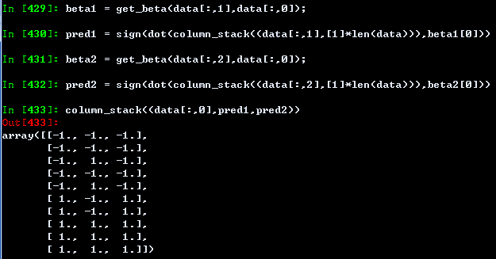
簡單線性分類器
比較只用x1或x2分類效果
第一欄為正確類別
僅用x2(第二欄)效果比僅用x1(第三欄)效果佳
Notes:
import numpy
import numpy.linalg
data = [-1. , 0.5, 0.4, -1. , 0.5, 0.2, -1. , 0.2, 0.3, -1. , 0.7, 0.2, -1. , 0.2, 0.4, 1. , 0.7, 0.8, 1. , 0.7, 0.9, 1. , 0. , 0.7, 1. , 0.4, 0.8, 1. , 0.2, 0.7]
data = asarray(data).reshape((10,3))
def get_beta(x,y):
X = column_stack((x,[1]*len(x)));
return(lstsq(X,y))
beta1 = get_beta(data[:,1],data[:,0]);
pred1 = sign(dot(column_stack((data[:,1],[1]*len(data))),beta1[0]))
beta2 = get_beta(data[:,2],data[:,0]);
pred2 = sign(dot(column_stack((data[:,2],[1]*len(data))),beta2[0]))
column_stack((data[:,0],pred1,pred2))

Slide 17
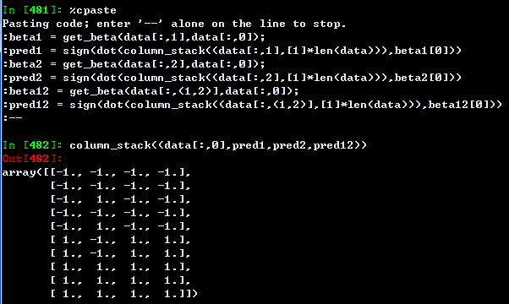
簡單線性分類器
用x1+x2分類結果
第一欄為正確類別
僅用x2(第二欄)，僅用x1(第三欄)，
同時用x2與x1(第四欄)
Notes:
import numpy
import numpy.linalg
data = [-1. , 0.5, 0.4, -1. , 0.5, 0.2, -1. , 0.2, 0.3, -1. , 0.7, 0.2, -1. , 0.2, 0.4, 1. , 0.7, 0.8, 1. , 0.7, 0.9, 1. , 0. , 0.7, 1. , 0.4, 0.8, 1. , 0.2, 0.7]
data = asarray(data).reshape((10,3))
def get_beta(x,y):
X = column_stack((x,[1]*len(x)));
return(lstsq(X,y))
beta1 = get_beta(data[:,1],data[:,0]);
pred1 = sign(dot(column_stack((data[:,1],[1]*len(data))),beta1[0]))
beta2 = get_beta(data[:,2],data[:,0]);
pred2 = sign(dot(column_stack((data[:,2],[1]*len(data))),beta2[0]))
beta12 = get_beta(data[:,(1,2)],data[:,0]);
pred12 = sign(dot(column_stack((data[:,(1,2)],[1]*len(data))),beta12[0]))
column_stack((data[:,0],pred1,pred2,pred12))

Slide 18
簡單線性分類器
用x1+x2分類，觀察分類器賦予特徵之權重
X1對應權重
X2對應權重
y=-0.28x1+3.7x2-1.9
訓練程序賦予好的特徵較高權重
Notes:
import numpy
import numpy.linalg
data = [-1. , 0.5, 0.4, -1. , 0.5, 0.2, -1. , 0.2, 0.3, -1. , 0.7, 0.2, -1. , 0.2, 0.4, 1. , 0.7, 0.8, 1. , 0.7, 0.9, 1. , 0. , 0.7, 1. , 0.4, 0.8, 1. , 0.2, 0.7]
data = asarray(data).reshape((10,3))
def get_beta(x,y):
X = column_stack((x,[1]*len(x)));
return(lstsq(X,y))
beta1 = get_beta(data[:,1],data[:,0]);
pred1 = sign(dot(column_stack((data[:,1],[1]*len(data))),beta1[0]))
beta2 = get_beta(data[:,2],data[:,0]);
pred2 = sign(dot(column_stack((data[:,2],[1]*len(data))),beta2[0]))
beta12 = get_beta(data[:,(1,2)],data[:,0]);
pred12 = sign(dot(column_stack((data[:,(1,2)],[1]*len(data))),beta12[0]))
column_stack((data[:,0],pred1,pred2,pred12))

Slide 19
簡單線性分類器
小結
  在一般情況下，若自變數(須連續性資料)和應變數Fisher score越高，則分類效果會較佳
  Fisher score缺點為僅適用兩類分類問題，對多類問題，須把問題拆解成數個兩類分類問題來用
Notes:
import numpy
import numpy.linalg
data = [-1. , 0.5, 0.4, -1. , 0.5, 0.2, -1. , 0.2, 0.3, -1. , 0.7, 0.2, -1. , 0.2, 0.4, 1. , 0.7, 0.8, 1. , 0.7, 0.9, 1. , 0. , 0.7, 1. , 0.4, 0.8, 1. , 0.2, 0.7]
data = asarray(data).reshape((10,3))
def get_beta(x,y):
X = column_stack((x,[1]*len(x)));
return(lstsq(X,y))
beta1 = get_beta(data[:,1],data[:,0]);
pred1 = sign(dot(column_stack((data[:,1],[1]*len(data))),beta1[0]))
beta2 = get_beta(data[:,2],data[:,0]);
pred2 = sign(dot(column_stack((data[:,2],[1]*len(data))),beta2[0]))
beta12 = get_beta(data[:,(1,2)],data[:,0]);
pred12 = sign(dot(column_stack((data[:,(1,2)],[1]*len(data))),beta12[0]))
column_stack((data[:,0],pred1,pred2,pred12))

Slide 20

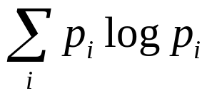
Mutual information
H(•): the entropy
H(X,Y): the joint entropy of X and Y
X, Y: one feature and class label
I(X,Y): the relevance measure between X and Y

Slide 21
Mutual information
H(•): the entropy
假設原始資料為
x1 = [ 0.5, 0.5, 0.2, 0.7, 0.2, 0.7, 0.7, 0. , 0.4, 0.2]
利用以下區間離散化
[ 0., 0.23333333, 0.46666667, 0.7]
結果為.[3, 3, 1, 3, 1, 3, 3, 1, 2, 1]
統計次數[4, 1, 5]
算1~3機率[ 0.4, 0.1, 0.5]
算entropy=1.36
-sum(asarray([ 0.4, 0.1, 0.5]) * log2(asarray([ 0.4, 0.1, 0.5])))
同理可得y之entropy=1

Slide 22
Mutual information
H(X,Y): the joint entropy of X and Y
假設原始資料為
x1 = [ 0.5, 0.5, 0.2, 0.7, 0.2, 0.7, 0.7, 0. , 0.4, 0.2]
y = [-1, -1, -1, -1, -1, 1, 1, 1, 1, 1]
利用以下區間離散化x1得
[ 0., 0.23333333, 0.46666667, 0.7]
結果為[3, 3, 1, 3, 1, 3, 3, 1, 2, 1]
算x1=1~3與y=±1排列組合
[(-1, 3), (-1, 3), (-1, 1), (-1, 3), (-1, 1), (1, 3), (1, 3), (1, 1), (1, 2), (1, 1)]
對應[(-1, 1), (-1, 2), (-1, 3), (1, 1), (1, 2), (1, 3)]之次數
統計次數[2, 0, 3, 2, 1, 2]
算x1=1~3與y=±1機率[ 0.2, 2.22044605e-16, 0.3, 0.2, 0.1, 0.2]
算joint entropy=2.25
-sum(asarray([0., 2.22044605e-16, 0.3, 0.2, 0.1, 0.2]) * log2(asarray([0.2, 2.22044605e-16, 0.3, 0.2, 0.1, 0.2])))

Slide 23
Mutual information
假設H(x1)=1.36，H(y)=1, H(x1,y)=2.26
I(x1,y)=1.36+1-2.25=0.11

Slide 24
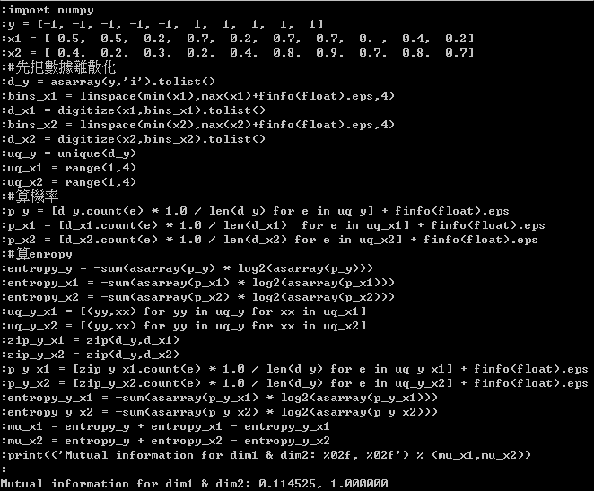
Mutual information
Notes:
import numpy
y = [-1, -1, -1, -1, -1, 1, 1, 1, 1, 1]
x1 = [ 0.5, 0.5, 0.2, 0.7, 0.2, 0.7, 0.7, 0. , 0.4, 0.2]
x2 = [ 0.4, 0.2, 0.3, 0.2, 0.4, 0.8, 0.9, 0.7, 0.8, 0.7]
#先把數據離散化
d_y = asarray(y,'i').tolist()
bins_x1 = linspace(min(x1),max(x1)+finfo(float).eps,4)
d_x1 = digitize(x1,bins_x1).tolist()
bins_x2 = linspace(min(x2),max(x2)+finfo(float).eps,4)
d_x2 = digitize(x2,bins_x2).tolist()
uq_y = unique(d_y)
uq_x1 = range(1,4)
uq_x2 = range(1,4)
#算機率
p_y = [d_y.count(e) * 1.0 / len(d_y) for e in uq_y] + finfo(float).eps
p_x1 = [d_x1.count(e) * 1.0 / len(d_x1) for e in uq_x1] + finfo(float).eps
p_x2 = [d_x2.count(e) * 1.0 / len(d_x2) for e in uq_x2] + finfo(float).eps
#p_y = asarray(p_y)
#p_x1 = asarray(p_x1)
#p_x2 = asarray(p_x2)
entropy_y = -sum(asarray(p_y) * log2(asarray(p_y)))
entropy_x1 = -sum(asarray(p_x1) * log2(asarray(p_x1)))
entropy_x2 = -sum(asarray(p_x2) * log2(asarray(p_x2)))
uq_y_x1 = [(yy,xx) for yy in uq_y for xx in uq_x1]
uq_y_x2 = [(yy,xx) for yy in uq_y for xx in uq_x2]
zip_y_x1 = zip(d_y,d_x1)
zip_y_x2 = zip(d_y,d_x2)
p_y_x1 = [zip_y_x1.count(e) * 1.0 / len(d_y) for e in uq_y_x1] + finfo(float).eps
p_y_x2 = [zip_y_x2.count(e) * 1.0 / len(d_y) for e in uq_y_x2] + finfo(float).eps
entropy_y_x1 = -sum(asarray(p_y_x1) * log2(asarray(p_y_x1)))
entropy_y_x2 = -sum(asarray(p_y_x2) * log2(asarray(p_y_x2)))
mu_x1 = entropy_y + entropy_x1 - entropy_y_x1
mu_x2 = entropy_y + entropy_x2 - entropy_y_x2
print(('Mutual information for dim1 & dim2: %02f, %02f') % (mu_x1,mu_x2))

Slide 25
比較Fisher score和Mutual information
F1=0.2, F2=3.0
MI1=0.1, MI2=1.0
二者趨勢一致
Fisher score僅適用於分二類問題之連續自變數
Mutual information用於分多類問題，但自變數須先離散化。另根據文獻記載，MI可表示自/應變數高階非線性關係
Class x1 x2
[-1. , 0.5, 0.4]
[-1. , 0.5, 0.2]
[-1. , 0.2, 0.3]
[-1. , 0.7, 0.2]
[-1. , 0.2, 0.4]
[ 1. , 0.7, 0.8]
[ 1. , 0.7, 0.9]
[ 1. , 0.0, 0.7]
[ 1. , 0.4, 0.8]
[ 1. , 0.2, 0.7]

Slide 26
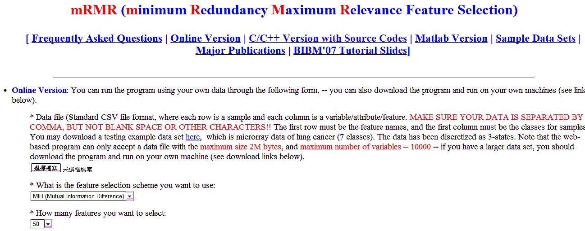
mRMR feature selection
http://penglab.janelia.org/proj/mRMR/

Slide 27
mRMR feature selection
D:\sw\mrmr>mrmr_win32.exe
Usage: mrmr_osx -i <dataset> -t <threshold> [optional arguments]
-i <dataset> .CSV file containing M rows and N columns, row - sample, column - variable/attribute.
-t <threshold> a float number of the discretization threshold; non-specifying this parameter means no discretizaton (i.e. data is already integer); 0 to make binarization.
-n <number of features> a natural number, default is 50.
-m <selection method> either "MID" or "MIQ" (Capital case), default is MID.
-s <MAX number of samples> a natural number, default is 1000. Note that if you don't have or don't need big m emory, set this value small, as this program will use this value to pre-allocate memory in data file reading.
-v <MAX number of variables/attibutes in data> a natural number, default is 10000. Note that if you don't have or don't need big memory, set this value small, as this program will use this value to pre-allocate memory in data file reading.
[-h] print this message.
*** This program and the respective minimum Redundancy Maximum Relevance (mRMR)
algorithm were developed by Hanchuan Peng <hanchuan.peng@gmail.com>for
the paper
"Feature selection based on mutual information: criteria of
max-dependency, max-relevance, and min-redundancy,"
Hanchuan Peng, Fuhui Long, and Chris Ding,
IEEE Transactions on Pattern Analysis and Machine Intelligence,
Vol. 27, No. 8, pp.1226-1238, 2005.

Slide 28
mRMR feature selection
D:\sw\mrmr>mrmr_win32.exe -i test_lung_s3.csv -n 5
You have specified parameters: no discretization, #fea=5 selection method=MID #maxVar=10000 #maxSample=1000
Target classification variable (#1 column in the input data) has name=class entropy score=2.591
*** MaxRel features ***
Order Fea Name Score
1 23 v23 0.773
2 11 v11 0.766
3 20 v20 0.756
4 30 v30 0.748
5 151 v151 0.736
*** mRMR features ***
Order Fea Name Score
1 23 v23 0.773
2 126 v126 0.555
3 244 v244 0.567
4 133 v133 0.533
5 243 v243 0.538
*** This program and the respective minimum Redundancy Maximum Relevance (mRMR)
algorithm were developed by Hanchuan Peng <hanchuan.peng@gmail.com>for
the paper
"Feature selection based on mutual information: criteria of
max-dependency, max-relevance, and min-redundancy,"
Hanchuan Peng, Fuhui Long, and Chris Ding,
IEEE Transactions on Pattern Analysis and Machine Intelligence,
Vol. 27, No. 8, pp.1226-1238, 2005.

Slide 29
練習
利用前述簡單線性分類器繪製決策邊界與簡單機率分佈(可以徒手畫/算)(資料與參考步驟如下)
Class x1 x2
[-1. , 0.5, 0.4]
[-1. , 0.5, 0.2]
[-1. , 0.2, 0.3]
[-1. , 0.7, 0.2]
[-1. , 0.2, 0.4]
[ 1. , 0.7, 0.8]
[ 1. , 0.7, 0.9]
[ 1. , 0.0, 0.7]
[ 1. , 0.4, 0.8]
[ 1. , 0.2, 0.7]

Slide 30

練習(參考步驟)
先計算迴歸公式
繪製決策邊界圖y=-0.28x1+3.7x2-1.9=0
Notes:
import numpy
import numpy.linalg
data = [-1. , 0.5, 0.4, -1. , 0.5, 0.2, -1. , 0.2, 0.3, -1. , 0.7, 0.2, -1. , 0.2, 0.4, 1. , 0.7, 0.8, 1. , 0.7, 0.9, 1. , 0. , 0.7, 1. , 0.4, 0.8, 1. , 0.2, 0.7]
data = asarray(data).reshape((10,3))
def get_beta(x,y):
X = column_stack((x,[1]*len(x)));
return(lstsq(X,y))
#計算迴歸公式
beta12 = get_beta(data[:,(1,2)],data[:,0]);
predd12 = dot(column_stack((data[:,(1,2)],[1]*len(data))),beta12[0])
pred12 = sign(predd12)
column_stack((data[:,0],pred12,predd12))
#繪製決策邊界圖
fig = plt.figure()
ax = fig.add_subplot(111)
#ax.plot(data[0:5,1], data[0:5,2],'x', data[6:10,1], data[6:10,2],'o')
x_min=-0.1; x_max=0.8;
y_min = (-beta12[0][2]-beta12[0][0]*x_min) / beta12[0][1]
y_max = (-beta12[0][2]-beta12[0][0]*x_max) / beta12[0][1]
ax.plot(data[0:5,1], data[0:5,2],'x', data[6:10,1], data[6:10,2],'o',[x_min,x_max],[y_min,y_max],'r-')
leg = ax.legend(('class 1', 'class 2','Decision boundary'), 'upper lefy', shadow=True)
ax.set_ylim([0,1]); ax.set_xlim([x_min,x_max]);
ax.grid(False)
ax.set_xlabel('x1'); ax.set_ylabel('x2')
ax.set_title('Distribution of 2 classes')

Slide 31
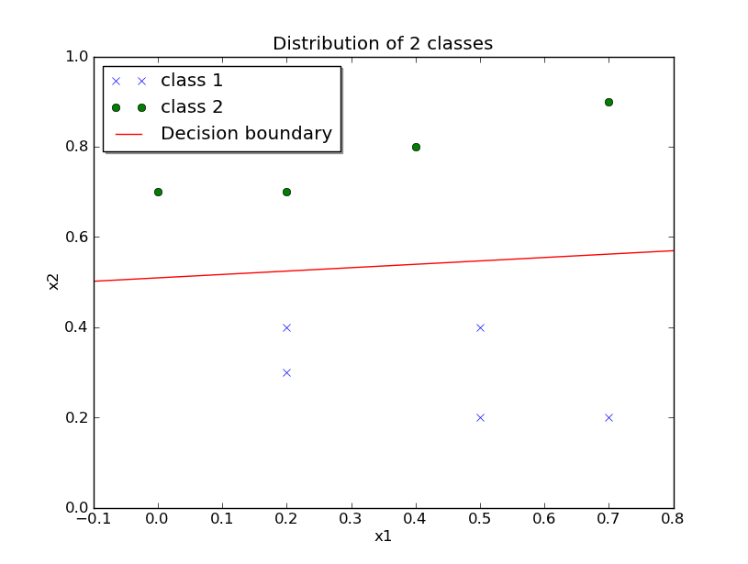
練習(參考步驟)
繪製決策邊界圖y=-0.28x1+3.7x2-1.9=0
Notes:
import numpy
import numpy.linalg
data = [-1. , 0.5, 0.4, -1. , 0.5, 0.2, -1. , 0.2, 0.3, -1. , 0.7, 0.2, -1. , 0.2, 0.4, 1. , 0.7, 0.8, 1. , 0.7, 0.9, 1. , 0. , 0.7, 1. , 0.4, 0.8, 1. , 0.2, 0.7]
data = asarray(data).reshape((10,3))
def get_beta(x,y):
X = column_stack((x,[1]*len(x)));
return(lstsq(X,y))
#計算迴歸公式
beta12 = get_beta(data[:,(1,2)],data[:,0]);
predd12 = dot(column_stack((data[:,(1,2)],[1]*len(data))),beta12[0])
pred12 = sign(predd12)
column_stack((data[:,0],pred12,predd12))
#繪製決策邊界圖
fig = plt.figure()
ax = fig.add_subplot(111)
#ax.plot(data[0:5,1], data[0:5,2],'x', data[6:10,1], data[6:10,2],'o')
x_min=-0.1; x_max=0.8;
y_min = (-beta12[0][2]-beta12[0][0]*x_min) / beta12[0][1]
y_max = (-beta12[0][2]-beta12[0][0]*x_max) / beta12[0][1]
ax.plot(data[0:5,1], data[0:5,2],'x', data[6:10,1], data[6:10,2],'o',[x_min,x_max],[y_min,y_max],'r-')
leg = ax.legend(('class 1', 'class 2','Decision boundary'), 'upper left', shadow=True)
ax.set_ylim([0,1]); ax.set_xlim([x_min,x_max]);
ax.grid(False)
ax.set_xlabel('x1'); ax.set_ylabel('x2')
ax.set_title('Distribution of 2 classes')

Slide 32
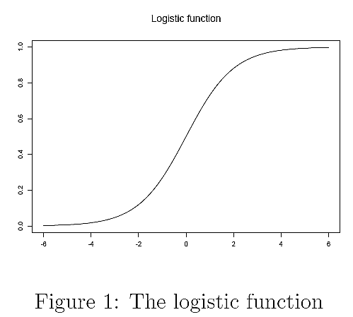
練習(參考步驟)
利用logistic function來近似機率p
p
用(o,p)=(0,0.5)來二分
x^{T}β

Slide 33
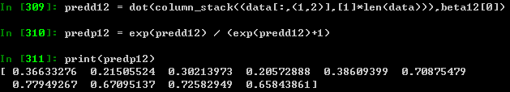
練習(參考步驟)
由於p/(1-p)=exp(β^{T}x)，p值為exp(β^{T}x)/(1+exp(β^{T}x))
Class x1 x2
[-1. , 0.5, 0.4]
[-1. , 0.5, 0.2]
[-1. , 0.2, 0.3]
[-1. , 0.7, 0.2]
[-1. , 0.2, 0.4]
[ 1. , 0.7, 0.8]
[ 1. , 0.7, 0.9]
[ 1. , 0.0, 0.7]
[ 1. , 0.4, 0.8]
[ 1. , 0.2, 0.7]
這代表屬於類別1的近似機率
Notes:
predd12 = dot(column_stack((data[:,(1,2)],[1]*len(data))),beta12[0])
predp12 = exp(predd12) / (exp(predd12)+1)
print(predp12)

Slide 34
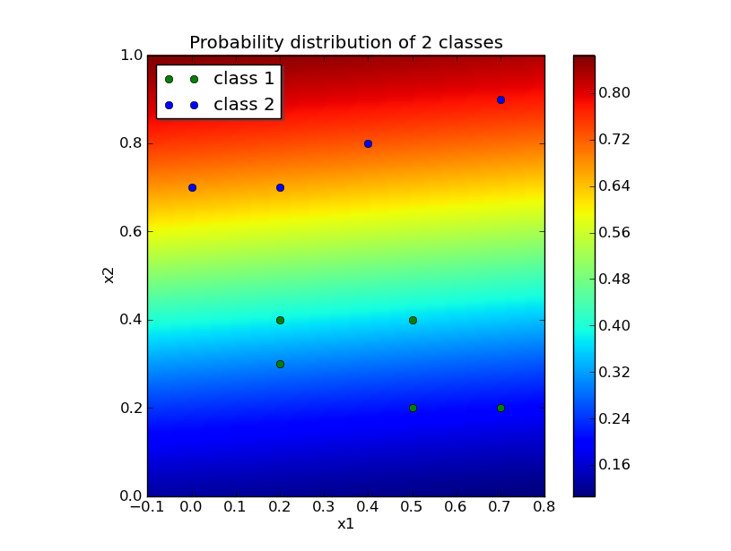
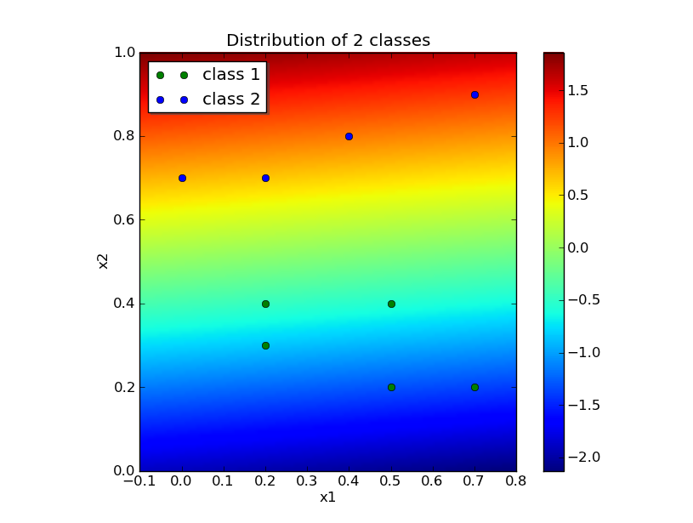
練習(參考步驟)
Notes:
#繪製機率圖
import numpy
import numpy.linalg
import matplotlib.pyplot as plt
data = [-1. , 0.5, 0.4, -1. , 0.5, 0.2, -1. , 0.2, 0.3, -1. , 0.7, 0.2, -1. , 0.2, 0.4, 1. , 0.7, 0.8, 1. , 0.7, 0.9, 1. , 0. , 0.7, 1. , 0.4, 0.8, 1. , 0.2, 0.7]
data = asarray(data).reshape((10,3))
def get_beta(x,y):
X = column_stack((x,[1]*len(x)));
return(lstsq(X,y))
#計算迴歸公式
beta12 = get_beta(data[:,(1,2)],data[:,0]);
predd12 = dot(column_stack((data[:,(1,2)],[1]*len(data))),beta12[0])
pred12 = sign(predd12)
column_stack((data[:,0],pred12,predd12))
fig = plt.figure()
ax = fig.add_subplot(111)
x_min=-0.1; x_max=0.8;
y_min = 0.0; y_max = 1.0
#ax.plot(data[0:5,1], data[0:5,2],'go', data[6:10,1], data[6:10,2],'bo')
#leg = ax.legend(('class 1', 'class 2'), 'upper left', shadow=True)
# define grid.
x1i = np.linspace(x_min,x_max,100)
x2i = np.linspace(y_min,y_max,100)
# grid the data.
x1i,x2i = meshgrid(x1i, x2i)
dim = x1i.shape
x1i = x1i.ravel(); x2i = x2i.ravel()
yi = dot(column_stack((x1i,x2i,[1]*len(x2i))),beta12[0])
yi = exp(yi) / (exp(yi)+1)
x1i = x1i.reshape(dim); x2i = x2i.reshape(dim); yi = yi.reshape(dim);
# contour the gridded data, plotting dots at the nonuniform data points.
#CS = plt.contour(x1i,x2i,yi,15,linewidths=0.5,colors='k')
#CS = plt.contourf(x1i,x2i,yi,15,cmap=plt.cm.jet)
imshow(yi,origin='lower',extent=(x_min,x_max,y_min,y_max))
plt.colorbar() # draw colorbar
ax.plot(data[0:5,1], data[0:5,2],'go', data[6:10,1], data[6:10,2],'bo')
leg = ax.legend(('class 1', 'class 2'), 'upper left', shadow=True)
ax.set_xlabel('x1'); ax.set_ylabel('x2')
ax.set_title('Probability distribution of 2 classes')
#決策邊界圖
import numpy
import numpy.linalg
import matplotlib.pyplot as plt
data = [-1. , 0.5, 0.4, -1. , 0.5, 0.2, -1. , 0.2, 0.3, -1. , 0.7, 0.2, -1. , 0.2, 0.4, 1. , 0.7, 0.8, 1. , 0.7, 0.9, 1. , 0. , 0.7, 1. , 0.4, 0.8, 1. , 0.2, 0.7]
data = asarray(data).reshape((10,3))
def get_beta(x,y):
X = column_stack((x,[1]*len(x)));
return(lstsq(X,y))
#計算迴歸公式
beta12 = get_beta(data[:,(1,2)],data[:,0]);
predd12 = dot(column_stack((data[:,(1,2)],[1]*len(data))),beta12[0])
pred12 = sign(predd12)
column_stack((data[:,0],pred12,predd12))
#繪製決策邊界圖
fig = plt.figure()
ax = fig.add_subplot(111)
x_min=-0.1; x_max=0.8;
y_min = 0.0; y_max = 1.0
#ax.plot(data[0:5,1], data[0:5,2],'go', data[6:10,1], data[6:10,2],'bo')
#leg = ax.legend(('class 1', 'class 2'), 'upper left', shadow=True)
# define grid.
x1i = np.linspace(x_min,x_max,100)
x2i = np.linspace(y_min,y_max,100)
# grid the data.
x1i,x2i = meshgrid(x1i, x2i)
dim = x1i.shape
x1i = x1i.ravel(); x2i = x2i.ravel()
yi = dot(column_stack((x1i,x2i,[1]*len(x2i))),beta12[0])
#yi = exp(yi) / (exp(yi)+1)
x1i = x1i.reshape(dim); x2i = x2i.reshape(dim); yi = yi.reshape(dim);
# contour the gridded data, plotting dots at the nonuniform data points.
#CS = plt.contour(x1i,x2i,yi,15,linewidths=0.5,colors='k')
#CS = plt.contourf(x1i,x2i,yi,15,cmap=plt.cm.jet)
imshow(yi,origin='lower',extent=(x_min,x_max,y_min,y_max))
plt.colorbar() # draw colorbar
ax.plot(data[0:5,1], data[0:5,2],'go', data[6:10,1], data[6:10,2],'bo')
leg = ax.legend(('class 1', 'class 2'), 'upper left', shadow=True)
ax.set_xlabel('x1'); ax.set_ylabel('x2')
ax.set_title('Distribution of 2 classes')

