Slide 1
An almost linear time and linear space algorithm for the longest common subsequence problem
J.Y. Guo and F.K. Wang
Information Processing Letters 94 (2005) 131–135
Presenter: Yung-Hsing Peng
Date: 2005.01.19

Slide 2
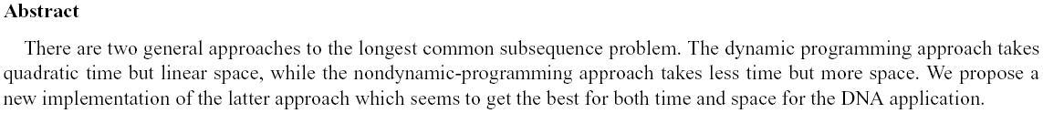

Slide 3
Basic Idea
LIS can be solved in O(nlogn) time by RSK algorithm.
By extending the idea of RSK, Hunt and Szymanski proposed an algorithm to solve LCS in O(rlogn) time, where r is the number of matches.→ worst case O(n²logn)
In this paper, the authors propose an O(nL) time and O(n) space implementation for the Hunt and Szymanski’s algorithm, where L is length of LCS.

Slide 4
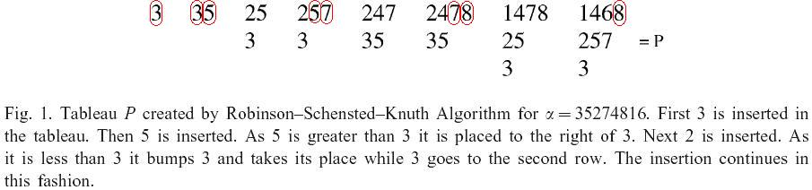
Robinson-Schensted-Knuth Algorithm
Main idea: Keep the best tail for each length of increasing sequence.
We can trace the LIS using an implicit tree if we record the left neighbor of when an element is inserted.

Slide 5
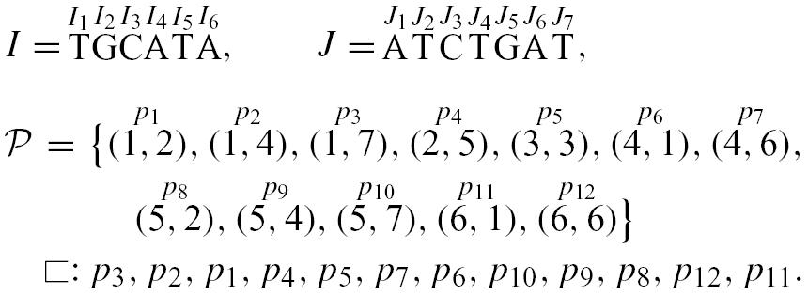
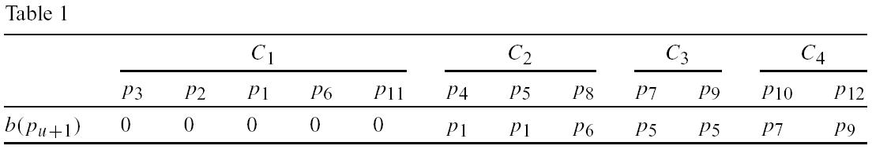
Hunt-Szymanki’s Algorithm
Main idea: Keep the best tail for each length of common sequence.
b(p_{u+1}) records the previous pair of p_{u+1}

Slide 6
Improvement
In Hunt-Szymanski algorithm, each pair of matches must be inserted and each insert takes O(logn) time.
→ If |Σ| is finite, then we can locate each matches in constant time with preprocessing. By doing so, we can skip all useless matches and only spend O(L) time inserting a letter in I.

Slide 7
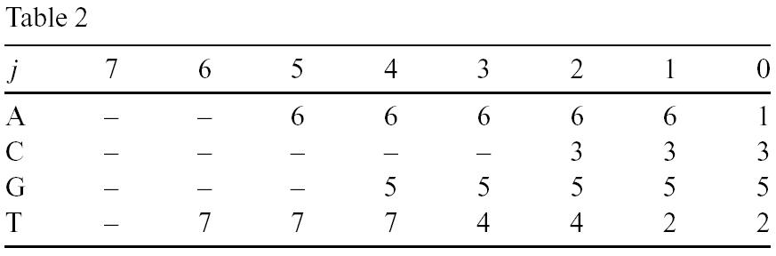
Example for Guo-Wang’s Implementation (1/2)
I = TGCATA, J = ATCTGAT
The above table records the location of nearest “A” “G” “C” “T” at the right ride of a given location j in J.
→ This can be done in O(|Σ|n)

Slide 8
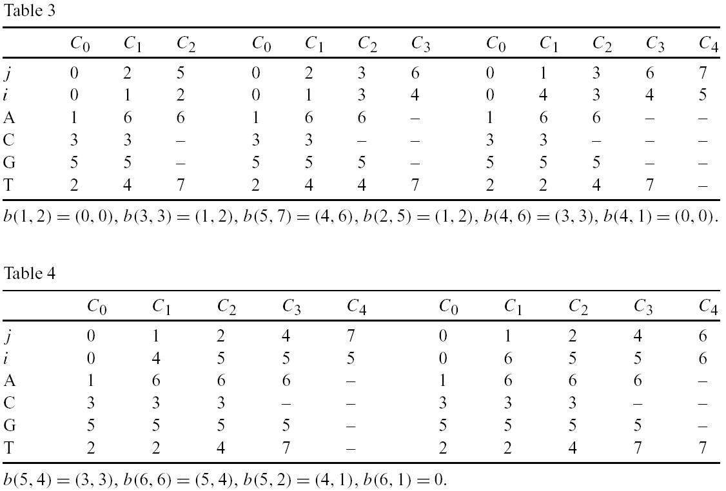
Example for Guo-Wang’s Implementation (2/2)
Each block represents the best paths before each replacement.

Slide 9
Discussion
(1)In Guo and Wang’s implementation, there are |I| letters to add.
(2)It costs O(L) time for adding a letter.
→ Time complexity O(nL)
→ Space complexity??? O(n)? O(L²)?

