Slide 1
An 8/13-Approximation Algorithm for the Asymmetric Maximum TSP
Markus Blaser
Journal of Algorithms, Vol. 50, 2004, pp. 23-48
Date: Feb. 17, 2006
Introducer: Hsing-Yen Ann

Slide 2


Abstract
We present a polynomial time approximation algorithm for the asymmetric maximum traveling salesperson problem that achieves performance ratio . The running time of our algorithm is .

Slide 3


The TSP Problems
NP-hard and hard to approximate
Min TSP (triangle inequality, symmetric):
Min TSP (triangle inequality, asymmetric):
Max TSP in this paper:
  Without triangle inequality
  Asymmetric weight function
  Find a longest Hamiltonian tour

Slide 4




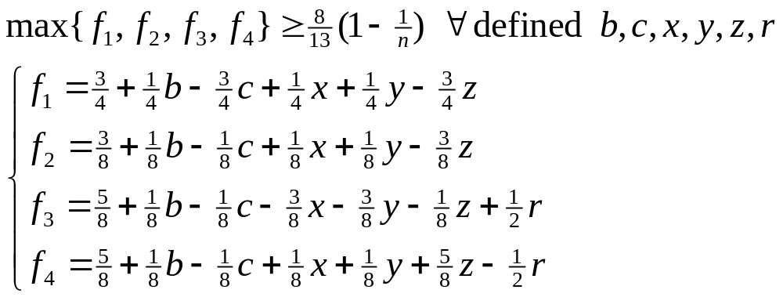
Algorithms
Previous results
  Fisher et al. (1979):
  Kosaraju et al. (1994):
  Lewenstein et al. (2003):
Four algorithms in this paper,

Slide 5
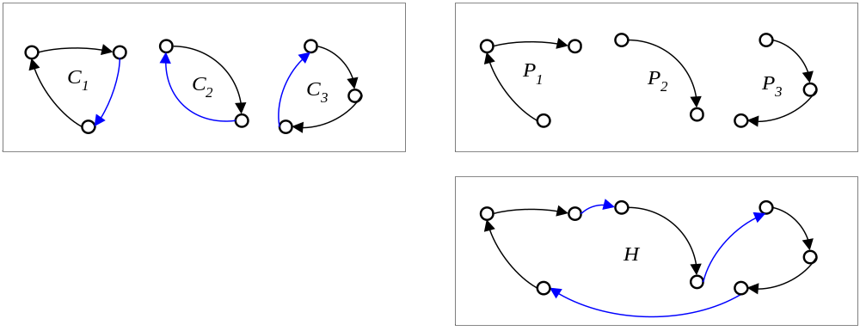
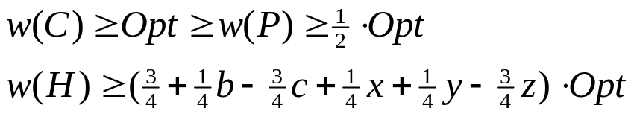
Algorithm 1
(1) Compute a maximum weight cycle cover C of G.
(2) Discard the lightest edge of each cycle in C.
(3) Join the disjoint paths arbitrarily.

Slide 6
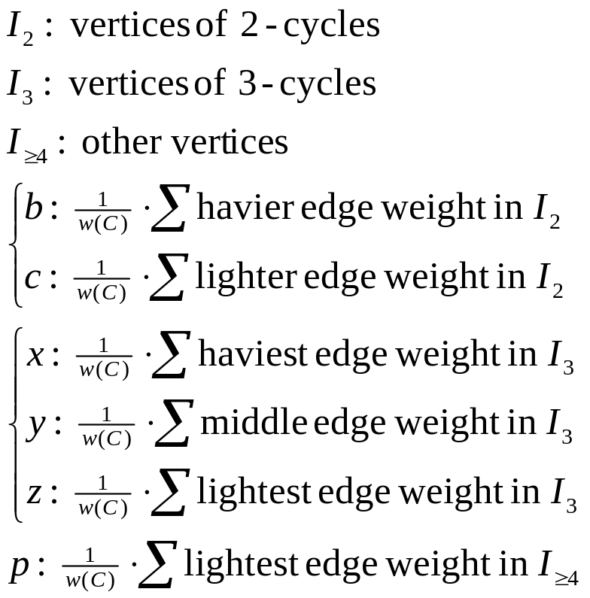
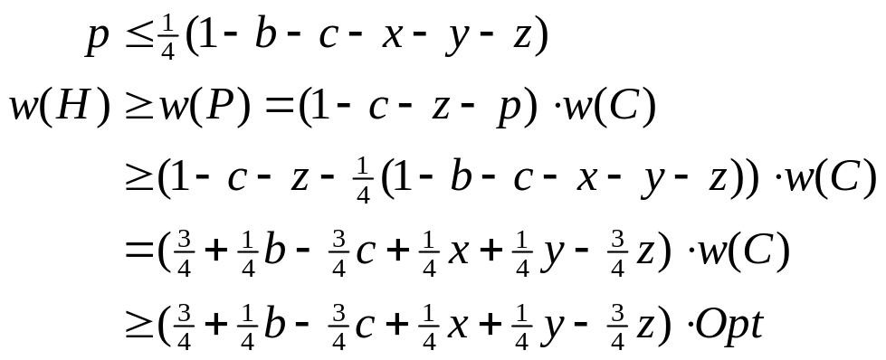
Analysis of Algorithm 1

Slide 7
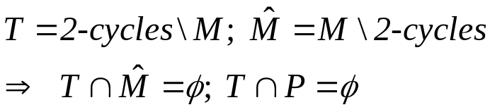


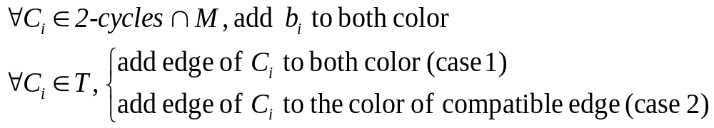
Algorithm 2
(1) Compute a maximum weight cycle cover C of G (w-weight)
(2) Compute the new weight function w' on G
(3) Compute a perfect matching M of G (w'-weight)
(4) Discard the lightest edge of k-cycles (k>2), form paths P
(5)
(6) contains disjoint paths; 2-coloring
(7)
(8) Choose the heavier color and join the disjoint paths arbitrarily.

Slide 8
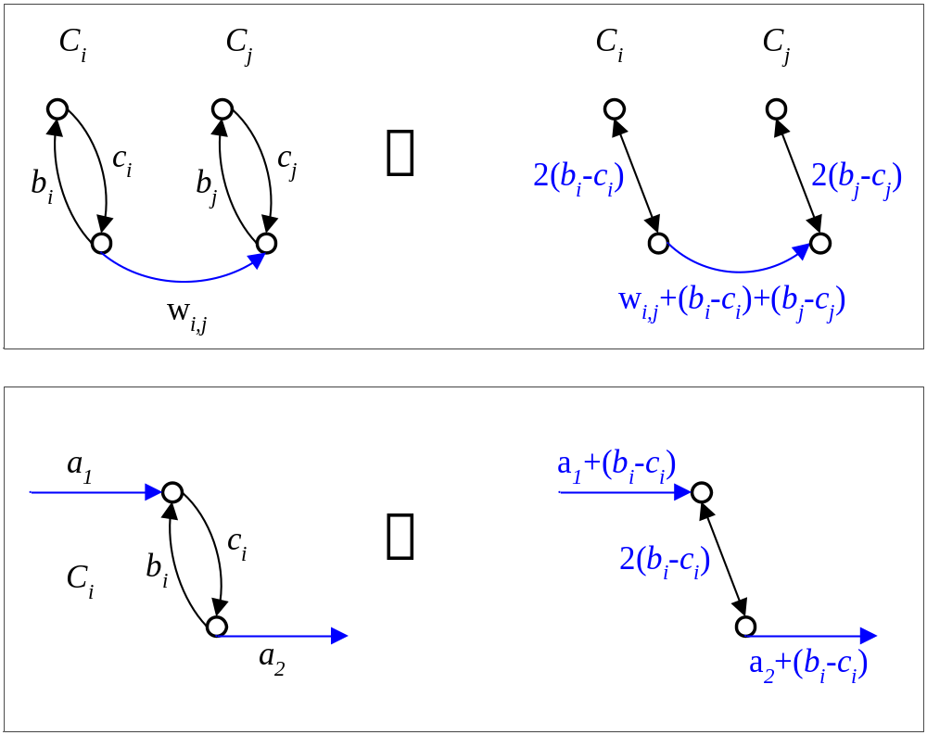
Step2: New Weight Function w' on G
Consider the edges of 2-cycles and their neighbor edges

Slide 9
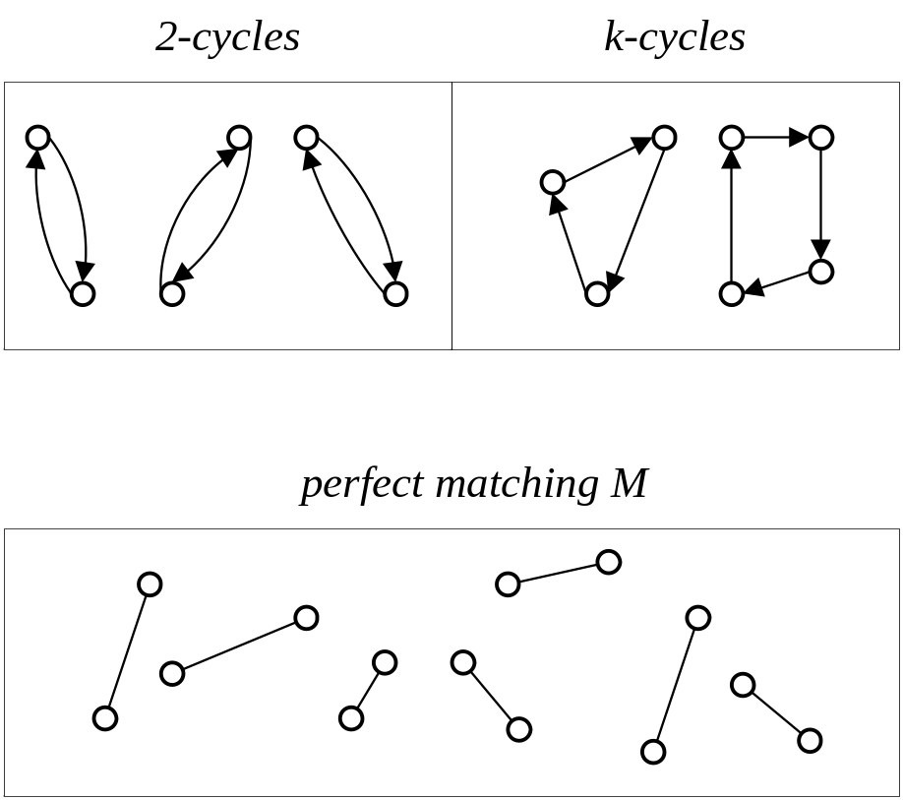
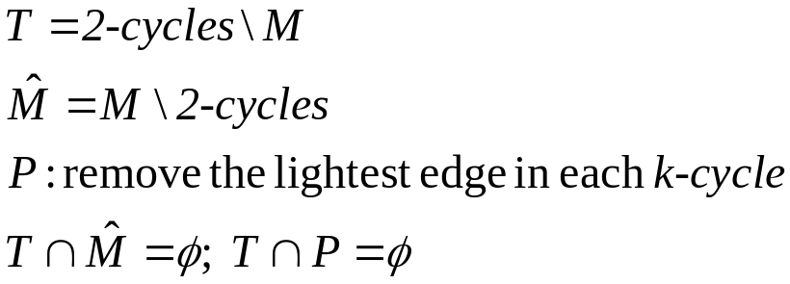
Definitions in Algorithm 2

Slide 10
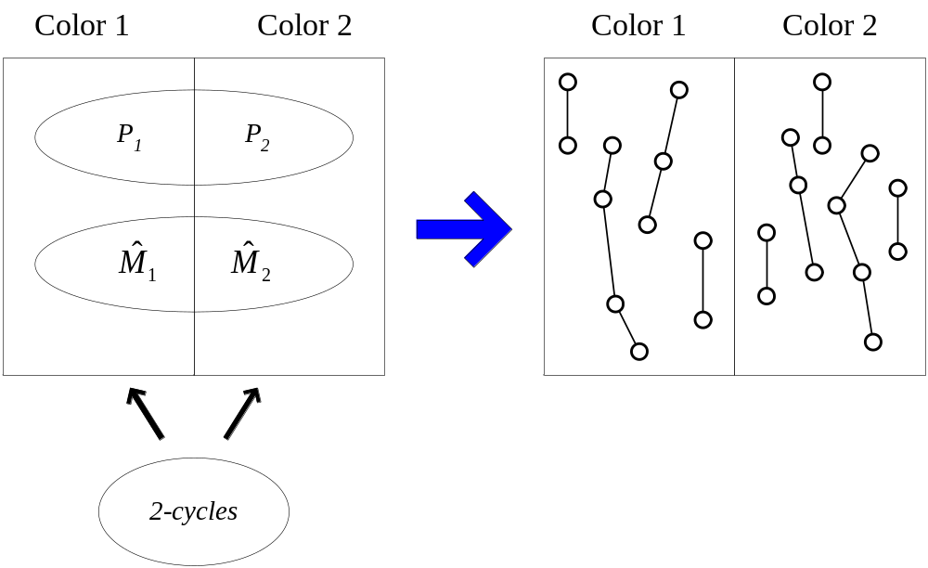
Step7: Coloring

Slide 11



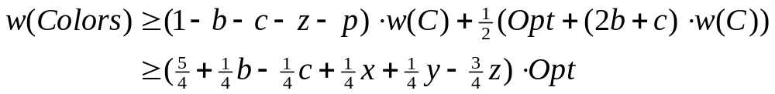
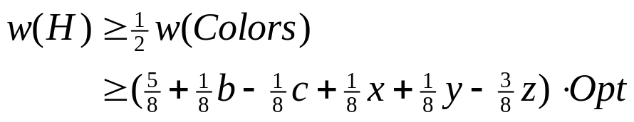
Analysis of Algorithm 2
P:
M: (on weight w')
Transform w' to w (after step 7)
Total weight in both colors:

Slide 12


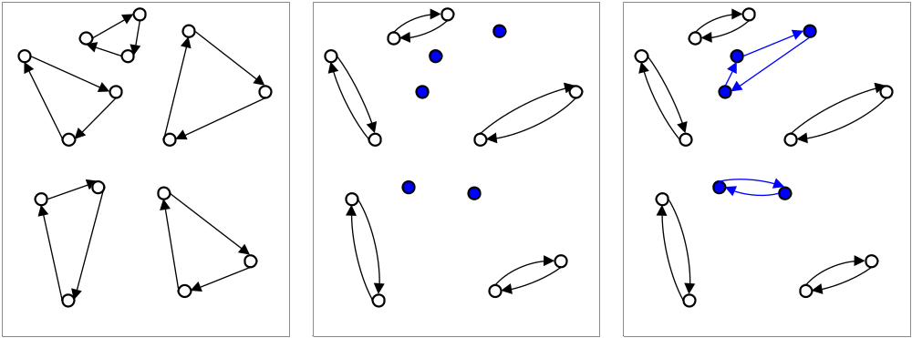
Algorithm 3
(1) Compute a maximum weight cycle cover C of G.
(2) Replace each 3-cycle by a 2-cycle ( ).
Forming new cycles arbitrarily with the remaining nodes.
(3) Run Algorithm 2 with the new cycle cover .

Slide 13
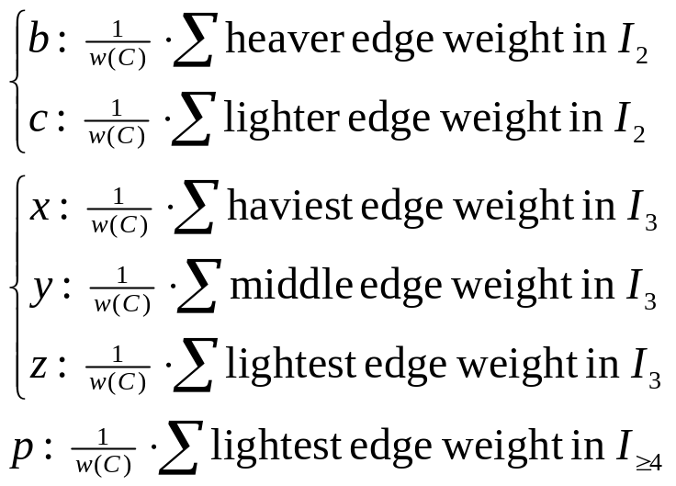
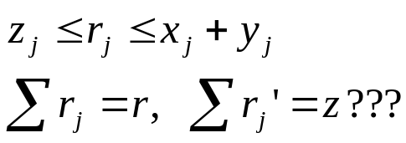
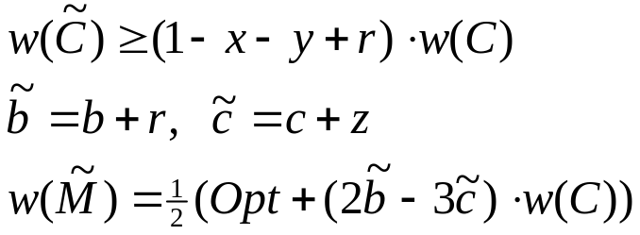
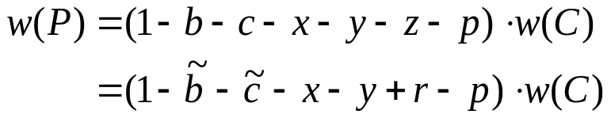
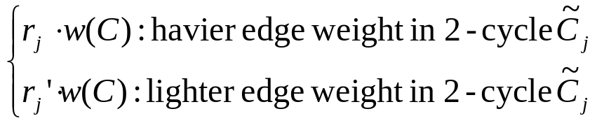
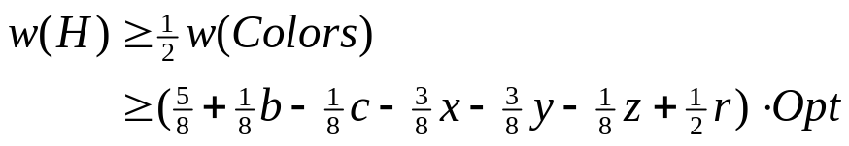
Analysis of Algorithm 3

Slide 14
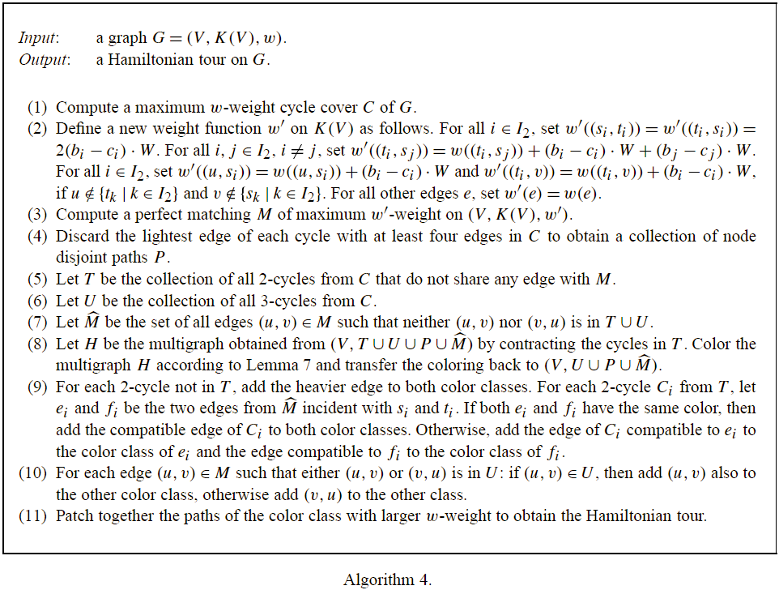
Algorithm 4

Slide 15

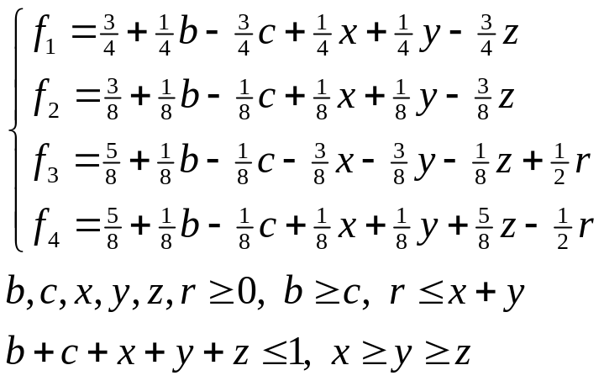
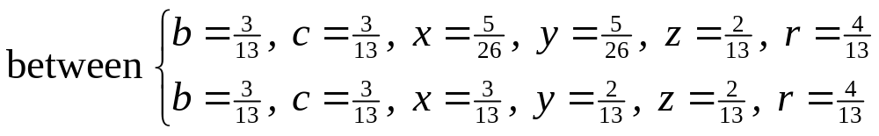

Overall Analysis
Minimize , where
Solved by a computer algebra system, it is attained for

