Slide 1
A fast algorithm for computing a longest common increasing subsequence
Information Processing Letters 93 (2005) 249-253
I-Hsuan Yang, Chien-Pin Huang, Kun-Mao Chao
Presenter: Jen-Hui Wang
Date:2006.2.17

Slide 2
Abstract

Slide 3
A straightforward algorithm
To sort the shorter sequence, and then find a longest common subsequence among the two sequences and the sorted sequence.
Time complexity: O(mn²)

Slide 4
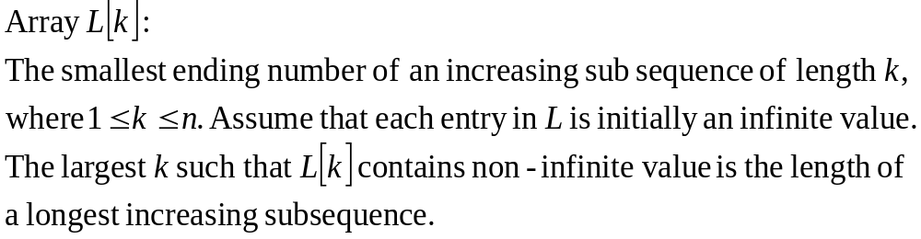
The algorithm
The array L will be explored between every pair of the prefix substrings of the two sequences.
We use linear search by a given starting point to update the array L.

Slide 5



The algorithm (cont.)

Slide 6
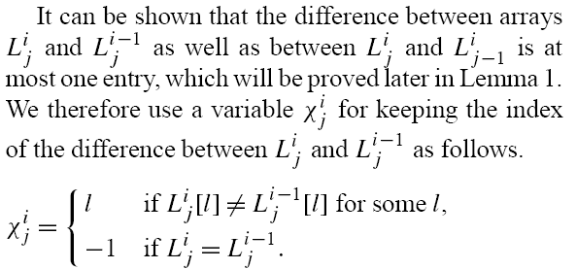

The algorithm (cont.)

Slide 7

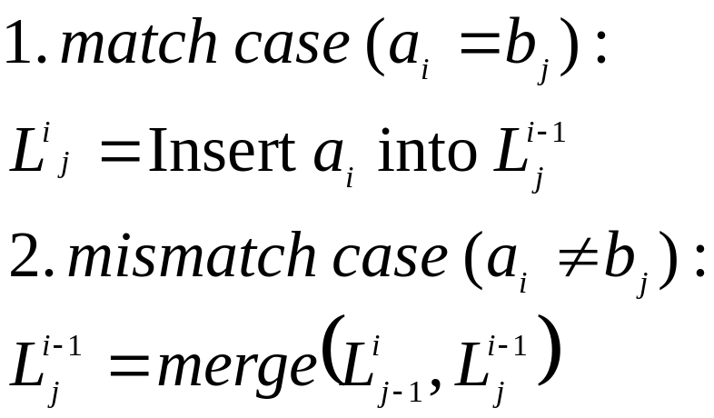
The algorithm (cont.)

Slide 8
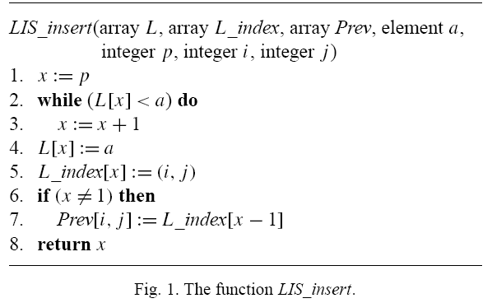
The algorithm (cont.)

Slide 9
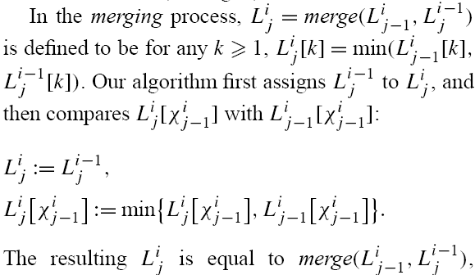
The algorithm (cont.)

Slide 10
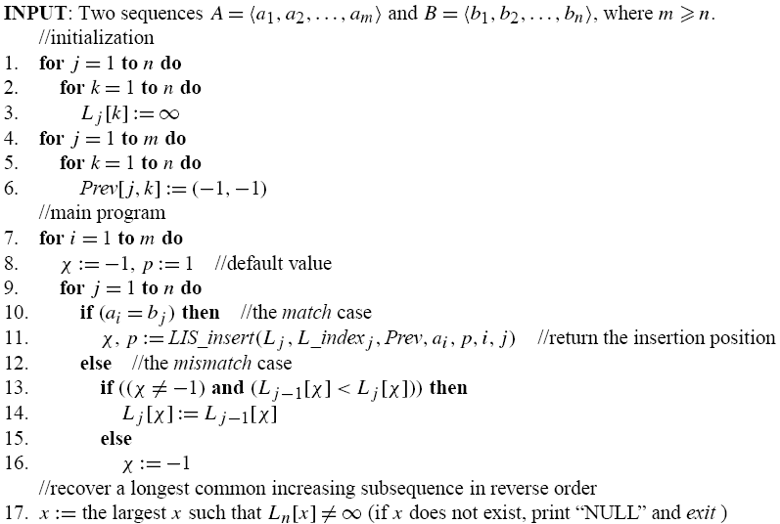
The algorithm (cont.)

Slide 11

The algorithm (cont.)

Slide 12






Example
A = 13245 B = 53124
index 0 1 2 3 4 5
index 0 1 2 3 4 5
 |  | 5 | 3 | 1 | 2 | 4
 | ∞ | ∞ | ∞ | ∞ | ∞ | ∞
1 | ∞
3 | ∞
2 | ∞
4 | ∞
5 | ∞
∞
∞
1
1
1
∞
3
1
1
1
2
∞ 3 1
2
∞ 3 1 2
4
5 3 1 2 4

Slide 13
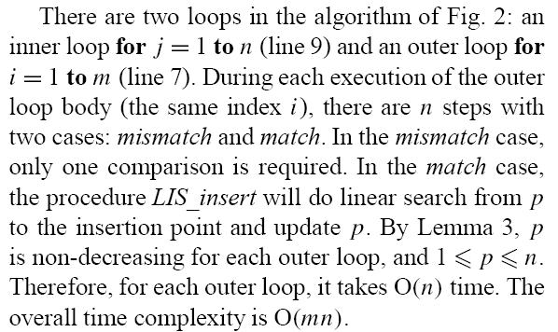
Time complexity

Slide 14
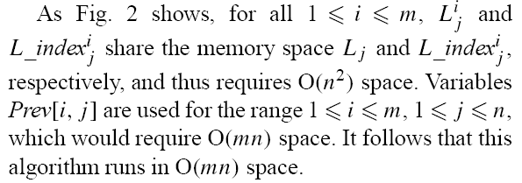
Space complexity

Slide 15
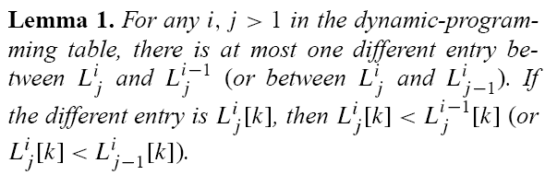
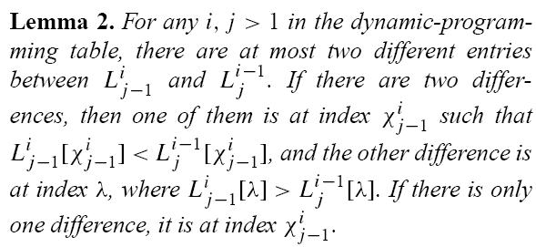
Correctness

Slide 16
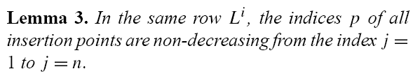
Correctness (cont.)

