Slide 1
CTSS: A Robust and Efficient Method for Protein Structure Alignment Based on Local Geometrical and Biological Features
Tolga Can and Yuan-Fang Wang
Proceedings of the Computational Systems Bioinformatics (CSB’03) 0-7695-2000-6/03 2003 IEEE
Created by Yu-Chieh Lo
Date: Mar. 3, 2006

Slide 2
abstract
We present a new method for conducting protein structure similarity searches, which improves on the accuracy, robustness, and efficiency of some existing techniques. Our method is grounded in the theory of differential geometry on 3D space curve matching. We generate shape signatures for proteins that are invariant, localized, robust, compact, and biologically meaningful. To improve matching accuracy, we smooth the noisy raw atomic coordinate data with spline fitting. To improve matching efficiency, we adopt a hierarchical coarse-to-fine strategy. We use an efficient hashing-based technique to screen out unlikely candidates and perform detailed pairwise alignments only for a small number of candidates that survive the screening process.

Slide 3
abstract
Contrary to other hashing based techniques, our technique employs domain specific information (not just geometric information) in constructing the hash key, and hence, is more tuned to the domain of biology. Furthermore, the invariancy, localization, and compactness of the shape signatures allow us to utilize a well-known local sequence alignment algorithm for aligning two protein structures. One measure of the efficacy of the proposed technique is that we were able to discover new, meaningful motifs that were not reported by other structure alignment methods.

Slide 4
methods
The main steps of our method can thus be summarized as follows:
For each protein in the database (an off-line process):
1. Calculate a spline fitting to best approximate the
positions of the Cα atoms.
2. Compute, for each residue, curvature and torsion
values at the Cα positions along the spline. The
secondary structure assignment of that residue is also
recorded in the signature.
3. Compute a hash key based on the signature and store
that in a hash table.

Slide 5
methods
For a query protein (an on-line process):
1. Repeat steps 1 to 2 above and use the shape signature to
screen the candidates from the hash table. Perform the
following steps only for the candidates surviving the screening
process.
2. For two proteins (a candidate database protein and
the query), construct the normalized scoring matrix based on
the distances between extracted features.
3. Run Smith-Waterman local sequence alignment algorithm on
the scoring matrix.
4. Superimpose the corresponding residues using a fast least-
squares solution .
5. Report results in an interactive visual form.

Slide 6

Spline Approximation
To construct a smoothing spline best approximating those points, we use the Java AppLib package which is an approximation library for Java.
The library package constructs the quintic smoothing spline, C(t), to given data, σ(ti), i = 0 , …, n − 1 , where n is the size of the Cα backbone
The method also ensures that the constructed spline does not deviate from the input data more than a given threshold by satisfying the following equation:
where wi are positive weights, and ε is
the maximum allowed deviation level.
helices:w=0.2,strands:w=0.4,turns:w=2.0

Slide 7
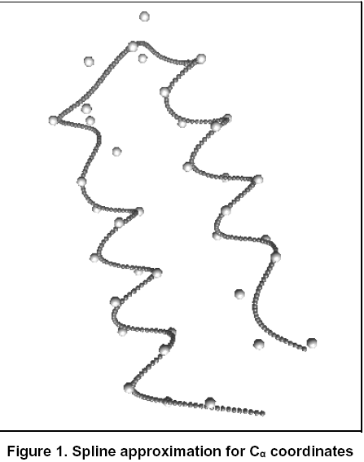
Figure 1 shows an example of approximating 3D quintic spline for a small protein (1EI0:A), where individual spheres represent the Cα atoms and the dark colored 3D curve passing through them is the constructed smoothing spline.

Slide 8



Feature Extraction
In other words, the curvature of a point on the curve denotes how rapidly the curve pulls away from the tangent at that point, or how non-colinear a curve is.
Similarly, the torsion of a point on the curve denotes how rapidly the curve pulls away from the osculating plane at that point [6], or how non-planar a curve is.

Slide 9
Feature Extraction
We compute the average curvature and torsion in a close neighborhood of a residue.
We also use the secondary structure assignment of a residue as a structural feature.
The signature value regarding the secondary structure assignment is one of the helix, turn, or strand.

Slide 10
Hashing for Fast Retrieval of Candidates
After the feature extraction phase, we perform a quantization and normalization procedure on the curvature and torsion values.
We create a three dimensional hash table for curvature, torsion, and secondary structure type.
To ensure a robust and reliable retrieval of candidates, the resolution of the hash table must be judicially chosen.
The coarser the resolution, the smaller the size of the hash table gets.
However, coarser resolutions reduce the discriminating power of the curvature-torsion descriptor and result in more false positive candidates surviving the screening process.
On the other hand, finer resolutions increase the size of the hash table.

Slide 11
Hashing for Fast Retrieval of Candidates
For each signature triplet, (κ, τ, ss), we compute a hash key, which is simply (κ/4, τ/4, ss).
By using that key as an index to the hash table, we store the signature triplet into the hash table along with its host protein chain identifier and its residue number.
This process is executed offline for each protein in the database.
For each residue of the query protein, we compute a hash key using its signature triplet, (κp/4, τp/4, ssp). We retrieve the hash table entry indexed by that key.

Slide 12
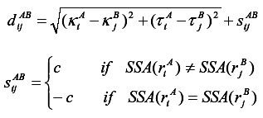

Pairwise Comparison
We perform pairwise comparison only for the candidates surviving the screening process.
The distance matrices we compute are the signature distance matrices between two proteins.

Slide 13
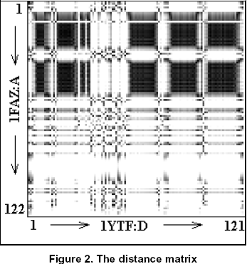
Pairwise Comparison
Figure 2 shows an example distance matrix for the shape signature relationships between the proteins 1FAZ:A and 1YTF:D. Darker regions indicate higher similarity of signatures

Slide 14

Pairwise Comparison
We convert those distance values to normalized score values in the interval [low, high] to be used by the local alignment in the dynamic programming phase.
This is done by using the following equation:
We then run the dynamic programming algorithm for sequence alignment by Smith and Waterman using the dynamically computed and normalized scoring matrix.

Slide 15
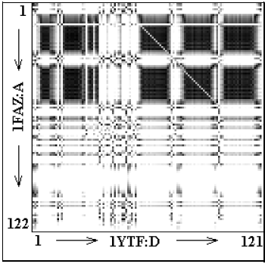
Pairwise Comparison
Figure 3 shows the best local alignment of 1FAZ and 1YTF on the distance matrix and the detection of a HTH motif shared between those structures

Slide 16

Pairwise Comparison
However, the best local alignment returned by the algorithm is not guaranteed to be the best structural alignment.
Thus, we superimpose the query protein on the database protein and check the RMSD values of a number of best local alignments to obtain the best local alignment.
We use a fast least-squares solution to superimpose an ordered corresponding set of points in 3D space.
We assign a score to each alignment by using the following equation:

Slide 17
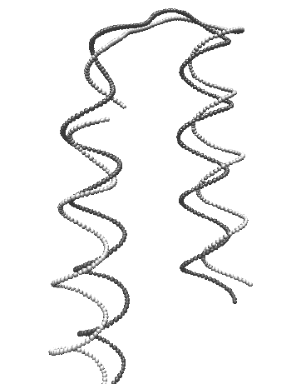
Pairwise Comparison
Figure 4 shows the superimposed result of the best local alignment found for 1FAZ:A and 1YTF:D

Slide 18
Experiments
The PDBSELECT database is a subset of the structures in the PDB that does not contain homologue sequences, i.e. no two proteins have more than 25% sequence identity.
Low sequence homologues present challenges to structure alignment algorithms, as it is not possible to use sequence similarity to predict structure similarity.
There are 1949 protein chains in that representative database (December 2002 version)
The total number of residues in the representative database was 314165.

Slide 19
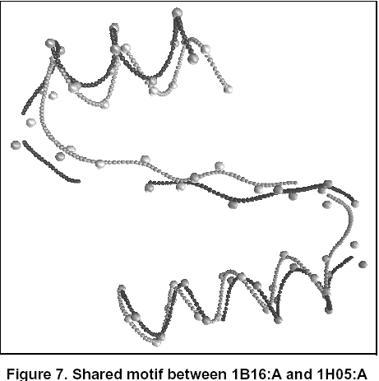
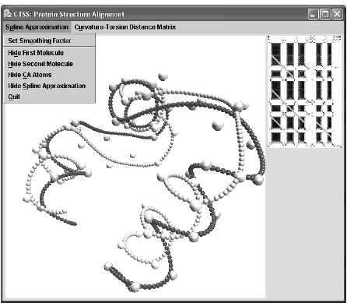
Experiments

