Slide 1
MASS: multiple structural alignment by secondary structures
O. Dror , H. Benyamini , R. Nussinov , and H. Wolfson
Vol. 19 , Suppl. 1 2003, pp. i95–i104
DOI: 10.1093/bioinformatics/btg1012
Presenter: Chung-Han Chiang
Date: Nov. 15, 2006 <number>

Slide 2
ABSTRACT
We present a novel method for multiple alignment of protein structures and detection of structural motifs. To date, only a few methods are available for addressing this task. Most of them are based on a series of pairwise comparisons.
In contrast, MASS (Multiple Alignment by Secondary Structures) considers all the given structures at the same time. Exploiting the secondary structure representation aids in filtering out noisy results and in making the method highly efficient and robust.
MASS disregards the sequence order of the secondary structure elements. Thus, it can find non-sequential and even nontopological structural motifs. An important novel feature of MASS is subset alignment detection: It does not require that all the input molecules be aligned. Rather, MASS is capable of detecting structural motifs shared only by a subset of the molecules. Given its high efficiency and capability of detecting subset alignments, MASS is suitable for a broad range of challenging applications: It can handle large-scale protein ensembles (on the order of tens) that may be heterogeneous, noisy, topologically unrelated and contain structures of low resolution.

Slide 3
INTRODUCTION
pairwise structural alignment and Multiple structural alignment
(i) classification of existing and newly discovered proteins
(ii) gaining insights into evolutionary relations between proteins
(iii) structure prediction algorithms like homology modeling and threading
Multiple structural alignment and MASS
dynamic programming

Slide 4
The benefits of SSEs:
(i) Efficiency, (ii) Accuracy, and noise filtering.
MASS disregards the order of the SSEs along the polypeptide chain and therefore can find non-sequential and even non-topological alignments.

Slide 5
PROBLEM DEFINITION
The pairwise case:
We are given two proteins. Each protein is represented as a set of points in 3D space, where each point is associated with an atom’s position. The task is to find the largest set that is congruent to two subsets of points, one from each input set (i.e. protein). In computational geometry this problem is known as the largest common point set (LCP) problem.
P = {pi } and Q = {q j } are the two largest congruent subsets of the input sets, P = T (Q) = R(Q) + t where R is a 3 × 3 rotation matrix and t is a translation vector.
A more practical task is to find two subsets P and Q that are E-congruent. for a predefined > 0, the goal is to find the two largest subsets of the input sets, P and Q, and a rigid transformation, T, so that distance(P, T (Q)) < E.

Slide 6
The multiple case:
This problem is a variant of the multiple-LCP problem.
The multiple subset case:
The problem is further complicated by the requirement to find solutions, where only a subset of the input proteins is well aligned.

Slide 7
METHOD
Input: m proteins with two inputs:
(i) 3D coordinates of its atoms in PDB
(ii) the assignment of SSE types to each residue in PDB
Assume that {b1, b2, . . . , bk } is a set of E-congruent bases, taken from proteins Pi1, Pi2, . . . , Pik respectively. Pick the first base (b1) as a pivot and compute all the k − 1 rigid transformations between this base and each of the remaining ones. The resulting k − 1 dimensional vector of rigid transformations, (T12, T13, . . . , T1k) defines a multiple alignment between Pi1, Pi2, . . . , Pik .
The alignments in each cluster are merged together so that the core of the new alignment is the union of the cores of the original alignments. As a result, we get a smaller non-redundant set of global multiple alignments.

Slide 8
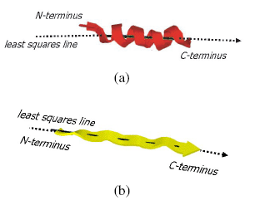
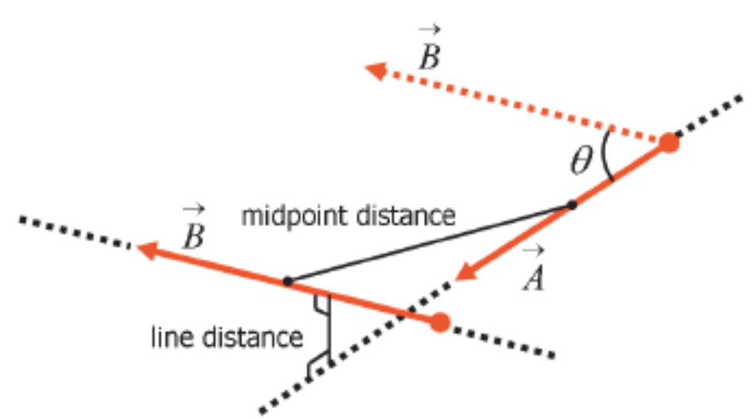
Detection of multiple base alignments: In this stage we
use Geometric Hashing to. The fingerprint is composed of: (i) the types of the two SSEs (i.e. helix or strand); (ii) the angle between their axial vectors; (iii) the midpoint-to-midpoint distance between their axes; and (iv) their line distance, which is the closest distance in space between their least-squares lines

Slide 9
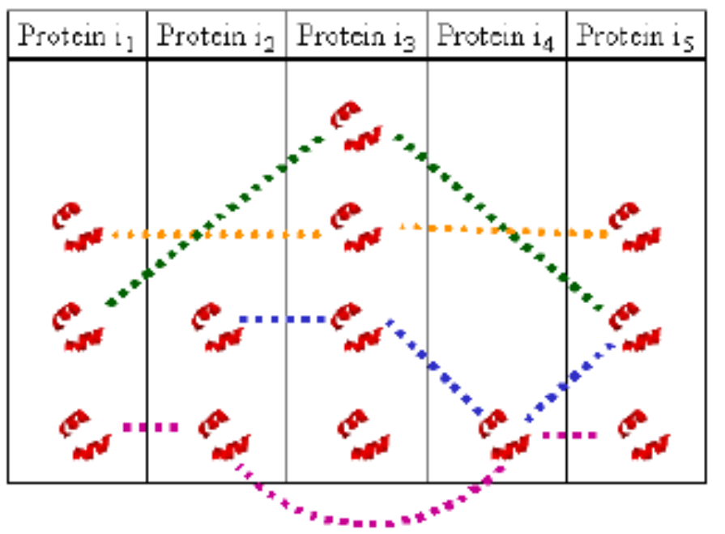
for each grid voxel, we retrieve all the bases in that voxel and in the adjacent voxels and group them into the same Base Bucket (BB)
BB(i ) as the set of all bases, stored in column i .
b1 = (S¹₁ , S¹₂) and b2 = b1 = (S²₁ , S²₂)
align b1 and b2 is to uniquely define an axis system on each base and superimpose the two axis systems. This alignment is useful especially when information about the protein atoms is not supplied and the only available information is about their secondary structures.

Slide 10
for each pair of proteins, we cluster the base alignments to find the ones with approximately the same transformation.
The match list of the new alignment is the union of the original match lists and its transformation is the one that aligns the atoms of the new match list with the smallest RMSD
The distance between two clusters is defined as the RMSD between the images of their transformations applied on an atom set, taken from the pivot protein. As long as the minimum distance between two clusters is below a predefined threshold, the two closest clusters are merged into a single cluster.

Slide 11
For each BB we compute the set of best multiple alignments in a recursive manner over its columns. The recursion works as follows: in each stage we have a set of multiple base alignments, obtained by the previous stage of the recursion. For each such alignment, (b1, . . . , bk), we check if there is a base, bk+1, from the current column that, when added to the alignment, will improve its score. The score of the multiple alignment is defined as k(^{l}₂) where k is number of aligned proteins and l is the core size. The core of the multiple alignment, Core(b1, . . . , bk+1), is Core(b1, . . . , bk)∩Core(b1, bk+1)
The returned set of multiple alignments at the end of this stage also contains trivial alignments, each with one base, for each base in the column. This means that each of the bases in the current column will also act as a pivot in a multiple alignment for the previous recursion calls.

Slide 12
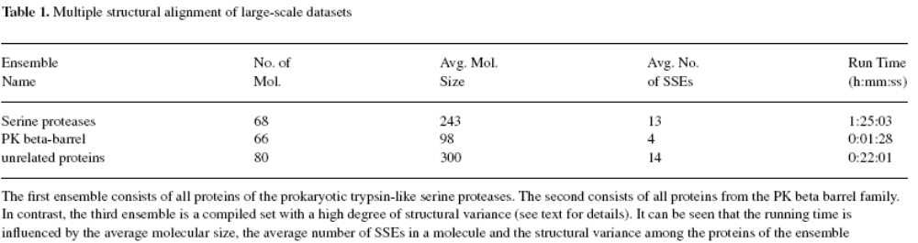
RESULT
Large-scale structural alignments
The results show that the running time is influenced by: (i) the number of molecules; (ii) the average molecular size (and the average number of SSEs in a molecule); and (iii) the structural variance among the molecules.

