Slide 1
TM-align: a protein structure alignment algorithm based on the TM-score
Yang Zhang and Jeffrey Skolnick*
2302–2309 Nucleic Acids Research, 2005, Vol. 33, No. 7
Presenter: Chiao-Wei Chiu (邱喬偉)
Date: Nov. 16, 2006

Slide 2
Abstract
We have developed TM-align, a new algorithm to identify the best structural alignment between protein pairs that combines the TM-score rotation matrix and Dynamic Programming (DP). The algorithm is 4 times faster than CE and 20 times faster than DALI and SAL. On average, the resulting structure alignments have higher accuracy and coverage than those provided by these most often-used methods. TM-align is applied to an all-against-all structure comparison of 10515 representative protein chains from the Protein Data Bank (PDB) with a sequence identity cutoff < 95%: 1996 distinct folds are found when a TM-score threshold of 0.5 is used.

Slide 3
Introduction
Need for fast and accurate structure comparison algorithms.
There are 2 types of comparisons for protein tertiary structures:
  Compare protein structures/models with an a priori specified equivalence between pairs of residues:
    RMSD (root-mean-square deviation)
    TM-score
  Compare a pair of structures where the alignment between equivalent residues is not a priori given: NP-hard problem with no exact solution
    CE, DALI, SAL

Slide 4
Method
Initial structural alignment
Heuristic Iteration
rotate the structures by the
TM-score rotation matrix
is stable?
No
Yes
done

Slide 5
Method – Initial structural alignment
TM-align only employs the backbone C_{α} coordinates of the given protein structures; however, the methodology is readily generalized to any type of atom.
  3 kinds of quickly identified initial alignments are exploited:
Aligning secondary structures (SSs) of two proteins using Dynamic Programming (DP):
  penalty = -1 work best
  ith residue is assigned as α (β) when
Gapless matching of two structures. As in SAL, for the smaller of the two compared proteins, we perform gapless threading against the larger structure, but rather than use RMSD as the comparison metric as was done in SAL, now the alignment with the best TM-score is selected.
DP using gap-opening penalty of -1, but the score matrix is a half/half combination of the SS score matrix and the distance score matrix selected in the second initial alignment.

Slide 6

Method - Heuristic Iteration
The above-obtained initial alignments are submitted to a heuristic iterative algorithm, which has been extensively used in refining NP-hard structure-based alignments (14,18,21).
In this procedure, we first rotate the structures by the TM-score rotation matrix (13) based on the aligned residues in the initial alignments. The score similarity matrix is defined as
  where d_{ij} is the distance of the ith residue in structure 1 and the jth residue in structure 2 under the TM-score superposition;
with L_{min} being the length of the smaller protein. A new alignment can be obtained by implementing DP on the matrix S(i, j) with an optimal gap-opening penalty of -0.6.
Because of the consistency of the TM-score based rotation
matrix and the DP similarity score, the alignments usually
converge very fast, and typically 2–3 iterations are enough
for the identification of the best alignment.

Slide 7
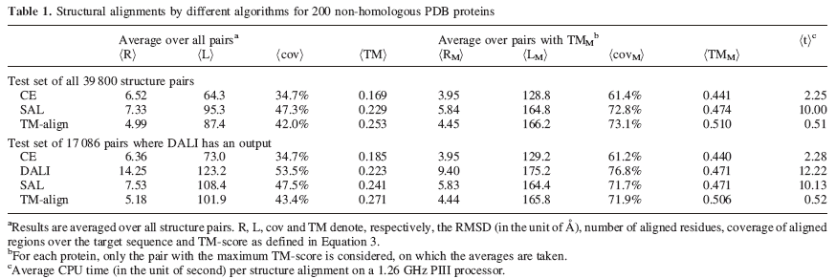
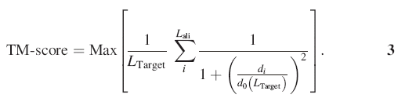
Results – Benchmark Test

Slide 8
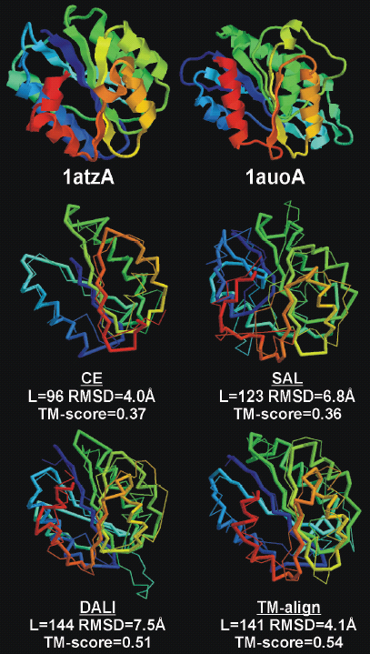
Example

Slide 9
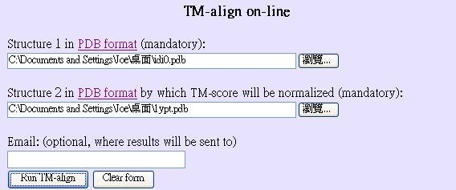
TM-align Online
Chain 1:A707003 Size= 148
Chain 2:B707003 Size= 278 (TM-score is normalized by 278)
Aligned length= 109, RMSD= 4.39, TM-score=0.28617, ID=0.074

Slide 10
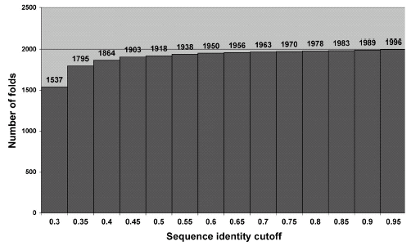
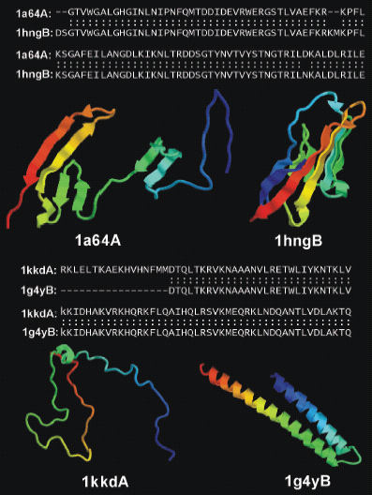
How many folds in PDB?
In the set of 10515 protein chains, TM-align found 52 protein pairs that have sequence identities >70% but have a TM-score <0.4.
  Two examples of protein pairs that have high sequence identities but adopt entirely different folds.

Slide 11
Discussion
The main difference:
  TM-score rotation matrix versus Kabsch RMSD rotation matrix
Faster:
  Because of the inherent consistency of the TM-score rotation matrix and the structural similarity scoring function, convergence is much faster.
More accurate:
  The TM-score rotation matrix weights smaller inter-structural distances stronger than larger inter-structural distances and is therefore more sensitive to the global structure topology than the RMSD rotation matrix.

