Slide 1
RNA Secondary Structural Alignment with Conditional Random Fields
Kengo Sato and Yasubumi Sakakibara
Bioinformatics, Vol. 21, Suppl. 2, pp. ii237–ii242, 2005
Date: Nov. 23, 2006
Introducer: Hsing-Yen Ann

Slide 2
Abstract (1/2)
Motivation: The computational identification of non-coding RNA regions on the genome is currently receiving much attention. However, it is essentially harder than gene-finding problems for protein-coding regions because non-coding RNA sequences do not have strong statistical signals. Since comparative sequence analysis is effective for non-coding RNA detection, efficient computational methods are expected for structural alignment of RNA sequences. Several methods have been proposed to accomplish the structural alignment tasks for RNA sequences, and we found that one of the most important points is to estimate an accurate score matrix for calculating structural alignments.

Slide 3
Abstract (2/2)
Results: We propose a novel approach for RNA structural alignment based on conditional random fields (CRFs). Our approach has some specific features compared with previous methods in the sense that the parameters for structural alignment are estimated such that the model can most probably discriminate between correct alignments and incorrect alignments, and has the generalization ability so that a satisfiable score matrix can be obtained even with a small number of sample data without overfitting. Experimental results clearly show that the parameter estimation with CRFs can outperform all the other existing methods for structural alignments of RNA sequences. Furthermore, structural alignment search based on CRFs is more accurate for predicting non-coding RNA regions than the other scoring methods. These experimental results strongly support our discriminative method employing CRFs to estimate the score matrix parameters.

Slide 4
Overview
Given some parameters, an optimal alignment between a RNA sequence and another known folded structure can be computed by Dynamic Programming.
The parameters can be trained by Conditional Random Fields technology.
Goals:
  To predicting the secondary structure of a given RNA sequence.
  To classifying the given unfolded RNA sequences.

Slide 5
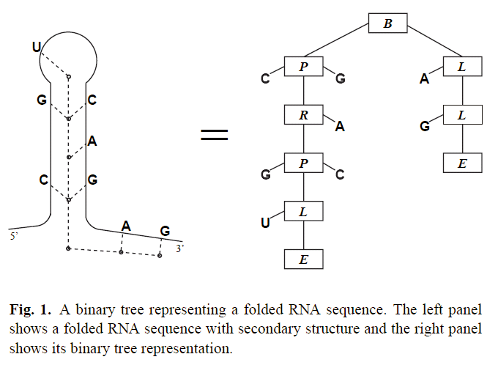
Representation of a Folded RNA Sequence
Branch
Pair
Right
Left
End

Slide 6
Definition – Structural Alignment
Alignment operations: Match, Insertion, Deletion
Given two structured data (sequence or tree), computes the optimal alignment (similarity score) between them.
Note: An alignment of two rooted binary trees (or a sequence and a tree) is also formed as a rooted binary tree.

Slide 7
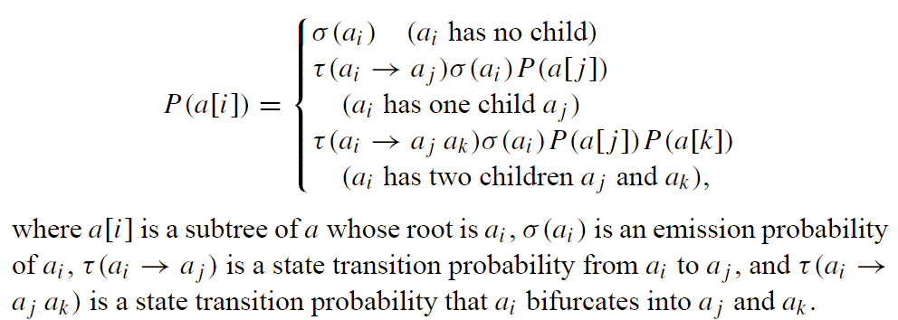
An Alignment of Two Rooted Binary Trees
Let a = a₁, a₂, …, a_{l} be an alignment of two rooted binary trees, the score (probability) of a can be calculated by following recurrence equation:

Slide 8
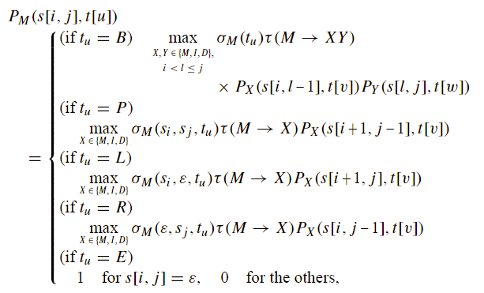
An Alignment of a Sequence and a Rooted Binary Tree (1/2)
Let s be an unfolded sequence, t be a binary tree, the recurrence equations (Match, Insertion, Deletion):

Slide 9
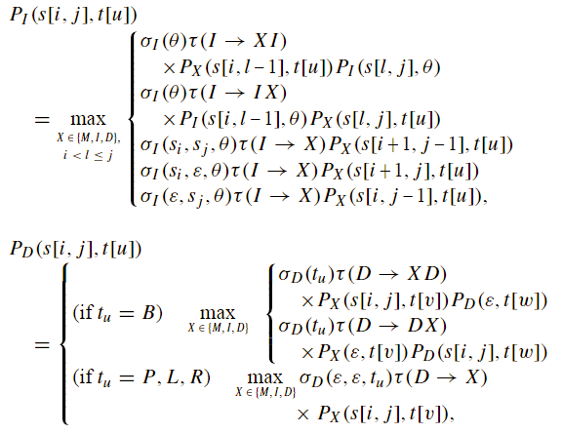
An Alignment of a Sequence and a Rooted Binary Tree (2/2)

Slide 10
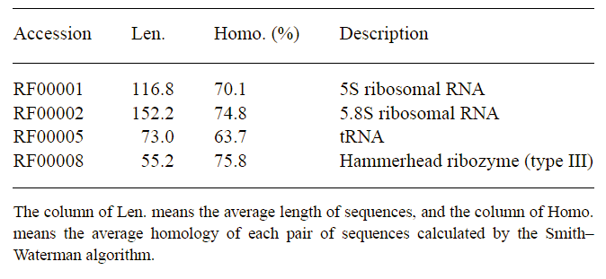
Experimental Results (1/5)
The dataset used in this paper:

Slide 11
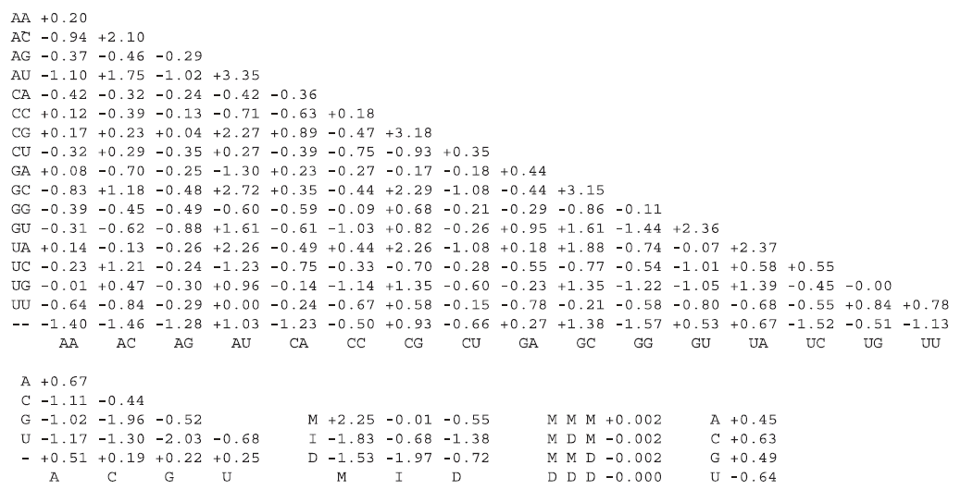
Experimental Results (2/5)
The estimated parameters:

Slide 12
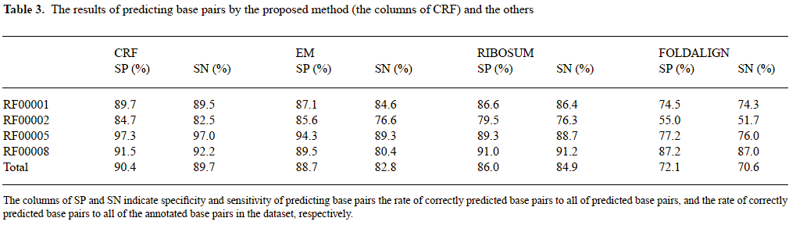
Experimental Results (3/5)
Compare to others:

Slide 13
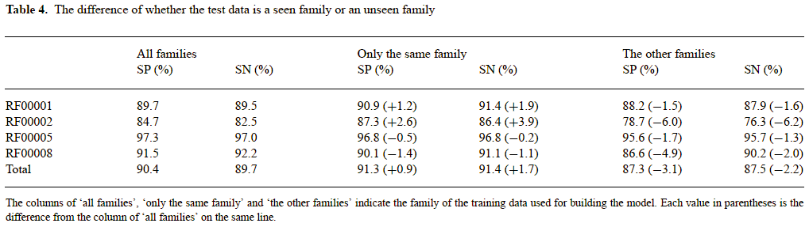
Experimental Results (4/5)
The estimated parameters:

Slide 14
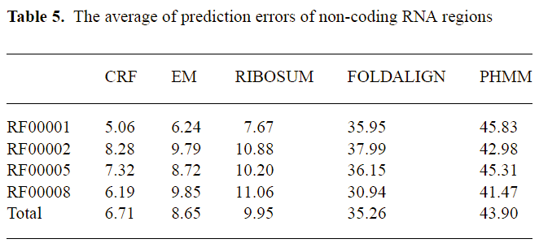
Experimental Results (5/5)
Prediction of non-coding RNA regions:

