Slide 1
Representing and Comparing Protein Structures as Paths in
Three-dimensional Space
D. Zhi, S. S. Krishna, H. Cao, P. Pevzner, and A. Godzik, BMC Bioinformatics, Vol. 7, pp. 460-474, 2006
Reporter: Chiou-Ting Tseng
Date: Nov. 23, 2006

Slide 2
Abstract
Background: Most existing formulations of protein structure comparison are based on detailed atomic level descriptions of protein structures and bypass potential insights that arise from a higher-level abstraction.
Results: We propose a structure comparison approach based on a simplified representation of proteins that describes its three-dimensional path by local curvature along the generalized backbone of the polypeptide. We have implemented a dynamic programming procedure that aligns curvatures of proteins by optimizing a defined sum turning angle deviation measure.
Conclusion: Although our procedure does not directly optimize global structural similarity as measured by RMSD, our benchmarking results indicate that it can surprisingly well recover the structural similarity defined by structure classification databases and traditional structure alignment programs. In addition, our program can recognize similarities between structures with extensive conformation changes that are beyond the ability of traditional structure alignment programs. We demonstrate the applications of procedure to several contexts of structure comparison. An implementation of our procedure, CURVE, is available as a public webserver.

Slide 3
Structure Classification
SCOP, CATH, and DALI domain dictionary.

Slide 4
Representation of Protein Structure
All-atom protein model, position of C_{α}, distance matrices (DALI), secondary structure vectors (VAST), mesostates of backbone dihedral angles.

Slide 5
Heuristics
Lowering the dimensionality of the problem by identifying 7 × 7 residue interaction patterns in DALI.
Describing the protein as a set of vectors based on secondary structure elements in VAST.
Using local structural similarities to identify short aligned fragment pairs (AFPs), which are used later to construct the alignment in methods such as CE and FATCAT.

Slide 6
Scoring Method
The RMS deviation (RMSD) for the optimal superposition of C_{α} atoms of aligned positions is the most popular similarity measure. Other groups use the difference between distance maps of two proteins, contact map overlap, or more complicated scoring systems, including, among others, such additional structural features as local secondary structure, hydrogen bonding pattern, burial status, or interaction environment.[1]

Slide 7
RMSD Drawback
RMSD fails to find similarities between structures with extensive conformation changes including structures with internal rearrangements and/or with swapped elements between domains.

Slide 8
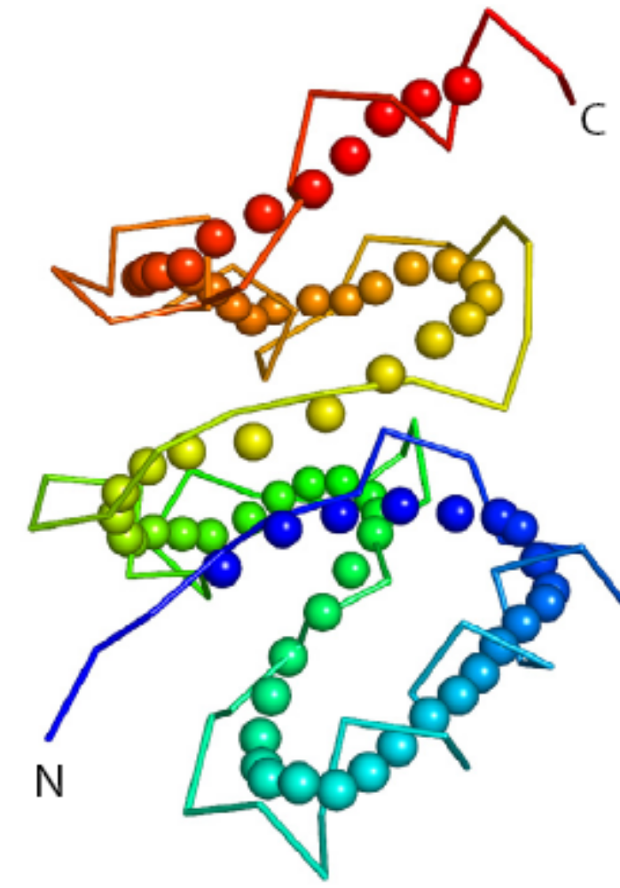
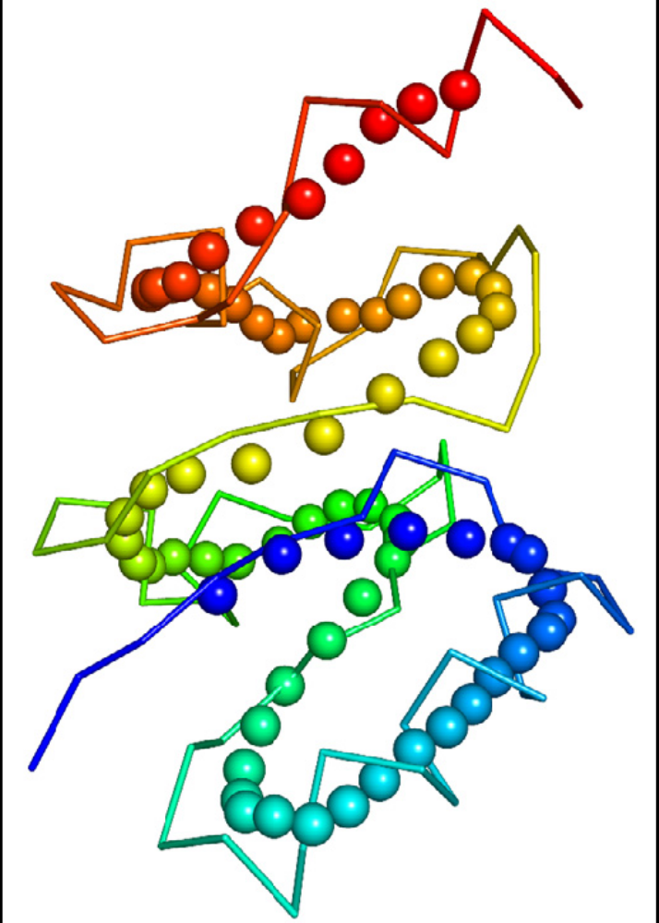
Smoothing(1)

Slide 9
Smoothing(2)
we "smooth" the protein backbone by averaging C_{α} position in a seven-residue window.
Local secondary structural information is partially lost, and protein structure is abstracted to a path in 3-D space, which for a typical protein structure winds through space by following a straight line for a 5–12 residues, then turning in a typically 4–5 residue turn only to assume a straight course for another 5–12 residues.

Slide 10
Turning Angle
We define the turning angles at residue i as the angle between the two vectors [i-d+1,i-d] and [i+d-1,i+d].
Intuitively, the angles are close to 180° along the straight fragments and are smaller where the backbone is changing directions.

Slide 11
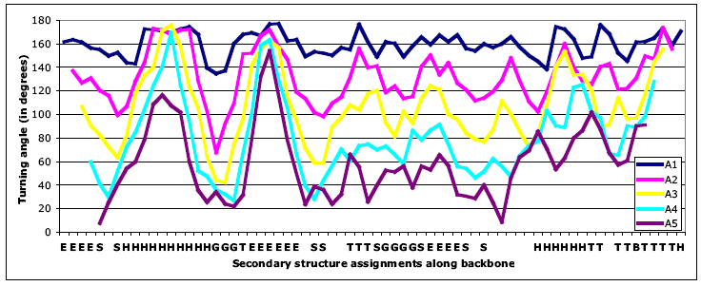
Turning Angle

Slide 12
Advantages of Turning Angle Series
It is invariant to rotation and translation.
It is tolerant to hinges, bending, or other structural distortions since these are reflected as small and well-localized changes of turning angles.
By treating the one-dimensional (1-D) turning angle series as a sequence of numbers, one can define the problem of comparing structures as aligning the angle series, similar to traditional sequence alignment, for which an optimal solution can be derived by standard dynamic programming techniques

Slide 13
Scoring
S(a_{i}, b_{j})= r₀² – min[ (a_{i}- b_{j})², 1.5(r₀) ²]
With affine gap penalty.
r₀=21, gap opening/extension penalties =300/100

Slide 14
Conclusion
Although very simple, the result is good and it is fast.

Slide 15
賣瓜時間

Slide 16
Results(1)
100 structures were chosen randomly from a database of 2939 representative structures and each of them was used as a query to search against the database.
A hit was called if there was at least one match from the same superfamily in the top ranking list (top 1, 5, or 10).

Slide 17
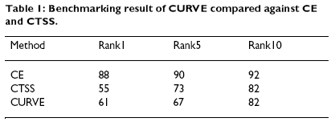
Results(2)

Slide 18
Results(3)
We take representative structural domains from three of the major SCOP classes, all-alpha, all-beta, and alpha-and-beta (a/b) proteins, and compare them against all structures in a 90% non-redundant set of SCOP version 1.65 (SCOP165_90) which contained 8666 structures.

Slide 19
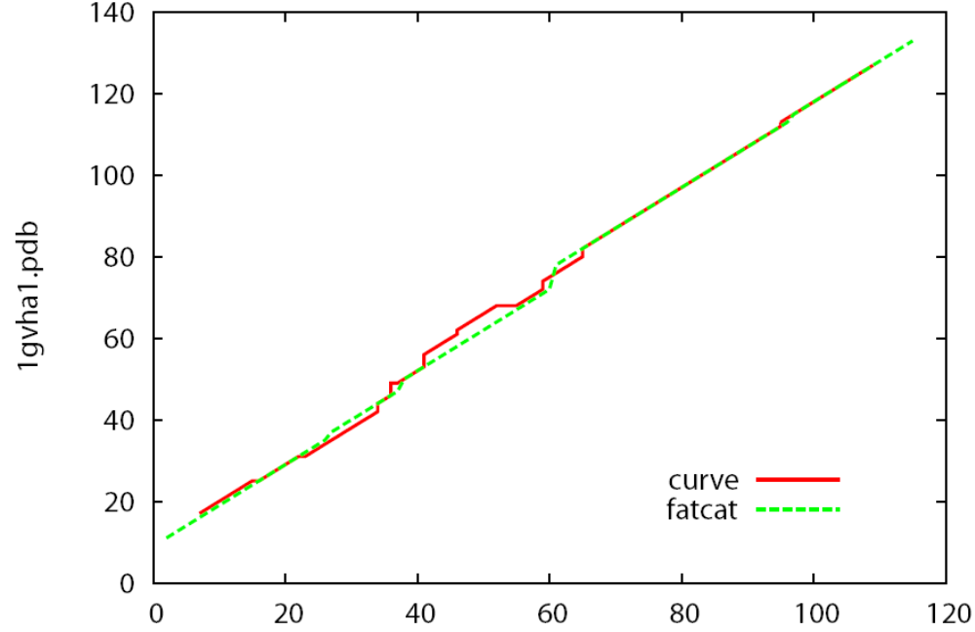
Results(4)

Slide 20
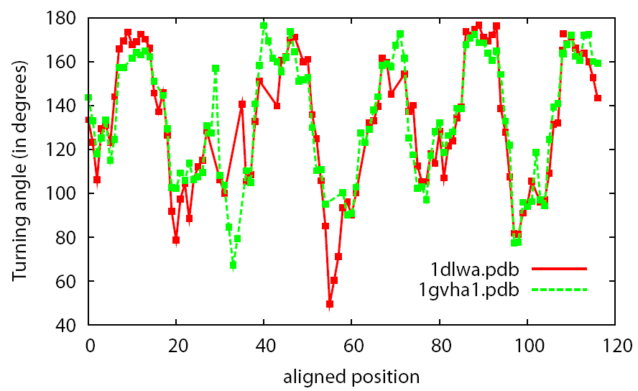
Results(5)

Slide 21
Results(6)
In this test, 2930 representative protein structures are selected from diverse CATH super-families, positive are defined as the pair of structures consisting of proteins from a same CATH topology category, and negative otherwise.
For each structure pair (i,j) in the benchmark set, we define the native score of CURVE to be their dynamic programming score S(i,j) normalized by the self alignment scores, i.e., S_{native}(i,j) = S(i,j)²/(S(i,i)S(j,j)).

Slide 22
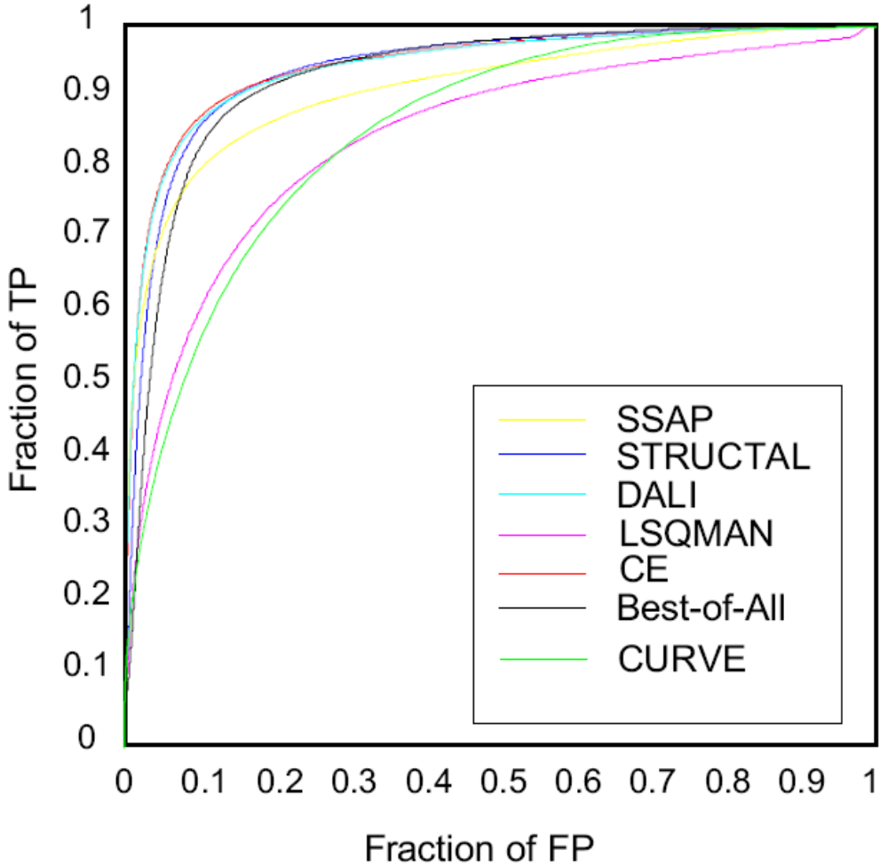
Results(7)

Slide 23
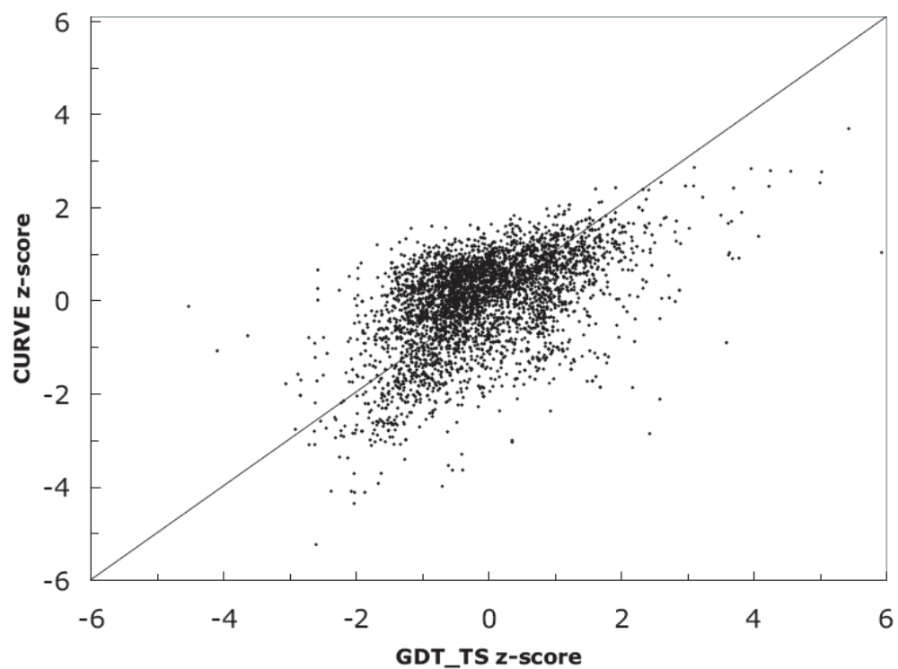
Results(8)

Slide 24
Results(9)
We take the 20 conformers of an NMR structure of diacylglycerol kinase alpha protein, 1tuz, and overlay the turning angle curves of its conformers.

Slide 25
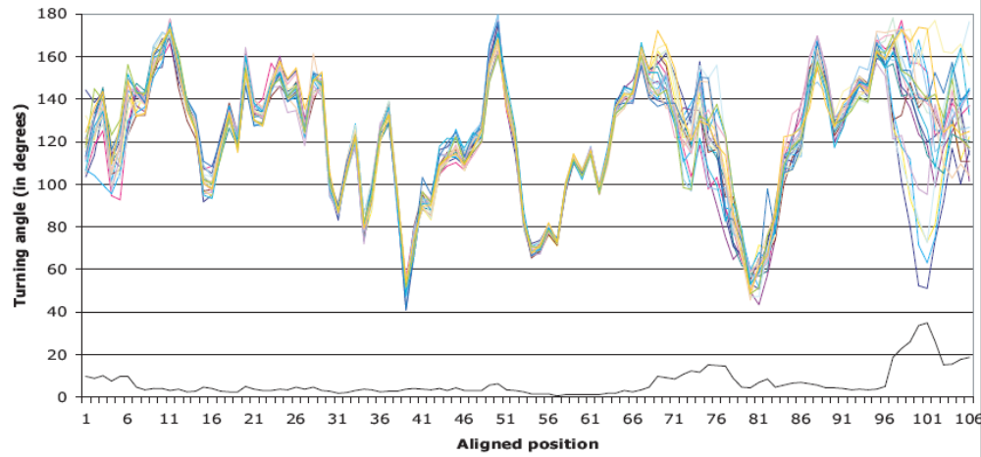
NMR Conformer

Slide 26
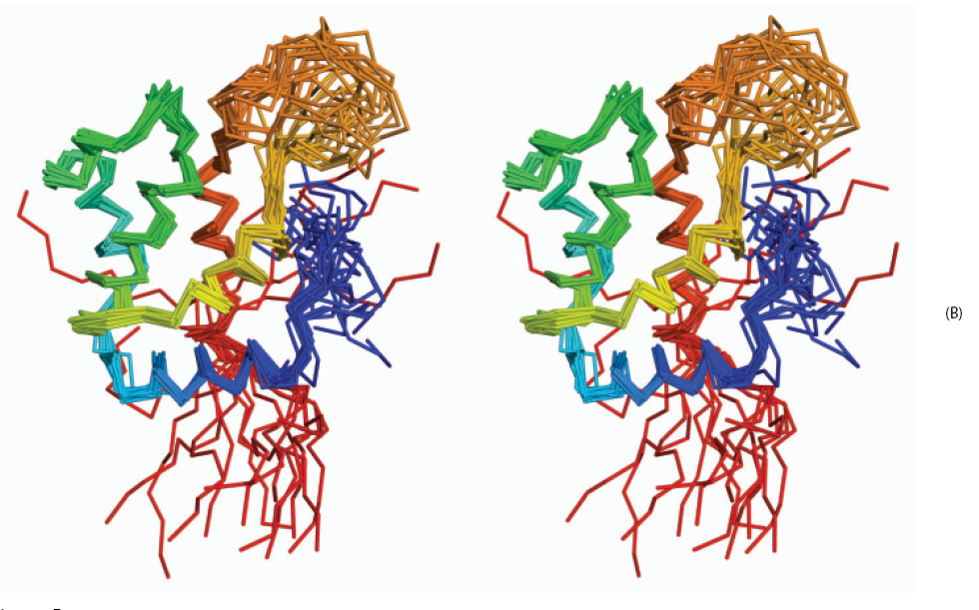
NMR Conformer

Slide 27
Results(10)
It is well known that the APO form and the calcium-binding form of calmodulin have distinct conformations.
In its calcium-binding form, calmodulin has two globular domains (N- and C- terminal domains) linked by a central α-helix. In its APO form, the central α-helix is broken into two short α-helices linked by a region with poorly defined secondary structure.

Slide 28
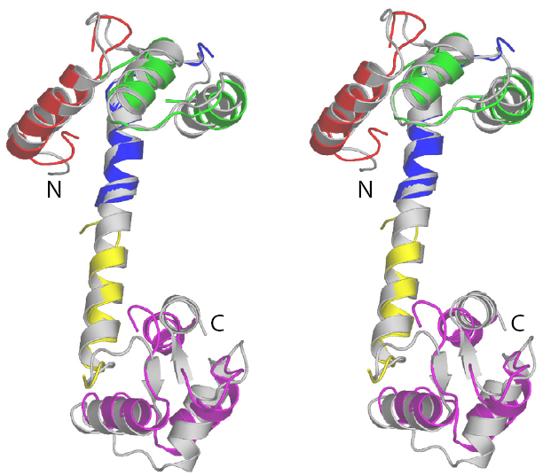
Results(11)

Slide 29
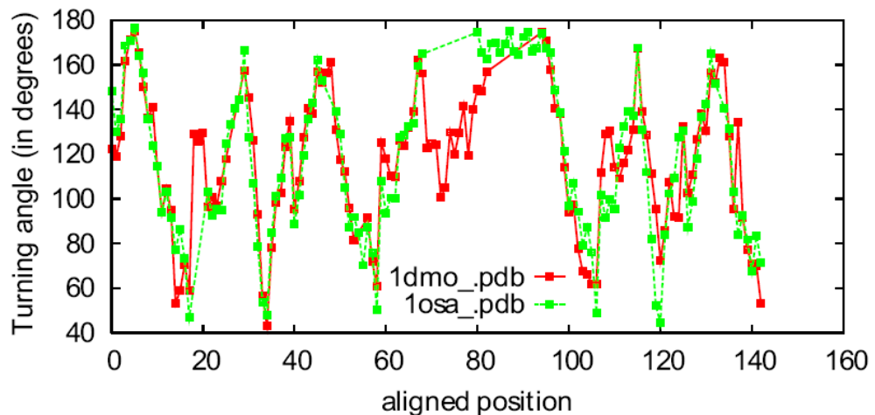
Results(12)

Slide 30
Monomer(1)
We compare two conformations of the catabolite repressor HPr-like protein from Bacillus subtilis. The monomer structure 1k1c:A has an anti-parallel β-strand of order 1423. In the dimer structure 1mu4, two subunits swap their N-terminal β-strands.

Slide 31
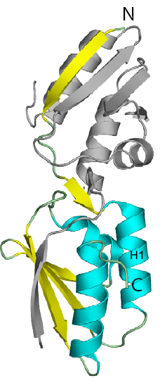
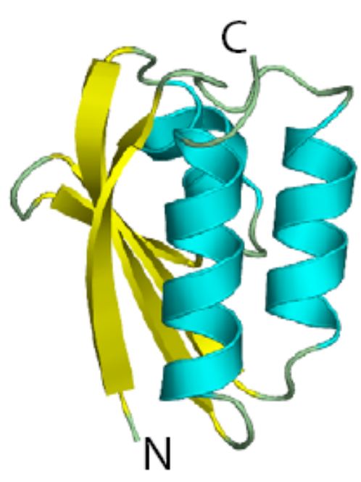
Monomer(2)

Slide 32
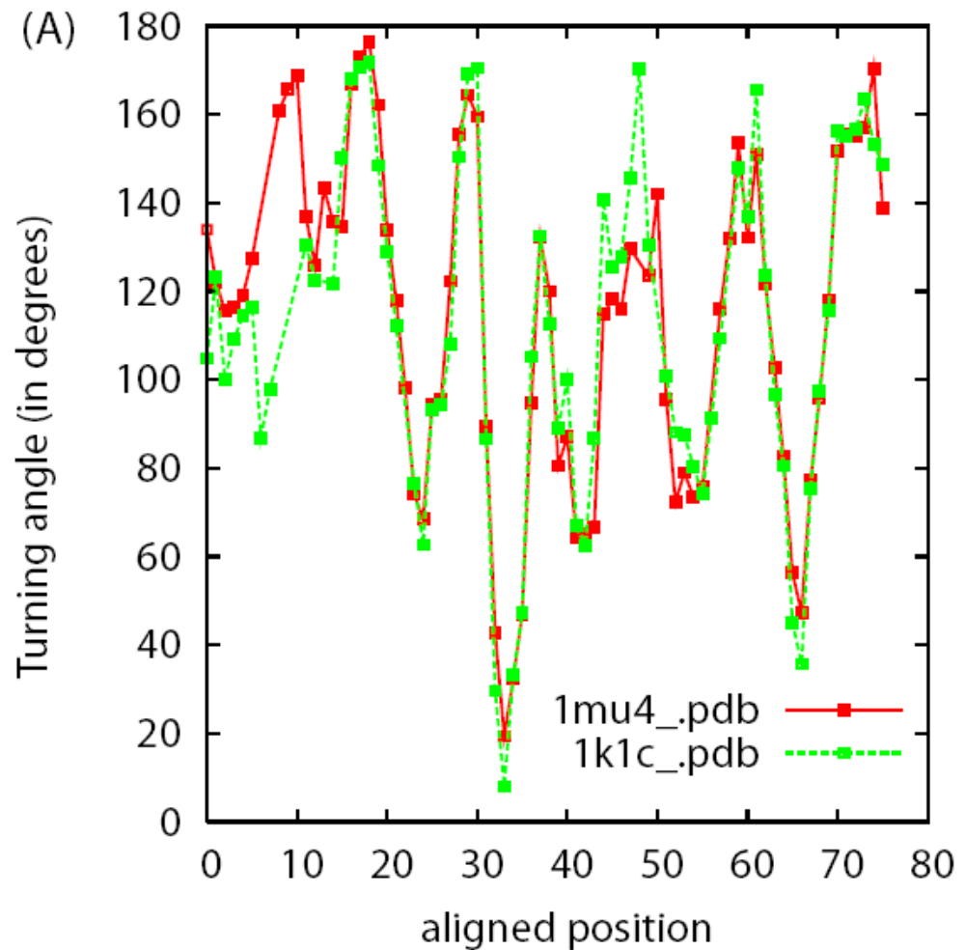
Monomer(3)

Slide 33
Mutant(1)
We compare the immunoglobulin binding domain B1 of streptococcal protein G (GB1), a favorite subject of studying protein folding and design. The wild type structure (PDBID: 3gb1) contains an α-helix and a four-stranded β-sheet made of two β-hairpins, one N-terminal and the other C-terminal to the α-helix. The structure of mutant HS#124F26A (PDBID: 1q10) reveals a domain-swapped dimer that involves exchange of the second β-hairpin. The resulting overall structure is comprised of an eightstranded β-sheet whose concave side is covered by two α-helices.

Slide 34
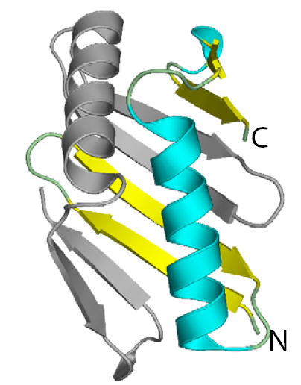
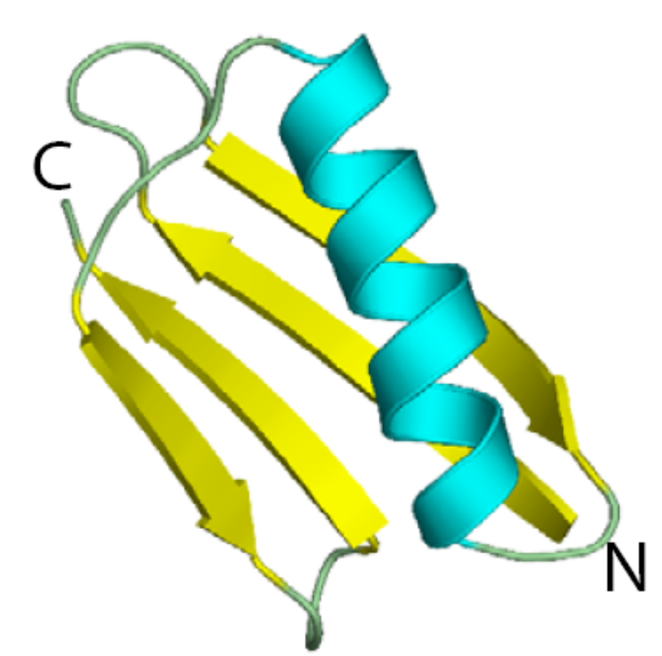
Mutant(2)

Slide 35
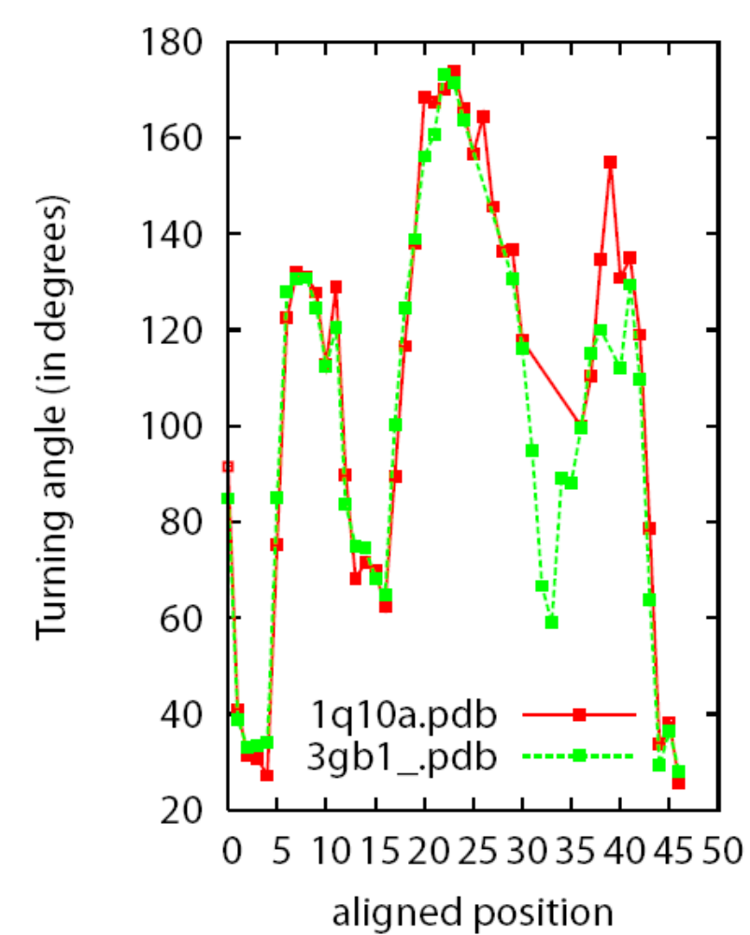
Mutant(3)

Slide 36
Turning-angle profile model of a structure family
We obtain multiple structure alignment of 10 structures of the triosephosphate isomerase family of the TIM-barrel topology from the expert-curated structure alignment database HOMSTRAD.
The curve overlap graph immediately suggests a profile representation of a structure family.

Slide 37
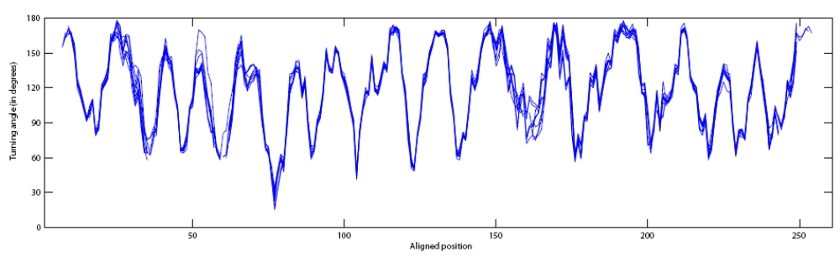
Turning-angle profile model of a structure family

Slide 38
Distinct folds but sharing structural similarities
We report an interesting case showing the structural similarities between the Ganglioside M2 (gm2) activator fold and the immunoglobulin-like (Iglike) β-sandwich fold.

Slide 39
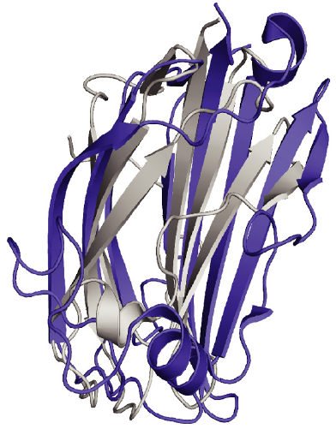
Distinct folds but sharing structural similarities

Slide 40
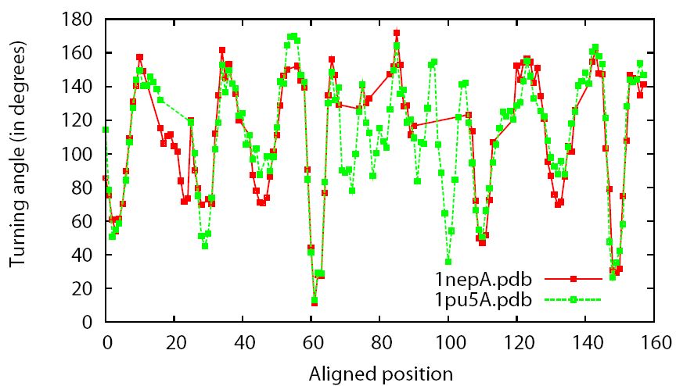
Distinct folds but sharing structural similarities

Slide 41
Reference
Godzik A, ”The structural alignment between two proteins: is there a unique answer?” Protein science, Vol. 5, Issue 7 pp. 1325-1338, 1996

