Slide 1
GASH: An improved algorithm for maximizing the number of equivalent residues between two protein structures
Daron M Standley, Hiroyuki Toh, and Haruki Naka
BMC Bioinformatics, Vol. 6:221, Sept. 8, 2005
Presenter: Kuo-Si Huang
Date: Nov. 30, 2006

Slide 2
Abstract -- Background
We introduce GASH, a new, publicly accessible program for structural alignment and superposition. Alignments are scored by the Number of Equivalent Residues (NER), a quantitative measure of structural similarity that can be applied to any structural alignment method. Multiple alignments are optimized by conjugate gradient maximization of the NER score within the genetic algorithm framework. Initial alignments are generated by the program Local ASH, and can be supplemented by alignments from any other program.

Slide 3
Abstract -- Results
We compare GASH to DaliLite, CE, and to our earlier program Global ASH on a difficult test set consisting of 3,102 structure pairs, as well as a smaller set derived from the Fischer-Eisenberg set. The extent of alignment crossover, as well as the completeness of the initial set of alignments are examined. The quality of the superpositions is evaluated both by NER and by the number of aligned residues under three different RMSD cutoffs (2,4, and 6Å). In addition to the numerical assessment, the alignments for several biologically related structural pairs are discussed in detail.

Slide 4
Abstract -- Conclusion
Regardless of which criteria is used to judge the superposition accuracy, GASH achieves the best overall performance, followed by DaliLite, Global ASH, and CE. In terms of CPU usage, DaliLite CE and GASH perform similarly for query proteins under 500 residues, but for larger proteins DaliLite is faster than GASH or CE. Both an http interface and a simple object application protocol (SOAP) interface to the GASH program are available at http://www.pdbj.org/GASH/.

Slide 5
Introduction
As of Tuesday Nov 21, 2006, there are 40261 structures in PDB
There is no universally accepted measure of structural similarity.
Structure alignment programs:
  Dali, CE, VAST

Slide 6
Introduction
Measurements of structural similarity
  Number of equivalent residues (NER)
  RMSD
  Number of aligned residues

Slide 7
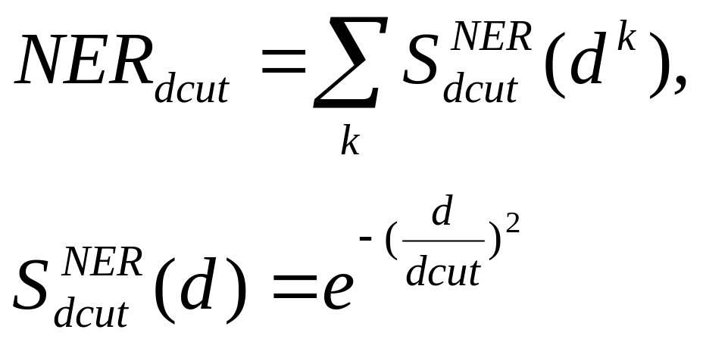
Number of equivalent residues (NER)
Given an initial alignment or superposition
NER is a sum over all aligned residue pairs of a similarity function S, d^{k} is the intermolecular distance between C_{α} atoms in the aligned pair k

Slide 8
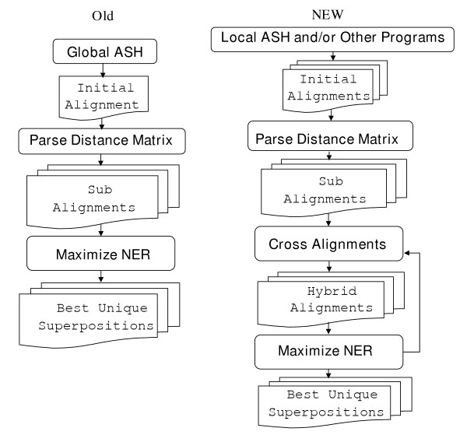
GASH flowchart

Slide 9
Implementation
Input: Two proteins
Output: The alignment with maximal NER
Produce a set of locally optimal alignments.
Parse each alignment into geometrically-consistent sub-alignments using distance matrix comparison.
Cross the alignments a fixed number of times and select the best unique set by NER maximization.

Slide 10
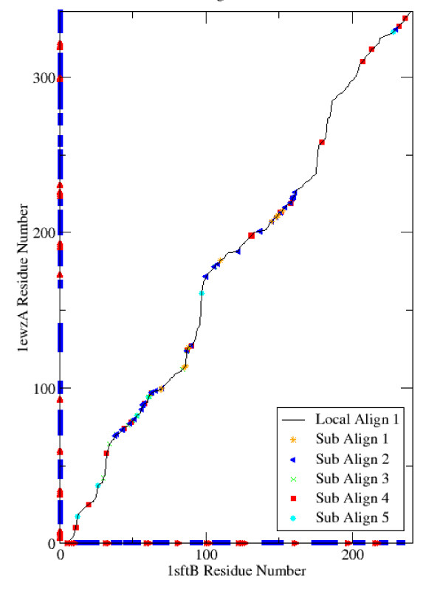
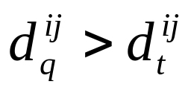
Figure 2 Alignment parsed by distance matrix.
The parsing of a single local alignment into geometrically consistent sub alignments is illustrated. Only five sub-alignments are shown, and consecutive aligned residue pairs belonging to the same sub-alignment are represented by a single point in order to make the plot easier to see. The secondary structure (helices in blue and strands in red) is plotted along the axis.
Fix aligned pair (i_{q}, i_{t}), consider another pair (j_{q}, j_{t}), reject (j_{q}, j_{t}) if

Slide 11
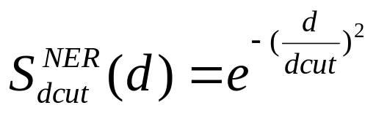
NER maximization
Minimize the C_{α} RMSD of the aligned residues [Mclachlan, 17]
Maximize the NER score by conjugate gradient optimization (共軛梯度法；解特定線性系統的數值解的方法；迭代方法；適用於稀疏矩陣系統) [Fletcher-Reeves-Polak-Rebiere, 18]
Re-calculate the alignment based on the residue-based similarity score (eqn. 2) using an ordinary dynamic programming calculation [19].

Slide 12
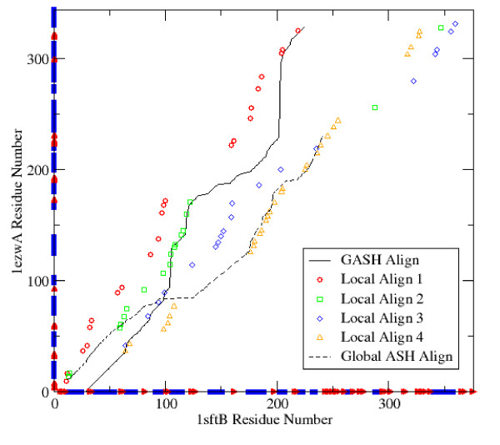
Figure 3 Local and global alignments

Slide 13
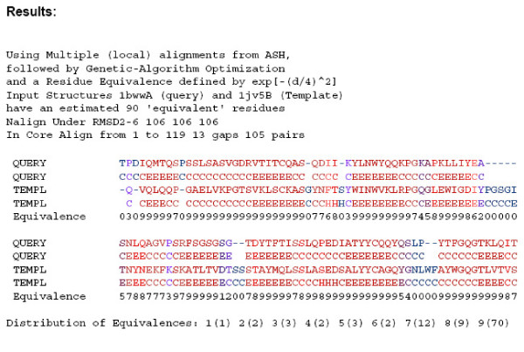

Slide 14
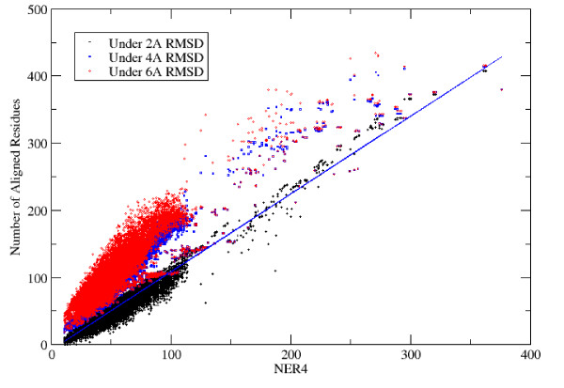

Slide 15
Query
Average CPU (seconds)
GASH
Global
GASH
GASH
ID
Nres
Default
Dalilite
CE
ASH
No Cross
High Cross
1bwwA
110
4
4
13
4
3
8
1qgtB
144
7
6
17
10
6
10
1mniA
154
4
4
13
5
4
9
1ab8A
178
5
3
15
6
5
9
1dwuA
214
13
9
18
17
13
20
1u02A
223
13
10
19
15
13
18
1frvA
263
14
10
18
16
13
20
1kyqB
268
15
10
20
20
15
21
1r6fA
273
7
5
17
10
7
11
1obaA
339
27
23
24
31
25
34
1gqeA
355
15
10
22
19
14
20
1sftB
381
25
22
24
28
24
32
1udyA
386
14
12
24
20
13
19
1nvbB
392
25
16
23
30
25
32
1e03L
424
22
22
18
31
21
36
1bgw
680
40
25
45
53
39
48
1bxrA
1074
60
28
61
83
58
69

Slide 16
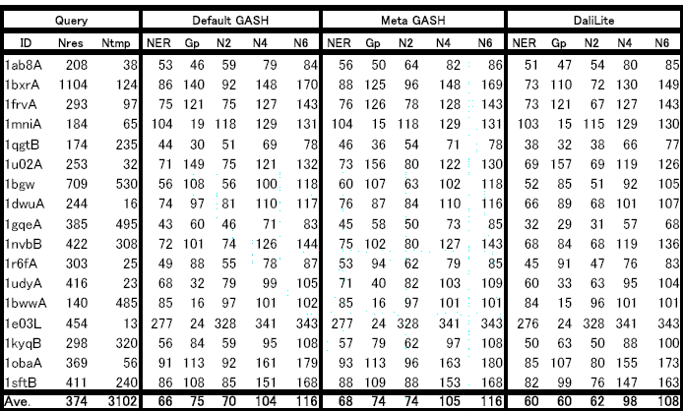
Additional File 1. Summary of SCOP-FSSP set results (1)

Slide 17
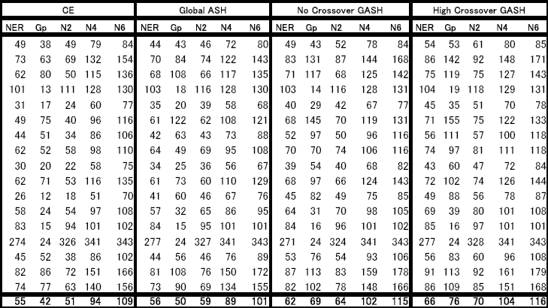
Additional File 1. Summary of SCOP-FSSP set results (2)

Slide 18
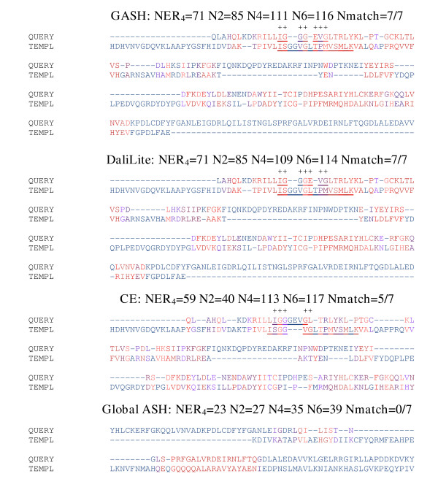
NAP(p)-binding loop residues are underlined

Slide 19
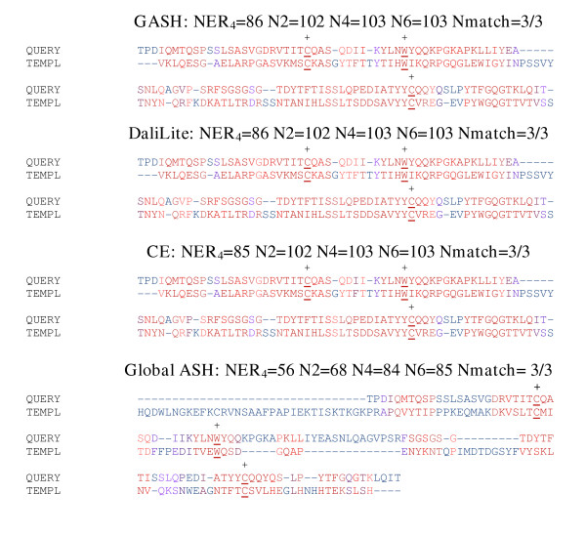
The characteristic disulfide bond and Thr residues are underlined

Slide 20
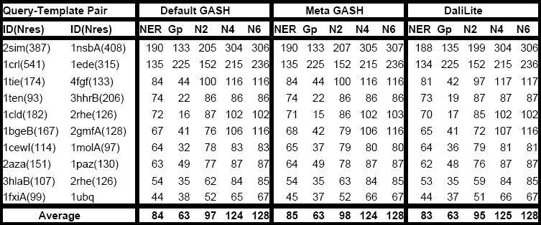
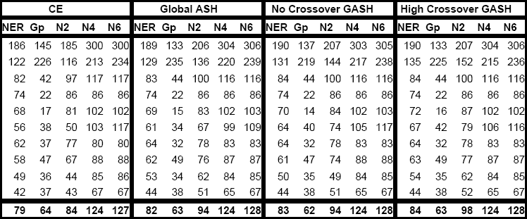
Additional File 2. Summary of Fischer-Eisenberg set results

