Slide 1
Application of Multiple Sequence Alignment Profiles to Improve Protein Secondary Structure Prediction
PROTEINS: Structure, Function, and Genetics 40:502–511 (2000)
James A. Cuff and Geoffrey J. Barton
Presenter: Jen-Hui, Wang
Date: Nov. 30, 2006

Slide 2
ABSTRACT
The effect of training a neural network secondary structure prediction algorithm with different types of multiple sequence alignment profiles derived from the same sequences, is shown to provide a range of accuracy from 70.5% to 76.4%. The best accuracy of 76.4% (standard deviation 8.4%), is 3.1% (Q3) and 4.4% (SOV2) better than the PHD algorithm run on the same set of 406 sequence non-redundant proteins that were not used to train either method. Residues predicted by the new method with a confidence value of 5 or greater, have an average Q3 accuracy of 84%, and cover 68% of the residues. Relative solvent accessibility based on a two state model, for 25, 5, and 0% accessibility are predicted at 76.2, 79.8, and 86.6% accuracy respectively. The source of the improvements obtained from training with different representations of the same alignment data are described in detail. The new Jnet prediction method resulting from this study is available in the Jpred secondary structure prediction server, and as a stand-alone computer program from: http://barton.ebi.ac.uk/.

Slide 3
Training and Testing Protein Sets
For development of the methods, 513 proteins from a previous study were screened to remove proteins that were shorter than 30 residues, and those from families that contained only two sequences and so did not generate valid PSIBLAST alignment profiles. This left 480 proteins to use for cross-validated training of the new methods
In this work, the data were split randomly into seven sets to perform cross-validation tests

Slide 4
Alignments
For each of the 480 training-set sequences, a multiple sequence alignment was constructed. For comparison, both BLAST and PSIBLAST were used to search the SWALL non-redundant protein sequence database, with a P-value cutoff of 0.0001
P-value
  The probability of an alignment occurring with the score in question or better. p-Value is an estimate of the False Positive Rate (FPR)
To compare the effect of different multiple sequence alignment methods, AMPS and CLUSTALW were both used.

Slide 5
Alignments (cont.)
The alignments were represented as profiles for input to the neural network and the profiles were scored in three ways:
  As frequency counts for each amino acid down a column in the alignment, expressed as a percentage of the total for a given column
  Each residue in an alignment column was scored by its corresponding BLOSUM62 matrix score. The scores were then averaged based on the number of sequences in that column
  As a position specific profile, generated by the HMMER2 package. The multiple sequence alignment is represented as a profile HMM, with position-specific scores to represent amino acids in the alignment

Slide 6
Alignments (cont.)
Figure 2 summarizes an attempt to improve the alignments obtained from PSI-BLAST by post-processing the result of the PSIBLAST search
  As shown in Figure 2 full length sequences were taken from the PSIBLAST search, the alignment was then constructed by making successive global alignments to the profile by adding sequences in the order determined by the P-value scores from the initial PSIBLAST sequence search. At each iteration the ends of the alignment were trimmed, to force the global alignment method to represent the query sequence

Slide 7
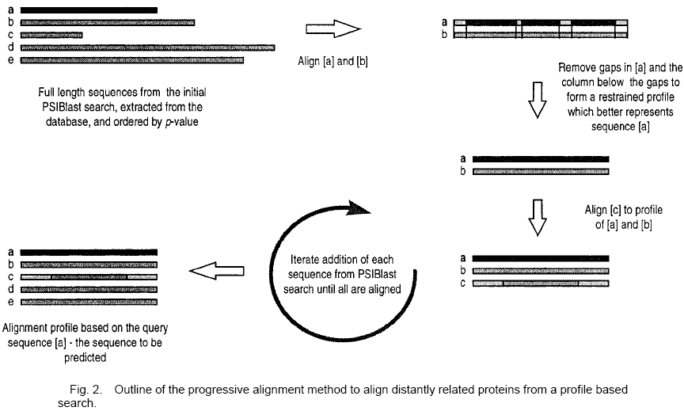
Alignments (cont.)

Slide 8
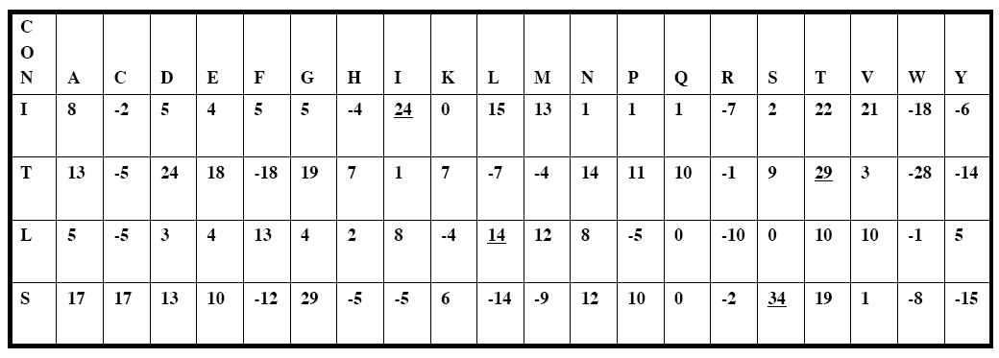
Alignments (cont.)
In addition to the method summarized in Figure 2 each of the PSIBLAST alignments were also represented by the profiles in the PSIBLAST report file. Two profiles were extracted, the simple frequency counts, and that denoted as the position-based scoring matrix (PSSM).

Slide 9
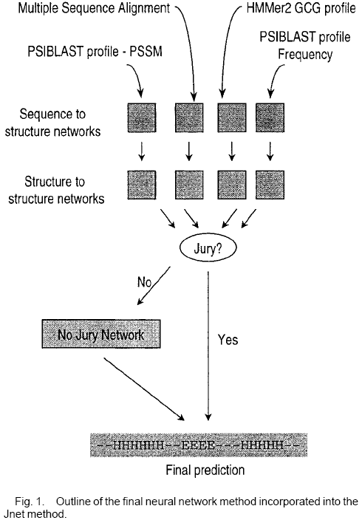


Slide 10
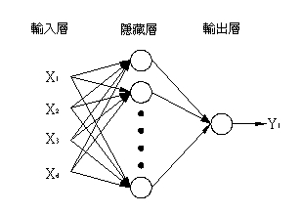
The Neural Network
In this work, the SNNS neural network package from Stuttgart University was applied
The network ensemble consisted of two artificial neural networks.
  The first was a network with a sliding window of 17 residues over each amino acid in the alignment, plus the addition of a conservation number as the input nodes. The network then comprised a further nine hidden nodes and three output nodes. The output from this network was windowed into 19 residues, plus a conservation number, which formed the input to the second network.
  This second network also had nine hidden nodes
  and three output nodes

Slide 11
Consensus Combination of Prediction Methods
The outputs from each of the networks trained previously, were also taken and positions examined where the predicted state was identical in all methods
Residues where the predictions did not all agree were classified as “no jury” positions. Positions where there was a full agreement in the predicted state between the different neural network methods were taken as the final prediction
Positions where there was “no jury” were used to train a separate neural network. The final prediction was obtained by replacing the original “no jury” positions with the predictions from this network.

Slide 12
Solvent Accessibility Prediction
The alignments were also used to predict 2-state (exposed/buried) relative solvent accessible residues. Prediction accuracy was based on DSSP solvent accessibility definitions
Three categories of relative accessibility were chosen for prediction: 25%, 5%, and 0% accessible. Neural networks were trained with profiles from the HMMER2 profiles and the PSSM matrices from the PSIBLAST reports. The HMMER and PSIBLAST trained networks were also combined to give an average relative accessibility prediction.

Slide 13
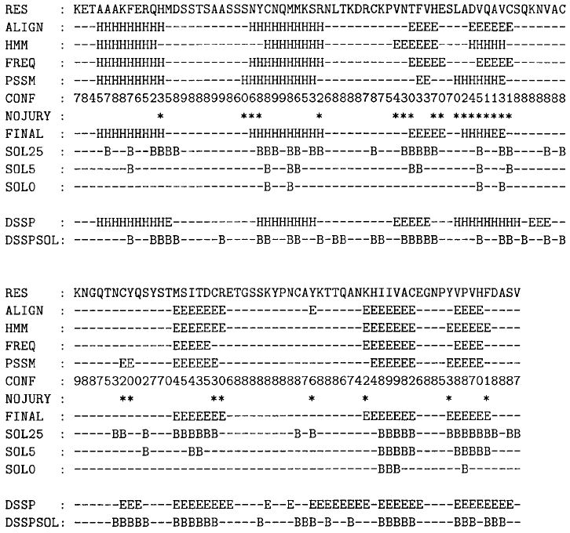

Slide 14
Assessment of Secondary Structure Prediction Accuracy
The accuracy of prediction was assessed by comparison to DSSP

Slide 15
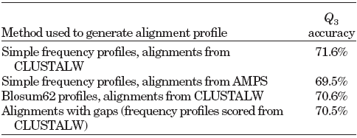
Effect of Alignment Method on Accuracy
The effect of two different alignment methods, CLUSTALW and AMPS is summarised in Table
This test shows CLUSTALW to be more favorable for generating multiple sequence alignments for secondary structure prediction
The frequency matrix was 1% more accurate than the matrix scored by BLOSUM62 mutation scores regardless of the alignment method
Including gaps in the query sequence during training and testing reduced the accuracy of prediction by 1.1%.

Slide 16
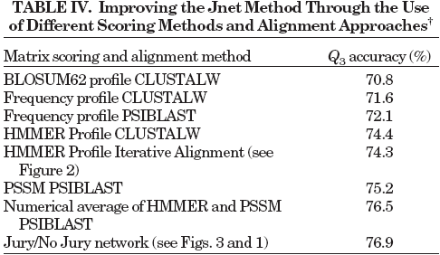
Effect of Training on PSIBLAST Profiles
The same neural network architecture was trained with PSIBLAST profiles. PSIBLAST generates two types of profile, a simple frequency, and a position-based scoring matrix

