Slide 1
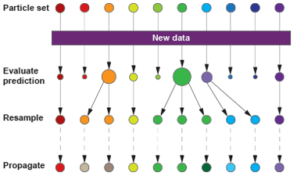
A Tutorial on Particle Filters for Online Nonlinear/Non-Gaussian Bayesian Tracking
M. Sanjeev Arulampalam, Simon Maskell, Neil Gordon, and Tim Clapp
IEEE Transactions on Signal Processing, Vol. 50, No. 2, pp.174-188, 2002
Date: Oct. 21, 2014
Presenter: Hung-Hsin Chen (陳紘昕)

Slide 2
Abstract
Increasingly, for many application areas, it is becoming important to include elements of nonlinearity and non-Gaussianity in order to model accurately the underlying dynamics of a physical system. Moreover, it is typically crucial to process data on-line as it arrives, both from the point of view of storage costs as well as for rapid adaptation to changing signal characteristics. In this paper, we review both optimal and suboptimal Bayesian algorithms for nonlinear/non-Gaussian tracking problems, with a focus on particle filters. Particle filters are sequential Monte Carlo methods based on point mass (or “particle”) representations of probability densities, which can be applied to any state-space model and which generalize the traditional Kalman filtering methods. Several variants of the particle filter such as SIR, ASIR, and RPF are introduced within a generic framework of the sequential importance sampling (SIS) algorithm. These are discussed and compared with the standard EKF through an illustrative example.

Slide 3
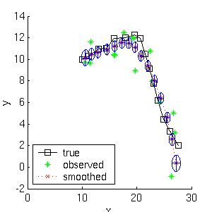
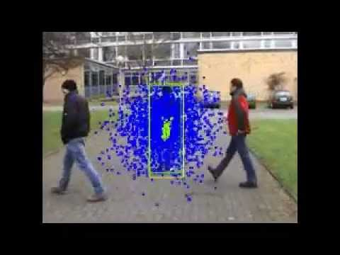
Particle filter applications

Slide 4
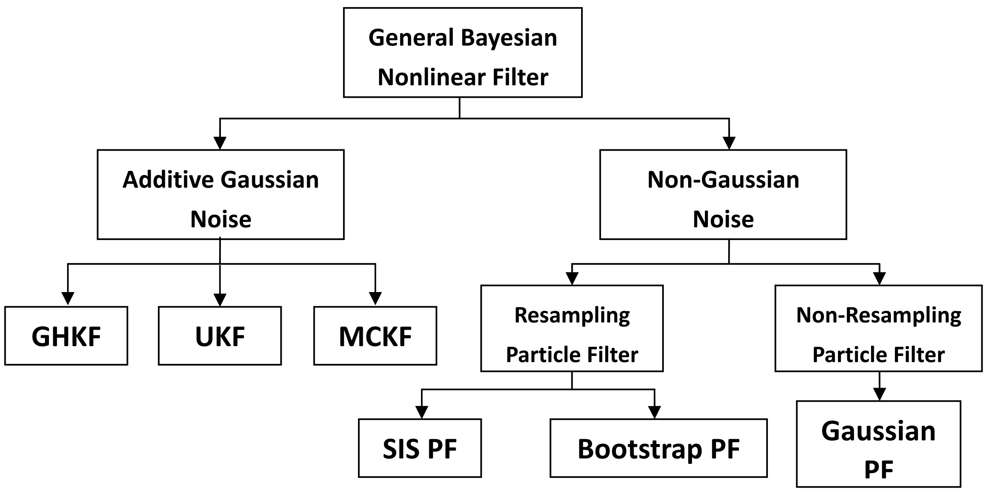

Slide 5
Gaussian hypothesis method

Slide 6
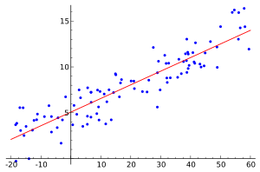
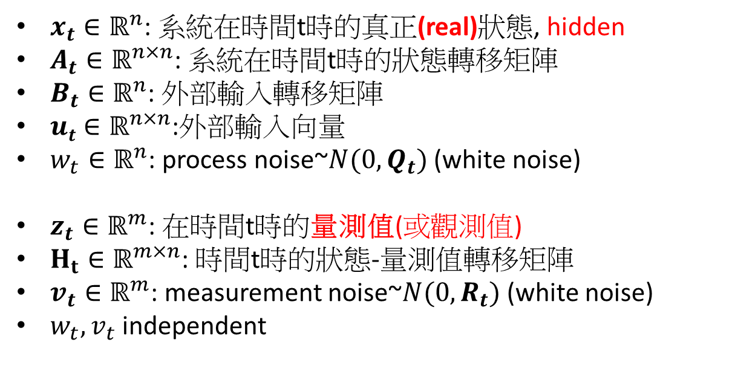
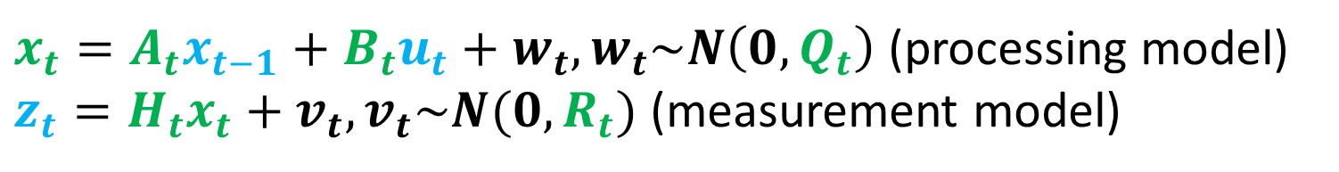
Linear state-space model
■: unknown
■: known or specified by users
$x_{t}=A_{t}x_{t−1}+B_{t}u_{t}+w_{t}, w_{t}\sim N\left(0, Q_{t}\right)$(processing model)
$z_{t}=H_{t}x_{t}+v_{t}, v_{t}\sim N(0, R_{t})$(measurement model)
$x_{t}∈ℝ^{n}$: 系統在時間t時的真正(real)狀態, hidden
$A_{t}∈ℝ^{n×n}$: 系統在時間t時的狀態轉移矩陣
$B_{t}∈ℝ^{n}$: 外部輸入轉移矩陣
$ut∈ℝ^{n×n}$:外部輸入向量
$w_{t}∈ℝ^{n}$: process noise~$N(0, Q_{t})$(white noise)
$z_{t}∈ℝ^{m}$: 在時間t時的量測值(或觀測值)
$H_{t}∈ℝ^{m×n}$: 時間t時的狀態-量測值轉移矩陣
$v_{t}∈ℝ^{m}$: measurement noise~$N(0, R_{t})$(white noise)
$w_{t}, v_{t}$independent
系統在狀態轉移時會受到系統雜訊(w_{t})的影響。
量測資料時，也會受到量測誤差(v_{t})的影響。
Goal: 如何估計出系統真正的狀態x_{t}, t=12,…

Slide 7
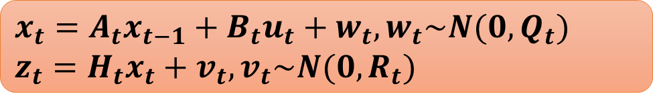
Kalman filter example
http://wiki.scipy.org/Cookbook/KalmanFiltering
$x_{t}=A_{t}x_{t−1}+B_{t}u_{t}+w_{t}, w_{t}\sim N(0,Q_{t})$
$$z_{t}=H_{t}x_{t}+v_{t}, v_{t}\sim N(0, R_{t})$$
import numpy
import pylab
# intial parameters
n_iter = 50
sz = (n_iter,) # size of array
x = -0.37727 # truth value
z = numpy.random.normal(x, 0.1, size=sz) # observations (normal about x, sigma=0.1)
Q = 1e-5 # process variance
# allocate space for arrays
xhat=numpy.zeros(sz) # a posteri estimate of x
P=numpy.zeros(sz) # a posteri error estimate
xhatminus=numpy.zeros(sz) # a priori estimate of x
Pminus=numpy.zeros(sz) # a priori error estimate
K=numpy.zeros(sz) # gain or blending factor

Slide 8
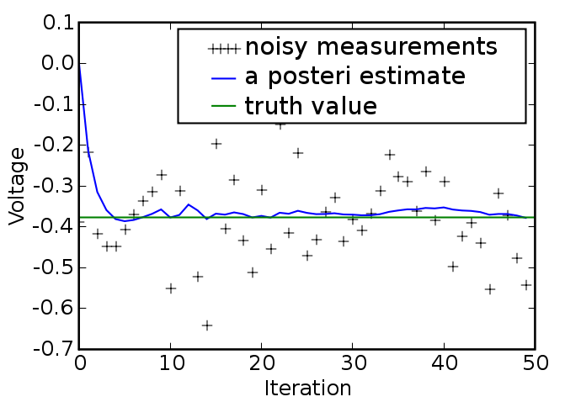
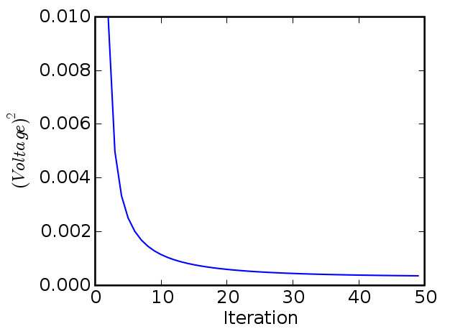

R = 0.1**2 # estimate of measurement variance, change to see effect # intial guesses
xhat[0] = 0.0
P[0] = 1.0
for k in (1,n_iter):
# time update
xhatminus[k] = xhat[k-1]
Pminus[k] = P[k-1]+Q
# measurement update
K[k] = Pminus[k]/( Pminus[k]+R )
xhat[k] = xhatminus[k]+K[k]*(z[k]-xhatminus[k])
P[k] = (1-K[k])*Pminus[k]
$x_{t}=A_{t}x_{t−1}+B_{t}u_{t}+w_{t}, w_{t}\sim N(0,Q_{t})$
$$z_{t}=H_{t}x_{t}+v_{t}, v_{t}\sim N(0, R_{t})$$

Slide 9
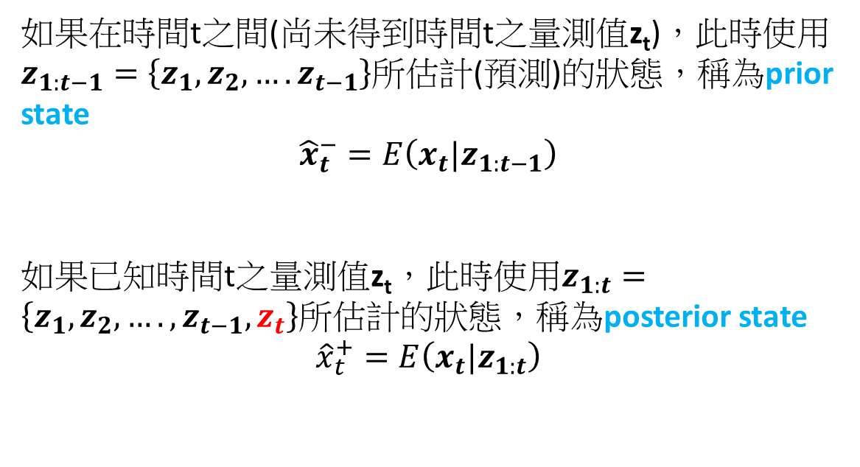
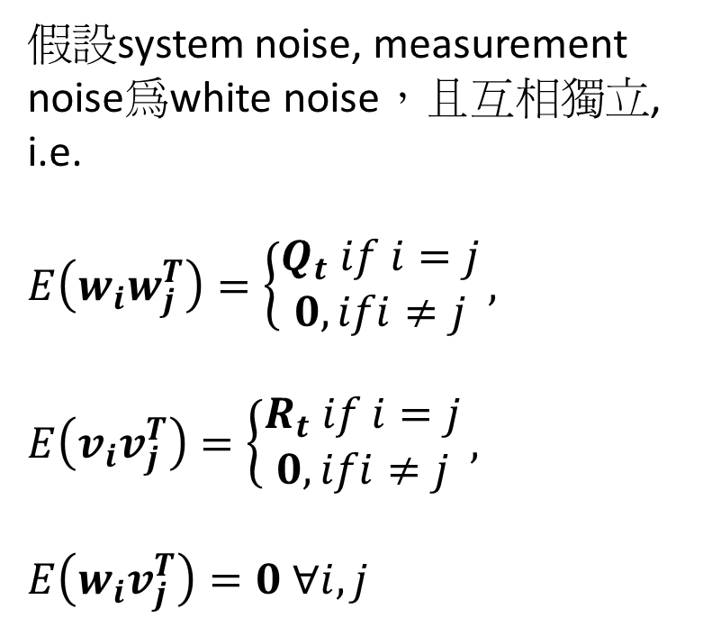
Kalman filter (1)
$x_{t}=A_{t}x_{t−1}+B_{t}u_{t}+w_{t}, w_{t}\sim N(0,Q_{t})$
$$z_{t}=H_{t}x_{t}+v_{t}, v_{t}\sim N(0, R_{t})$$
假設system noise, measurement noise為white noise，且互相獨立, i.e.
$$E\left(w_{i}w_{j}^{T}\right)=\left\{\begin{matrix}Q_{t} if i=j \\ 0, ifi≠j\end{matrix}\right.,$$
$$E\left(v_{i}v_{j}^{T}\right)=\left\{\begin{matrix}R_{t} if i=j \\ 0, ifi≠j\end{matrix}\right.,$$
$$E\left(w_{i}v_{j}^{T}\right)=0 ∀i, j$$
如果在時間t之間(尚未得到時間t之量測值z_{t})，此時使用$z_{1:t−1}=\left\{z_{1},z_{2},….z_{t−1}\right\}$所估計(預測)的狀態，稱為prior state
$${\hat{x}}_{t}^{−}=E\left(x_{t}|z_{1:t−1}\right)$$
如果已知時間t之量測值z_{t}，此時使用$z_{1:t}=\left\{z_{1},z_{2},….,z_{t−1}, z_{t}\right\}$所估計的狀態，稱為posterior state
$${\hat{x}}_{t}^{+}=E\left(x_{t}|z_{1:t}\right)$$

Slide 10
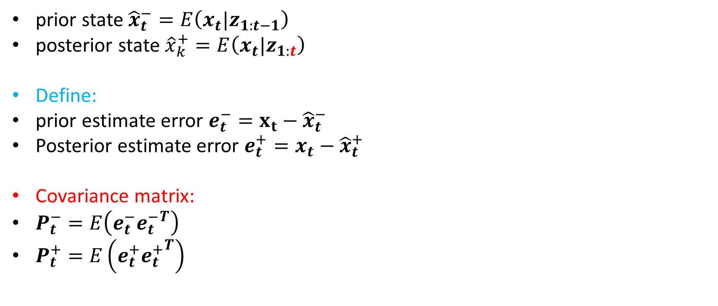
Kalman filter (2)
$x_{t}=A_{t}x_{t−1}+B_{t}u_{t}+w_{t}, w_{t}\sim N(0,Q_{t})$
$$z_{t}=H_{t}x_{t}+v_{t}, v_{t}\sim N(0, R_{t})$$
prior state ${\hat{x}}_{t}^{−}=E\left(x_{t}|z_{1:t−1}\right)$
posterior state${\hat{x}}_{k}^{+}=E\left(x_{t}|z_{1:t}\right)$
Define:
prior estimate error $e_{t}^{−}=x_{t}−{\hat{x}}_{t}^{−}$
Posterior estimate error $e_{t}^{+}=x_{t}−{\hat{x}}_{t}^{+}$
Covariance matrix:
$P_{t}^{−}=E\left(e_{t}^{−}{e_{t}^{−}}^{T}\right)$
$P_{t}^{+}=E\left(e_{t}^{+}{e_{t}^{+}}^{T}\right)$

Slide 11
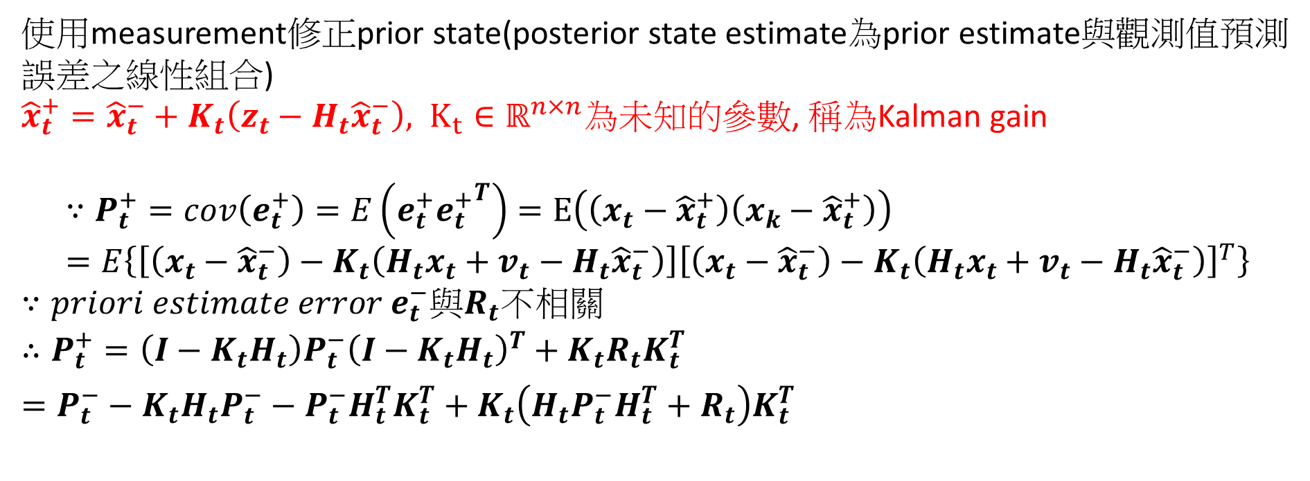
Kalman filter(3)
$x_{t}=A_{t}x_{t−1}+B_{t}u_{t}+w_{t}, w_{t}\sim N(0,Q_{t})$
$$z_{t}=H_{t}x_{t}+v_{t}, v_{t}\sim N(0, R_{t})$$
使用measurement修正prior state(posterior state estimate為prior estimate與觀測值預測誤差之線性組合)
${\hat{x}}_{t}^{+}={\hat{x}}_{t}^{−}+K_{t}\left(z_{t}−H_{t}{\hat{x}}_{t}^{−}\right), K_{t}∈ℝ^{n×n}為未知的參數$, 稱為Kalman gain
$$∵P_{t}^{+}=cov\left(e_{t}^{+}\right)=E\left(e_{t}^{+}{e_{t}^{+}}^{T}\right)=E\left(\left(x_{t}−{\hat{x}}_{t}^{+}\right)\left(x_{k}−{\hat{x}}_{t}^{+}\right)\right)=E\left\{\left[\left(x_{t}−{\hat{x}}_{t}^{−}\right)−K_{t}\left(H_{t}x_{t}+v_{t}−H_{t}{\hat{x}}_{t}^{−}\right)\right]{\left[\left(x_{t}−{\hat{x}}_{t}^{−}\right)−K_{t}\left(H_{t}x_{t}+v_{t}−H_{t}{\hat{x}}_{t}^{−}\right)\right]}^{T}\right\}$$
$$∵priori estimate error e_{t}^{−}與R_{t}不相關$$
$$∴P_{t}^{+}=\left(I−K_{t}H_{t}\right)P_{t}^{−}{\left(I−K_{t}H_{t}\right)}^{T}+K_{t}R_{t}K_{t}^{T}=P_{t}^{−}−K_{t}H_{t}P_{t}^{−}−P_{t}^{−}H_{t}^{T}K_{t}^{T}+K_{t}\left(H_{t}P_{t}^{−}H_{t}^{T}+R_{t}\right)K_{t}^{T}$$

Slide 12
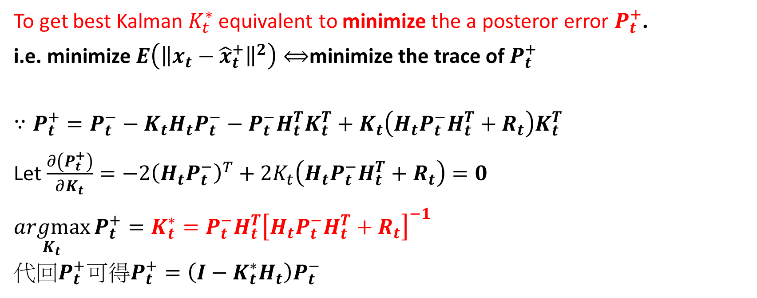
Kalman gain
To get best Kalman $K_{t}^{∗}$ equivalent to minimize the a posteror error $P_{t}^{+}$.
i.e. minimize $E\left({\left\|x_{t}−{\hat{x}}_{t}^{+}\right\|}^{2}\right)⟺$minimize the trace of $P_{t}^{+}$
$$∵P_{t}^{+}=P_{t}^{−}−K_{t}H_{t}P_{t}^{−}−P_{t}^{−}H_{t}^{T}K_{t}^{T}+K_{t}\left(H_{t}P_{t}^{−}H_{t}^{T}+R_{t}\right)K_{t}^{T}$$
Let $\frac{∂\left(P_{t}^{+}\right)}{∂K_{t}}=−2{\left(H_{t}P_{t}^{−}\right)}^{T}+2K_{t}\left(H_{t}P_{t}^{−}H_{t}^{T}+R_{t}\right)=0$
$$\underset{K_{t}}{argmax}{P_{t}^{+}}=K_{t}^{∗}=P_{t}^{−}H_{t}^{T}{\left[H_{t}P_{t}^{−}H_{t}^{T}+R_{t}\right]}^{−1}$$
代回$P_{t}^{+}可得P_{t}^{+}=\left(I−K_{t}^{∗}H_{t}\right)P_{t}^{−}$

Slide 13
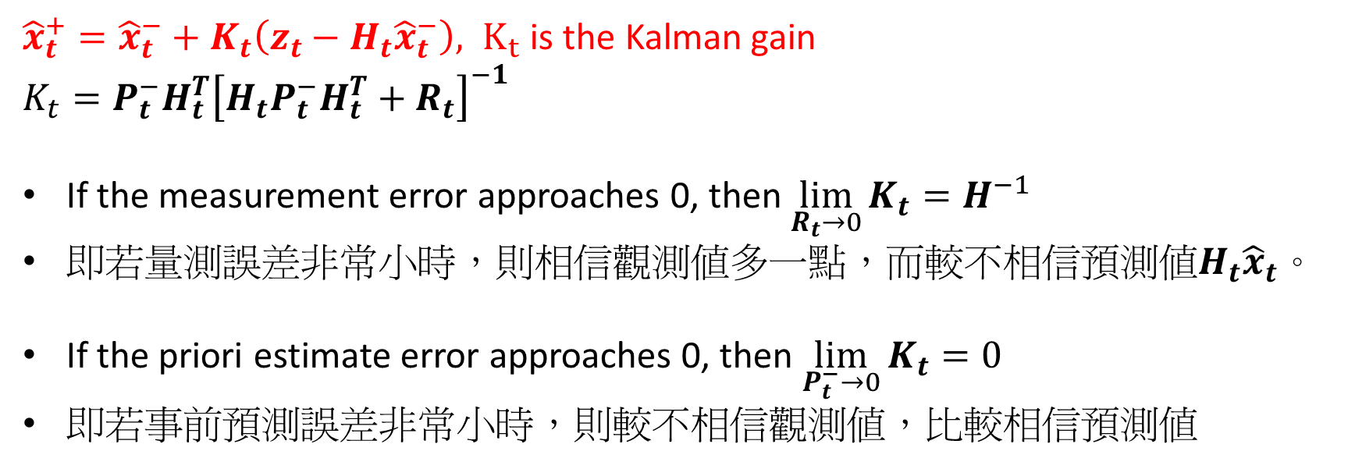
Kalman gain
$x_{t}=A_{t}x_{t−1}+B_{t}u_{t}+w_{t}, w_{t}\sim N(0,Q_{t})$
$$z_{t}=H_{t}x_{t}+v_{t}, v_{t}\sim N(0, R_{t})$$
${\hat{x}}_{t}^{+}={\hat{x}}_{t}^{−}+K_{t}\left(z_{t}−H_{t}{\hat{x}}_{t}^{−}\right), K_{t}$ is the Kalman gain
$$K_{t}=P_{t}^{−}H_{t}^{T}{\left[H_{t}P_{t}^{−}H_{t}^{T}+R_{t}\right]}^{−1}$$
If the measurement error approaches 0, then $\lim_{R_{t}→0}{K_{t}}=H^{−1}$
即若量測誤差非常小時，則相信觀測值多一點，而較不相信預測值$H_{t}{\hat{x}}_{t}$。
If the priori estimate error approaches 0, then $\lim_{P_{t}^{−}→0}{K_{t}}=0$
即若事前預測誤差非常小時，則較不相信觀測值，比較相信預測值

Slide 14

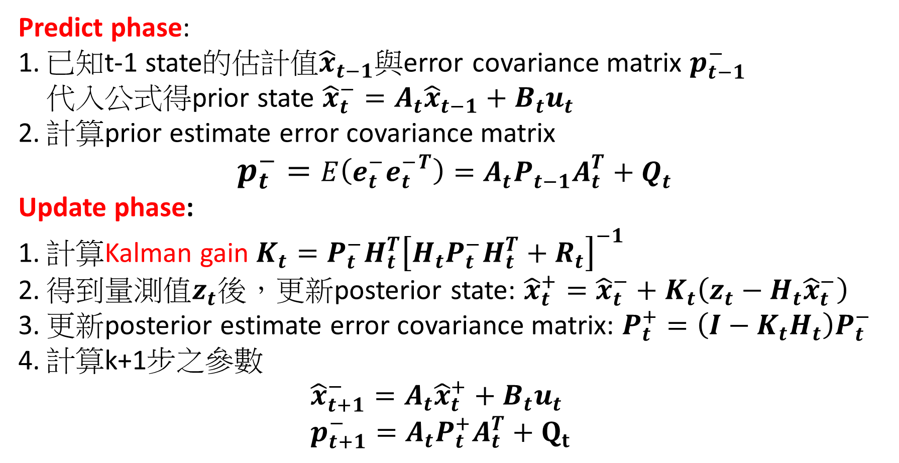
Kalman filter steps:
$x_{t}=A_{t}x_{t−1}+B_{t}u_{t}+w_{t}, w_{t}\sim N(0,Q_{t})$
$$z_{t}=H_{t}x_{t}+v_{t}, v_{t}\sim N(0, R_{t})$$
Predict phase:
已知t-1 state的估計值${\hat{x}}_{t−1}$與error covariance matrix $p_{t−1}^{−}$ 代入公式得prior state ${\hat{x}}_{t}^{−}=A_{t}{\hat{x}}_{t−1}+B_{t}u_{t}$
計算prior estimate error covariance matrix $p_{t}^{−}=E\left(e_{t}^{−}{e_{t}^{−}}^{T}\right)=A_{t}P_{t−1}A_{t}^{T}+Q_{t}$
Update phase:
計算Kalman gain$K_{t}=P_{t}^{−}H_{t}^{T}{\left[H_{t}P_{t}^{−}H_{t}^{T}+R_{t}\right]}^{−1}$
得到量測值$z_{t}$後，更新posterior state: ${\hat{x}}_{t}^{+}={\hat{x}}_{t}^{−}+K_{t}\left(z_{t}−H_{t}{\hat{x}}_{t}^{−}\right)$
更新posterior estimate error covariance matrix: $P_{t}^{+}=\left(I−K_{t}H_{t}\right)P_{t}^{−}$
計算k+1步之參數 ${\hat{x}}_{t+1}^{−}=A_{t}{\hat{x}}_{t}^{+}+B_{t}u_{t}$ $p_{t+1}^{−}=A_{t}P_{t}^{+}A_{t}^{T}+Q_{t}$

Slide 15
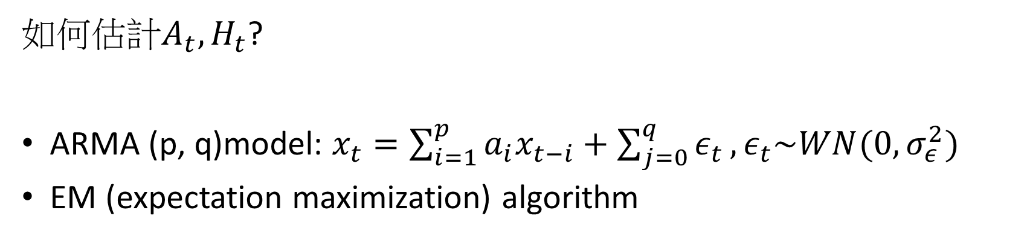

Kalman filter parameter estimation
如何估計$A_{t}, H_{t}$?
ARMA (p, q)model: $x_{t}=\sum_{i=1}^{p}{a_{i}x_{t−i}+\sum_{j=0}^{q}{ε_{t}}, ε_{t}\sim WN(0, σ_{ε}^{2})}$
EM (expectation maximization) algorithm
$x_{t}=A_{t}x_{t−1}+B_{t}u_{t}+w_{t}, w_{t}\sim N(0,Q_{t})$
$$z_{t}=H_{t}x_{t}+v_{t}, v_{t}\sim N(0, R_{t})$$
Pykalman python package

Slide 16
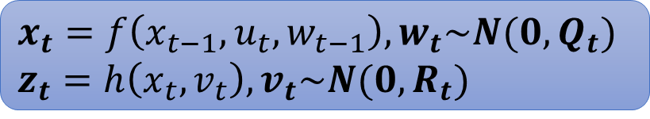
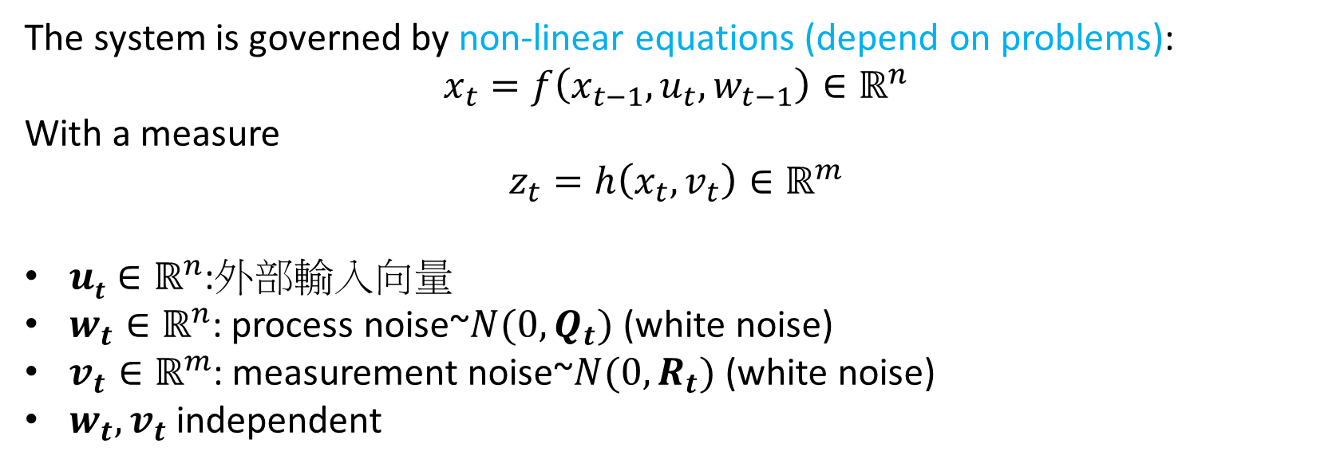
Nonlinear state space model
$x_{t}=f\left(x_{t−1}, u_{t}, w_{t−1}\right), w_{t}\sim N(0,Q_{t})$
$$z_{t}=h\left(x_{t},v_{t}\right), v_{t}\sim N(0, R_{t})$$
The system is governed by non-linear equations (depend on problems):
$$x_{t}=f\left(x_{t−1}, u_{t}, w_{t−1}\right)∈ℝ^{n}$$
With a measure
$$z_{t}=h\left(x_{t},v_{t}\right)∈ℝ^{m}$$
$ut∈ℝ^{n}$:外部輸入向量
$w_{t}∈ℝ^{n}$: process noise~$N(0, Q_{t})$(white noise)
$v_{t}∈ℝ^{m}$: measurement noise~$N(0, R_{t})$(white noise)
$w_{t}, v_{t}$independent

Slide 17


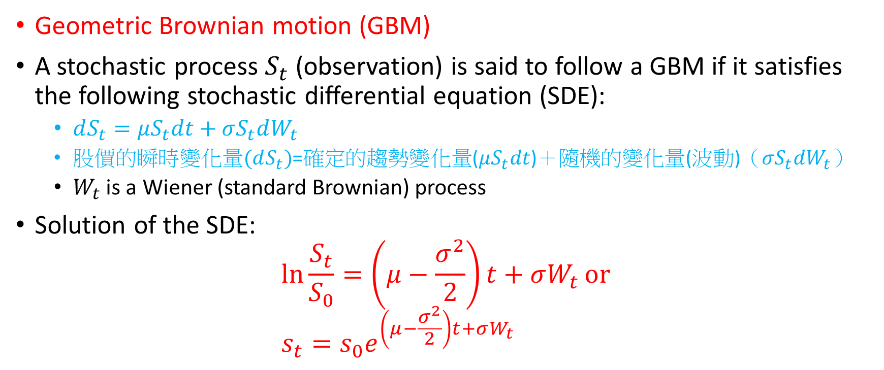

Non-linear transition function of stock price
Geometric Brownian motion (GBM)
A stochastic process $S_{t}$ (observation) is said to follow a GBM if it satisfies the following stochastic differential equation (SDE):
$dS_{t}=μS_{t}dt+σS_{t}dW_{t}$
股價的瞬時變化量$(dS_{t})$=確定的趨勢變化量($μS_{t}dt$)＋隨機的變化量(波動)（$σS_{t}dW_{t}$）
$W_{t}$ is a Wiener (standard Brownian) process
Solution of the SDE: $\ln{\frac{S_{t}}{S_{0}}=\left(μ−\frac{σ^{2}}{2}\right)t+σW_{t}}or$ $s_{t}=s_{0}e^{\left(μ−\frac{σ^{2}}{2}\right)t+σW_{t}}$
Brownian process $\left\{B_{t}\right\}$ (Einstein, 1905):
$B_{0}=0$
$\left\{B_{t}−B_{s}\right\}\sim N(0, σ^{2}\left(t−s\right))$
Independent increment
$∀t>0, B_{t}\sim N(0, σ^{2}t)$
$B_{t}$is continuous
If $σ^{2}=1$,it’s Wiener process $\left\{W_{t}\right\}$

Slide 18
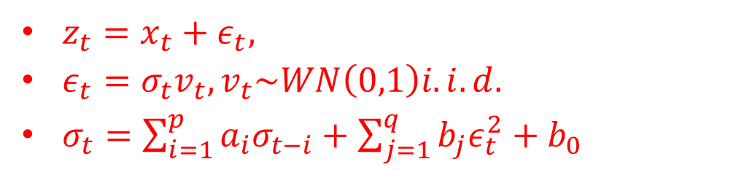
Non-linear transition function of stock price
GARCH (generalized autoregressive conditional heteroskedasticity) family model (Engle, 2003 Nobel Economic Prize)
$z_{t}=x_{t}+ε_{t},$
$ε_{t}=σ_{t}v_{t}, v_{t}\sim WN\left(0,1\right)i.i.d.$
$σ_{t}=\sum_{i=1}^{p}{a_{i}σ_{t−i}+\sum_{j=1}^{q}{b_{j}ε_{t}^{2}+b_{0}}}$
GARCH可描述以下金融時間序列性質(Stylized facts)：
波動(Volatility) 會隨時間變動而改變。
波動不會發散到無窮大，會在固定範圍內變化。
波動具有很強的持續性，即「叢集效應」( volatility clustering )。
資料分佈具厚尾(fat-tail) 性質，即峰度大於3。

Slide 19
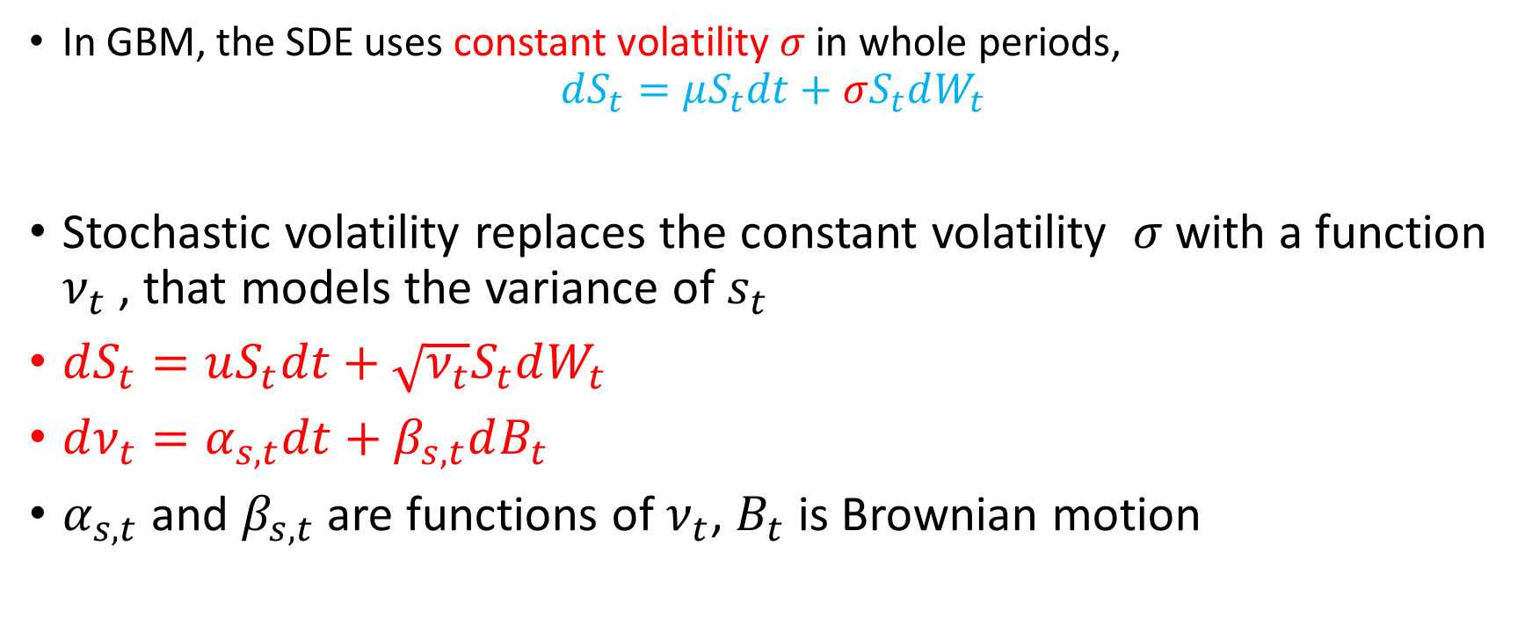
Non-linear transition function of stock price
In GBM, the SDE uses constant volatility $σ$in whole periods, $dS_{t}=μS_{t}dt+σS_{t}dW_{t}$
Stochastic volatility replaces the constant volatility $σ$with a function $ν_{t}$ , that models the variance of $s_{t}$
$dS_{t}=uS_{t}dt+\sqrt{ν_{t}}S_{t}dW_{t}$
$dν_{t}=α_{s,t}dt+β_{s,t}dB_{t}$
$α_{s,t}$ and $β_{s,t}$ are functions of $ν_{t}$, $B_{t}$ is Brownian motion

Slide 20
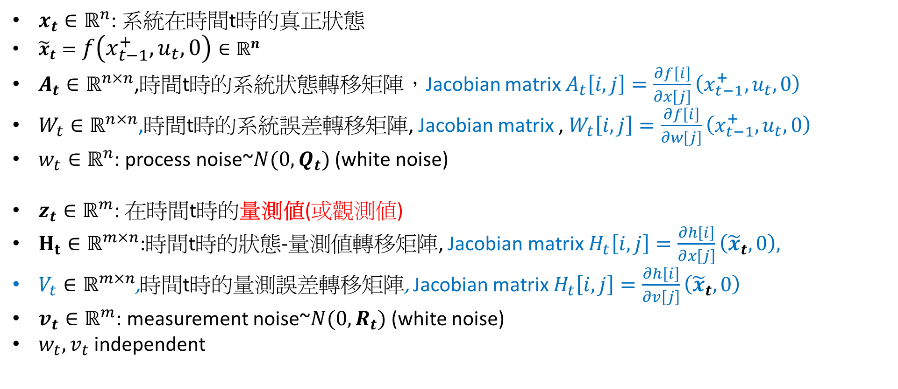
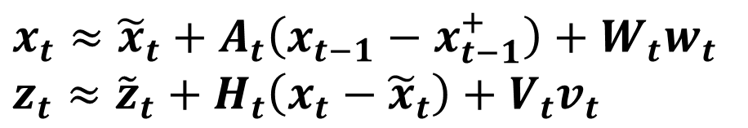
Extend KF(EKF):
$x_{t}≈{\tilde{x}}_{t}+A_{t}\left(x_{t−1}−x_{t−1}^{+}\right)+W_{t}w_{t}$
$z_{t}≈{\tilde{z}}_{t}+H_{t}\left(x_{t}−{\tilde{x}}_{t}\right)+V_{t}v_{t}$
$x_{t}∈ℝ^{n}$: 系統在時間t時的真正狀態
${\tilde{x}}_{t}=f\left(x_{t−1}^{+}, u_{t}, 0\right)∈ℝ^{n}$
$A_{t}∈ℝ^{n×n}$,時間t時的系統狀態轉移矩陣，Jacobian matrix $A_{t}\left[i,j\right]=\frac{∂f\left[i\right]}{∂x\left[j\right]}\left(x_{t−1}^{+},u_{t},0\right)$
$W_{t}∈ℝ^{n×n}$,時間t時的系統誤差轉移矩陣, Jacobian matrix , $W_{t}\left[i,j\right]=\frac{∂f\left[i\right]}{∂w\left[j\right]}\left(x_{t−1}^{+},u_{t},0\right)$
$w_{t}∈ℝ^{n}$: process noise~$N(0, Q_{t})$(white noise)
$z_{t}∈ℝ^{m}$: 在時間t時的量測值(或觀測值)
$H_{t}∈ℝ^{m×n}$:時間t時的狀態-量測值轉移矩陣, Jacobianmatrix $H_{t}\left[i,j\right]=\frac{∂h\left[i\right]}{∂x\left[j\right]}\left({\tilde{x}}_{t}, 0\right),$
$V_{t}∈ℝ^{m×n}$,時間t時的量測誤差轉移矩陣, Jacobian matrix $H_{t}\left[i,j\right]=\frac{∂h\left[i\right]}{∂v\left[j\right]}\left({\tilde{x}}_{t}, 0\right)$
$v_{t}∈ℝ^{m}$: measurement noise~$N(0, R_{t})$(white noise)
$w_{t}, v_{t}$independent

Slide 21
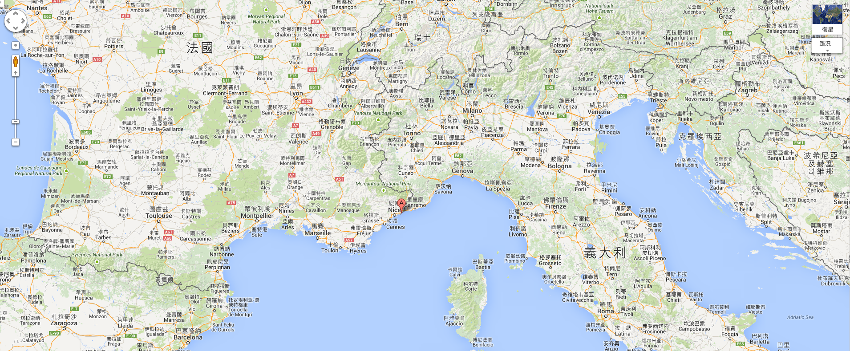
Monte Carlo sampling method

Slide 22
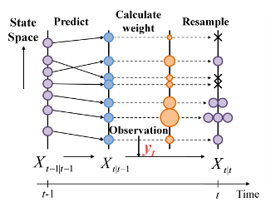
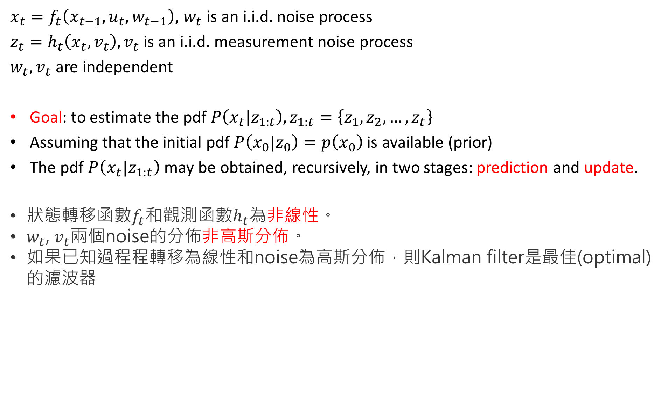
Nonlinear/non-Gaussian state space model
$x_{t}=f_{t}\left(x_{t−1}, u_{t}, w_{t−1}\right)$, $w_{t}$ is an i.i.d. noise process
$z_{t}=h_{t}\left(x_{t}, v_{t}\right), v_{t}$is an i.i.d. measurement noise process
$w_{t}, v_{t}$ are independent
Goal: to estimate the pdf $P\left(x_{t}|z_{1:t}\right), z_{1:t}=\left\{z_{1},z_{2},…,z_{t}\right\}$
Assuming that the initial pdf $P\left(x_{0}|z_{0}\right)=p\left(x_{0}\right)$is available (prior)
The pdf $P\left(x_{t}|z_{1:t}\right)$ may be obtained, recursively, in two stages: prediction and update.
狀態轉移函數$f_{t}$和觀測函數$h_{t}$為非線性。
$w_{t}$, $v_{t}$兩個noise的分佈非高斯分佈。
如果已知過程程轉移為線性和noise為高斯分佈，則Kalmanfilter是最佳(optimal)的濾波器

Slide 23
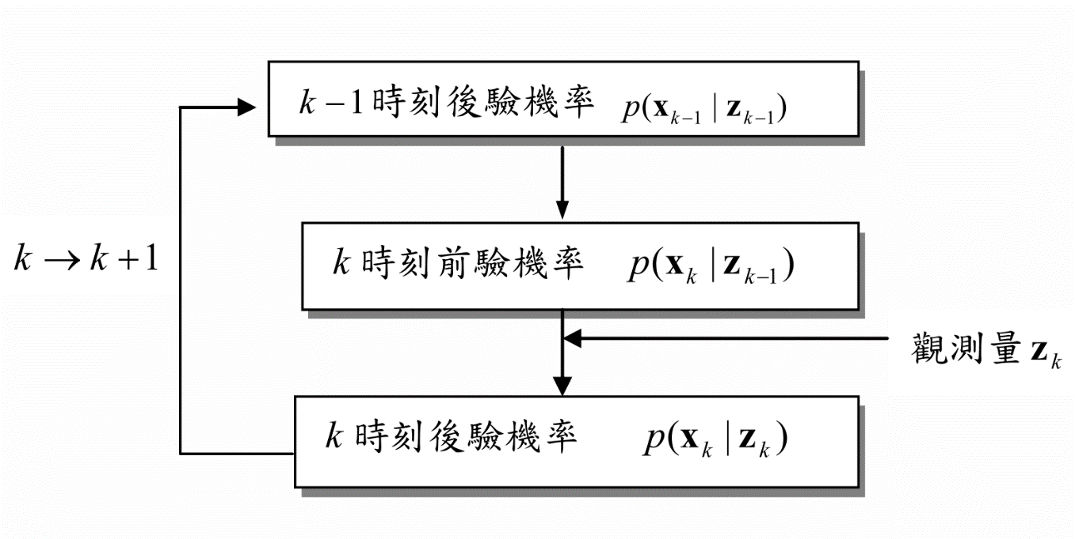
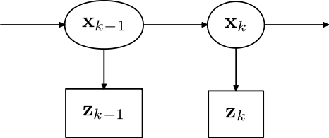
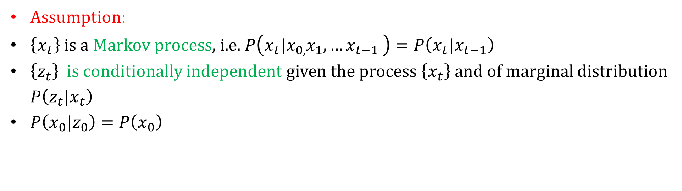
Nonlinear Bayesian tracking
Assumption:
$\left\{x_{t}\right\}$ is a Markov process, i.e. $P\left(x_{t}|x_{0,}x_{1},…x_{t−1} \right)=P\left(x_{t}|x_{t−1}\right)$
$\left\{z_{t}\right\}$is conditionally independent given the process $\left\{x_{t}\right\}$ and of marginal distribution $P\left(z_{t}|x_{t}\right)$
$P\left(x_{0}|z_{0}\right)=P\left(x_{0}\right)$

Slide 24
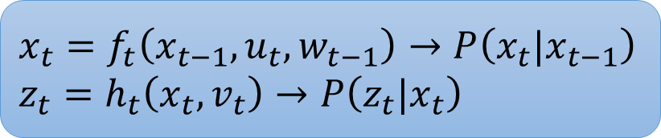
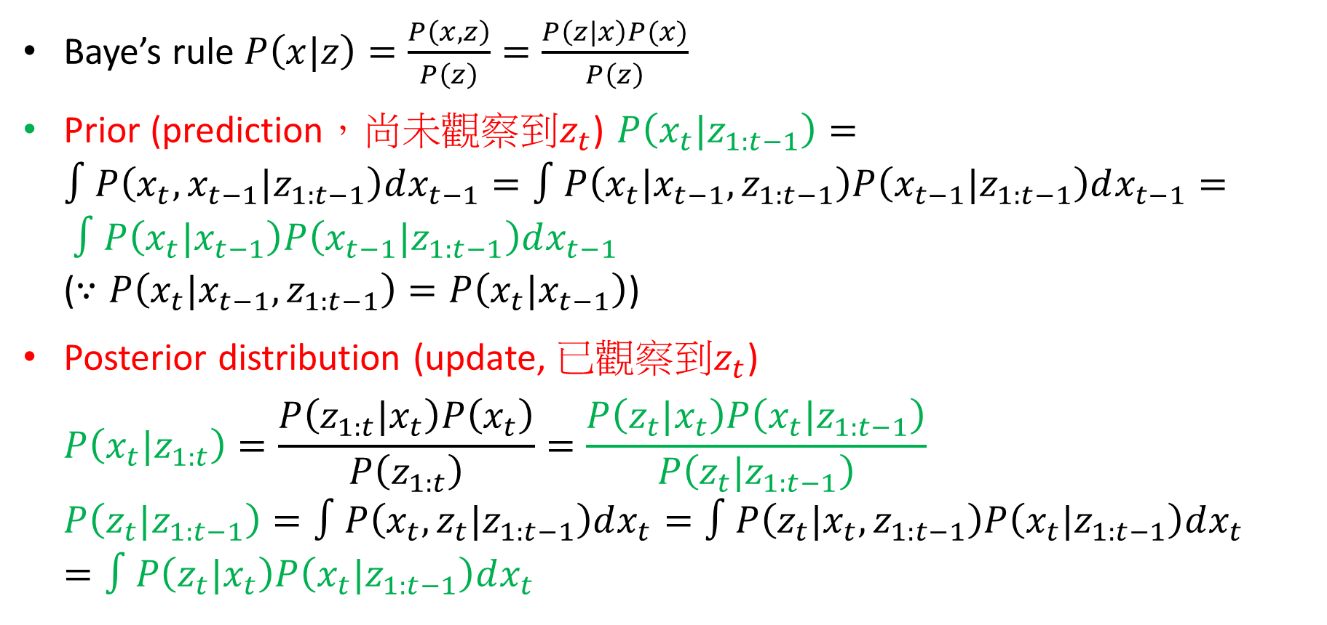
Nonlinear Bayesian tracking
$$x_{t}=f_{t}\left(x_{t−1}, u_{t}, w_{t−1}\right)→P\left(x_{t}|x_{t−1}\right)$$
$$z_{t}=h_{t}\left(x_{t}, v_{t}\right)→P\left(z_{t}|x_{t}\right)$$
Baye’s rule $P\left(x|z\right)=\frac{P\left(x,z\right)}{P\left(z\right)}=\frac{P\left(z|x\right)P(x)}{P\left(z\right)}$
Prior (prediction，尚未觀察到$z_{t}$) $P\left(x_{t}|z_{1:t−1}\right)=∫P\left(x_{t},x_{t−1}|z_{1:t−1}\right)dx_{t−1}=∫P\left(x_{t}|x_{t−1},z_{1:t−1}\right)P\left(x_{t−1}|z_{1:t−1}\right)dx_{t−1}= ∫P\left(x_{t}|x_{t−1}\right)P\left(x_{t−1}|z_{1:t−1}\right)dx_{t−1}$ ($∵P\left(x_{t}|x_{t−1},z_{1:t−1}\right)=P\left(x_{t}|x_{t−1}\right)$)
Posterior distribution (update, 已觀察到$z_{t}$) $P\left(x_{t}|z_{1:t}\right)=\frac{P\left(z_{1:t}|x_{t}\right)P\left(x_{t}\right)}{P\left(z_{1:t}\right)}=\frac{P\left(z_{t}|x_{t}\right)P\left(x_{t}|z_{1:t−1}\right)}{P\left(z_{t}|z_{1:t−1}\right)}$ $P\left(z_{t}|z_{1:t−1}\right)=∫P\left(x_{t},z_{t}|z_{1:t−1}\right)dx_{t}=∫P\left(z_{t}|x_{t},z_{1:t−1}\right)P\left(x_{t}|z_{1:t−1}\right)dx_{t}=∫P\left(z_{t}|x_{t}\right)P\left(x_{t}|z_{1:t−1}\right)dx_{t}$

Slide 25
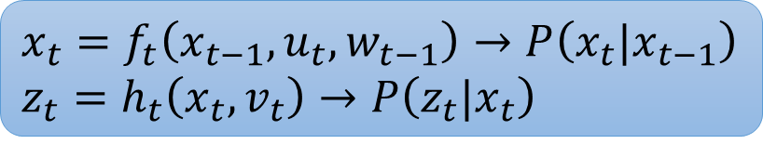
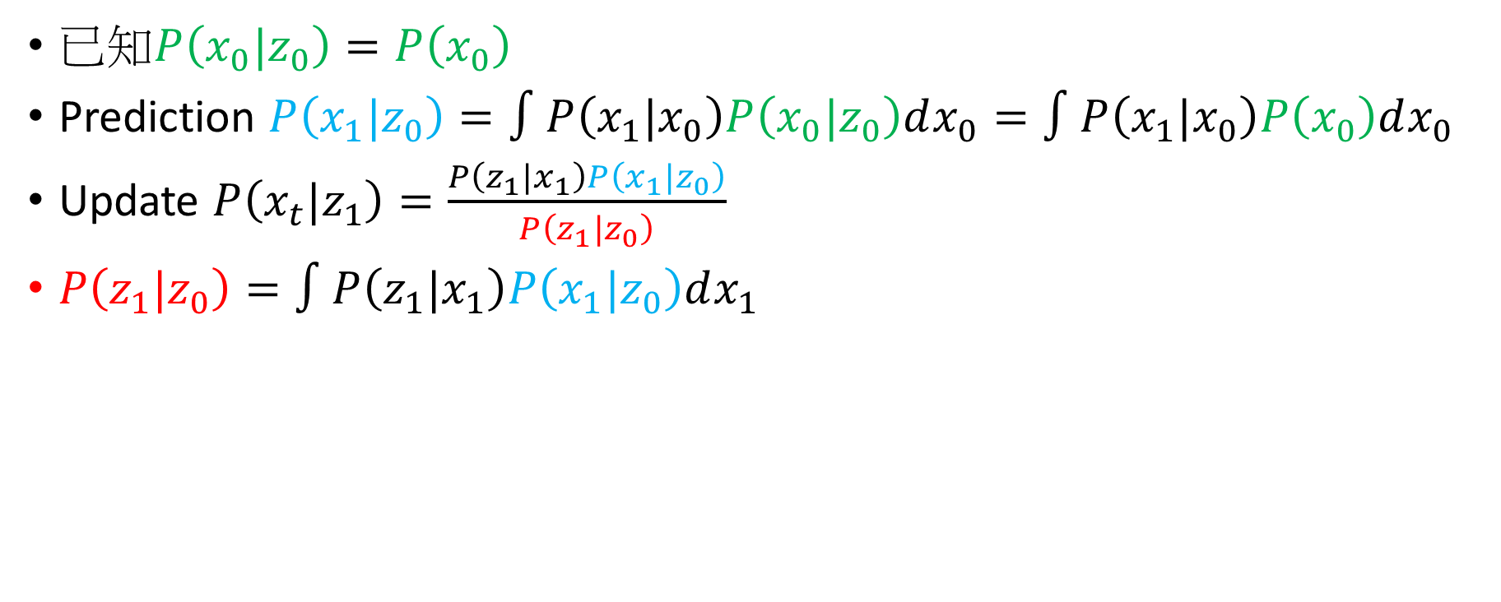
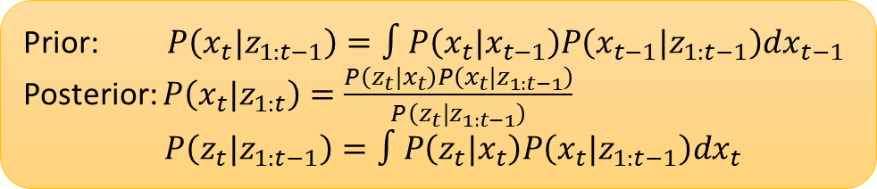
Nonlinear Bayesian tracking
Prior: $P\left(x_{t}|z_{1:t−1}\right)=∫P\left(x_{t}|x_{t−1}\right)P\left(x_{t−1}|z_{1:t−1}\right)dx_{t−1}$
Posterior: $P\left(x_{t}|z_{1:t}\right)=\frac{P\left(z_{t}|x_{t}\right)P\left(x_{t}|z_{1:t−1}\right)}{P\left(z_{t}|z_{1:t−1}\right)}$ $P\left(z_{t}|z_{1:t−1}\right)=∫P\left(z_{t}|x_{t}\right)P\left(x_{t}|z_{1:t−1}\right)dx_{t}$
$$x_{t}=f_{t}\left(x_{t−1}, u_{t}, w_{t−1}\right)→P\left(x_{t}|x_{t−1}\right)$$
$$z_{t}=h_{t}\left(x_{t}, v_{t}\right)→P\left(z_{t}|x_{t}\right)$$
已知$P\left(x_{0}|z_{0}\right)=P\left(x_{0}\right)$
Prediction $P\left(x_{1}|z_{0}\right)=∫P\left(x_{1}|x_{0}\right)P\left(x_{0}|z_{0}\right)dx_{0}=∫P\left(x_{1}|x_{0}\right)P\left(x_{0}\right)dx_{0}$
Update $P\left(x_{t}|z_{1}\right)=\frac{P\left(z_{1}|x_{1}\right)P\left(x_{1}|z_{0}\right)}{P\left(z_{1}|z_{0}\right)}$
$P\left(z_{1}|z_{0}\right)=∫P\left(z_{1}|x_{1}\right)P\left(x_{1}|z_{0}\right)dx_{1}$

Slide 26
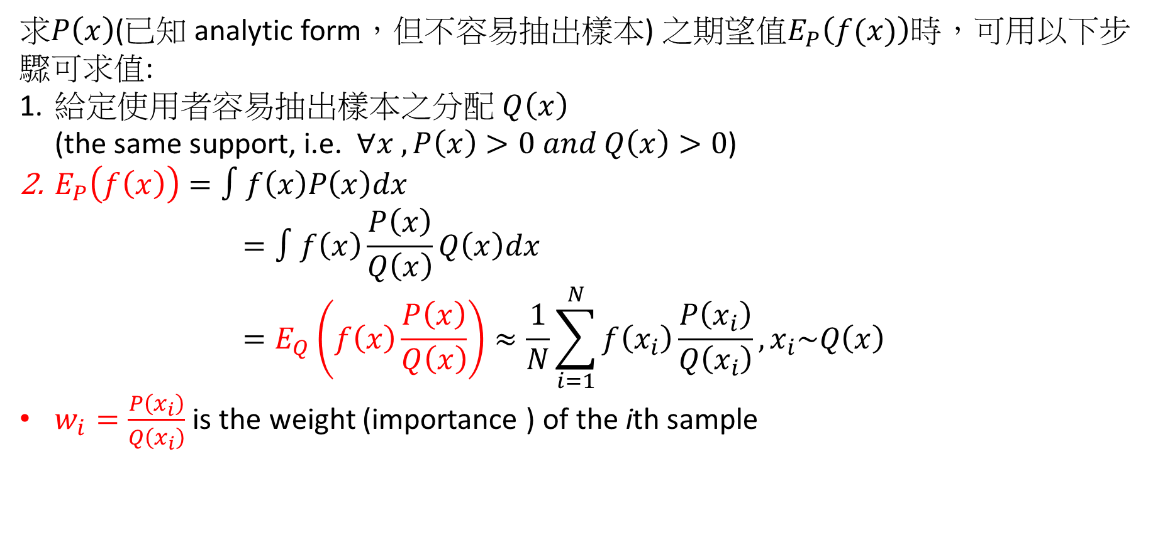
Importance sampling (IS)
求$P\left(x\right)$(已知 analytic form，但不容易抽出樣本) 之期望值$E_{P}\left(f(x)\right)$時，可用以下步驟可求值:
給定使用者容易抽出樣本之分配 $Q\left(x\right)$ (the same support, i.e. $∀x , P\left(x\right)>0 and Q\left(x\right)>0$)
$E_{P}\left(f\left(x\right)\right)=∫f\left(x\right)P\left(x\right)dx$ $=∫f\left(x\right)\frac{P\left(x\right)}{Q\left(x\right)}Q\left(x\right)dx$ $=E_{Q}\left(f\left(x\right)\frac{P\left(x\right)}{Q\left(x\right)}\right)≈\frac{1}{N}\sum_{i=1}^{N}{f\left(x_{i}\right)\frac{P\left(x_{i}\right)}{Q\left(x_{i}\right)}, x_{i}\sim Q\left(x\right)}$
$w_{i}=\frac{P\left(x_{i}\right)}{Q\left(x_{i}\right)}$ is the weight (importance ) of the ith sample

Slide 27
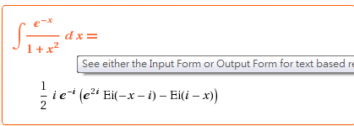
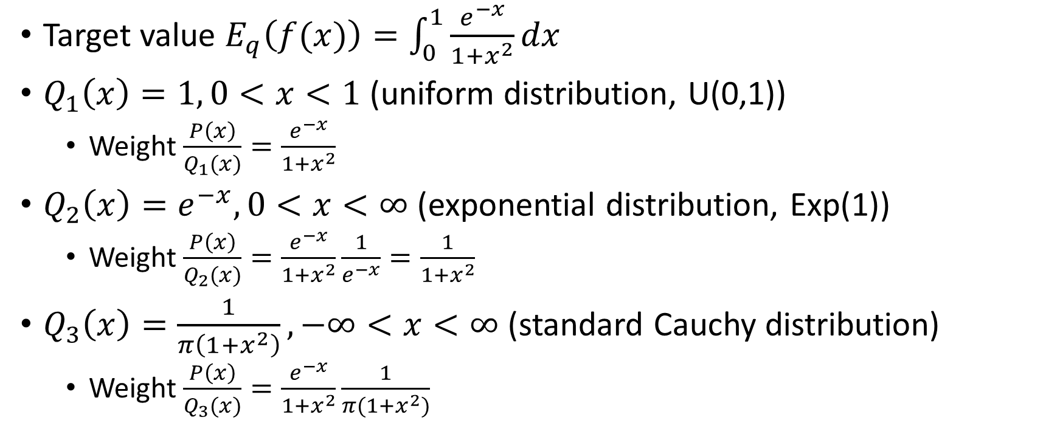
IS Example
Target value $E_{q}\left(f(x)\right)=\int_{0}^{1}{\frac{e^{−x}}{1+x^{2}}dx}$
$Q_{1}\left(x\right)=1, 0<x<1$ (uniform distribution, U(0,1))
Weight $\frac{P\left(x\right)}{Q_{1}(x)}=\frac{e^{−x}}{1+x^{2}}$
$Q_{2}\left(x\right)=e^{−x}, 0<x<∞$ (exponential distribution, Exp(1))
Weight $\frac{P\left(x\right)}{Q_{2}(x)}=\frac{e^{−x}}{1+x^{2}}\frac{1}{e^{−x}}=\frac{1}{1+x^{2}}$
$Q_{3}\left(x\right)=\frac{1}{π\left(1+x^{2}\right)}, −∞<x<∞$ (standard Cauchy distribution)
Weight $\frac{P\left(x\right)}{Q_{3}(x)}=\frac{e^{−x}}{1+x^{2}}\frac{1}{π(1+x^{2})}$

Slide 28
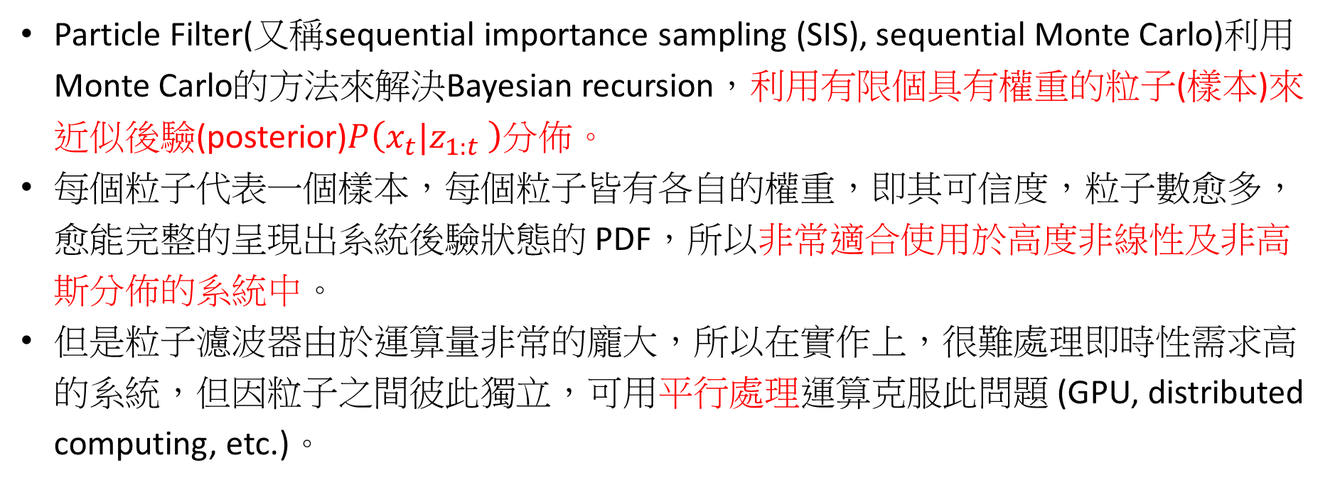
Particle filter
Particle Filter(又稱sequential importance sampling (SIS), sequential Monte Carlo)利用Monte Carlo的方法來解決Bayesian recursion，利用有限個具有權重的粒子(樣本)來近似後驗(posterior)$P\left(x_{t}|z_{1:t} \right)$分佈。
每個粒子代表一個樣本，每個粒子皆有各自的權重，即其可信度，粒子數愈多，愈能完整的呈現出系統後驗狀態的 PDF，所以非常適合使用於高度非線性及非高斯分佈的系統中。
但是粒子濾波器由於運算量非常的龐大，所以在實作上，很難處理即時性需求高的系統，但因粒子之間彼此獨立，可用平行處理運算克服此問題 (GPU, distributed computing, etc.)。

Slide 29
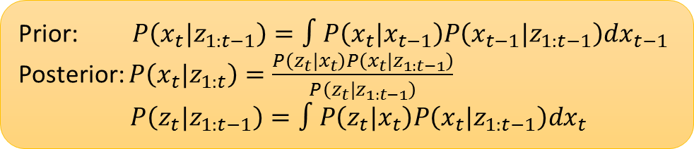
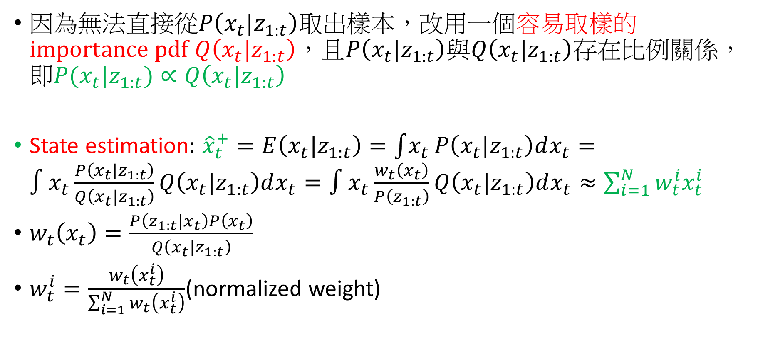
Particle filter
Prior: $P\left(x_{t}|z_{1:t−1}\right)=∫P\left(x_{t}|x_{t−1}\right)P\left(x_{t−1}|z_{1:t−1}\right)dx_{t−1}$
Posterior: $P\left(x_{t}|z_{1:t}\right)=\frac{P\left(z_{t}|x_{t}\right)P\left(x_{t}|z_{1:t−1}\right)}{P\left(z_{t}|z_{1:t−1}\right)}$ $P\left(z_{t}|z_{1:t−1}\right)=∫P\left(z_{t}|x_{t}\right)P\left(x_{t}|z_{1:t−1}\right)dx_{t}$
因為無法直接從$P\left(x_{t}|z_{1:t}\right)$取出樣本，改用一個容易取樣的importance pdf $Q\left(x_{t}|z_{1:t}\right)$，且$P\left(x_{t}|z_{1:t}\right)$與$Q\left(x_{t}|z_{1:t}\right)$存在比例關係，即$P(x_{t}|z_{1:t})∝Q\left(x_{t}|z_{1:t}\right)$
State estimation: ${\hat{x}}_{t}^{+}=E\left(x_{t}|z_{1:t}\right)=\int{x_{t}}P\left(x_{t}|z_{1:t}\right)dx_{t}=∫x_{t}\frac{P\left(x_{t}|z_{1:t}\right)}{Q\left(x_{t}|z_{1:t}\right)}Q\left(x_{t}|z_{1:t}\right)dx_{t}=∫x_{t}\frac{w_{t}\left(x_{t}\right)}{P\left(z_{1:t}\right)}Q\left(x_{t}|z_{1:t}\right)dx_{t}≈\sum_{i=1}^{N}{w_{t}^{i}x_{t}^{i}}$
$w_{t}\left(x_{t}\right)=\frac{P\left(z_{1:t}|x_{t}\right)P\left(x_{t}\right)}{Q\left(x_{t}|z_{1:t}\right)}$
$w_{t}^{i}=\frac{w_{t}\left(x_{t}^{i}\right)}{\sum_{i=1}^{N}{w_{t}\left(x_{t}^{i}\right)}}$(normalized weight)

Slide 30
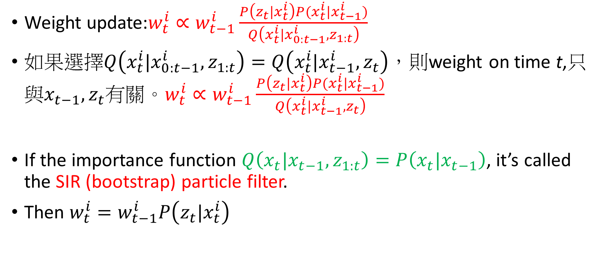
Sample importance resampling (SIR) (bootstrap) particle filter
Weight update:$w_{t}^{i}∝w_{t−1}^{i}\frac{P\left(z_{t}|x_{t}^{i}\right)P(x_{t}^{i}|x_{t−1}^{i})}{Q\left(x_{t}^{i}|x_{0:t−1}^{i},z_{1:t}\right)}$
如果選擇$Q\left(x_{t}^{i}|x_{0:t−1}^{i},z_{1:t}\right)=Q\left(x_{t}^{i}|x_{t−1}^{i},z_{t}\right)$，則weighton time t,只與$x_{t−1},z_{t}$有關。$w_{t}^{i}∝w_{t−1}^{i}\frac{P\left(z_{t}|x_{t}^{i}\right)P(x_{t}^{i}|x_{t−1}^{i})}{Q\left(x_{t}^{i}|x_{t−1}^{i},z_{t}\right)}$
If the importance function $Q\left(x_{t}|{x_{t−1},z}_{1:t}\right)=P\left(x_{t}|x_{t−1}\right)$, it’s called the SIR (bootstrap) particle filter.
Then $w_{t}^{i}=w_{t−1}^{i}P\left(z_{t}|x_{t}^{i}\right)$

Slide 31
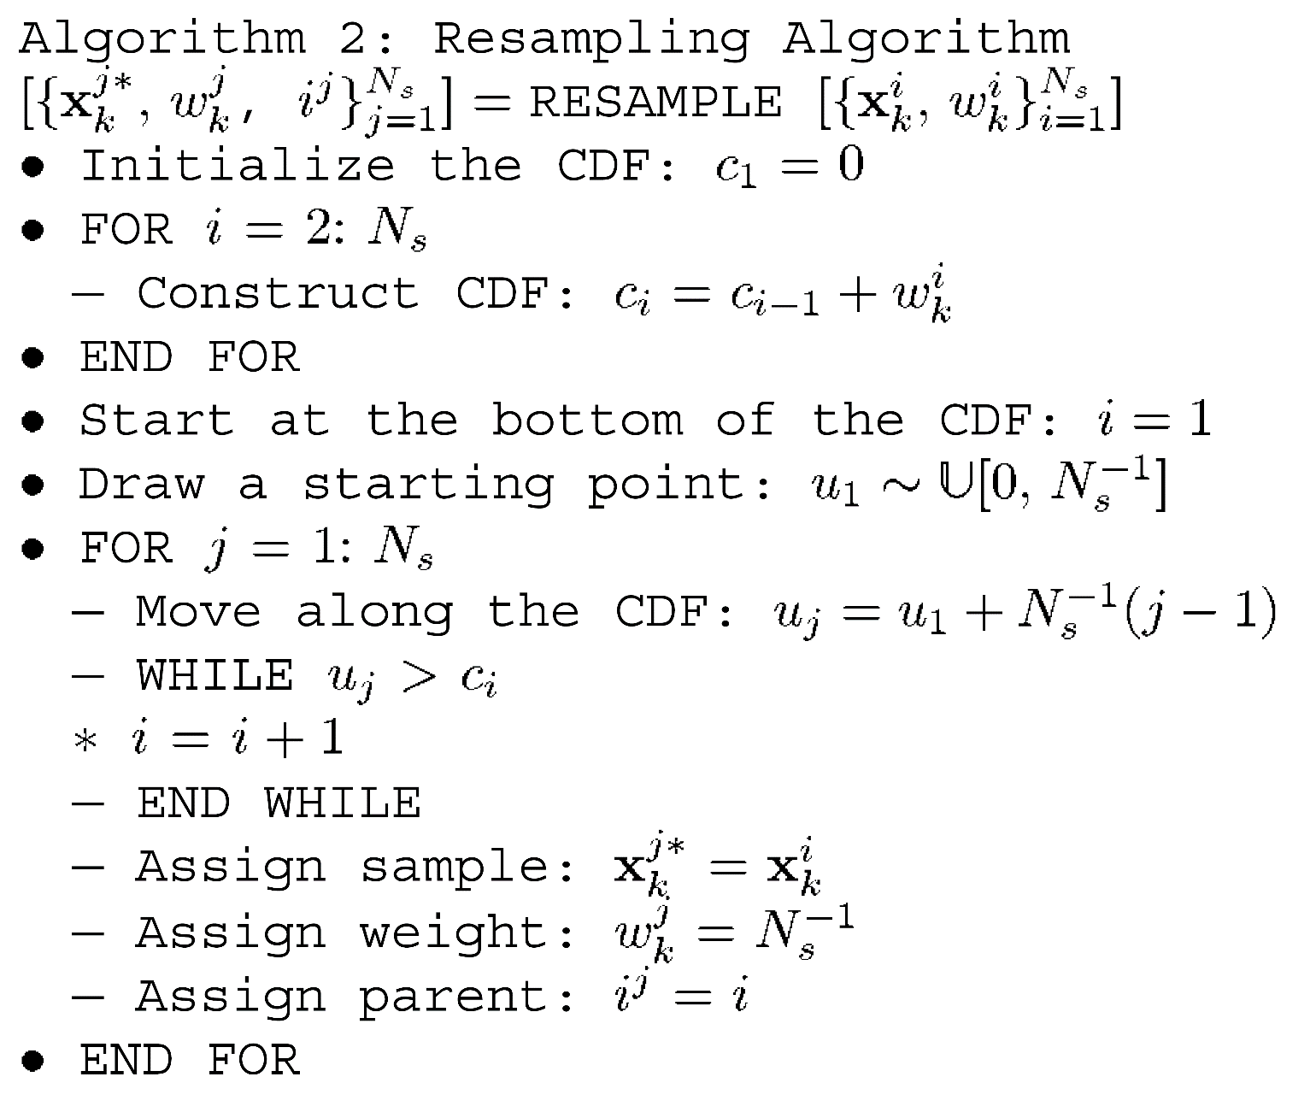
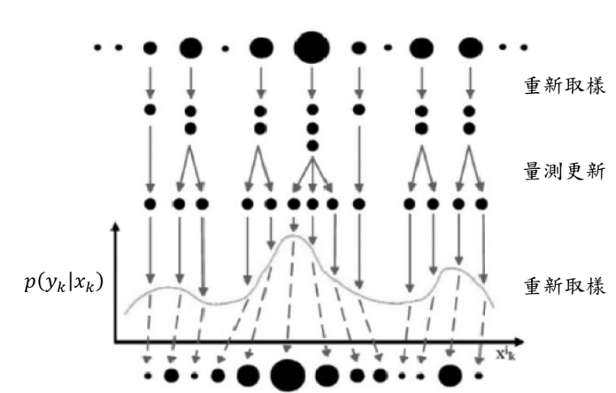
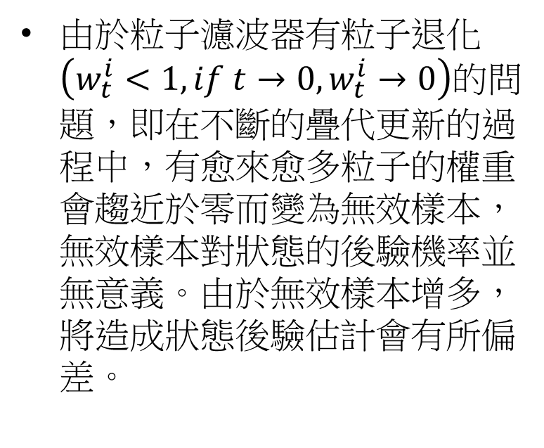
Resampling
由於粒子濾波器有粒子退化$\left(w_{t}^{i}<1, if t→0, w_{t}^{i}→0\right)$的問題，即在不斷的疊代更新的過程中，有愈來愈多粒子的權重會趨近於零而變為無效樣本，無效樣本對狀態的後驗機率並無意義。由於無效樣本增多，將造成狀態後驗估計會有所偏差。

Slide 32

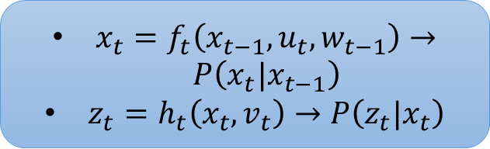
$x_{t}=f_{t}\left(x_{t−1}, u_{t}, w_{t−1}\right)→P\left(x_{t}|x_{t−1}\right)$
$z_{t}=h_{t}\left(x_{t}, v_{t}\right)→P\left(z_{t}|x_{t}\right)$

Slide 33
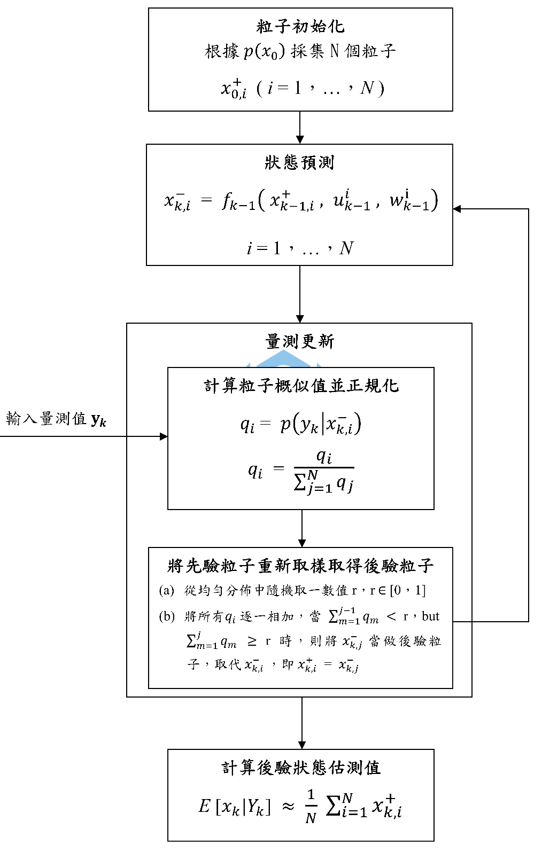
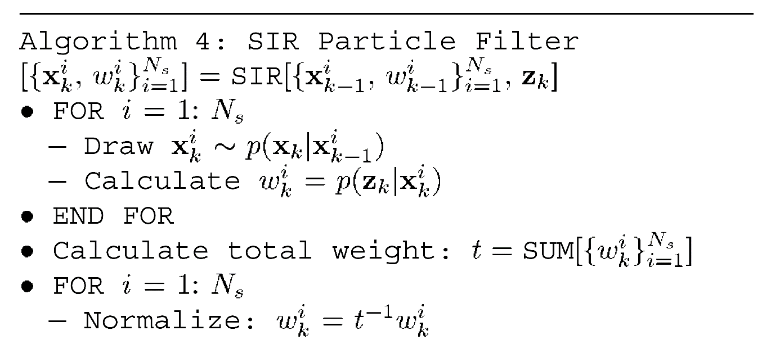

Slide 34



Slide 35



Example
$P\left(x_{t}|x_{t−1}\right)=N\left(x_{t};f_{t}\left(x_{t−1},t\right), Q_{t−1}\right)$
$P\left(z_{t}|x_{t}\right)=N\left(z_{t};\frac{x_{t}^{2}}{20},R_{t}\right)$
Or equivalently
$x_{t}=f_{t}\left(x_{t−1},t\right)+w_{t−1}, w_{t}\sim N\left(0, Q_{t}\right)$
$z_{t}=\frac{x_{t}^{2}}{20}+v_{t}, v_{t}\sim N\left(0, R_{t}\right)$
$where f_{t}\left(x_{t−1},t\right)=\frac{x_{t−1}}{2}+\frac{25x_{t−1}}{1+x_{t−1}^{2}}+8cos⁡(1.2t)$
Set $Q_{t−1}=10, R_{t}=1$

Slide 36


EKF results

Slide 37





SIR, Auxiliary, Regularized, and likelihood PFs

Slide 38


Slide 39

Thanks for your listening!

