Slide 1
Time-Series Classification Based on Individualised Error Prediction
Krisztian Buza, Alexandros Nanopoulos, Lars Schmidt-Thieme
Computational Science and Engineering (CSE), 2010 IEEE 13th International Conference on pp.48-54
Presenter：Guan-Cheng Guo Date：2014/12/30

Slide 2
Abstract
Time-series classification is an active research topic in machine learning, as it finds applications in numerous domains. The k-NN classifier, based on the discrete time warping (DTW) distance, had been shown to be competitive to many state-of-the art time-series classification methods. Nevertheless, due to the complexity of time-series data sets, our investigation demonstrates that a single, global choice for k (≥ 1) can become suboptimal, because each individual region of a data set may require a different k value.

Slide 3
Abstract
In this paper, we proposed a novel individualized error prediction (IEP) mechanism that considers a range of k-NN classifiers (for different k values) and uses secondary regression models that predict the error of each such classifier. This permits to perform k-NN time-series classification in a more fine grained fashion that adapts to the varying characteristics among different regions by avoiding the restriction of a single value of k. Our experimental evaluation, using a large collection of real time-series data, indicates that the proposed method is more robust and compares favorably against two examined baselines by resulting in significant reduction in the classification error.

Slide 4
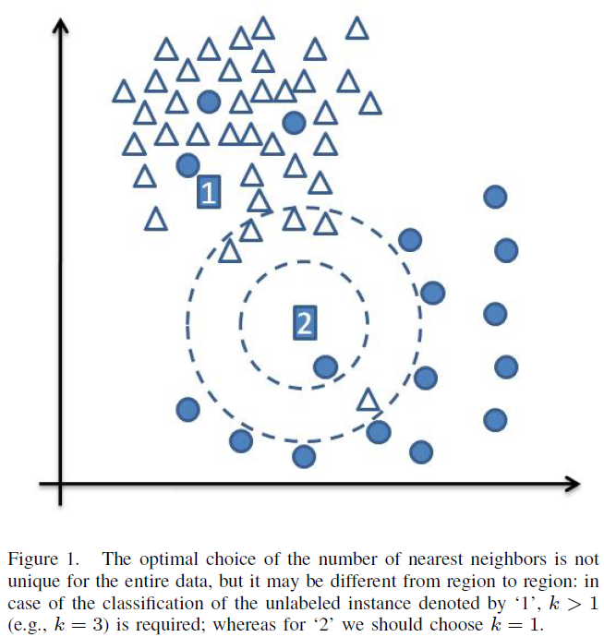
K-NN classifier
Assume ‘1’ as a triangle, whereas ‘2’ as a circle

Slide 5
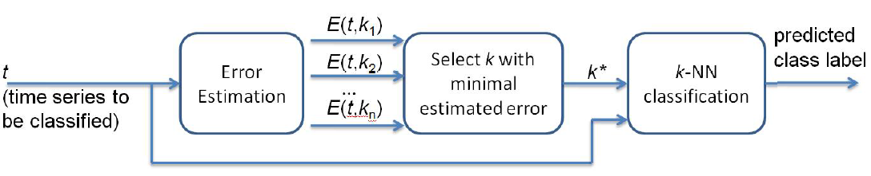
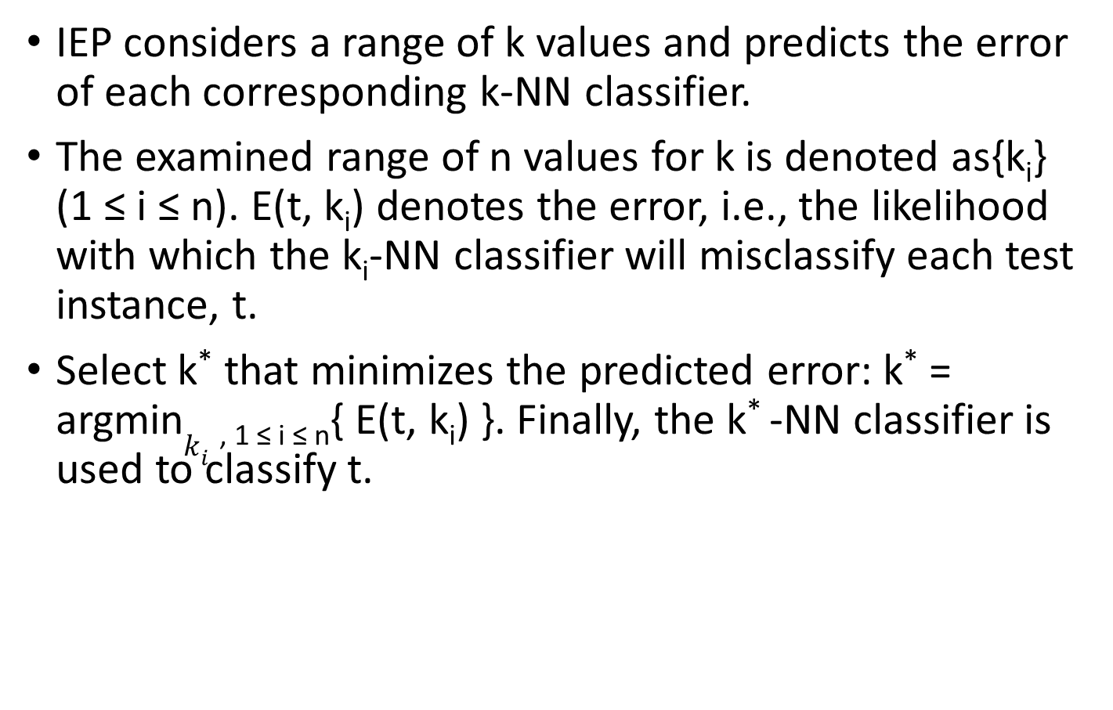
Individualized Error Prediction(IEP)
IEP considers a range of k values and predicts the error of each corresponding k-NN classifier.
The examined range of n values for k is denoted as{k_{i}} (1 ≤ i ≤ n). E(t, k_{i}) denotes the error, i.e., the likelihood with which the k_{i}-NN classifier will misclassify each test instance, t.
Select k*that minimizes the predicted error: k* = argmin$k_{i}$ _{, 1 ≤ i ≤ n}{ E(t, k_{i}) }. Finally, the k* -NN classifier is used to classify t.

Slide 6
Time-series Classification Based on IEP
IEP-based classification involves two types of models:
Primary models, which classify time series with the k-NN classifier (based on the DTW distance).
Secondary models, which predict the error of the primary models.
Partition the original training data set, D, in two disjoint subsets D₁ and D₂. D₂ is called hold-out set.
For each time series t ϵ D₂, and for each examined value of k_{i} in a range 1 ≤ i ≤ n, we use D₁ to classify t with the k_{i} -NN classifier.

Slide 7
Time-series Classification Based on IEP
Based on the class label of t that is given in D₂, we determine if the k_{i} -NN classifier (for each 1 ≤ i ≤ n) has correctly classified t. In case of correct classification, we associate with t an error value of 0, otherwise we associate an error value of 1.
From the hold-out set D₂ we can generate n new data sets D’_{i}, 1 ≤ i ≤ n. Each D’_{i} contains all time-series of the hold-out set D₂ along with their associated error values (0 or 1) for the corresponding k_{i}-NN classifier.

Slide 8
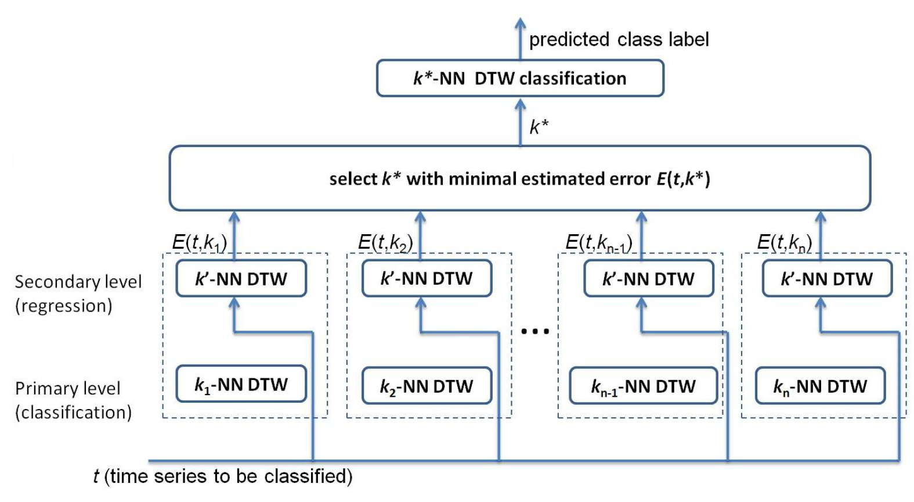
Time-series Classification Based on IEP
Each generated D’_{i} acts as the training set for the corresponding secondary model.
Implement each secondary level model as a k’-NN regression model based on the DTW distance.

Slide 9
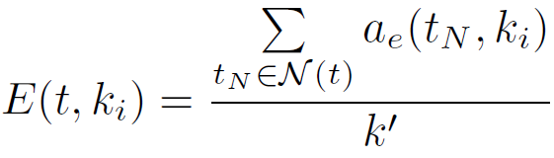
Time-series Classification Based on IEP
The secondary level prediction for a time series t is calculated the following way:
N(t) ⊂ D₂ is the set of k’-NNs of t and
a_{e}(t_{N}, k_{i}) is the associated error value of each t_{N} ϵ N(t).

Slide 10
Experimental Results
Compare the proposed method, denoted as IEP, against two baselines: the 1-NN classifier and the k-NN classifier that selects k using a hold-out set from the training data.
Examine all k values in the range 1-10.

Slide 11
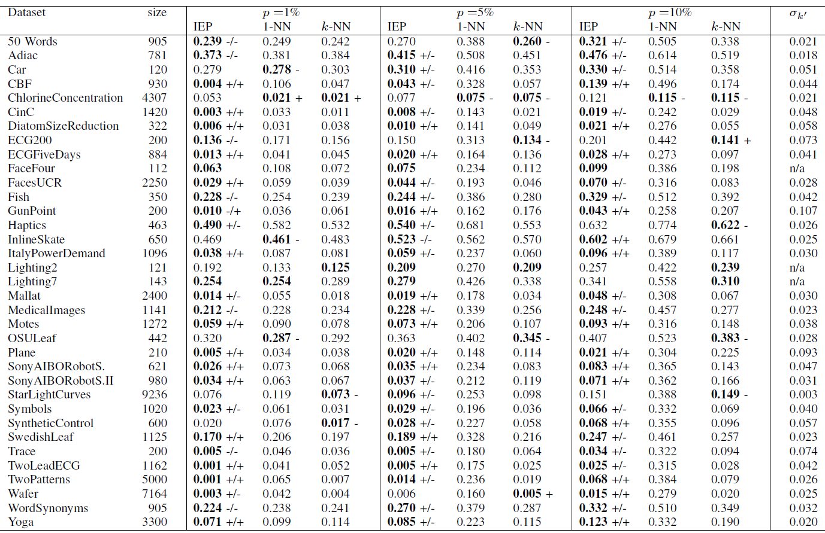
Experimental Results

Slide 12
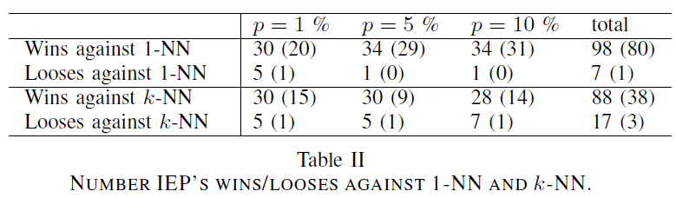
Experimental Results

