Slide 1
Two algorithms for LCS Consecutive Suffix Alignment
Gad M. Landau, Eugene Myers, Michal Ziv-Ukelson
Journal of Computer and System Sciences
Volume 73, Issue 7, pp. 1095–1117 (2007)
Presenter: Tzu-Chiang Hsu (徐子強)
2014/12/30

Slide 2
Abstract (1/3)
The problem of aligning two sequences A and B to determine their similarity is one of the fundamental problems in pattern matching.
A challenging, basic variation of the sequence similarity problem is the incremental string comparison problem, denoted Consecutive Suffix Alignment, which is, given two strings A and B, to compute the alignment solution of each suffix of A versus B.

Slide 3
Abstract (2/3)
Here, we present two solutions to the Consecutive Suffix Alignment Problem under the LCS (Longest Common Subsequence) metric, where the LCS metric measures the subsequence of maximal length common to A and B.

Slide 4
Abstract (3/3)
The first solution is an O(nL) time and space algorithm for constant alphabets, where the size of the compared strings is O(n) and L≤n denotes the size of the LCS of A and B.
The second solution is an O(nL+nlog|Σ|) time and O(n) space algorithm for general alphabets, where Σ denotes the alphabet of the compared strings.

Slide 5
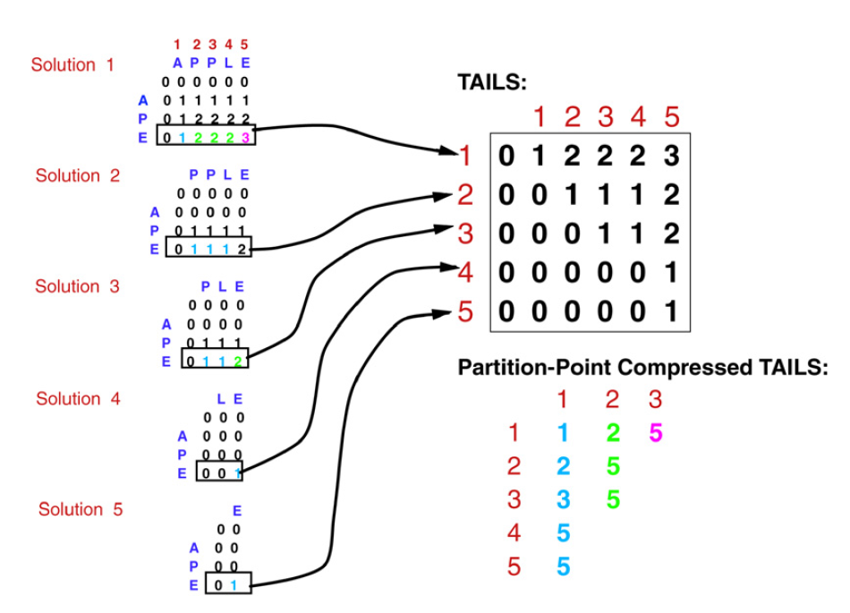

Slide 6
 |  | 1 | 2 | 3 | 4 | 5 | 6 | 7 | 8 | 9
 |  | B | C | B | A | D | B | D | C | D
1 | B |  |  |  | 0 | 0 | 1- | 1 | 1 | 1
2 | C |  |  |  | 0 | 0 | 1 | 1 | 2- | 2
3 | B |  |  |  | 0 | 0 | 1- | 1 | 2 | 2
4 | D |  |  |  | 0 | 1- | 1 | 2- | 2 | 3-
 |  | B | C | B | A | D | B | D | C | D
1 |  |  |  |  |  | 4 | 1 | 1 | 1 | 1
2 |  |  |  |  |  |  |  | 4 | 2 | 2
3 |  |  |  |  |  |  |  |  |  | 4

Slide 7
 |  | 1 | 2 | 3 | 4 | 5 | 6 | 7 | 8 | 9
 |  | B | C | B | A | D | B | D | C | D
1 | B |  |  | 1- | 1 | 1 | 1- | 1 | 1 | 1
2 | C |  |  | 1 | 1 | 1 | 1 | 1 | 2- | 2
3 | B |  |  | 1- | 1 | 1 | 2- | 2 | 2 | 2
4 | D |  |  | 1 | 1 | 2- | 2 | 3- | 3 | 3-
 |  | B | C | B | A | D | B | D | C | D
1 |  |  |  | 1 | 1 | 1 | 1 | 1 | 1 | 1
2 |  |  |  |  |  | 4 | 3 | 3 | 2 | 2
3 |  |  |  |  |  |  |  | 4 | 4 | 4

Slide 8
 |  | 1 | 2 | 3 | 4 | 5 | 6 | 7 | 8 | 9
 |  | B | C | B | A | D | B | D | C | D
1 | B |  |  | 1- | 0 | 0 | 1- | 1 | 1 | 1
2 | C |  |  |  | 0 | 0 | 1 | 1 | 2- | 2
3 | B |  |  |  | 0 | 0 | 1- | 1 | 2 | 2
4 | D |  |  |  | 0 | 1- | 1 | 2- | 2 | 3-
 |  | B | C | B | A | D | B | D | C | D
1 |  |  |  |  |  | 4 | 1 | 1 | 1 | 1
2 |  |  |  |  |  |  |  | 4 | 2 | 2
3 |  |  |  |  |  |  |  |  |  | 4

Slide 9
 |  | 1 | 2 | 3 | 4 | 5 | 6 | 7 | 8 | 9
 |  | B | C | B | A | D | B | D | C | D
1 | B |  |  | 1- | 0 | 0 | 1- | 1 | 1 | 1
2 | C |  |  | 1 | 0 | 0 | 1 | 1 | 2- | 2
3 | B |  |  | 1- | 0 | 0 | 1- | 1 | 2 | 2
4 | D |  |  | 1 | 0 | 1- | 1 | 2- | 2 | 3-
 |  |  |  | 0 | 0 | 0
 |  | B | C | B | A | D | B | D | C | D
1 |  |  |  | 1 |  | 4 | 1 | 1 | 1 | 1
2 |  |  |  |  |  |  |  | 4 | 2 | 2
3 |  |  |  |  |  |  |  |  |  | 4

Slide 10
 |  | 1 | 2 | 3 | 4 | 5 | 6 | 7 | 8 | 9
 |  | B | C | B | A | D | B | D | C | D
1 | B |  |  | 1- | 1 | 0 | 1- | 1 | 1 | 1
2 | C |  |  | 1 | 1 | 0 | 1 | 1 | 2- | 2
3 | B |  |  | 1- | 1 | 0 | 1- | 1 | 2 | 2
4 | D |  |  | 1 | 1 | 1- | 1 | 2- | 2 | 3-
 |  |  |  | 0 | 0 | 0
 |  | B | C | B | A | D | B | D | C | D
1 |  |  |  | 1 | 1 | 4 | 1 | 1 | 1 | 1
2 |  |  |  |  |  |  |  | 4 | 2 | 2
3 |  |  |  |  |  |  |  |  |  | 4

Slide 11
 |  | 1 | 2 | 3 | 4 | 5 | 6 | 7 | 8 | 9
 |  | B | C | B | A | D | B | D | C | D
1 | B |  |  | 1- | 1 | 0->1 | 1- | 1 | 1 | 1
2 | C |  |  | 1 | 1 | 0->1 | 1 | 1 | 2- | 2
3 | B |  |  | 1- | 1 | 0->1 | 1- | 1 | 2 | 2
4 | D |  |  | 1 | 1 | 1->2 | 1 | 2- | 2 | 3-
 |  | B | C | B | A | D | B | D | C | D
1 |  |  |  | 1 | 1 | 4 | 1 | 1 | 1 | 1
2 |  |  |  |  |  |  |  | 4 | 2 | 2
3 |  |  |  |  |  |  |  |  |  | 4

Slide 12
 |  | 1 | 2 | 3 | 4 | 5 | 6 | 7 | 8 | 9
 |  | B | C | B | A | D | B | D | C | D
1 | B |  |  | 1- | 1 | 1 | 1- | 1 | 1 | 1
2 | C |  |  | 1 | 1 | 1 | 1 | 1 | 2- | 2
3 | B |  |  | 1- | 1 | 1 | 1- | 1 | 2 | 2
4 | D |  |  | 1 | 1 | 2- | 1 | 2- | 2 | 3-
 |  | B | C | B | A | D | B | D | C | D
1 |  |  |  | 1 | 1 | 1 | 1 | 1 | 1 | 1
2 |  |  |  |  |  | 4 |  | 4 | 2 | 2
3 |  |  |  |  |  |  |  |  |  | 4

Slide 13
 |  | 1 | 2 | 3 | 4 | 5 | 6 | 7 | 8 | 9
 |  | B | C | B | A | D | B | D | C | D
1 | B |  |  | 1- | 1 | 1 | 1- | 1 | 1 | 1
2 | C |  |  | 1 | 1 | 1 | 1 | 1 | 2- | 2
3 | B |  |  | 1- | 1 | 1 | 1->2 | 1 | 2 | 2
4 | D |  |  | 1 | 1 | 2- | 1->2 | 2- | 2 | 3-
 |  | B | C | B | A | D | B | D | C | D
1 |  |  |  | 1 | 1 | 1 | 1 | 1 | 1 | 1
2 |  |  |  |  |  | 4 | 3 | 4 | 2 | 2
3 |  |  |  |  |  |  |  |  |  | 4

Slide 14
 |  | 1 | 2 | 3 | 4 | 5 | 6 | 7 | 8 | 9
 |  | B | C | B | A | D | B | D | C | D
1 | B |  |  | 1- | 1 | 1 | 1- | 1 | 1 | 1
2 | C |  |  | 1 | 1 | 1 | 1 | 1 | 2- | 2
3 | B |  |  | 1- | 1 | 1 | 2- | 1 | 2 | 2
4 | D |  |  | 1 | 1 | 2- | 2 | 2- | 2 | 3-
 |  | B | C | B | A | D | B | D | C | D
1 |  |  |  | 1 | 1 | 1 | 1 | 1 | 1 | 1
2 |  |  |  |  |  | 4 | 3 | 4 | 2 | 2
3 |  |  |  |  |  |  |  |  |  | 4

Slide 15
 |  | 1 | 2 | 3 | 4 | 5 | 6 | 7 | 8 | 9
 |  | B | C | B | A | D | B | D | C | D
1 | B |  |  | 1- | 1 | 1 | 1- | 1 | 1 | 1
2 | C |  |  | 1 | 1 | 1 | 1 | 1 | 2- | 2
3 | B |  |  | 1- | 1 | 1 | 2- | 2 | 2 | 2
4 | D |  |  | 1 | 1 | 2 | 2 | 3- | 2 | 3-
 |  | B | C | B | A | D | B | D | C | D
1 |  |  |  | 1 | 1 | 1 | 1 | 1 | 1 | 1
2 |  |  |  |  |  | 4 | 3 | 3 | 2 | 2
3 |  |  |  |  |  |  |  | 4 |  | 4

Slide 16
 |  | 1 | 2 | 3 | 4 | 5 | 6 | 7 | 8 | 9
 |  | B | C | B | A | D | B | D | C | D
1 | B |  |  | 1- | 1 | 1 | 1- | 1 | 1 | 1
2 | C |  |  | 1 | 1 | 1 | 1 | 1 | 2- | 2
3 | B |  |  | 1- | 1 | 1 | 2- | 2 | 2 | 2
4 | D |  |  | 1 | 1 | 2 | 2 | 3- | 3 | 3-
 |  | B | C | B | A | D | B | D | C | D
1 |  |  |  | 1 | 1 | 1 | 1 | 1 | 1 | 1
2 |  |  |  |  |  | 4 | 3 | 3 | 2 | 2
3 |  |  |  |  |  |  |  | 4 | 4 | 4

Slide 17
 |  | 1 | 2 | 3 | 4 | 5 | 6 | 7 | 8 | 9
 |  | B | C | B | A | D | B | D | C | D
1 | B |  |  | 1- | 1 | 1 | 1- | 1 | 1 | 1
2 | C |  |  | 1 | 1 | 1 | 1 | 1 | 2- | 2
3 | B |  |  | 1- | 1 | 1 | 2- | 2 | 2 | 2
4 | D |  |  | 1 | 1 | 2 | 2 | 3- | 3 | 3-
 |  | B | C | B | A | D | B | D | C | D
1 |  |  |  | 1 | 1 | 1 | 1 | 1 | 1 | 1
2 |  |  |  |  |  | 4 | 3 | 3 | 2 | 2
3 |  |  |  |  |  |  |  | 4 | 4 | 4

Slide 18
 |  | 1 | 2 | 3 | 4 | 5 | 6 | 7 | 8 | 9
 |  | B | C | B | A | D | B | D | C | D
1 | B |  |  | 1- | 1 | 1 | 1- | 1 | 1 | 1
2 | C |  |  | 1 | 1 | 1 | 1 | 1 | 2- | 2
3 | B |  |  | 1- | 1 | 1 | 2- | 2 | 2 | 2
4 | D |  |  | 1 | 1 | 2 | 2 | 3- | 3 | 3-
 |  | B | C | B | A | D | B | D | C | D
1 |  |  |  | 1 | 1 | 1 | 1 | 1 | 1 | 1
2 |  |  |  |  |  | 4 | 3 | 3 | 2 | 2
3 |  |  |  |  |  |  |  | 4 | 4 | 4
O(nL) time and space

