Slide 1
Average Case Analysis of Algorithms on
Sequences
Wojciech Szpankowski, John Wiley & sons, INC.,
ISBN: 0-471-24063-X, 2001
Section 2.1~2.3
Presenter: Chiou-Ting Tseng
Date: July 11, 2007

Slide 2
Probabilistic Models of Strings
Memoryless Source
Markov Source
(Strongly)Ψ-Mixing Source
Stationary and Ergodic Source
X=X₁X₂X₃...

Slide 3
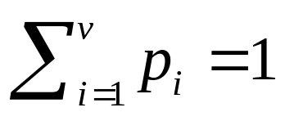
Memoryless Source
Symbols of the string occur independently of one another.
Pr{X_{j} =ω_{i}} = p_{i} and

Slide 4
Markov Source
There is a Markovian dependency between consecutive symbols in a string.
p_{ij} = Pr{X_{k+1} =ω_{j} | X_{k} =ω_{i} }
In general X_{k+1} may depend on the last r symbols, and then we have rth order Makov chains.
Finite state source, hidden Markov source: X_{k} = f(S_{k})

Slide 5
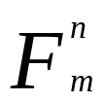
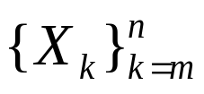
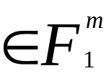
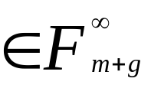
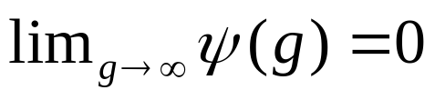
(Strongly)Ψ-Mixing Source
Let be a σ-field generated by for m ≤ n. The source is called mixing, if there exists a bounded function ψ(g) such that for all m, g ≥ 1 and any two events A and B the following holds
If in addition, , then the source is called strongly mixing
i.i.d.→ Pr{AB}=Pr{A}Pr{B}

Slide 6
φ-mixing
Ψ-mixing implies φ-mixing condition but not vice versa.
Theorem 2.1 If X_{k} is a finite-state irreducible stationary aperiodic Markov chain, then X_{k} is a stronglyΨ-mixing process, hence also φ-mixing.

Slide 7
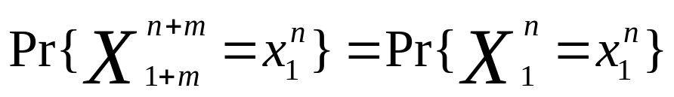
Stationary and Ergodic Source
In stationary model,

Slide 8
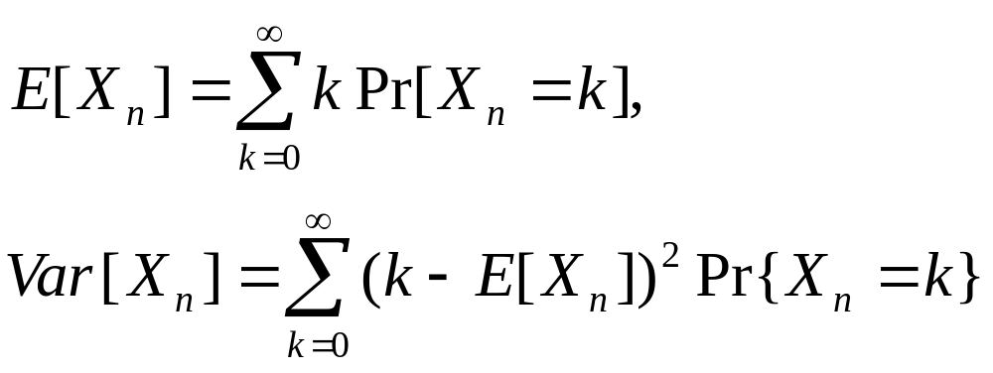
Review of Probability
I(A) = 1 when event A occurs, 0 otherwise.

Slide 9
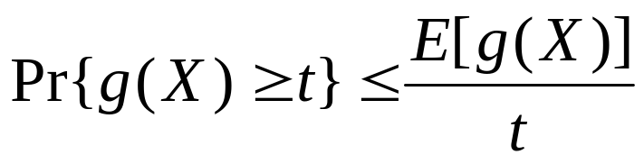
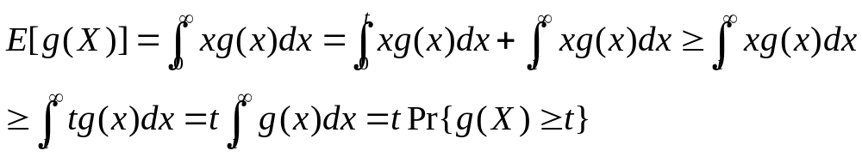
Markov’s Inequality
Proof:

Slide 10
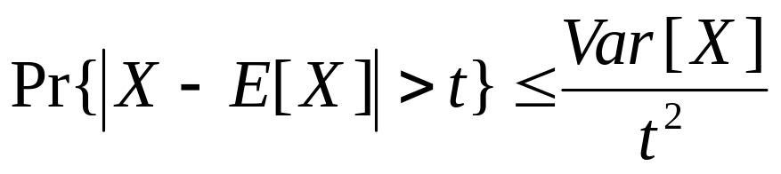
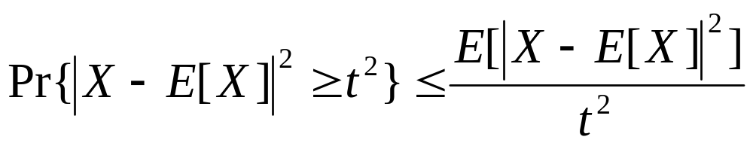
Chebyshev’s Inequality
g(X)→| X – E[X]|², t →t²

Slide 11
(Cauchy-)Schwarz’s Inequality
Let X and Y be such that E[X²] < ∞ and E[Y²] < ∞. Then
E[|XY|]² ≤ E[X²]E[Y²]
equal iff X=αY

Slide 12
Jensen’s Inequality
Let f() be a downward convex function, that is for λ∈(0, 1), λf(x)+(1- λ)f(y) ≥ f(λx+(1- λ)y). Then
f(E[X]) ≤ E[f(X)]
with the equality holding when f() is a linear function.

Slide 13
Minkowski’s Inequality
If E[|X|^{p}] < ∞ and E[|Y|^{p}] < ∞, then E[|X+Y|^{p}] < ∞ and
E[|X+Y|^{p}]^{1/p} ≤ E[|X|^{p}]^{1/p} + E[|Y|^{p}]^{1/p}
for 1 ≤ p < ∞
(triangular inequality in L^{p}-space)

Slide 14
Hölder’s Inequality
Let 0 ≤ θ ≤1, and E[X] < ∞, E[Y] < ∞. Then
E[X^{θ}Y^{1-θ}] ≤ E[X]^{θ}E[Y]^{1-θ}
Let 1 ≤ p, q ≤ ∞ with 1/p+1/q = 1
E[XY] ≤E[X^{p}]^{1/p}E[Y^{q}]^{1/q}
When p = q = 2, it is Cauchy-Schwarz’s Inequality.

Slide 15
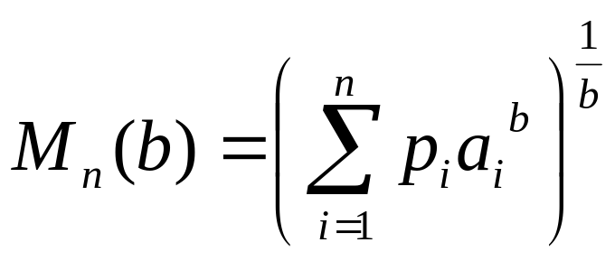
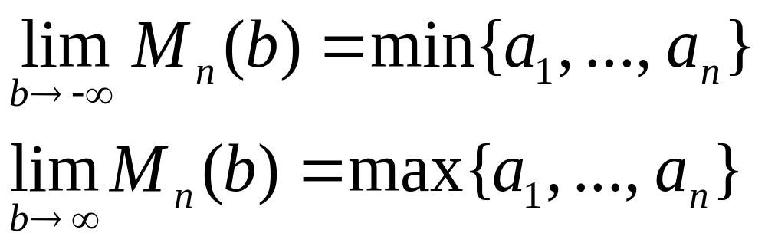
Inequality on Means
, b∈ [-∞, ∞] - {0}
r < s → M_{n}(r) ≤ M_{n}(s), equality holds when a₁ = a₂ = a₃ = ... = a_{n}
Hilbert’s inequality on Means

Slide 16
Types of Stochastic Convergence
Convergence in probability
Almost sure convergence / Strong Convergence
Convergence in distribution / Convergence in law.
Convergence in mean of order p / Convergence in L^{p}
Convergence in moments

Slide 17
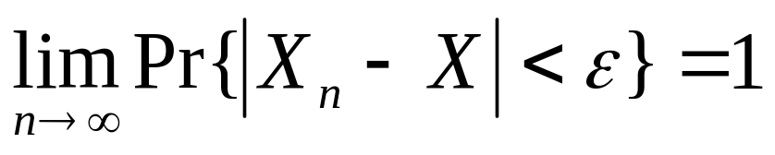
Convergence in probability

Slide 18
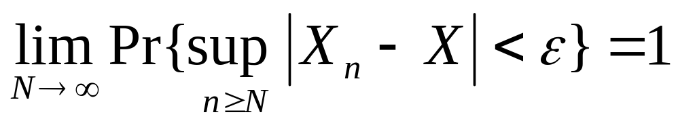
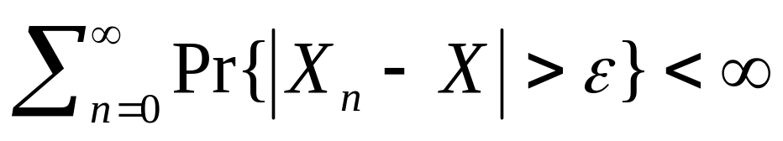
Almost sure convergence
If for every ε> 0,
, then X_{n} almost surely converges to X.

Slide 19
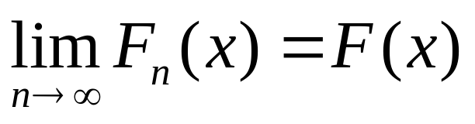
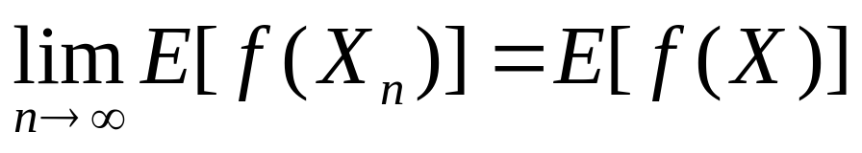
Convergence in distribution
Let the distribution of a sequence of random variables be F_{n}(x).

Slide 20
Convergence in mean of order p
Convergence in L^{p}
E[|X_{n} – X|^{p}] → 0 as n → ∞

Slide 21
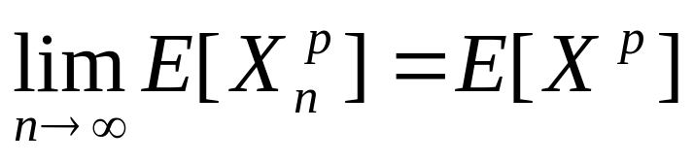
Convergence in moments
for any p ≥ 1

Slide 22
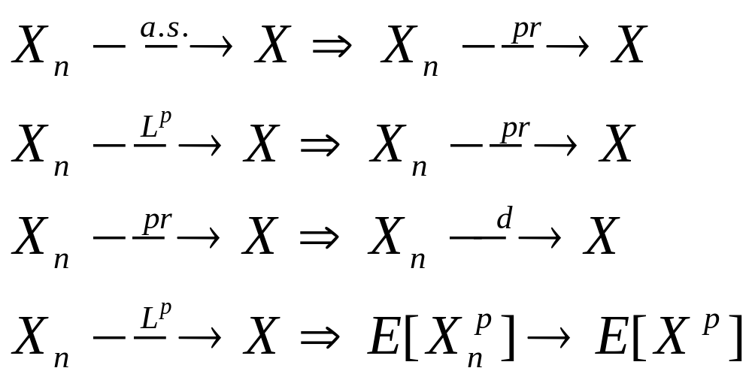
Implications
No other implications hold in general

Slide 23
Analytic Function
Analytic functions can be characterized by one of three equivalent ways: by convergent series, by differentiability property, and by integrals vanishing on cycles

Slide 24
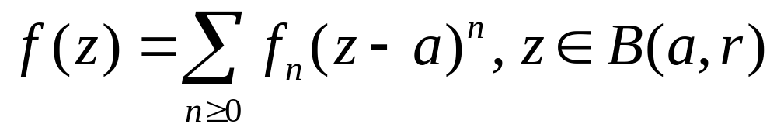
Convergent Series
If f(z), g(z) are analytic then f(z)+g(z), f(z)g(z), f(z)/g(z) with g(z)≠0 are analytic, too.
Disk of convergence (discussed in Ch. 7)

Slide 25
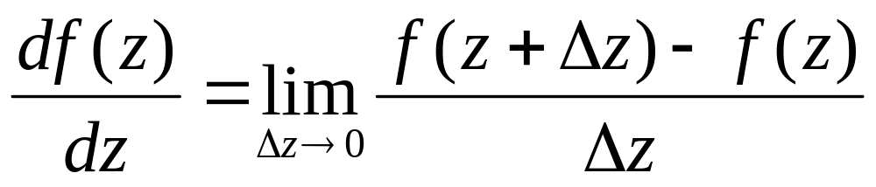
Holomorphic Function
Holomorphic function is analytic

Slide 26
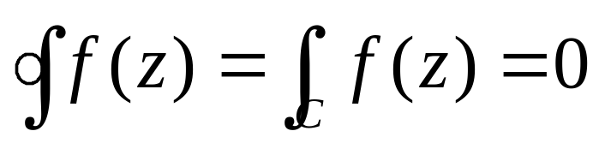
Integrals
Simply connected domain is an open connected set having the property that any simple closed path can be continuously deformed to a point inside this set.
If f(z) is an analytic function on an open simply connected set, then

Slide 27
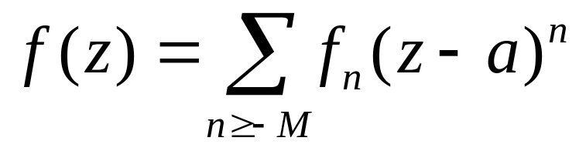
Meromorphic Functions
A meromorphic function f(z) can be represented in a neighborhood of z = a with z ≠ a by the Laurent series
If the above holds with f_{-M} ≠ 0, then it is said that f(z) has a pole of order M at z = a.

Slide 28
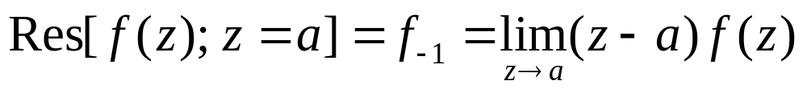
Residue
The residue of f(z) at a point a is the coefficient at (z - a)⁻¹ in the Laurent expansion of f(z) around a,

Slide 29
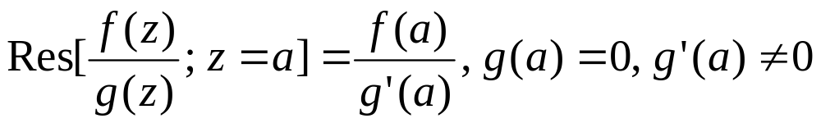
Residue
If f(z) and g(z) are analytic around z = a
If g(z) is not analytic at z = a, then

Slide 30
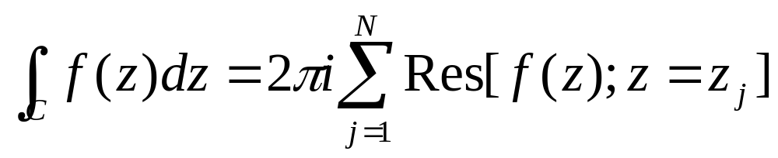
Cauchy Residue Theorem
Suppose C is a positively oriented, simple closed contour. If f is analytic on and inside C except for the finite number of singular points z₁, z₂, . . . , z_{n}, then

Slide 31
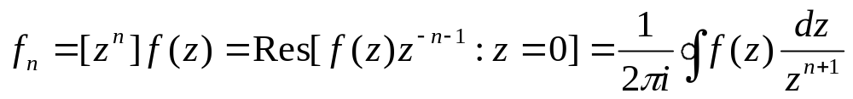
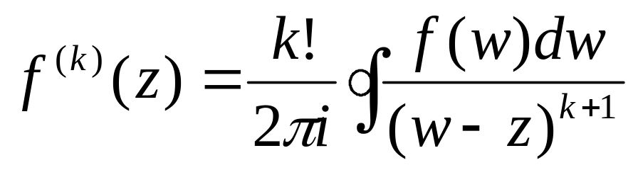
Cauchy Coefficient Formula
Let f(z) be analytic in a simply connected region D and let C be a closed curve oriented positively and located inside D that simply encircles the origin. Then

