Slide 1
Average Case Analysis of
Algorithms on Sequences
Section 2.4
Wojciech Szpankowski, John Wiley & sons, INC., ISBN: 0-471-24063-X, 2001
Presenter: Chiou-Ting Tseng
Date: Aug. 29, 2007

Slide 2
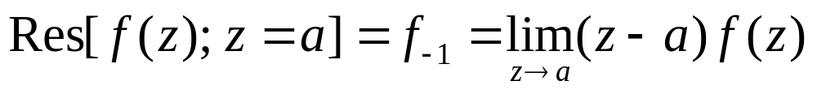
Residue
The residue of f(z) at a point a is the coefficient at (z - a)⁻¹ in the Laurent expansion of f(z) around a,

Slide 3
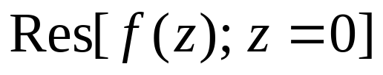
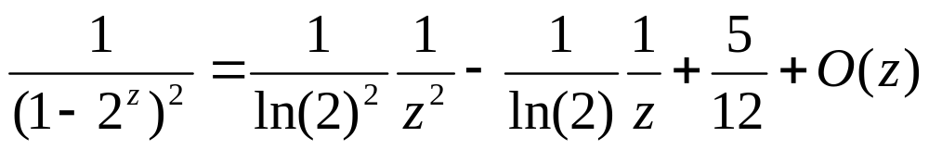
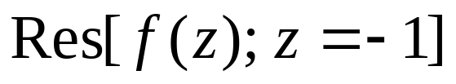
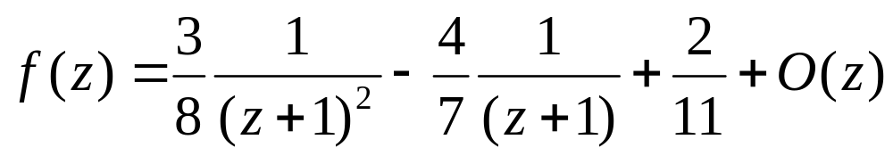
Residue

Slide 4
Section 2.4
Special Functions

Slide 5
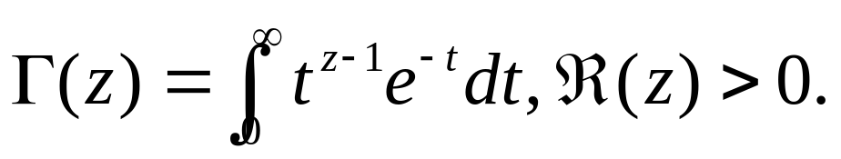

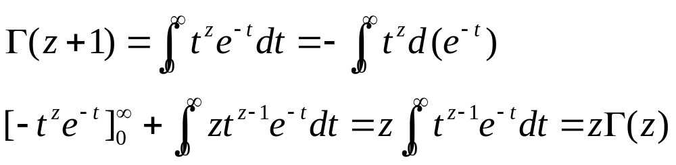
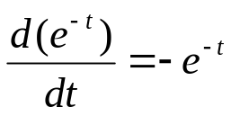
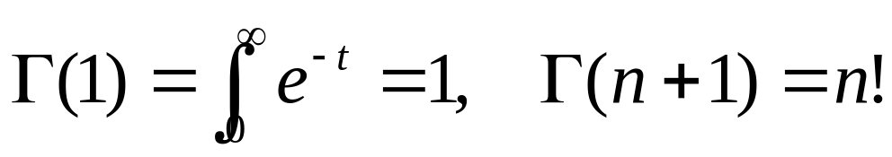
Euler’s Gamma Function
Compute n! in complex plane
By integral by parts

Slide 6
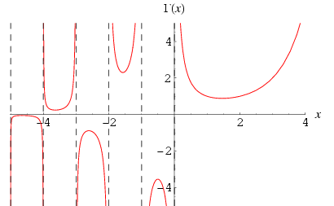
Euler’s Gamma Function

Slide 7
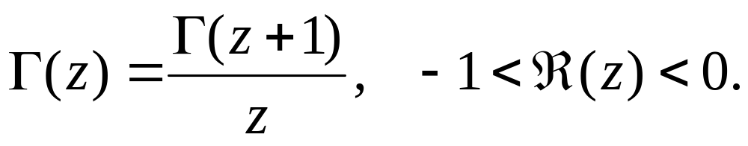
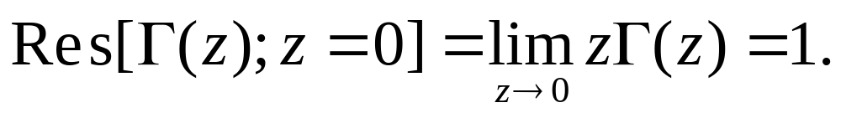
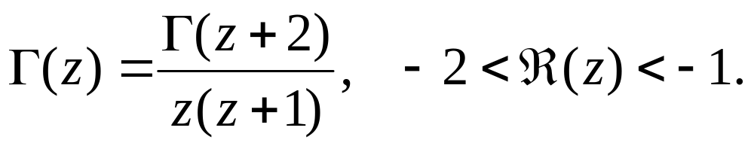
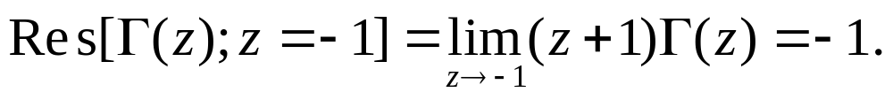
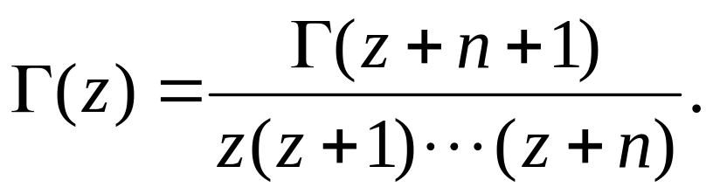
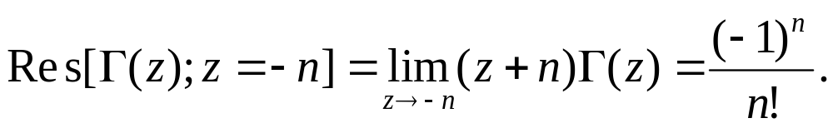
Analytic Continuation

Slide 8
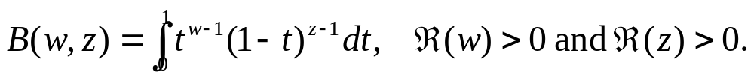
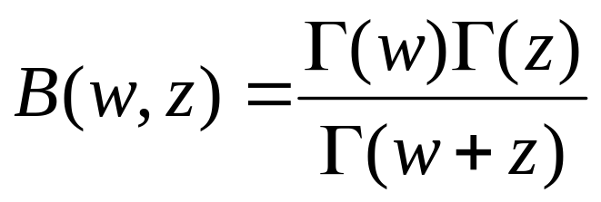
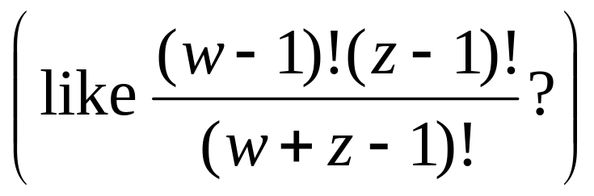
Beta Function
Beta function is often used to prove properties of the gamma function.

Slide 9
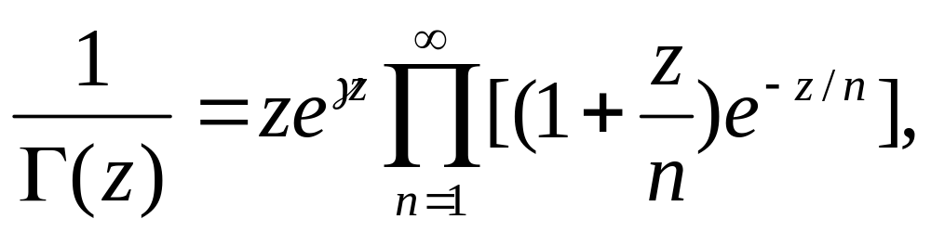
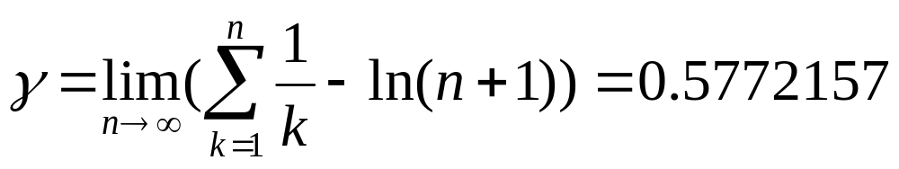
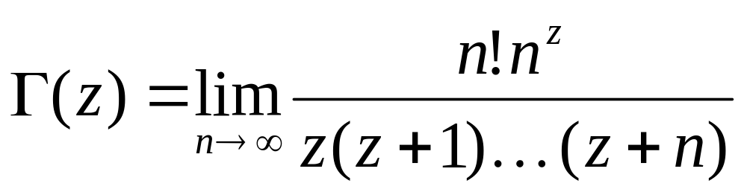
Infinite Products
Euler’s product representation
[Weierstrass 1856]

Slide 10
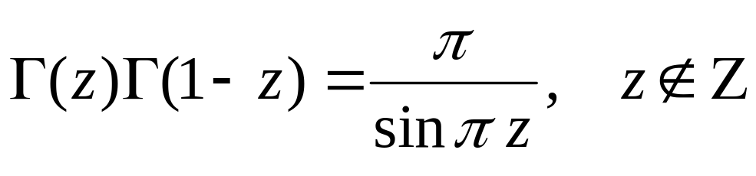
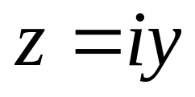
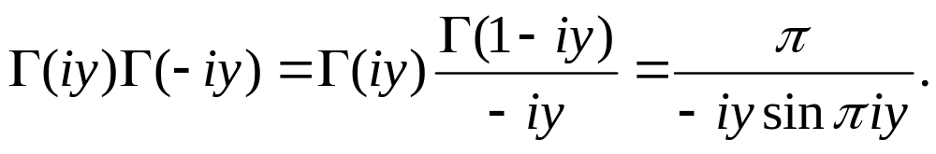
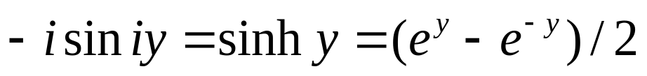
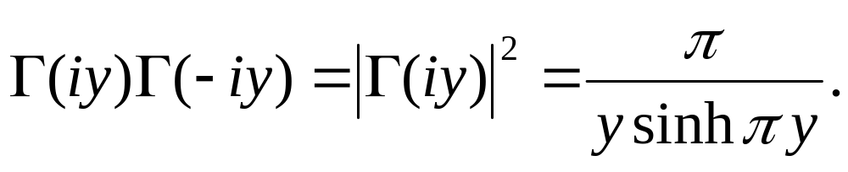
Gamma Function on Imaginary Line(1)
Reflection formula of the gamma function

Slide 11
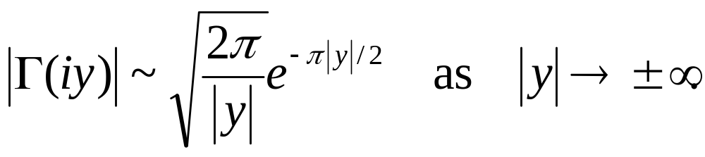
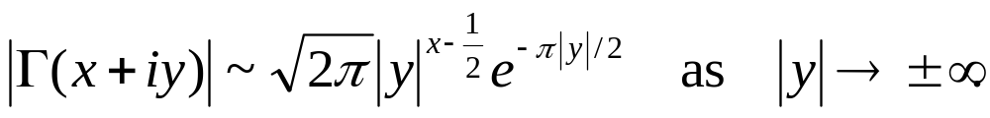
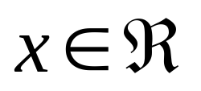
Gamma Function on Imaginary Line(2)
The above shows that the gamma function decays exponentially fast on the imaginary line.
for any

Slide 12
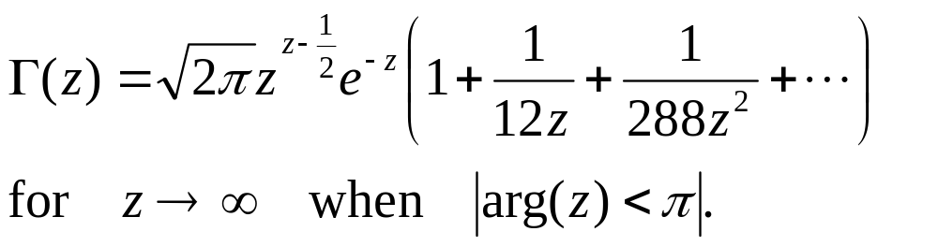
Asymptotic Expansions(1)
Stirling’s asymptotic formula

Slide 13
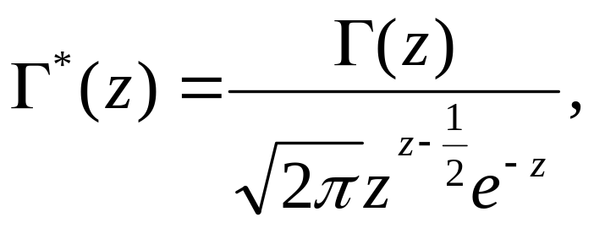

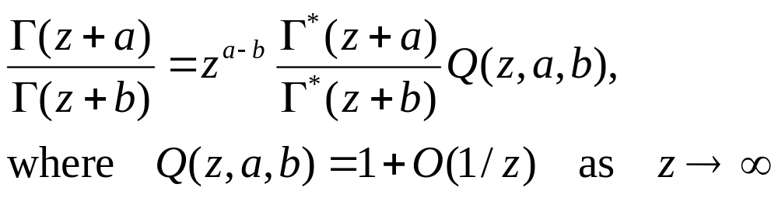
Asymptotic Expansions(2)
Consider
which tends to 1 as
hence the ratio is approximately z^{a-b}

Slide 14
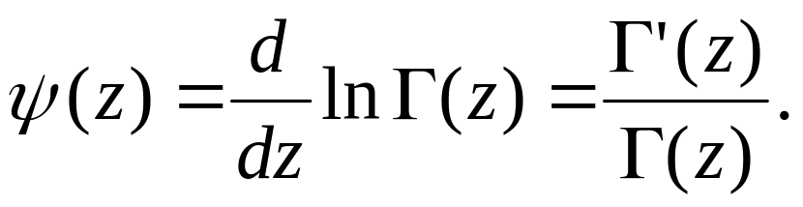
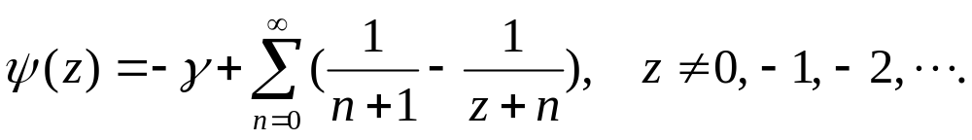
Psi function

Slide 15
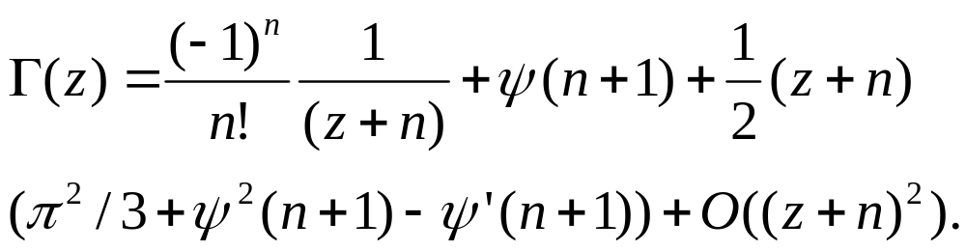
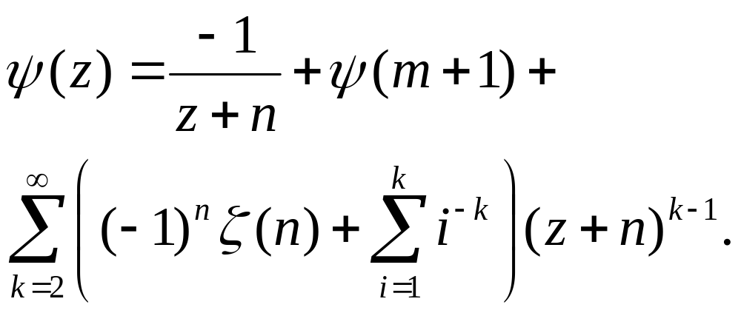
Laurent’s Expansions
ζ(n): Riemann’s Zeta Function

Slide 16
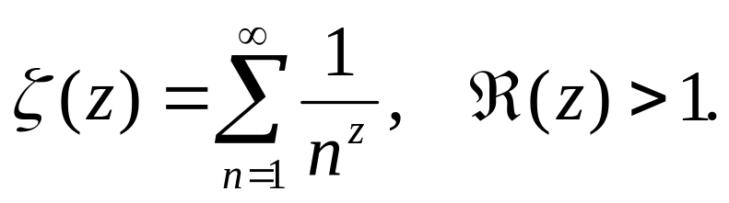
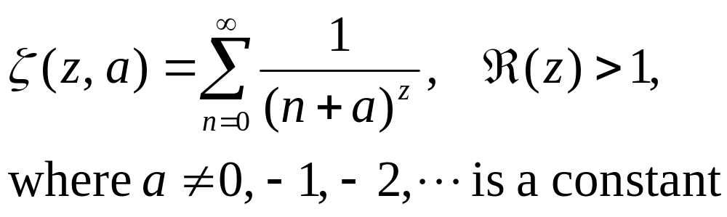
Riemann’s Zeta Function
Generalized zeta function (Hurwitz)

Slide 17
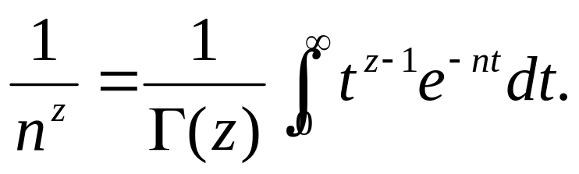
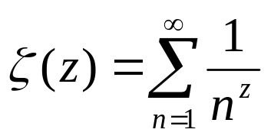
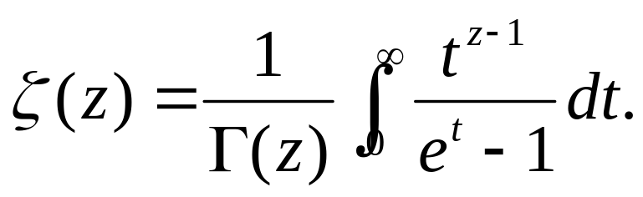
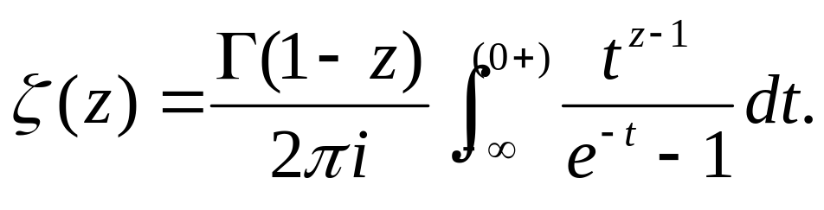
Integral Representation
Explain in Table 8.3

Slide 18
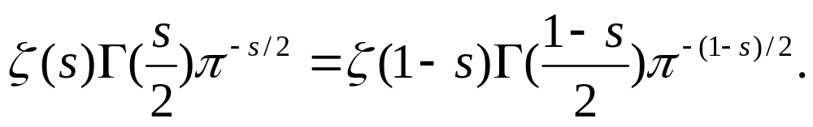
Reflection Formula for ζ(z)

Slide 19
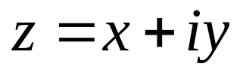
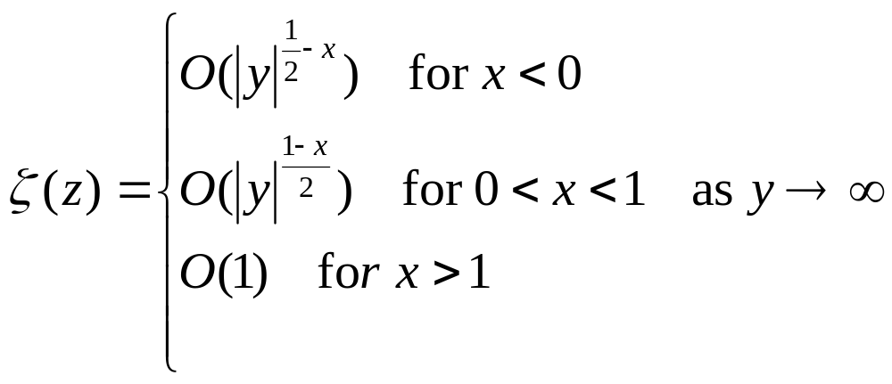
ζ(z) on Imaginary Line
ζ(z) function has a polynomial growth along the imaginary axis.

Slide 20
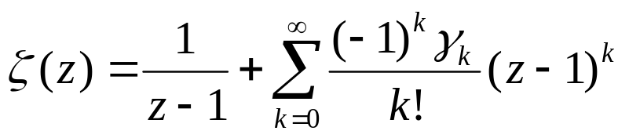
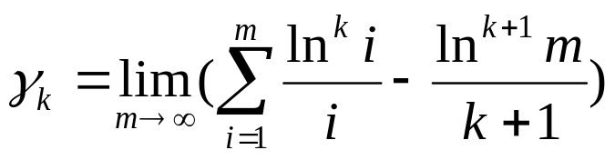
Laurent’s Expansion
Laurent’s series around z = 1 is
In particular, γ₀ =γ= 0.577215 is the Euler constant, and γ₁ = -0.072815

