Slide 1
Demonstration of two novel methods for predicting functional siRNA efficiency
Peilin Jia, Tieliu Shi, Yudong Cai and Yixue Li
BMC Bioinformatics Vol. 7 No. 1 1-10
Presenter: Chu-Kai Liu
Date: Jan. 5, 2010

Slide 2
Abstract (1/3)
Background: siRNAs are small RNAs that serve as sequence determinants during the gene silencing process called RNA interference (RNAi). It is well know that siRNA efficiency is crucial in the RNAi pathway, and the siRNA efficiency for targeting different sites of a specific gene varies greatly. Therefore, there is high demand for reliable siRNAs prediction tools and for the design methods able to pick up high silencing potential siRNAs.

Slide 3
Abstract (2/3)
Results: In this paper, two systems have been established for the prediction of functional siRNAs: (1) a statistical model based on sequence information and (2) a machine learning model based on three features of siRNA sequences, namely binary description, thermodynamic profile and nucleotide composition. Both of the two methods show high performance on the two datasets we have constructed for training the model.

Slide 4
Abstract (3/3)
Conclusion: Both of the two methods studied in this paper emphasize the importance of sequence information for the prediction of functional siRNAs. The way of denoting a bio-sequence by binary system in mathematical language might be helpful in other analysis work associated with fixed-length bio-sequence.

Slide 5
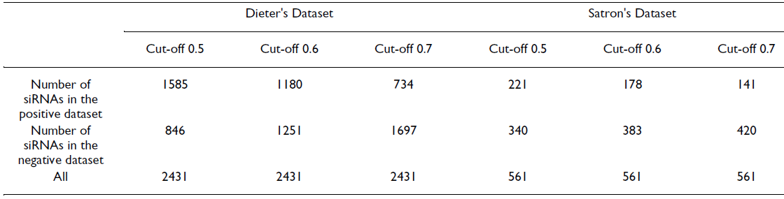
1. Data set
The cut-off value for siRNA inhibitory activity might be various according to the requests from different experimenter or different experimental intention.

Slide 6
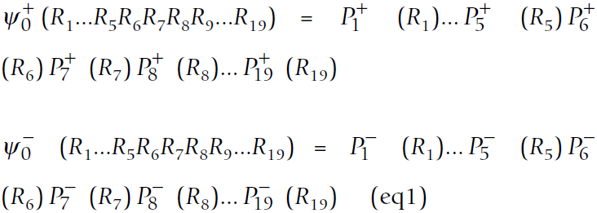
2. The sequence-based model(1/2)
P_{i}⁺(R_{i}) is the probability of nucleotide R_{i} at the sub-site i (i = 1,2,...,19) for the functional siRNAs.
P_{i}⁻ (R_{i}) the corresponding probability for the non-functional siRNAs.

Slide 7
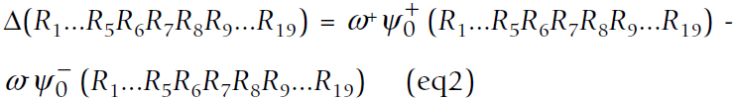
2. The sequence-based model(2/2)
The RNA oligo is functional if Δ > 0, and it is non-functional if Δ ≤ 0.

Slide 8
3. Support Vector Machine(1/4)
Three features of siRNA sequences:
  Binary description.
  Thermodynamic profile.
  Nucleotide composition.
Binary description:
  Adenine =0001.
  Uracil or thymine = 0010.
  Cytosine = 0100.
  Guanine = 1000.
  Then a 19-nt siRNA is represented by a 76-dimension vector.

Slide 9
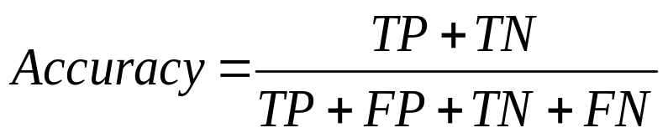
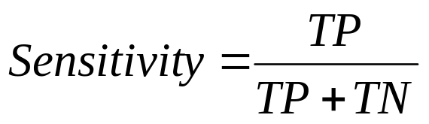
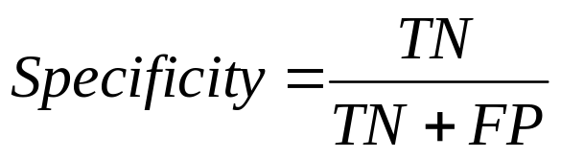
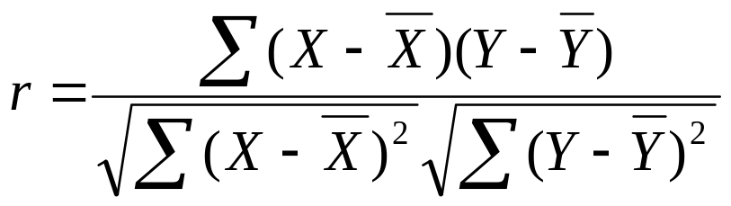
3. Support Vector Machine(2/4)
To objectively assess the prediction system, employed the following measurements.
ROC(receiver operating characteristics)
Pearson correlation coefficiency :
 |  | Actual condition
 |  | Present | Absent
Test result | Positive | True Positive | False Positive
 | Negative | False Negative | True Negative

Slide 10
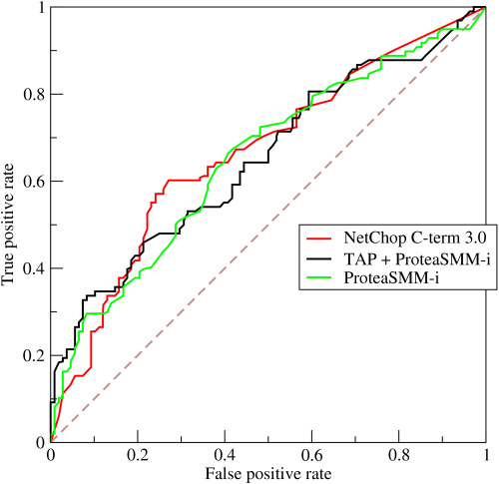
3. Support Vector Machine(3/4)
ROC is a graphical plot of the sensitivity vs.
(1 − specificity) for
a binary classifier
system as its
discrimination
threshold is varied.

Slide 11
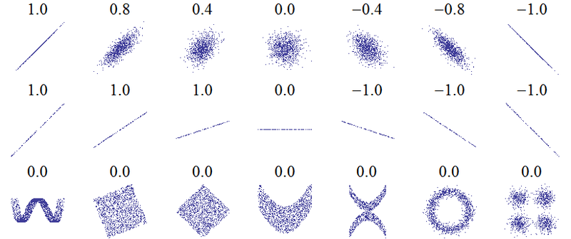
3. Support Vector Machine(4/4)
Pearson correlation coefficiency is a measure of the correlation (linear dependence) between two variables X and Y, giving a value between +1 and −1 inclusive.

Slide 12
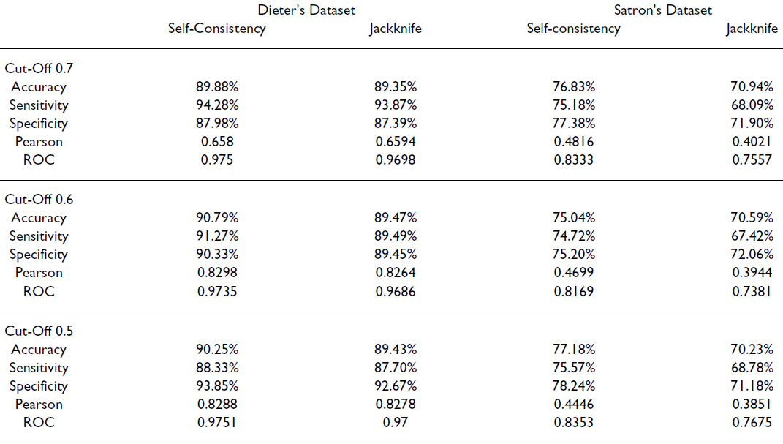
4. Results(1/3)
Table 2

Slide 13
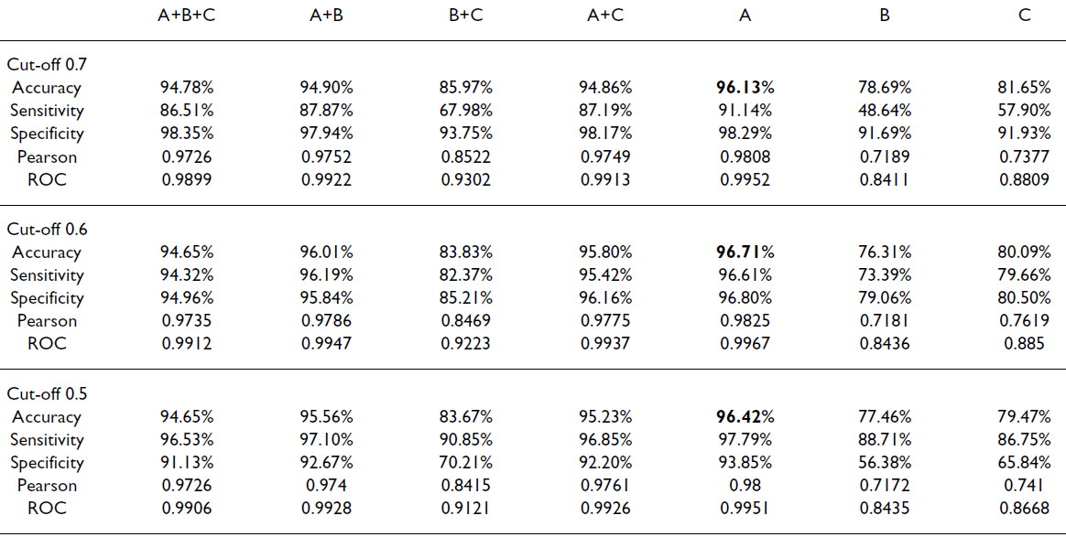
4. Results-Dieter’s dataset(2/3)
Table 3

Slide 14
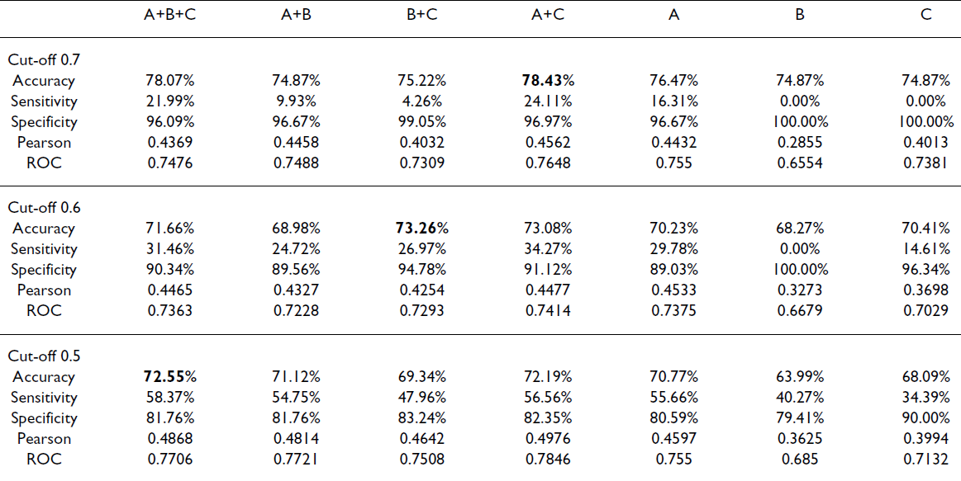
4. Results-Satron’s dataset(3/3)
Table 4

