Slide 1
Predicting Non-protein-coding RNA Genes in Escherichia Coli Using SVM with Signature Descriptor
Hong-Wei Liu
The 2nd International Symposium on Optimization and Systems Biology ,
pp. 287-293, Lijiang, China, 2008
Presenter: Chu-Kai Liu
Date: Jan. 26, 2010

Slide 2
Abstract
Non-protein-coding RNA (ncRNA) genes are known to play significant roles. Along with transfer RNAs, ribosomal RNAs and mRNAs, ncRNAs contribute to gene splicing, nucleotide modification, protein transport and regulation of gene expression. Several methods exist for predicting ncRNA genes in Escherichia coli(大腸桿菌) (E.coli). In this paper, we describe a very general, high-throughput method for predicting ncRNA genes in E.coli. The method predicts more than two hundred intergenic regions to contain ncRNA genes, and over half of these overlap with previous tested candidates. Our results indicate that the number of ncRNA genes in E.coli is larger than what has previously been estimated.

Slide 3
1. Non-coding RNA
非編碼RNA，是指各種不轉譯成蛋白質的RNA分子。
DNA序列中專門轉錄成ncRNA的部分稱為RNA基因或是非編碼RNA基因。非編碼RNA基因用來生產tRNA (轉移RNA)與rRNA(核糖體RNA)，以及一些sRNA。

Slide 4
2. Sequence data
Escherichia coli K-12 strain MG1655 cells genome sequence.
From a 2006 release of the EMBLars FTP server.
A set of 157 experimentally verified ncRNA sequences(positive examples).
A set of 660 intergenic sequences(INT)(negative examples).

Slide 5
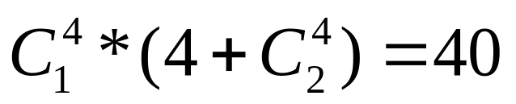
3. Signature(1/2)
Example: ATCGGCG → ATC, TCG, CGG, GGC and GCG → T(AC) + C(GT) + 2G(CG) + C(GG).
The number of features:

Slide 6
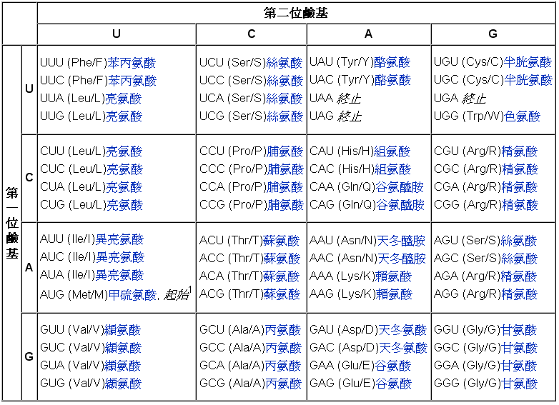
3. Signature(2/2)
Example

Slide 7
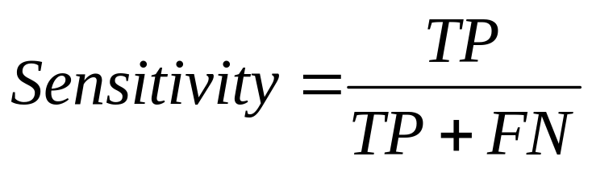
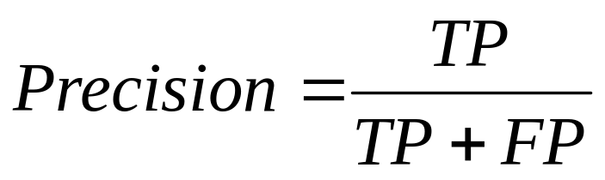
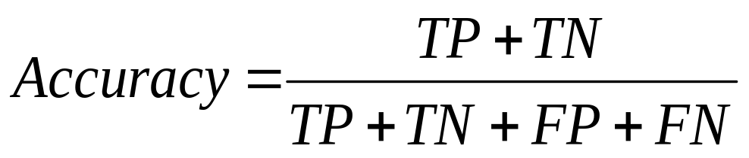
4. Results(1/2)
10-fold cross-validation.
 |  | Actual condition
 |  | Present | Absent
Test result | Positive | True Positive | False Positive
 | Negative | False Negative | True Negative

Slide 8
4. Results(2/2)
The average accuracy is 92.776%.
The average precision is 66.375%.
The average sensitivity is 79.458%.

