Slide 1
List colourings of planar graphs
Margit Voigt
Discrete Mathematics, Vol. 306, pp. 1076 – 1079, 2006
Presenter: Dong-Jian Lin Date: Feb. 23, 2010

Slide 2
Abstract
A graph G = G(V,E) is called L-list colourable if there is a vertex
colouring of G in which the colour assigned to a vertex v is
chosen from a list L(v) associated with this vertex. We say G is
k-choosable if all lists L(v) have the cardinality k and G is L-list
colourable for all possible assignments of such lists. There are
two classical conjectures from Erdos, Rubin and Taylor 1979
About the choosability of planar graphs:
(1) every planar graph is 5-choosable and,
(2) there are planar graphs which are not 4-choosable.
We will prove the second conjecture.

Slide 3
Introduction
A graph G = G(V,E) is called L-list colourable if there is a
colouring f of vertices of G with:
(1) f (u) ≠ f (v), ∀(u, v) ∈ E(G),
(2) f (v) ∈ L(v), ∀v ∈ V (G).
G is called k-choosable if G is L-list-colourable for every
assignment of lists L(v) where each L(v) has exactly k elements.

Slide 4
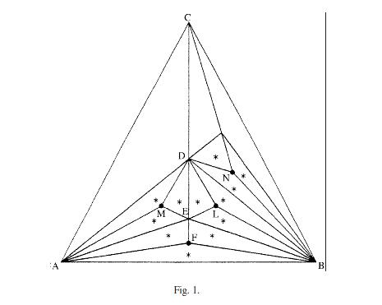

Slide 5
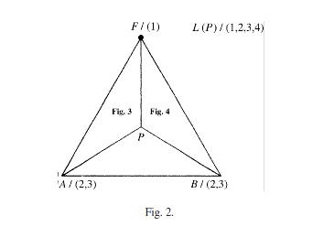

Slide 6
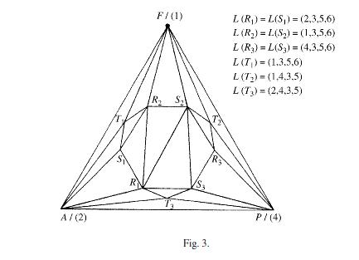

Slide 7
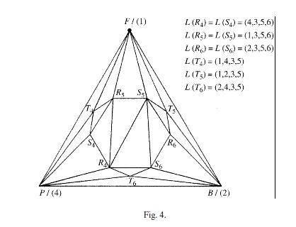

Slide 8
Theorem. The planar graph G_{p} constructed in the previous section is not 4-choosable.
Proof. We assume there is a L-list colouring f of G_{p} for the given list assignment.
Lemma. One of the marked vertices F, M, L, N in Fig. 1 is coloured with colour 1.

Slide 9
We consider the K₄ : ABCD. The assigned lists are
L(A)=L(B)=L(C)=L(D)=(1, 2, 3, 4).
(1)f(A) = 1.The vertices A,B,D,E form a K₄. Thus, B,D, and E are coloured with 2, 3 and 4. Consequently, the vertex L
has the colour 1.
(2) f(B) = 1.We obtain in an analogous way f (M) = 1.
(3) f(C) = 1.We obtain in an analogous way f (N) = 1.
(4) f(D) = 1.We obtain in an analogous way f (F) = 1.

Slide 10
Without loss of generality we assume that f(F)=1,we suppose:
f(F) = 1, f(A) ∈ {2, 3}, f(B) ∈ {2, 3}.
Case 1. We use Fig. 3: Because of f(F) = 1, f(A) = 2 and f(P) = 4 it follows immediately:
{f(R₁), f(S₁), f(R₂), f(S₂), f(R₃), f(S₃)} = {3, 5, 6}.
Consequently, one of the vertices T₁, T₂, T₃ is not colourable in accordance with the given lists.
Case 2. In Fig. 4 one of the vertices T₄, T₅, T₆ is not colourable.

Slide 11
A smaller planar graph without 4-, 5-cycles and intersecting triangles that is not
3-choosable
De-Qiang Wang(王德强) , Yu-Peng Wen(溫玉鹏) ,
Ke-Lun Wang(王克倫)
Information Processing Letters,Vol. 108, pp. 87–89, 2009

Slide 12
Abstract
In 2006, Montassier et al. constructed a planar graph without 4-,
5-cycles and intersecting triangles that is not 3-choosable [M.
Montassier, A. Raspaud, W. Wang, Bordeaux 3-color conjecture
and 3-choosability, Discrete Math. 306 (2006) 573–579]. It has
506 vertices. In this paper, we construct a smaller planar graph
with the same properties. The planar graph has 380 vertices.

Slide 13
Let H(s, t) be the graph depicted in Fig. 1 and L_{a,b} its list
assignment in Fig. 2. It is easy to see that the graph H(s, t) has no
4-cycles, 5-cycles and intersecting triangles.
Theorem1. With list assignment L_{a,b}, the color-restricted graph
H(s, t) has no L_{a,b}-coloring.
Proof. Let H = H(s, t). Suppose that H has an L_{a,b}-coloring σ.

Slide 14
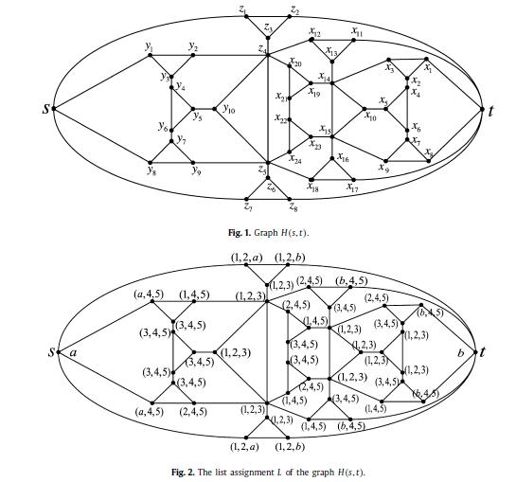

Slide 15


Let (s’, t’) be the graph (see Fig. 3) obtained from 9 copies of
H(s, t), named as H(s_{i} , t_{j}) (1 ≦ i ≦ 3, 1 ≦ j ≦ 3) be merging s_{i}
into the new vertex s, merging t _{j} into the new vertex t .
Theorem 2. The graph (s’, t’) without 4-cycles, 5-cycles and
intersecting triangles is not 3-choosable.

Slide 16
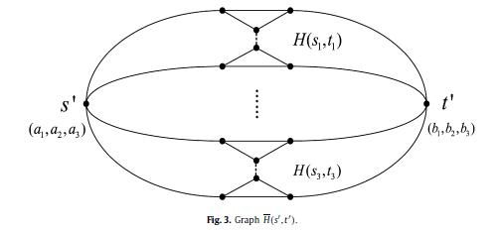

Slide 17
Thank for your listening !

