Slide 1
Reliability of Assessment of Protein Structure Prediction Methods
Marc A. Marti-Renom, M.S. Madhusudhan,
Andra´ s Fiser, Burkhard Rost, and Andrej Sali
Structure, Vol. 10, 435–440, March, 2002
Speaker: Chun-Jen Chen
Date: Feb. 23, 2010

Slide 2
Abstract
The reliability of ranking of protein structure modeling methods is assessed. The assessment is based on the parametric Student’s t test and the nonparametric Wilcox signed rank test of statistical significance of the difference between paired samples. The approach is applied to the ranking of the comparative modeling methods tested at the fourth meeting on Critical Assessment of Techniques for Protein Structure Prediction (CASP).
115/11/08

Slide 3
Abstract
It is shown that the 14 CASP4 test sequences may not be sufficient to reliably distinguish between the top eight methods, given the model quality differences and their standard deviations. We suggest that CASP needs to be supplemented by an assessment of protein structure prediction methods that is automated, continuous in time, based on several criteria applied to a large number of models, and with quantitative statistical reliability assigned to each characterization.
115/11/08

Slide 4
Ranking of different methods generally consists of the following steps:
(1) define a set of test sequences
(2) define one or more model quality criteria
(3) apply the modeling methods to the test sequences
(4) assess the methods by calculating the quality scores for the models
(5) rank the methods based on a comparison of the corresponding model quality scores.
115/11/08

Slide 5
When the number of test sequences is not large or the quality difference between the two methods is relatively small. Does the ranking of the methods reflect their true performance or is it a consequence of chance?
If the ranking is not reliable, how many more test sequences are needed for it to become reliable? Alternatively, how large should the difference in quality between the two methods be for the ranking to be reliable, given the available number of test sequences?

Slide 6
We first propose one reasonable quality criterion for comparative models. Although we do not focus on model quality criteria, we need to define one such criterion to be able to illustrate the issue of statistical significance of ranking with a practical example.

Slide 7
Two fundamentally distinct features that are not comparable to each other describe the quality of a model:
(1) the fraction of the protein sequence that is modeled (i.e., coverage)
(2) the accuracy of the modeled region. There are many criteria to assess the accuracy of different aspects of a model (e.g., core, loops, and side chains).

Slide 8
The coverage and accuracy are generally dependent on each other. The smaller the modeled fraction of the sequence, the more accurate is the model. For example, the accuracy of a model can be increased at the expense of coverage by retaining only the core of the fold and eliminating loops and termini from the model.
It is necessary to combine coverage and accuracy into a single number when comparing methods that model different parts of the test sequences

Slide 9
We define model quality as the average percentage of the C atoms that are within 1, 2, and 3 Å of their correct positions upon least squares superposition of the model with the corresponding experimentally determined structure.
The resulting quality criterion has a reasonable dynamic range in the sense that it can discriminate between backbones of models differing only in minor details (i.e., the 1Å cutoff) as well as models differing at the level of alignment (i.e., the 3 Å cutoff).

Slide 10
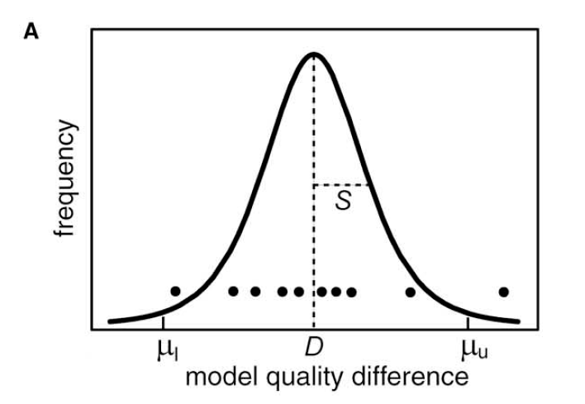
In principle, there are two extreme possibilities:
(1) The model quality difference is distributed around zero indicating the lack of a statistically significant difference between the performances of the two methods
(2) The distribution is shifted from zero significantly relative to its standard deviation, indicating a statistically significant difference between the performances of the two methods.

Slide 11
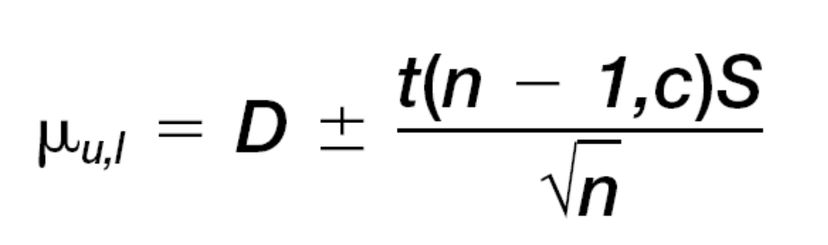
If the distribution of the model quality difference is at least approximately Gaussian, the lower and upper bounds on the average model quality difference of the whole population of the models sampled by the common models in the test set are [12]:
A modeling method is significantly better than another at the given confidence level if the estimated interval of the average model quality difference lies below or above zero.

Slide 12
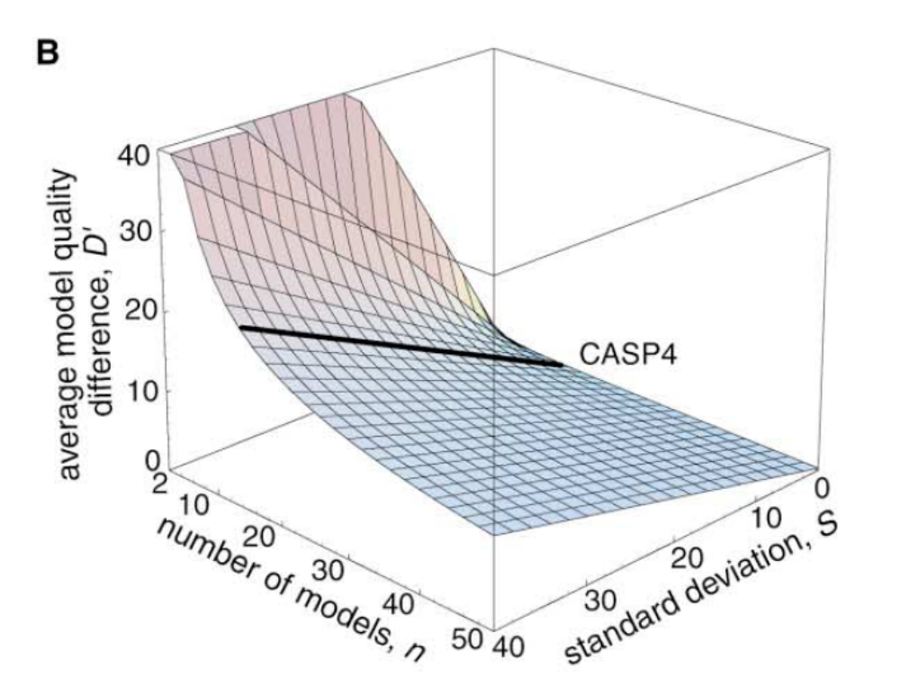

Slide 13
