Slide 1
Gapped BLAST and PSI-BLAST: a new generation of protein database search programs
Stephen F. Altschul, Thomas L. Madden, Alejandro A. Schäffer, Jinghui Zhang, Zheng Zhang, Webb Miller and David J. Lipman
Nucleic Acids Research, 1997, Vol. 25, No. 17 3389–3402
Presenter : Chih-Ying Lin
Date : Mar. 2, 2010

Slide 2
ABSTRACT
The BLAST programs are widely used tools for searching protein and DNA databases for sequence similarities. For protein comparisons, a variety of definitional, algorithmic and statistical refinements described here permits the execution time of the BLAST programs to be decreased substantially while enhancing their sensitivity to weak similarities. A new criterion for triggering the extension of word hits, combined with a new heuristic for generating gapped alignments, yields a gapped BLAST program that runs at approximately three times the speed of the original. In addition, a method is introduced for automatically combining statistically significant alignments produced by BLAST into a position-specific score matrix, and searching the database using this matrix. The resulting Position-Specific Iterated BLAST (PSI-BLAST) program runs at approximately the same speed per iteration as gapped BLAST, but in many cases is much more sensitive to weak but biologically relevant sequence similarities. PSI-BLAST is used to uncover several new and interesting members of the BRCT superfamily.

Slide 3
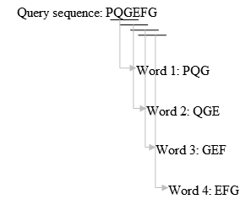
BLAST
Remove low-complexity region or sequence repeats in the query sequence.
Make a k-letter word list of the query sequence.

Slide 4
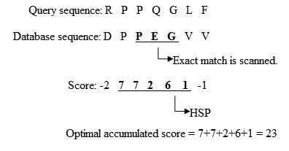
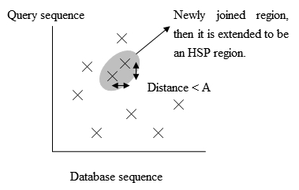
BLAST
List the possible matching words.
Organize the remaining high-scoring words into an efficient search tree.
Scan the database sequences for exact match with the remaining high-scoring words.
Extend the exact matches to high-scoring segment pair (HSP).

Slide 5
BLOSUM62
A R N D C Q E G H I L K M F P S T W Y V B Z X *
A 4 -1 -2 -2 0 -1 -1 0 -2 -1 -1 -1 -1 -2 -1 1 0 -3 -2 0 -2 -1 0 -4
R -1 5 0 -2 -3 1 0 -2 0 -3 -2 2 -1 -3 -2 -1 -1 -3 -2 -3 -1 0 -1 -4
N -2 0 6 1 -3 0 0 0 1 -3 -3 0 -2 -3 -2 1 0 -4 -2 -3 3 0 -1 -4
D -2 -2 1 6 -3 0 2 -1 -1 -3 -4 -1 -3 -3 -1 0 -1 -4 -3 -3 4 1 -1 -4
C 0 -3 -3 -3 9 -3 -4 -3 -3 -1 -1 -3 -1 -2 -3 -1 -1 -2 -2 -1 -3 -3 -2 -4
Q -1 1 0 0 -3 5 2 -2 0 -3 -2 1 0 -3 -1 0 -1 -2 -1 -2 0 3 -1 -4
E -1 0 0 2 -4 2 5 -2 0 -3 -3 1 -2 -3 -1 0 -1 -3 -2 -2 1 4 -1 -4
G 0 -2 0 -1 -3 -2 -2 6 -2 -4 -4 -2 -3 -3 -2 0 -2 -2 -3 -3 -1 -2 -1 -4
H -2 0 1 -1 -3 0 0 -2 8 -3 -3 -1 -2 -1 -2 -1 -2 -2 2 -3 0 0 -1 -4
I -1 -3 -3 -3 -1 -3 -3 -4 -3 4 2 -3 1 0 -3 -2 -1 -3 -1 3 -3 -3 -1 -4
L -1 -2 -3 -4 -1 -2 -3 -4 -3 2 4 -2 2 0 -3 -2 -1 -2 -1 1 -4 -3 -1 -4
K -1 2 0 -1 -3 1 1 -2 -1 -3 -2 5 -1 -3 -1 0 -1 -3 -2 -2 0 1 -1 -4
M -1 -1 -2 -3 -1 0 -2 -3 -2 1 2 -1 5 0 -2 -1 -1 -1 -1 1 -3 -1 -1 -4
F -2 -3 -3 -3 -2 -3 -3 -3 -1 0 0 -3 0 6 -4 -2 -2 1 3 -1 -3 -3 -1 -4
P -1 -2 -2 -1 -3 -1 -1 -2 -2 -3 -3 -1 -2 -4 7 -1 -1 -4 -3 -2 -2 -1 -2 -4
S 1 -1 1 0 -1 0 0 0 -1 -2 -2 0 -1 -2 -1 4 1 -3 -2 -2 0 0 0 -4
T 0 -1 0 -1 -1 -1 -1 -2 -2 -1 -1 -1 -1 -2 -1 1 5 -2 -2 0 -1 -1 0 -4
W -3 -3 -4 -4 -2 -2 -3 -2 -2 -3 -2 -3 -1 1 -4 -3 -2 11 2 -3 -4 -3 -2 -4
Y -2 -2 -2 -3 -2 -1 -2 -3 2 -1 -1 -2 -1 3 -3 -2 -2 2 7 -1 -3 -2 -1 -4
V 0 -3 -3 -3 -1 -2 -2 -3 -3 3 1 -2 1 -1 -2 -2 0 -3 -1 4 -3 -2 -1 -4
B -2 -1 3 4 -3 0 1 -1 0 -3 -4 0 -3 -3 -2 0 -1 -4 -3 -3 4 1 -1 -4
Z -1 0 0 1 -3 3 4 -2 0 -3 -3 1 -1 -3 -1 0 -1 -3 -2 -2 1 4 -1 -4
X 0 -1 -1 -1 -2 -1 -1 -1 -1 -1 -1 -1 -1 -1 -2 0 0 -2 -1 -1 -1 -1 -1 -4
* -4 -4 -4 -4 -4 -4 -4 -4 -4 -4 -4 -4 -4 -4 -4 -4 -4 -4 -4 -4 -4 -4 -4 1

Slide 6
BLAST
List all of the HSPs in the database whose score is high enough to be considered.
Evaluate the significance of the HSP score.
Make two or more HSP regions into a longer alignment.
Show the gapped Smith-Waterman local alignments of the query and each of the matched database sequences.
Report the matches whose expect score is lower than a threshold parameter E.

Slide 7
PSI-BLAST
Perform initial alignment with BLAST using BLOSUM 62 substitution matrix.
Construct a multiple alignment from hits.
Prepare a position speciﬁc scoring matrix (PSSM).
Use PSSM proﬁle as the scoring matrix for a second BLAST (run against database).
Repeat steps 2-4 until convergence.

Slide 8
PSSM
Run BLAST against the database (local alignment).
Collect database sequence segments with E-value below threshold (default is 0.01).
Remove similar sequences.
Remove sequence segments identical to a query segment.
Retain one copy for any rows that are >98% identical to one another.
Construct the multiple alignment block M with the remaining segments (length M = query length ).
Ignore pairwise alignment columns that involve gap characters inserted into the query.

Slide 9
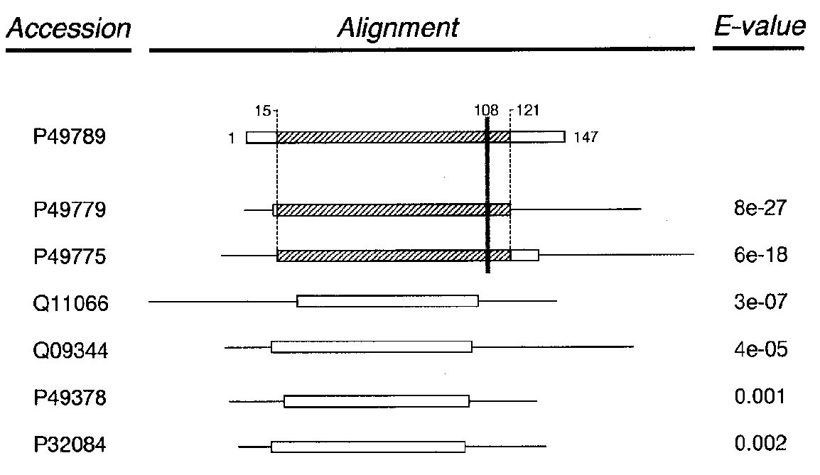
M

Slide 10
PSSM
5. For each column C:
a) Reduce M to M_{C} (1 ≦ C ≦ query length)
i. Let R be the set of sequences with a residue in C.
ii. Columns of M_{C} are columns of M with all sequences in R. In other words, M_{C} only contains those database sequences in R. Therefore, M_{C} contains a subset of M’s columns and rows.
b) Compute weights for each sequence in R.
c) Compute P_{i}, the background frequency of residue i over M_{C}.
d) Compute weighted frequency f_{i} for each residue i.
e) Estimate the relative number of independent observations N_{C} as
the mean number of different residue including gap characters.

Slide 11
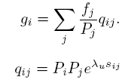
PSSM
f) Compute psuedocount g_{i} for each residue i (expectation based on
score matrix).
where are the target frequencies implicit in the substitution matrix,
s_{ij} is the substitution matrix score for aligning each pair of amino
acids i and j, and ¸ λ_{u} is a constant parameter for ungapped
alignments.

Slide 12
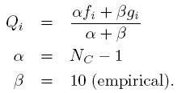

PSSM
g) Compute Q_{i} as the weighted sum of f_{i} and g_{i}.
h) PSSM score for residue i is given by

Slide 13
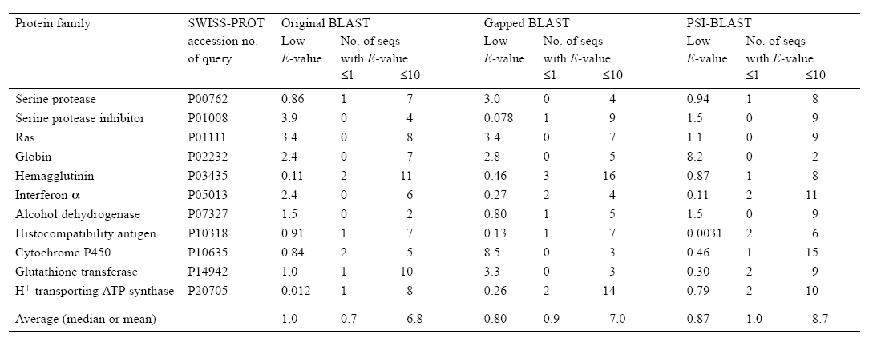
PERFORMANCE EVALUATION

Slide 14
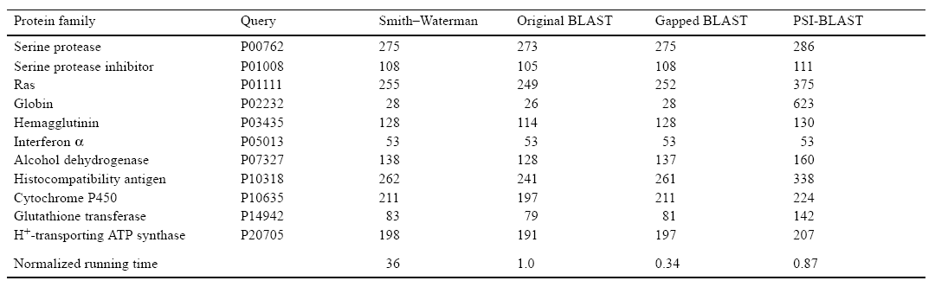
PERFORMANCE EVALUATION

Slide 15
NCBI
http://blast.ncbi.nlm.nih.gov/Blast.cgi
>sp|P01403|TXF7_DENAN
TMCYSHTTTSRAILTNCGENSCYRKSRRHPPKMVLGRGCGCPPGDDYLEVKCCTSPDKCNY

