Slide 1
Supervised feature selection by clustering using conditional mutual information-based distances
Jose Martinez Sotoca, Filiberto Pla
Pattern Recognition 43 (2010) 2068–2081

Slide 2
Abstract
In this paper, a supervised feature selection approach is presented, which is based on metric applied on continuous and discrete data representations. This method builds a dissimilarity space using information theoretic measures, in particular conditional mutual information between features with respect to a relevant variable that represents the class labels.

Slide 3
Abstract(Contd)
Applying a hierarchical clustering, the algorithm searches for a compression of the information contained in the original set of features. The proposed technique is compared with other state of art methods also based on information measures. Eventually, several experiments are presented to show the effectiveness of the features selected from the point of view of classification accuracy.

Slide 4
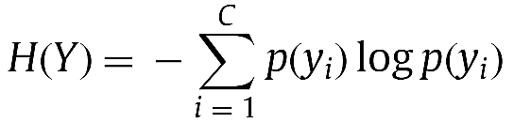
The Shannon Entropy
y: 類別(或特徵)變數
C: 總類別數
p(yi): yi出現機率分佈(probability distribution)
凌亂程度或資訊含量(想像當p(yi)=1時的狀況)

Slide 5

Mutual Information
X: 特徵變數(集合)
y: 類別變數
C: 總類別數
Ω: 總特徵變數集合
p(x,yi): x和yi共同出現機率分佈(joint probability distribution)

Slide 6
Mutual Information (Contd)
The mutual information (MI) is a measure of generalized correlation between two random variables, and can also be interpreted as the amount of information shared by two random variables or the quantity of information one variable can predict about the other one.
如果x代表特徵變數，y代表類別變數，則MI為衡量x可預測y的程度。

Slide 7

Conditional Mutual Information
xi, xj: 特徵變數
y: 類別變數
C: 總類別數
N: the number of samples
p(xi,xj,yk): xi,xj和yk共同出現機率分佈(joint probability distribution)

Slide 8
Conditional Mutual Information (Contd)
Being corresponding to two feature spaces over the same data set, and the relevant variable Y, representing the class labels. In this case, I(Xi; y| Xj) can be interpreted as how much information the feature space Xi can predict about the relevant variable Y that the feature space Xj cannot.
用於衡量Xi比Xj多出來預測y的能力

Slide 9


Metric distance (dissmilarity) between features
用於衡量Xi比Xj多出來預測y的能力
利用Xi比Xj多出來(加上Xj比Xi多出來)預測y的能力來衡量兩個特徵相似(異)程度
正規化版本

Slide 10
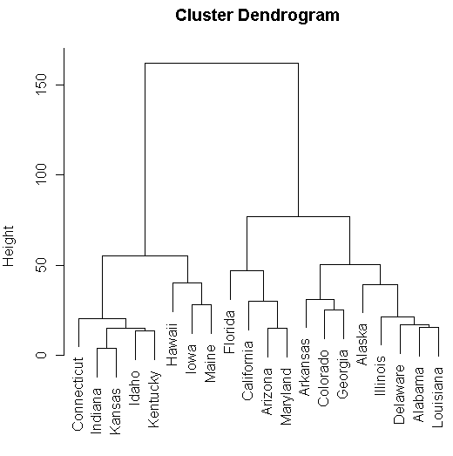
(Feature) Hierarchical Clustering
依照資料相似程度逐漸合併(如左圖由下而上)
如果最下方項目代表特徵，那每一合併後之群集(cluster)代表群集內特徵的預測能力是相似的

Slide 11
(Feature) Hierarchical Clustering
假設欲選定7個特徵(如綠線所示)，則分別從線段以下群集挑出一個最厲害的特徵
群集內的特徵以MI值最高者最厲害
本文方法簡稱為mRR(minimum relevant redundancy)

Slide 12

Other information-theoretical feature selection methods
MIFS(mutual information feature selection)
在挑選第i特徵(Xi)時，必須與類別變數越相關越好(即I(Xi;Y)越大)，然與已經選定的特徵Xs相關性越小越好(I(Xi;Xs))，其中β為可調參數

Slide 13

Other information-theoretical feature selection methods
MIFS-U
在挑選第i特徵(Xi)時，必須與類別變數越相關越好(即I(Xi;Y)越大)，然與已經選定的特徵Xs相關性越小越好(I(Xi;Xs)乘上一權重)，其中β為可調參數

Slide 14

Other information-theoretical feature selection methods
mRMR
(minimum Redundancy Maximal Relevance)
在挑選第i特徵(Xi)時，必須與類別變數越相關越好(即I(Xi;Y)越大)，然與已經選定的特徵Xs平均相關性越小越好(avg(I(Xi;Xs)))

Slide 15


ReliefF-mRMR vs. mRMR algorithm
use mutual information to encourage features
mRMR
ReliefF-mRMR
mRR: using Conditional Mutual Information
use mutual information to penalize features
use correlation to penalize features
use reliefF to encourage features

Slide 16
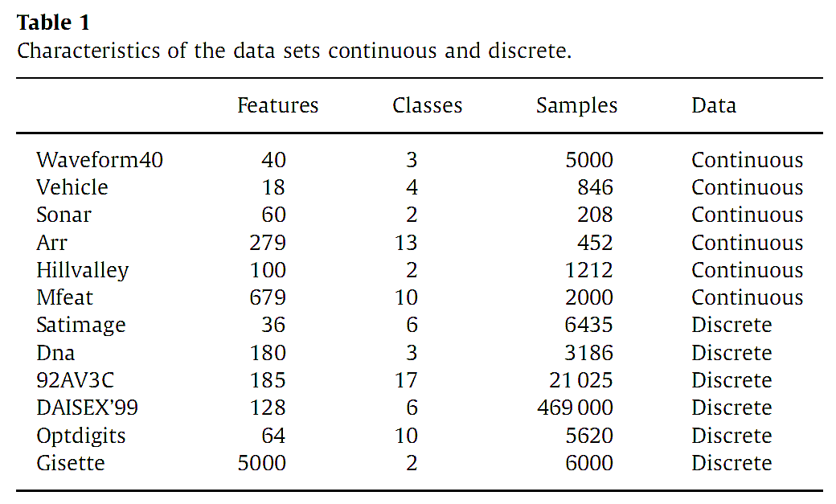
Experiment data and settings

Slide 17
Experiment data and settings
10 fold cross validation
Classifiers: 3 nearest neighbor (3NN), support vector machine (SVM), C4.5 (a decision tree classifier)

Slide 18
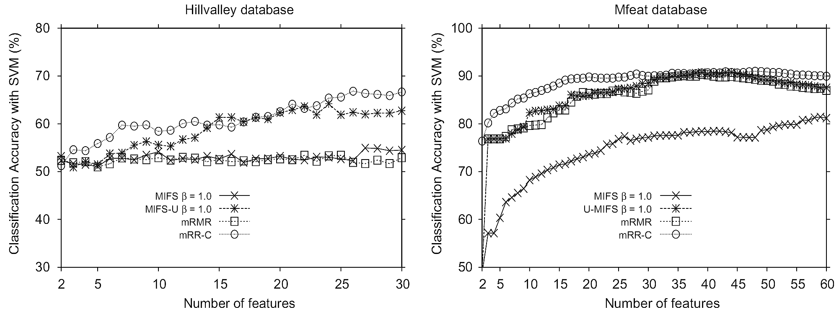
Experimential results

Slide 19
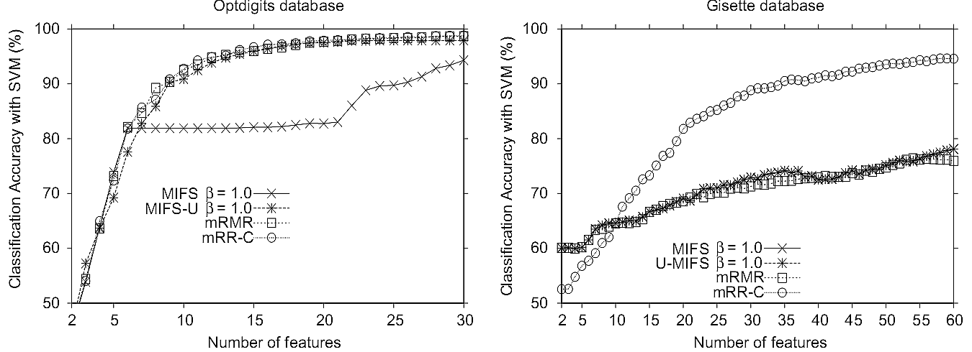
Experimential results

Slide 20
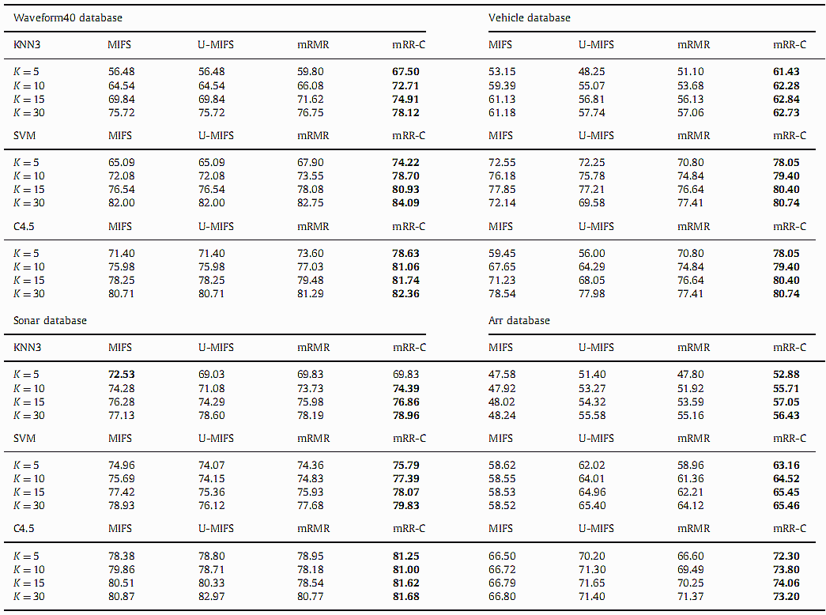
Experimential results
K=5 means average classification rate from 2~5 features selected

Slide 21
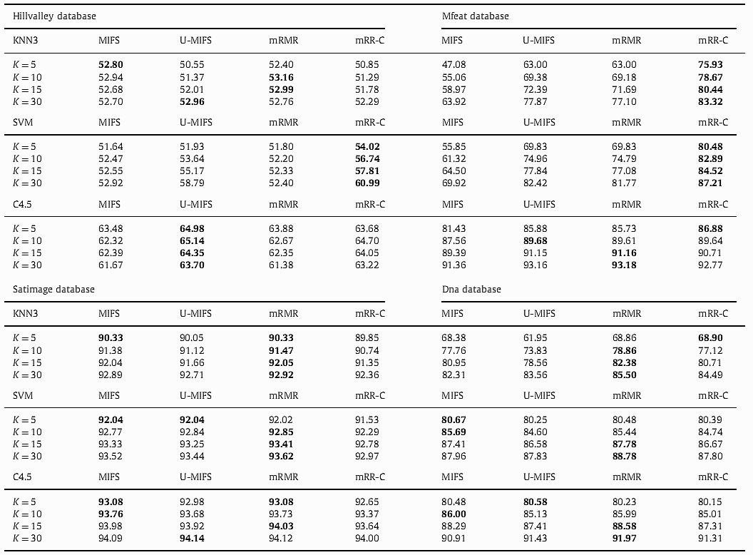
Experimential results

Slide 22
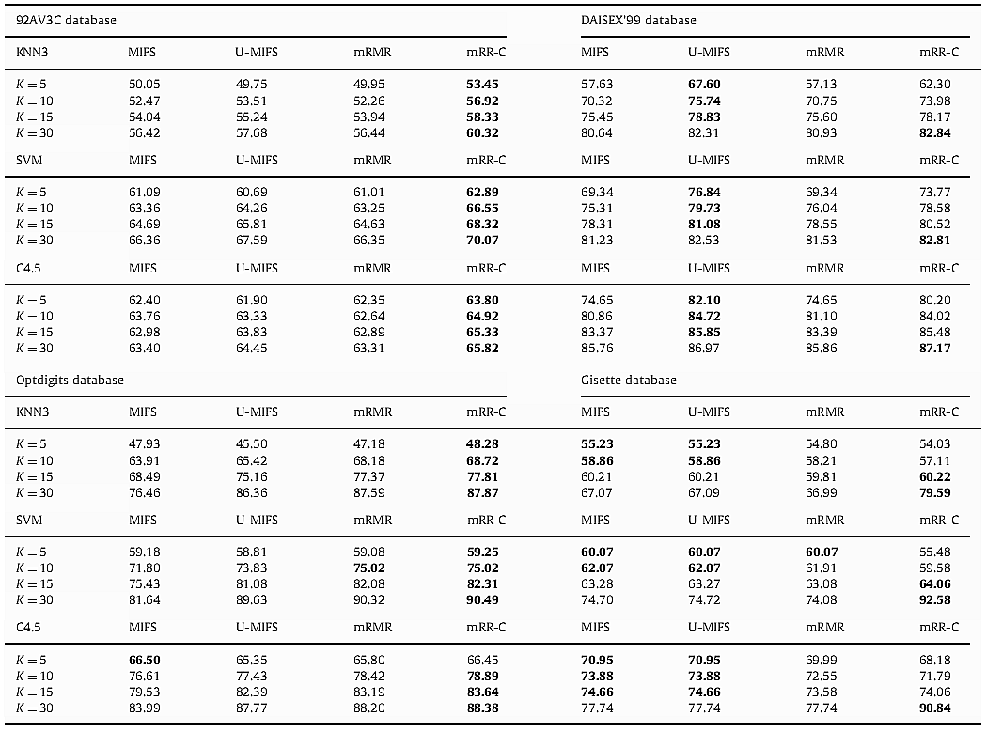
Experimential results

