Slide 1
Mining Closed Sequential Patterns with Time Constraints
Ming-Yen Lin(林明言), Sue-Chen Hsueh(薛夙珍) and Chia-Wen Chang(張家汶)
Journal of Information Science and Engineering 24, 33-46 (2008)
Speaker: Chong-Jie Wang
Date: Mar. 23, 2010

Slide 2
Abstract(1/2)
The mining of closed sequential patterns has attracted researchers for its capability of using compact results to preserving the same expressive power as traditional mining. Many studies have shown that constraints are essential for applications of sequential patterns. However, time constraints have not been incorporated into closed sequence mining yet. Therefore, we propose an algorithm called CTSP for closed sequential pattern mining with time constraints. CTSP loads the database into memory and constructs time-indexes to facilitate both pattern mining and closure checking, within the patterngrowth framework.

Slide 3
Abstract(2/2)
The index sets are utilized to efficiently mine the patterns without generating any candidate or sub-database. The bidirectional closure checking strategy further speeds up the mining. The comprehensive experiments with both synthetic and real datasets show that CTSP efficiently mines closed sequential patterns satisfying the time constraints, and has good linear scalability with respect to the database size.

Slide 4
Mining sequential patterns with time constraints
Three time constraints : minimum gap, maximum gap and sliding time-window
pattern<(TV)(Audio, Jukebox)>
sequence<₁(TV)₇(Audio)₉(Jukebox)>

Slide 5
Problem statement
sequence s = <e₁e₂…e_{w}>
e_{i} : itemset
k-sequence : |s| = k
A data sequence ds has a unique identifier sid and is represented by <_{t1}e₁’ _{t2}e₂’ … _{tn}e_{n}’>, where element e_{i}’ occurred at time t_{i} , t₁ < t₂ < … < t_{n}.

Slide 6
Problem statement(cont)
A sequence s in the sequence database DB is a time-constrained sequential pattern (abbreviated as time-pattern) if s.sup ≥ minsup, where s.sup is the support of the sequence s and minsup is the user specified minimum support threshold.

Slide 7
Problem statement(cont)
A data sequence ds = <_{t1}e₁’ _{t2}e₂’ … _{tn}e_{n}’> contains a sequence s = <e₁e₂…e_{w}> if there exist integers l1, u1, l2, u2, …, lw, uw and 1 ≤ l1 ≤ u1 < l2 ≤ u2 < … < lw ≤ uw ≤ n such that the four conditions hold: (1) e_{i} ⊆ (e_{li}’ ∪ … ∪ e_{ui}’), 1 ≤ i ≤ w; (2) t_{ui} − t_{li} ≤ swin, 1 ≤ i ≤ w; (3) t_{ui} − t_{li}-1 ≤ maxgap, 2 ≤ i ≤ w; (4) t_{li} − t_{ui}-1 ≥ mingap, 2 ≤ i ≤ w.

Slide 8
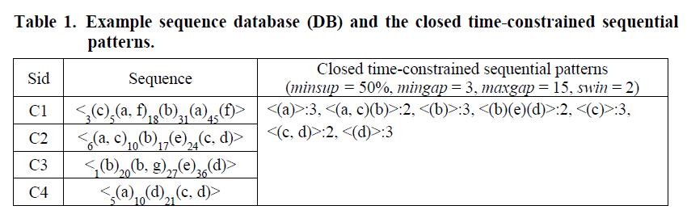

Slide 9
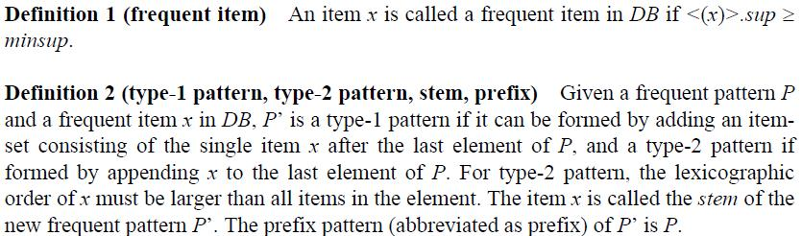
CTSP: Close Time-constraint Sequential Pattern Mining

Slide 10
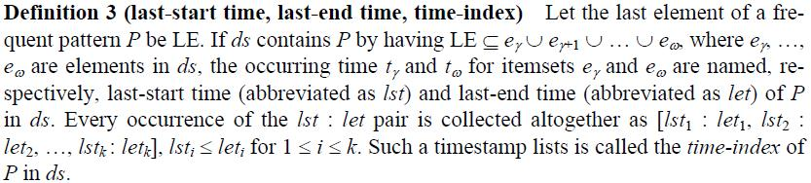
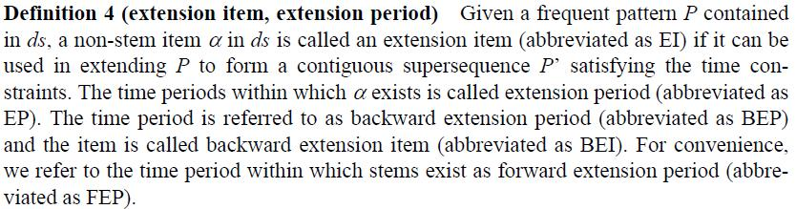

Slide 11
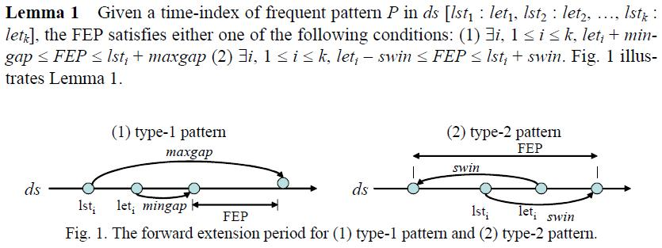

Slide 12
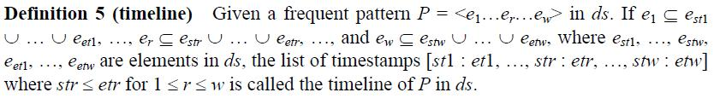
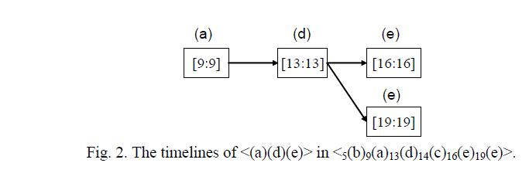

Slide 13
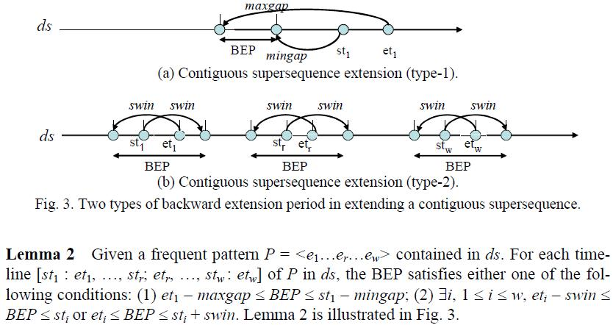

Slide 14
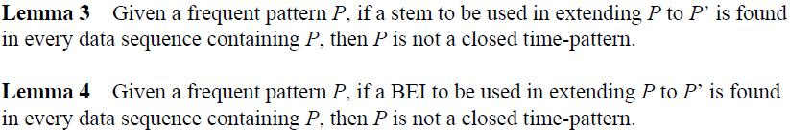

Slide 15
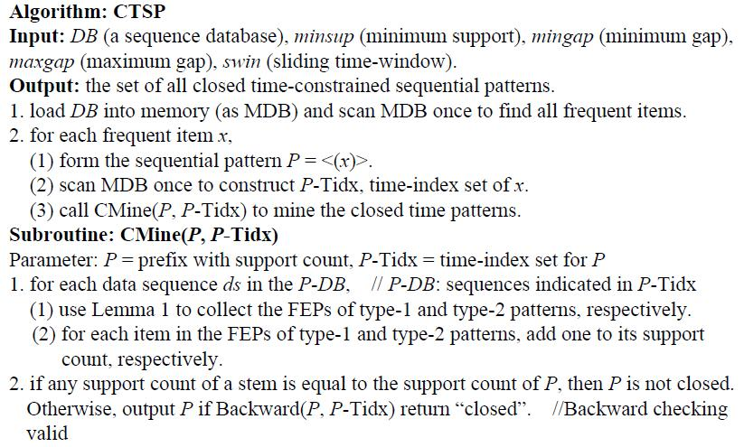

Slide 16
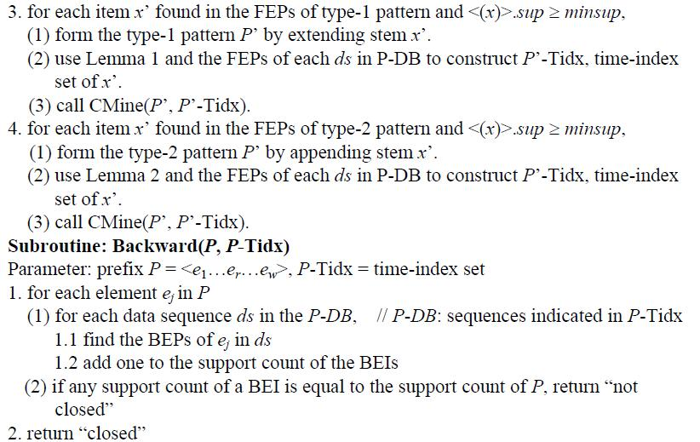

Slide 17
Experimental Evaluations
We describe the result of dataset C10T2.5S4I1.25 having 100,000 data sequences (|DB| = 100k), with N_{s} = 5000, N_{I} = 25000 and N = 10000.

Slide 18
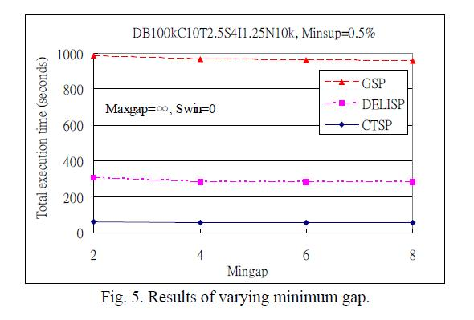

Slide 19
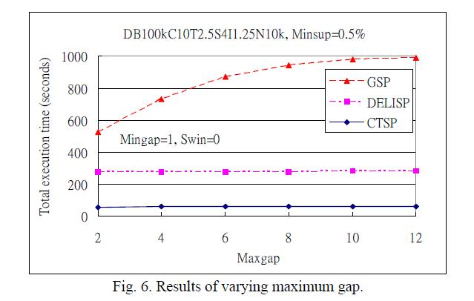

Slide 20
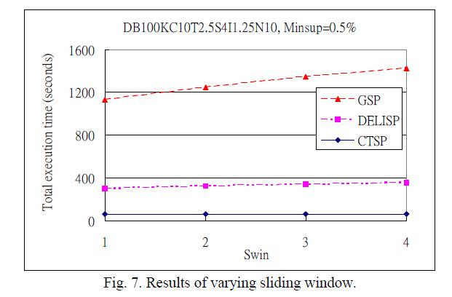

Slide 21
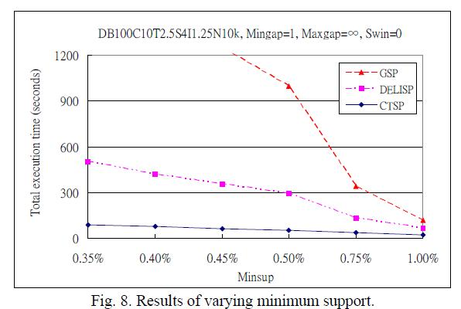

Slide 22
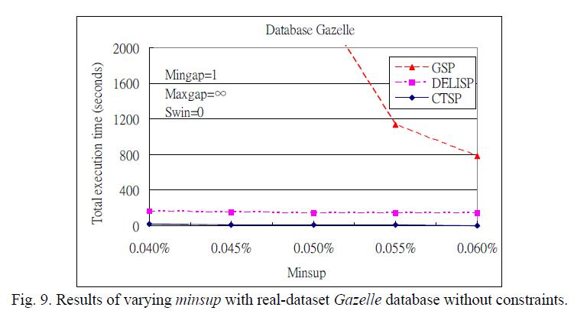

Slide 23
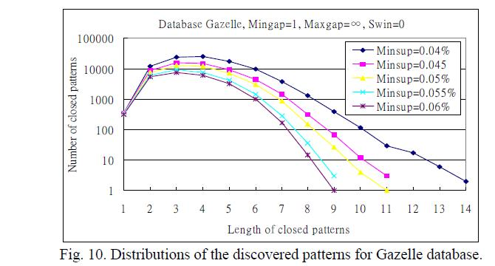

Slide 24
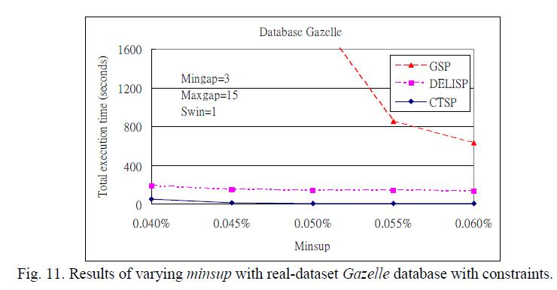

Slide 25
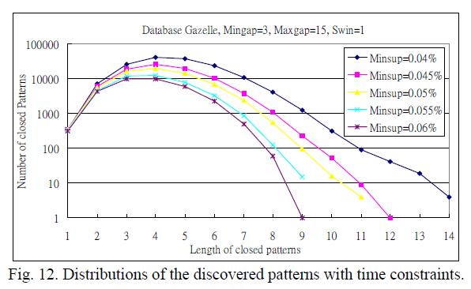

Slide 26
