Slide 1
Sparse Bayesian Learning and the Relevance Vector Machine
Michael Tpping
Journal of Machine Learning Research, No. 1, 2001, pp.211-244

Slide 2
Abstract
This paper introduces a general Bayesian framework for obtaining sparse solutions to regression and classification tasks utilising models linear in the parameters. Although this framework is fully general, we illustrate our approach with a particular specialisation that we denote the 'relevance vector machine' (RVM), a model of identical functional form to the popular and state-of-the-art 'support vector machine' (SVM). We demonstrate that by exploiting a probabilistic Bayesian learning framework, we can derive accurate prediction models which typically utilise dramatically fewer basis functions than a comparable SVM while offering a number of additional advantages.

Slide 3
Abstract
These include the benefits of probabilistic predictions, automatic estimation of 'nuisance' parameters, and the facility to utilise arbitrary basis functions (e.g. non-'Mercer' kernels). We detail the Bayesian framework and associated learning algorithm for the RVM, and give some illustrative examples of its application along with some comparative benchmarks. We offer some explanation for the exceptional degree of sparsity obtained, and discuss and demonstrate some of the advantageous features, and potential extensions, of Bayesian relevance learning.

Slide 4
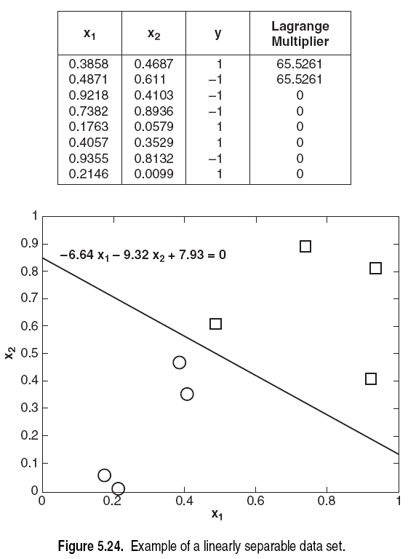
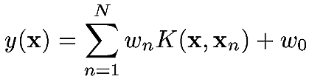
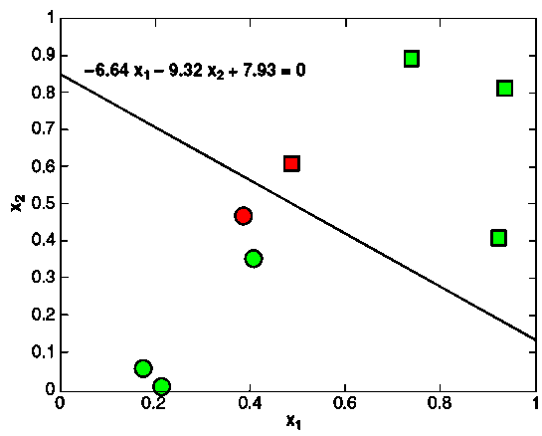
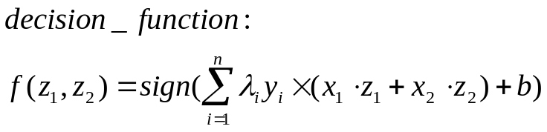
λ_{i}
Informative samples
Non-informative samples
w0=7.93, w1=65.5, w2=-65.5
Taken from the textbook: Introduction to Data Mining

Slide 5
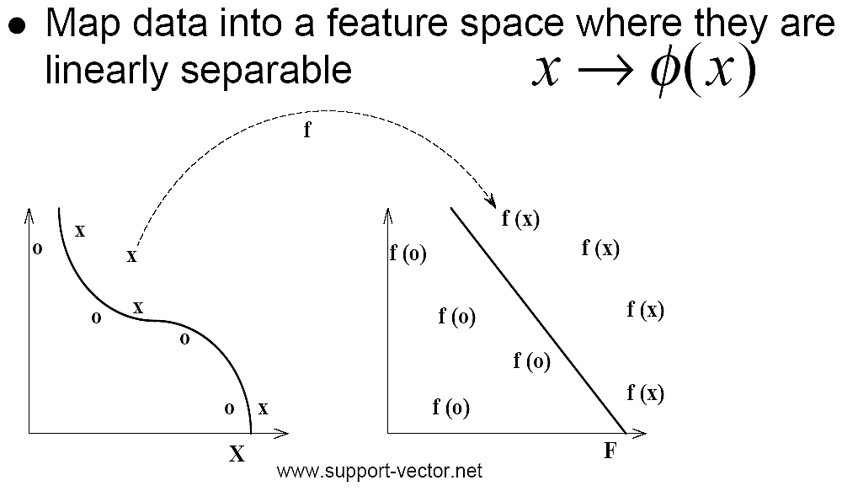
把x應射至高維空間
K(x,y)=<φ(x),φ(y)>
From Nello Cristianini' ICML 2001

Slide 6
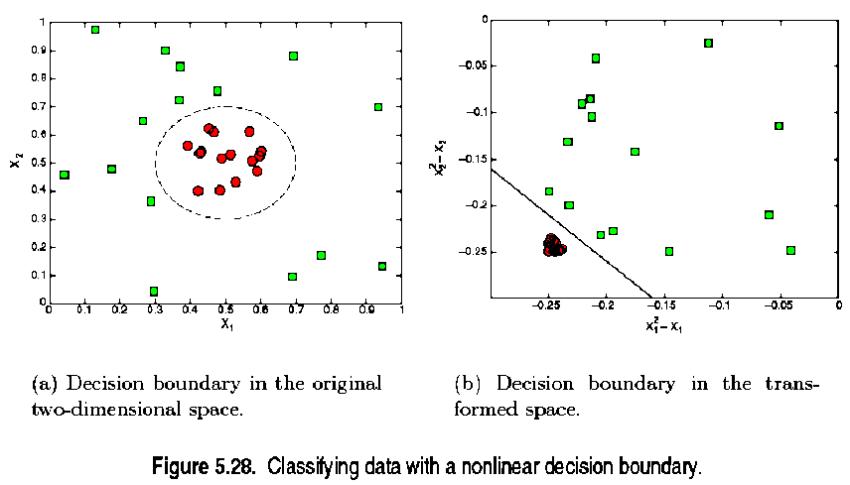
(x₁-0.5)² +(x₂-0.5)² =2 ⇒(x₁²-x₁)+(x₂² -x₂)-0.46=0
Taken from the textbook: Introduction to Data Mining

Slide 7
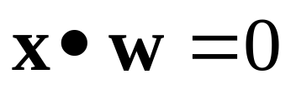
Original decision boundary is:
  (x₁-0.5)²+(x₂-0.5)²=2 ⇒
  x₁²-x₁+x₂ ²-x₂-0.46=0 ⇒
  (x₁²,x₂²,x₁,x₂,1)• (1,1,-1,-1,1)=0
The transformation is:
  Φ:(x₁, x₂)_{2D}→(x₁²,x₂², x₁, x₂,1)_{4D}
  Class1: (x₁²,x₂², x₁, x₂,1)•(1,1,-1,-1,1)>0
  Class2: (x₁²,x₂², x₁, x₂,1)•(1,1,-1,-1,1)<0
The transformed decision boundary has the following form. It is linear in the higher dimension.
在高維空間有線型決策邊界!
Taken from the textbook: Introduction to Data Mining

Slide 8
RVM vs. SVM預測
SVM prediction
  其中w_{n}為SVM訓練後所得參數，假設K(x,y)=exp(-(x-y)²)，N=2, w0=0, w1=-1, w2=+1。
x1=-1
0
x2=1

Slide 9
RVM vs. SVM預測
SVM prediction
  假設要預測x=0.5應該是屬那一類，則
  K(-1,0.5)=exp(-(-1-0.5)^2)=0.105
  K(1,0.5)=exp(-(1-0.5)^2)=0.779
  y(0.5)=-1*0.105+1*0.779=0.674>0
  故應該屬於+1這一類
x1=-1
0
x2=1

Slide 10
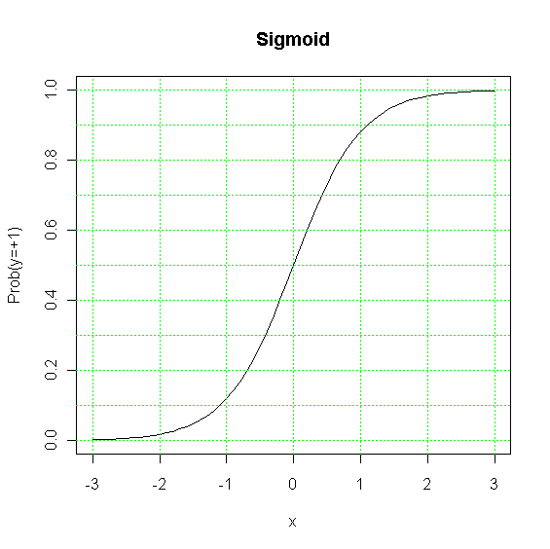
RVM vs. SVM預測
SVM prediction probability
  迴歸本身不提供預測信心區間
  但分類可用sigmoid函式得到，例如：p(y)=1/(1+exp(-k*y))
  時間複雜度O(N)
Notes:
x=seq(-3,3,.1)
plot(x,1/(1+exp(-2*x)),type='l',xlab='x',ylab='Prob(y=+1)',main='Sigmoid')
abline(h = seq(0,1,.1), v = -3:3, col = "green", lty=3)

Slide 11
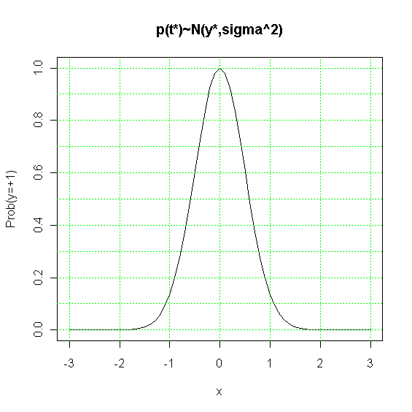
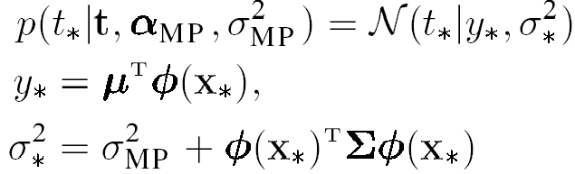
RVM vs. SVM預測
RVM prediction probability
  迴歸預測函式本身就提供機率(信心區間)
  t*為預測結果，其期望值為y*，變異數為σ*²
  最差時間複雜度O(N²)(實際上少些)
Notes:
x=seq(-3,3,.1)
plot(x,exp(-2*x^2),type='l',xlab='x',ylab='Prob(y=+1)',main='p(t*)~N(y*,sigma^2)')
abline(h = seq(0,1,.1), v = -3:3, col = "green", lty=3)

Slide 12
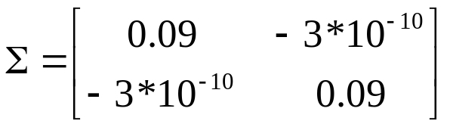
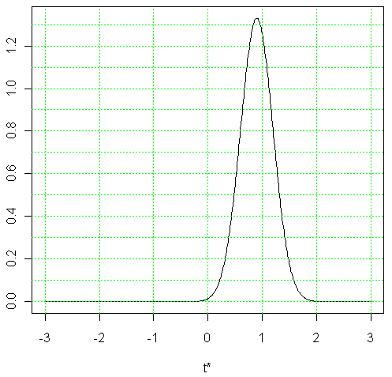
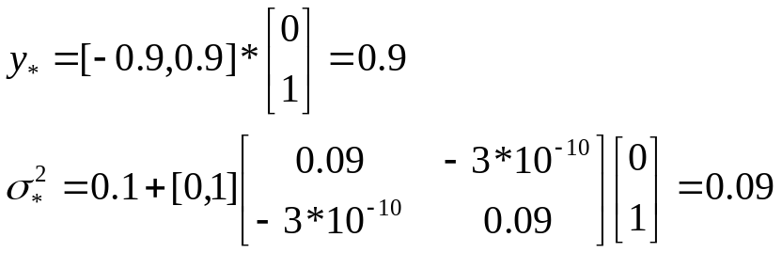
RVM vs. SVM預測
RVM prediction probability
  迴歸預測函式提供信心區間
  t*為預測結果，其期望值為y*，變異數為σ*²
  假設φ(x*)=[0,1] '， μ=[-0.9,0.9]'，σ_{MP}²=0.1，根據
  得
Notes:
delta=0.01
x=seq(-3,3,delta)
plot(x,1/sqrt(2*pi*0.09)*exp(-1/0.09/2*(x-0.9)^2),type='l',xlab='t*',ylab='Prob(y=+1)',main='p(t*)~N(y*,sigma^2)')
abline(h = seq(0,1.5,.1), v = -3:3, col = "green", lty=3)
#check
sum(1/sqrt(2*pi*0.09)*exp(-1/0.09/2*(x-0.9)^2))*delta

Slide 13
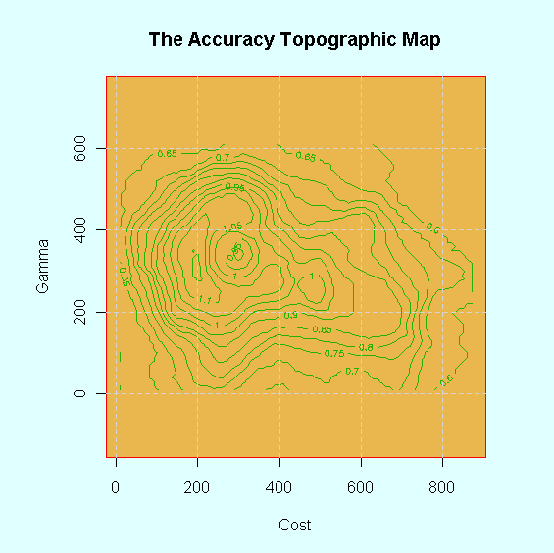
RVM vs. SVM參數估計
對於RBF(radial basis function) SVM而言，需靠grid search方式+交叉驗證找到最佳的cost/ε與gamma
Notes:
rx <- range(x <- 10*1:nrow(volcano))
ry <- range(y <- 10*1:ncol(volcano))
ry <- ry + c(-1,1) * (diff(rx) - diff(ry))/2
tcol <- terrain.colors(12)
par(opar);
opar <- par(pty = "s", bg = "lightcyan")
plot(x = 0, y = 0,type = "n", xlim = rx, ylim = ry, xlab = "Cost", ylab = "Gamma")
u <- par("usr")
rect(u[1], u[3], u[2], u[4], col = tcol[8], border = "red")
contour(x, y, volcano*0.006, col = tcol[2], lty = "solid", add = TRUE, vfont = c("sans serif", "plain"))
title("The Accuracy Topographic Map", font = 4)
abline(h = 200*0:4, v = 200*0:4, col = "lightgray", lty = 2, lwd = 0.1)

Slide 14



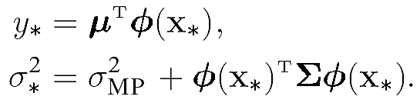
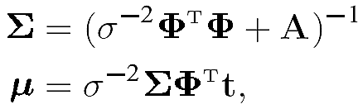
RVM vs. SVM參數估計
對於RVM而言，參數會在訓練(最佳化，在此僅介紹其中一種)過程獲得，疊代方式如下：
反複疊代直到收斂
Notes:
library(kernlab)
x=matrix(c(-1,1),ncol=1)
y=c(-1,1)
r=rvm(x,y,kpar=list(sigma=5))

Slide 15
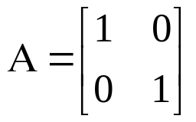
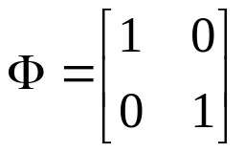
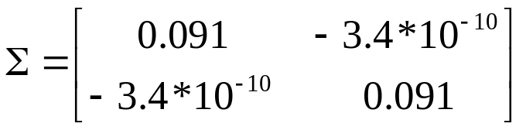

RVM vs. SVM參數估計
α更新範例
  假設t=[-1,1] '，σ²=0.1，
  則根據 得 μ=[-0.083,0.083]
  根據
  得γ=[0.909,0.909], A=diag(133.1,133.1)
Notes:
library(kernlab)
x=matrix(c(-1,1),ncol=1)
y=c(-1,1)
type = "regression"
kernel = "rbfdot"
kpar = kpar=list(sigma=5)
alpha = ncol(as.matrix(x))
var = 0.1 # variance
var.fix = FALSE # fixed variance?
iterations = 100 # no. of iterations
verbosity = 0
tol = .Machine$double.eps
minmaxdiff = 1e-3
cross = 0
fit = TRUE
ret <- new("rvm")
ncols <- ncol(x)
m <- nrows <- nrow(x)
thetavec <- rep(1/alpha, m)
wvec <- rep(1, m)
piter <- iterations*0.4
kernel <- do.call(kernel, kpar)
K <- kernelMatrix(kernel, x)
diag(K) <- diag(K)+ 10e-7
Kml <- crossprod(K, y)

Slide 16
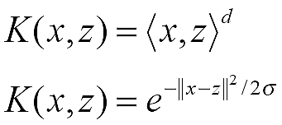
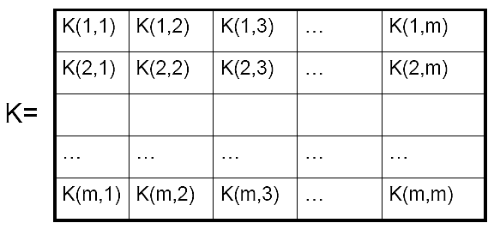
Kernel/Gram matrix
A function that returns the value of the dot product between the images of the two arguments
K(x,y)=<φ(x),φ(y)>
Polynomial
RBF
From Nello Cristianini' ICML 2001

Slide 17
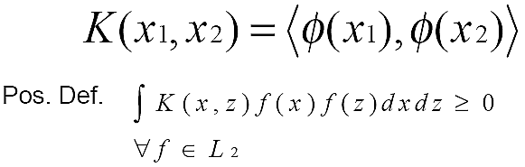
Mercer’s Theorem
Any symmetric positive definite matrix can be regarded as a kernel matrix, that is as an inner product matrix in some space
Every (semi) positive definite, symmetric function is a kernel: i.e. there exists a mapping φ such that it is possible to write:
From Nello Cristianini' ICML 2001

Slide 18
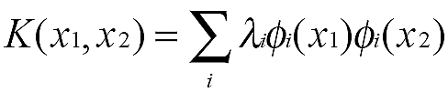
Mercer’s Theorem
Eigenvalues expansion of Mercer’s Kernels:
That is: the eigenfunctions act as features!
From Nello Cristianini' ICML 2001

Slide 19
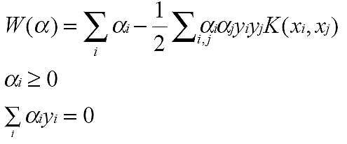
RVM vs. SVM關於Mercer's condition
RVM的kernel function不受Mercer's condition限制，SVM的kernel function則受Mercer's condition限制
想像SVM訓練(最佳化)過程：

Slide 20
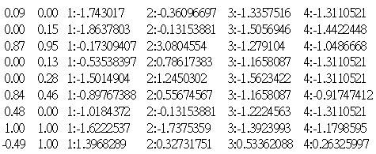
SVM vs. RVM 均須記住訓練資料
LibSVM產生的分類器
svm_type c_svc
kernel_type rbf
gamma 0.25
nr_class 3
total_sv 51
rho -0.0203317 0.131165 -0.0626818
label 1 2 3
nr_sv 8 22 21
SV

Slide 21
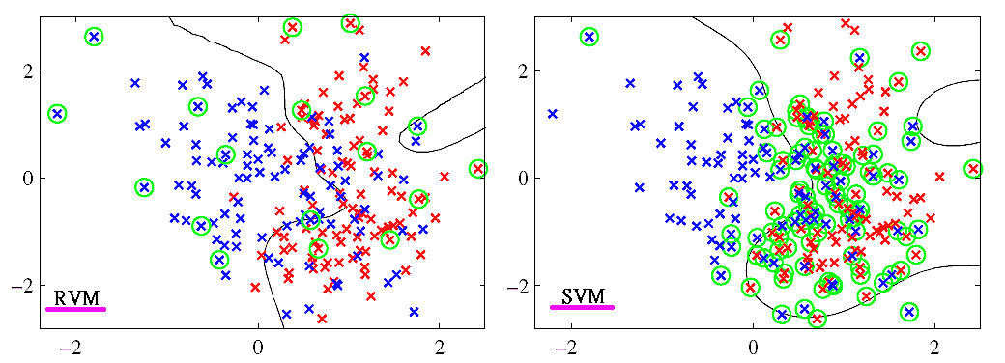
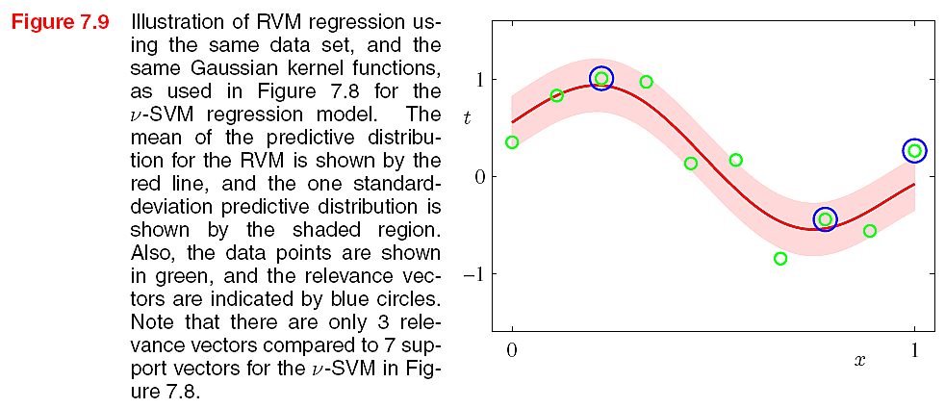
SVM vs. RVM 均須記住訓練資料
classification
from Bishop's "pattern recognition and machine learning"

Slide 22
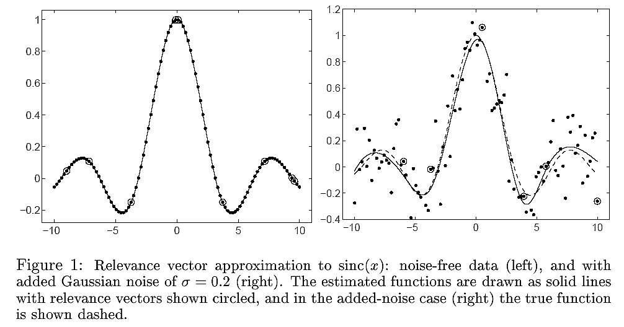
SVM vs. RVM 均須記住訓練資料

Slide 23
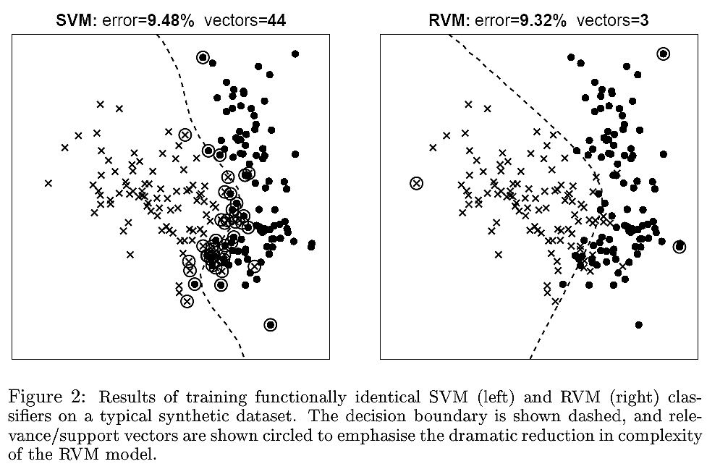
SVM vs. RVM 均須記住訓練資料

Slide 24
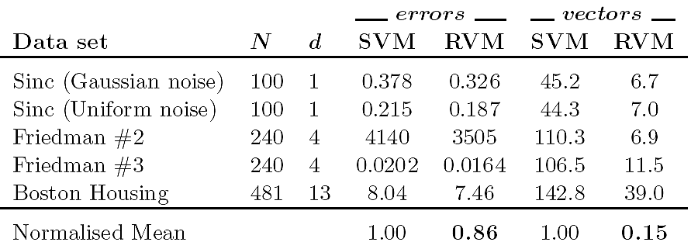
SVM vs. RVM 迴歸效能

Slide 25
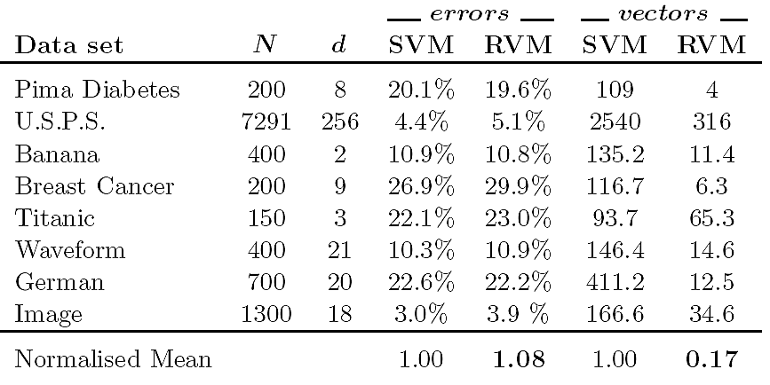
SVM vs. RVM 分類效能

Slide 26
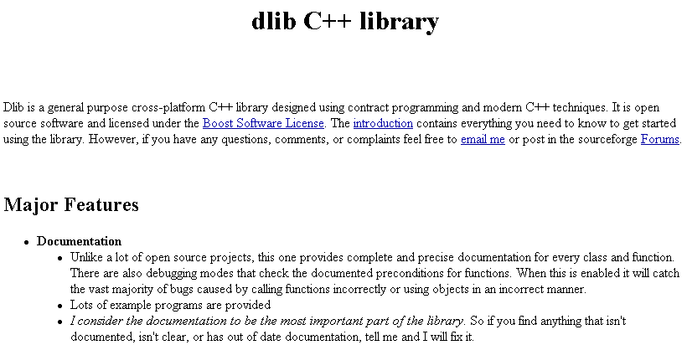
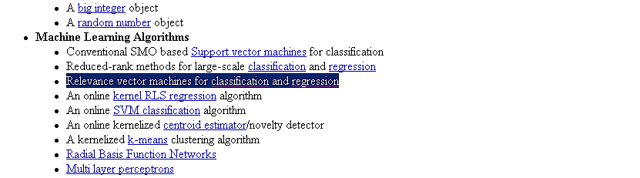
Relevance vector machine resources
http://dlib.net/

Slide 27
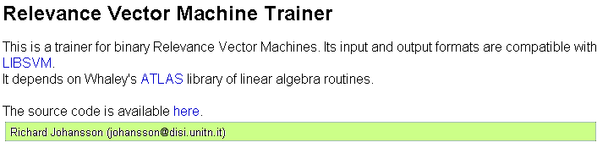
Relevance vector machine resources
http://www.df.lth.se/~richardj/rvm.cgi

Slide 28
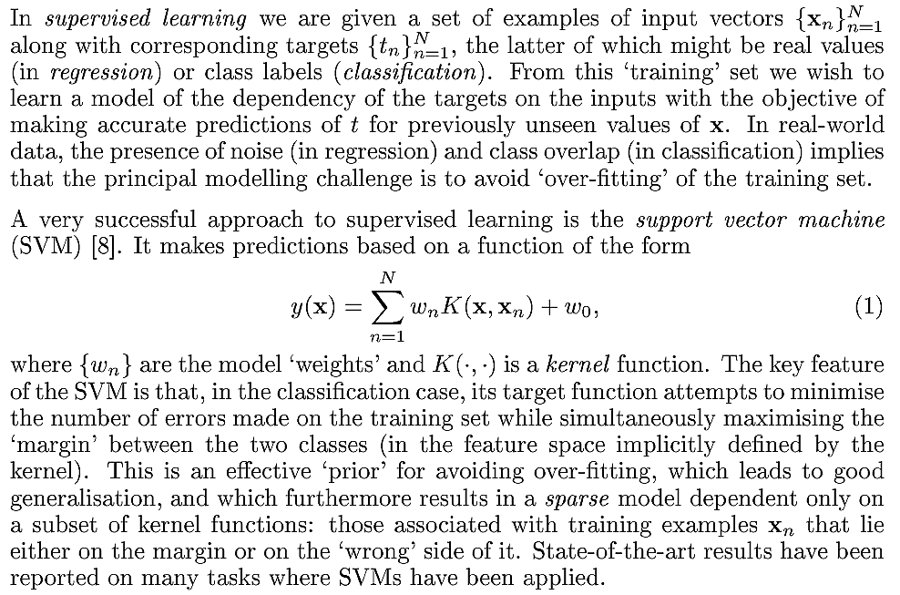
The RVM theory
目標是定義好K(x,y)=<φ(x),φ(y)>後，求最佳wi

Slide 29
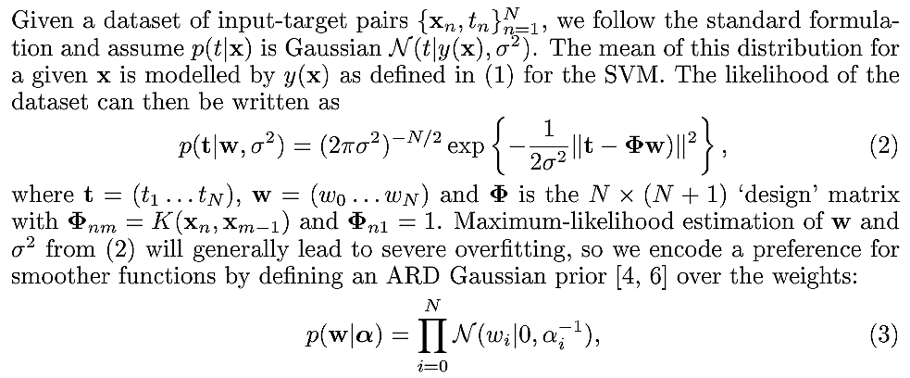
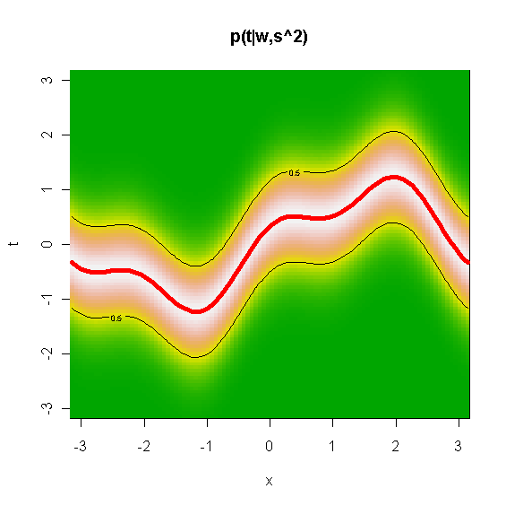
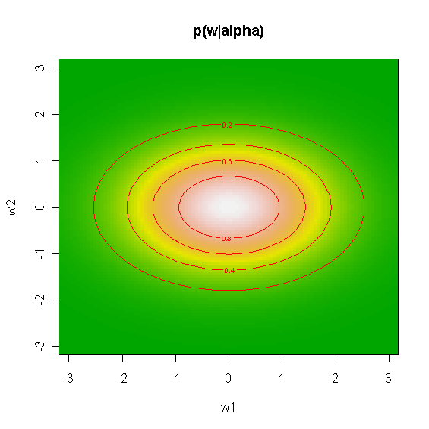
迴歸
Φw
α₂
α₁
Notes:
(2)
N <- 100
x <- seq(-pi, pi, length=N)
y <- seq(-pi, pi, length=N)
xx <- matrix(x, nr=N, nc=N)
yy <- matrix(y, nr=N, nc=N, byrow=TRUE)
z <- exp(-(yy-sin(xx)-cos(3*xx)/3)^2)
#image(x, y, z, xlab = "x", ylab = "t",main='p(t|w,s^2)', col = terrain.colors(100) )
image(x, y, z, xlab = "x", ylab = "t",main=expression(paste('p(t|w,',sigma^2,')')), col = terrain.colors(100) )
contour(x, y, z, lwd=1, add=TRUE,nlevels=2)
lines(x,sin(x)+cos(3*x)/3,col='red',lwd=5)
(3)
x11()
z <- exp(-(yy^2/2+xx^2/4))
#image(x, y, z, xlab = "w1", ylab = "w2",main='p(w|alpha)', col = terrain.colors(100) )
image(x, y, z, xlab = "w1", ylab = "w2",main=expression(paste('p(w|',alpha,')')), col = terrain.colors(100) )
contour(x, y, z, lwd=1, add=TRUE,nlevels=6,col='red')

Slide 30
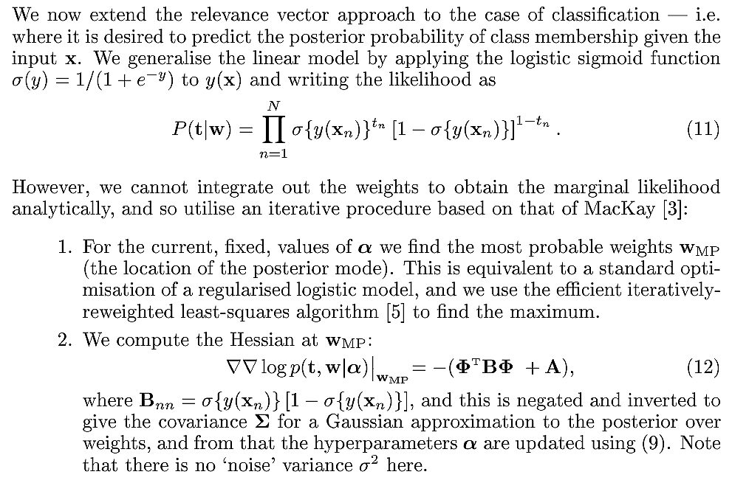
分類

Slide 31

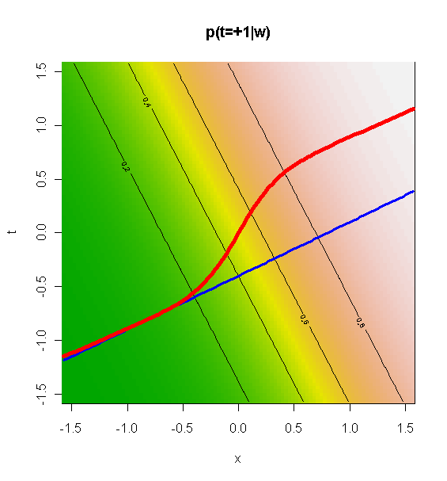
Notes:
(11)
N <- 100
x <- seq(-pi/2, pi/2, length=N)
y <- seq(-pi/2, pi/2, length=N)
xx <- matrix(x, nr=N, nc=N)
yy <- matrix(y, nr=N, nc=N, byrow=TRUE)
z <- 1/(exp(-(yy+2*xx))+1)
image(x, y, z, xlab = "x", ylab = "t",main='p(t=+1|w)', col = terrain.colors(100) )
contour(x, y, z, lwd=1, add=TRUE,nlevels=4)
lines(x,x/2-.4,col='blue',lwd=3)
theta=atan(.5)
lines(x,x*sin(theta)+(1/(1+exp(-6*x))-.5)*cos(theta),col='red',lwd=5)

Slide 32
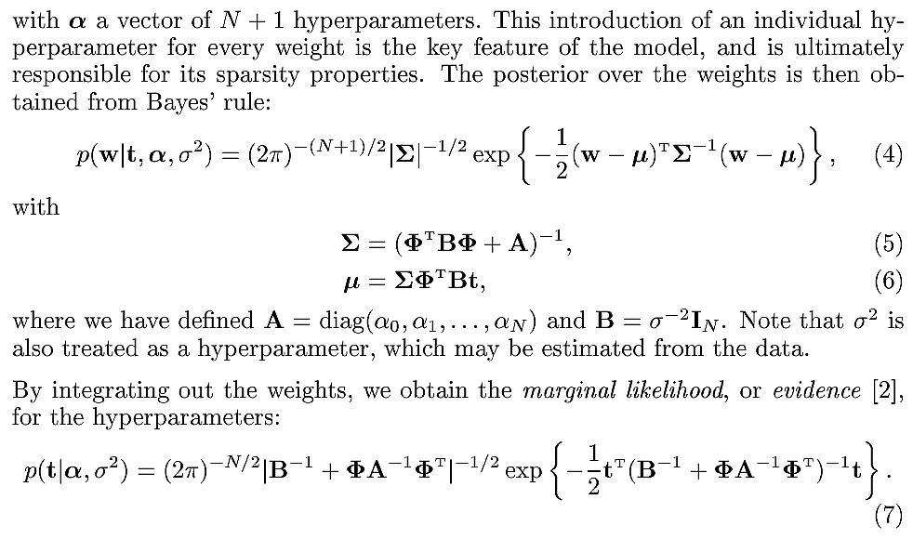
RVM的訓練乃找到α、 σ² 、 Σ及μ，使得目標函式(7)最大化
一般這些參數無法同時最佳化，因此先給定初始α與σ²，然後估算Σ及μ，接著又調整α與σ²，使得目標函式(7)最大化。反複疊代，直到收斂為止
假設資料量為N，每次疊代均需求N*N矩陣之反矩陣，故需O(N³)時間

Slide 33
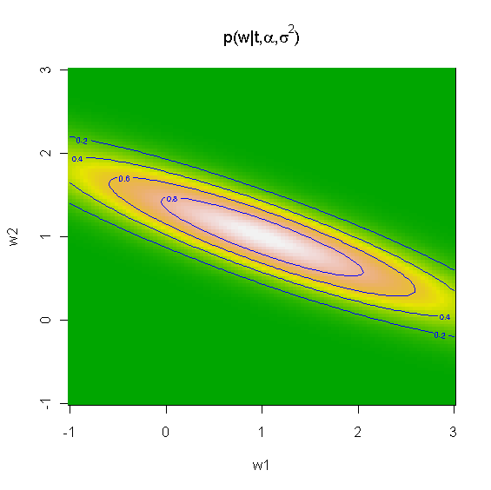
μ
Notes:
(4)
N <- 100
theta=atan(.5)
x <- seq(-1, 3, length=N)
y <- seq(-1, 3, length=N)
xx <- matrix(x, nr=N, nc=N)
yy <- matrix(y, nr=N, nc=N, byrow=TRUE)
#z <- exp(-(yy^2/2+xx^2/4))
S=matrix(c(1,2,2,5),nrow=2)
xo=1; yo=1
z=outer(x,y,function(x,y) exp(-((5*(y-yo)+2*(x-xo))*(y-yo)+(x-xo)*(2*(y-yo)-xo+x) )))
image(x, y, z, xlab = 'w1', ylab = 'w2',main=expression(paste('p(w|t,',alpha,',',sigma^2,')')), col = terrain.colors(100) )
contour(x, y, z, lwd=1, add=TRUE,nlevels=6,col='blue')

Slide 34
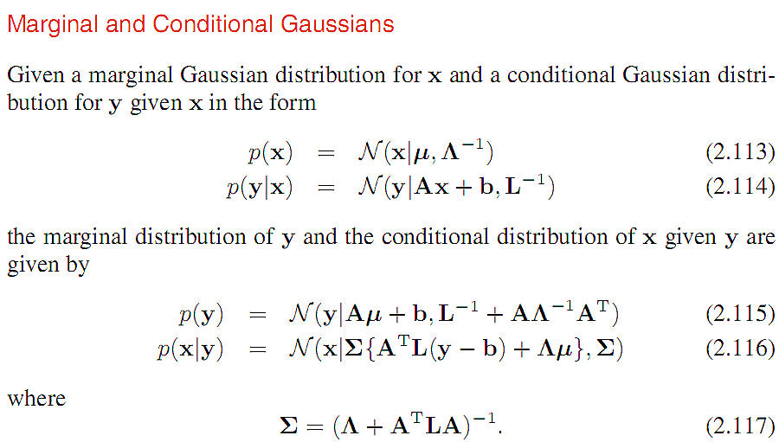
The auxiliary functions

Slide 35
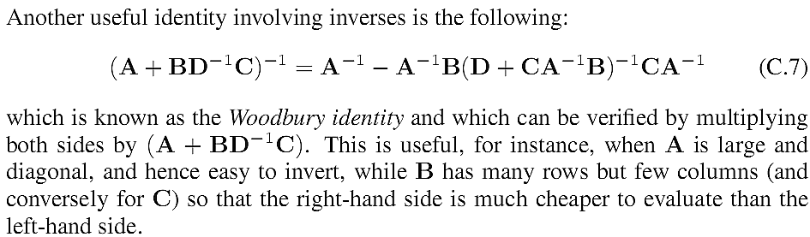
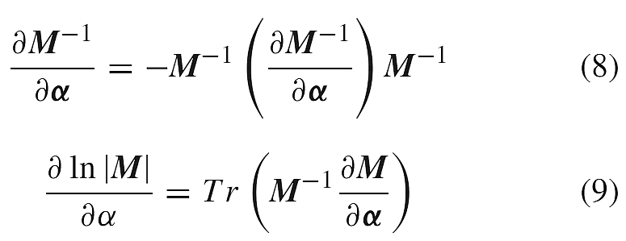
The Woodbury identity
The Matrix Manipulation

Slide 36
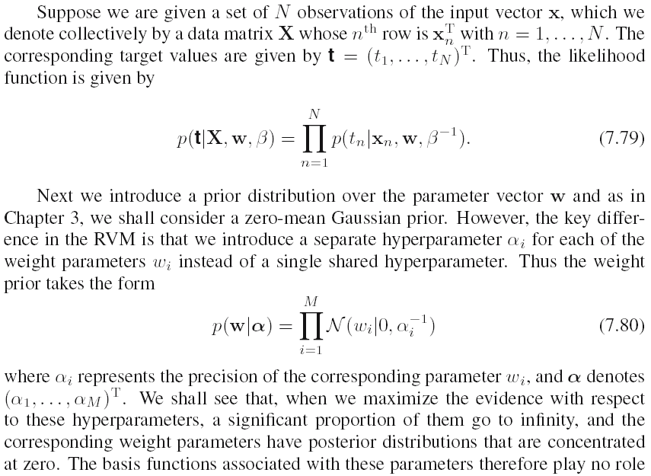
Derivation

Slide 37
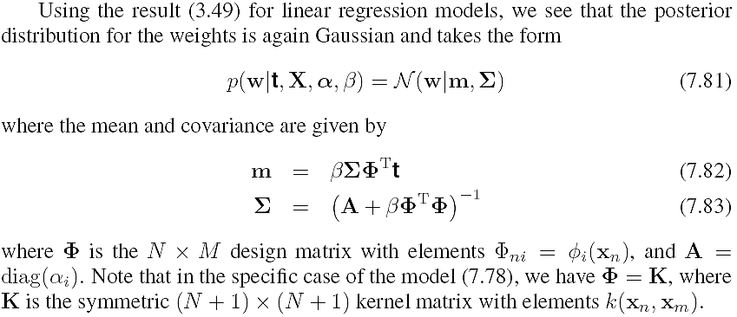
Derivation

Slide 38
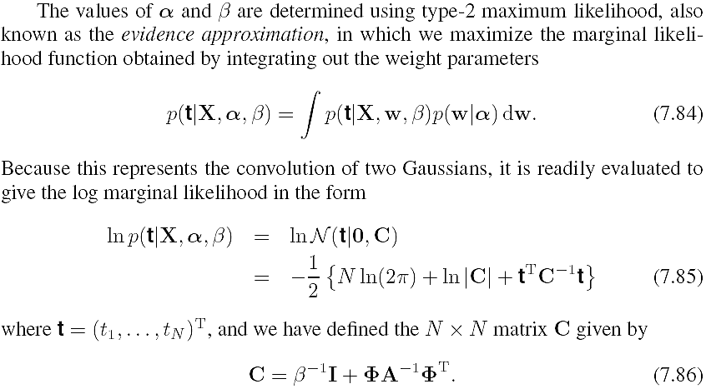
Derivation

Slide 39
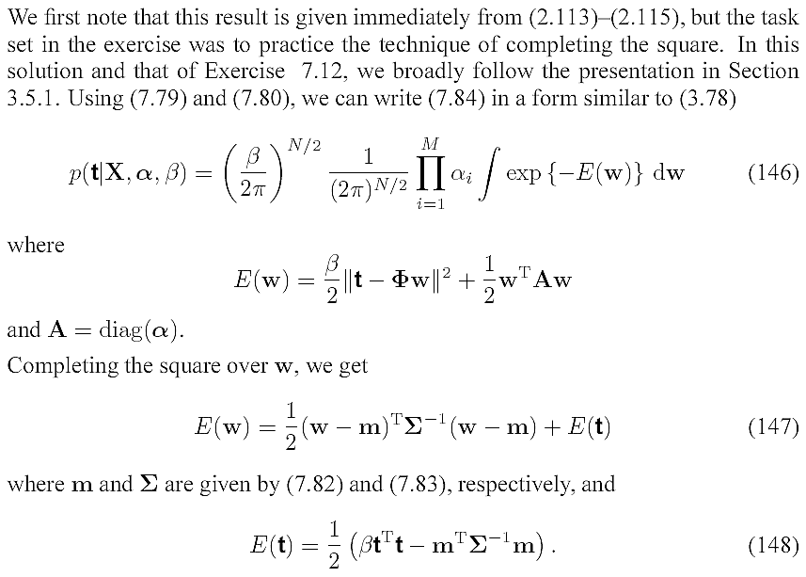
Derivation

Slide 40
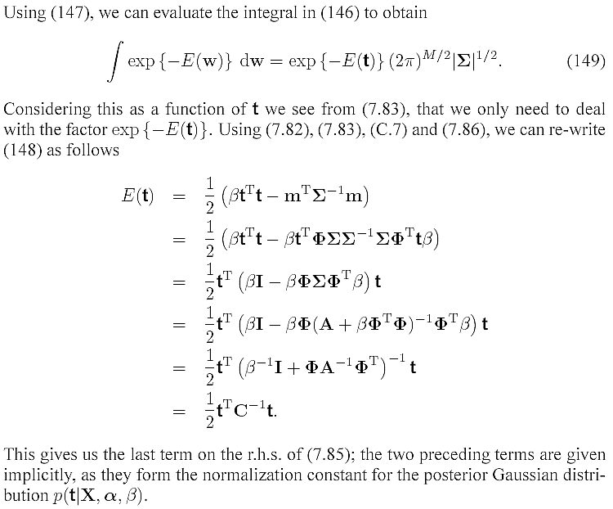
Derivation

Slide 41


Derivation

Slide 42


Derivation

Slide 43


Derivation

