Slide 1
A Distributed Storage MLCS Algorithm with Time Efficient Upper Bound and Precise Lower Bound
Chunyang Wang , Yuping Wang , Xiangjuan Wu, Xiaofang Guo
Information Sciences, Volume 618, December 2022, pp. 118-135
Presenter: Wen-Wen Liao
Date: Jan. 10, 2023

Slide 2
Abstract (1/2)
Finding the longest common subsequence of multiple sequences (i.e., the MLCS problem) is a key issue in data mining, such as pattern recognition of bio-sequences (e.g., DNA and protein sequences), diagnosis of diseases, and deciphering human genetic codes. The length of the longest common subsequence is often used to measure the similarity between sequences. Current state-of-the-art algorithms for the MLCS problem often transform the problem into finding the longest path in a directed acyclic graph (DAG); however, their fatal flaw is that the time cost or constructed DAG is too large.

Slide 3
Abstract (2/2)
Aiming at solving the problem of the existing algorithms, this paper proposes a time-efficient upper bound estimation method that can estimate the upper bound for the length of any path through a node in much less time, and then proposes an adaptive lower bound estimation strategy that can estimate the more precise lower bound for the length of the longest common subsequences. This study also describes a distributed storage scheme that stores most parts of the DAG in external devices and only a few parts in memory. A comparison with several state-of-the-art algorithms in the experiments indicates that the proposed algorithm is more efficient and effective.

Slide 4
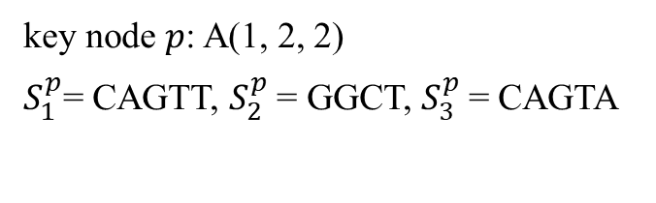
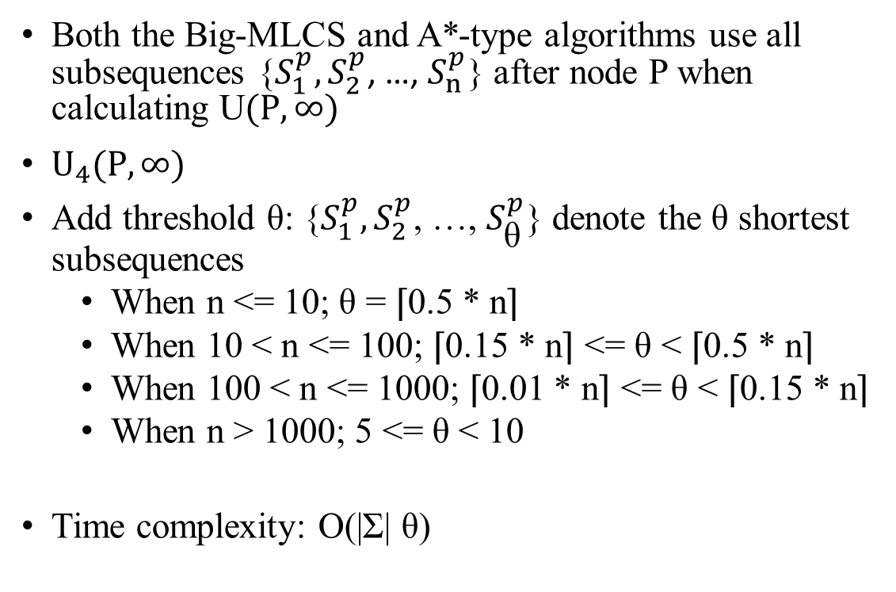
Step MLCS: A Time Efficient Upper Bound Estimation Strategy
Both the Big-MLCS and A*-type algorithms use all subsequences {$S_{1}^{p}, S_{2}^{p}$, …, $S_{n}^{p}$} after node P when calculating U$(P, ∞)$
$U_{4}(P, ∞)$
Add threshold θ: {$S_{1}^{p}, S_{2}^{p}$, …, $S_{\text{θ}}^{p}$} denote the θ shortest subsequences
When n <= 10; θ = ⌈0.5 * n⌉
When 10 < n <= 100; ⌈0.15 * n⌉ <= θ < ⌈0.5 * n⌉
When 100 < n <= 1000; ⌈0.01 * n⌉ <= θ < ⌈0.15 * n⌉
When n > 1000; 5 <= θ < 10
Time complexity: O(|Ʃ| θ)
S1 = ACAGTT
S2 = CAGGCT
S3 = GACAGTA
key node $p$: A(1, 2, 2)
$S_{1}^{p}$= CAGTT, $S_{2}^{p}$= GGCT, $S_{3}^{p}$= CAGTA

Slide 5
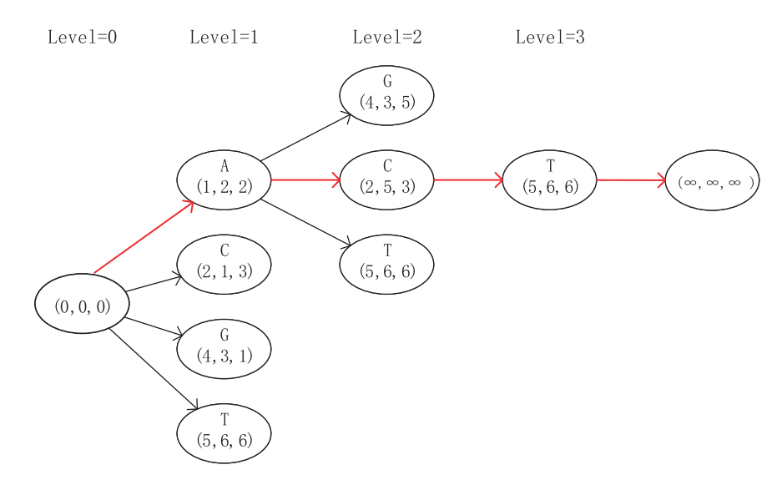
Step MLCS: Construct Smaller DAG and Estimate Precise Lower Bound
Initial path in Big-MLCS: choose the node with the minimum sum of components in each level and record this sum at each level
LMLCS: length of the path
Sum(1) = 5, Sum(2) = 10, Sum(3) = 17
S1 = ACAGTT
S2 = CAGGCT
S3 = GACAGTA
sum = 12
sum = 5
sum = 10
sum = 17
sum = 6
sum = 17
sum = 8
LMLCS = 3
sum = 17

Slide 6
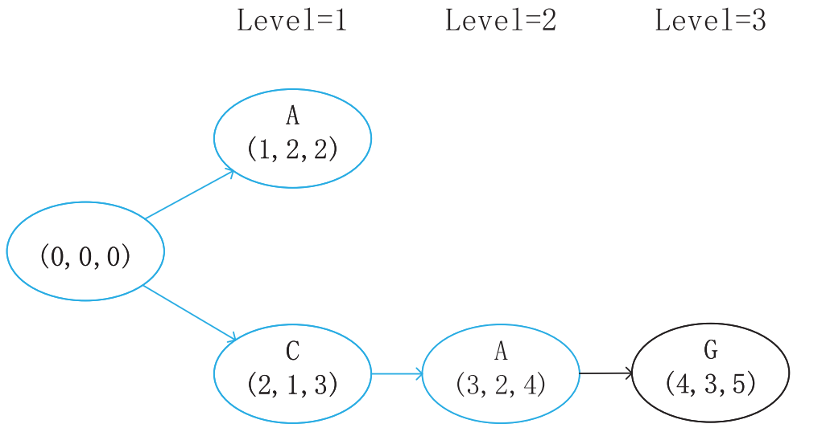
Step MLCS: Construct Smaller DAG and Estimate Precise Lower Bound
Suc(1) = {A(1, 2, 2), C(2, 1, 3), G(4, 3, 1), T(5, 6, 6)}
MinSuc(1) = {A(1, 2, 2), C(2, 1, 3), G(4, 3, 1)}
L(1) = {A(1, 2, 2), C(2, 1, 3)} (by branch-and-bound)
Suc(2) = {A(3, 2, 4), C(2, 5, 3), G(4, 3, 5), T(5, 6, 6)}
MinSuc(2) = {A(3, 2, 4), C(2, 5, 3)}
A(3, 2, 4) = 9 < 10 = Sum(2) => update lower bound
S1 = ACAGTT
S2 = CAGGCT
S3 = GACAGTA

Slide 7




Step MLCS: Update Lower Bound (2 Methods)
Method 1:
Find successors of level 2, denoted by Suc(3) = {G(4, 3, 5), T(5, 6, 6)}, choose minimal sum G(4, 3, 5) as next node P at level 3.
Method 2:
Find successors of level 2, denoted by Suc(3) = {G(4, 3, 5), T(5, 6, 6)}. For each node Q ∈ Suc(3), compute $U_{4}(Q, ∞)$, choose maximal $U_{4}(Q^{∗}, ∞)$ and $Q^{∗}$as next node P at level 3.
S1 = ACAGTT
S2 = CAGGCT
S3 = GACAGTA
G(4, 3, 5), n = 3, θ = ⌈0.5 * 3⌉ = 2
${S_{∗}^{}=S}_{1}^{p}$= TT, $S_{3}^{p}$= TA
$deversity(S_{∗}^{}$, $S_{3}^{p}$) = $\frac{0}{2}\left(0−1\right)+$ $\frac{2}{2}$ $\left(2−1\right)+ \frac{0}{2} \left(0−0\right)$ $+$ $\frac{0}{2}$ $\left(0−0\right)$ = $1$
T(5, 6, 6), n = 3, θ = ⌈0.5 * 3⌉ = 2
${S_{∗}^{}=S}_{2}^{p}$= null, $S_{1}^{p}$= T
$deversity(S_{∗}^{}$, $S_{3}^{p}$) = $\frac{0}{0}\left(0−0\right)+$ $\frac{0}{0}$ $\left(0−1\right)+ \frac{0}{0} \left(0−0\right)$ $+$ $\frac{0}{0}$ $\left(0−0\right)$ = $0$

Slide 8
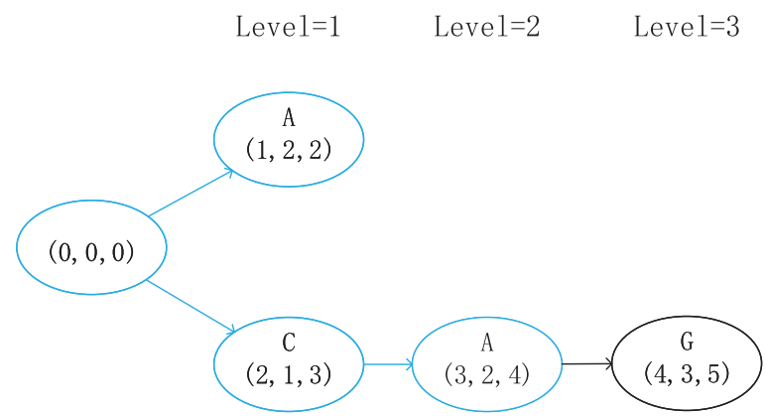
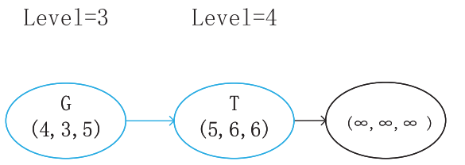
Step MLCS: Distributed Storage Scheme
λ = 2
Store in external storage device
Store in external storage device

Slide 9
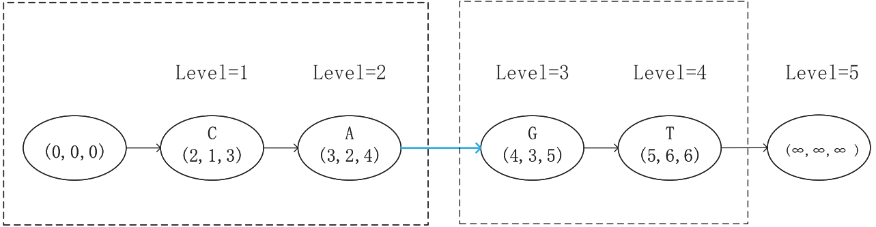
Step MLCS
S1 = ACAGTT
S2 = CAGGCT
S3 = GACAGTA

Slide 10
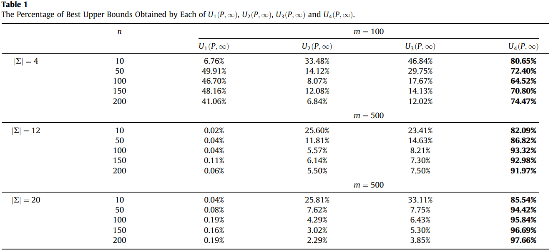

Step MLCS: Experiments and Analysis
Compared the quality of the upper bounds $U_{1}(P, ∞)$, $U_{2}(P, ∞)$, $U_{3}(P, ∞)$ used in the A*-type algorithms and our proposed upper bound $U_{4}(P, ∞)$

Slide 11
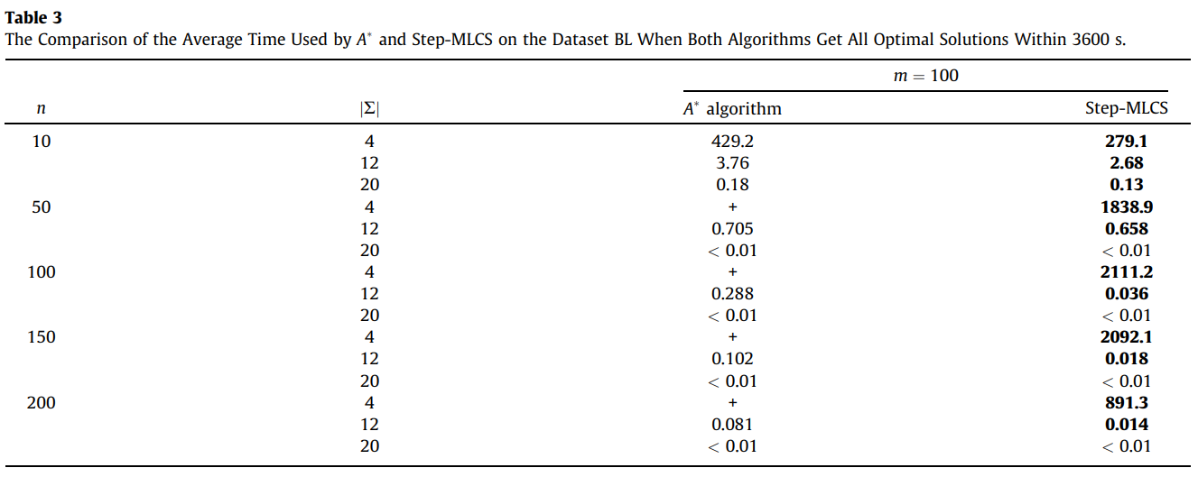
Step MLCS: Experiments and Analysis

Slide 12
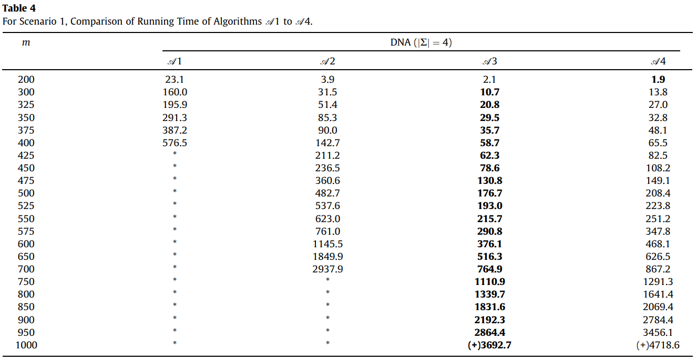
Step MLCS: Experiments and Analysis
Scenario 1: The number of sequences remained unchanged at four, and the length of the sequence was gradually increased from 200 to 1000.

Slide 13
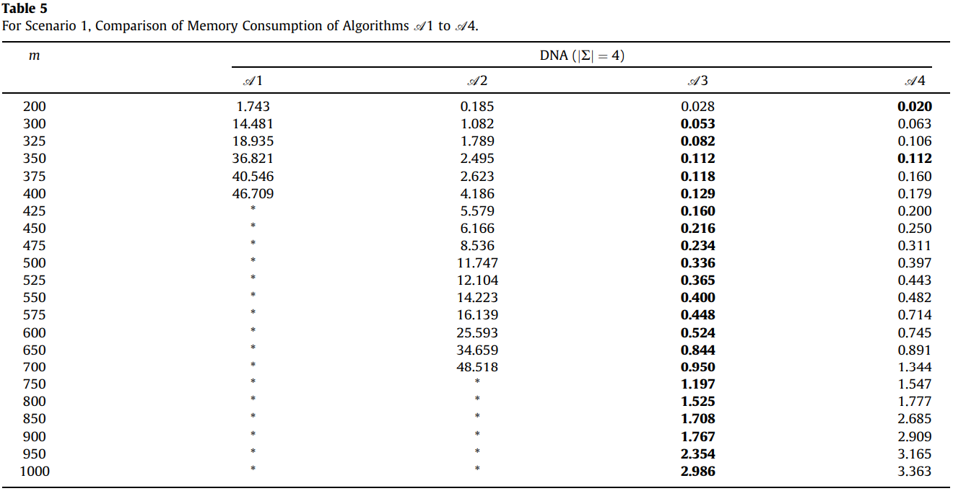
Step MLCS: Experiments and Analysis
Scenario 1: The number of sequences remained unchanged at four, and the length of the sequence was gradually increased from 200 to 1000.

Slide 14
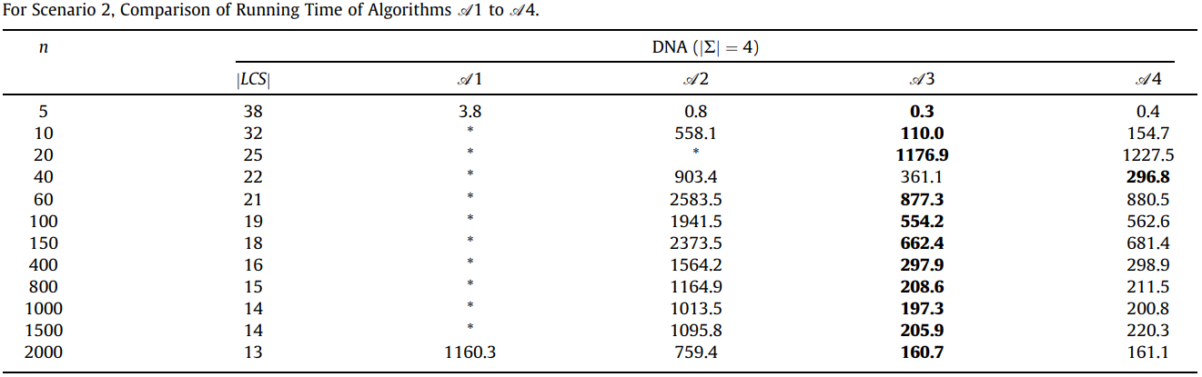
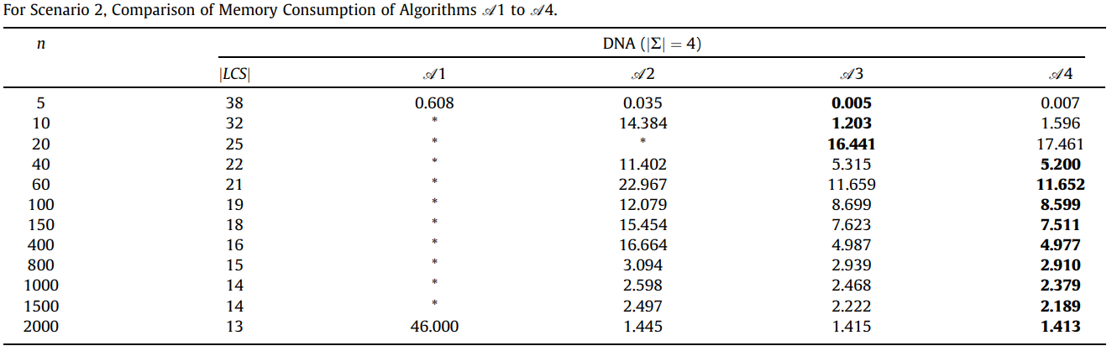
Step MLCS: Experiments and Analysis
Scenario 2: The length of the sequences remained unchanged at 90, and the number of sequences was gradually increased from 5 to 2000.

Slide 15
Conclusion
Time-efficient upper bound estimation method
Adaptive lower-bound estimation strategy
Distributed storage scheme

