Slide 1
Superhuman AI for heads-up no-limit poker: Libratus beats top professionals
Noam Brown, Tuomas Sandholm
SCIENCE, December 2017, Vol 359, Issue 6374, pp. 418-424
Presenter: Ying-Yu Lin
Date: Jan.10, 2023

Slide 2
Abstract
No-limit Texas hold’em is the most popular form of poker. Despite artificial intelligence
(AI) successes in perfect-information games, the private information and massive game tree
have made no-limit poker difficult to tackle. We present Libratus, an AI that, in a 120,000-hand
competition, defeated four top human specialist professionals in heads-up no-limit Texas
hold’em, the leading benchmark and long-standing challenge problem in imperfect-information
game solving. Our game-theoretic approach features application-independent techniques: an
algorithm for computing a blueprint for the overall strategy, an algorithm that fleshes out the
details of the strategy for subgames that are reached during play, and a self-improver algorithm
that fixes potential weaknesses that opponents have identified in the blueprint strategy.

Slide 3
Heads-Up No-Limit Texas Hold’em
No-Limit Betting = Continuous Action Space
- No-limit Texas Hold’em : 10¹⁶¹ decisions
No prior AI has been able to beat top humans
Because an optimal strategy for a subgame cannot be determined from that subgame alone
Why are imperfect-information games hard?

Slide 4
Nash Equilibrium
Nash Equilibrium: a profile of strategies in which no player can improve by deviating.
In two-player zero-sum games, playing a Nash equilibrium ensures you will not lose in expectation
Exploitability: Distance from a Nash equilibrium
Real-world AI must be robust to adversarial adaptation and exploitation
Why care about exploitability?
Notes:
在賽局理論中，如果每個參與者都選擇了自己的策略，並且沒有玩家可以透過改變策略而其他參與者保持不變而獲益，那麼當前的策略選擇的集合及其相應的結果構成了納許均衡。

Slide 5
Example game: Coin Toss
C
P=0.5
Heads
P=0.5
Tails
P1
P1
Sell
Play
Sell
Play
EV=0.5
P2
EV=-0.5
P2
Heads
Tails
Heads
Tails
-1
1
1
-1

Slide 6
Example game: Coin Toss
C
P=0.5
Heads
P=0.5
Tails
P1
P1
Sell
Play
Sell
Play
EV=0.5
P2
EV=-0.5
P2
Heads
Tails
Heads
Tails
-1
1
1
-1
Imperfect-Information Subgame

Slide 7
Example game: Coin Toss
C
P=0.5
Heads
P=0.5
Tails
P1
P1
Sell
Play
Sell
Play
EV=-1.0
EV=1.0
EV=0.5
P2
EV=-0.5
P2
P=1.0
Heads
P=0.0
Tails
P=1.0
Heads
P=0.0
Tails
-1
1
1
-1

Slide 8
Example game: Coin Toss
C
P=0.5
Heads
P=0.5
Tails
P1
P1
Sell
Play
Sell
Play
EV=-1.0
EV=1.0
Heads EV = 0.5
Tails EV = 1.0
Average = 0.75
EV=0.5
P2
EV=-0.5
P2
P=1.0
Heads
P=0.0
Tails
P=1.0
Heads
P=0.0
Tails
-1
1
1
-1

Slide 9
Example game: Coin Toss
C
P=0.5
Heads
P=0.5
Tails
P1
P1
Sell
Play
Sell
Play
EV=1.0
EV=-1.0
EV=0.5
P2
EV=-0.5
P2
P=0.0
Heads
P=1.0
Tails
P=0.0
Heads
P=1.0
Tails
-1
1
1
-1

Slide 10
Example game: Coin Toss
C
P=0.5
Heads
P=0.5
Tails
P1
P1
Sell
Play
Sell
Play
EV=1.0
EV=-1.0
Heads EV = 1.0
Tails EV = -0.5
Average = 0.25
EV=0.5
P2
EV=-0.5
P2
P=0.0
Heads
P=1.0
Tails
P=0.0
Heads
P=1.0
Tails
-1
1
1
-1

Slide 11
Example game: Coin Toss
C
P=0.5
Heads
P=0.5
Tails
P1
P1
Sell
Play
Sell
Play
EV=0.5
EV=-0.5
Heads EV = 0.5
Tails EV = -0.5
Average = 0
EV=0.5
P2
EV=-0.5
P2
P=0.25
Heads
P=0.75
Tails
P=0.25
Heads
P=0.75
Tails
-1
1
1
-1

Slide 12
Example game: Coin Toss
Determining the optimal strategy in the “Play” subgame requires knowledge of the opponent could receive in other subgames
C
P=0.5
Heads
P=0.5
Tails
P1
P1
Sell
Play
Sell
Play
EV=0.5
EV=-0.5
EV=-0.5
P2
EV=0.5
P2
P=0.25
Heads
P=0.75
Tails
P=0.25
Heads
P=0.75
Tails
-1
1
1
-1

Slide 13
Solving the whole game
Limited Texas Hold’em : 10¹³ decisions
- Essentially solved with Counterfactual Regret Minimization+
- Required 262TB compressed to 11TB
No-limit Texas Hold’em : 10¹⁶¹ decisions
- Way too big

Slide 14
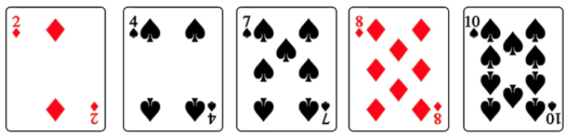
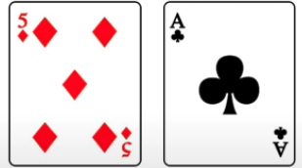
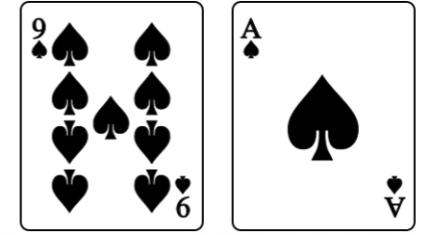
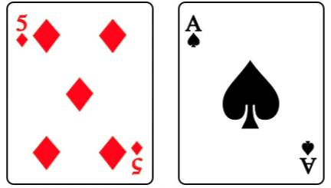
Card abstraction
Best hand

Slide 15
Libratus Abstraction
1st and 2nd round: no card abstraction, dense action abstraction
3rd and 4th round: card abstraction, sparse action abstraction
- Helps reduce exponential blowup
Total size of abstract strategy: ~50TB

Slide 16
Monte Carlo Counterfactual Regret Minimization (MCCFR)
P1
Regrets = [0,0]
P2
P1
Regrets = [0,0,0]
$50

Slide 17
Monte Carlo Counterfactual Regret Minimization (MCCFR)
P1
Regrets = [0,0]
P2
P1
Regrets = [0,-50,50]
$50
$0
$100

Slide 18
Monte Carlo Counterfactual Regret Minimization (MCCFR)
Regrets = [0,0]
P1
Reward $50
P2
P2
P1
P1
Regrets = [0,-50,50]
$50
$0
$100
-$500

Slide 19
Monte Carlo Counterfactual Regret Minimization (MCCFR)
Regrets = [0,-550]
P1
Reward $50
Reward -$500
P2
P2
P1
P1
Regrets = [0,600]
Regrets = [0,-50,50]
$50
$0
$100
-$500
$100

Slide 20
Unsafe Subgame Solving
C
Estimate the opponent’ s strategy
This gives a belief distribution over states
Update beliefs via Bayes Rule
P=0.5
Heads
P=0.5
Tails
50% Probability
50% Probability
P1
P1
P=0.2
Sell
P=0.8
Play
P=0.7
Sell
P=0.3
Play
EV=0.5
P2
EV=-0.5
P2
27% Probability
73% Probability
P=1.0
Heads
P=0.0
Tails
P=1.0
Heads
P=0.0
Tails
-1
1
1
-1

Slide 21
Unsafe Subgame Solving
C
Estimate the opponent’ s strategy
This gives a belief distribution over states
Update beliefs via Bayes Rule
May result in very high exploitability
P=0.5
Heads
P=0.5
Tails
50% Probability
50% Probability
P1
P1
P=1.0
Sell
P=0.0
Play
P=0.0
Sell
P=1.0
Play
EV=0.5
P2
EV=-0.5
P2
27% Probability
73% Probability
P=1.0
Heads
P=0.0
Tails
P=1.0
Heads
P=0.0
Tails
-1
1
1
-1

Slide 22
Safe Subgame Solving
C
Estimate what the expected value is for the opponent’ s subgame
Theorem: If subgame estimated values are close to the true values, then subgame solving plays close to a Nash equilibrium strategy.
P=0.5
Heads
P=0.5
Tails
P1
P1
Sell
Play
Sell
Play
EV=-0.5
P2
EV=0.5
P2
EV=-0.5
EV=0.5
P=0.75
Heads
P=0.25
Tails
P=0.75
Heads
P=0.25
Tails
-1
1
1
-1

Slide 23
Experiments
Libratus against four of the best heads-up no-limited Texas Hold’em pros
120,000 hands over 20 days in 2017
Win $200,000
Each human lost to Libratus

