Slide 1
Window-chained longest common subsequence: Common event matching in sequences
Chunyao Song, Tingjian Ge
2015 IEEE 31st International Conference on Data Engineering
Seoul, Korea (South)
Presenter: Guan-Jie Chen
Date: Jan. 17, 2023

Slide 2
Abstract (1 / 3)
Sequence data is prevalent, and event processing over sequences is increasingly important in this Big Data era, drawing much attention from both research and industry. In this paper, we address a novel problem, which is to find common event subsequences from two long sequences. This problem is well motivated, with applications in diverse domains.

Slide 3
Abstract (2 / 3)
We propose the window-chained longest common subsequence (WCLCS) semantics, and argue that the traditional longest common subsequence (LCS) cannot serve this need. We then devise efficient algorithms to solve this problem by reducing it to a graph problem.

Slide 4
Abstract (3 / 3)
We also propose two more methods to improve the performance: one is based on informed search and exploration, and the other is an approximation algorithm with accuracy guarantees. We finally carry out a systematic experimental evaluation using two real-world datasets and some synthetic datasets.

Slide 5
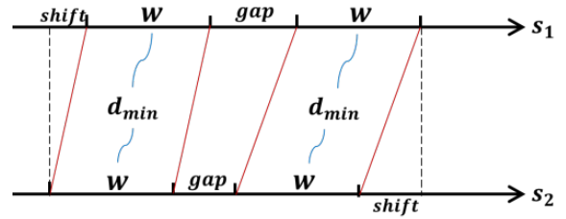




Constraints
minimum density:
maximum gap:
maximum shift:
Notes:
w: window size
𝑑𝑚𝑖𝑛 = 0, 𝑔𝑚𝑎𝑥 = ∞, and 𝑠𝑚𝑎𝑥 = ∞ 就是 LCS

Slide 6
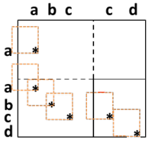
Notes:
有 timestamp 所以空白

Slide 7
WCLCS
Step1. Obtain the longest common subsequence within each
two-dimensional time window (WLCS)
PerWinLCS1
PerWinLCS2

Slide 8
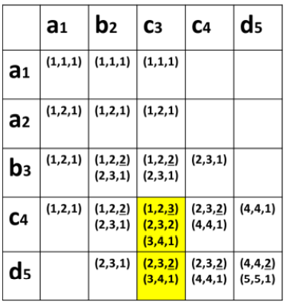
PerWinLCS1
w = 3
Notes:
從 (1, 1) 做到結束
↓↓↓↓↓

Slide 9
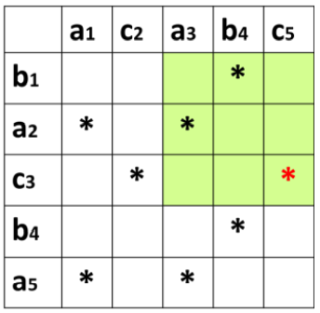
PerWinLCS2
c[1] = 1
c[2] = 1
c[3] = 2
w = 3
Notes:
？

Slide 10
WCLCS
Step2. Find an optimal chain of windows that satisfy the constraints
WCLCS-AnyGap
WCLCS-MaxGap

Slide 11
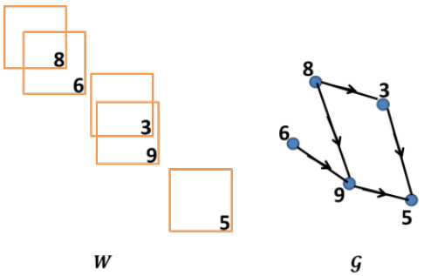
Converting the WCLCS Selection into a Graph Problem (1 / 2)
no edge from 6 to 3 since the two windows overlap
no edge from 8 to 5 since they are beyond the maximum gap allowed

Slide 12
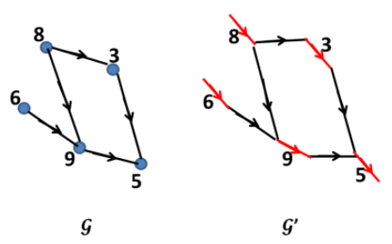
Converting the WCLCS Selection into a Graph Problem (2 / 2)
with all weights negated, it becomes a single-source shortest path problem
(can be solved by Bellman-Ford)
Notes:
黑邊 cost = 0
一個 vertex 變兩個，8-in 8-out 依此類推

Slide 13
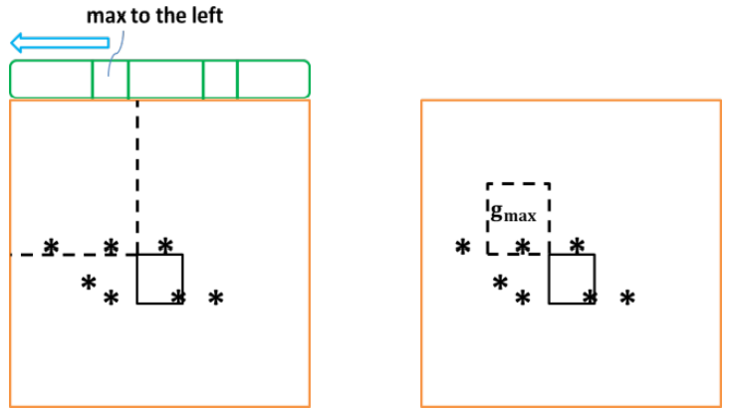
AnyGap and MaxGap

Slide 14
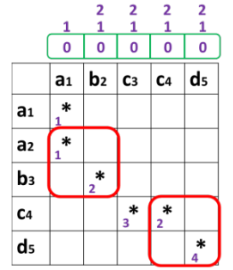
WCLCS-AnyGap
w = 2
Notes:
第四個 star 進來後，L[1] = 1，往後傳，所以 star-3 = 1 + WLCS(star-3) = 1 + 2 = 3
第五個 star 進來後，L[2] = 2，往後傳
row by row

Slide 15
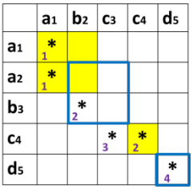
WCLCS-MaxGap (1 / 2)
w = 2
𝑔𝑚𝑎𝑥 = 1
scan [(𝑥 − 𝑤 − 𝑔𝑚𝑎𝑥, 𝑦 − 𝑤 − 𝑔𝑚𝑎𝑥), (𝑥 − 𝑤, 𝑦 − 𝑤)]
Notes:
小心 scan 的 2 * 2 不是因為 w = 2
找 label 最大的

Slide 16
WCLCS-MaxGap (2 / 2)
It may involve a large number of spatial index operations when
the number of matching windows is large
Solution: WCLCS-Astar

Slide 17
WCLCS-Astar (1 / 5)
Storing a set of window chains (most of which are partial) in a priority queue, where the priority of a window chain 𝐶 can be written as
𝑓(𝐶) = 𝑔(𝐶) + ℎ(𝐶)
𝑔(𝐶): the total matching length of the windows in 𝐶
ℎ(𝐶): an upper bound of the total matching length of the windows
that could potentially be added to chain 𝐶
𝑓(𝐶): an upper bound of any potential window chain derived from 𝐶

Slide 18
WCLCS-Astar (2 / 5)
ℎ(𝐶) = 𝐿𝐶𝑆(𝑥, 𝑦) − 𝑤(𝑥, 𝑦)
Notes:
LCS(x, y) 是從頭到 (x, y)
w(x, y) 是 window (x, y) 的 WLCS

Slide 19
WCLCS-Astar (3 / 5)
Step1. Pop the maximum priority chain C from the priority queue
Step2.
If there exists preceding windows:
For each preceding window, we prepend it to 𝐶 and add the new chain to priority queue, then update ℎ(𝐶)
If not:
Set ℎ(𝐶) to 0 and add C to the priority queue

Slide 20
WCLCS-Astar (4 / 5)
Step3. Recursively do step1. and step2, if the popped chain C has
ℎ(𝐶) = 0, it must be the WCLCS

Slide 21
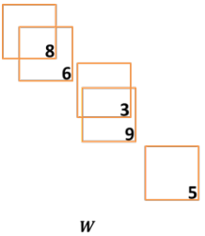
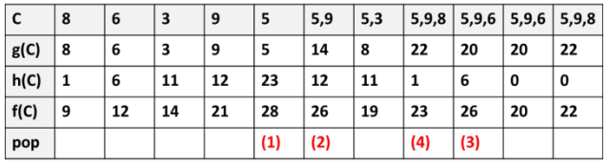
WCLCS-Astar (5 / 5)
Notes:
WCLCS 是 5, 9, 8

Slide 22
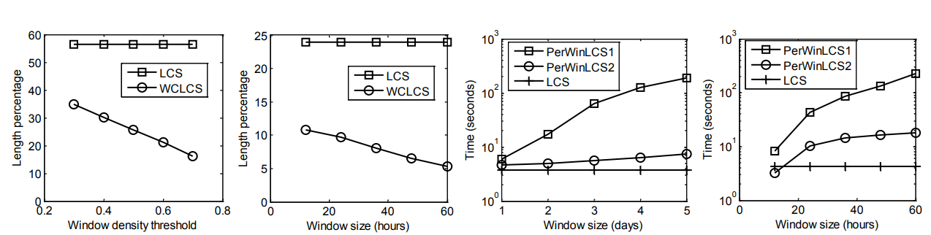
Result (1 / 2)

Slide 23
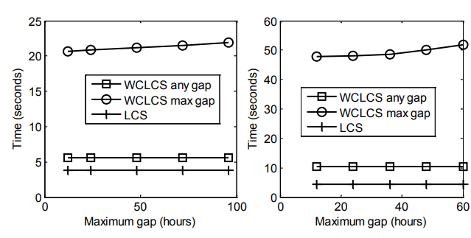
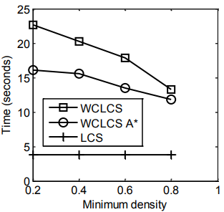
Result (2 / 2)

Slide 24
Thanks for your patience

