Slide 1
Hand Strength Evaluation in Bridge Games with the Evolutionary Algorithms
Presenter: Yun-An Chen
Date: May. 9, 2023

Slide 2
Contract Bridge – Strength of the Hand
Long suit method:
Add an extra one point for each card exceeding four
Evaluation method | A | K | Q | J | 10
Goren | 4 | 3 | 2 | 1 | 0
Bamberger | 7 | 5 | 3 | 1 | 0
Collet | 4 | 3 | 2 | 0.5 | 0.5
Four Aces | 3 | 2 | 1 | 0.5 | 0
Polish | 7 | 4 | 3 | 0 | 0
Reith | 6 | 4 | 3 | 2 | 1
Robertson | 7 | 5 | 3 | 2 | 1
Vernes | 4 | 3.1 | 1.9 | 0.9 | 0
AKQ | 4 | 3 | 2 | 0 | 0
Short suit methods
Void | Singleton | Doubleton
3 | 2 | 0
3 | 2 | 1
4 | 2 | 0
4 | 2 | 1
5 | 3 | 1

Slide 3
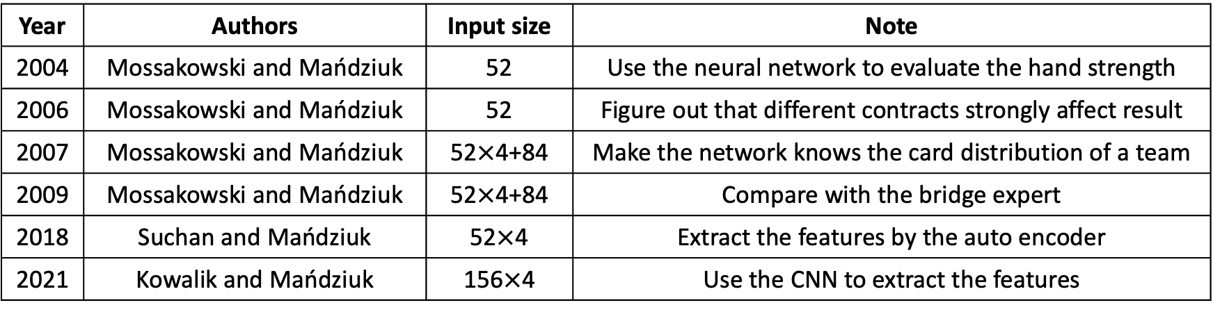
Neural Network Hand Strength Evaluation
Year | Authors | Input size | Note
2004 | Mossakowski and Mańdziuk | 52 | Use the neural network to evaluate the hand strength
2006 | Mossakowski and Mańdziuk | 52 | Figure out that different contracts strongly affect result
2007 | Mossakowski and Mańdziuk | 52$×$4+84 | Make the network knows the card distribution of a team
2009 | Mossakowski and Mańdziuk | 52$×$4+84 | Compare with the bridge expert
2018 | Suchan and Mańdziuk | 52$×$4 | Extract the features by the auto encoder
2021 | Kowalik and Mańdziuk | 156$×$4 | Use the CNN to extract the features

Slide 4
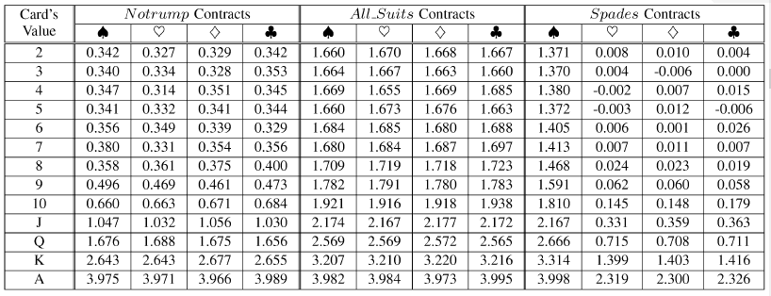
Neural Network Strength of the Hand
The image is copy from K. Mossakowski and J. Mandziuk, “Learning without human expertise: A case study of the double dummy bridge problem,” IEEE Transactions on Neural Networks, Vol. 20, No. 2, pp. 278~299, 2009.

Slide 5
Our Methods – Training Process
Design of formulas. Design the various formulas of hand strength evaluation methods.
Dataset Generation. Build datasets with different sizes for different stage of training.
Preliminary formula combinations. Find better formula combinations and the hyperparameters of GA with small datasets.
Better formula combinations. Select the best combination from the 25 better formula combinations.
Manual adjustment. Make the variables of the formula more easily to memorize and calculate.

Slide 6
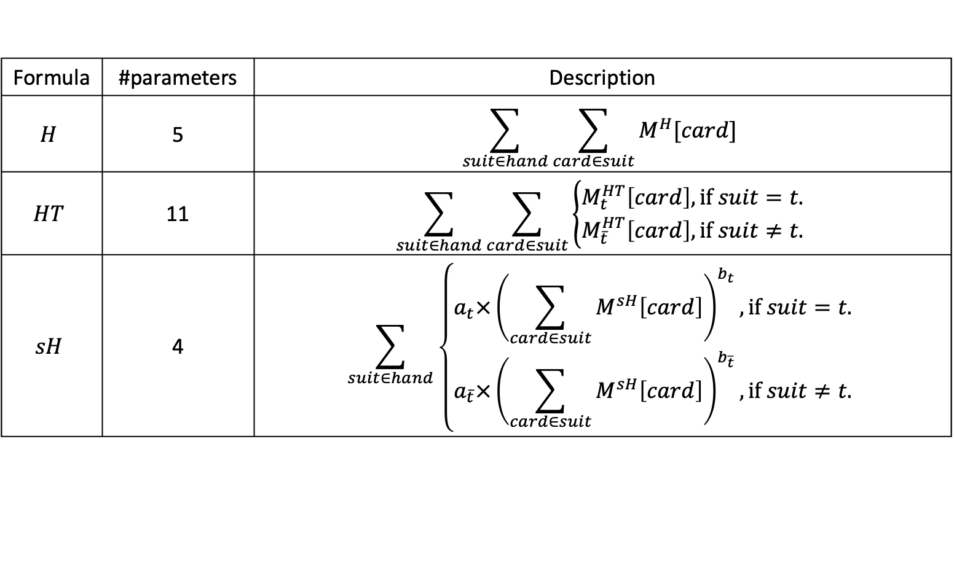
Design of Formulas – Individual Card Strength Formula
Formula | #parameters | Description
$$H$$ | 5 | $$\sum_{suit∈hand}{\sum_{card∈suit}{M^{H}[card]}}$$
$$HT$$ | 11 | $$\sum_{suit∈hand}{\sum_{card∈suit}{\left\{\begin{aligned}M_{t}^{HT}\left[card\right], \text{if} suit=t. \\ M_{\overline{t}}^{HT}\left[card\right], \text{if} suit≠t.\end{aligned}\right.}}$$
$$sH$$ | 4 | $$\sum_{suit∈hand}{\left\{\begin{aligned}a_{t}×{\left(\sum_{card∈suit}{M^{sH}\left[card\right]}\right)}^{b_{t}}, \text{if} suit=t. \\ a_{\overline{t}}×{\left(\sum_{card∈suit}{M^{sH}\left[card\right]}\right)}^{b_{\overline{t}}}, \text{if} suit≠t.\end{aligned}\right.}$$

Slide 7
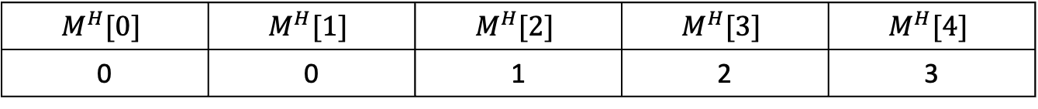
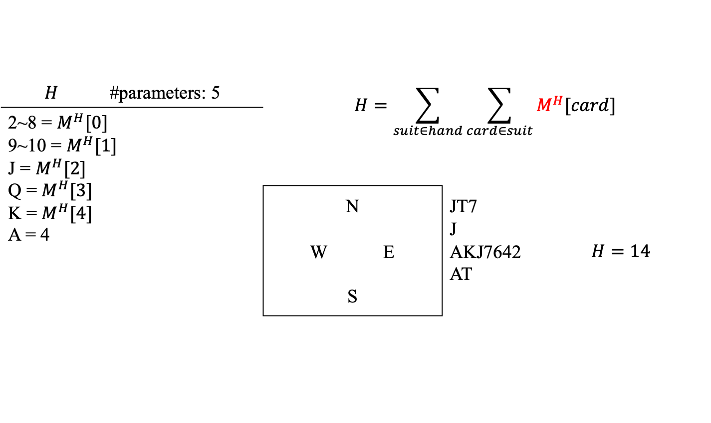
Design of Formulas – Individual Card Strength Formula
$$H$$ | #parameters: 5 | $$H=\sum_{suit∈hand}{\sum_{card∈suit}{M^{H}[card]}}$$
2~8 = $M^{H}[0]$ 9~10 = $M^{H}[1]$ J = $M^{H}[2]$ Q = $M^{H}[3]$ K = $M^{H}[4]$ A = 4
 |  | N W E S |  | JT7 J AKJ7642 AT | $$H=14$$
$$M^{H}[0]$$ | $$M^{H}[1]$$ | $$M^{H}[2]$$ | $$M^{H}[3]$$ | $$M^{H}[4]$$
0 | 0 | 1 | 2 | 3

Slide 8
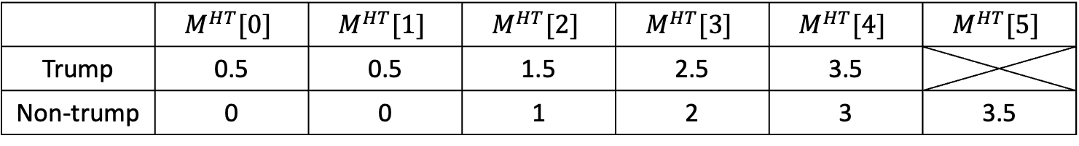
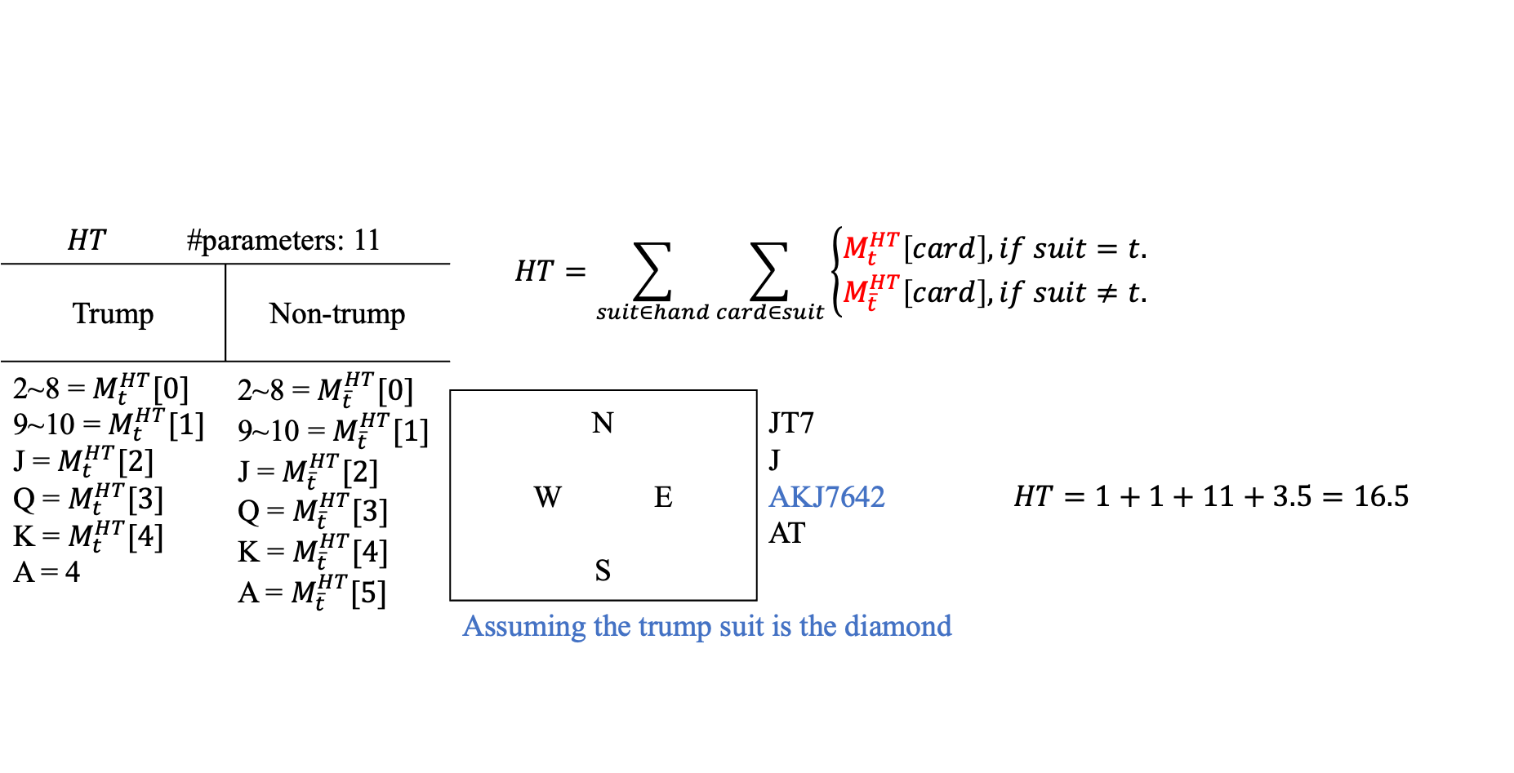
Design of Formulas – Individual Card Strength Formula
$$HT$$ | #parameters: 11 |  | $$HT=\sum_{suit∈hand}{\sum_{card∈suit}{\left\{\begin{aligned}M_{t}^{HT}\left[card\right], if suit=t. \\ M_{\overline{t}}^{HT}\left[card\right], if suit≠t.\end{aligned}\right.}}$$
Trump |  | Non-trump
2~8 = $M_{t}^{HT}[0]$ 9~10 = $M_{t}^{HT}[1]$ J = $M_{t}^{HT}[2]$ Q = $M_{t}^{HT}[3]$ K = $M_{t}^{HT}[4]$ A = 4 |  | 2~8 = $M_{\overline{t}}^{HT}[0]$ 9~10 = $M_{\overline{t}}^{HT}[1]$ J = $M_{\overline{t}}^{HT}[2]$ Q = $M_{\overline{t}}^{HT}[3]$ K = $M_{\overline{t}}^{HT}[4]$ A = $M_{\overline{t}}^{HT}[5]$
 |  |  | N W E S | JT7 J AKJ7642 AT | $$HT=1+1+11+3.5=16.5$$
 |  |  | Assuming the trump suit is the diamond
 | $$M^{HT}[0]$$ | $$M^{HT}[1]$$ | $$M^{HT}[2]$$ | $$M^{HT}[3]$$ | $$M^{HT}[4]$$ | $$M^{HT}[5]$$
Trump | 0.5 | 0.5 | 1.5 | 2.5 | 3.5
Non-trump | 0 | 0 | 1 | 2 | 3 | 3.5

Slide 9
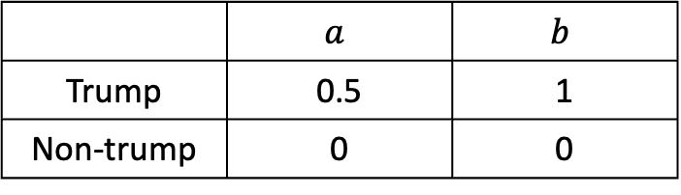
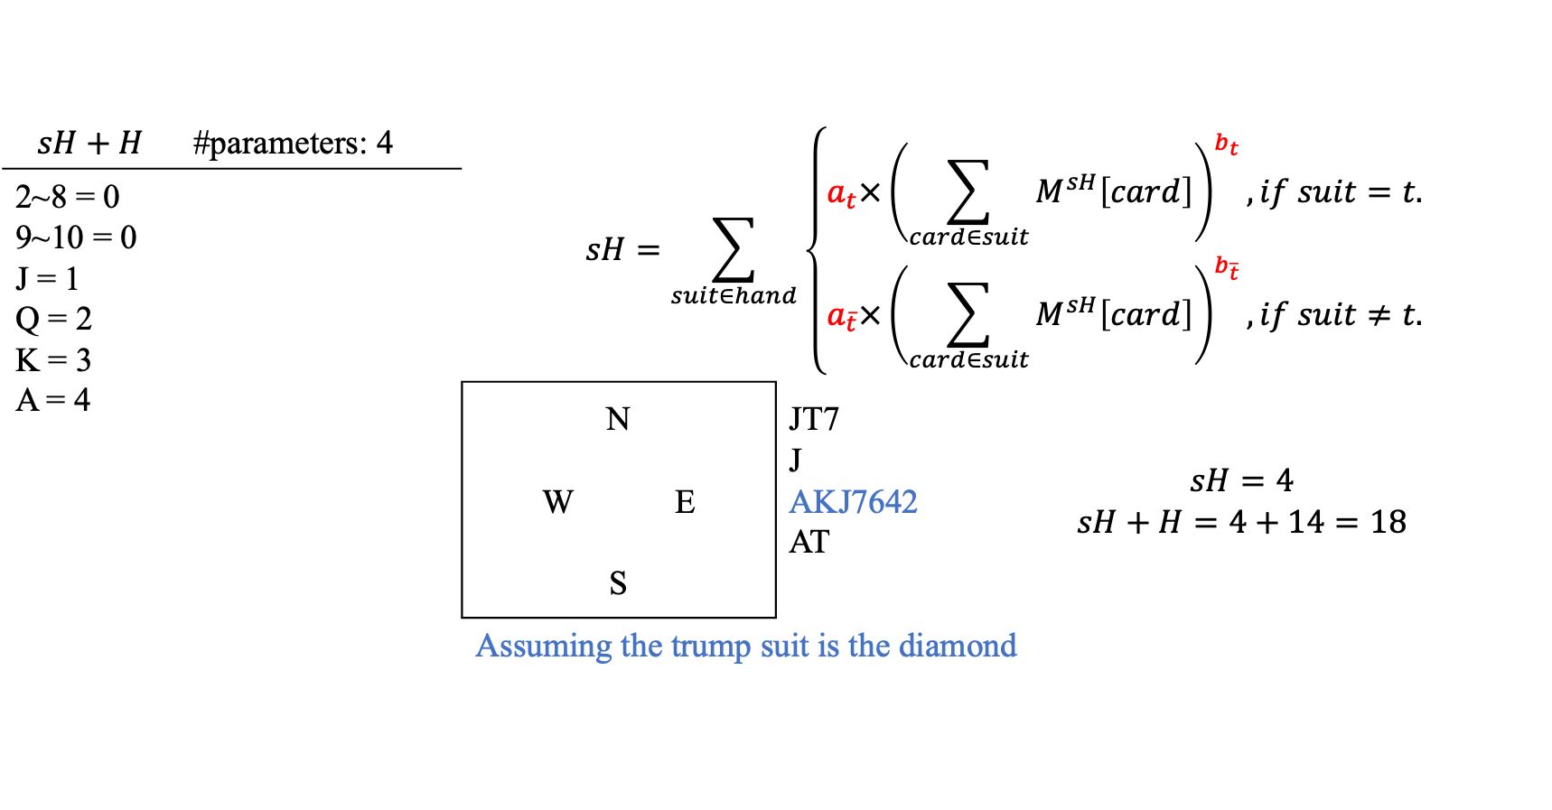
Design of Formulas – Individual Card Strength Formula
$$sH+H$$ | #parameters: 4 | $$sH=\sum_{suit∈hand}{\left\{\begin{aligned}a_{t}×{\left(\sum_{card∈suit}{M^{sH}\left[card\right]}\right)}^{b_{t}}, if suit=t. \\ a_{\overline{t}}×{\left(\sum_{card∈suit}{M^{sH}\left[card\right]}\right)}^{b_{\overline{t}}}, if suit≠t.\end{aligned}\right.}$$
2~8 = 0 9~10 = 0 J = 1 Q = 2 K = 3 A = 4
 |  | N W E S | JT7 J AKJ7642 AT | $$sH=4$$ $$sH+H=4+14=18$$
 |  | Assuming the trump suit is the diamond
 | $$a$$ | $$b$$
Trump | 0.5 | 1
Non-trump | 0 | 0

Slide 10
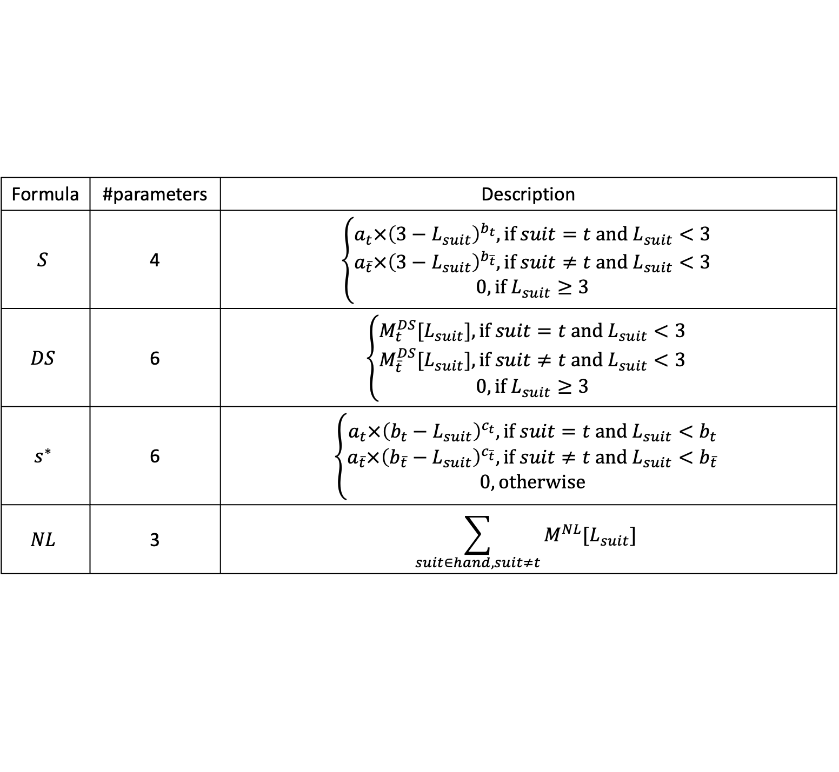
Design of Formulas – Short Suit Formulas
Formula | #parameters | Description
$$S$$ | 4 | $$\left\{\begin{aligned}a_{t}×{\left(3−L_{suit}\right)}^{b_{t}}, \text{if} suit=t &\text{and} L_{suit}<3 \\ a_{\overline{t}}×{\left(3−L_{suit}\right)}^{b_{\overline{t}}}, \text{if} suit≠t &\text{and} L_{suit}<3 \\ 0, \text{if} L_{suit}≥3\end{aligned}\right.$$
$$DS$$ | 6 | $$\left\{\begin{aligned}M_{t}^{DS}[L_{suit}], \text{if} suit=t &\text{and} L_{suit}<3 \\ M_{\overline{t}}^{DS}[L_{suit}], \text{if} suit≠t &\text{and} L_{suit}<3 \\ 0, \text{if} L_{suit}≥3\end{aligned}\right.$$
$$s^{∗}$$ | 6 | $$\left\{\begin{aligned}a_{t}×{\left(b_{t}−L_{suit}\right)}^{c_{t}}, \text{if} suit=t &\text{and} L_{suit}<b_{t} \\ a_{\overline{t}}×{\left(b_{\overline{t}}−L_{suit}\right)}^{c_{\overline{t}}}, \text{if} suit≠t &\text{and} L_{suit}<b_{\overline{t}} \\ 0, \text{otherwise}\end{aligned}\right.$$
$$NL$$ | 3 | $$\sum_{suit∈hand, suit≠t}{M^{NL}[L_{suit}]}$$

Slide 11
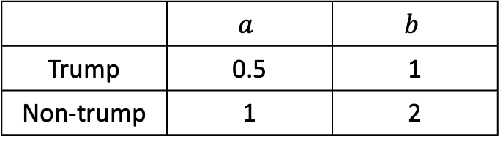
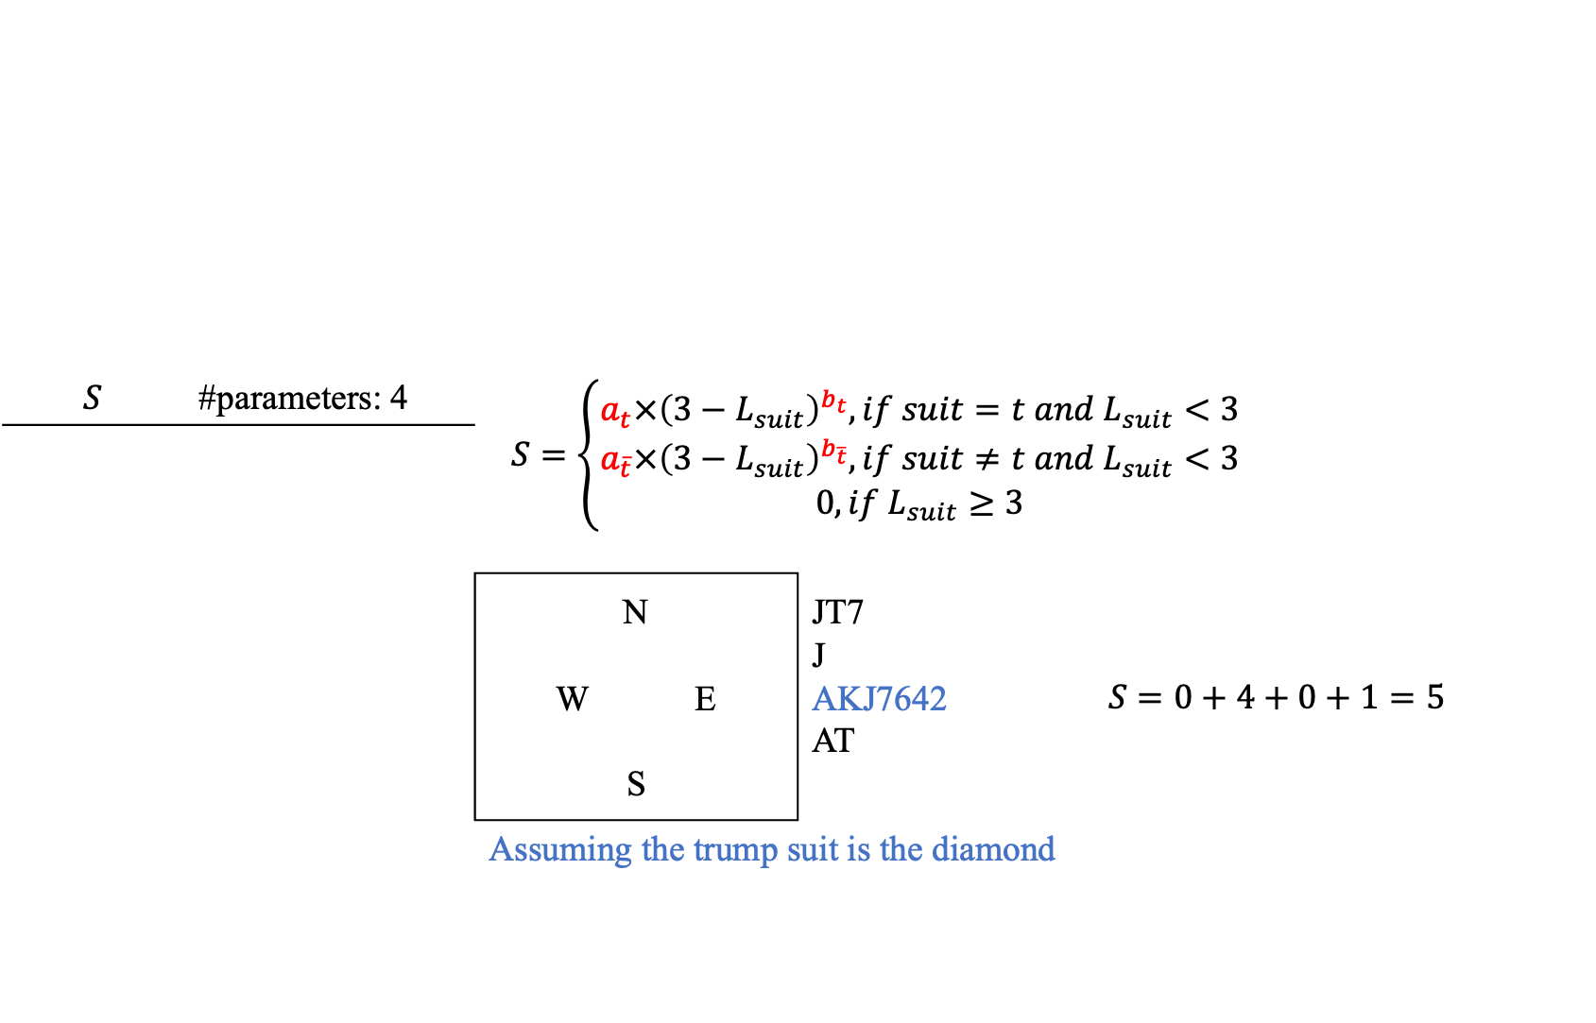
Design of Formulas – Short Suit Formulas
$$S$$ | #parameters: 4 | $$S=\left\{\begin{aligned}a_{t}×{\left(3−L_{suit}\right)}^{b_{t}}, if suit=t &and L_{suit}<3 \\ a_{\overline{t}}×{\left(3−L_{suit}\right)}^{b_{\overline{t}}}, if suit≠t &and L_{suit}<3 \\ 0, if L_{suit}≥3\end{aligned}\right.$$
 |  | N W E S | JT7 J AKJ7642 AT | $$S=0+4+0+1=5$$
 |  | Assuming the trump suit is the diamond
 | $$a$$ | $$b$$
Trump | 0.5 | 1
Non-trump | 1 | 2

Slide 12
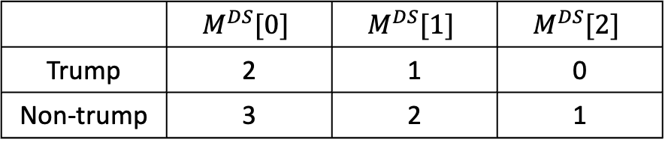
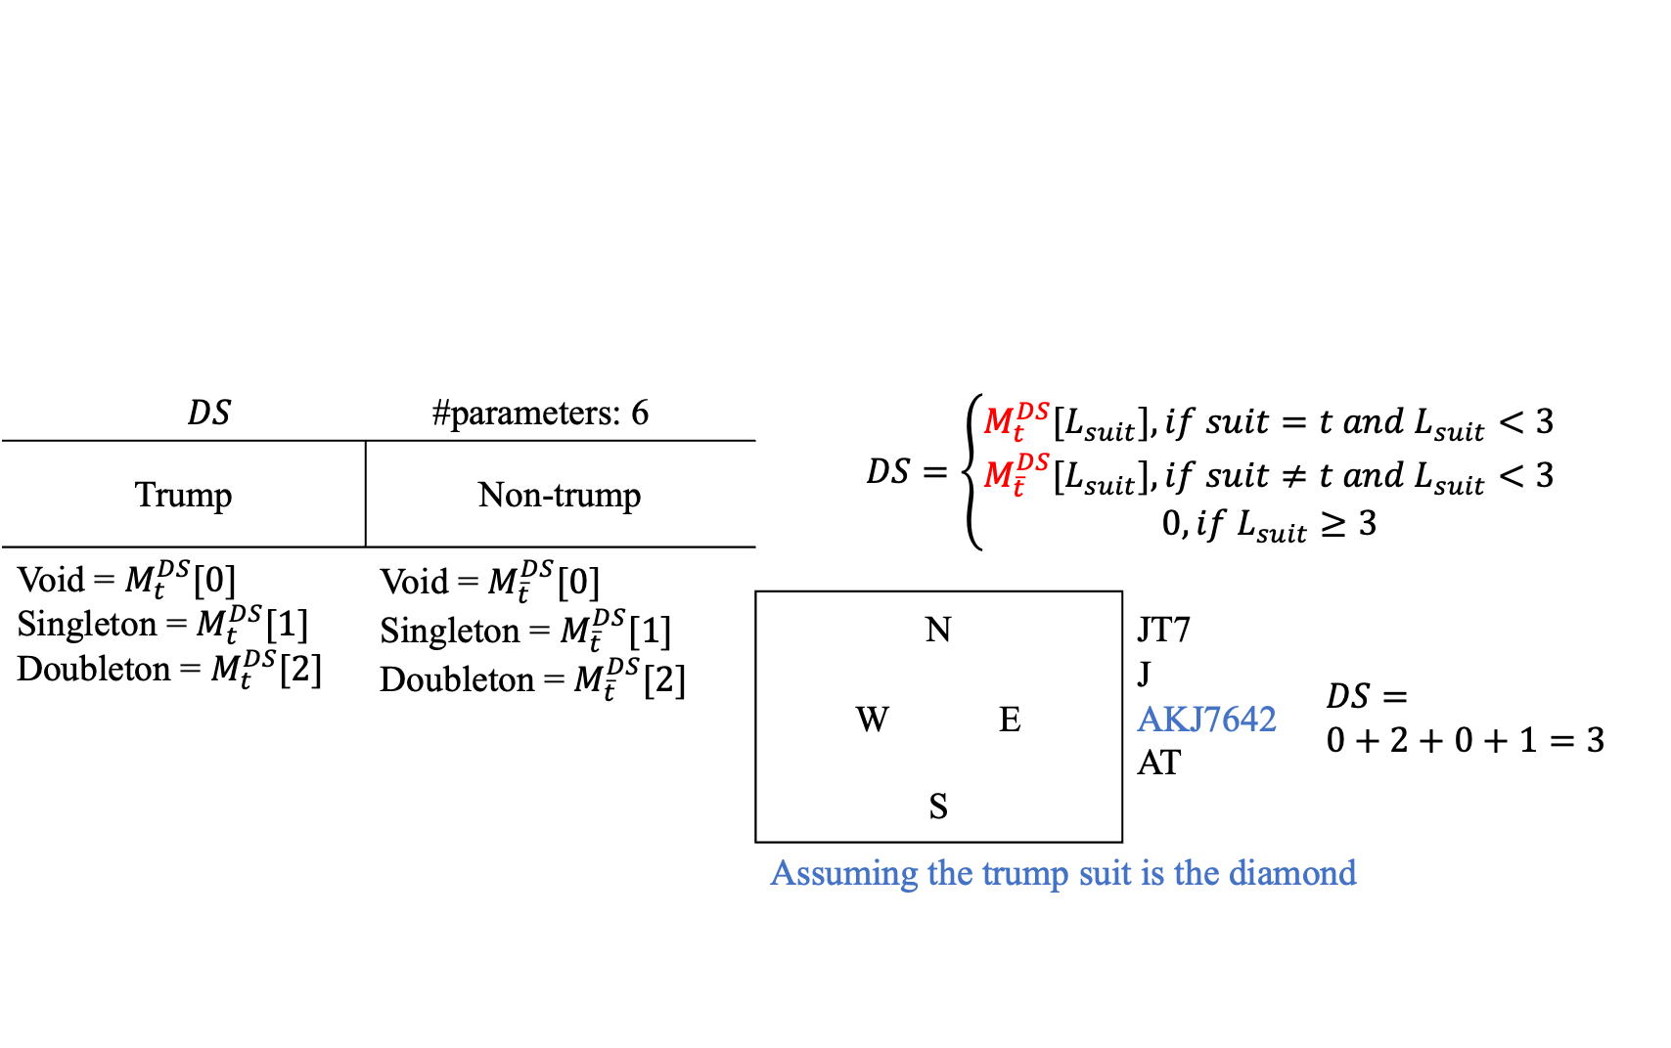
Design of Formulas – Short Suit Formulas
$$DS$$ |  | #parameters: 6 | $$DS=\left\{\begin{aligned}M_{t}^{DS}[L_{suit}], if suit=t &and L_{suit}<3 \\ M_{\overline{t}}^{DS}[L_{suit}], if suit≠t &and L_{suit}<3 \\ 0, if L_{suit}≥3\end{aligned}\right.$$
Trump | Non-trump
Void = $M_{t}^{DS}[0]$ Singleton = $M_{t}^{DS}[1]$ Doubleton = $M_{t}^{DS}[2]$ | Void = $M_{\overline{t}}^{DS}[0]$ Singleton = $M_{\overline{t}}^{DS}[1]$ Doubleton = $M_{\overline{t}}^{DS}[2]$
 |  |  | N W E S | JT7 J AKJ7642 AT | $$DS=$$ $$0+2+0+1=3$$
 |  |  | Assuming the trump suit is the diamond
 | $$M^{DS}[0]$$ | $$M^{DS}[1]$$ | $$M^{DS}[2]$$
Trump | 2 | 1 | 0
Non-trump | 3 | 2 | 1

Slide 13
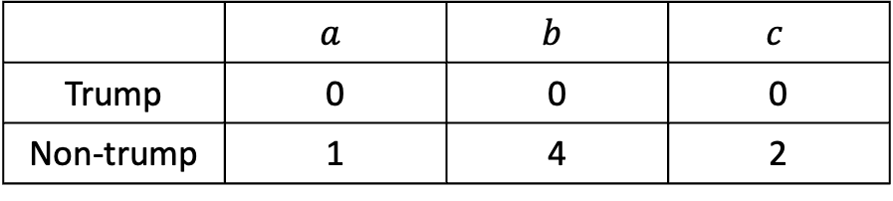
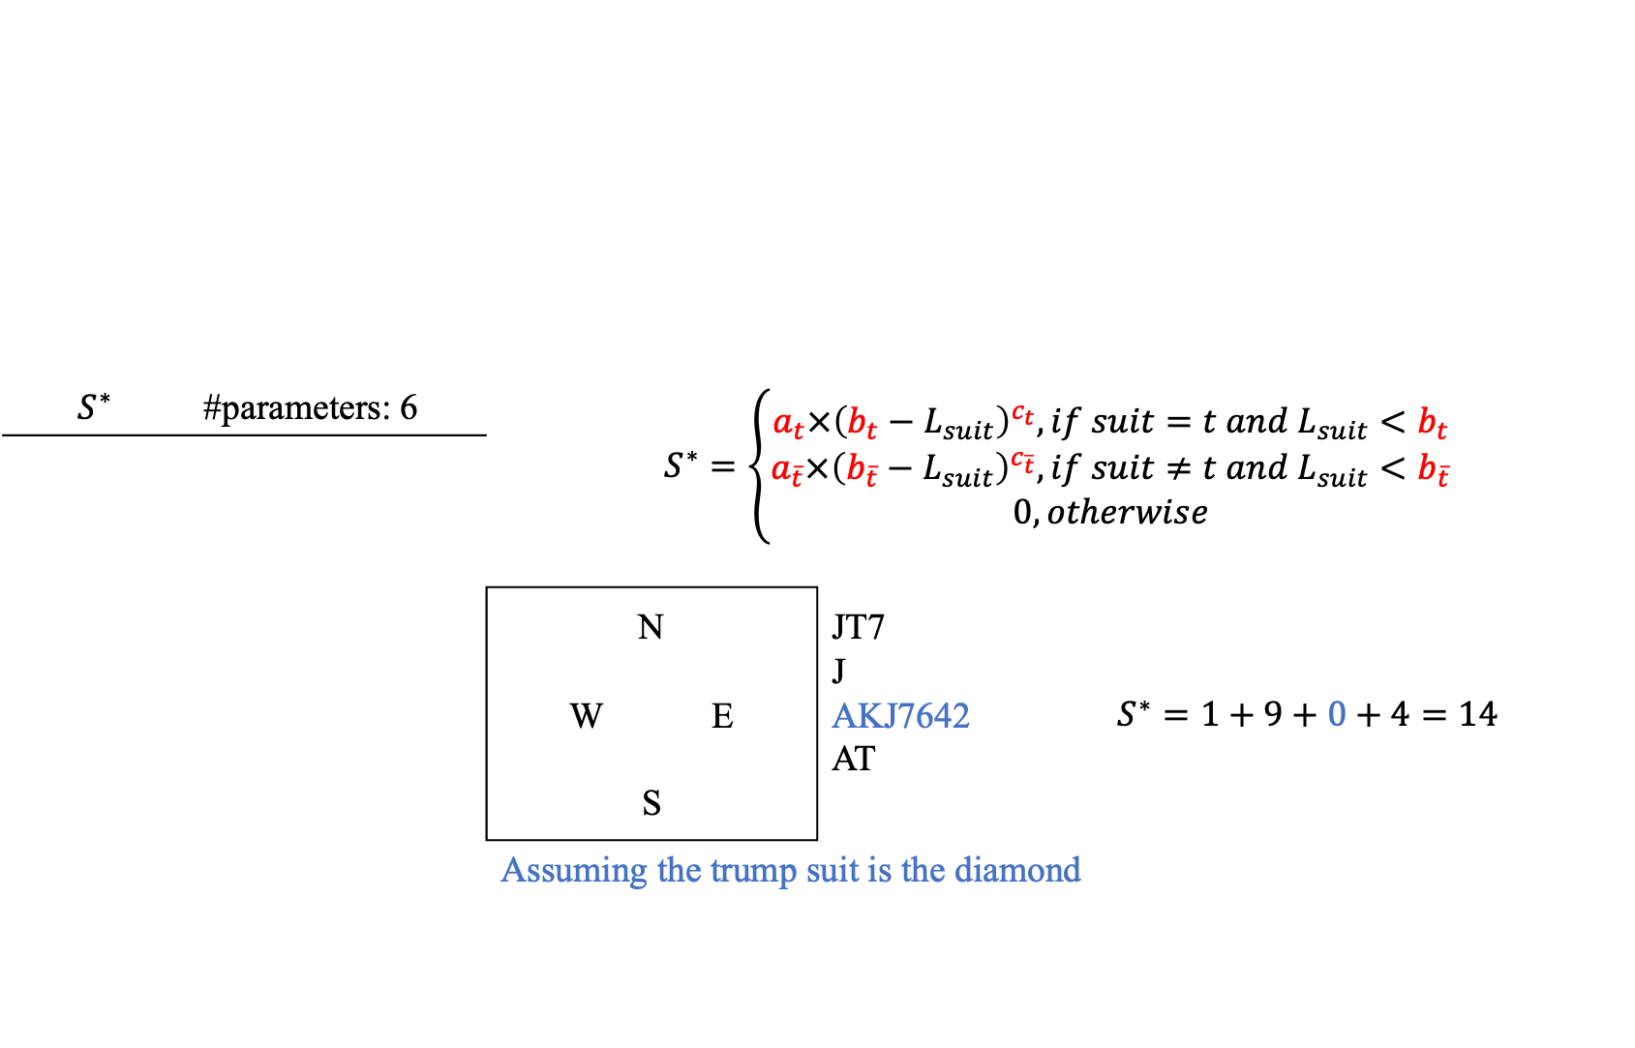
Design of Formulas – Short Suit Formulas
$$S^{∗}$$ | #parameters: 6 | $$S^{∗}=\left\{\begin{aligned}a_{t}×{\left(b_{t}−L_{suit}\right)}^{c_{t}}, if suit=t &and L_{suit}<b_{t} \\ a_{\overline{t}}×{\left(b_{\overline{t}}−L_{suit}\right)}^{c_{\overline{t}}}, if suit≠t &and L_{suit}<b_{\overline{t}} \\ 0, otherwise\end{aligned}\right.$$
 |  | N W E S | JT7 J AKJ7642 AT | $$S^{∗}=1+9+0+4=14$$
 |  | Assuming the trump suit is the diamond
 | $$a$$ | $$b$$ | $$c$$
Trump | 0 | 0 | 0
Non-trump | 1 | 4 | 2

Slide 14
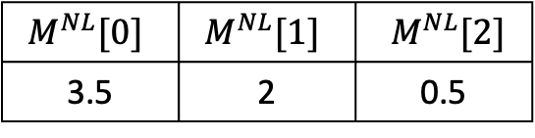
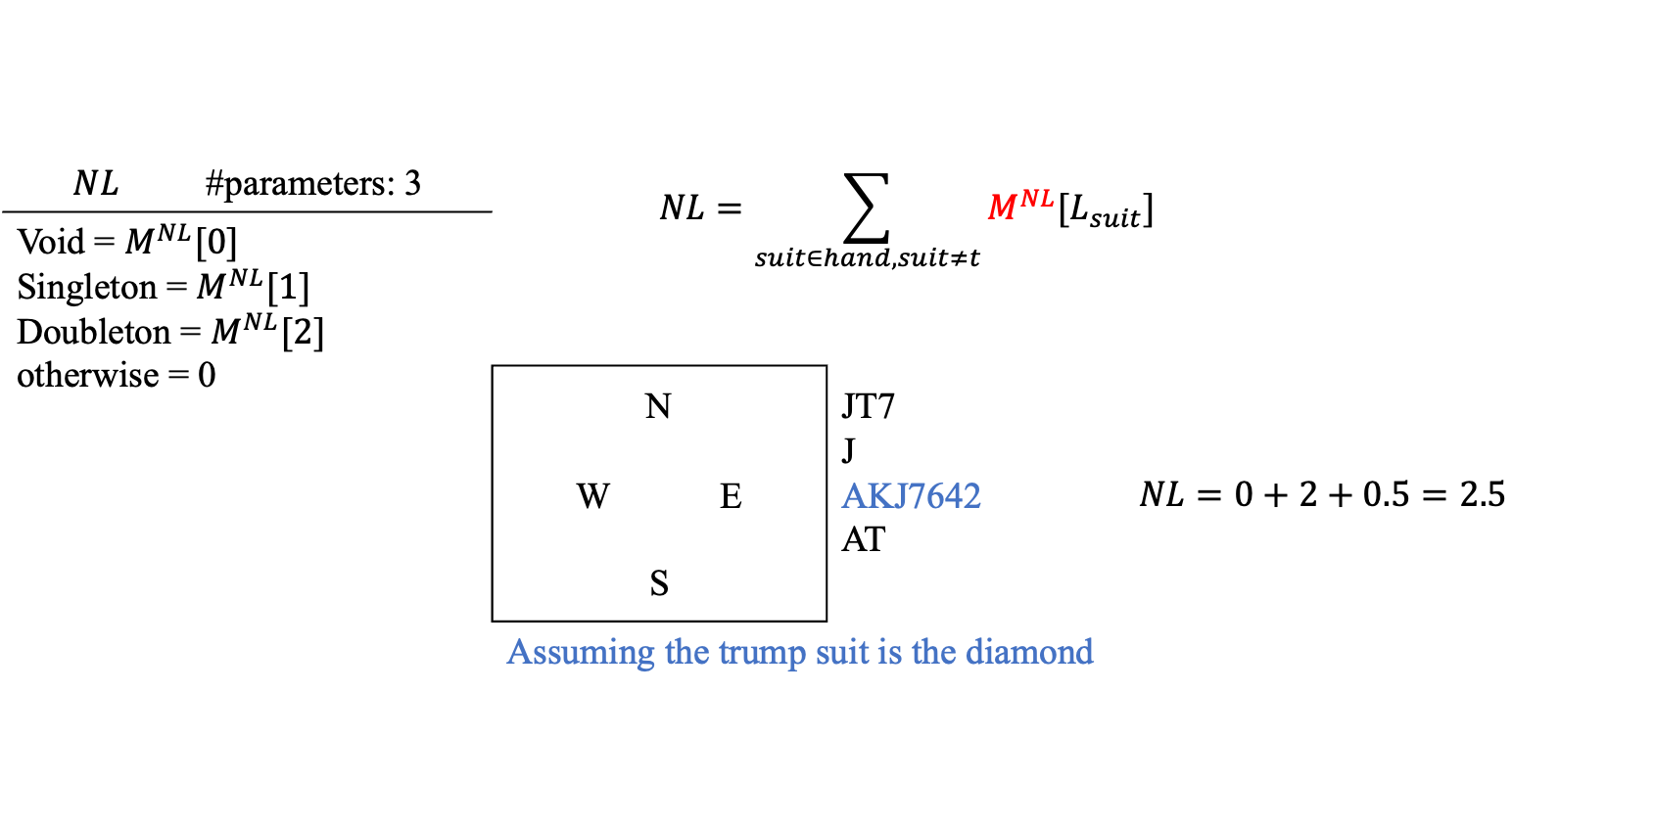
Design of Formulas – Short Suit Formulas
$$NL$$ | #parameters: 3 | $$NL=\sum_{suit∈hand, suit≠t}{M^{NL}[L_{suit}]}$$
Void = $M^{NL}[0]$ Singleton = $M^{NL}[1]$ Doubleton = $M^{NL}[2]$ otherwise = 0
 |  | N W E S | JT7 J AKJ7642 AT | $$NL=0+2+0.5=2.5$$
 |  | Assuming the trump suit is the diamond
$$M^{NL}[0]$$ | $$M^{NL}[1]$$ | $M^{NL}[2]$
3.5 | 2 | 0.5

Slide 15
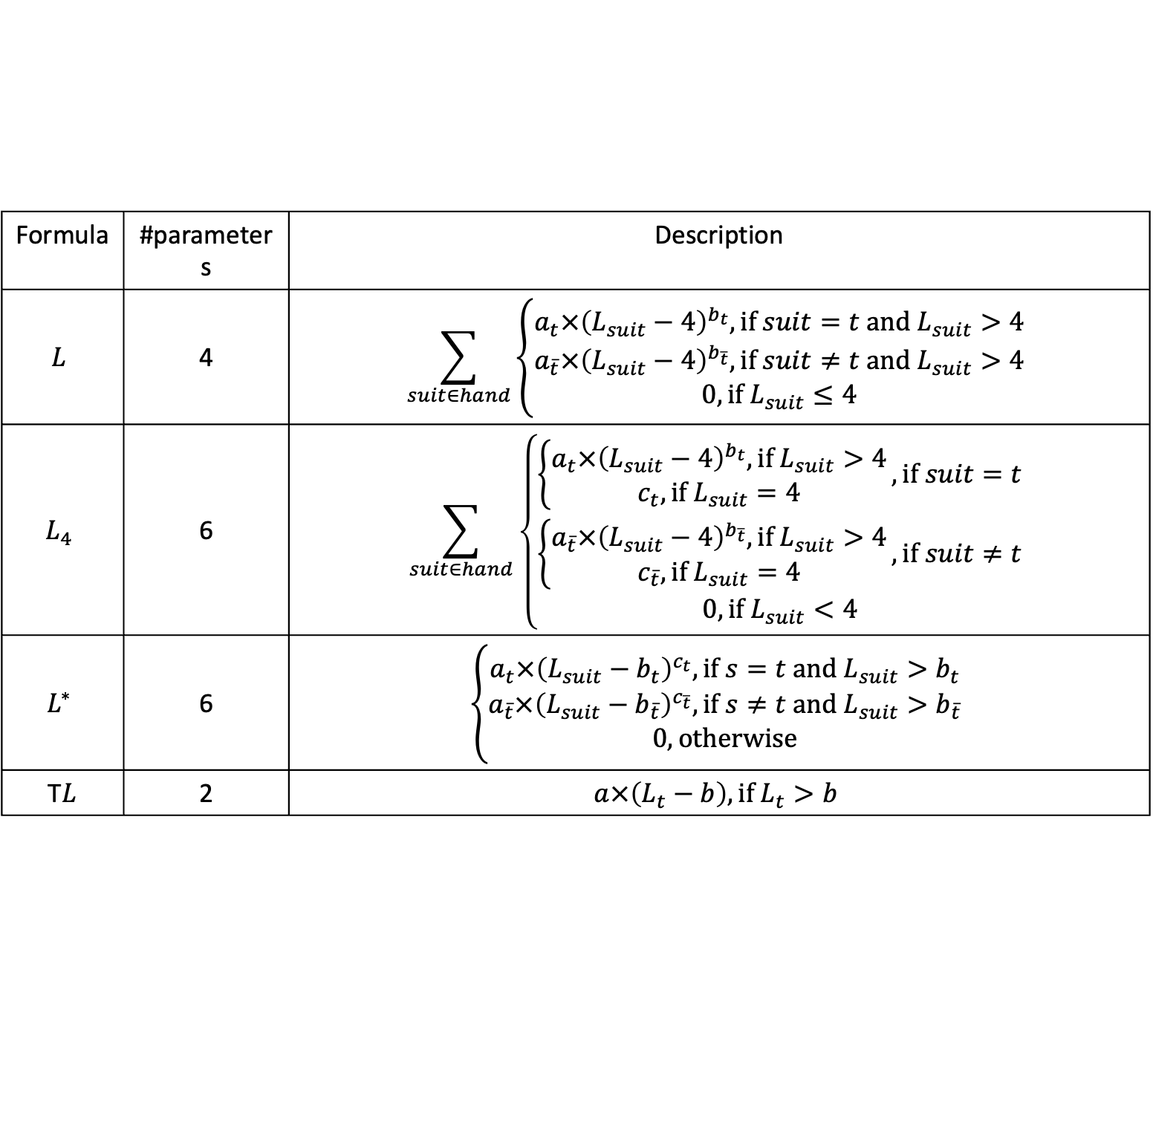
Design of Formulas – Long Suit Formulas
Formula | #parameters | Description
$$L$$ | 4 | $$\sum_{suit∈hand}{\left\{\begin{aligned}a_{t}×{\left(L_{suit}−4\right)}^{b_{t}}, \text{if} suit=t &\text{and} L_{suit}>4 \\ a_{\overline{t}}×{\left(L_{suit}−4\right)}^{b_{\overline{t}}}, \text{if} suit≠t &\text{and} L_{suit}>4 \\ 0, \text{if} L_{suit}≤4\end{aligned}\right.}$$
$$L_{4}$$ | 6 | $$\sum_{suit∈hand}{\left\{\begin{aligned}\left\{\begin{aligned}a_{t}×{\left(L_{suit}−4\right)}^{b_{t}}, \text{if} L_{suit}>4 \\ c_{t}, \text{if} L_{suit}=4\end{aligned}\right., \text{if} suit=t \\ \left\{\begin{aligned}a_{\overline{t}}×{\left(L_{suit}−4\right)}^{b_{\overline{t}}}, \text{if} L_{suit}>4 \\ c_{\overline{t}}, \text{if} L_{suit}=4\end{aligned}\right., \text{if} suit≠t \\ 0, \text{if} L_{suit}<4\end{aligned}\right.}$$
$$L^{∗}$$ | 6 | $$\left\{\begin{aligned}a_{t}×{\left(L_{suit}−b_{t}\right)}^{c_{t}}, \text{if} s=t &\text{and} L_{suit}>b_{t} \\ a_{\overline{t}}×{\left(L_{suit}−b_{\overline{t}}\right)}^{c_{\overline{t}}}, \text{if} s≠t &\text{and} L_{suit}>b_{\overline{t}} \\ 0, \text{otherwise}\end{aligned}\right.$$
T$L$ | 2 | $$a×\left(L_{t}−b\right), \text{if} L_{t}>b$$

Slide 16
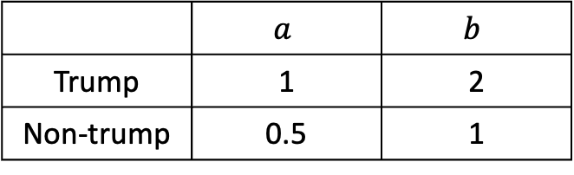
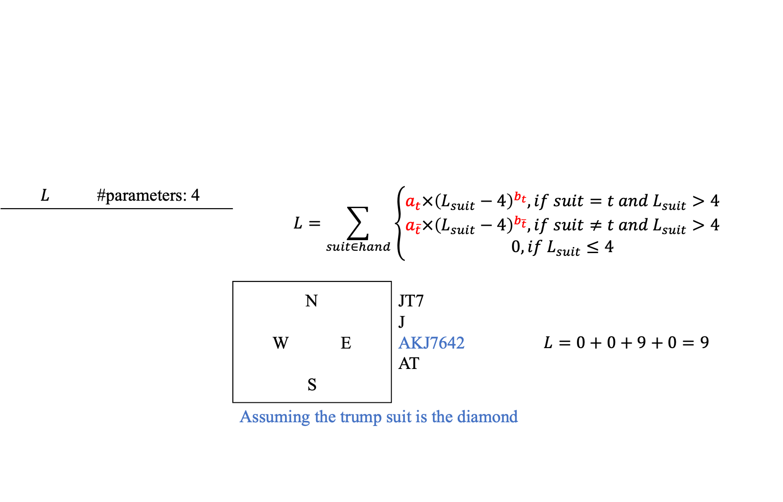
Design of Formulas – Long Suit Formulas
$$L$$ | #parameters: 4 | $$L=\sum_{suit∈hand}{\left\{\begin{aligned}a_{t}×{\left(L_{suit}−4\right)}^{b_{t}}, if suit=t &and L_{suit}>4 \\ a_{\overline{t}}×{\left(L_{suit}−4\right)}^{b_{\overline{t}}}, if suit≠t &and L_{suit}>4 \\ 0, if L_{suit}≤4\end{aligned}\right.}$$
 |  | N W E S | JT7 J AKJ7642 AT | $$L=0+0+9+0=9$$
 |  | Assuming the trump suit is the diamond
 | $$a$$ | $$b$$
Trump | 1 | 2
Non-trump | 0.5 | 1

Slide 17
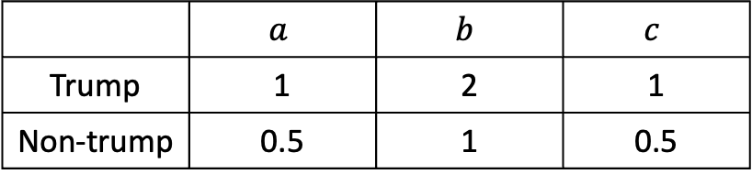
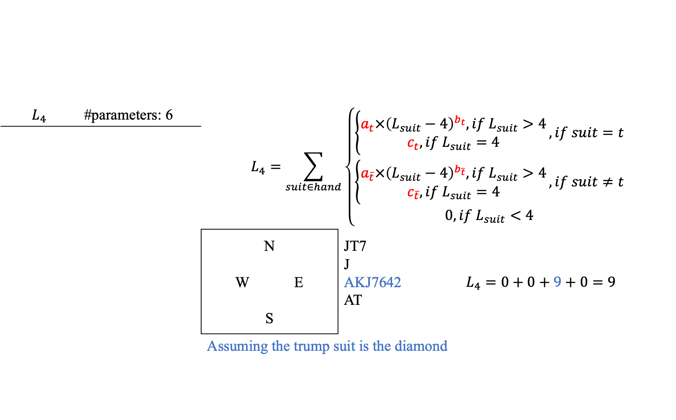
Design of Formulas – Long Suit Formulas
$$L_{4}$$ | #parameters: 6 | $$L_{4}=\sum_{suit∈hand}{\left\{\begin{aligned}\left\{\begin{aligned}a_{t}×{\left(L_{suit}−4\right)}^{b_{t}}, if L_{suit}>4 \\ c_{t}, if L_{suit}=4\end{aligned}\right., if suit=t \\ \left\{\begin{aligned}a_{\overline{t}}×{\left(L_{suit}−4\right)}^{b_{\overline{t}}}, if L_{suit}>4 \\ c_{\overline{t}}, if L_{suit}=4\end{aligned}\right., if suit≠t \\ 0, if L_{suit}<4\end{aligned}\right.}$$
 |  | N W E S | JT7 J AKJ7642 AT | $$L_{4}=0+0+9+0=9$$
 |  | Assuming the trump suit is the diamond
 | $$a$$ | $$b$$ | $$c$$
Trump | 1 | 2 | 1
Non-trump | 0.5 | 1 | 0.5

Slide 18
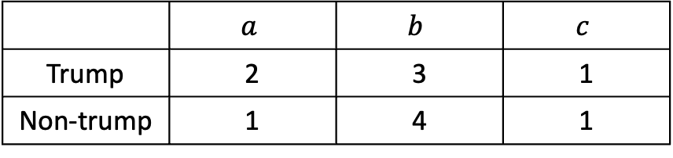
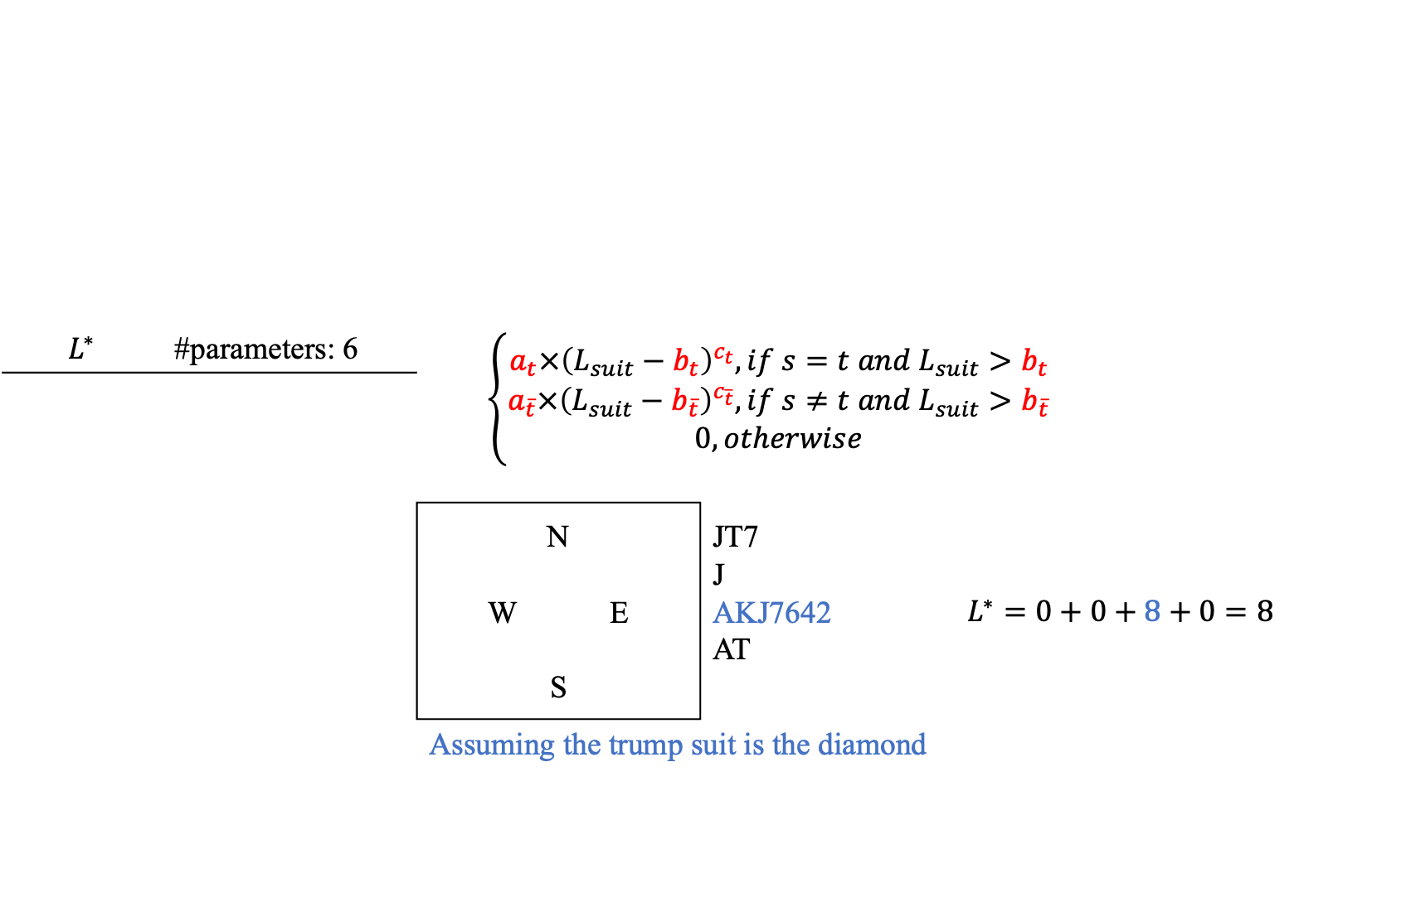
Design of Formulas – Long Suit Formulas
$$L^{∗}$$ | #parameters: 6 | $$\left\{\begin{aligned}a_{t}×{\left(L_{suit}−b_{t}\right)}^{c_{t}}, if s=t &and L_{suit}>b_{t} \\ a_{\overline{t}}×{\left(L_{suit}−b_{\overline{t}}\right)}^{c_{\overline{t}}}, if s≠t &and L_{suit}>b_{\overline{t}} \\ 0, otherwise\end{aligned}\right.$$
 |  | N W E S | JT7 J AKJ7642 AT | $$L^{∗}=0+0+8+0=8$$
 |  | Assuming the trump suit is the diamond
 | $$a$$ | $$b$$ | $$c$$
Trump | 2 | 3 | 1
Non-trump | 1 | 4 | 1

Slide 19
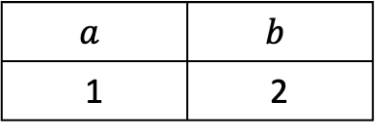
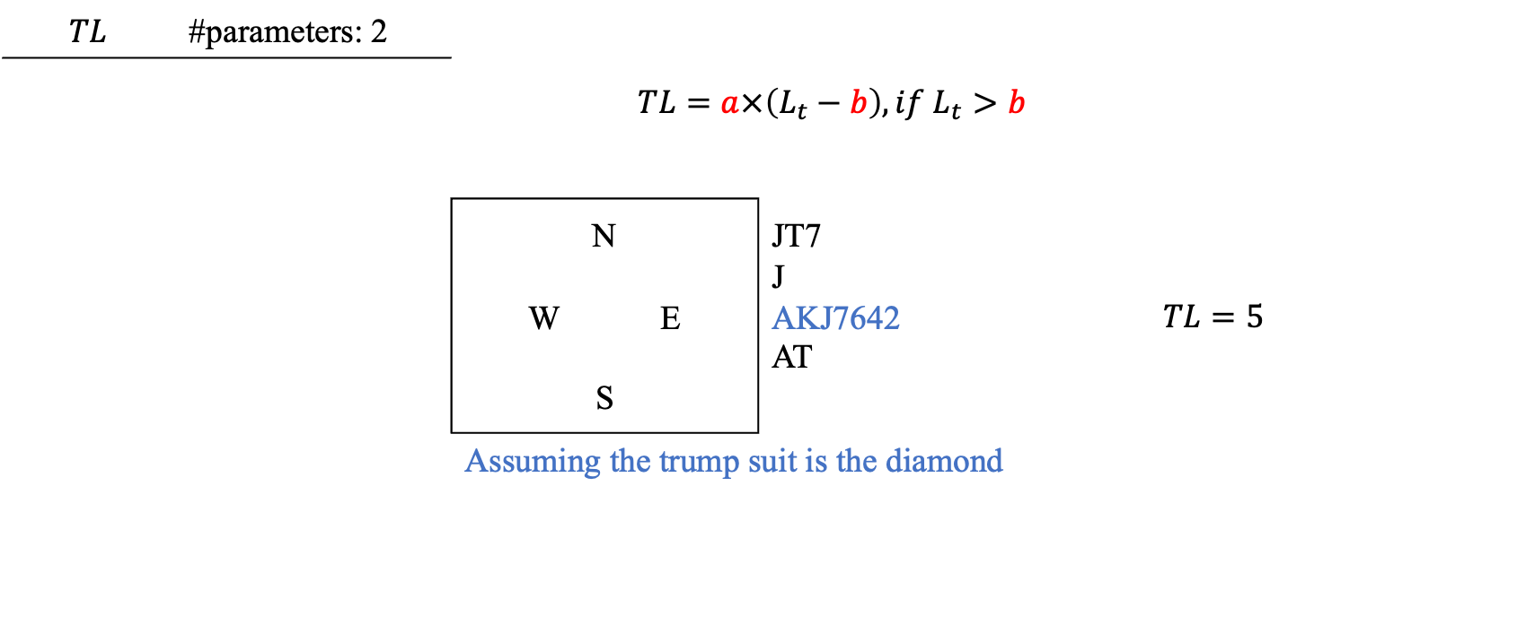
Design of Formulas – Long Suit Formulas
$$TL$$ | #parameters: 2 | $$TL=a×\left(L_{t}−b\right), if L_{t}>b$$
 |  | N W E S | JT7 J AKJ7642 AT | $$TL=5$$
 |  | Assuming the trump suit is the diamond
$$a$$ | $$b$$
1 | 2

Slide 20
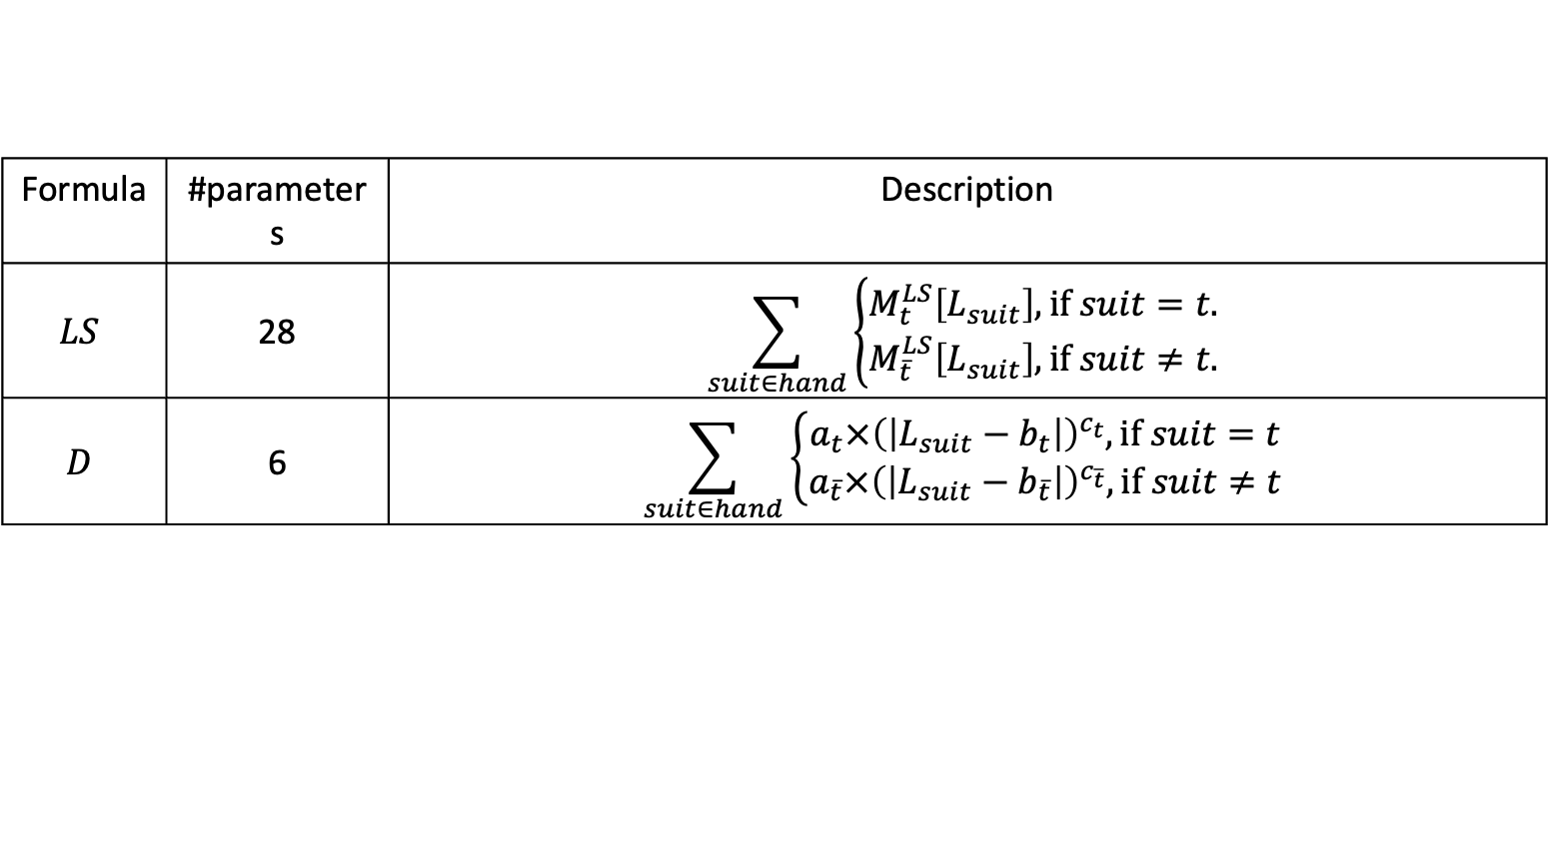
Design of Formulas – Length Formulas
Formula | #parameters | Description
$$LS$$ | 28 | $$\sum_{suit∈hand}{\left\{\begin{aligned}M_{t}^{LS}\left[L_{suit}\right], \text{if} suit=t. \\ M_{\overline{t}}^{LS}\left[L_{suit}\right], \text{if} suit≠t.\end{aligned}\right.}$$
$$D$$ | 6 | $$\sum_{suit∈hand}{\left\{\begin{aligned}a_{t}×{\left(\left|L_{suit}−b_{t}\right|\right)}^{c_{t}}, \text{if} suit=t \\ a_{\overline{t}}×{\left(\left|L_{suit}−b_{\overline{t}}\right|\right)}^{c_{\overline{t}}}, \text{if} suit≠t\end{aligned}\right.}$$

Slide 21
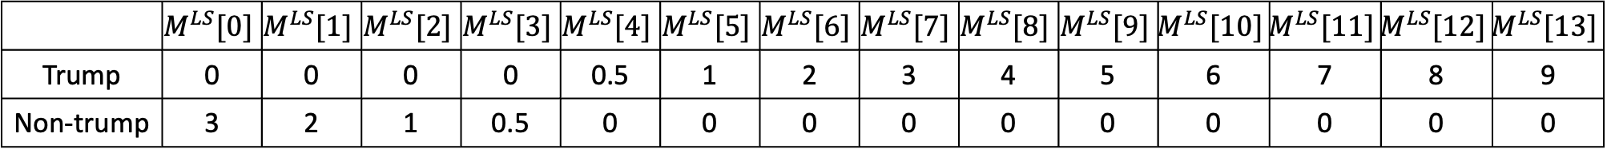
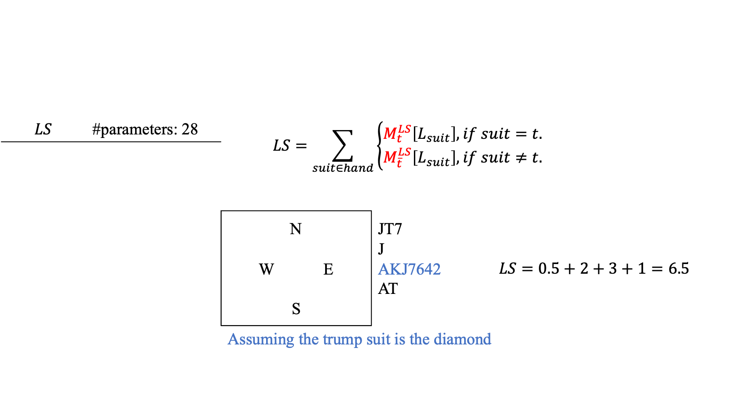
Design of Formulas – Length Formulas
$$LS$$ | #parameters: 28 | $$LS=\sum_{suit∈hand}{\left\{\begin{aligned}M_{t}^{LS}\left[L_{suit}\right], if suit=t. \\ M_{\overline{t}}^{LS}\left[L_{suit}\right], if suit≠t.\end{aligned}\right.}$$
 |  | N W E S | JT7 J AKJ7642 AT | $$LS=0.5+2+3+1=6.5$$
 |  | Assuming the trump suit is the diamond
 | $$M^{LS}[0]$$ | $$M^{LS}[1]$$ | $$M^{LS}[2]$$ | $$M^{LS}[3]$$ | $$M^{LS}[4]$$ | $$M^{LS}[5]$$ | $$M^{LS}[6]$$ | $$M^{LS}[7]$$ | $$M^{LS}[8]$$ | $$M^{LS}[9]$$ | $$M^{LS}[10]$$ | $$M^{LS}[11]$$ | $$M^{LS}[12]$$ | $$M^{LS}[13]$$
Trump | 0 | 0 | 0 | 0 | 0.5 | 1 | 2 | 3 | 4 | 5 | 6 | 7 | 8 | 9
Non-trump | 3 | 2 | 1 | 0.5 | 0 | 0 | 0 | 0 | 0 | 0 | 0 | 0 | 0 | 0

Slide 22
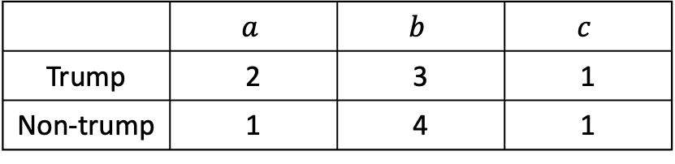
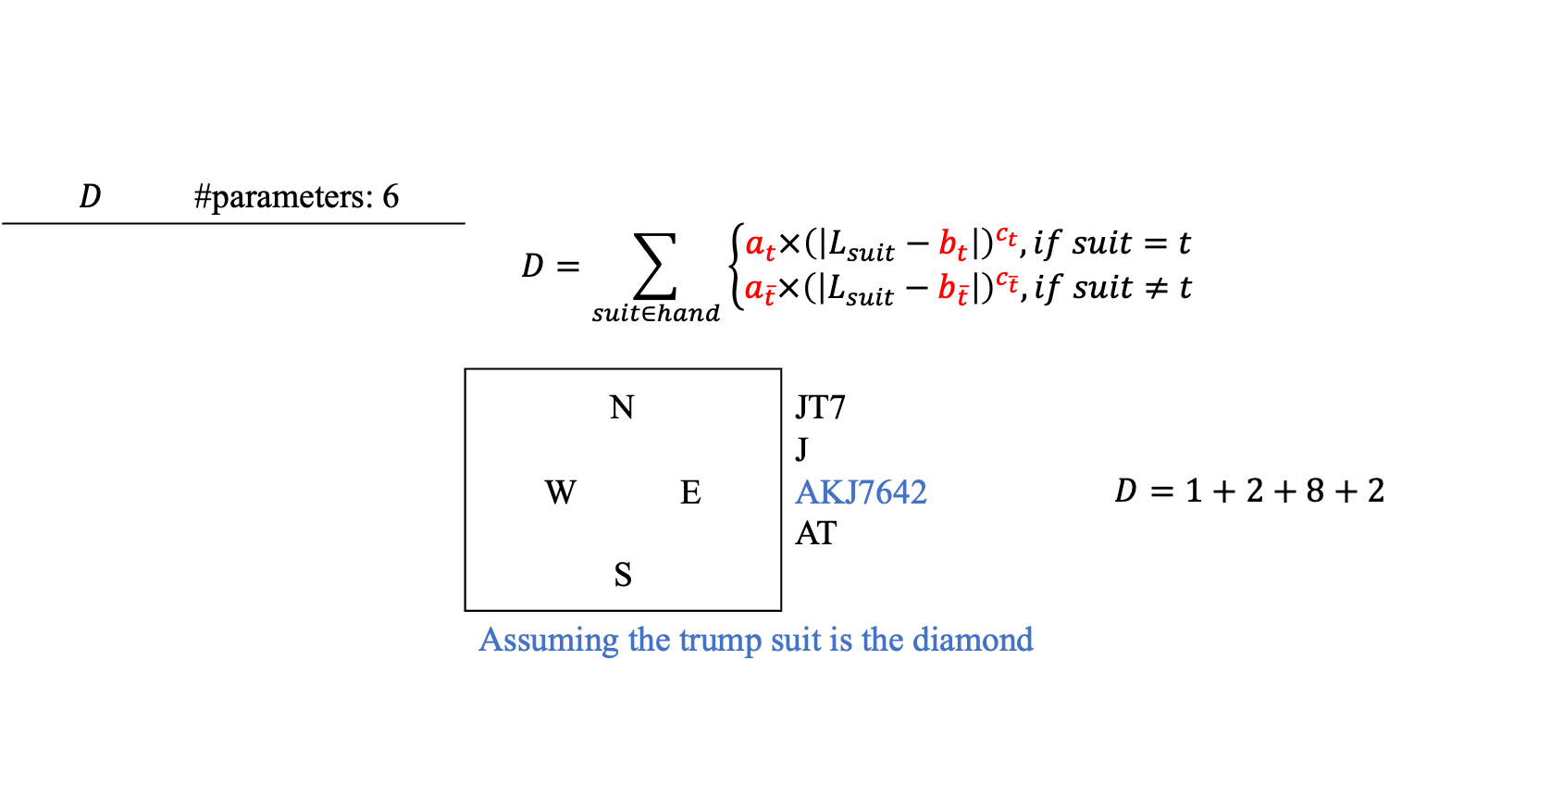
Design of Formulas – Length Formulas
$$D$$ | #parameters: 6 | $$D=\sum_{suit∈hand}{\left\{\begin{aligned}a_{t}×{\left(\left|L_{suit}−b_{t}\right|\right)}^{c_{t}}, if suit=t \\ a_{\overline{t}}×{\left(\left|L_{suit}−b_{\overline{t}}\right|\right)}^{c_{\overline{t}}}, if suit≠t\end{aligned}\right.}$$
 |  | N W E S | JT7 J AKJ7642 AT | $$D=1+2+8+2$$
 |  | Assuming the trump suit is the diamond
 | $$a$$ | $$b$$ | $$c$$
Trump | 2 | 3 | 1
Non-trump | 1 | 4 | 1

Slide 23
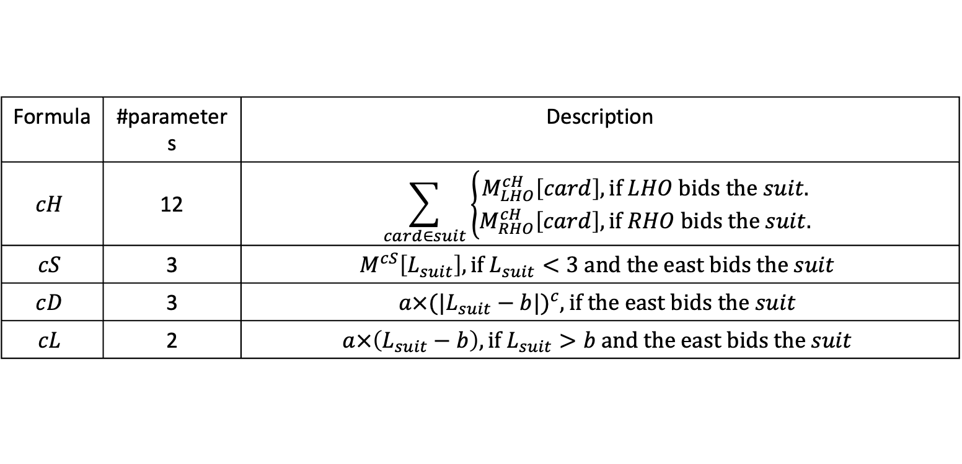
Design of Formulas – Fine-Tune if the East Bids
Formula | #parameters | Description
$$cH$$ | 12 | $$\sum_{card∈suit}{\left\{\begin{aligned}M_{LHO}^{cH}\left[card\right], \text{if} LHO \text{bids} \text{the} suit. \\ M_{RHO}^{cH}\left[card\right], \text{if} RHO \text{bids} \text{the} suit.\end{aligned}\right.}$$
$$cS$$ | 3 | $$M^{cS}\left[L_{suit}\right], \text{if} L_{suit}<3 \text{and} \text{the} \text{east} \text{bids} \text{the} suit$$
$$cD$$ | 3 | $$a×{(|L_{suit}−b|)}^{c}, \text{if} \text{the} \text{east} \text{bids} \text{the} suit$$
$$cL$$ | 2 | $$a×\left(L_{suit}−b\right), \text{if} L_{suit}>b \text{and} \text{the} \text{east} \text{bids} \text{the} suit$$

Slide 24
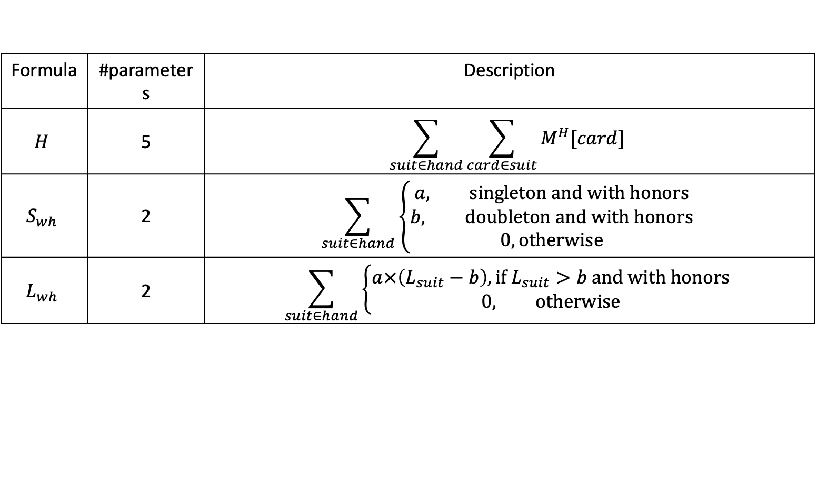
Design of Formulas – No-Trump Contract
Formula | #parameters | Description
$$H$$ | 5 | $$\sum_{suit∈hand}{\sum_{card∈suit}{M^{H}[card]}}$$
$$S_{wh}$$ | 2 | $$\sum_{suit∈hand}{\left\{\begin{aligned}a, \text{singleton} \text{and} \text{with} \text{honors} \\ b, \text{doubleton} \text{and} \text{with} \text{honors} \\ 0, \text{otherwise}\end{aligned}\right.}$$
$$L_{wh}$$ | 2 | $$\sum_{suit∈hand}{\left\{\begin{aligned}a×\left(L_{suit}−b\right), \text{if} L_{suit}>b \text{and} \text{with} \text{honors} \\ 0, \text{otherwise}\end{aligned}\right.}$$

Slide 25
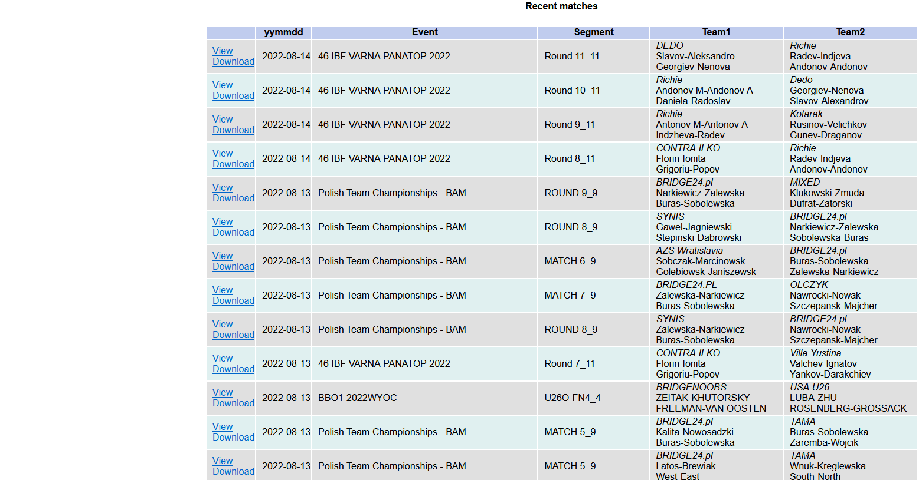
Dataset Generation
The image is copy from https://www.bridgebase.com/vugraph_archives/vugraph_archives.php

Slide 26
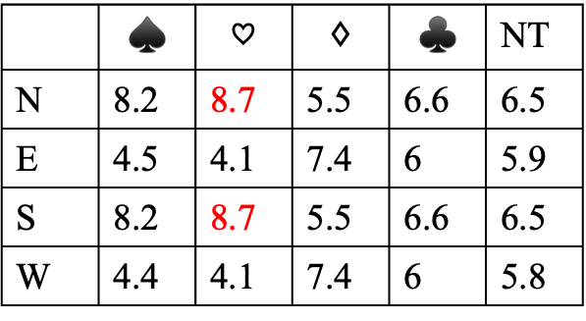
Dataset Generation
 | 42 AT74 853 QJ95
 | N W E S
 | AKQ96 Q965 QT K3
Randomly generate 100 WE hands and the double dummy results
 | $$♠$$ | $$♡$$ | $$♢$$ | $$♣$$ | NT
N | 8.2 | 8.7 | 5.5 | 6.6 | 6.5
E | 4.5 | 4.1 | 7.4 | 6 | 5.9
S | 8.2 | 8.7 | 5.5 | 6.6 | 6.5
W | 4.4 | 4.1 | 7.4 | 6 | 5.8

Slide 27
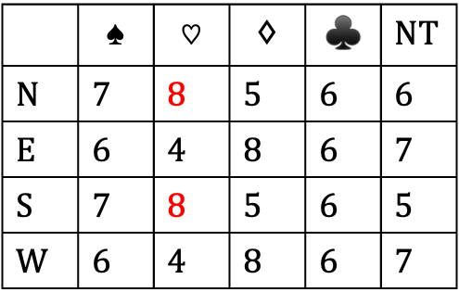
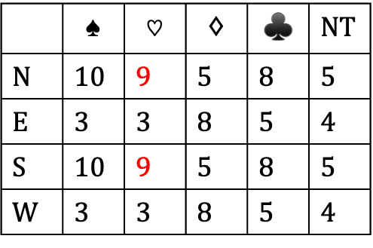
Dataset Generation
 | 42 AT74 853 QJ95
853 K832 9 87642 | N W E S | JT7 J AKJ7642 AT
 | AKQ96 Q965 QT K3
 | 42 AT74 853 QJ95
T8753 J3 72 AT64 | N W E S | J K82 AKJ964 872
 | AKQ96 Q965 QT K3
 | $$♠$$ | $$♡$$ | $$♢$$ | $$♣$$ | NT
N | 10 | 9 | 5 | 8 | 5
E | 3 | 3 | 8 | 5 | 4
S | 10 | 9 | 5 | 8 | 5
W | 3 | 3 | 8 | 5 | 4
 | $$♠$$ | $$♡$$ | $$♢$$ | $$♣$$ | NT
N | 7 | 8 | 5 | 6 | 6
E | 6 | 4 | 8 | 6 | 7
S | 7 | 8 | 5 | 6 | 5
W | 6 | 4 | 8 | 6 | 7

Slide 28
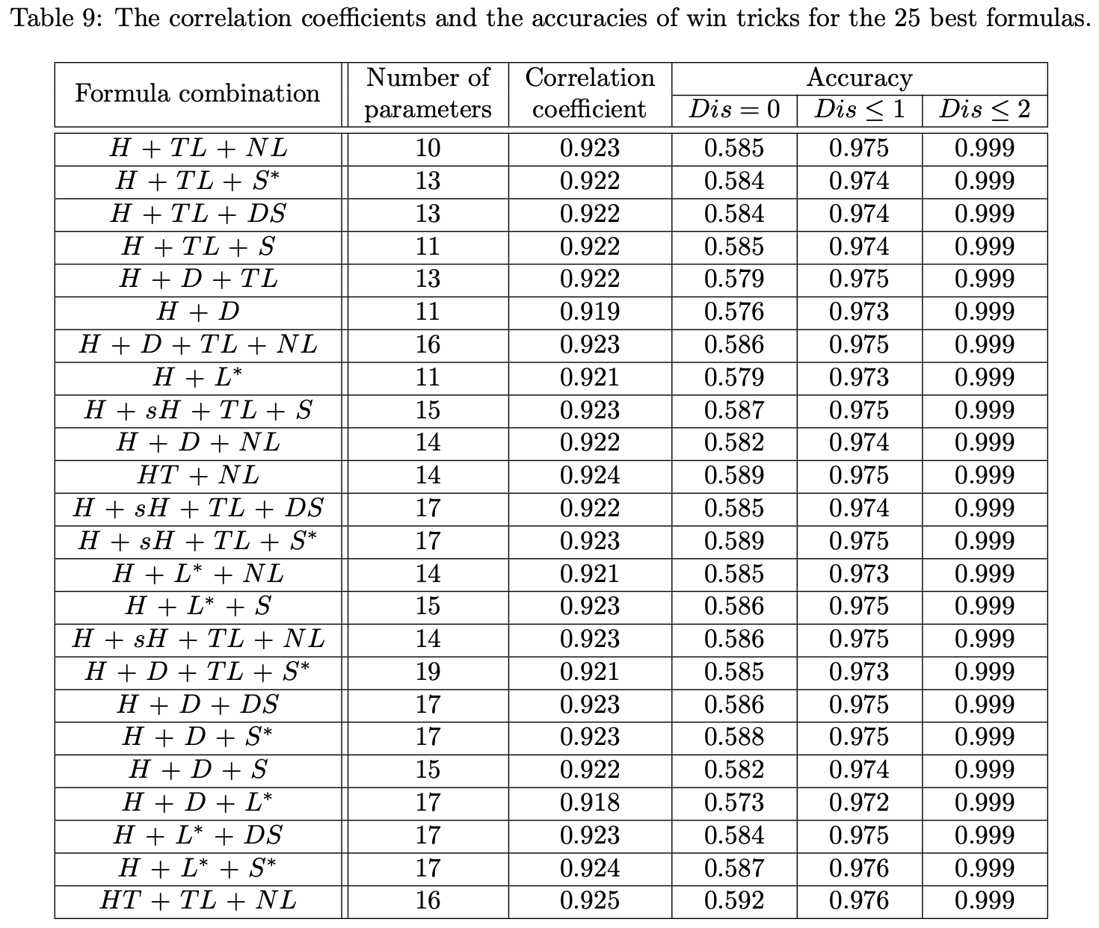

Slide 29
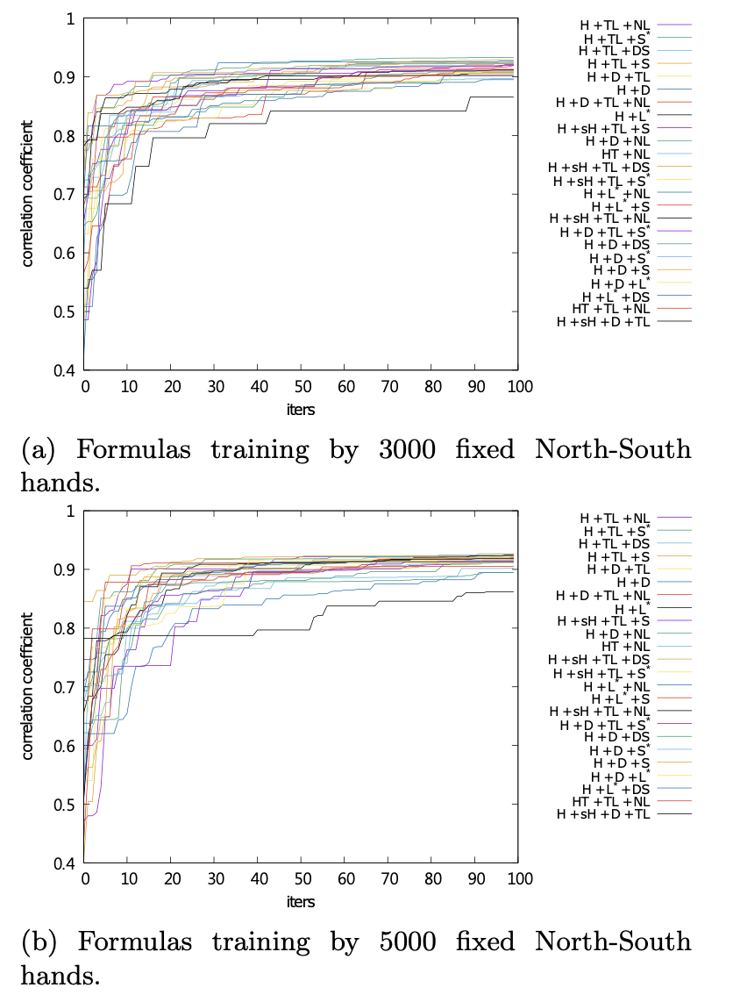
Better Formula Combinations

Slide 30
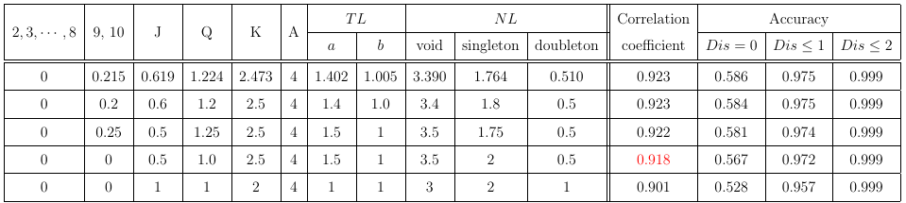

Experimental Results – Suit Contract
$H+TL+NL$

Slide 31
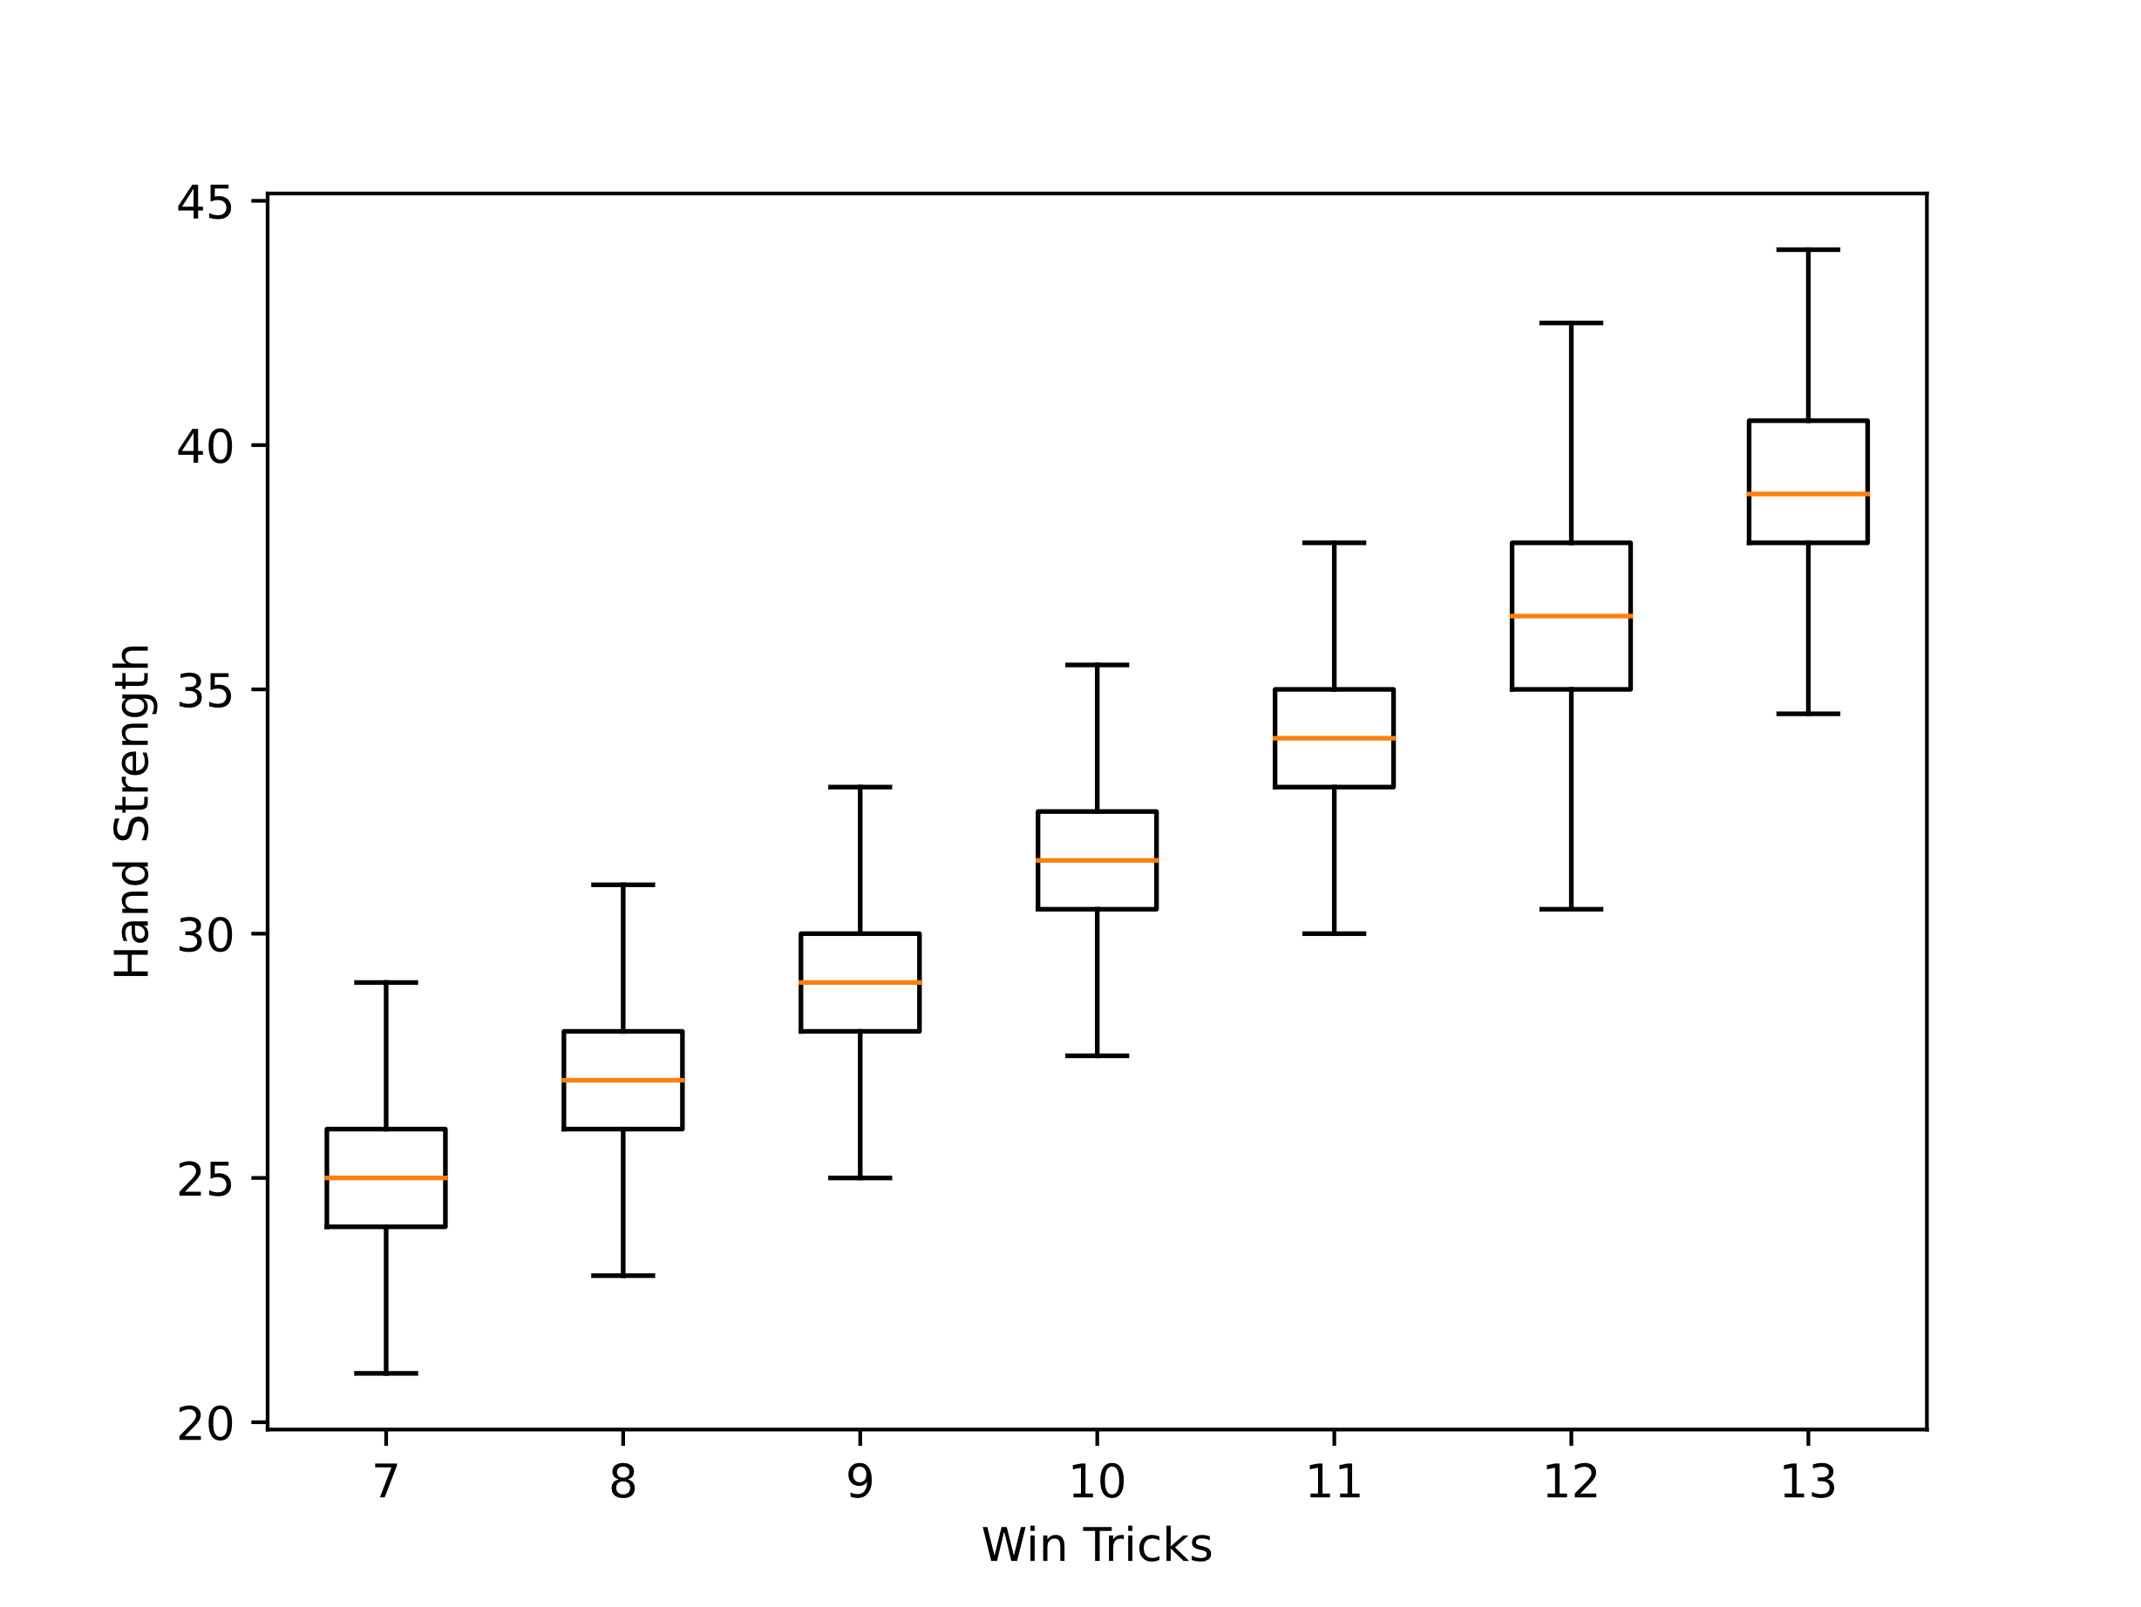
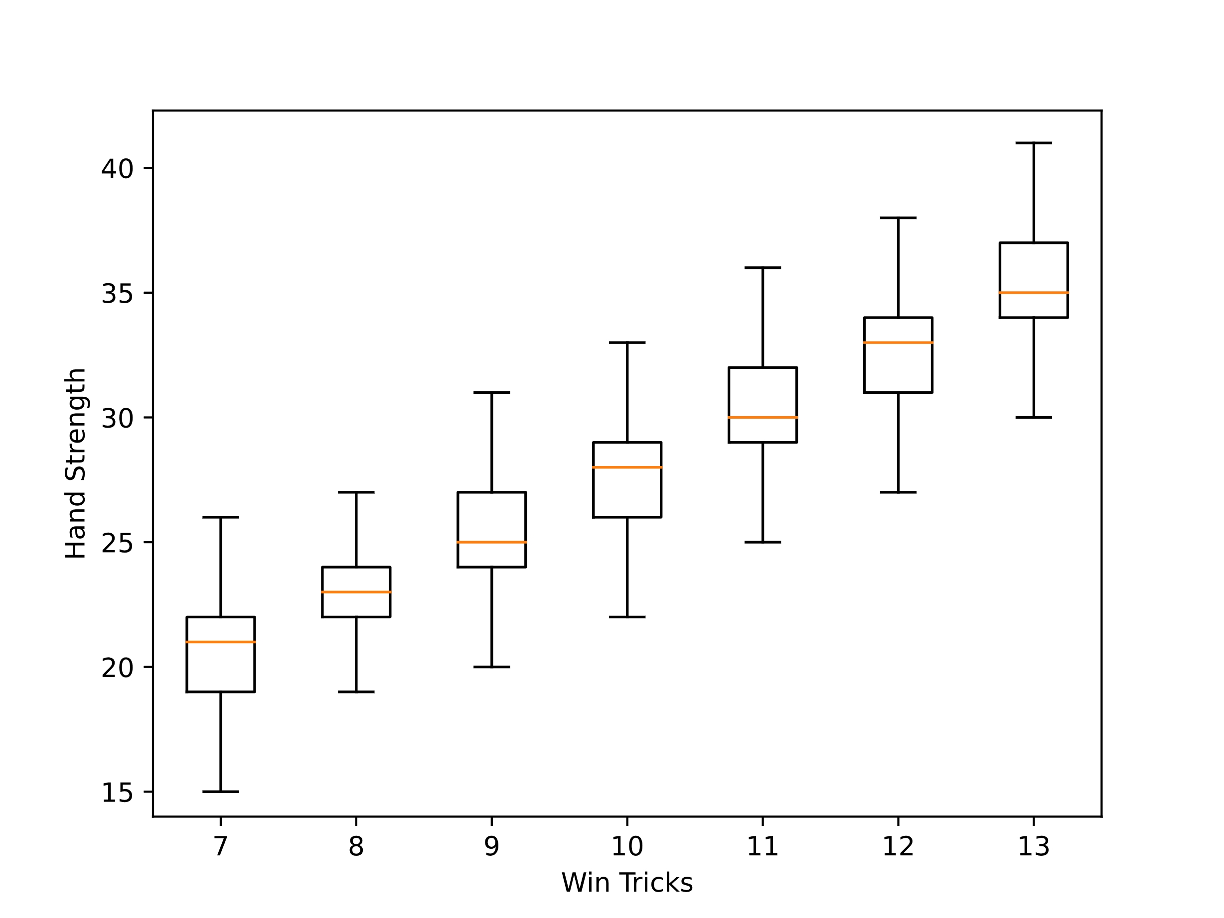
Experimental Results – Suit Contract
fine-tune H + TL + NL with resolution=0.5
Goren point count + short method(void=5, singleton=3, doubleton=1)

Slide 32
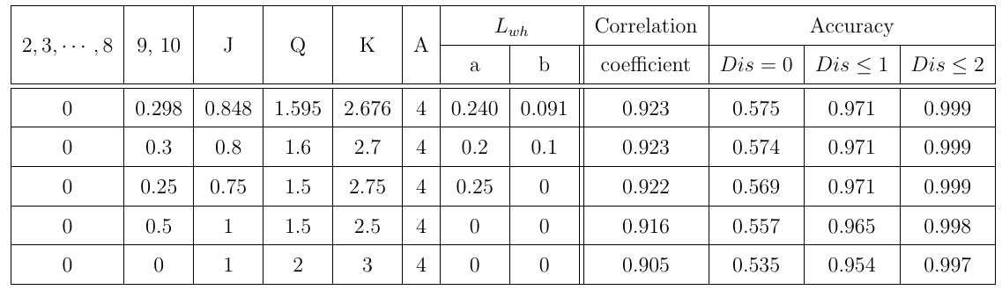
Experimental Results – No-Trump Contract
Size of the dataset that is the no-trump contract: about 90000

Slide 33

Conclusion
$H+TL+NL$ : the long suit for trump suit and the short suit for others
Increase the correlation coefficient from 0.871 to 0.918

