Slide 1
Task Scheduling of Feasible Assignments with the Adaptive Branch and Bound Algorithm
Presenter: Chih-Hsuan Chien​
Date: May 09, 2023

Slide 2






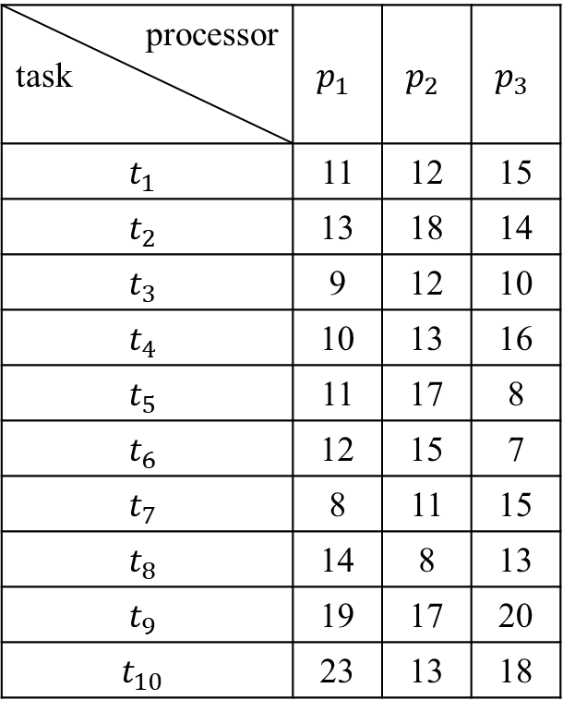




Task Scheduling Problem
$${ t}_{1}$$
processor task | $$p_{1}$$ | $$p_{2}$$ | $$p_{3}$$
$$t_{1}$$ | 11 | 12 | 15
$$t_{2}$$ | 13 | 18 | 14
$$t_{3}$$ | 9 | 12 | 10
$$t_{4}$$ | 10 | 13 | 16
$$t_{5}$$ | 11 | 17 | 8
$$t_{6}$$ | 12 | 15 | 7
$$t_{7}$$ | 8 | 11 | 15
$$t_{8}$$ | 14 | 8 | 13
$$t_{9}$$ | 19 | 17 | 20
$$t_{10}$$ | 23 | 13 | 18
12
17
11
18
$${ t}_{2}$$
$${ t}_{3}$$
$${ t}_{4}$$
$${ t}_{5}$$
18
18
27
13
21
18
20
$${ t}_{6}$$
$${ t}_{7}$$
$${ t}_{8}$$
$${ t}_{9}$$
11
12
18
19
$${ t}_{10}$$
Notes:
Task scheduling problem 指的是一個工作流程不同的task的機器分配問題，一個工作流程可以用一個有向無環圖去表示，在dag圖中節點代表的是任務，那edge代表的是不同task之間的先後順序關係，edge上的權重指的是傳輸時間，如果兩個task放在不同的機器上後面的task就要等傳輸時間結束後才能開始執行。那如果兩個task放在同意台機器上就不需要這個傳輸時間

Slide 3












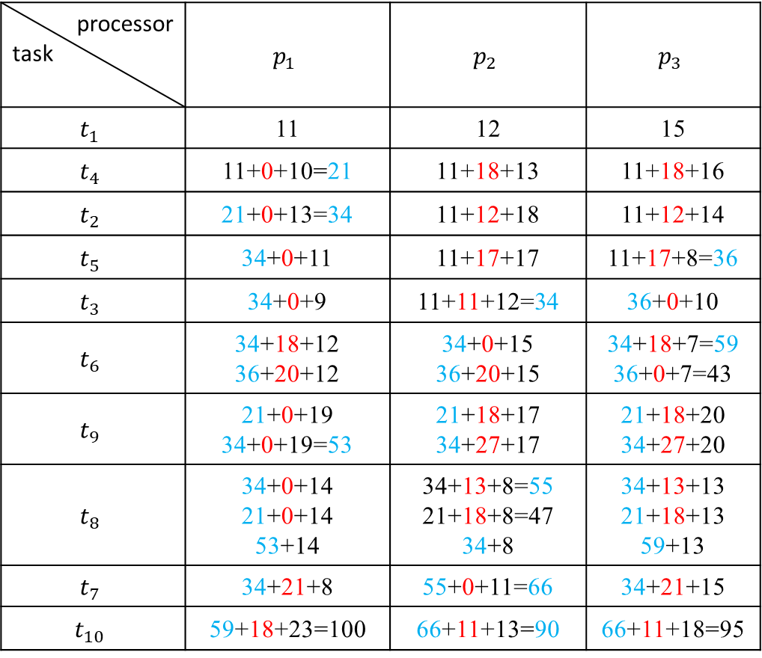








$${ t}_{1}$$
12
17
11
18
$${ t}_{2}$$
$${ t}_{3}$$
$${ t}_{4}$$
$${ t}_{5}$$
processor task | $$p_{1}$$ | $$p_{2}$$ | $$p_{3}$$
$$t_{1}$$ | 11 | 12 | 15
$$t_{4}$$ | 11+0+10=21 | 11+18+13 | 11+18+16
$$t_{2}$$ | 21+0+13=34 | 11+12+18 | 11+12+14
$$t_{5}$$ | 34+0+11 | 11+17+17 | 11+17+8=36
$$t_{3}$$ | 34+0+9 | 11+11+12=34 | 36+0+10
$$t_{6}$$ | 34+18+12 36+20+12 | 34+0+15 36+20+15 | 34+18+7=59 36+0+7=43
$$t_{9}$$ | 21+0+19 34+0+19=53 | 21+18+17 34+27+17 | 21+18+20 34+27+20
$$t_{8}$$ | 34+0+14 21+0+14 53+14 | 34+13+8=55 21+18+8=47 34+8 | 34+13+13 21+18+13 59+13
$$t_{7}$$ | 34+21+8 | 55+0+11=66 | 34+21+15
$$t_{10}$$ | 59+18+23=100 | 66+11+13=90 | 66+11+18=95
18
18
27
18
13
21
20
$${ t}_{6}$$
$${ t}_{7}$$
$${ t}_{8}$$
$${ t}_{9}$$
11
12
18
19
$${ t}_{10}$$
$${ t}_{10}$$
$${ t}_{8}$$
$${ t}_{6}$$
$${ t}_{7}$$
$${ t}_{9}$$
$${ t}_{2}$$
$${ t}_{3}$$
$${ t}_{5}$$
$${ t}_{4}$$
$${ t}_{1}$$
Notes:
這邊是一個排成的例子，假設我們是以1425….的順序下去安排任務的分配問題，那我們會以task能夠完成的最早完成時間去做機器的選擇

Slide 4


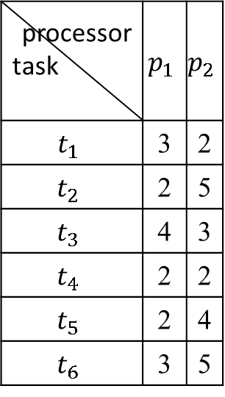




processor task | $$p_{1}$$ | $$p_{2}$$
$$t_{1}$$ | 3 | 2
$$t_{2}$$ | 2 | 5
$$t_{3}$$ | 4 | 3
$$t_{4}$$ | 2 | 2
$$t_{5}$$ | 2 | 4
$$t_{6}$$ | 3 | 5
$${ t}_{1}$$
1
2
$${ t}_{2}$$
$${ t}_{3}$$
4
2
3
$${ t}_{4}$$
$${ t}_{5}$$
L1
4
2
$${ t}_{6}$$
L2
L3
L4
L5
b
L6
a
c
d
Notes:
學姊的演算法是以branch and bound的方法去解決排成問題，左上角是一個工作流程圖，那右邊是我們的展開圖，我們會先挑選估計值小的去往下做延伸，

Slide 5

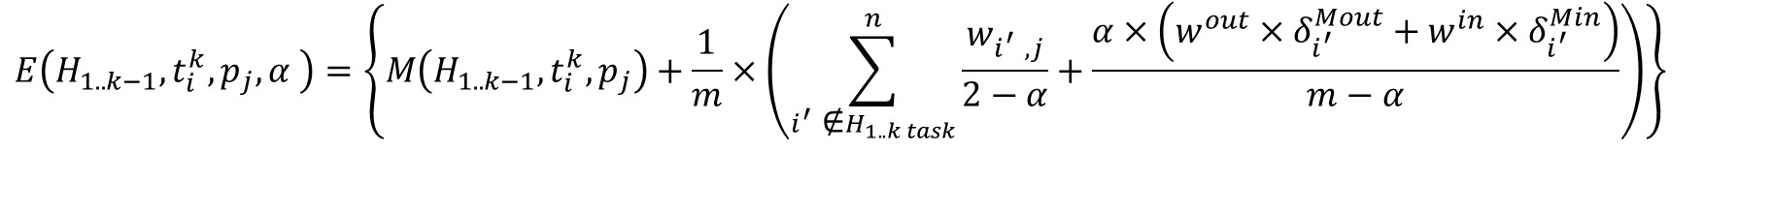
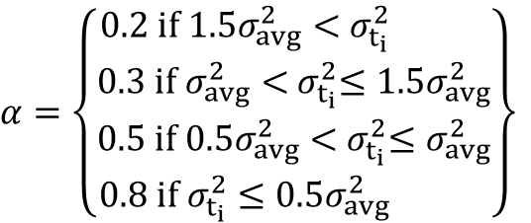
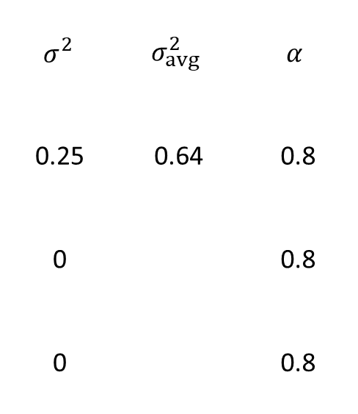

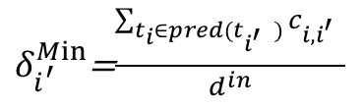
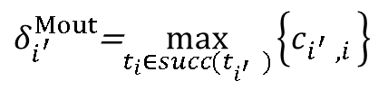
Our parameters
$$E\left(H_{1..k−1},t_{i}^{k},p_{j},α \right)=\left\{M\left(H_{1..k−1},t_{i}^{k},p_{j}\right)+\frac{1}{m}×\left(\sum_{i_{}^{′}\text{∉}H_{1..k task}}^{n}{\frac{w_{i_{}^{′},j}}{2−α}+\frac{α×\left(w^{out}×δ_{i_{}^{′}}^{Mout}+w^{in}×δ_{i_{}^{′}}^{Min}\right)}{m−α}}\right)\right\}{ }$$
$δ_{i_{}^{′}}^{Mout}$=$\max_{t_{i}∈succ(t_{i_{}^{′}})}\left\{c_{i_{}^{′},i }\right\}$
$${ σ}_{}^{2}$$ | $$σ_{avg}^{2}$$ | $$α$$
0.25 | 0.64 | 0.8
0 |  | 0.8
0 |  | 0.8
$δ_{i_{}^{′}}^{Min}$=$\frac{\sum_{t_{i}∈pred(t_{i_{}^{′}})}{c_{i,i_{}^{′}}}}{d^{in}}$
$${ t}_{1}$$
$${ t}_{1}$$
1
2
1
2
$$α∈\left\{0.2,0.3,0.5,0.8\right\}$$
$${ t}_{2}$$
$${ t}_{3}$$
$${ t}_{2}$$
$${ t}_{3}$$
$$α=\left\{\begin{aligned}0.2 if{ 1.5σ}_{avg}^{2}<{ σ}_{t_{i}}^{2} \\ 0.3 if{ σ}_{avg}^{2}<{ σ}_{t_{i}}^{2}≤{1.5σ}_{avg}^{2} \\ 0.5 if 0.5σ_{avg}^{2}<{ σ}_{t_{i}}^{2}≤σ_{avg}^{2} \\ 0.8 if{ σ}_{t_{i}}^{2}≤{0.5σ}_{avg}^{2} \end{aligned}\right\}$$
4
2
3
3
3
$${ t}_{4}$$
$${ t}_{5}$$
$${ t}_{4}$$
$${ t}_{5}$$
3
4
2
$σ_{avg}^{2}$=$\frac{\sum{{(c_{i,j}−μ)}^{2}}}{n}$
$${ t}_{6}$$
$${ t}_{6}$$
Notes:
上面這個公式是我們估計未來makespan的一個function ，h i~k-1 是我們已分配好機器的task，那t i以及pj是第ti個task要分配到第j個機器上，公式裡的m function 是我們到目前為止的makespan，右邊這塊是我們對剩下的task所需時間的估計值，
Delta mout I prime 是第I prime的outcoming edge
W out 高估後可用a調整
取平均是因為不知道這個edge是從哪一層連過來的

Slide 6

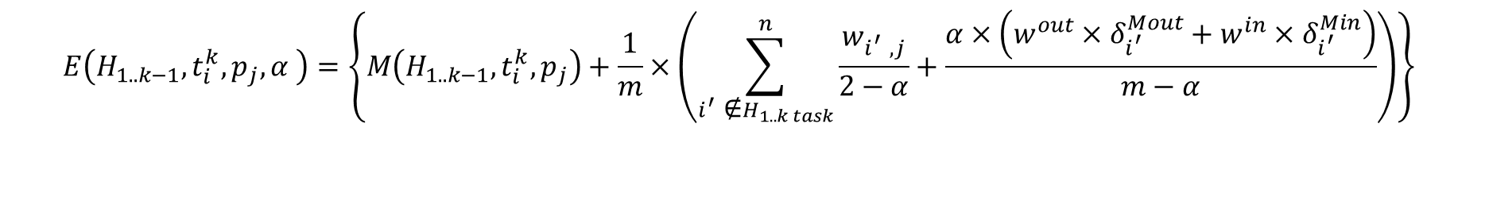

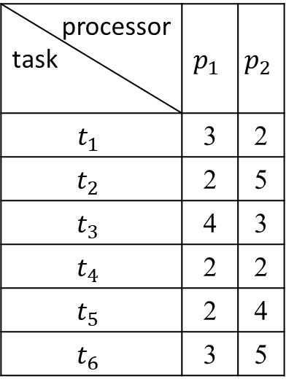
processor task | $$p_{1}$$ | $$p_{2}$$
$$t_{1}$$ | 3 | 2
$$t_{2}$$ | 2 | 5
$$t_{3}$$ | 4 | 3
$$t_{4}$$ | 2 | 2
$$t_{5}$$ | 2 | 4
$$t_{6}$$ | 3 | 5
START
$${ t}_{1}$$
1
2
$${ t}_{2}$$
$${ t}_{3}$$
$$<{ t}_{1}{, p}_{1}>$$
$${ <t}_{1}{, p}_{2}>$$
4
2
3
$${ t}_{4}$$
$${ t}_{5}$$
4
2
$${ t}_{6}$$
$$E\left(\left\langle \right\rangle ,1,1,0.8\right)=M\left(\left\langle \right\rangle ,1,1\right)+\frac{1}{2}×\left(\frac{2+4+2+2+3}{2−0.8}+\frac{0.8×\left(0.8×\left(4+3+4+2+0\right)+0.2×\left(1+2+3+3+3\right)\right)}{2−0.8}\right)=3+9.6=12.6$$
$$E\left(\left\langle \right\rangle ,1,2,0.8\right)=M\left(\left\langle \right\rangle ,1,2\right)+\frac{1}{2}×\left(\frac{5+3+2+4+5}{2−0.8}+\frac{0.8×\left(0.8×\left(4+3+4+2+0\right)+0.2×\left(1+2+3+3+3\right)\right)}{2−0.8}\right)=2+12.1=14.1$$
$$E\left(H_{1..k−1},t_{i}^{k},p_{j},α \right)=\left\{M\left(H_{1..k−1},t_{i}^{k},p_{j}\right)+\frac{1}{m}×\left(\sum_{i_{}^{′}\text{∉}H_{1..k task}}^{n}{\frac{w_{i_{}^{′},j}}{2−α}+\frac{α×\left(w^{out}×δ_{i_{}^{′}}^{Mout}+w^{in}×δ_{i_{}^{′}}^{Min}\right)}{m−α}}\right)\right\}{ }$$

Slide 7
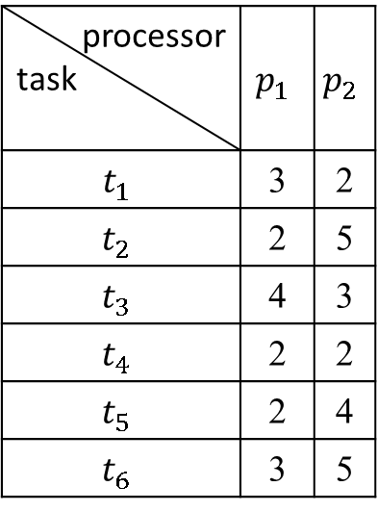


$${ t}_{1}$$
START
processor task | $$p_{1}$$ | $$p_{2}$$
$$t_{1}$$ | 3 | 2
$$t_{2}$$ | 2 | 5
$$t_{3}$$ | 4 | 3
$$t_{4}$$ | 2 | 2
$$t_{5}$$ | 2 | 4
$$t_{6}$$ | 3 | 5
1
2
$${ t}_{2}$$
$${ t}_{3}$$
$$<{ t}_{1}{, p}_{1}>$$
12.6
$${ <t}_{1}{, p}_{2}>$$
14.1
4
2
3
$${ t}_{4}$$
$${ t}_{5}$$
4
2
$${ t}_{6}$$
$E\left(\left\langle \left\langle 1,1\right\rangle \right\rangle ,2,1,0.8\right)=M\left(\left\langle \left\langle 1,1\right\rangle \right\rangle ,2,1\right)+\frac{1}{2}×\left(\frac{4+2+2+3}{2−0.8}+\frac{0.8×\left(0.8×\left(3+4+2+0\right)+0.2×\left(2+3+3+3\right)\right)}{2−0.8}\right)=$5+7.6=12.6
$E\left(\left\langle \left\langle 1,1\right\rangle \right\rangle ,2,2,0.8\right)=M\left(\left\langle \left\langle 1,1\right\rangle \right\rangle ,2,2\right)+\frac{1}{2}×\left(\frac{3+2+4+5}{2−0.8}+\frac{0.8×\left(0.8×\left(3+4+2+0\right)+0.2×\left(2+3+3+3\right)\right)}{2−0.8}\right)=$9+8.9=17.9
$E\left(\left\langle \left\langle 1,1\right\rangle \right\rangle ,3,1,0.8\right)=M\left(\left\langle \left\langle 1,1\right\rangle \right\rangle ,3,1\right)+\frac{1}{2}×\left(\frac{2+2+2+3}{2−0.8}+\frac{0.8×\left(0.8×\left(4+4+2+0\right)+0.2×\left(1+3+3+3\right)\right)}{2−0.8}\right)=$7+7=14
$E\left(\left\langle \left\langle 1,1\right\rangle \right\rangle ,3,2,0.8\right)=M\left(\left\langle \left\langle 1,1\right\rangle \right\rangle ,3,2\right)+\frac{1}{2}×\left(\frac{5+2+4+5}{2−0.8}+\frac{0.8×\left(0.8×\left(4+4+2+0\right)+0.2×\left(1+3+3+3\right)\right)}{2−0.8}\right)=$8+10=18

Slide 8
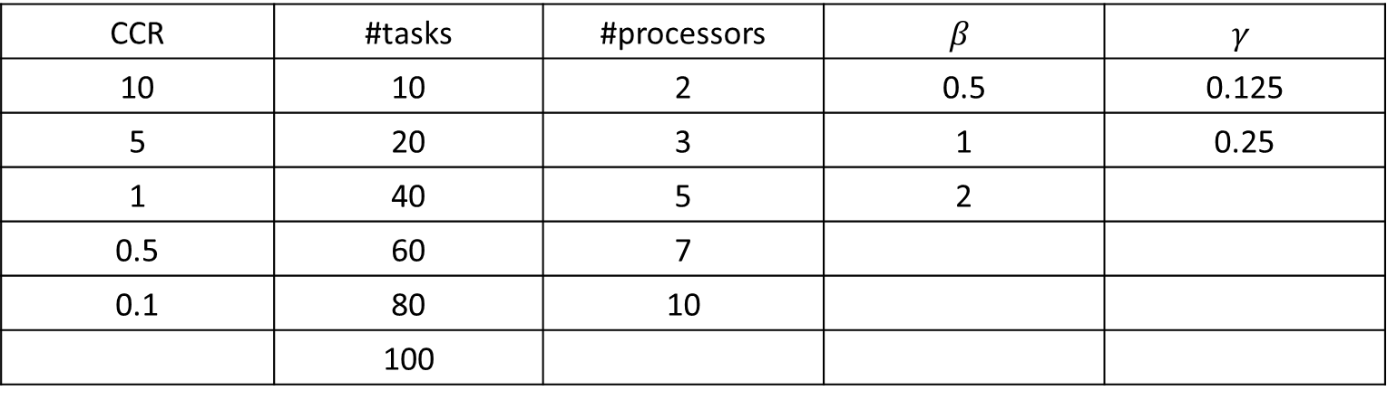
Datasets
CCR | #tasks | #processors | $$β$$ | $$γ$$
10 | 10 | 2 | 0.5 | 0.125
5 | 20 | 3 | 1 | 0.25
1 | 40 | 5 | 2
0.5 | 60 | 7
0.1 | 80 | 10
 | 100
Notes:
Beta 層數 100/beta開根號
Gama communication 亂度
Ccr全稱

Slide 9
Experimental Results(1/2)
(CCR, #task, #processor)=

Slide 10
Experimental Results(2/2)
(CCR, #task, #processor)
Notes:
層數越多a值會有更多的變化

Slide 11
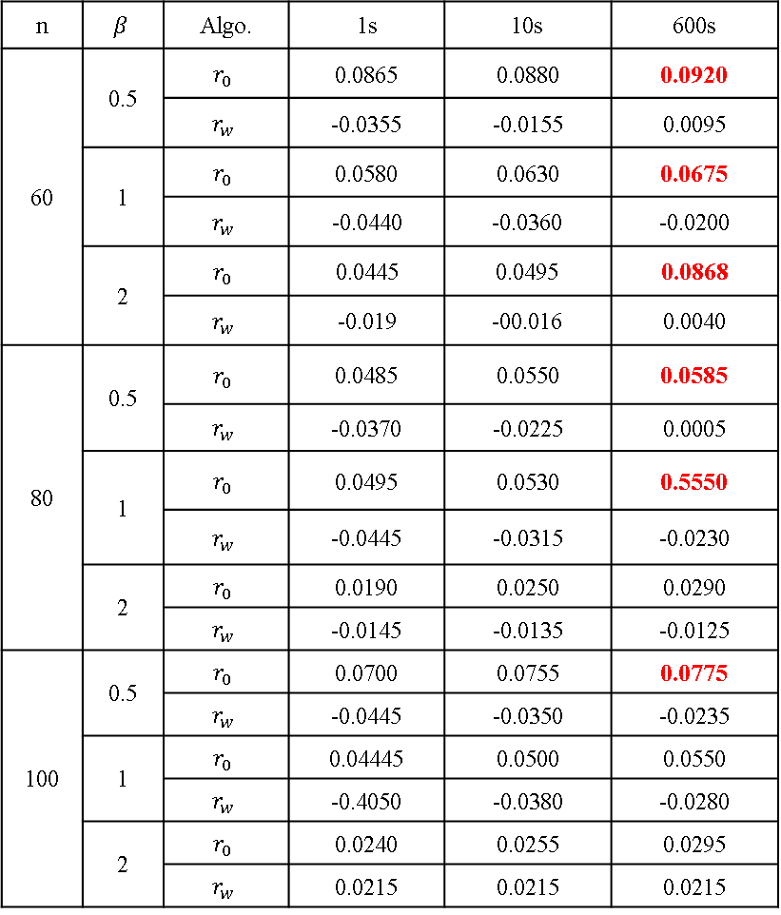
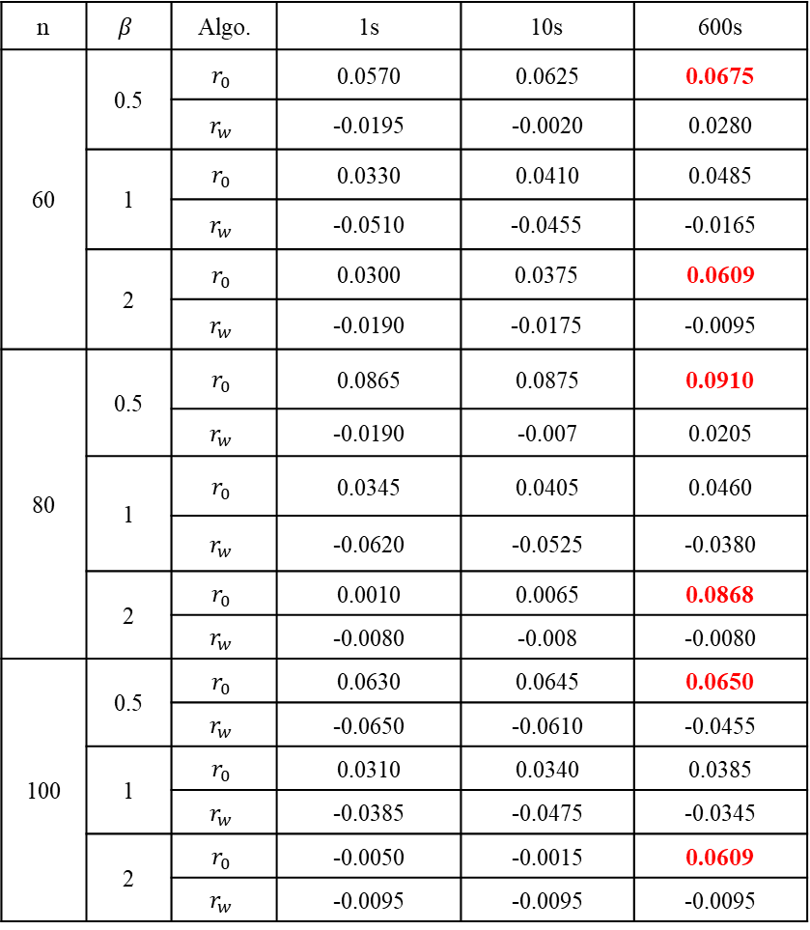
Experimental Results(3/3)
(CCR 10, #task, Processor 7)
(CCR 10, #task, Processor 10)
n | $$β$$ | Algo. | 1s | 10s | 600s
60 | 0.5 | $$r_{0}$$ | 0.0865 | 0.0880 | 0.0920
 |  | $$r_{w}$$ | -0.0355 | -0.0155 | 0.0095
 | 1 | $$r_{0}$$ | 0.0580 | 0.0630 | 0.0675
 |  | $$r_{w}$$ | -0.0440 | -0.0360 | -0.0200
 | 2 | $$r_{0}$$ | 0.0445 | 0.0495 | 0.0868
 |  | $$r_{w}$$ | -0.019 | -00.016 | 0.0040
80 | 0.5 | $$r_{0}$$ | 0.0485 | 0.0550 | 0.0585
 |  | $$r_{w}$$ | -0.0370 | -0.0225 | 0.0005
 | 1 | $$r_{0}$$ | 0.0495 | 0.0530 | 0.5550
 |  | $$r_{w}$$ | -0.0445 | -0.0315 | -0.0230
 | 2 | $$r_{0}$$ | 0.0190 | 0.0250 | 0.0290
 |  | $$r_{w}$$ | -0.0145 | -0.0135 | -0.0125
100 | 0.5 | $$r_{0}$$ | 0.0700 | 0.0755 | 0.0775
 |  | $$r_{w}$$ | -0.0445 | -0.0350 | -0.0235
 | 1 | $$r_{0}$$ | 0.04445 | 0.0500 | 0.0550
 |  | $$r_{w}$$ | -0.4050 | -0.0380 | -0.0280
 | 2 | $$r_{0}$$ | 0.0240 | 0.0255 | 0.0295
 |  | $$r_{w}$$ | 0.0215 | 0.0215 | 0.0215
n | $$β$$ | Algo. | 1s | 10s | 600s
60 | 0.5 | $$r_{0}$$ | 0.0570 | 0.0625 | 0.0675
 |  | $$r_{w}$$ | -0.0195 | -0.0020 | 0.0280
 | 1 | $$r_{0}$$ | 0.0330 | 0.0410 | 0.0485
 |  | $$r_{w}$$ | -0.0510 | -0.0455 | -0.0165
 | 2 | $$r_{0}$$ | 0.0300 | 0.0375 | 0.0609
 |  | $$r_{w}$$ | -0.0190 | -0.0175 | -0.0095
80 | 0.5 | $$r_{0}$$ | 0.0865 | 0.0875 | 0.0910
 |  | $$r_{w}$$ | -0.0190 | -0.007 | 0.0205
 | 1 | $$r_{0}$$ | 0.0345 | 0.0405 | 0.0460
 |  | $$r_{w}$$ | -0.0620 | -0.0525 | -0.0380
 | 2 | $$r_{0}$$ | 0.0010 | 0.0065 | 0.0868
 |  | $$r_{w}$$ | -0.0080 | -0.008 | -0.0080
100 | 0.5 | $$r_{0}$$ | 0.0630 | 0.0645 | 0.0650
 |  | $$r_{w}$$ | -0.0650 | -0.0610 | -0.0455
 | 1 | $$r_{0}$$ | 0.0310 | 0.0340 | 0.0385
 |  | $$r_{w}$$ | -0.0385 | -0.0475 | -0.0345
 | 2 | $$r_{0}$$ | -0.0050 | -0.0015 | 0.0609
 |  | $$r_{w}$$ | -0.0095 | -0.0095 | -0.0095
Notes:
這邊是我們的實驗結果，

Slide 12
Conclusion
When CCR, #tasks, #processors and #level are large, our algorithm can get better solutions.
The improvement of average makespan in these datasets, which CCR ∈ {5, 10}, the numbers of tasks n ∈ {60, 80, 100} and processors m ∈ {7, 10}, are about 5 %.
Every DAG has its own feature, maybe we can set more parameters to adjust the paths more precisely to achieve the goal.
Notes:
每個圖形都有自己的特徵，那學姊的演算法再針對ccr較大以及層數較多時較有較有優勢 ，所以在未來我們希望能夠設定更多的參數來去調整估計值讓我們預測能夠更準確

Slide 13
Thank you for listening.

