Slide 1
Bidding in Spades
Gal Cohensius, Reshef Meir, Nadav Oved and Roni Stern
24th European Conference on Artificial Intelligence(ECAI)
Santiago de Compostela, Spain, 2020.
Presenter: Yun-An Chen
Date: July 4, 2023

Slide 2
Abstract(1/2)
We present a Spades bidding algorithm that is superior to recreational human players and to publicly available bots. Like in Bridge, the game of Spades is composed of two independent phases, bidding and playing. This paper focuses on the bidding algorithm, since this phase holds a precise challenge: based on the input, choose the bid that maximizes the agent’s winning probability. Our Bidding-in-Spades (BIS) algorithm heuristically determines the bidding strategy by comparing the expected utility of each possible bid.

Slide 3
Abstract(2/2)
A major challenge is how to estimate these expected utilities. To this end, we propose a set of domain-specific heuristics, and then correct them via machine learning using data from real-world players. The BIS algorithm we present can be attached to any playing algorithm. It beats rule-based bidding bots when all use the same playing component. When combined with a rule-based playing algorithm, it is superior to the average recreational human.

Slide 4
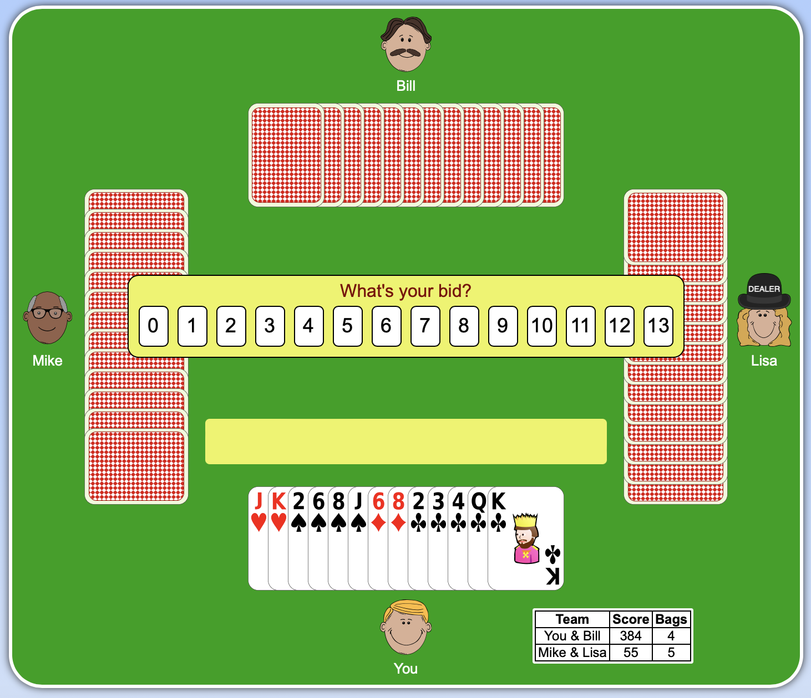
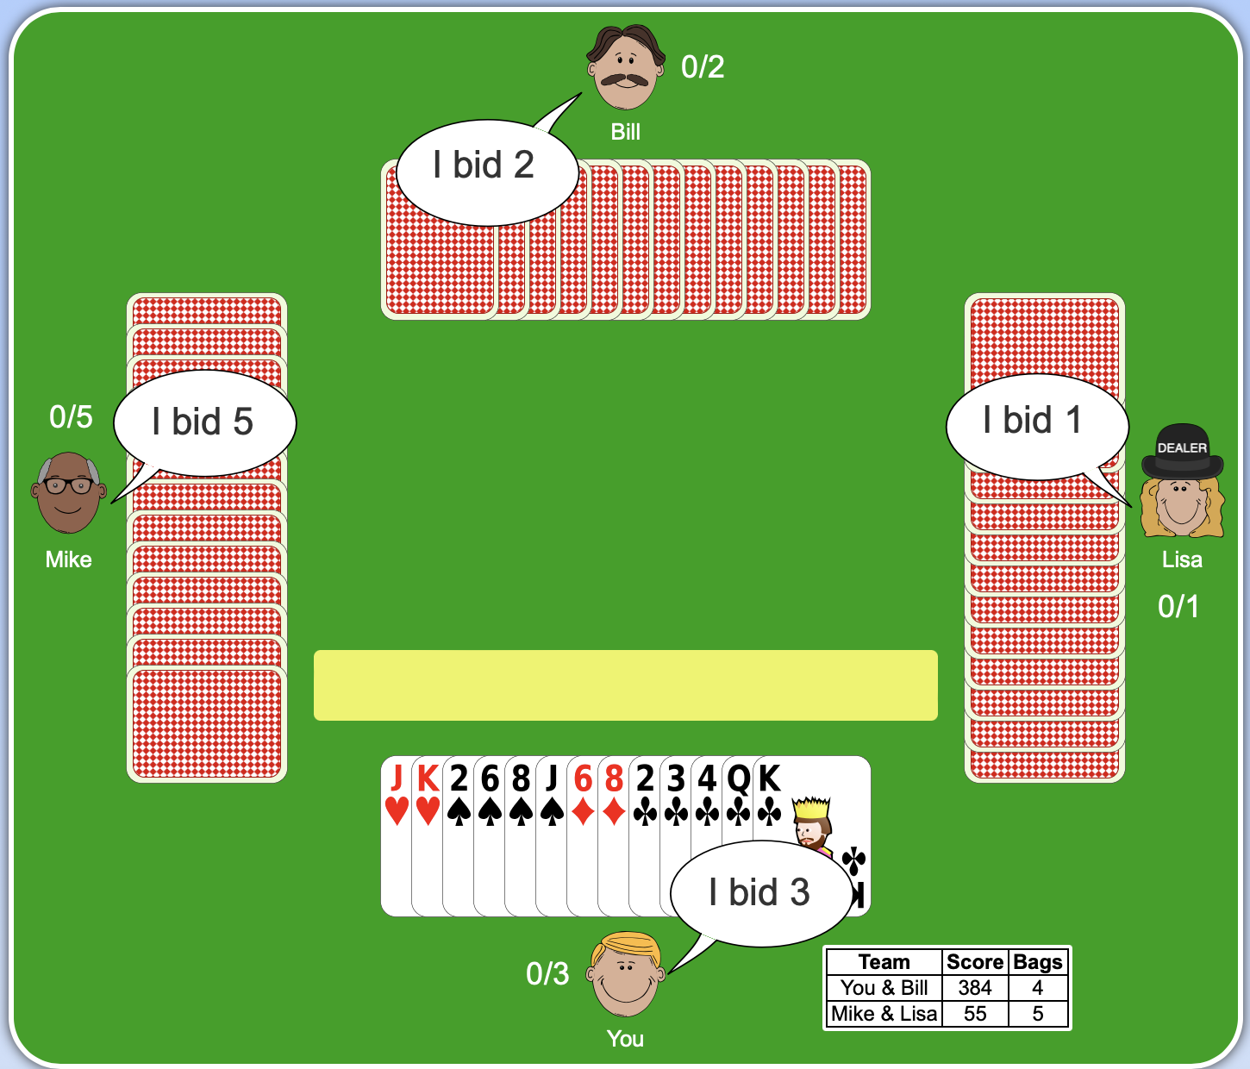
Spades
https://cardgames.io/spades/

Slide 5
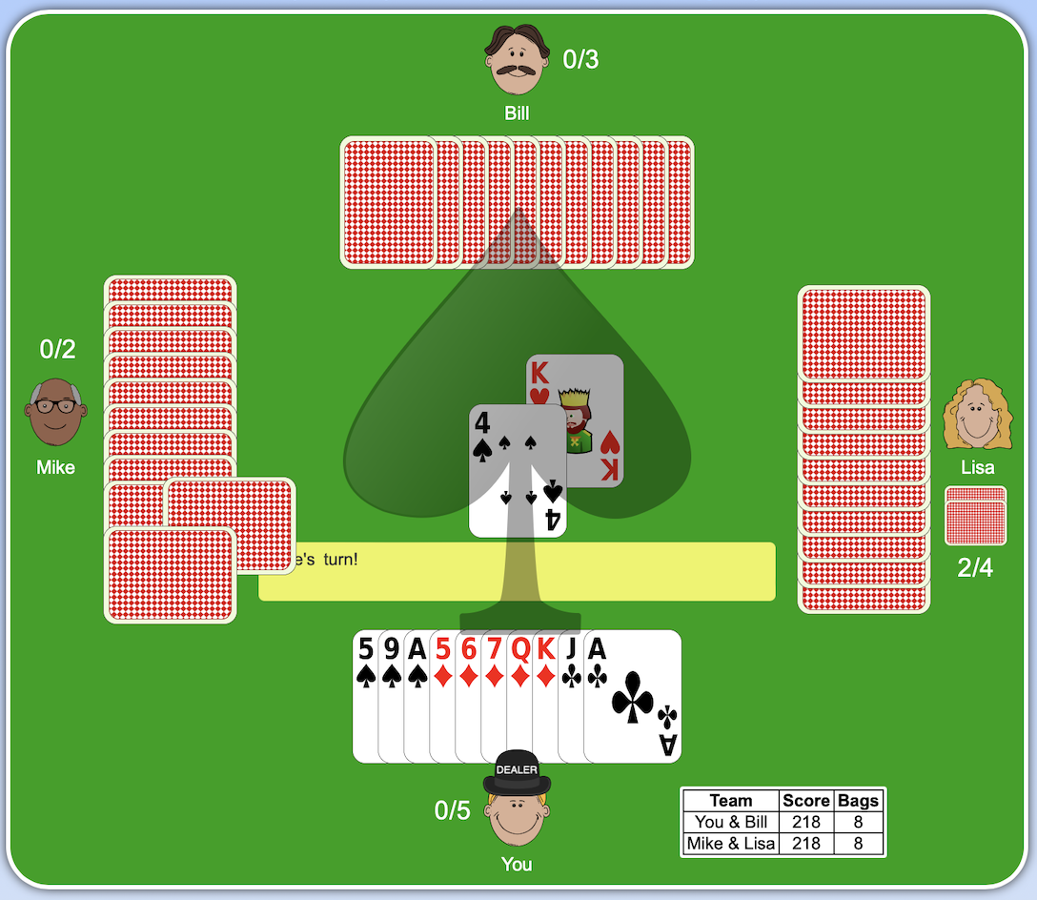
Spades
https://cardgames.io/spades/

Slide 6
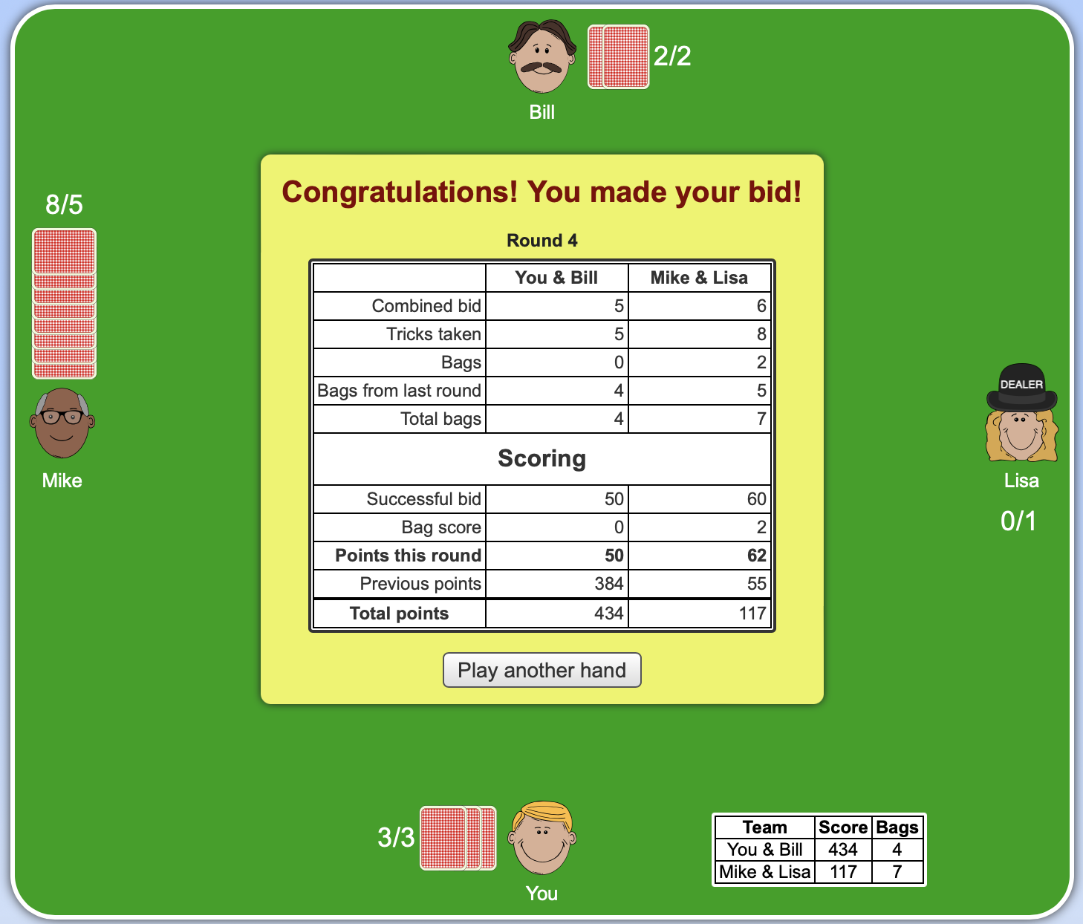
Spades
https://cardgames.io/spades/

Slide 7
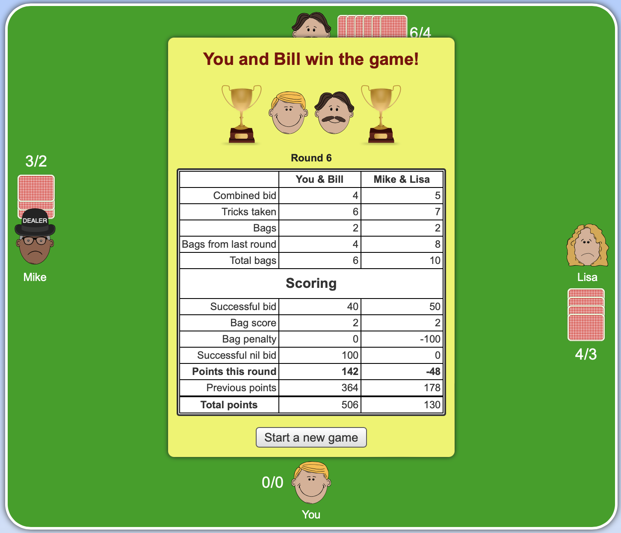
Spades
https://cardgames.io/spades/

Slide 8
Bids
Regular bid (1-13 tricks)
Side suits high cards
Spades high cards
Spades long suits
Short side suits with spades
Nil bid (0 trick)
Tyler Wong. Spades: tactics and trickery. www. sharkfeeder.com/spadsbook/basicbidding.html.

Slide 9
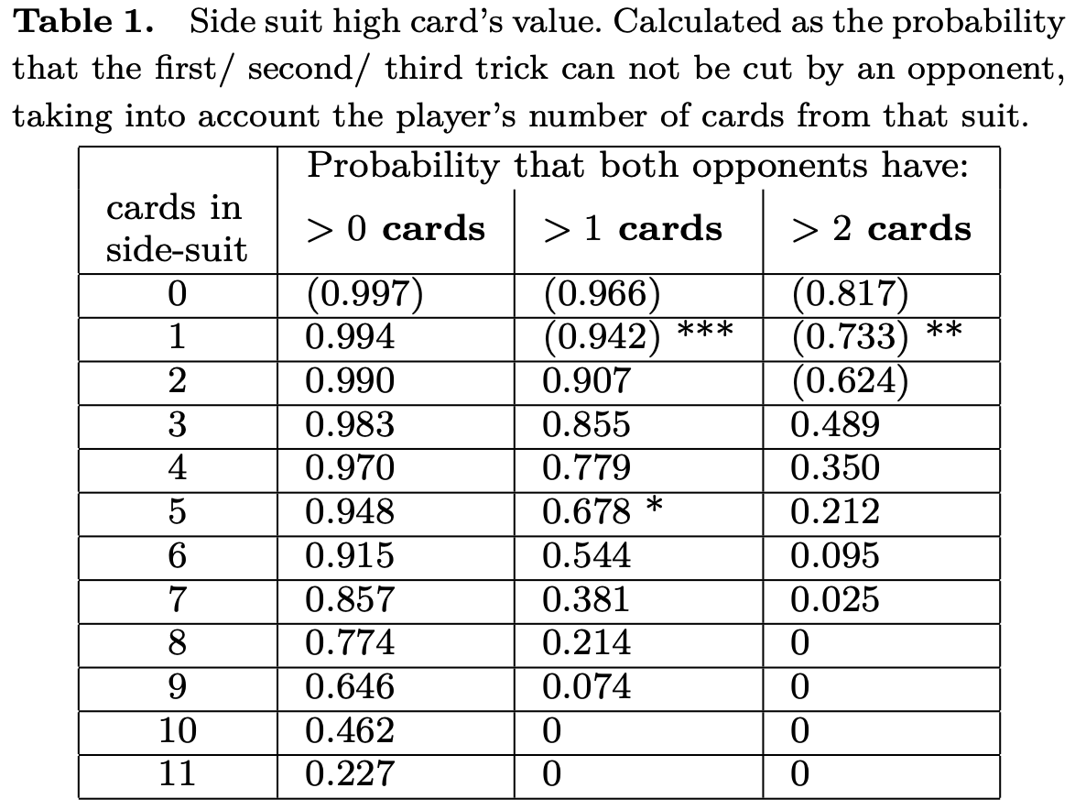
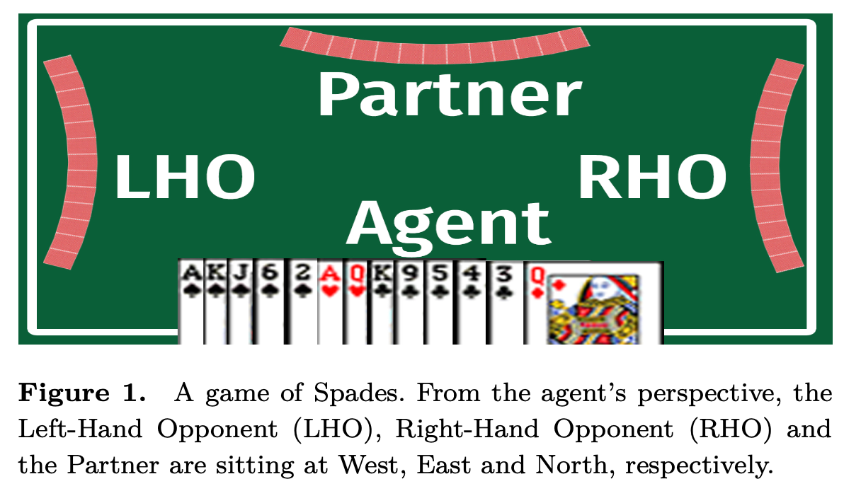
Regular bid - Side suits high cards
CK: 0.678
DQ: 0
HA: 0.990
HQ: 0

Slide 10
Regular bid - Spades high cards
SA is worth one trick.
SK is worth one trick if the hand contains another spade.
SQ needs 2 protectors in order to be counted as a take.
SJ needs 3 protectors in order to be counted as a take.
The finesse version: Tyler Wong. Spades: tactics and trickery. www. sharkfeeder.com/spadsbook/basicbidding.html.

Slide 11
Regular bid - Spades long suits
Every spade beyond the fourth is counted as a take since given the agent holds five spades or more.
Four tricks:
SA
SK
SJ with S2 as a blocker
The fifth spade

Slide 12
Regular bid - Short side suits with spades

Slide 13
Example
The side suit high cards contribute 0.678 (for CK) and 0.990 (for HA). While the HQ, DQ contribute 0.
The SA, SK contribute 1 take each.
The SJ, S6, S2 can be counted as a high card (SJ) with a blocker and a fifth spade and contribute 1 + 1 = 2.
Alternatively, the SJ, S6, S2, can be counted as short side suits cuts, which worth 0.942 + 0.733 + 0.624 = 2.3.
The expected regular takes is 0.678 + 0.99 + 2 + max{2, 2.3} = 5.97

Slide 14
Nil-value
C: The 3 lowest cards are perfectly safe, thus Pr(cnil(C)|hand) = 1.
D: The singleton Q has 57.8% to be covered (partner is void, partner holds either the K or the A, one of the opponents holds only higher D.) Pr(cnil(D)|hand) = 0.578.
H: Pr(cnil(H)|hand) < 0.001. It is non-zero only due to the chance is that partner is void.
S: The A guarantees Pr(cnil(S)|hand) = 0.
The Nil-Value is 1·0.578·0.001·0 = 0

Slide 15
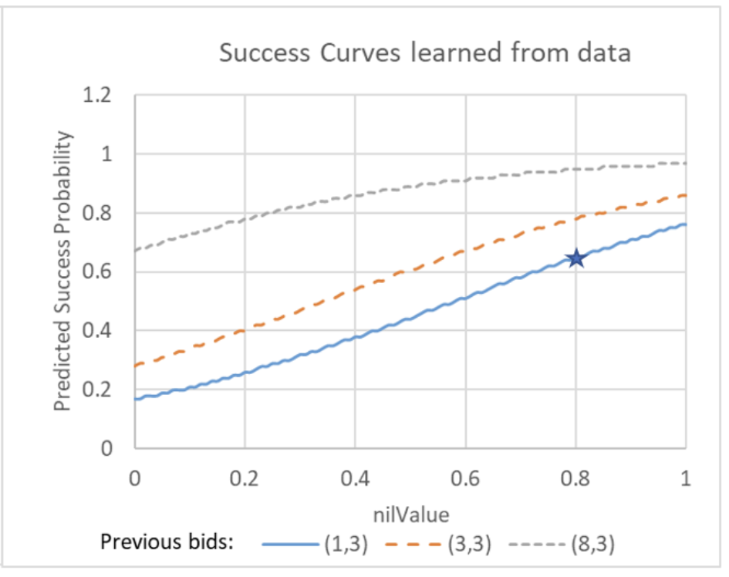
Nil Success Probability
Dataset: 2 million rounds from online games played during December 2018.
All games had three bots and a single human player.
If the agent bids third, previous bids are (1, 3), and the calculated nil value is 0.8 then the estimated nil success probability is 65%

Slide 16
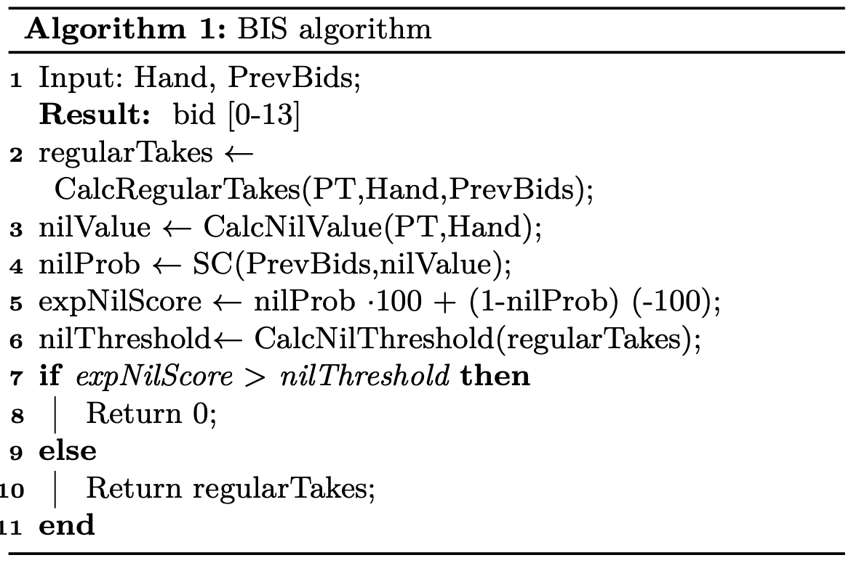
The BIS Agent
Monte-Carlo simulation: the probability that other players hold various cards. The output is in the form of Probability Tables (PT).
Success probabilities of nil bids: the output is in the form a real-valued function called success curves (SC).

Slide 17
Experiments - Competition with other bots
In every game there was one BIS partnership (two agents using BIS for bidding) and one competing partnership.
IO: Cardsgame.io website.
MS: an implementation in the book Master Spades.
RB: rule-based Bidder.
In each comparison 10K games were played.
With the same playing module: WRP, SRP, UCT.
The winning goal is 200 points, and the losing goal is -100 points.
Notes:
Nil: partner’s bid ≥ 4 and hand contains no A or K, and no A-T and no more than 3 spades.
Regular bid: spade A to T is worth 1 trick, spade 9 to 2 is worth 0.4 trick, in side-suits, each A is worth 1 trick, each {AK} is worth 2 tricks and each {Kx} is worth 0.5 a trick.

Slide 18
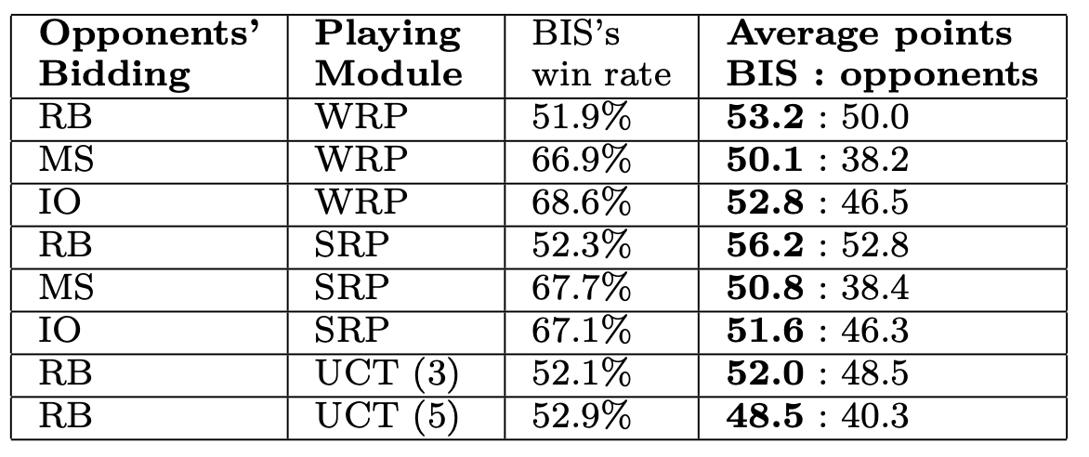
Experiments - Competition with other bots

Slide 19
Experiments - Playing against humans
Dataset: 400K rounds from games played during October 2019, between a partnership of two BIS+SRP agents and a partnership composed of a BIS+SRP and a human player.
The overall winning rate of the BIS partnership is 56% of all games.

