Slide 1
A Survey of Path Planning Algorithms for Mobile Robots
Karthik Karur, Nitin Sharma, Chinmay Dharmatti, Joshua E. Siegel (2021). A Survey of Path Planning Algorithms for Mobile Robots. Vehicles, 3(3), 448-468.
Presenter: Yu-Chen Lin
Date: July 4, 2023

Slide 2
Abstract
Path planning algorithms are used by mobile robots, unmanned aerial vehicles, and autonomous cars in order to identify safe, efficient, collision-free, and least-cost travel paths from an origin to a destination. Choosing an appropriate path planning algorithm helps to ensure safe and effective point-to-point navigation, and the optimal algorithm depends on the robot geometry as well as the computing constraints, including static/holonomic and dynamic/non-holonomically-constrained systems, and requires a comprehensive understanding of contemporary solutions. The goal of this paper is to help novice practitioners gain an awareness of the classes of path planning algorithms used today and to understand their potential use cases—particularly within automated or unmanned systems. To that end, we provide broad, rather than deep, coverage of key and foundational algorithms, with popular algorithms and variants considered in the context of different robotic systems. The definitions, summaries, and comparisons are relevant to novice robotics engineers and embedded system developers seeking a primer of available algorithms.

Slide 3
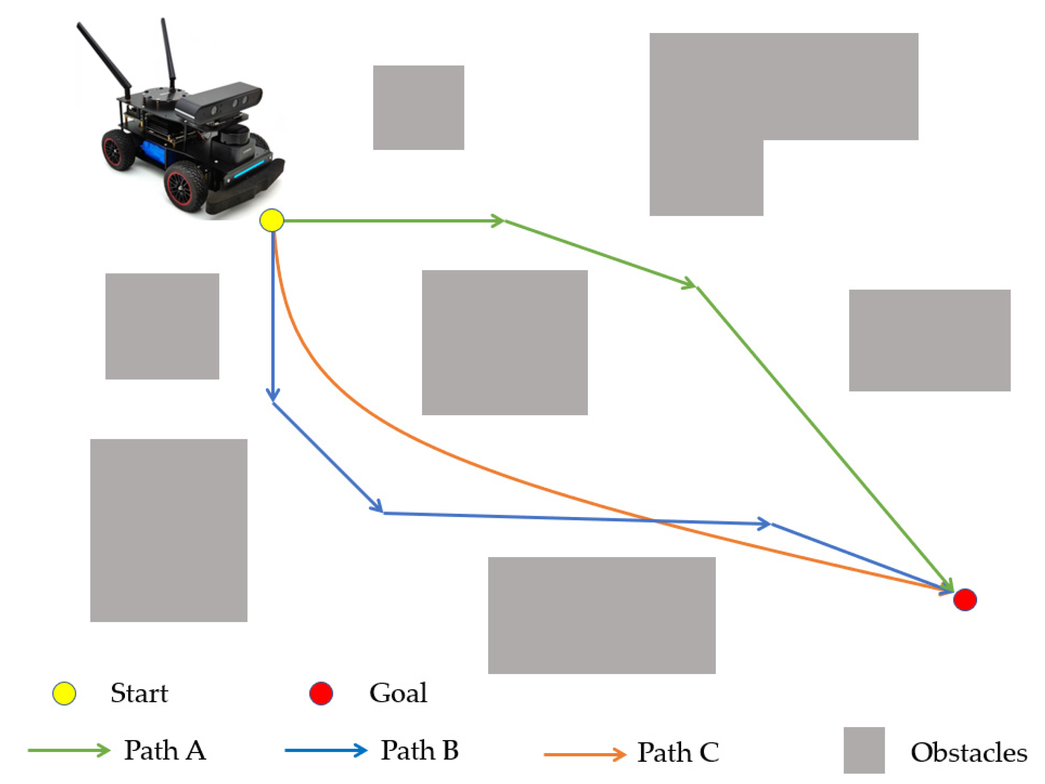
Problem Description

Slide 4
Path Planning
NP-hard problem
Static/Dynamic environment
Shortest path between end points
Minimum time to travel without any collisions

Slide 5
Path Planning Algorithms
Dijkstra Algorithm
The Floyd Algorithm
A* Algorithm
D* Algorithm
Rapidly-Exploring Random Trees
Genetic Algorithm
Ant Colony Algorithm

Slide 6
Dijkstra Algorithm
Acyclic environment
Greedy strategy
Static environment and global path planning as most of the data required are pre-defined

Slide 7
Improved Dijkstra Algorithm
Reserves all nodes with the same distance from the source node as intermediate nodes.
Multi-layer dictionary

Slide 8
Breadth-first search

Slide 9
Best-first search

Slide 10
Best-first search

Slide 11

A* Algorithm
Search towards the most promising states
Static environments
Notes:
A* 算法首先从起点开始，计算周围的点的优先值并且加入优先队列。之后开始从优先队列中选取优先值最小的点，将其加入 close list 并且同样计算周围的点的优先值加入优先队列（close list 中的点就不需要再计算了）。不断重复这个过程直到搜索到终点算法就结束，返回路径。
相對於其他路徑規劃演算法，A算法在計算上較為簡單，並且它的效率使得它適用於受限制和嵌入式系統上的運行。A算法是一種利用啟發式信息尋找最佳路徑的演算法，可以通過設置適當的啟發式函數來指導搜索，例如歐幾里得距離、曼哈頓距離或對角距離等。
在使用A*算法時，速度和準確性之間存在一個折衷。我們可以通過增加內存來降低算法的時間複雜度，或者通過降低內存來獲得較慢的執行速度。
總的來說，A算法在靜態環境中具有較高的計算效率，這使得它適合應用在靜態環境中。A算法及其變體的計算速度和效率取決於啟發式函數的準確性。

Slide 12
D* Algorithm
Informed incremental search algorithm
Repairs the cost map partially and the previously calculated cost map
Dynamic environments

Slide 15
Rapidly-exploring Randomized Trees
Rapidly expands by randomly sampling in various regions, starting from the initial point and expanding until the tree is sufficiently close to the goal point.
Dynamic environments

Slide 16
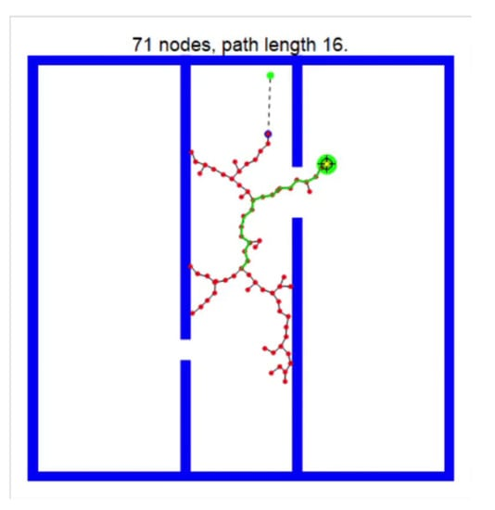
Rapidly-exploring Randomized Trees

Slide 17
Conclusion
Presented several widely used path planning algorithms and their variants.
Each algorithm was suited best based on a static or dynamic environment.

