Slide 1
A Space Efficient Algorithm for Sequence Alignment with Inversions
Yong Gao, Junfeng Wu, Robert Niewiadomski, Yang Wang, Zhi-Zhong Chen and Guohui Lin
Computing and Combinatorics COCOON 2003, Big Sky, MT, USA. Lecture Notes in Computer Science, vol 2697, pp.57-67.
Presenter : Shie-Yan Lee
2017/05/17

Slide 2
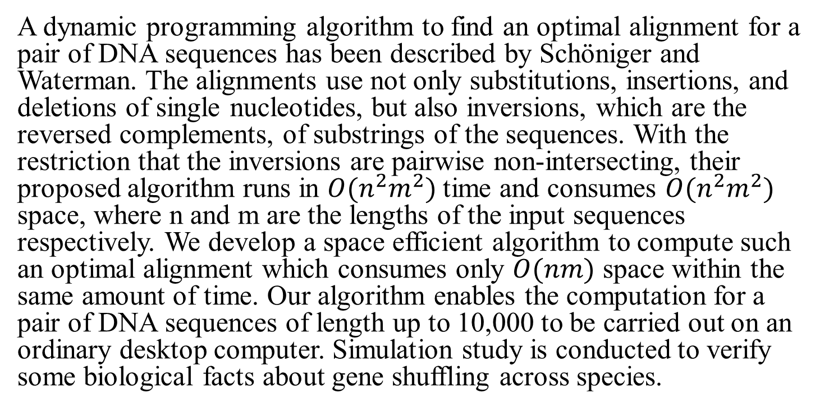
Abstract
A dynamic programming algorithm to find an optimal alignment for a pair of DNA sequences has been described by Schöniger and Waterman. The alignments use not only substitutions, insertions, and deletions of single nucleotides, but also inversions, which are the reversed complements, of substrings of the sequences. With the restriction that the inversions are pairwise non-intersecting, their proposed algorithm runs in $O(n^{2}m^{2})$time and consumes $O(n^{2}m^{2})$ space, where n and m are the lengths of the input sequences respectively. We develop a space efficient algorithm to compute such an optimal alignment which consumes only $O(nm)$ space within the same amount of time. Our algorithm enables the computation for a pair of DNA sequences of length up to 10,000 to be carried out on an ordinary desktop computer. Simulation study is conducted to verify some biological facts about gene shuffling across species.

Slide 3
Problem Description
S₁ ACAG
S₂ CTGG
Operation
Insertion/Deletion
Subtitution
Inversion
S₁ | A | C | A | - | G
S₂ | - | C | T | G | G
S₁ | A | CAG | -
S₂ | - | CTG | G

Slide 4
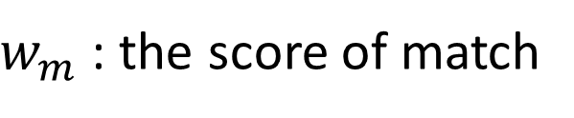




Score Scheme : linear gap penalty
$$(w_{m},w_{s},w_{i})$$
$w_{m}$ : the score of match
$w_{s}$ : the penalty of substitution
$w_{i}$ : the penalty of insertion or deletion
S₁ | A | C | A | - | G
S₂ | - | C | T | G | G
$$(10,−5,−3)$$
-3+10-5-3+10 = 9

Slide 5
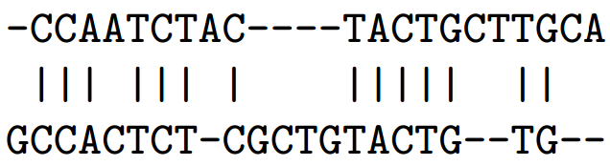
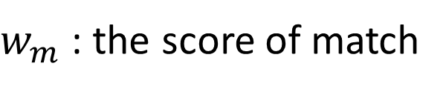


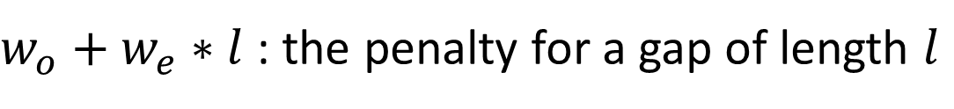

Score Scheme : affine gap penalty
$$(w_{m},w_{s},w_{o},w_{e})$$
$w_{m}$ : the score of match
$w_{s}$ : the penalty of substitution
$w_{o}+w_{e}∗l$ : the penalty for a gap of length $l$
$$(10,−11,−15,−5)$$
-20+30-11+30-20+10-35+50-25+20-25 = 4

Slide 6
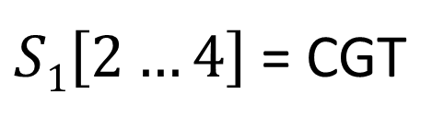
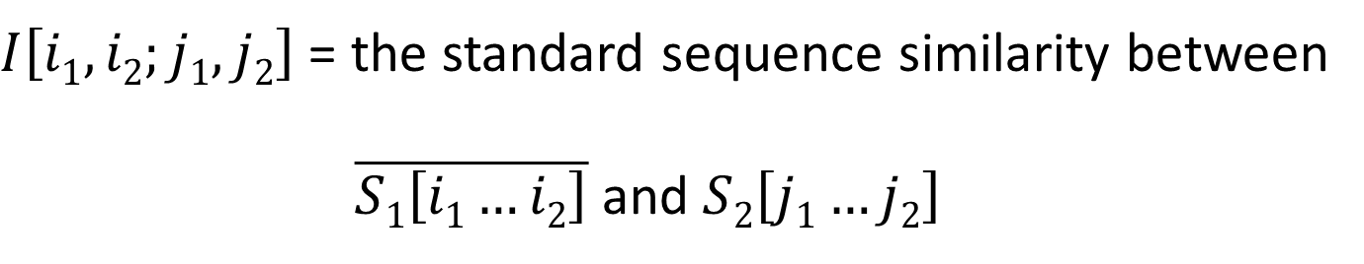

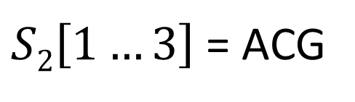
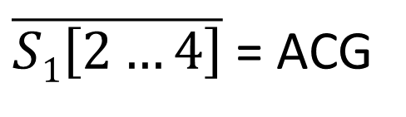
A Less Space Efficient Algorithm
$I\left[i1,i2;j1,j2\right]$ = the standard sequence similarity between
$\overline{S1\left[i1…i2\right]}$ and $S2\left[j1…j2\right]$
S₁ ACGT
S₂ ACGA
$S1\left[2…4\right]$ = CGT
$\overline{S1\left[2…4\right]}$ = ACG
$$I\left[2,4;1,3\right]=3wm$$
$S2\left[1…3\right]$ = ACG

Slide 7



A Less Space Efficient Algorithm
$I\left[i1,i2;j1,j2\right]$ = the standard sequence similarity between
$\overline{S1\left[i1…i2\right]}$ and $S2\left[j1…j2\right]$
$$j1$$
$$j2$$
$$S2$$

Slide 8
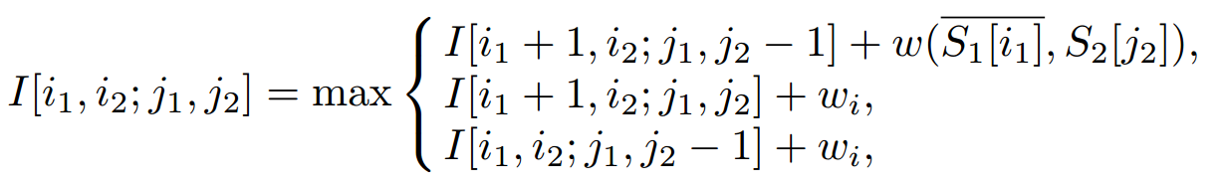
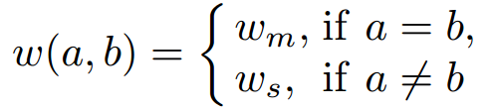















$$i1$$
$$i2$$
$$i2$$
$i1+$1
$$i1$$
$$S1$$
$$i2$$
$$i1$$
$$j1$$
$$j2−1$$
$$j2$$
$$\overline{S1}$$
$$j1$$
$$j2$$
$$S2$$

Slide 9
$$i1$$
$$i2$$
$$i2$$
$i1+$1
$$i1$$
$$S1$$
$$i2$$
$$i1$$
$$j1$$
$$j2$$
$$\overline{S1}$$
$$j1$$
$$j2$$
$$S2$$

Slide 10
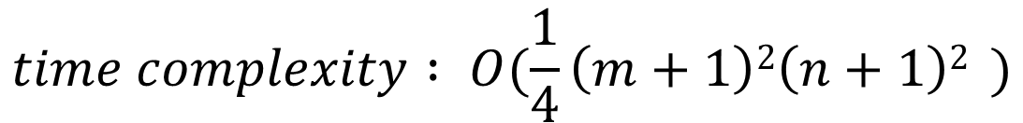
$$i1$$
$$i2$$
$$i2$$
$$i1$$
$$S1$$
$$i2$$
$$i1$$
$$j1$$
$$j2−1$$
$$j2$$
$$\overline{S1}$$
$$j1$$
$$j2$$
$$S2$$
$$time complexity : O(\frac{1}{4}\left(m+1\right)2\left(n+1\right)2 )$$

Slide 11
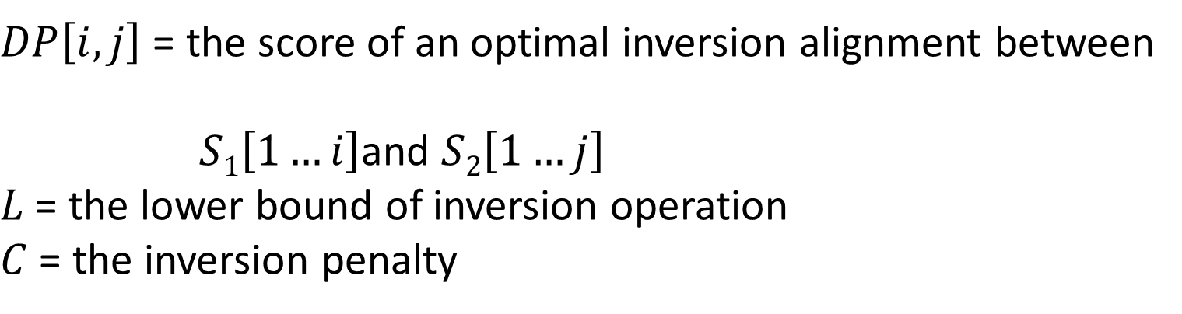
A Less Space Efficient Algorithm
$DP\left[i,j\right]$ = the score of an optimal inversion alignment between
$S1\left[1…i\right]$and $S2\left[1…j\right]$
$L$ = the lower bound of inversion operation
$C$ = the inversion penalty

Slide 12
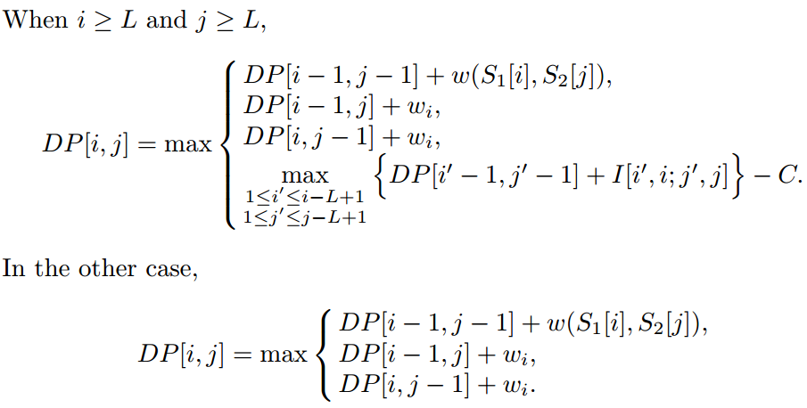










$$1$$
$$i$$
$$1$$
$$i−1$$
$$S1$$
$$1$$
$$j$$
$$1$$
$$j−1$$
$$S2$$

Slide 13








$$1$$
$$i$$
$$1$$
$$i−1$$
$$1$$
$$i$$
$$S1$$
$$1$$
$$j$$
$$1$$
$$j$$
$$1$$
$$j−1$$
$$S2$$

Slide 14






$$1$$
$$i$$
$$1$$
$$i′−1$$
$$i$$
$$i′$$
$$S1$$
$$1$$
$$j$$
$$1$$
$$j′−1$$
$$j′$$
$$j$$
$$S2$$

Slide 15
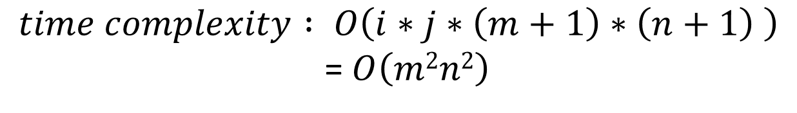
$$time complexity : O\left(i∗j∗\left(m+1\right)∗\left(n+1\right) \right)$$
=$O\left(m2n2\right)$
$$space complexity : O\left(m2n2\right)$$

Slide 16
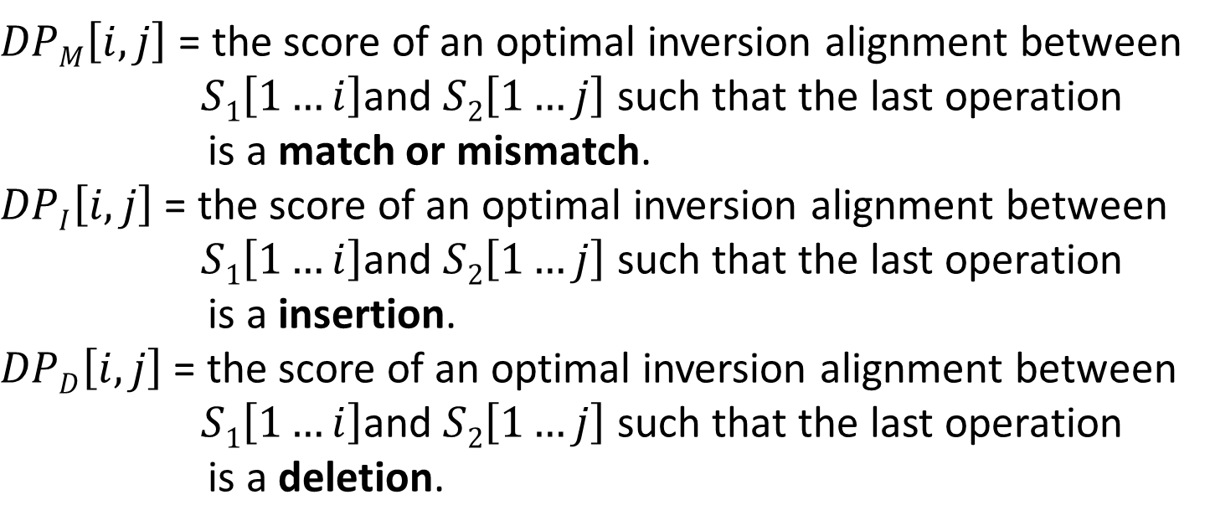
A Space Efficient Algorithm for Affine Gap Penalty Score Schemes
$DPM\left[i,j\right]$ = the score of an optimal inversion alignment between
$S1\left[1…i\right]$and $S2\left[1…j\right]$ such that the last operation
is a match or mismatch.
$DPI\left[i,j\right]$ = the score of an optimal inversion alignment between
$S1\left[1…i\right]$and $S2\left[1…j\right]$ such that the last operation
is a insertion.
$DPD\left[i,j\right]$ = the score of an optimal inversion alignment between
$S1\left[1…i\right]$and $S2\left[1…j\right]$ such that the last operation
is a deletion.

Slide 17
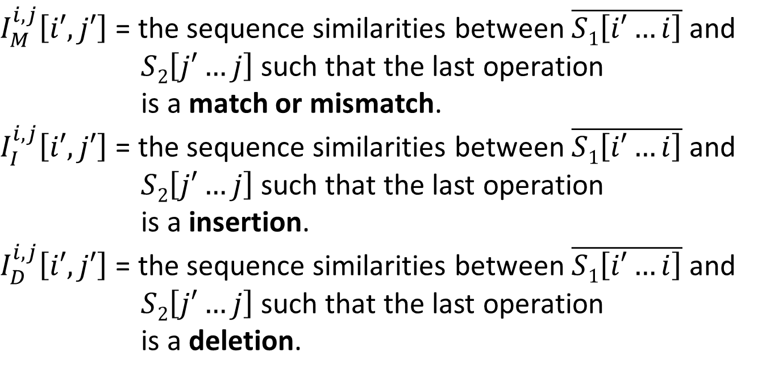
A Space Efficient Algorithm for Affine Gap Penalty Score Schemes
$I_{M}^{i,j}\left[i′,j′\right]$ = the sequence similarities between $\overline{S1\left[i′…i\right]}$ and
$S2\left[j′…j\right]$ such that the last operation
is a match or mismatch.
$I_{I}^{i,j}\left[i′,j′\right]$ = the sequence similarities between $\overline{S1\left[i′…i\right]}$ and
$S2\left[j′…j\right]$ such that the last operation
is a insertion.
$I_{D}^{i,j}\left[i′,j′\right]$ = the sequence similarities between $\overline{S1\left[i′…i\right]}$ and
$S2\left[j′…j\right]$ such that the last operation
is a deletion.

Slide 18
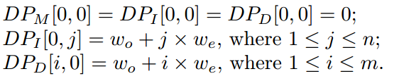
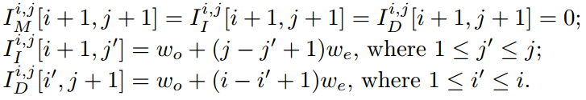
Boundary

Slide 19
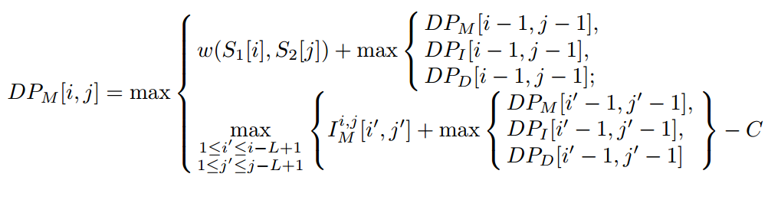










Recurrence relations for DP tables
$$1$$
$$i$$
$$1$$
$$i−1$$
$$S1$$
$$1$$
$$j$$
$$1$$
$$j−1$$
$$S2$$

Slide 20








Recurrence relations for DP tables
$$1$$
$$i$$
$$1$$
$$i′−1$$
$$i$$
$$i′$$
$$S1$$
$$1$$
$$j$$
$$1$$
$$j′−1$$
$$j′$$
$$j$$
$$S2$$

Slide 21
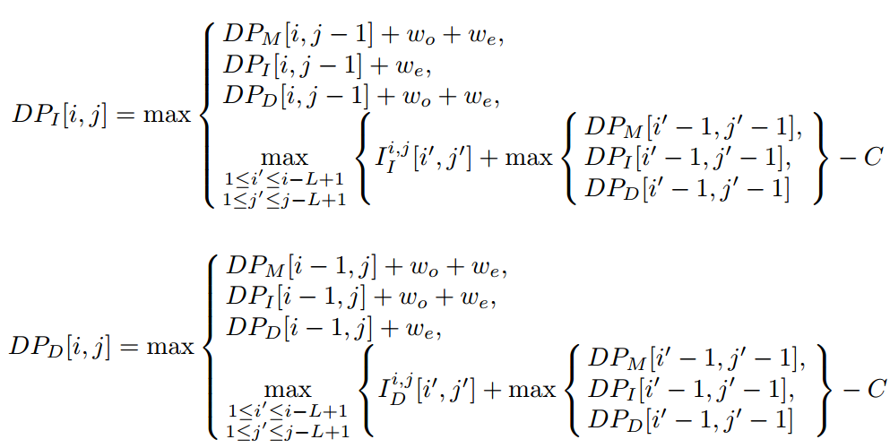










Recurrence relations for DP tables
$$1$$
$$i$$
$$1$$
$$i$$
$$S1$$
$$1$$
$$j$$
$$1$$
$$j−1$$
$$S2$$

Slide 22
Recurrence relations for DP tables
$$1$$
$$i$$
$$1$$
$$S1$$
$$i′−1$$
$$i$$
$$i′$$
$$1$$
$$j$$
$$j$$
$$S2$$
$$1$$
$$j′−1$$
$$j′$$

Slide 23





Recurrence relations for DP tables
$$1$$
$$i$$
$$1$$
$$i−1$$
$$i$$
$$S1$$
$$1$$
$$j$$
$$1$$
$$j$$
$$S2$$

Slide 24
Recurrence relations for DP tables
$$1$$
$$i$$
$$1$$
$$S1$$
$$i′−1$$
$$i$$
$$i′$$
$$1$$
$$j$$
$$j$$
$$S2$$
$$1$$
$$j′−1$$
$$j′$$

Slide 25
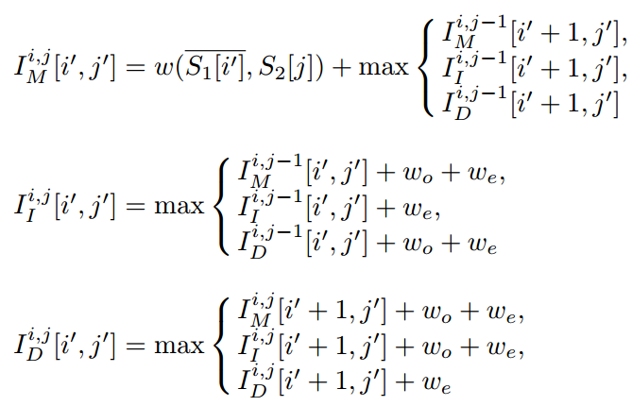


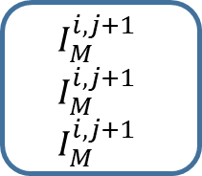
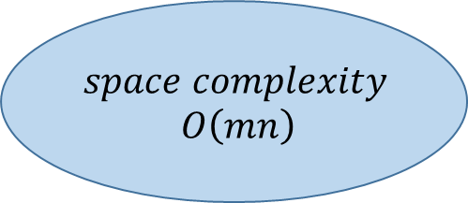
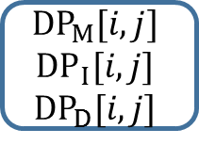
Recurrence relations for I tables
$$space complexity$$
$$O\left(mn\right)$$
$${DP}_{M}[i,j]$$
$${DP}_{ I}[i,j]$$
$${DP}_{D}[i,j]$$
$$I_{M}^{i,j+1}$$
$$I_{M}^{i,j+1}$$
$$I_{M}^{i,j+1}$$

Slide 26

Conclusions
$$time complexity : O\left(m2n2\right)$$
$$space complexity : O\left(mn\right)$$
Find an optimal inversion alignment between two DNA sequences of length up to
10,000bp on a normal desktop with 1Gb memory.

