Slide 1
Efficient Searches for Similar Subsequences of Different Lengths in Sequence Databases
Sanghyun Park
Wesley W. Chu
Jeehee Yoon
ChihCheng Hsu
Proceedings of 16th International Conference on Data Engineering, San Diego, USA, 2000
Presenter: Hsiu-Chieh Hung
Date: 2017/5/24

Slide 2
Abstract
We propose an indexing technique for fast retrieval of similar subsequences using time warping distances. A time warping distance is a more suitable similarity measure than the Euclidean distance in many applications, where sequences may be of different lengths or different sampling rates. Our indexing technique uses a disk-based suffix tree as an index structure and employs lower-bound distance functions to filter out dissimilar subsequences without false dismissals. To make the index structure compact and thus accelerate the query processing, we convert sequences of continuous values to sequences of discrete values via a categorization method and store only a subset of suffixes whose first values are different from their preceding values. The experimental results reveal that our proposed technique can be a few orders of magnitude faster than sequential scanning.

Slide 3

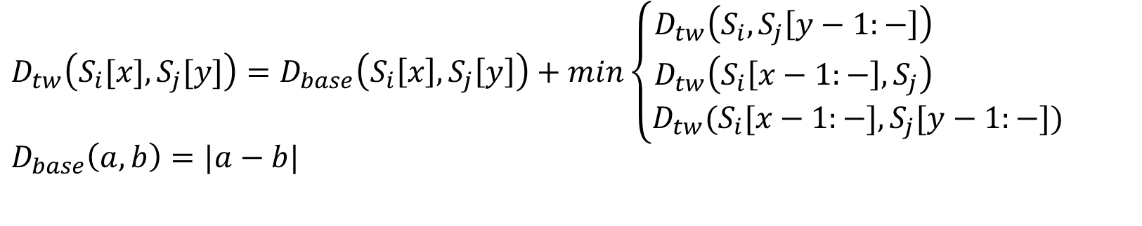

DTW
$$D_{tw}\left(S_{i}[x], S_{j}[y]\right)=D_{base}\left(S_{i}\left[x\right],S_{j}\left[y\right]\right)+min\left\{\begin{aligned}D_{tw}\left(S_{i},S_{j}\left[y−1:−\right]\right) \\ D_{tw}\left(S_{i}\left[x−1:−\right],S_{j}\right) \\ D_{tw}(S_{i}[x−1:−],S_{j}[y−1:−])\end{aligned}\right.$$
$$D_{base}\left(a,b\right)=|a−b|$$
6 | 16 | 11 | 11
6 | 13 | 9 | 9
7 | 10 | 7 | 7
6 | 6 | 4 | 4
5 | 3 | 2 | 2
4 | 1 | 1 | 1
 | 3 | 4 | 4
$$<4, 5, 6, 7, 6, 6>$$
$$<3, 4, 4>$$

Slide 4
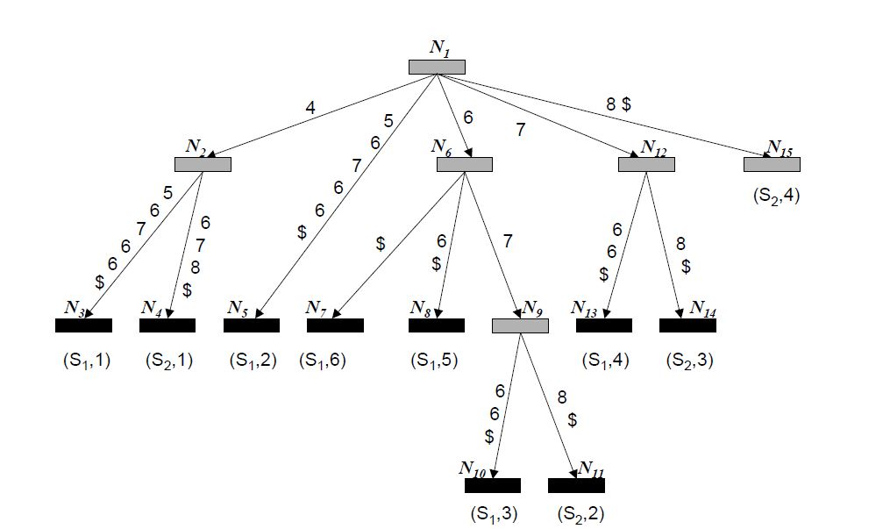


Suffix Tree
$$S_{1}=<4, 5, 6, 7, 6, 6>$$
$$S_{2}=<4, 6, 7, 8>$$

Slide 5

user-given threshold：Ɛ = 2
Q：$<3, 4, 4>$

Slide 6
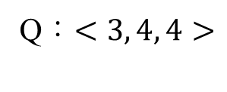

4 | 1 | 1 | 1
 | 3 | 4 | 4
user-given threshold：Ɛ = 2
4 | 1 | 1 | 1
 | 3 | 4 | 4
Q：$<3, 4, 4>$
answer set：$<4>$

Slide 7
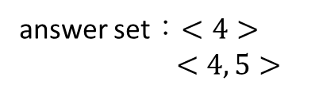
user-given threshold：Ɛ = 2
4 | 1 | 1 | 1
 | 3 | 4 | 4
Q：$<3, 4, 4>$
6 | 16 | 11 | 11
6 | 13 | 9 | 9
7 | 10 | 7 | 7
6 | 6 | 4 | 4
5 | 3 | 2 | 2
4 | 1 | 1 | 1
 | 3 | 4 | 4
answer set：$<4>$
$<4, 5>$

Slide 8
4 | 1 | 1 | 1
 | 3 | 4 | 4
user-given threshold：Ɛ = 2
4 | 1 | 1 | 1
 | 3 | 4 | 4
Q：$<3, 4, 4>$
6 | 16 | 11 | 11
6 | 13 | 9 | 9
7 | 10 | 7 | 7
6 | 6 | 4 | 4
5 | 3 | 2 | 2
4 | 1 | 1 | 1
 | 3 | 4 | 4
answer set：$<4>$
$<4, 5>$

Slide 9
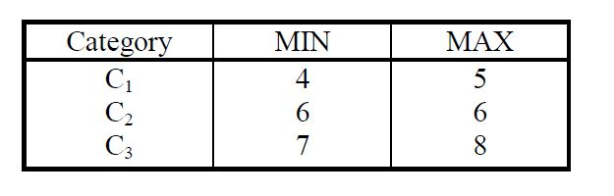


Categorization
$$S_{1}=<4, 5, 6, 7, 6, 6>$$
$$S_{2}=<4, 6, 7, 8>$$
$${CS}_{1}=<C_{1},C_{1},C_{2},C_{3},C_{2},C_{2}>$$
$${CS}_{2}=<C_{1},C_{2},C_{3},C_{3}>$$

Slide 10
Internal node

Slide 11
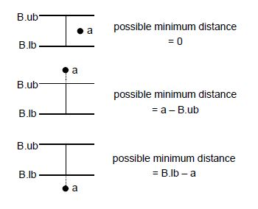
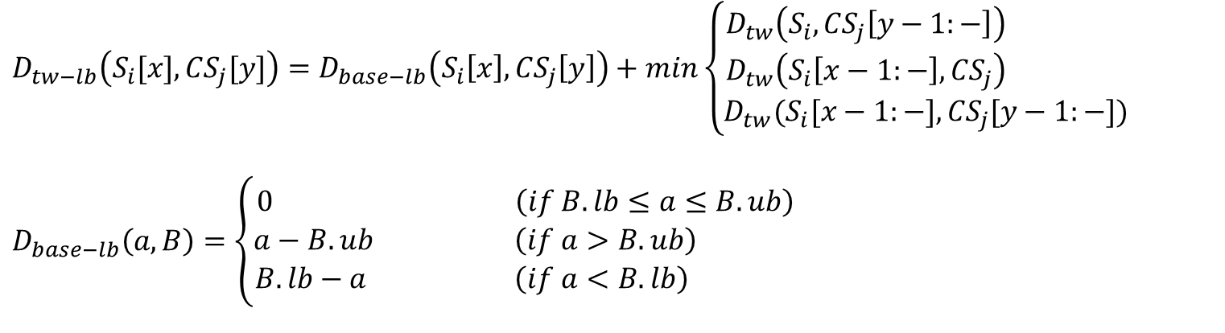

$$D_{tw−lb}\left(S_{i}[x], {CS}_{j}[y]\right)=D_{base−lb}\left(S_{i}\left[x\right],{CS}_{j}\left[y\right]\right)+min\left\{\begin{aligned}D_{tw}\left(S_{i},{CS}_{j}\left[y−1:−\right]\right) \\ D_{tw}\left(S_{i}\left[x−1:−\right],{CS}_{j}\right) \\ D_{tw}(S_{i}[x−1:−],{CS}_{j}[y−1:−])\end{aligned}\right.$$
$$D_{base−lb}\left(a,B\right)=\left\{\begin{aligned}0 \left(if B.lb≤a≤B.ub\right) \\ a−B.ub \left(if a>B.ub\right) \\ B.lb−a \left(if a<B.lb\right) \end{aligned}\right.$$
$$D_{tw−lb}\left(S_{i}[x], {CS}_{j}[y]\right)≤D_{tw}\left(S_{i}[x], S_{j}[y]\right)$$
Do the DTW for every sequence in answer set with Q !

Slide 12
Sparse Suffix Tree

Slide 13



The suffix is stored only if ${CS}_{j}[p]≠{CS}_{j}[p−1]$
$${CS}_{1}=<C_{1},C_{1},C_{2},C_{3},C_{2},C_{2}>$$
$${CS}_{2}=<C_{1},C_{2},C_{3},C_{3}>$$
Only seven suffixes are stored :
$${CS}_{1}\left[1:−\right],{CS}_{1}\left[3:−\right],{CS}_{1}\left[4:−\right],{CS}_{1}\left[5:−\right],{CS}_{2}\left[1:−\right],{CS}_{2}\left[2:−\right],{CS}_{2}\left[3:−\right]$$

Slide 14
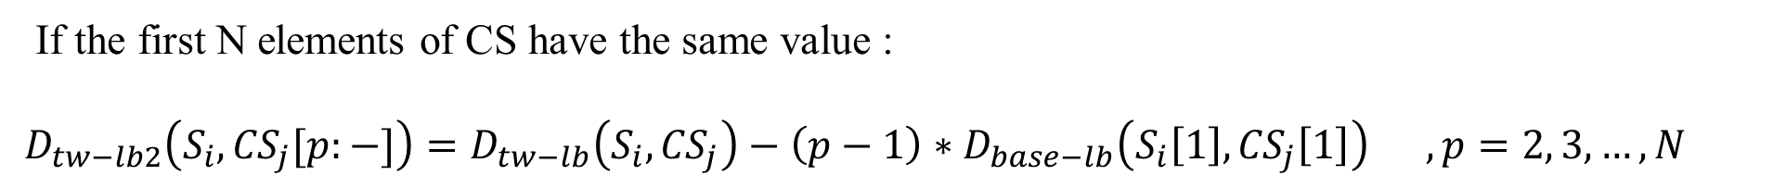
$$D_{tw−lb}\left(S_{i}[x], {CS}_{j}[y]\right)=D_{base−lb}\left(S_{i}\left[x\right],{CS}_{j}\left[y\right]\right)+min\left\{\begin{aligned}D_{tw}\left(S_{i},{CS}_{j}\left[y−1:−\right]\right) \\ D_{tw}\left(S_{i}\left[x−1:−\right],{CS}_{j}\right) \\ D_{tw}(S_{i}[x−1:−],{CS}_{j}[y−1:−])\end{aligned}\right.$$
$$D_{base−lb}\left(a,B\right)=\left\{\begin{aligned}0 \left(if B.lb≤a≤B.ub\right) \\ a−B.ub \left(if a>B.ub\right) \\ B.lb−a \left(if a<B.lb\right) \end{aligned}\right.$$
If the first N elements of CS have the same value :
$$D_{tw−lb2}\left(S_{i}, {CS}_{j}[p:−]\right)=D_{tw−lb}\left(S_{i},{CS}_{j}\right)−\left(p−1\right)∗D_{base−lb}\left(S_{i}\left[1\right],{CS}_{j}\left[1\right]\right) , p=2, 3, …, N$$

Slide 15

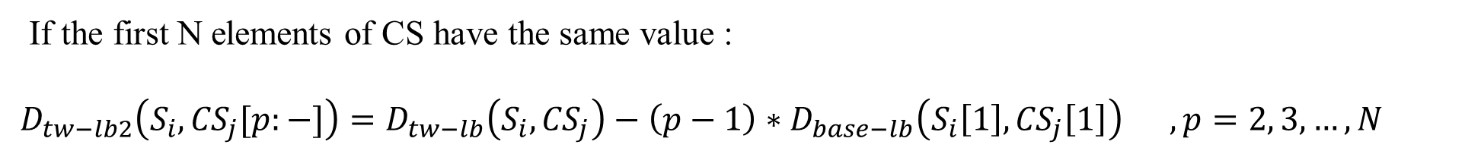
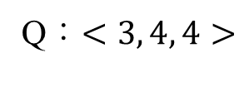
If the first N elements of CS have the same value :
$$D_{tw−lb2}\left(S_{i}, {CS}_{j}[p:−]\right)=D_{tw−lb}\left(S_{i},{CS}_{j}\right)−\left(p−1\right)∗D_{base−lb}\left(S_{i}\left[1\right],{CS}_{j}\left[1\right]\right) , p=2, 3, …, N$$
Q：$<3, 4, 4>$
$${CS}_{1}=<C_{1},C_{1},C_{2},C_{3},C_{2},C_{2}>$$
Do the DTW for every sequence in answer set with Q !

Slide 16
Experimental results
545 stock data sequences extracted from S&P 500
Average length：232
20% | $0 ～ $30
50% | $30 ～ $60
30% | $60 ～

Slide 17
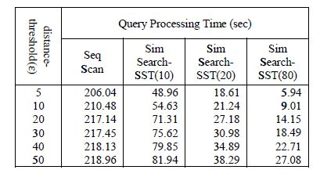
Experimental results

Slide 18
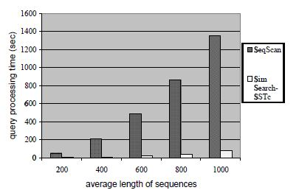
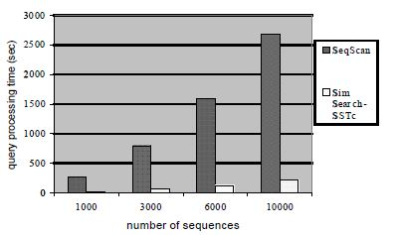
Experimental results

